Slide 1
Architectural Optimizations
David Ojika
March 27, 2014

Slide 2
Focus
From OpenCL to High-Performance Hardware on FPGAs
Tomasz S. Czajkowski, Altera OpenCL Optimization Group
IEEE 2012
OpenCL for FPGAs: Prototyping a Compiler
Tomasz S. Czajkowski, Altera OpenCL Optimization Group
ESRA 2012

Slide 3
Outline
Introduction
FPGA as an Acceleration Platform
HLS Vs. OpenCL in Accelerators
OpenCL-To-FPGA Compiler
System Integration
Implementation Details
Optimization Strategies
Memory Issues
Experimental Setup
Results
Conclusion

Slide 4
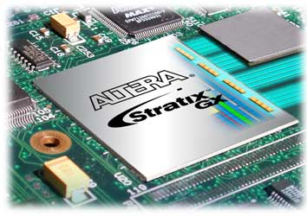
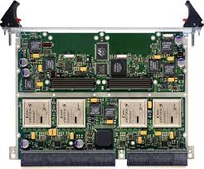
Introduction
Traditionally, FPGAs been used as de-factor standard for many high-performance applications
Some of the largest and most complex circuits
Applications in medical imaging, molecular dynamics, etc.
Nowadays, FPGA’s being used as accelerator to speedup computationally-intensive applications
Orders of magnitude reduction in runtime compared to traditional stand-alone computers
Hardware parallelism enable many computations to be performed at same time
Traditional
Emerging

Slide 5
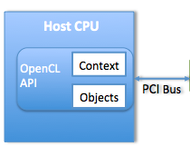
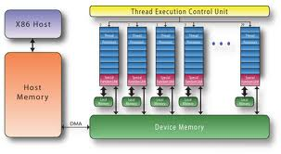
FPGA as Acceleration Platform
FPGAs enable high application acceleration in many domains
FPGA Accelerator
Kernel
OpenCL Model
However, parallel computation at hardware level requires great expertise
Poses limitations in adoption of FPGAs as hardware accelerators
GPUs being used as accelerators in computing for many years
Interests by software programmers to use GPU in general-purpose computing lead to development of new programming models
CUDA for GPU
OpenCL for GPU, CPU, FPGA, DSP
CUDA Model
FPGAs starting to compete with GPGPUs for app acceleration
GPGPU: General-Purpose Graphics Processing Unit

Slide 6
HLS Vs. OpenCL in Accelerators
Traditional HLS
OpenCL
Tool implement FPGA circuit from software-like languages
Many circuits can simultaneously process data
Does not exploit parallelism in hardware
Pipelining not explicit in C programming language
Performance may be suffer comparable in to VHDL/Verilog implementation
Computation performed using combination of host & kernels
Host responsible for I/O and setup of task
Kernel perform computation on independent inputs
Kernel can be implemented as high-performance circuit
Kernel can be replicated to improve performance of application
Challenge → Efficiently synthesize kernel into HW circuits?
Solution → Compiler that performs architectural optimizations!

Slide 7
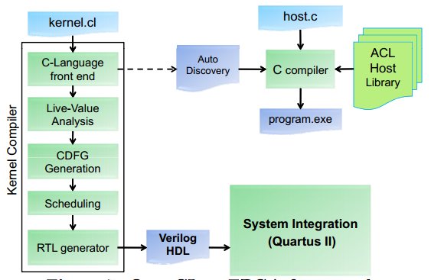
OpenCL-To-FPGA Compiler
Framework based on LLVM compiler infrastructure
Input 1: OpenCL app with set of kernels (.cl)
Input 2: Host program (.c)
Output: Verilog HDL
Kernel Compilation
C language parser produces LLVM IR of each kernel
Representation optimized to target FPGA platform
Optimized LLVM converted to CDFG
CDFG optimized to improve area and performance
RTL generation produces Verilog HDL for kernel
HDL compiled to generated bitstream for programming
Host Compilation
ACL Host Library:
Implements OpenCL function calls; allows exchange of information between host and FPGA
Auto-Discovery module:
Allows host program to discover types of kernels on FPGA
Notes:
LLVM IR: in form of instructions and dependencies between them
Auto-Discovery Module: Embedded in system by kernel compiler; stores information pertaining to kernels

Slide 8
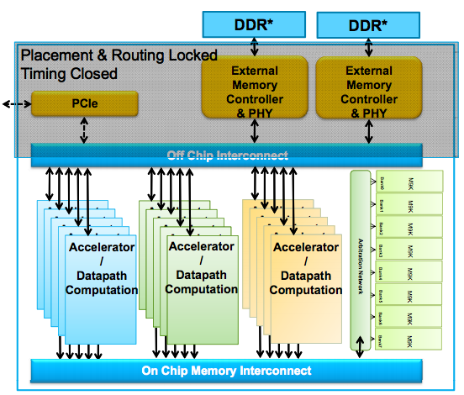
System Integration
FPGA Accelerator
Kernel
Host accesses kernel
Specifies workspace parameter (global & local work size)
Sets kernel arguments
Enqueues kernel
Device replicates kernel
Runs kernel
Provides result to DDR mem.

Slide 9
Implementation Details
1. ACL Host Library
Host Library: Implements OpenCL data and control specs.
2. Kernel Compiler
Kernel: Compute-intensive workload offloaded from CPU

Slide 10
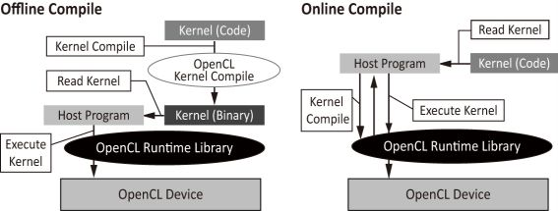
ACL Host Library
Implements Platform & Runtime APIs of OpenCL 1.0 spec
Platform API
Discover FPGA accelerator device
Manage execution contexts
Runtime API
Manage command queues
Memory objects
Program objects
Discover and invoke precompiled kernels
Consists of two layers
Platform Independent Layer: Performs device independent processing
Provides user visible OpenCL API functions
Performs generic book-keeping and scheduling
Hardware Abstraction Layer: adapts to platform specifics
Provides low-level services to platform independent layer
Device and kernel discovery, raw memory allocation, memory transfers, kernel launch and completion

Slide 11
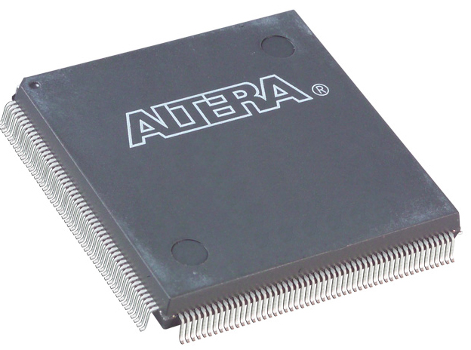
Kernel Compiler
Compiles kernel into hardware circuit using LLVM open-source compiler
Extends compiler to target FPGA platforms
LLVM Flow:
Represents program as sequence of instructions: load, add, store
Each instruction has associated input; produces results that can be used in downstream computation
Basic Block: group of instructions in contiguous sequence
Basic block have a terminal instruction that ends program or redirects execution to another basic block
Compiler uses representation to create hardware implementation of each basic block; put together to form complete kernel circuit
Notes:
Each basic block constitutes an input and output interface with which it talks to other basic blocks
- First and last basic blocks have interfaces exposed at top level, forming input and output of kernel module

Slide 12
Optimization Strategies
1
2
3
4
5
1. C-Language Front-End
Produce intermediate representation
2. Live Variable Analysis
Identifies variables produced and consumed by each basic block
3. CDFG Generation
Challenge: Each operational node can be independently stalled when successor node unable to accept data
Solution: Two signals and gates. Valid signal into node is AND gate of its data sources
Loop Handling (Handled in Basic Block building step)
Challenge: It is entirely possible that a loop can stall
Solution: Insert addition stage of registers into merged node; allows pipeline to have additional spot into which that can be placed

Slide 13
Optimization Strategies
1
2
3
4
5
4. Scheduling
Challenge: No sharing of resources occurs; need to sequence operations into pipeline
Solution: Apply SDC scheduling algorithm; uses system of linear equations to schedule operations while minimizing cost function
Objective: Area reduction & amount of pipeline balancing regs required
Solution: Minimize cost function that reduces number of bits required by pipeline
5. Hardware Generation
Challenge: Potentially large number of independent threads need to execute using a kernel hardware
Solution: Implement each basic block module as pipelined circuit rather than finite state machine with datapath (FSMD)
Notes:
Scheduling: No sharing of resources occurs; need to sequence operations into pipeline where independent operations occurs in parallel

Slide 14
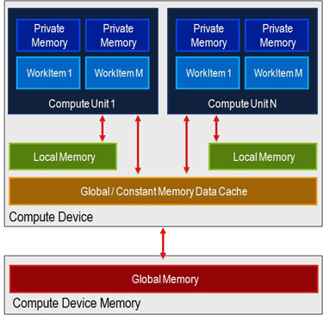
Memory Issues
Global memory
Local memory
Private memory

Slide 15
Global Memory
Designated for access by all threads
Large capacity for data storage; I/O by all threads
Long access latency
Optimization
Access are coalesced when possible to increase throughput
Compiler can detect when accesses are random or sequential and takes advantage of it
When access sequential, special read or write module that includes large buffer created for burst transactions
When access random, coalescing unit collects request to see if seemingly random accesses address the same 256-bit word in memory. If so, request coalesced in single data transfer, improving memory throughput

Slide 16
Local Memory
Access by threads in same work group
Short latency and multiple ports; efficient kernel access by kernels
Enable synchronized exchange of data
Barriers/memory fences used to force threads to wait on one another before proceeding
Enables complex algorithm that require collaboration of threads, E.g. Bitonic sort
Optimization
Shared memory space for each LD/ST to any local memory
Map logical ports required by kernel unto set of dual-ported on-chip memory modules
Access split into multiple memory banks to enable faster data access

Slide 17
Private Memory
Implemented with registers; store data on per-thread basis
Pipelined through kernel to ensure each thread keeps data required as it proceeds with execution through the kernel
Optimization
None

Slide 18
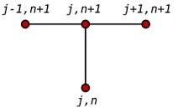
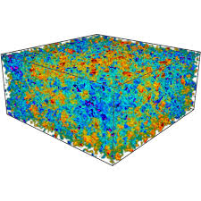
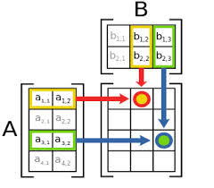
Experimental Setup
Accelerator
Stratix-IV on Terasic DE4 board
Host
Windows XP 64-bit machine
Offline Kernel Compiler
ACDS 12.0
Benchmarks
Monte Carlo Black-Scholes
Matrix Multiplication
Finite Differences
Particle Simulation

Slide 19
Results
Table 1: Circuit Summary and Application Throughput
Matrix Multiplication
1024 x 1024 matrix size
Vectorized kernel
Improves thread access to memory; increased throughput by x4
Unrolled inner loop
Performs 64 floating-point multiplications and addition simultaneously
Results in 88.4 GFLOPS throughput
Monte Carlo Black Scholes
OpenCL against Verilog code
Throughput: 2.2 Gsims/sec in comparison to 1.8 GSims/sec with 2 Stratix-III FPGAs
Finite Difference and Particle Simulation
Not much comparative performance with previous work recorded

Slide 20
Conclusion
Developed compilation framework that includes host library for communicating with kernels
Developed OpenCL-to-FPGA compiler with optimizations
Results show that tool flow is not only feasible, but also effective in designing high-performance circuits
Results indicate that OpenCL well suited for automatic generation of efficient circuits for FPGA
Coverage of OpenCL language: synchronization (barriers), support for local memory and floating-point operations
THANKS!

