Slide 1
Architectural Optimizations
Ed Carlisle

Slide 2
DARA: A Low-Cost Reliable Architecture Based on Unhardened Devices and Its Case Study of Radiation Stress Test
Jun Yao, Shogo Okada, Masaki Masuda, Kazutoshi Kobayashi, and Yasuhiko Nakashima
IEEE Transactions on Nuclear Science, December 2012

Slide 3

Outline
Background
System Overview
Adaptive Redundancy
Error Recovery
Instruction Decomposition for Atomic Updates
Unhardened vs Hardened Circuits
Radiation Testing
Results
Shortfalls
Conclusions

Slide 4
Background
As processor switching voltages and feature sizes decrease, susceptibility to SEEs increases
Typical causes of Single Event Effects:
  Cosmic Rays
  Solar Energetic Particles
  Trapped protons in the Van Allen Belts
Circuits can be hardened by process or by design
Typical approaches:
  Triple Modular Redundancy (TMR)
  Watchdog timers facilitating rollback and recovery from system checkpoints

Slide 5
DARA System Overview
Dynamic Adaptive Redundancy Architecture
Stage-level data bypassing to facilitate data comparison between pipelines
Well-tuned instruction decomposition to ensure atomic updates in commercial instruction set architectures (ISA)
Fast roll-back recovery scheme

Slide 6
Adaptive Redundancy
Third module is disabled via power-gating
If errors occur frequently third module can be enabled to identify defective pipeline
Once defective module has been disabled, system reverts back to DMR operation
DMR (Dual-Modular Redundancy) is used for fast, power-efficient SEE tolerance

Slide 7
Checkpoint and Rollback
Many rollback strategies typically rely on a coarse-grained checkpoint that is stored in hardened storage
  Contents include register file data, control register status, and memory updates
These checkpoints can incur a large overhead depending on the size of an application’s working set
Rollback procedures also incur a performance penalty, particularly if the system experiences a high error rate
Instead DARA, uses a fine-grained fast recovery scheme that makes full use of the redundant information inside the dual-pipeline architecture

Slide 8
DARA Error Recovery
Fast recovery procedure:
  Error detected from instruction I2 in execution stage
  Recovery preparation; pipeline behaves as if instruction I1 was a mispredicted branch by flushing the preceding pipeline stages
  Execution continues with instruction I2 restarting in the instruction fetch pipeline stage
Emulating mispredicted branch behavior allows for implementation in out-of-order processors

Slide 9
Instruction Decomposition for Atomic Updates
DARA’s roll-back based recovery requires updating atomicity inside one instruction
  This is not always guaranteed by all ISAs
DARA implements the SH-2 RISC ISA
  Example problematic instruction: LD Rn, @(Rm+)
    Performs two operations: memory load (Rn <- @(Rm)) and address update (Rm++)
    Causes issue for recovery if an error occurs during memory load while address update is successful
    This issue is resolved by performing instruction decomposition in the instruction decode pipeline stage

Slide 10
Instruction Decomposition for Atomic Updates
Decomposition rules:
  Always perform address updates after memory access
  Use shadow registers for intermediate values
  Program Counter should only be updated in the final sub-instruction
Example:
  RTE instruction performs LD PC, @(R15+); LD SR @(R15+)
    Decomposed as:
      TMP1 <- R15 (stack pointer)
      TMP2 <- R15 + #4
      SR <- @(TMP2)
      R15 <- TMP2
      PC <- @(TMP1)

Slide 11
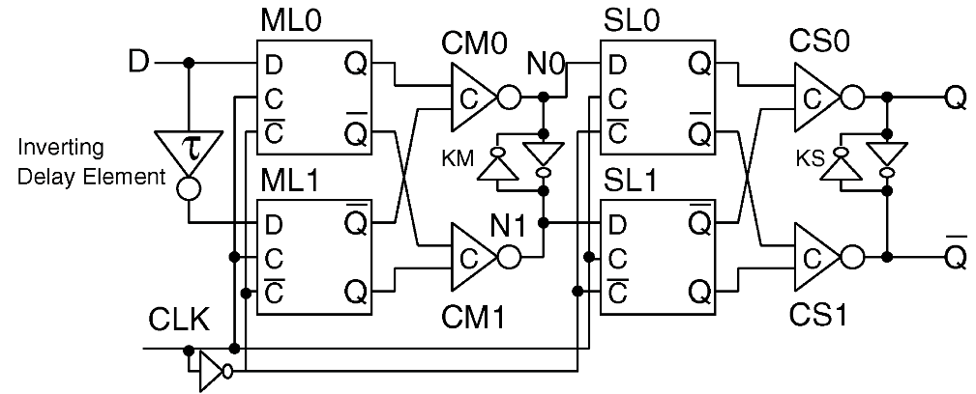
Unhardened vs Hardened Circuits
Radiation testing is performed to compare architecture implemented with both unhardened and hardened circuits
Unhardened circuit uses typical D flip flops
Hardened circuit uses Bi-stable Cross-coupled Dual-Modular (BCDMR) flip flops

Slide 12
Radiation Testing
Circuits are exclusively enabled by the selector
Without a practical method to inject hard faults, only DMR configuration is tested
L2 cache contents are not protected by DARA, they are physically stored in host server DIMMs
Host server handles start/stop signals and L1 misses
Radiation source is calibrated so that DARA is the only component exposed to radiation

Slide 13
Results
Average number of recoveries is recorded to track the number of errors the device experienced
Programs ran on both DARA-DFF and DARA-BCDMR give the same memory data access sequences and identical final memory results for both radiation and non-radiation tests
Execution time differences represent overhead for error recovery roll-back
Circuit hardening results in a 71% increase in area and a 28% increase in power consumption

Slide 14
Shortfalls
Did not test operation of TMR configuration
Hardened and unhardened circuits were manufactured on the same chip

Slide 15
Conclusions
DARA was able to achieve hardened circuit reliability while using unhardened circuits
  Unhardened circuits use less power and require less area than their hardened counterparts
Adaptive DMR/TMR redundancy further reduces power consumption while still providing both soft and hard error protection
DARA’s fine-grained rollback scheme offers reduced overhead and faster recovery compared to typical checkpointing schemes

Slide 16
Questions?

