Slide 1
Reconfigurable Computing Applications
Ed Carlisle

Slide 2
Outline
Reconfigurable Multi-Core Platform
E-health and robotics case studies
Reconfigurable Computing Framework for Robotics
Leverages dynamic partial reconfiguration to fully utilize smaller devices required from tight constraints of micro UAVs
SURF Image Processing on Xilinx Zynq SOC
Tremendous speedup achieved over software SURF implementation
Conclusions

Slide 3
A reconfigurable multi-core computing platform for robotics and e-health applications
Dennis Majoe, Lars Widmer, Liu Ling, Jim Chih-Chen Kao, Jürg Gutknecht
2012 IEEE/ACIS 11th International Conference on Computer and Information Science

Slide 4
RC System Development
Reconfiguration can be useful both during development for debugging and after development for functional upgrades
Typically algorithms are mapped to a custom architecture to be implemented on an FPGA
High development costs for register transfer level (RTL)
General purpose soft-cores can be used to increase efficiency of development
Xilinx’s MicroBlaze and Altera’s Nios II cores
Can even be used to run Linux operating system
May limit amount of parallelism that can be exploited

Slide 5
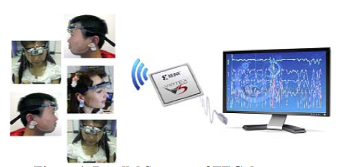
E-Health Case Study
Group relaxation session with 5 patients
Each patient uses an EEG sensor to determine their level of relaxation and compare with rest of the group
Parallel FFT analysis is performed on each EEG stream
Processing and visualization must happen simultaneously in real time

Slide 6
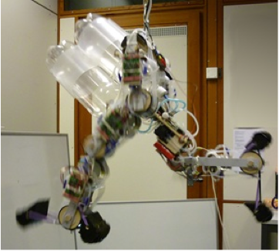
Robotics Case Study
Must process 60 sensor signals and produce 30 output control signals
7 moving limbs
4 or more actuators each
Each limb contains accelerometers, angle and pressure sensors
Machine learning is used to stabilize and maneuver the robot
Data processing must occur in real time

Slide 7
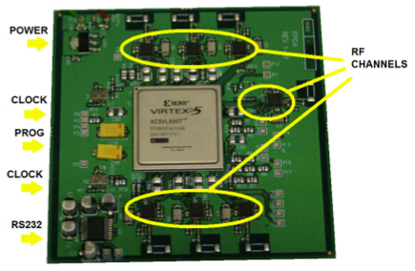
System Architecture
Virtex 5XC5VLX50T FPGA
Tiny Register Machine (TRM)
2 stage pipeline running at 116MHz
Very light on FPGA resource usage
Communication between cores buffered with FIFOs
RF sensor communication over SPI protocol
Application software written in OBERON
Development environment integrated into Xilinx ISE
Software is instantiated onto parallel TRM cores
Software can be targeted at a specific core or generalized for a group of parallel cores

Slide 8
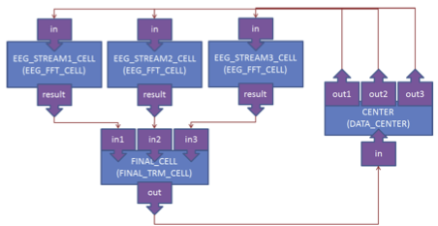
EEG Data Stream Processing
Data_Center provides SPI communication to RF sensors for data input from EEGs
FFT_Cells perform 512 point floating-point FFT calculations
Final_TRM_Cell groups results and prepares data for transfer over RF to output display

Slide 9
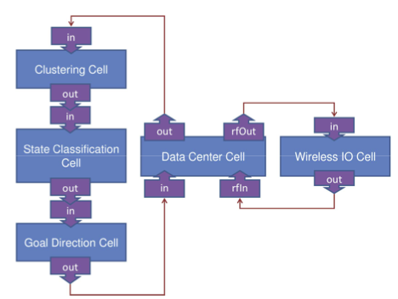
Robot Hierarchical Processing
Machine learning handled by Clustering and State Classification Cells
Clustering Cell performs feature extraction
Wireless IO Cell used for communications with RF components
Data Center Cell is responsible for formatting data for use with processing cells

Slide 10
Platform Development Results
Communication between FPGA prototype and robot I/O processors was verified
Machine learning, goal direction, and classification processing cells are still under construction
SPI communication with RF sensors has been measured at 120KB/s per channel
Internal communication between processing cells achieved 100MB/s with latency between 10-50 ns
512 point floating-point FFT for EEG processing completes in 9.52 ms at 100MHz clock rate

Slide 11
An Adaptively Reconfigurable Computing Framework for Intelligent Robotics
Moazzam Hussain, Ahmad Din, Massimo Violante, Basilio Bona
2011 IEEE/ASME International Conference on Advanced Intelligent Mechatronics

Slide 12
Introduction
Micro Unmanned Aerial Vehicles (UAVs) are designed to be easily transportable platforms for rapid deployment with very small payloads
Ground Control Stations (GCS) are used after deployment to control and acquire information from micro UAVs
Post-disaster assessment case study will be explored
Micro UAVs provide affordable and timely access to imagery of affected areas

Slide 13
Micro UAV System Constraints
Micro UAVs have tight constraints for processing payload size and power consumption
Dynamic Reconfiguration can allow the use of smaller FPGA devices by reusing the same region for multiple tasks
Onboard computers usually work in a controlled loop
Inertial sensors update attitude information every 20ms
Computation of this information only requires 3ms
Navigation controller must then wait 17ms for next set of inputs
During this time hardware resources may be rescheduled for another computationally intensive task

Slide 14
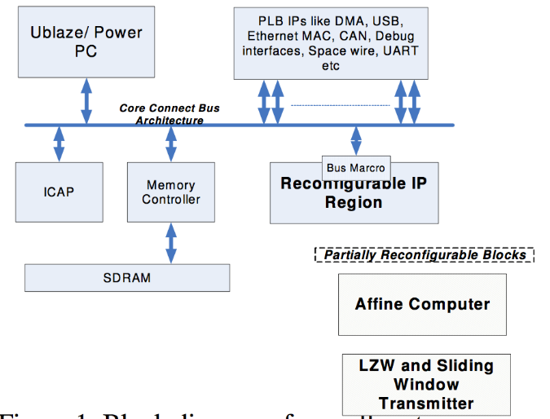
Framework Architecture
Proposed framework consists of many reusable pre-verified IP cores
Pre-verified cores will not require the use of Chipscope cores which are incompatible with PR regions
Generic fully parameterized cores allow use of a wide range of devices
Target applications have severely limited power budgets
Cores implement efficient power management by using clock gating
Partially reconfigurable regions are gated through bus macros to implement a power saving mode since simply programming a blank bitstream will not reduce power consumption
Static regions are used for communication interfaces, memory controllers, and configuration managers (embedded processors)
Computationally intensive cores are implemented as PR blocks
Navigation, image transformation and compression, feature matching engines, Kalman filters, etc.

Slide 15
Micro UAV Processing Architecture
Image data is buffered in a FIFO and written to SRAM using DMA
External DSP can be added if needed
1 Gb/s communication with FPGA

Slide 16
Disaster Assessment Case Study
Acquired images are transmitted from Micro UAV to ground station to generate a mosaic in order to assess damage level
To transmit full images would require high bandwidth and power consumption
8 million bits per image at 4 frames per second
Instead smaller geometrically aligned images are created and compressed
Implementation only requires 115 Kb/s of bandwidth

Slide 17
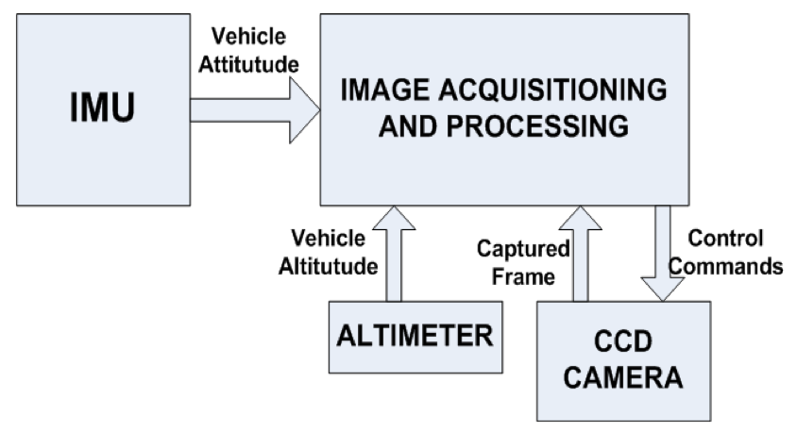
Image Transformation
Vehicle attitude information is used to transform acquired images by scaling and rotating
Roll, pitch, and heading information is obtained from an onboard IMU every 20ms
Each acquired image is tagged with IMU and GPS data
UAV is subjected to 6 degrees of freedom and therefore attitude may be different for each image
Camera coordinates must be transformed into world coordinates
The resulting transformed images are then compressed for transmission to the ground station

Slide 18
Mosaic Generation
Images received at the ground station and north aligned and affine transformed so view point and scale don’t significantly change
A feature point detection algorithm is then used to determine the distance between images and where they overlap in order to stitch them together
Harris corner detection used for this case study

Slide 19
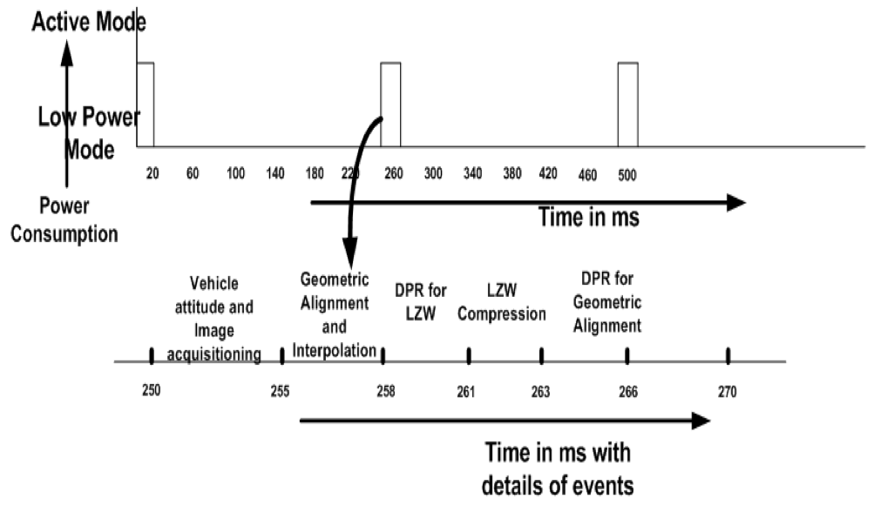
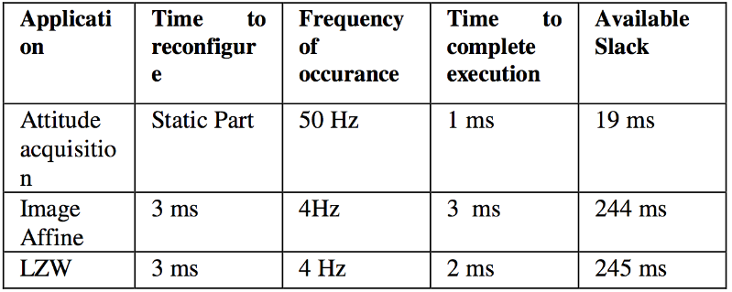
Case Study Results
Partial reconfiguration region is only operative during discrete intervals (10% of overall time)
Remains in power save mode for the other 90% of time
Static regions are only active during attitude acquisition and image processing, otherwise they are also in power save mode
Due to the low variance in images, image compression can achieve a ratio of 1/100
Multiple overlapped images are acquired per second

Slide 20
Shortfalls
Platform for Robots and E-Health
Paper was very brief, light on details
Tiny Register Machine (TRM) used for computation but details on capabilities are absent
Much work still to be completed
Only basic architecture has been implemented and verified
Dynamic Reconfiguration Framework for UAVs
Although power consumption was a main concern for the post-disaster assessment case study, actual power consumption was not measured
Only percentage of time the system was active is presented
Does not mention difference in power consumption between active and power saving modes

Slide 21
Conclusions
Platform for Robots and E-Health
Software and hardware co-design with FPGAs satisfies the need for simple, efficient, and highly parallel reconfigurable computing
An integrated development environment is important for productivity
In this case OBERON code is compiled down to bit streams where the OBERON code is running on language defined tiny RISC processors
This approach can be applied to multiple domains
Dynamic Reconfiguration Framework for UAVs
Reduces size and power requirements by reusing reconfiguration regions for different tasks that are executed in a loop
Case study for post-disaster assessment with a micro UAV was explored

Slide 22
Questions?

Slide 23
Hardware Parallelization of SURF Image-Processing Algorithm on Xilinx Zynq SOC
Christopher Wilson, Paolo Zicari, Patrick Gauvin, Stefan Craciun, Ed Carlisle

Slide 24
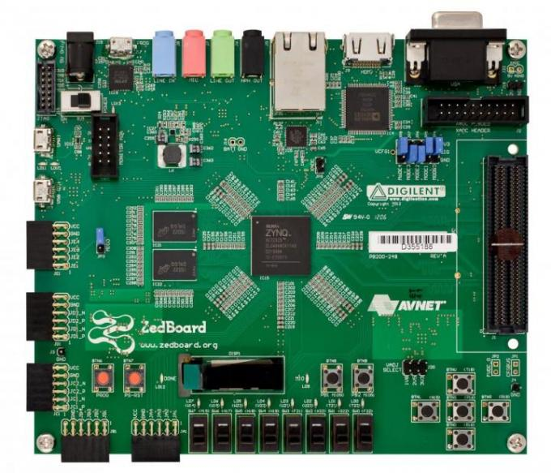
Xilinx Zynq SoC
Xilinx’s new next generation processing chip
SoC – System on a Chip
Includes dual ARM A-9 processors
Significant FPGA fabric for hardware acceleration
Certain steps in applications are not always easily parallelizable on dedicated reconfigurable hardware
Advantages
Faster Place and Route Times (No Softcore Microblaze Processor)
Easy, ready-to-use Linux (xiLinux) boot images to place on the processors
Transition data quickly between the processor and the programmable logic
Lower power and small design footprint

Slide 25
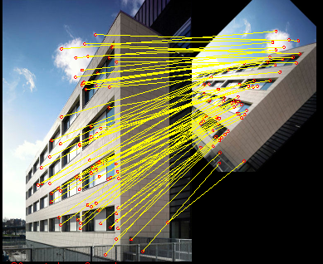
Introduction to SURF
Background Description
Speeded Up Robust Features (SURF)
Scale and rotation-invariant detector and descriptor
Developed and refined by Bay et al in 2010
Interest point detection forms the basics of many key computer vision algorithms
Image registration
Camera calibration
Object recognition
Image retrieval
The most important feature of an interest point is its repeatability
The interest point extractor must reliably find the same interest points of a given object even if it is observed under different viewing conditions
The neighborhood around every interest point can be described by a vector called a descriptor
Matching descriptors is how an image or parts of an image can be identified
These algorithms are computationally intensive
Of these SURF is unique because it outperforms older schemes including SIFT
Open SURF ex. courtesy of naufolio.augmentedrealityag.com

Slide 26
SURF Phase Description
Two main phases of SURF
Feature Point Detection (Locates the Interest Point)
Feature Descriptor Generation (Describes Area)
Stages of Phase 1
Calculating the Integral Image
Evaluating the Determinant Matrices
Identifying Local Maximums

Slide 27
Architecture Road Map
Camera Input
2D Filter
Integral Image Generator
Gaussian Filters
Clk Divider
Filter CTRL
Max Value CTRL
Local Maximum
Determinant Calculation
Interest Point Buffer
External Connections
Added Design Cores
Frame Buffer
VGA Output
Camera SCCB

Slide 28
Integral Image Background
i(x’,y’)

Slide 29
Integral Image Background
D
B
0
1
C
A
2
3

Slide 30
Integral Image Hardware Architecture
X
FIFO
MUX
CTRL
REG
+
*Control signals left out for clarity

Slide 31
Architecture Road Map
Camera Input
2D Filter
Integral Image Generator
Gaussian Filters
Clk Divider
Filter CTRL
Max Value CTRL
Local Maximum
Determinant Calculation
Interest Point Buffer
External Connections
Added Design Cores
Frame Buffer
VGA Output
Camera SCCB

Slide 32
Hessian Matrix Background

Slide 33
Gaussian Kernels
Discrete and Cropped Versions of the Gaussian Kernels (second order Gaussian derivative approximations)
2D filter approximations

Slide 34
Gaussian Kernels
Assigned Filter Values
Memory Access Locations

Slide 35
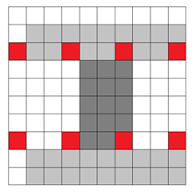
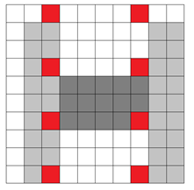
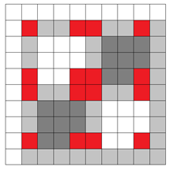
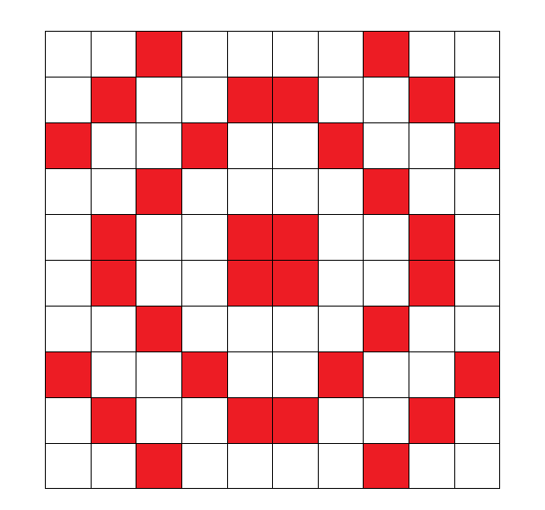
Combined Kernel View

Slide 36
Gaussian Kernel Shift Filter
II
Integral Image
Combined Box Filters
FIFOs
Dxx
Logic and Arithmetic Units
Dyy
Dxy
*9x9 Filter Example

Slide 37
Gaussian Kernel Shift Filter – Alternative View
Dxx
Logic and Arithmetic Units
Dyy
Dxy
*9x9 Filter Example

Slide 38
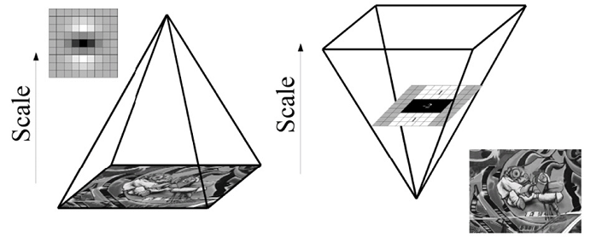
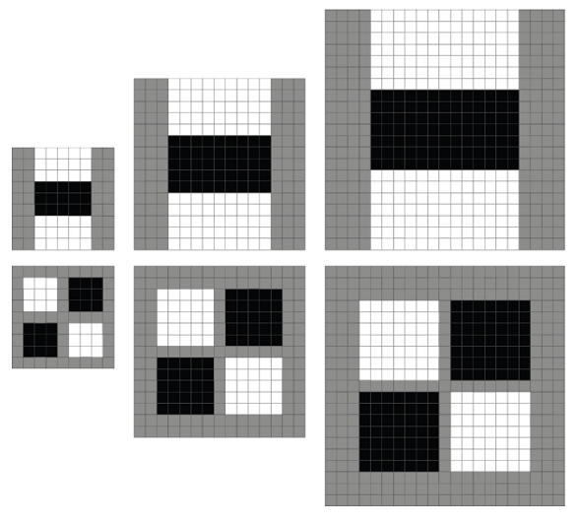
Scale Space Approximation
Scale-Space: This allows the interest point detector to locate the same interest points after the image has been scaled to a different size (scale transform)
Typically, scale-spaces are described as a pyramid of different sized image layers
The interest point detector operates on each scaled level of the generated pyramid.
SURF relies on simple filters to determine the points therefore the filters can be scaled instead of the image
This approach is still mathematically equivalent
Reduces the computations and resources
Example of Image Pyramid
Scaled Filter Examples

Slide 39
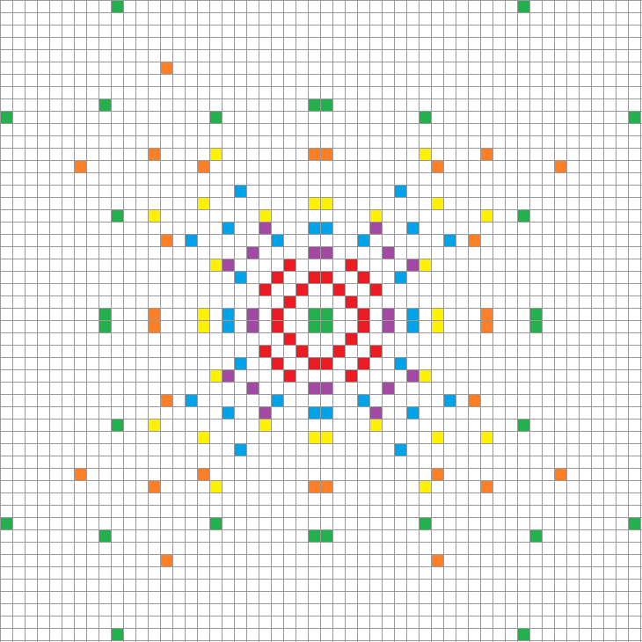
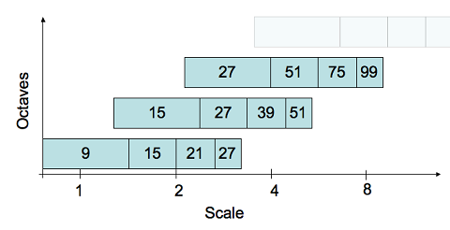
Overlaid Gaussian Kernels
Colored points identify the positions in the filter mask of the integral image pixels necessary to calculate Dxx, Dyy and Dxy
The scale-space is divided into octaves, and each octave is divided into a certain number of intervals
Represents 6 scale levels (2 octaves of 4 intervals each) with the largest filter size as 51x51
Each color represents a different scale

Slide 40
Gaussian Kernel Shift Filter
Gaussian filters are calculated in parallel for all the scale levels
II
51x51 Filter Block
9x9
Dxx
Dyy
Dxy
15x15
Dxx
Dyy
Dxy
21x21
Dxx
Dyy
Dxy
Logic and Arithmetic Units
27x27
Dxx
Dyy
Dxy
39x39
Dxx
Dyy
Dxy
51x51
Dxx
Dyy
Dxy

Slide 41
Architecture Road Map
Camera Input
2D Filter
Integral Image Generator
Gaussian Filters
Clk Divider
Filter CTRL
Max Value CTRL
Local Maximum
Determinant Calculation
Interest Point Buffer
External Connections
Added Design Cores
Frame Buffer
VGA Output
Camera SCCB

Slide 42
Hessian Determinant Calculation
Inverse Area
(0.,1,16)
Pipeline Registers
X
DXX
(1,15,16)
X
(1,15,16)
Inverse Area
X
(1,15,16)
-
DYY
.9
Inverse Area
(0,1,16)
X
X
DXY
X
(1,15,16)
Normalize with respect to area
$$H\left(x,y\right)=dxx×dyy−.9{\left(dxy\right)}^{2}$$
*Single Scale Size Example

Slide 43
Architecture Road Map
Camera Input
2D Filter
Integral Image Generator
Gaussian Filters
Clk Divider
Filter CTRL
Max Value CTRL
Local Maximum
Determinant Calculation
Interest Point Buffer
External Connections
Added Design Cores
Frame Buffer
VGA Output
Camera SCCB

Slide 44
Interest Point Localization
Threshold controls the overall sensitivity of the detector
Each candidate point is compared to each of its 26 neighbors 8 in the same scale and 18 in the scales above and below
Points that are not local maximums are suppressed
The candidate can be located in any scale level that has both neighbor scale levels
Candidate
26 Neighbors

Slide 45
Local Maximum Point Identification
9x9 Det
Design equivalent to checking 4 candidates simultaneously
15x15 Det
21x21 Det
27x27 Det
39x39 Det
51x51 Det

Slide 46
Performance Comparison
Matlab Serial Operation
Evaluation CPU System 1 Hardware Specifications
Quad-Core AMD Opteron 2372 HE
16 GB RAM
Evaluation System 2 Hardware Specifications
Intel Pentium 4 630 @ 3GHz
4GB RAM
Software
OpenSURF ver 1c
FPGA
Evaluation System
Avnet Zedboard
Zynq-7000 XC7Z020-CLG484-1
Software
Hardware Accelerated IP
Starting Latency (25MHz Clk)
.001352 sec
System | Avg. Time per Frame (sec)
CPU 1 | 0.94359
CPU 2 | 2.25150
FPGA (25Mhz) | 0.01229
$$\frac{.94359 sec}{.01228 sec}=76.79 Speedup$$
$$\frac{2.2515 sec}{.01228 sec}=183.35 Speedup$$
Does not include image acquisition times
Performance Dependent on Camera Clock Speed

Slide 47
SURF Conclusions
Xilinx Zynq SoC offers the versatility of hardware acceleration and a more advanced processing system than previously offered on Xilinx devices
FPGA image processing cores are limited by the clock speed of the camera
An FPGA based system can out perform general CPUs for many image processing applications including SURF
This greater performance can be used for high-speed image processing with available memory on the FPGA as the limiting factor
Additional sensors and peripherals can be easily added to the Zynq so there is no loss of functionality
The prototype was developed with low cost components, higher grade sensors can be purchased to improve results

Slide 48
Questions?

