Slide 1
Simulation Fault-Injection &
Software Fault-Tolerance
Ed Carlisle

Slide 2

Outline
Background
  Radiation Effects
  Fault Injection
  Fault Tolerance
Simulation Fault-Injection
  Methodology
  Results
  Related Research
Process-Level Redundancy
  Architecture
  Maintaining Transparency
  Results & Overhead
Conclusions

Slide 3
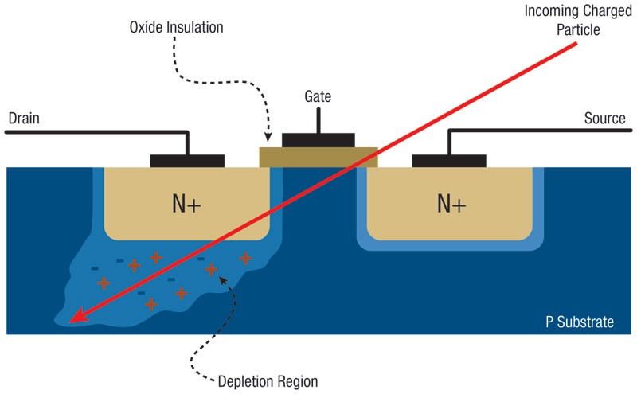
Radiation Effects
Transient faults (or soft errors)
  Occur when particles strike a device causing the deposit or removal of energy which inverts transistor state
  Usually observed as a bit-flip
In order to study these effects in the lab, some form of fault injection can be used

Slide 4
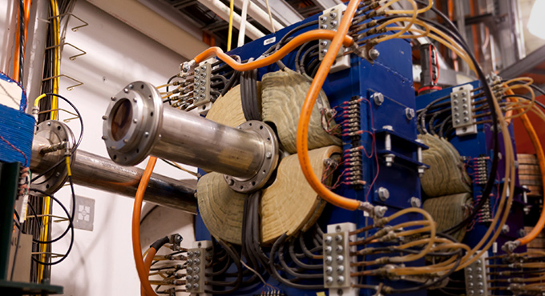
Hardware Fault-Injection
Using radiation beam or electromagnetic interference
  Similar to what a device would experience in harsh environment
Using probes to introduce voltage or current changes
Advantage
  Closely resembles real-world effects on device
Disadvantages
  Possible to damage
  device under test
  Device under test
  must be modified
  to perform injection

Slide 5
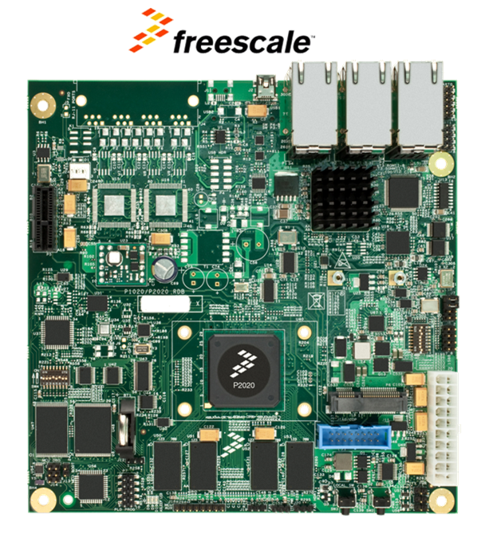

Software Fault-Injection
Compile-time injection
  Corrupts an application’s instructions during compilation
Runtime injection
  Uses a trigger mechanism to inject faults during execution
  Faults can be targeted at any software-visible components
Advantage
  Device under test does not
  need to be modified
Disadvantage
  Possible to disturb processing
  workload in unintended ways

Slide 6
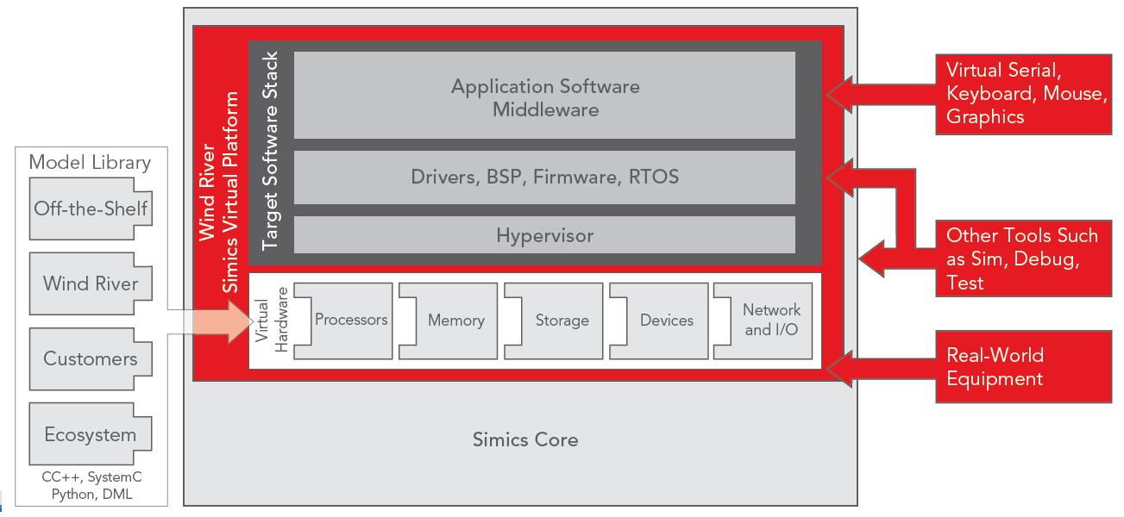
Simulation Fault-Injection
Fault injection can be performed in simulation of system
Advantages
  Injections are transparent to target system
  Simulation offers greatest amount of controllability and observability
Disadvantages
  Building simulation for target device is not a trivial task
  Faults in physical system may not manifest in simulation
Python

Slide 7
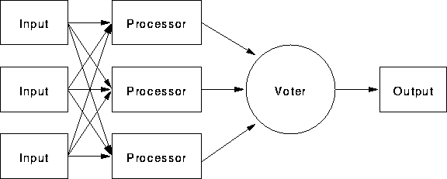
Fault Tolerance
Usually involves some form of redundancy
Hardware Fault-Tolerance
  Memory and caches can be protected with ECC or parity
  TMR is one of the most common forms of HW FT
    Example of TMR (Triple Modular Redundancy) shown below

Slide 8
Fault Tolerance
Hardware Fault-Tolerance (cont’d)
  Hardware devices can also be fabricated using processes that are less susceptible to radiation effects
  Process of radiation hardening devices can be prohibitively expensive and time consuming
    RadHard devices are generations behind their COTS counterparts in terms of performance and power consumption
Software Fault-Tolerance
  Very cost-effective approach compared to hardware FT
  Does not require any modification to device architecture
  Leverages high-performance, low-power commercial off-the-shelf (COTS) components

Slide 9
Questions?

Slide 10
Characterizing the Effects of Transient Faults on a High Performance Processor Pipeline
Nicholas J. Wange, Justin Quek, Todd M. Rafacz, Sanjay J. Patel
Univeristy of Illinois at Urbana-Champaign
International Conference on Dependable Systems and Networks 2004

Slide 11
Overview
Detailed Verilog model created for a microprocessor architecture, similar in complexity to the Alpha 21264 or AMD Athlon
Created a methodology for performing fault injection on a detailed latch-level simulation of a complex processor
Studied the propagation and/or masking of faults from the micro-architectural level to the architectural level

Slide 12
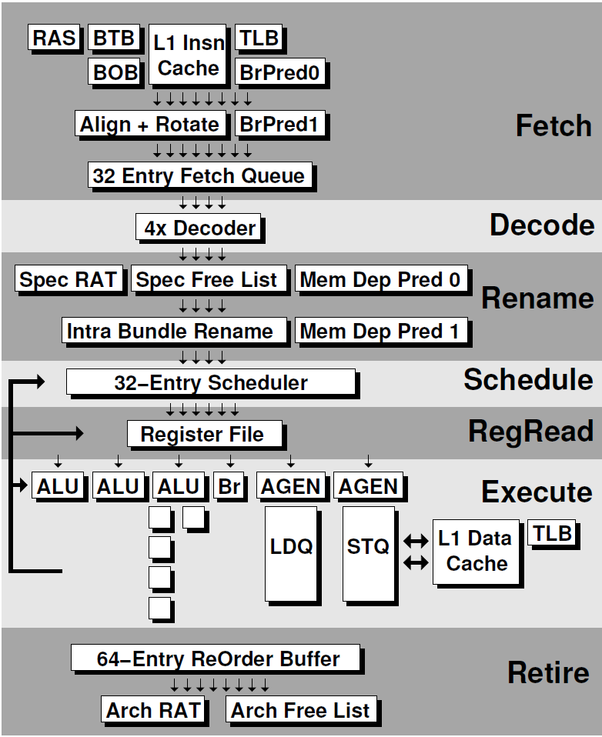
Verilog Processor Model Features
Alpha ISA subset
Speculative instruction scheduling
Memory dependence prediction
Sophisticated branch prediction
Up to 132 instructions can occupy the 12 stage pipeline

Slide 13
Fault-Injection Methodology
A time at which to inject fault is first selected
  Randomly selected from 250-300 start points
Then the bit to corrupt is randomly selected
  Injected faults are a single bit-flip of a state element
The trial is monitored for up to 10,000 cycles
  At each cycle, architectural state is verified against non-injected golden execution
Trials are placed into four categories depending on the outcome
Each experiment consists of 25,000-30,000 trials

Slide 14
Trial Outcome Categories
Micro-architectural state match
  Occurs when every bit of state in the machine is equivalent to a non-fault-injected simulation
Termination
  Premature termination of the workload (execution error)
Silent data corruption
  Trials that result in software-visible register or memory corruption (data error)
Gray area
  Trial that does not result in failure (termination or silent data corruption) or micro-architectural state match

Slide 15
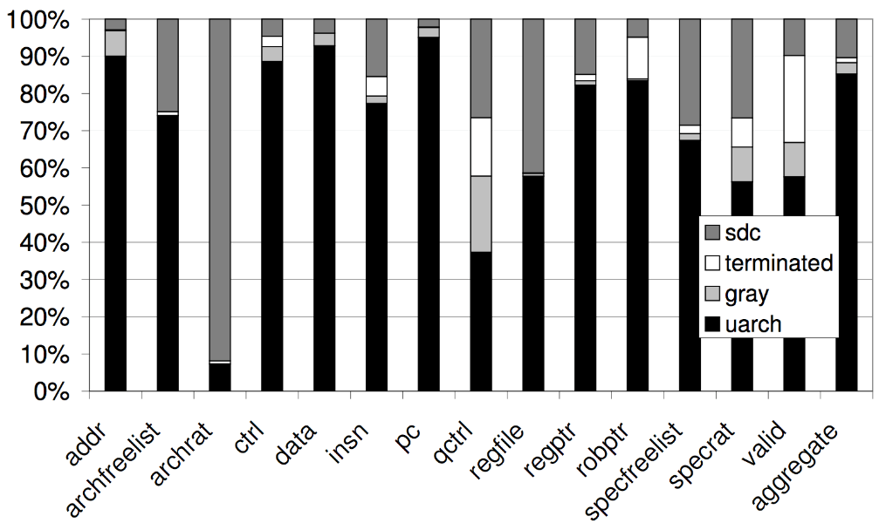
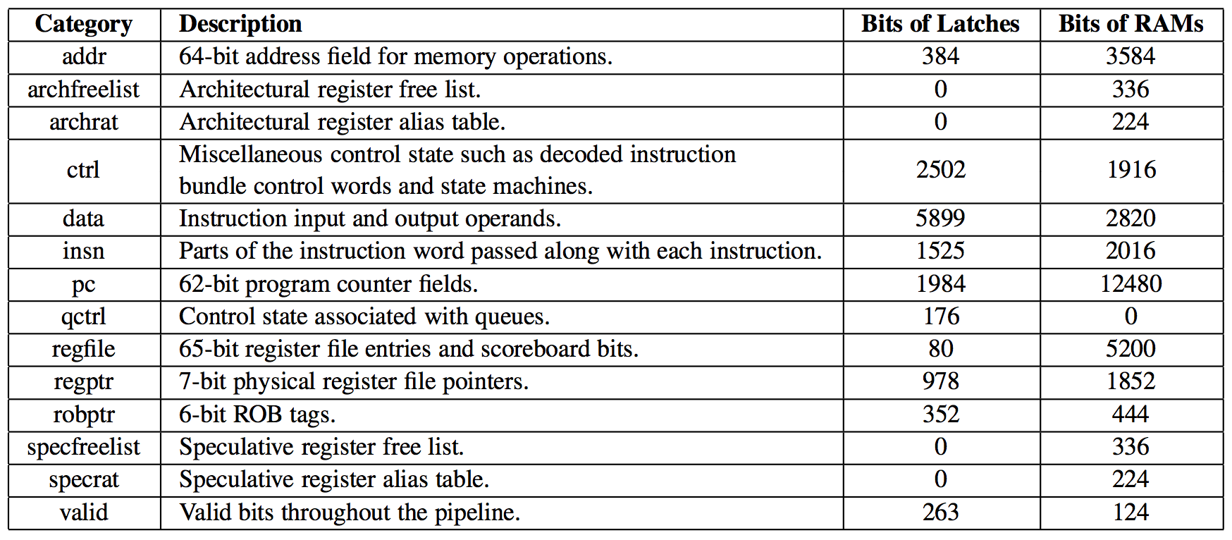
Results

Slide 16
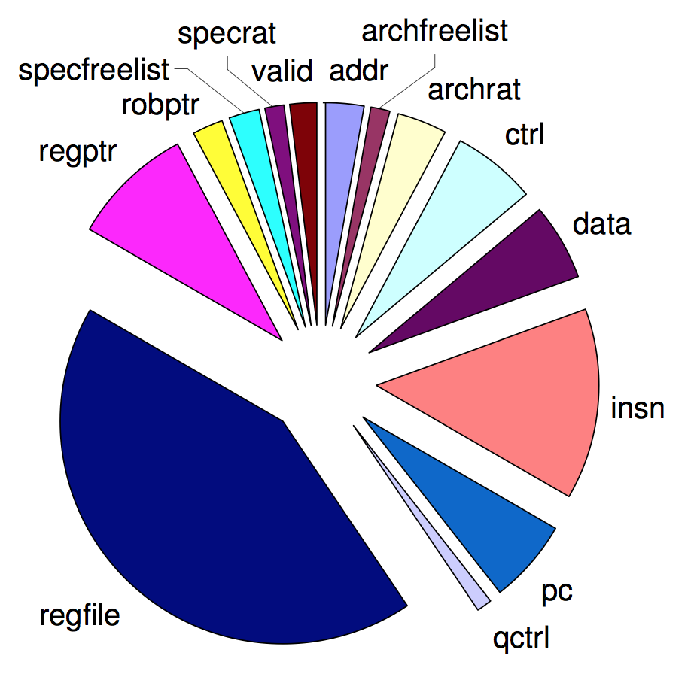
Results
This chart shows which types of state (relative to their contribution of overall state) contribute to silent data corruption and terminated results
Register file corruption is the leading cause of silent data corruption (data errors) and terminated (execution errors) outcomes

Slide 17
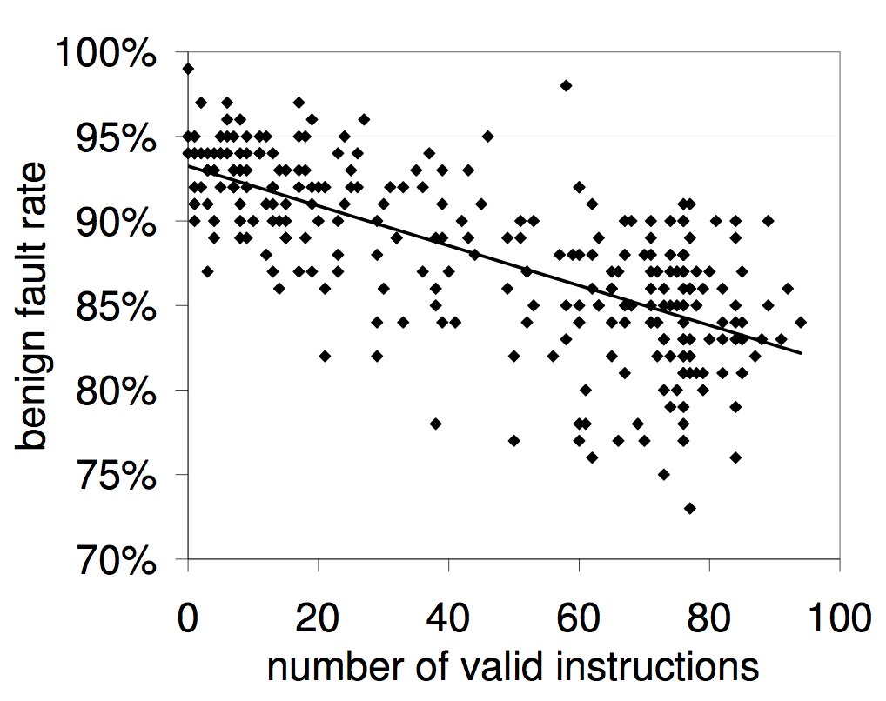
Results
Although noise is present in the graph, a correlation between processor utilization and benign fault rate can be seen
As the number of valid instructions (those that will commit results) in the pipeline decreases the benign fault rate increases
Benign faults do not affect program correctness

Slide 18
Shortfalls
Some instructions of the Alpha ISA were not implemented in the processor model
10,000 cycle limit for monitoring is quite low
  Certainly not enough time for most benchmarks to complete
Certain components were ignored for fault injection
  These include caches and prediction structures
Corrupted registers were considered application failures
  However, I have observed in my research that the majority of faults targeted at registers do not affect program execution or output
  In my research I use the Simics cycle-accurate system simulation environment to perform fault injections into the register file of the Freescale P2020 dual-core PowerPC-based processor

Slide 19
Simics Fault-Injection Workflow
Create Simics script to load initial checkpoint
Run Simics script
Calculate cycles required for execution
Create checkpoints and exit Simics
Select checkpoint for injection and inject fault
Create Simics script to load and execute injected checkpoint
Run Simics script
Monitor console output to determine outcome
Log results and exit Simics

Slide 20
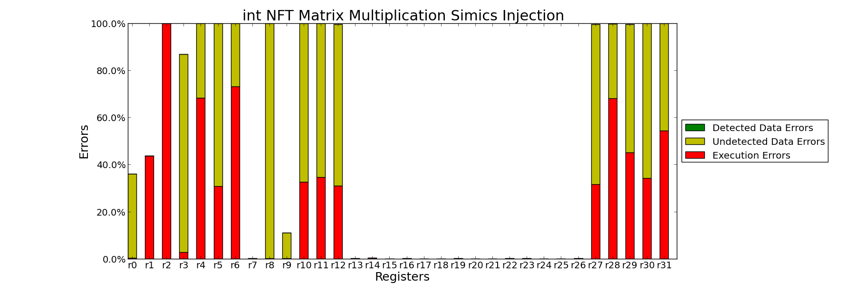
Simics Simulation Fault-Injection Results
Simics simulation does not have the same level of detail needed to perform fault injection at the micro-architectural level, but does allow for register file fault-injection
The chart below shows results obtained when injecting single-bit faults into each of the general purpose registers, during a matrix multiplication application

Slide 21
Questions?

Slide 22
PLR: A Software Approach to Transient Fault Tolerance for Multicore Architectures
Alex Shye, Joseph Blomstedt, Tipp Moseley, Vijay Janapa Reddi, Daniel A. Connors
IEEE Transaction on Dependable and Secure Computing April-June 2009

Slide 23
Process-Level Redundancy
Similar to TMR hardware fault-tolerance scheme
Creates a set of redundant processes for an application and compares each output to ensure correct execution
Leverages multiple processing cores by allowing the operating system to schedule redundant processes to available cores
Biggest challenge is maintaining determinism
Transparency can be achieved by maintaining user-expected process semantics
Does not require any modifications to target application, operating system, or device architecture
  Important for legacy binaries whose source is no longer available

Slide 24
Sphere of Replication
Specifies the boundary for fault detection and containment
  Data entering the SoR is replicated
  All execution within the SoR is redundant
  Any data leaving the SoR is compared to check for faults
  Any execution outside the SoR is not protected
A typical hardware-centric SoR is shown on the left
PLR’s software-centric SoR is shown on the right

Slide 25
PLR Components
Monitor process
  Maintains semantics
Figurehead process
  Maintains semantics
Master process
Slave processes
  Redundant processes
System call emulation
  Maintains determinism
  Responsible for fault detection and recovery

Slide 26
Maintaining Process Semantics
Example semantics:
  Each application is assigned a process identifier (PID) which exists throughout execution and returned to the operating system after completion
  When an application exits, it returns the correct exit code
  A signal that is sent to a valid PID will have the intended effects (e.g. SIGKILL will kill the process)
Figurehead process
  Original process becomes figurehead process after redundant processes are created
  Does not perform any real work

Slide 27
Maintaining Process Semantics
Figurehead process (cont’d)
  Sleeps and waits for redundant processes to complete
  Receives application exit value and exits correctly
  Responsible for forwarding incoming signals to all redundant processes
Monitor process
  Certain signals are not easily forwarded
    A SIGKILL signal would kill the figurehead process, but leave behind all redundant processes
  Monitor process polls the state of figurehead process
  If figurehead is killed or stopped, monitor process will kill or stop redundant processes

Slide 28
Maintaining Determinism & Transparency
System call emulation unit
  Responsible for input replication, output comparison, and system call emulation
  Responsible for ensuring that redundant processes interacting with the system appear as if only the original process is executing
  System calls that return nondeterministic data (such as the system time) must be emulated to ensure all processes use the same data
Master vs. slave processes
  System calls that modify any system state are only executed by the master process
  Other system calls are performed once for the master process and replicated for the slave processes

Slide 29
Fault Detection
The system call emulation unit is responsible for providing fault detection and recovery
A fault causing the application to hang can be detected by a watchdog timer attached to the emulation unit
  The timer begins when a processes enters the unit
  If the rest of processes do not enter the unit within a specified amount of time, an execution error is signaled
Faults causing control-flow errors can also be detected if all processes do not request the same system call when entering the emulation unit

Slide 30
Fault Recovery
If an output mismatch occurs, a majority vote can be used to kill process producing incorrect data
  Bad process is then replaced by forking correct process
A watchdog timeout can occur in two cases
  If a faulty process calls the emulation unit while other processes are executing, it is killed and replaced by forking a correct process at the next system call
  If a faulty process hangs while the other processes are waiting in the emulation unit, it is killed and replaced by a correct process
If a process fails, it is simply replaced by duplicating one of the remaining processes

Slide 31
Results
PLR eliminates all failed, abort, and incorrect cases
  Output comparison converts abort and incorrect cases to mismatches
  PLR detects failed cases, converting them into sighandler cases
  A small number of failed cases are detected as mismatch with PLR
    The mismatch is caught before the application can fail
Some floating-point benchmarks actually caused correct outcomes to become mismatches with PLR enabled
  The specdiff tool included with the benchmarks uses a tolerance when checking output data, whereas PLR’s output comparison checks raw data

Slide 32
Overhead Incurred
A) 2 processes B) 3 processes C) 2 processes optimized D) 3 processes optimized
Contention overhead is mainly caused by sharing memory bandwidth between redundant processes
Emulation overhead is caused by synchronization and transferring/comparing data in shared memory

Slide 33
Shortfalls
Functionality of system call emulation unit is detailed, however not many implementation details are provided
  Replicating results would be hard to accomplish without more specific implementation details
Faults occurring during PLR code or operating system execution are not protected against
Only supports single-threaded applications
May not function as intended if using more redundant processes than physical cores available
  Timeouts assume all processes are running concurrently

Slide 34
Conclusions
Simulation Fault-Injection
  Allowed for injections to target areas not accessible to software or hardware fault-injection tools
  Showed that many faults are masked before they are even visible to software
Process-Level Redundancy
  Software fault-tolerance scheme
  Similar to triple modular redundancy hardware scheme
  Transparent to system and target application
    Does not require any user intervention to apply protection
  Able to detect all application failures and incorrect output

Slide 35
Questions?

