Slide 1
FTCA: On-Board Processing Design Optimization Framework
Dr. Alan D. George
Professor of ECE
University of Florida
Dr. Herman Lam
Assoc. Professor of ECE
University of Florida
Dr. Ann Gordon-Ross
Asst. Professor of ECE
University of Florida
Nicholas Wulf
Research Student
University of Florida

Slide 2
Outline
OBP Design Optimization Framework Overview
Dependability and power evaluation metrics
Hyperspectral imaging case study
Dependability Metric
Space Orbit Overview
Space radiation analysis with CREME96
Atmospheric radiation
Power and Performance Metric
Constrained linear optimization with linear programming

Slide 3
Outline
OBP Design Optimization Framework Overview
Dependability and power evaluation metrics
Hyperspectral imaging case study
Dependability Metric
Space Orbit Overview
Space radiation analysis with CREME96
Atmospheric radiation
Power and Performance Metric
Constrained linear optimization with linear programming

Slide 4
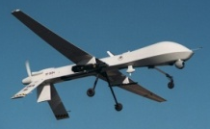
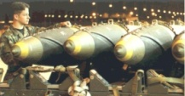
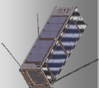
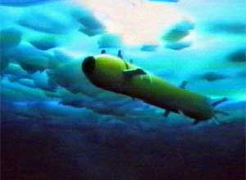
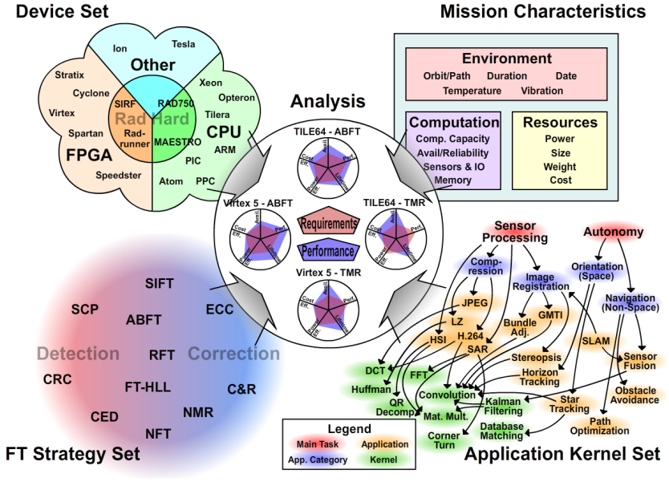
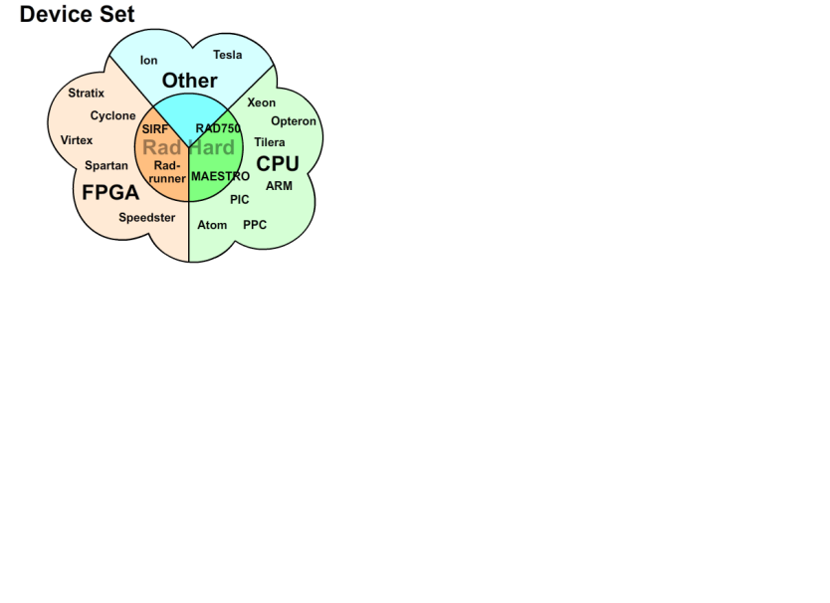
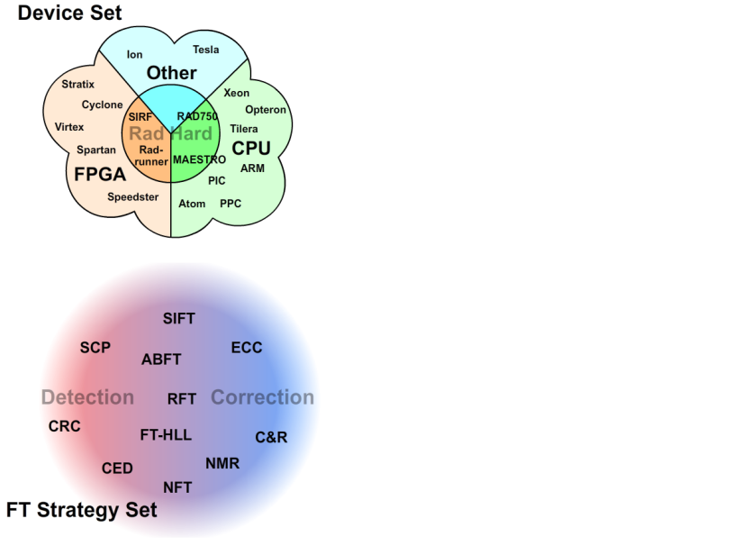
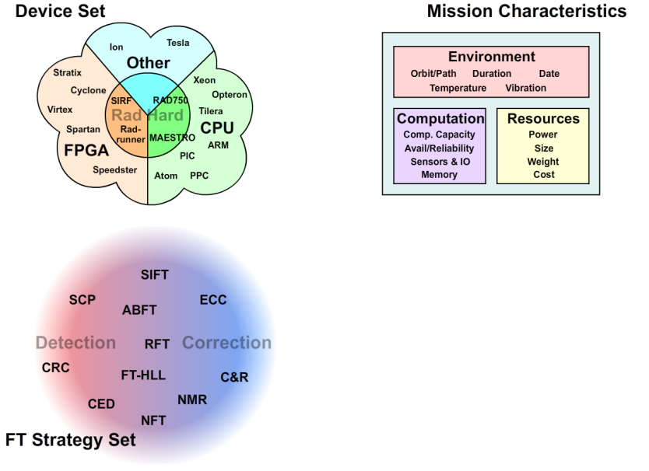
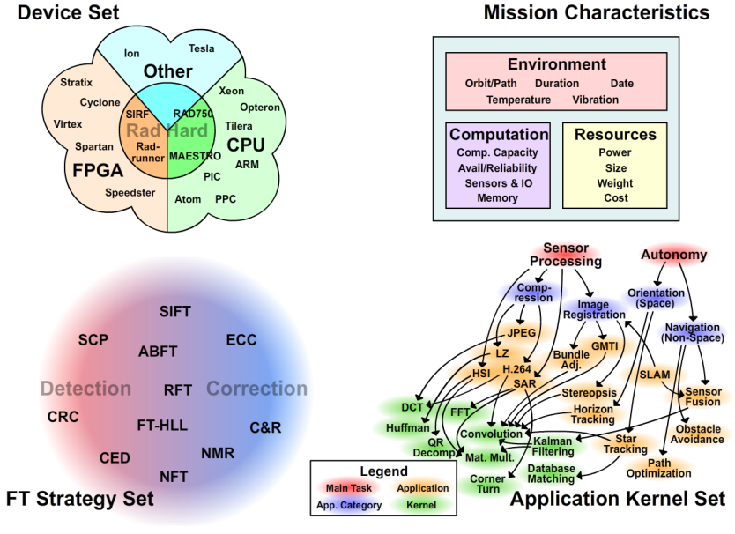
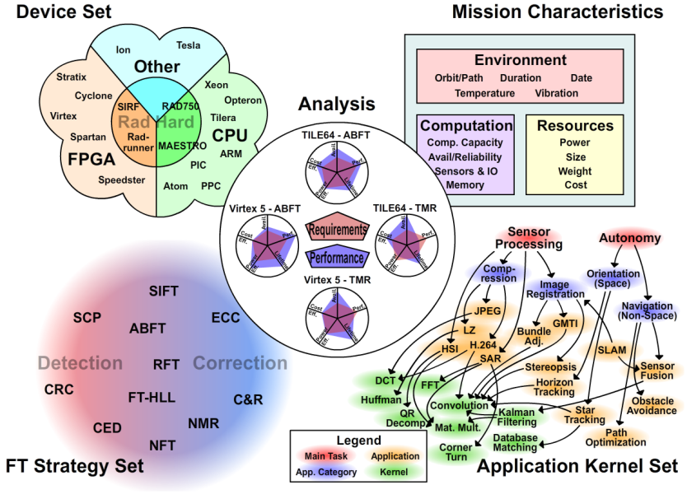
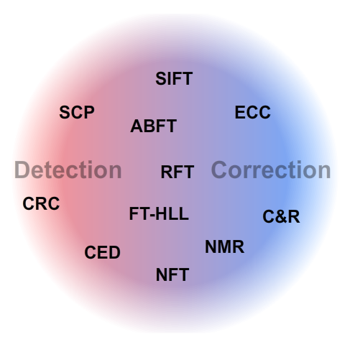
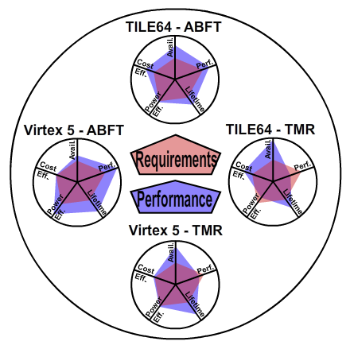
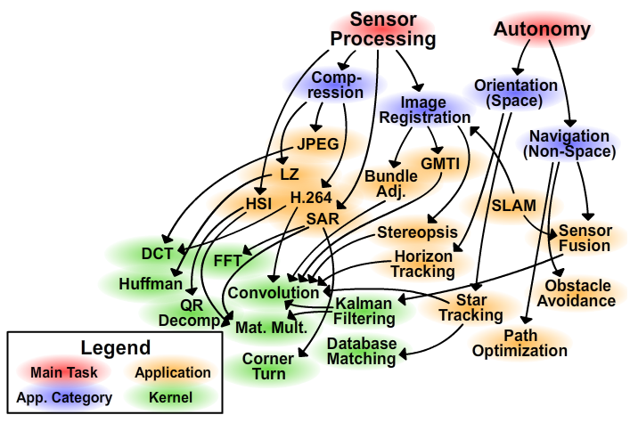
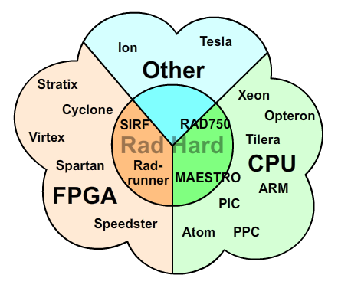
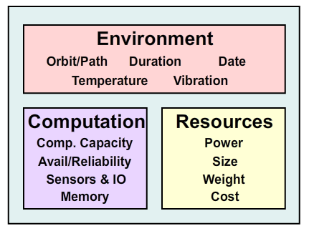
On-Board Proc. Framework
Goal: Provide theory for determining Pareto-optimal device & fault-tolerant (FT) strategy for on-board processing systems
Focus on small satellites, UAVs, smart munitions, AUVs
Generalized comparison framework deters ad hoc design methodology, leading to Pareto-optimal designs
Approach: Divide exploration space into its key components for study
Device Set – Includes CPUs, DSPs, FPGAs, GPUs, & any Rad-Hard versions
FT Strategies – Sacrifice resources for fault tolerance (may be app-specific)
Mission Characteristics – Defines system’s environmental conditions
Application Set – Includes most common kernels (e.g., space apps.)
Analysis – Design evaluation metrics calculated from other components
Is selected design acceptable?
How does it compare to others?
Application
Kernel Set
Mission Characteristics
Device Set
Analysis
FT Strategy Set

Slide 5
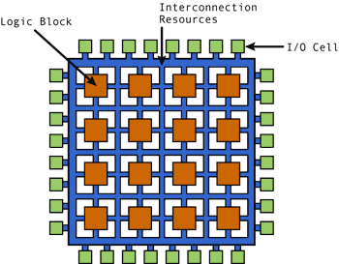
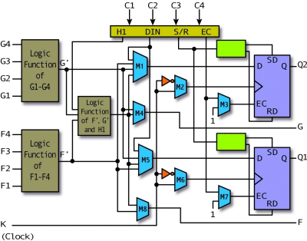
What is an FPGA?
Field-programmable gate arrays provide large amounts of logic resources connected with a complex, configurable routing network
Logic resources: LUTs & FFs
Routing resources: Switchboxes
Specialized cores: BRAMs, DSPs, SERDES
FPGA configuration memories stores the current state of the device
Modification of configuration memories effects the functionality of the device
Benefits of FPGAs over traditional processors
Application-specific hardware enables efficient processing at low frequency and power
Large logic fabric enables massive algorithm parallelism
Run-time reconfiguration allows for time-multiplexing of multiple designs
Xilinx CLB Architecture
5

Slide 6
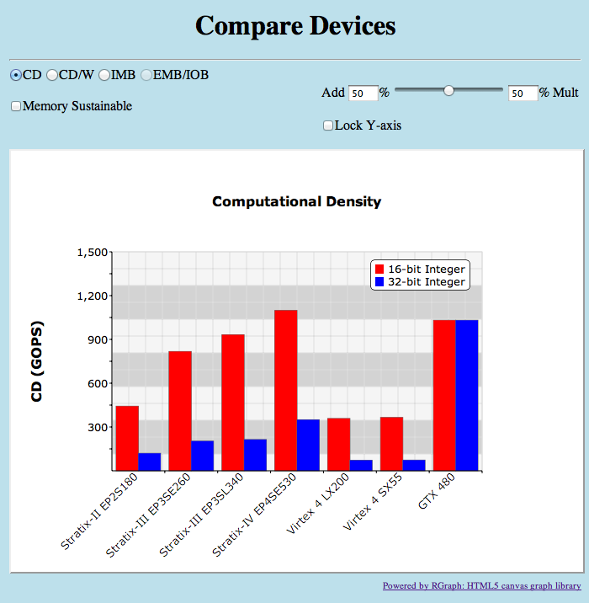
Calculating Computational Density
Computational Density (CD) used to analyze device performance
Developed within CHREC at the University of Florida
Applicable to wide range of architectures (e.g., CPU, DSP, GPU, FPGA, etc.)
Produces results in terms of operations per second
Different CD result for each type of precision (e.g., bit, 8-bit int., 64-bit double)
CD also depends on type of operation (e.g., add, multiply, divide)
Standard objective methodology for calculating CD on FPGAs
Generate and analyze compute core on FPGA
Perform twice for each core; one with and one without DSP resources
Core must match desired precision & operation
Collect data on resources used and max freq.
Use optimal packing algorithm to determine maximum number of cores on device
CD equals number of cores times worst clock rate from the list of cores used

Slide 7
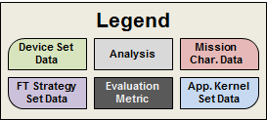
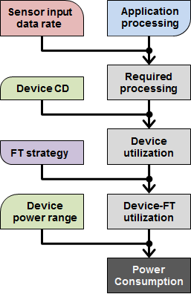
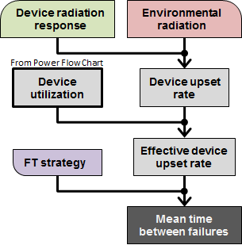
Framework Methodology
Designs evaluated according to two metrics
Power – power consumed by device
Sensor data rate & application determine amount and type of required processing
Device utilization is ratio of corresponding device CD to required processing
FT strategy overhead increases utilization
Linear interpolation between power range to find power consumption
Dependability – time between failures
Device radiation characteristics and environment determine device upset rate
Low utilization causes lower vulnerability
FT strategies help to mitigate upsets
Power
Sensor
Power
Sensor
Device
Device
TMR
Utilization: 72%
Utilization: 24%
Consumed
Max
Dependability
Dependability
Device Upset Rate:
Static
10 upsets/day
0%
50%
72%
100%
Environmental Radiation (Particles / m²·ster·s)
Device Cross-Section (SEE / Particle·m²)
Utilization
0
50
100
LET $\left(\frac{MeV}{mg∙{cm}^{2}}\right)$
Only 72% of device is vulnerable
TMR protects against 99% of upsets
0.14
MTBF:
13.89
0.10
days
TMR = Triple-Modular Redundancy
CD = Computational Density

Slide 8
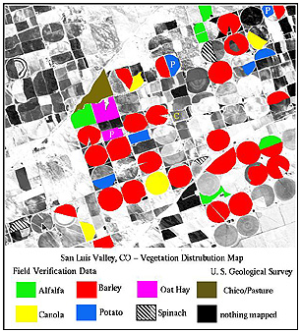
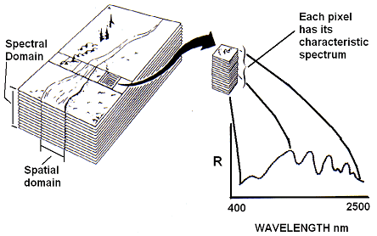
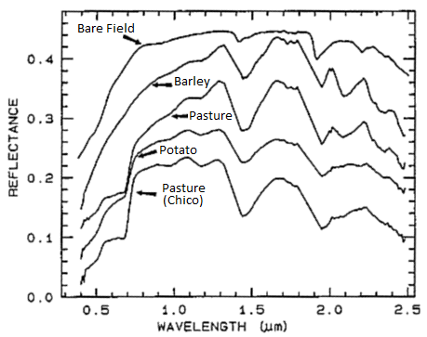
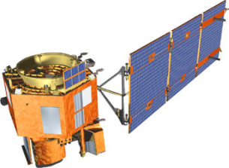
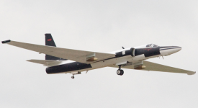
HSI Case Studies
Hyperspectral Imaging (HSI) enables detection of key materials within a scene
Detects intensities of hundreds of wavelengths for each pixel forming an image cube
Compares characteristic spectrum of pixels to spectral signatures of desired materials
Marks location of identified materials within the scene
Image cube too large for transfer to processing station due to limited bandwidth
Solution: perform computation in-situ and only transfer final results
Two HSI missions chosen as case studies for on-board processing
Hyperion on EO-1 satellite requiring 2.2×10⁹ 32-bit integer MAC/s
AVIRIS on ER-2 aircraft requiring 348×10⁶ 32-bit integer MAC/s
Identify
Detect
Compare
MAC = Multiply Accumulate

Slide 9
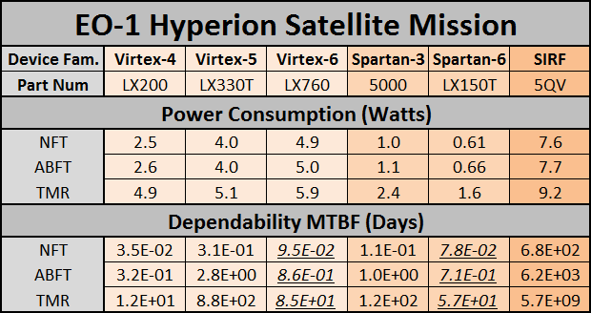
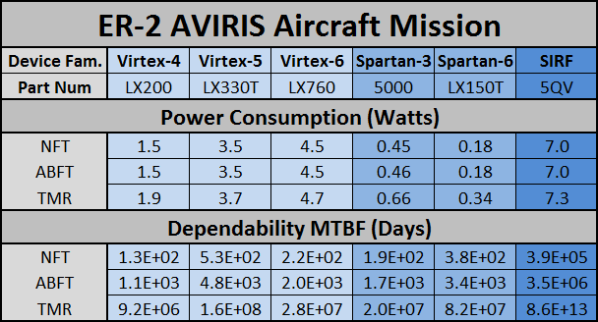
Raw Results
Studied design combinations of 6 FPGAs and 3 fault-tolerant strategies
Devices: 3 standard Virtexes, 2 low power Spartans, and 1 Rad-Hard SIRF
Fault-tolerant strategies:
No fault tolerance (NFT): 0% overhead and no added reliability
Algorithm-based FT (ABFT): 10% overhead and significant added reliability
Triple-modular redundancy (TMR): 200% overhead and strongest reliability
Power consumption and dependability metrics calculated for each design
Values predicted with linear regression on feature size in underlined italics
FPGA = Field-Programmable Gate Array

Slide 10
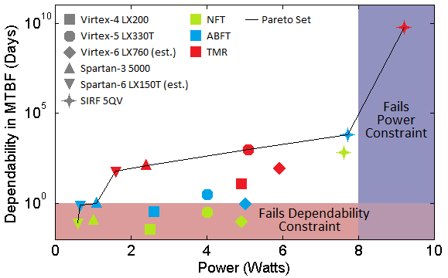
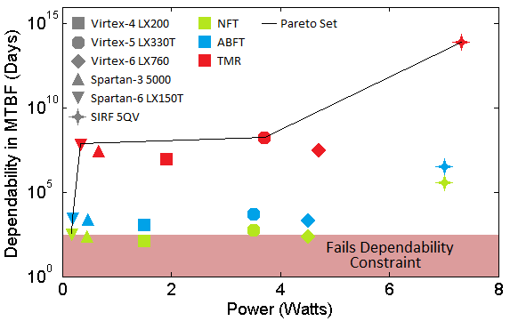
Optimal Design Selection
Framework determines Pareto-optimal designs based on metrics
Non-Pareto-optimal designs can be completely ignored
Constraints on metrics enforced to remove invalid designs
Removes unreliable and/or power-hungry designs based on mission
Out of 18 designs, only 5 designs selected as optimal for each mission
Designers decide which design is best based on desired tradeoffs
EO-1 Hyperion Satellite
ER-2 AVIRIS Aircraft

Slide 11
Outline
OBP Design Optimization Framework Overview
Dependability and power evaluation metrics
Hyperspectral imaging case study
Dependability Metric
Space Orbit Overview
Space radiation analysis with CREME96
Atmospheric radiation
Power and Performance Metric
Constrained linear optimization with linear programming

Slide 12
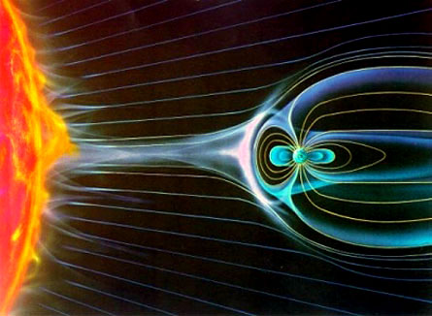
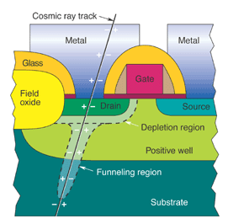
Radiation & Single-Event Effects
Radiation sources
Galactic cosmic rays
Solar flares and wind
Trapped protons & heavy ions (Van Allen Belts)
Single-event effects (SEEs) are caused by energetic particles passing through Silicon
SEU – soft errors; appear as transient pulses or bit flips in memory
SEFI – soft error; causes entire device to stop functioning
SEL – results in high operating, possible damage to the device
Effects of SEEs on FPGAs
Configuration memory faults
Routing faults– broken connections or short circuits
LUT faults - change in logical functions implemented
BRAM and FF faults – data errors in the running design
Total Ionizing Dose (TID) limits component lifetime
Silicon lattice damage
Charge buildup within gate oxide
SEU: single event upset
MBU: multi-bit upset
SEL: single event latchup
12
SEFI: single event functional interrupt

Slide 13
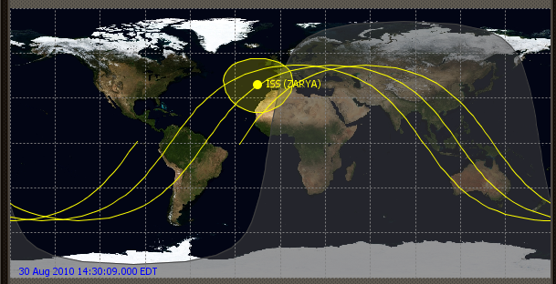
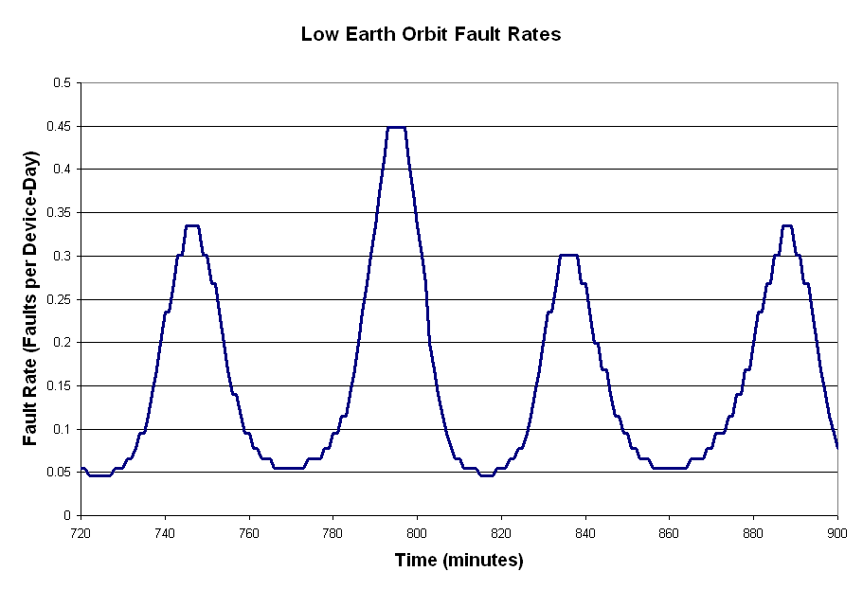
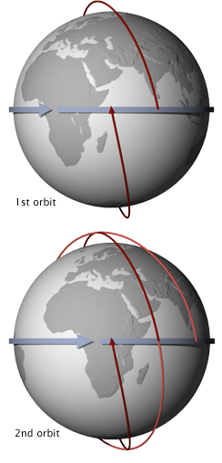
Various Orbits – LEO
Low Earth Orbit
90-minute orbit
(ISS)
Low Earth Orbit (LEO)
Altitude: 160 - 2000 km
Too much atmosphere under 200 km
Trapped ion radiation from poles and South Atlantic Anomaly (SAA)
Avg. upsets per day: <1 - 10
A popular orbit for communications satellites
Proximity to Earth means less energy to achieve orbit, less energy to communicate, and more detailed sensing
Orbits may be sun-synchronous, but still orbit about once every 90 minutes, requiring a “constellation” network in order to provide continuous coverage
Also the home of the ISS: ~350 km altitude
Increasing space debris is a growing concern here

Slide 14
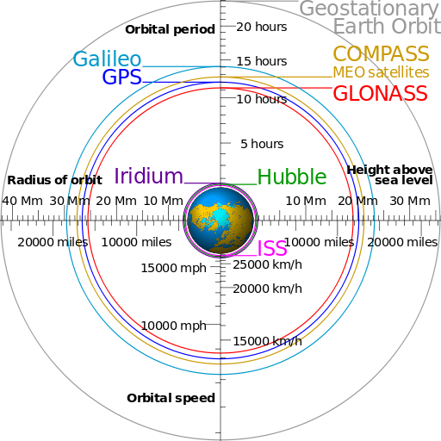
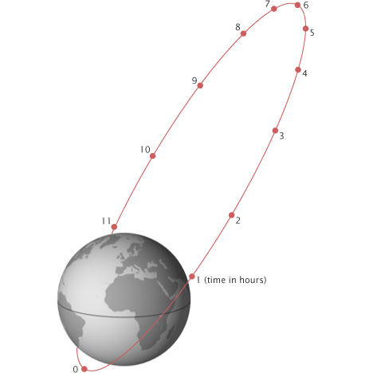
Various Orbits – MEO & HEO
Medium Earth Orbit (MEO)
Altitude: 2000 – 35,786 km
Upper bound is Geostationary Earth Orbit (GEO)
Trapped ion radiation in Van Allen belt is most intense here
Greater than 2000 upsets per device-day in worst parts
Home of GPS (12 hr period), Glonass (Russian), and Galileo (European)
Includes Highly Elliptical Orbit (HEO)
Molniya orbit was invented by Russians to observe high latitude regions
High Earth Orbit (HEO)
Altitude: > 35,786 km (anything above GEO)
Radiation from protons, heavy ions, and cosmic rays
About 7 upsets per device-day around GEO
GEO is useful for communications and weather satellites

Slide 15
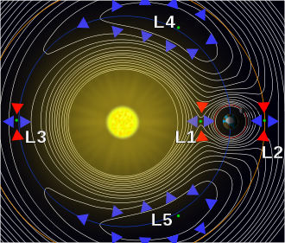
Various Orbits – Lagrangian Points
Special case of 3-body problem
Discovered by Joseph Lagrange in 1772
Horseshoe Orbits
Interesting but not really useful
L1 (Unstable)
Useful for sun-observing satellites
L2 (Unstable)
Sun and Earth on same side of satellite means only 1 side needs heat shield
Useful for sensitive telescopes (James Webb & WMAP)
L3 (Unstable)
Sun blocks communications with Earth; not currently used
L4 & L5 (Stable)
These extremely stable orbits will allow the Solar Terrestrial Relations Observatory (STEREO) to capture 3D views of the sun; not currently used

Slide 16
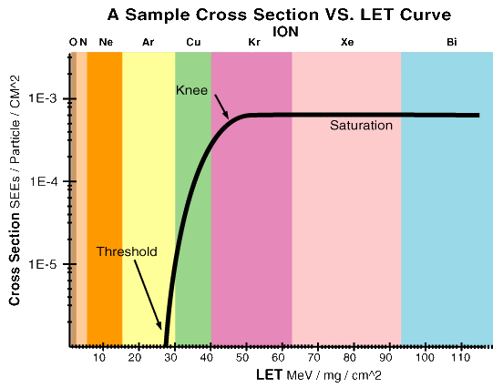
Space Radiation - CREME96
Model used to predict the effects of radiation on electronics
Requires the user to input several parameters
Orbit
Two-line elements (TLE) contain orbit parameters for specific satellites
Solar conditions
Cosmic radiation is at a maximum during solar minimum
Shielding
Satellite structure will usually provide some shielding
Shielding can sometimes worsen things, causing a particle shower
Device linear energy transfer (LET) characterization
Specifies the likelihood of an upset occurring based on the amount of energy deposited by the intersecting particle

Slide 17
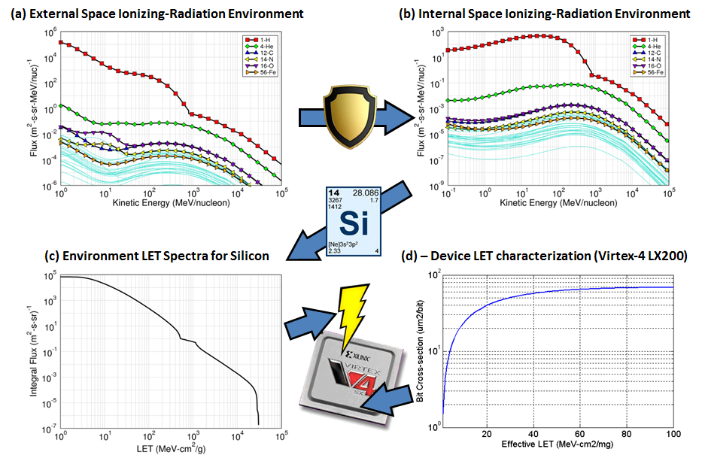
CREME96 Example
A) Based on orbit and other input parameters, CREME96 predicts the amount, species, and energy of all ions passing through a unit area per unit time (flux)
B) Fluxes are modified based on sheilding
C) Fluxes are converted to LET specific to silicon
D) Inner product of environment & device LET gives upset rate

Slide 18
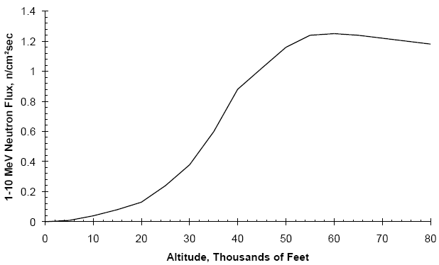
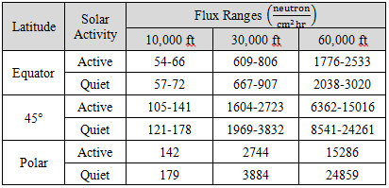
Atmospheric Radiation
Radiation may still affect devices that are not in space
Cosmic radiation is powerful enough to push through the magnetosphere and results in a neutron shower at higher altitudes
Neutron flux peaks around 60,000 ft
This is where the cosmic rays have fully cascaded into a swarm of energetic neutrons that haven’t yet been absorbed by the air
Xilinx produces device neutron radiation characteristics in its Rosetta report, which can be used to determine upset rates

Slide 19
Outline
OBP Design Optimization Framework Overview
Dependability and power evaluation metrics
Hyperspectral imaging case study
Dependability Metric
Space Orbit Overview
Space radiation analysis with CREME96
Atmospheric radiation
Power and Performance Metric
Constrained linear optimization with linear programming

Slide 20
Improved CD Calculation
Old Method
Pack device to its maximum to find max ops/cycle (1000 ops/cycle)
Multiply this by limiting frequency of all used cores (150 MHz)
1000 ops/cycle * 150 MHz = 150 GOPS
New Method
Perform old method to find first CD
Restrict use of core with limiting frequency and find new CD
Continue removing limiting cores until design is impossible
Use design that reported best CD
800 ops/cycle * 200 MHz = 160 GOPS
50% Mult, 50% Add
Mult DSP
400 units
200 MHz
Mult Logic
100 units – 150 MHz
Add Logic
500 units – 300 MHz
50% Mult, 50% Add
Mult DSP
400 units
200 MHz
EMPTY
Add Logic
400 units – 300 MHz

Slide 21
CD Packing Algorithm
Packing algorithm requires us to optimize CD while obeying several constraints
Can’t use a negative number of resources or cores
Can’t exceed the device’s resource limits when placing cores
Must maintain a certain ratio between two or more groups of cores
This problem is ideally suited for linear programming, which is used to optimize a system of linear equations consisting of non-negative variables
Developed in 1939 by Leonid Kantorovich to help Soviets in WWII by planning expenditures to reduce cost to Soviets and increase losses to the enemy
Kept secret until 1947 when George Dantzig published the simplex algorithm
Used postwar by many industries in their daily planning
Here’s a simple example using only 2 variables (x and y)
Constraints: x ≥ 0, y ≥ 0, x + y ≤ 5, x ≤ 3, y ≤ 4
Maximize z: z = 2x + y
Constraints form a convex polytope
Equation for z sets a gradient
Only need to test the vertices (extreme points)

Slide 22
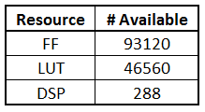
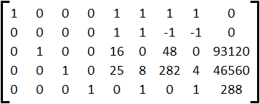
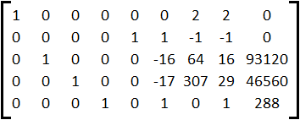
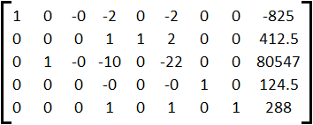
CD Packing Algorithm Example
In this example, CD is calculated for the Virtex-6 LX75T-FF484-1 with a distribution of 50% multipliers and 50% adders and Int16 precision
These are our available cores and core/device resources used/available
Thus our equations are:
AddLogic = x₁ ≤ 0, AddDSP = x₂ ≤ 0, MultLogic = x₃ ≤ 0, MultDSP = x₄ ≤ 0
Distribution equation: x₁ + x₂ – x₃ – x₄ = 0
Resource constraints (use slack variables to handle inequalities): 16x₁ + 48x₃ + s_{FF} = 93120, 25x₁ + 8x₂ + 282x₃ + 4x₄ + s_{LUT} = 46560, x₂ + x₄ + s_{DSP} = 288
CD minimizing equation: -x₁ – x₂ – x₃ – x₄ = -CD
Original matrix for simplex method
Simplex phase 1 finds first basic feasible solution (BFS)
Top row is non-positive. Final BFS. Results on right.

Slide 23
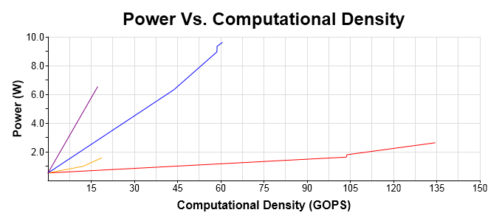
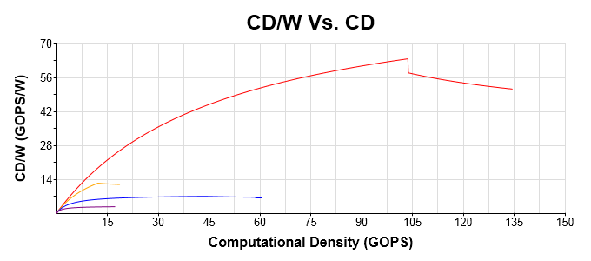
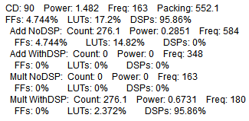
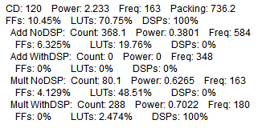
Optimizing for Power
There’s only one solution for achieving the maximum CD, but possible infinite solutions for a lower target CD, so we can optimize for power in these cases
Thankfully, Xilinx and Altera power estimator tools assume dynamic power increases linearly with the number and frequency of each resource used
Using these tools, we can find the power required per resource per cycle
We can then use the resource count of each core to find it’s power/unit/cycle
We can then modify our system of equations to lock CD and optimize for power
CD/W can easily be found then for each CD
Legend
Int16 Int32 Float32 Float64
Target CD: 120
Target CD: 90

Slide 24
Conclusions
Demand continues to grow for on-board processing
Increasing need for autonomy in outer space and sensor processing for handling improved sensors
Increasing demand for space processing capabilities require innovative solutions to also satisfy the harsh constraints of space
The OBP Design Optimization Framework aids designers in handling all of these constraints simultaneosly
Dependability is evaluated with CREME96 and vendor produced device datasheets
Power and performance are evaluated with linear programming

