Slide 1
Hardware/ Software partitioning and pipelined scheduling on Run time Reconfigurable FPGAs
Yuan, M., Gu, Z., He, X., Liu, X., and Jiang, L. 2010. Hardware/Software partitioning and pipelined
scheduling on runtime reconfigurable FPGAs. ACMTrans. Des. Autom. Electron. Syst. 15, 2, Article
13 (February 2010), 41 pages

Slide 2
Why FPGAs are being used?
FPGAs are now being used as replacement for application specific integrated circuits (ASICs) for many space-based applications
FPGAs provide:
Reconfigurable Architectures
Low Cost solution
Rapid Development Times
Time to market is lesser
Partial reconfiguration (PR) allows the ability to reconfigure a portion of an FPGA
Real advantage arises when PR is done during runtime also know as dynamic reconfiguration
Dynamic Reconfiguration allows the reconfiguration of a portion of an FPGA while the remainder continues operating without any loss of data

Slide 3
Design exploration on Latest FPGAs
Exploration and evaluation of designs with latest FPGAs can be difficult
Continuous endeavor as performance and capabilities improve significantly with each release
Each vendors products can have different characteristics and utilities
Often there are unique capabilities
Thus side by side evaluation of designs among different products are not straightforward
One such advancement of particular importance is partial reconfiguration (PR)
Three Vendors provide some degree of this feature
Xilinx
Atmel
Lattice

Slide 4
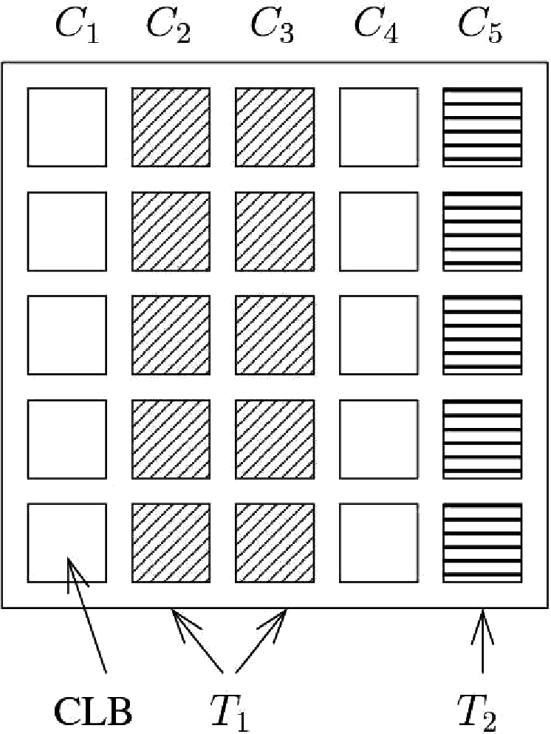
1D and 2D reconfigurable FPGAs
Each task occupies a contiguous set of columns
Task scheduling similar to scheduling on identical multiprocessors
Each hw task may occupy multiple columns in FPGA, but sw tasks occupy single column in CPU
Each task occupies a rectangular area with a width and height in terms of number of Configurable Logic Blocks (CLBs), also referred to as cells, on the two dimensions
Though feasible, technical obstacles prevent it from being used widespread( like fragmentation problems)

Slide 5
Characteristics of HW reconfiguration
Large reconfiguration delay and unique reconfiguration controller
FPGA reconfiguration has a significant overhead in the range of milliseconds proportional to the size of area reconfigured.
Task invocation consists of the reconfiguration and execution stages
Configuration Prefetch: hides the reconfiguration delay by allowing a tasks configuration to be loaded on the FPGA sometime before the actual start of execution.
By configuration prefetch the 2 stages separated by a time gap.
Results in overlap of reconfiguration stage of one task with the execution stage of another task.

Slide 6
Contd..
Commercial FPGAs have one reconfiguration controller, so that reconfiguration stages of different tasks have to be serialised on the timeline, while their execution stages occur concurrently because they occupy different parts of the FPGA
Major source of complexity of real time scheduling on FPGAs
Though there are multiple reconfiguration controllers , but not taken into account in the paper

Slide 7
Problems addressed in this paper
HW/SW partitioning and scheduling on a hybrid FPGA/CPU
Given an input task graph, where each task has two equivalent implementations:
a HW implementation that can run on the FPGA, and a SW implementation that can run on the CPU, partition and schedule it on a platform consisting of a PRTR FPGA and a CPU, with the objective of minimizing the schedule length
The CPU may be a softcore CPU carved out of the configurable logic in the FPGA,
for eg, MicroBlaze for Xilinx FPGAs or a separate CPU connected to the FPGA via a bus.
This paper presents a Satisfiability Modulo Theories (SMT) encoding for finding the optimal solution, and compare its performance with a heuristic algorithm(KLFM)

Slide 8
Pipelined Scheduling on a PRTR FPGA
Given an input task graph, construct a pipelined schedule on a PRTR FPGA with the objective of maximizing system throughput while meeting a given task graph deadline
Deadline can be latency sensitive as well as throughput oriented, hence maximizing throughput without regard to latency may negatively impact application QoS.

Slide 9
Assumptions
The FPGA is 1D reconfigurable with a single reconfiguration controller, as supported by commercial FPGA technology
Each HW or SW task has a known worst-case execution time. Each HW task has a known size in terms of the number of contiguous columns it occupies on the FPGA
Tasks are not pre-emptable on either the FPGA or the CPU
The communication delay between a HW task on the FPGA and a SW task on the CPU is proportional to the data size transmitted.
The entire FPGA area is uniformly reconfigurable, and each dynamic task can be flexibly placed anywhere on the FPGA as long as there is enough empty space

Slide 10
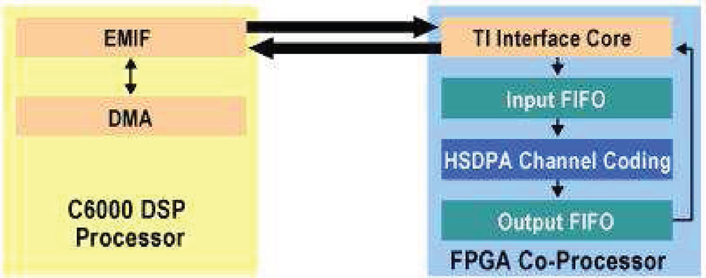
Motivation for HW/SW partitioning using FPGA as the coprocessor, FPGAs may be used in place of ASICs as HW coprocessors, also called HW accelerators, for computation-intensive kernels in the application
As HW coprocessors, FPGAs have a number of advantages over ASICs : effective, flexible, dynamically reconfigurable
coprocessors based on FPGAs can be applied to the speedup of arbitrary SW programs with some distinctive characteristics, for eg, programs with parallelizable bit-level operations
Example configuration of Altera FPGA co-processor

Slide 11
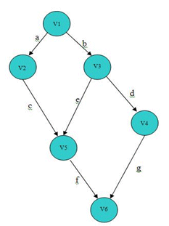
Task Graphs
A task graph is a directed acyclic graph
where each vertex represents a task, and each edge represents precedence relationship between two tasks
Ri proportional to Wi
Task invocation consists of reconfiguration stage Ri followed by the execution stage Ei
precedence relationships in the task graph constrain task execution stages, not reconfiguration stages, which can occur in arbitrary order.

Slide 12
HW/SW partitioning on a hybrid CPU/FPGA device
ID | Ri | Wi | Ei
1 | 1 | 1 | 3
2 | 2 | 2 | 1
3 | 1 | 1 | 2
4 | 1 | 1 | 1
5 | 2 | 2 | 2
Task graph example for HW task scheduling on FPGA
Ri - task i’s Reconfiguration delay on the FPGA
Wi- task i’s Size in terms of the number of contiguous FPGA columns it occupies
Ei- task i’s Execution time on the FPGA

Slide 13
Scheduling task graph using 3 columns
Dark areas-reconfiguration stage;
white areas denote the execution stage;
striped areas denote the gap between a task’s reconfiguration stage and execution stage, within which no other task can execute.
Task graph period( SL+R1+R2) a) 13 b) 12 c) 12 d) 10

Slide 14
Hardware task scheduling
M size of the reconfigurable area on the FPGA in terms of number of contiguous columns
N number of tasks in the task graph
SEi task i ’s execution time on the CPU for its SW implementation
SL upper bound of the schedule length
pli position of task i’s leftmost column on the FPGA
pri position of task i’s rightmost column on the FPGA
tri start time of task i’s reconfiguration stage
fri finish time of taski ’s reconfiguration stage
tei start time of task i’s execution stage
fei finish time of taski ’s execution stage
hsi boolean variable denoting if taski is a HW task on the FPGA (hsi = 0) or a SW task on the CPU (hsi = 1)
taski on the 2D time-FPGA position chart.

Slide 15
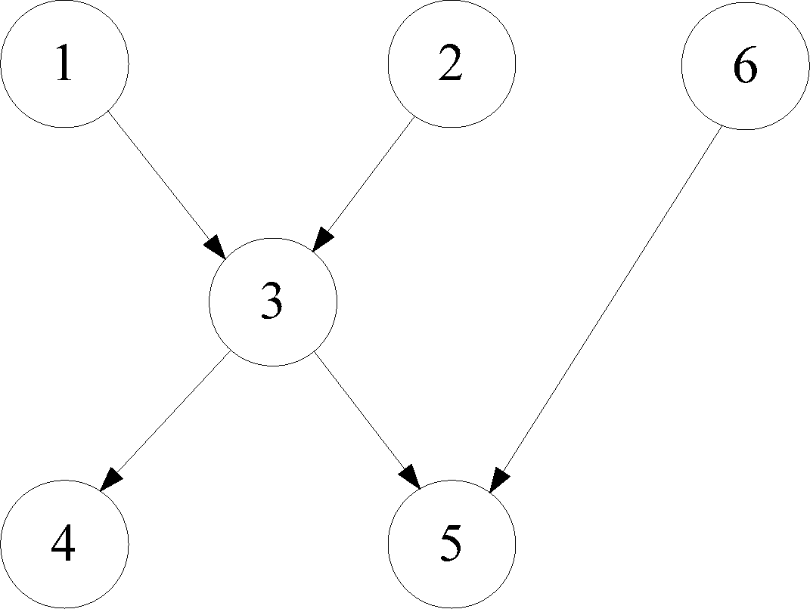
Scheduling on hybrid FPGA/CPU
ID | Wi | Ri | Ei | SEi
1 | 1 | 1 | 3 | 12
2 | 2 | 2 | 1 | 4
3 | 1 | 1 | 2 | 8
4 | 1 | 1 | 1 | 4
5 | 2 | 2 | 2 | 8
6 | 2 | 2 | 1 | 4
Possible schedule for task graph on hybrid FPGA/CPU
Task graph example for for hw/sw partitioning on hybrid FPGA/CPU

Slide 16
SMT(Satisfiability Modulo Theories) for scheduling
Scheduling problems are NP-Hard
SAT( Satisfiability solvers)- is an NP- complete problem of assigning values to a set of boolean variables to make a propositional logic formula true
SMT is an extension to SAT by adding the ability to handle arithmetic and other decidable theories such as equality with un-interpreted function symbols, linear integer/real arithmetic(LIA/LRA), integer/real difference logic
In this article, SMT solver Yices ( from Stanford) was used
SMT with LIA exhibits better performance, so all variables integer in this paper
SMT provides only a yes/ no reply to the feasibility of a given constraint set

Slide 17
Constraint set input to SMT solver
A HW task must fit on the FPGA
Pre emption is not allowed for either the execution stage or the reconfiguration stage of a HW task, or for a SW task.
If a HW task is a source task in the task graph without any predecessors and it starts at time 0, then it has been preconfigured in the previous period and does not experience any reconfiguration delay
Related to Condition 4, the task graph period (if it is periodically executed) should be larger than or equal to sum of reconfiguration delays of all source tasks whose reconfiguration stages have been pushed to the end of the period, that is, their reconfiguration delays do not contribute to the schedule length.
A task’s reconfiguration stage (which may have length 0) must precede its execution stage

Slide 18
Contd..
Two HW task rectangles in the 2D time-position chart should not overlap with each other.
Reconfiguration stages of different tasks must be serialized since the reconfiguration controller is a shared resource
If there is an edge from taski to task j in the task graph, then task j can only begin its execution after taski has finished its execution, taking into account any possible communication delay between the FPGA and CPU
Two SW tasks cannot overlap on the time axis due to the shared CPU resource.
Sink tasks must finish before the specified schedule length SL (this is the deadline constraint).

Slide 19
Algorithm 1. Top-Level Binary Search Algorithm for Finding the Minimum Schedule length
Input: Lower bound LB and upper bound UB of the schedule length
Output: Minimum schedule length and the corresponding schedule
lb = LB, ub = UB;
while lb < ub do
SL = (lb + ub)/2;
hasSolution :=InvokeYices(GenSMTModel(SL));
if hasSolution then
ub := SL, and record the schedule;
else
lb := SL + 1;
return ub as the minimum schedule length, along with the corresponding schedule.

Slide 20
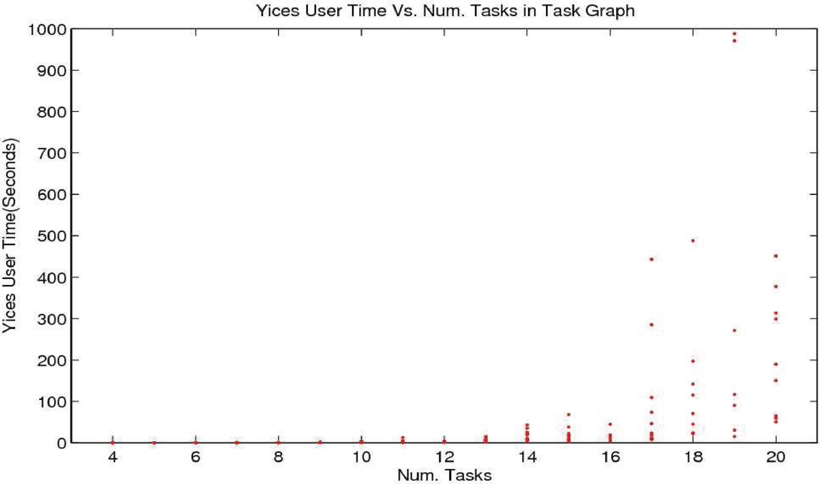
Performance Evaluation of HW/SW Partitioning
SMT-based optimization algorithm running time for HW/SW partitioning on a hybrid FPGA/CPU device.

Slide 21
Comparison of schedule length between Yices and heuristic algorithm

Slide 22
Any Questions??????

Slide 23
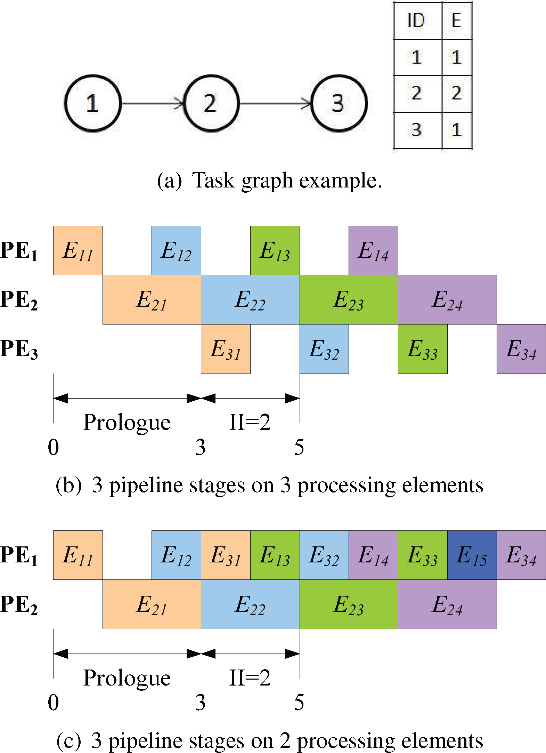
Pipelined scheduling
Application is divided into different pipeline stages and different iterations are scheduled in an overlapped manner to maximize throughput
If large FPGA, each pipeline stage occupy a fixed PE on the HW
It is desirable to let 2/ more pipeline stages share the same PE with time multiplexing to increase resource utilization.
Increased Resource utilization and reduced resource requirements

Slide 24
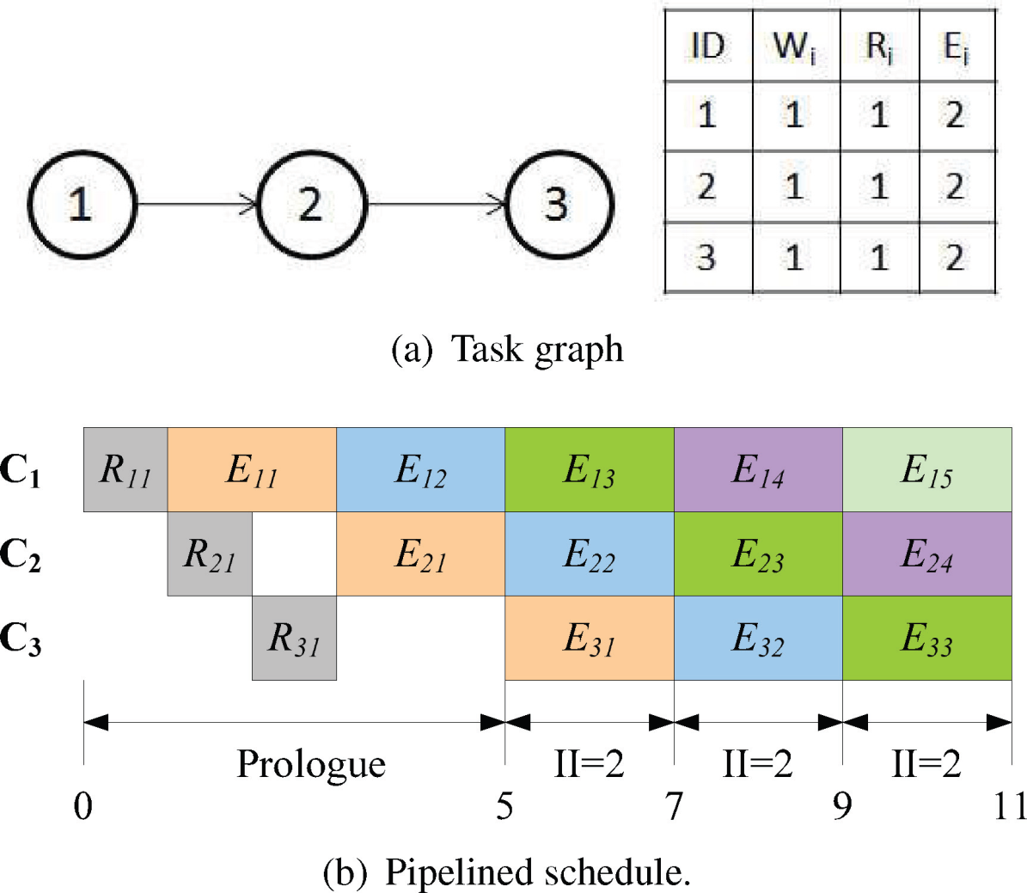
II – Initiation Interval ( time difference between the start of 2 consecutive iterations of task graph execution in the steady state)
II = Inverse of the system throughput

Slide 25
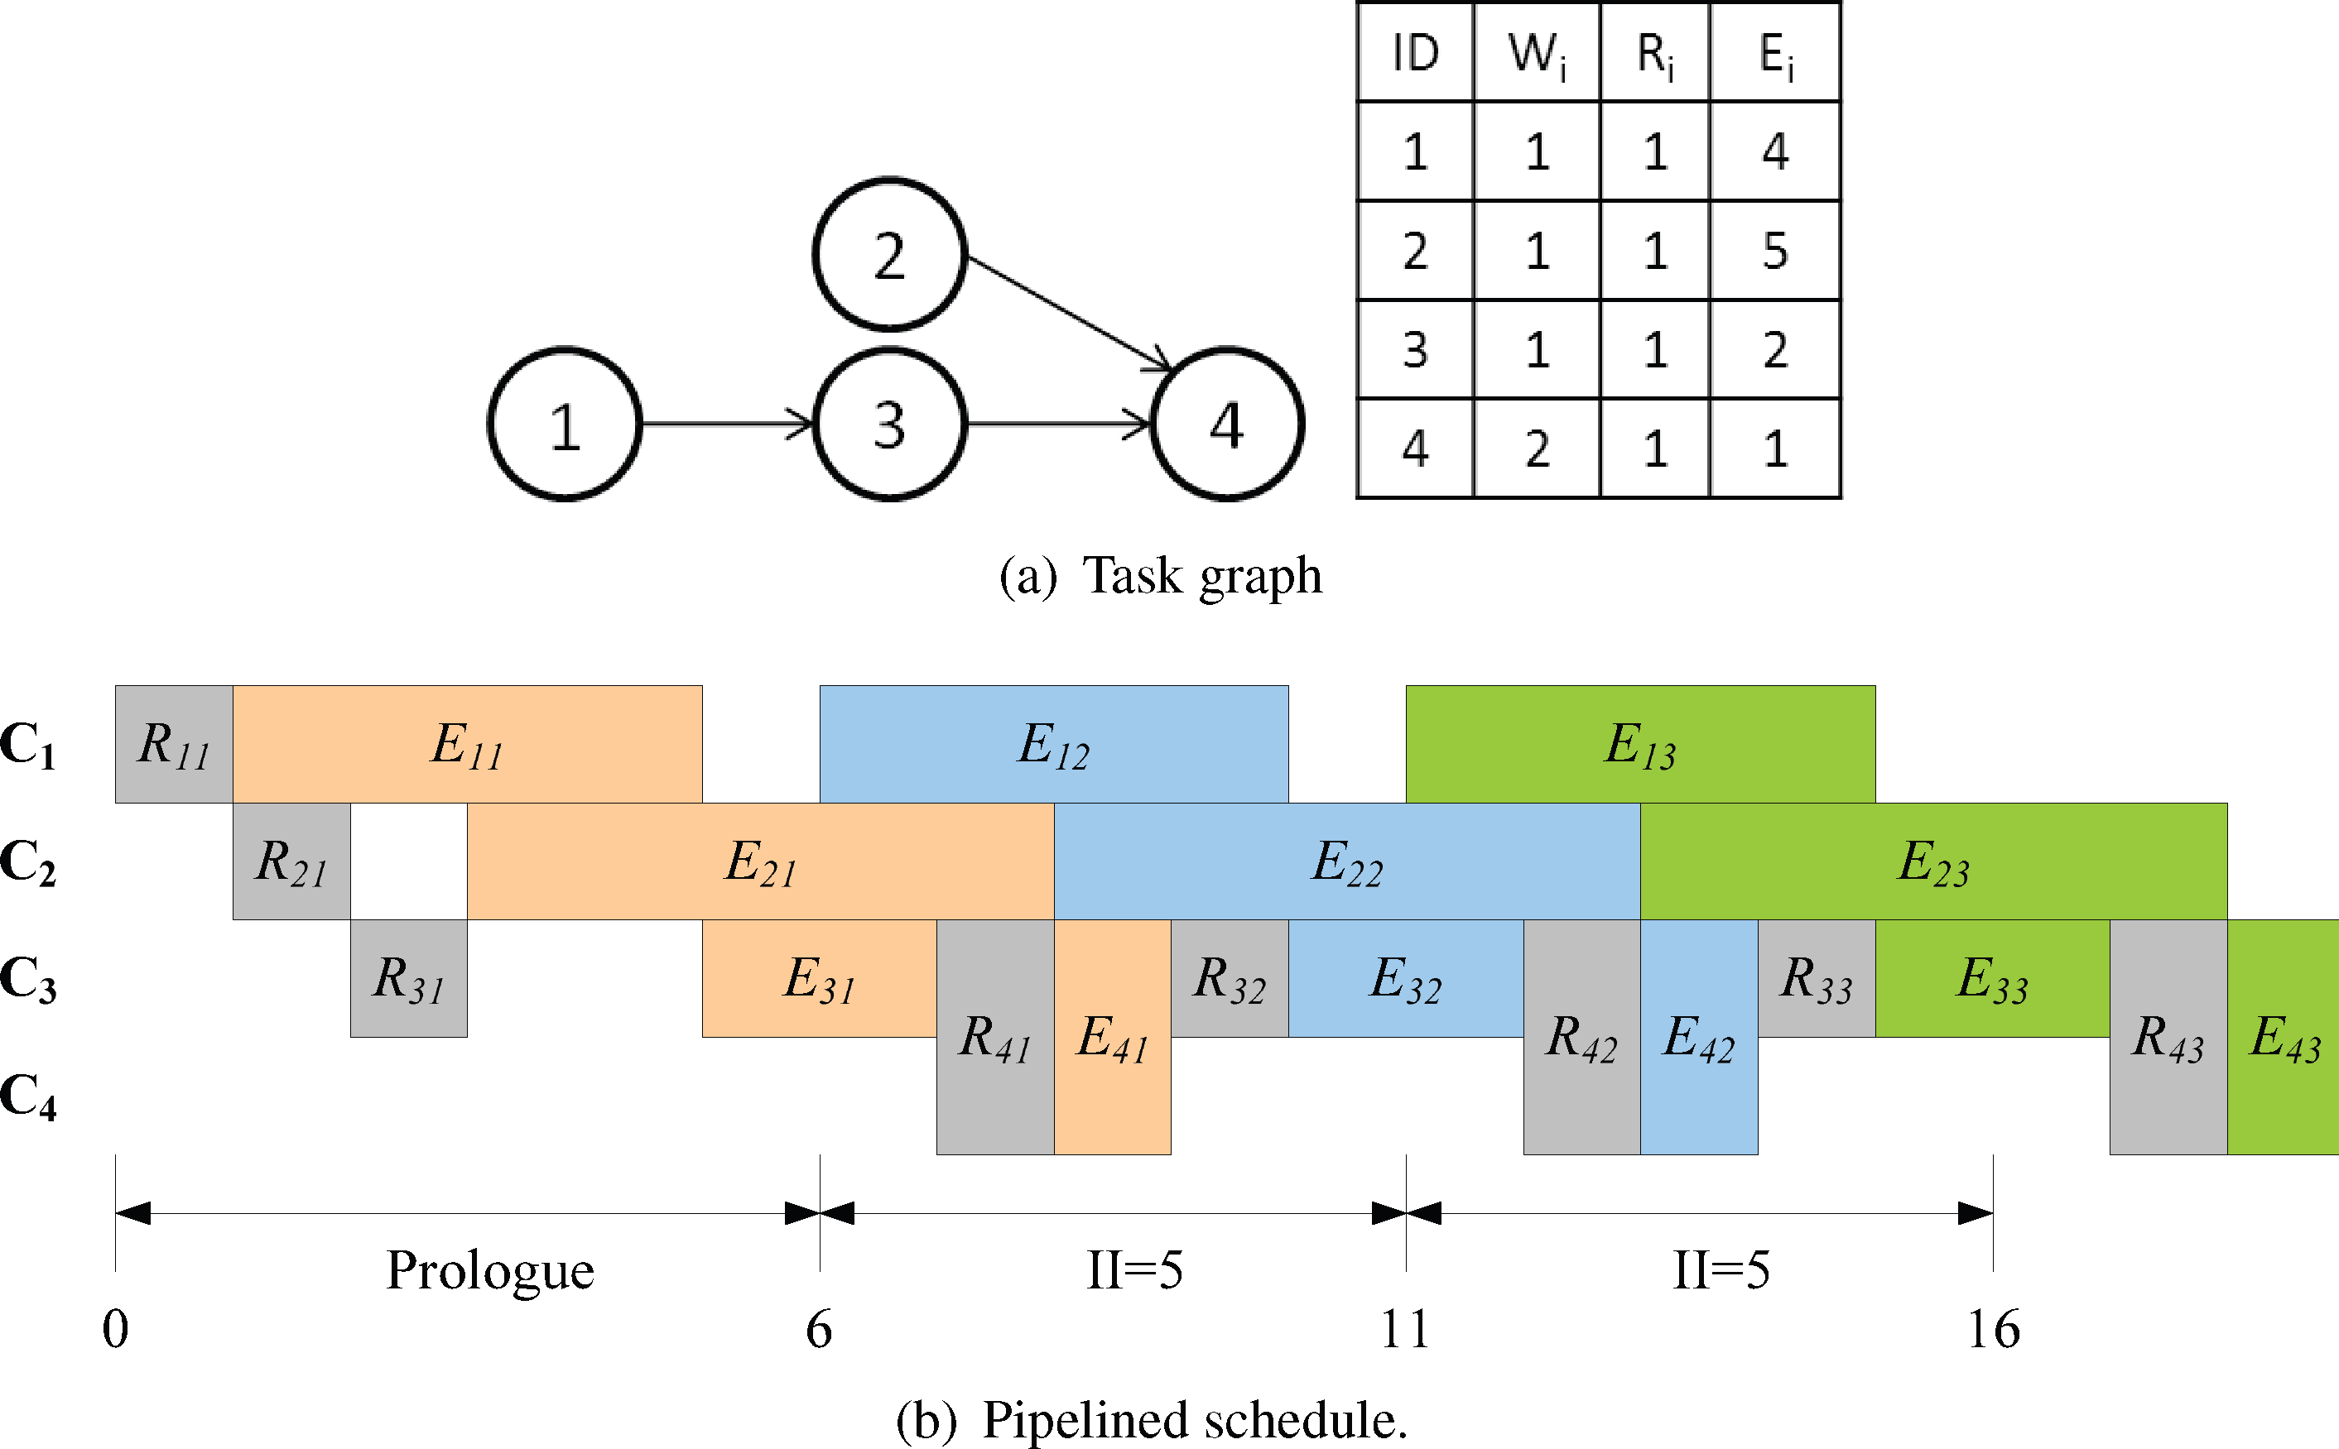

Slide 26
SMT model for pipelined Scheduling
Objective: Find the optimal schedule with the maximum throughput under a user defined deadline constraint(latency)
Along with the previous constraint set, possible wrap around of a task’s rectangle on the time axis for pipelined scheduling.
In the slide 24, a pipeline stage contains once instance each of the three task’s execution stages, but in 25, no matter how we divide up the time axis into pipeline stages, there is always some task’s reconfiguration or execution stage cut at its boundary and wraps around the pipeline stage
The top level binary search algorithm is similar, except the binary search variable is minimum II

Slide 27
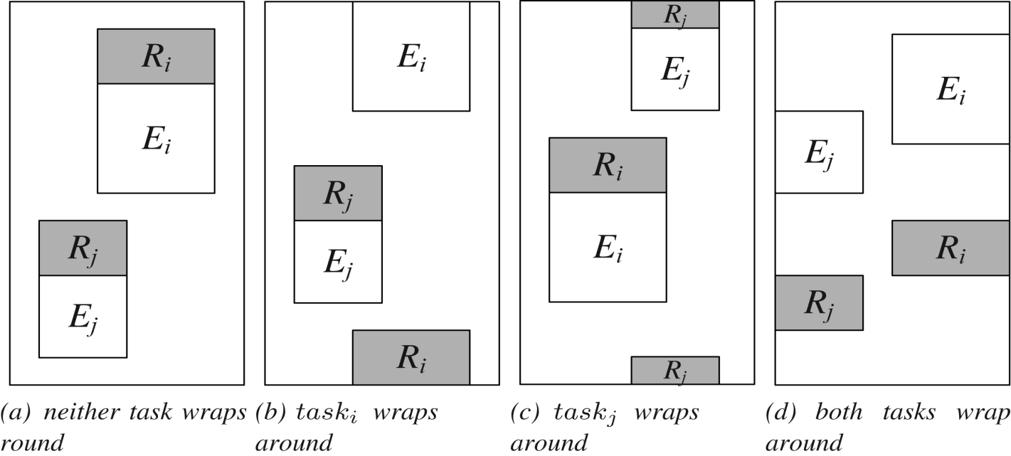
Constraints for pipelined scheduling
Each task must fit into a pipeline stage
Task i’s reconfiguration delay is either 0 or Ri
Constraints corresponding to the Possible spatial and temporal relationships between 2 tasks in the same pipeline stage

Slide 28
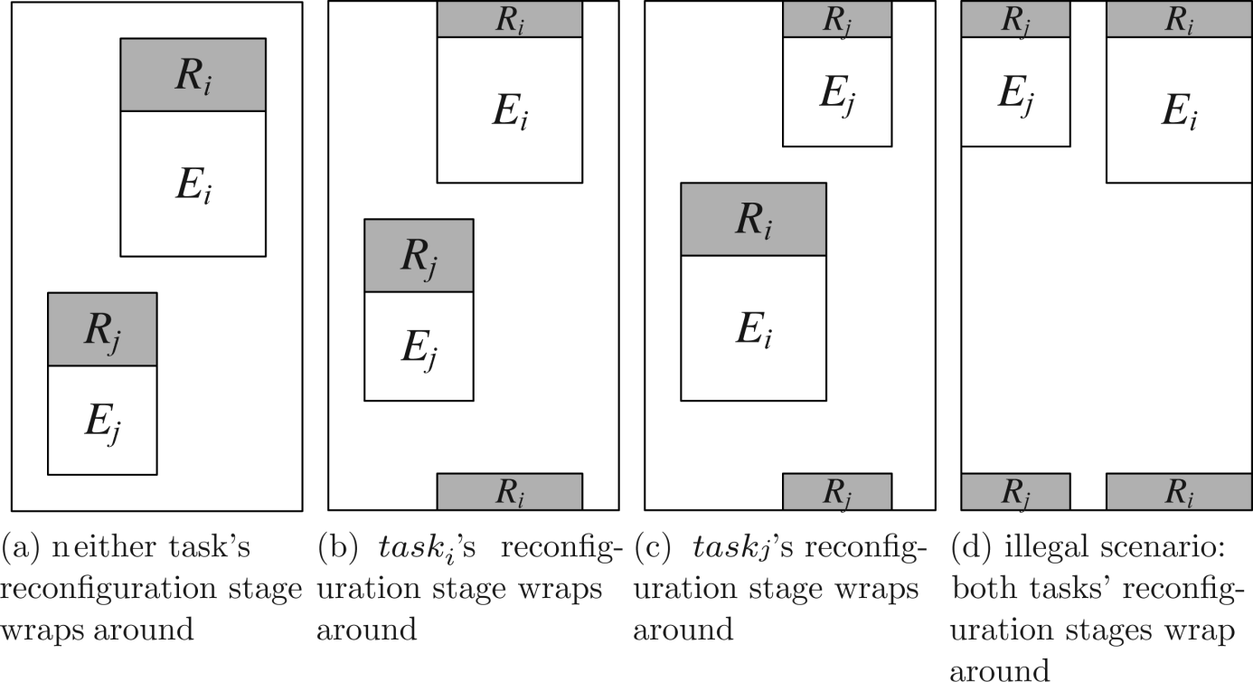
Contd..
Considered only FPGAs with single configuration controller
Constraints on the Reconfiguration stages of a task pair, depending on whether one or more of them wrap around the pipeline stage

Slide 29
Kernel recognition based heuristic algorithm
Software pipelining refers to scheduling a SW loop on multiple functional units to maximize throughput
Types :
modulo scheduling
Kernel recognition( also called Perfect pipelining)
Working of Perfect Pipelining:
Unroll the loop and note dependencies
Schedule the operations as early as dependencies allow
Look for a block of instructions that form a repeating pattern. This block represents the new loop body
List scheduling is a greedy algorithm for task graph scheduling on multiprocessors based on a priority function
i.e task node with the highest priority value is chosen and scheduled.

Slide 30
Pseudocode for Pipelined Scheduling Based on Kernel Recognition
while true do
Unroll the task graph once;
while Some nodes are not scheduled yet do
Obtain ready list;
Get the highest-priority node in ready list;
Place it on a suitable position on FPGA;
Mark it as scheduled;
if Repeating pattern detected then
break;

Slide 31
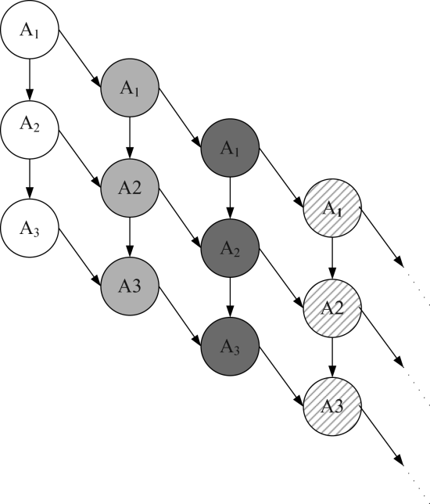
Algorithm for pipelined scheduling based on Kernel recognition and list scheduling
Step 1: Task graph unrolling
No auto-concurrency (ie iteration i of task
must be completed before iteration i+1
Step 2: Obtaining Ready List and Highest-Priority Ready Node
Ready list obtained from task graph dependencies
Priority function [ pi = w1 ∗ Ei + w2 ∗ Ri + w3 ∗ Wi ]
Choose the next ready task node to schedule based on the priority function

Slide 32
Contd..
Step 3: Finding a Suitable Position on FPGA
Spread out all task configurations to cover the entire FPGA area (or a user-specified portion) from L -> R (to exploit the available parallelism to reduce the II)
configuration reuse (If a set of contiguous columns have already been configured for one iteration of taski , then we try to place the next iteration of task on the same position to reuse the configuration pattern and eliminate Ri)
look for any opportunity of configuration prefetch (if configuration reuse not successful)
search forward from taski ’s ready time Ready(taski) to look for a time instant t ≥ Ready(taski) and a position P to configure task (if configuration prefetch not successful)

Slide 33
Step 4: Detecting Repeating Patterns
System snapshot states Si and Sj are defined to be identical when every task is in the same configuration or execution stage as one of its previous iterations
During system execution, whenever a task finishes execution, we record the current system snapshot state s0 and compare it with what we have seen so far to detect a possible match.
If s0 has not been seen before, then we add it to a linked list of snapshot states from time 0.
If the current snapshot state is identical to a previous snapshot state s1, then we have detected a repeating execution pattern as the pipeline kernel

Slide 34
Step 5: Complexity Analysis
N- Number of tasks in the task graph
M- width of the FPGA reconfigurable area.
Task Graph Unrolling. Complexity is O(N)
Obtaining Ready List and Highest-Priority Ready Node. Complexity is O(N)
Finding a Suitable Position on FPGA. Complexity is O(NM)
Detecting a Repeating Pattern. Complexity is O(NM)
complexity of the statements within the while loop is O(NM)
total no. of times that the while loop is executed is the no. of times the task graph is unrolled before a repeating pattern is detected, which is O(N)
overall algorithm complexity is O(N²M)

Slide 35
Performance Evaluation of Pipelined Scheduling
Comparison of IIs obtained with SMT-based pipelined scheduling algorithm with different deadlines, and the KR-based heuristic algorithm with no deadline constraint

Slide 36
Comparison of algorithm running times for pipelined scheduling. The y-axis is drawn in log-scale.

Slide 37
Shortfalls
Not discussed any interrupts
More heterogeneous set of computing resources
Various loop structures could have been implemented in the pipelined scheduling

Slide 38
Conclusion
Addresses 2 problems related to HW task scheduling on PRTR FPGAs
HW/SW partitioning - task graph with known execution times on the HW (FPGA) and SW (CPU), and known area sizes on the FPGA, finds an valid allocation of tasks to either HW or SW and a static schedule with the objective of minimizing the total schedule length
Pipelined scheduling - Given an input task graph, construct a pipelined schedule on a PRTR FPGA with the goal of maximizing system throughput while meeting a given end-to-end deadline

Slide 39
Questions???

Slide 40
Hardware/Software Co-design
Wiangtong, Theerayod, Peter YK Cheung, and Wayne Luk. "Hardware/software codesign: a systematic approach targeting data-intensive applications." Signal Processing Magazine, IEEE 22.3 (2005): 14-22.

Slide 41
Outline
Increasing attention to reconfigurable hardware
Instead of using FPGAs as replacement for ASICs, designers combine reconfigurable hardware with conventional instruction processors in a co-design system
flexible & powerful means of implementing computationally demanding data intensive digital signal processing (DSP) applications
focus on application processes that can be represented in directed acyclic graphs (DAGs) and use a synchronous dataflow (SDF) model
Co-design system is based on the UltraSONIC reconfigurable platform, a system designed jointly at Imperial College and the SONY Broadcast Laboratory
System model consists of a loosely coupled structure consisting of a single instruction processor and multiple reconfigurable hardware elements

Slide 42
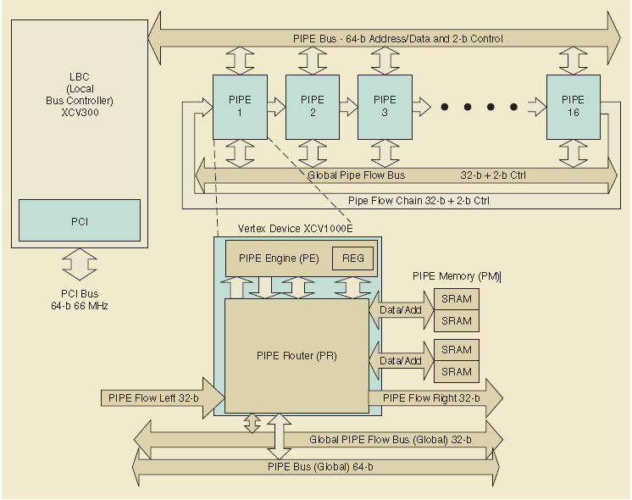
Architecture of the Ultrasonic reconfigurable platform
Plug in processing
Elements( perform actual computation)
handles computations specified by the user
receive parameter values from the
host
Connects board to PC
responsible for data movement. Routes are
programmable via the internal PR registers
provides local buffering of data. 2 independent
data/address ports are provided for two equal memory
blocks -4 MB each

Slide 43
System specification and models
reconfigurable hardware element of our codesign system is the programmable FPGAs
There are many hardware processing elements (PEs) that are reconfigurable
Reconfiguration can be performed at run-time
All parameters such as the number of PEs, the number of gates on each PE, communication time, and configuration time are taken into account
On each PE where the number of logic gates is limited, hardware tasks may have to be divided into several temporal groups that will be reconfigured at run-time
Tasks must be scheduled without conflicts on shared resources, such as buses or memories

Slide 44
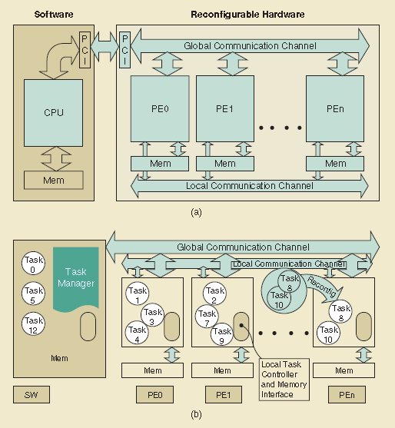
The UltraSONIC system (a) The system model. (b) An example of task implementation
no shared memory used as a medium for transferring data
There is only local memory on each PE
To transfer data between PEs, a communication channel is directly established between both ends that must communicate
Global bus: Configurations can be completed through this.
Also used as a communication channel between hardware and software
Local bus: transferring data between the hardware Pes
PE mem: storing input and output data for all internal tasks
users can control PEs from the host processor based on a set of well-defined (API) functions.
local controller in each PE to interact with the task manager & responsible for all local operations such as executing tasks, memory interfacing, and transferring data between PEs.

Slide 45
Task model
Software and hardware tasks are built uniformly to be performed under the same control mechanism
Tasks implemented in each hardware PE are coarse-grain tasks
Communication between tasks is always through local single port memory used as buffers between tasks
Tasks for a PE may be dynamically swapped in and out using dynamic reconfiguration
Different types of tasks to be specified in this system: normal, software-only, hardware-only, and dummy tasks

Slide 46
Execution Criteria
The tasks are non pre-emptive
Task execution is completed in three consecutive steps: read input data, process the data, and write the results
the communication time between the local memory and the task (while executing) is considered to be a part of the task execution time
Main restriction of this execution model is that exactly one task in a given PE is active at any one time
Direct consequence of the single-port memory restriction that allows one task to access the memory at a time
Multiple tasks can run concurrently when mapped to different PEs.

Slide 47
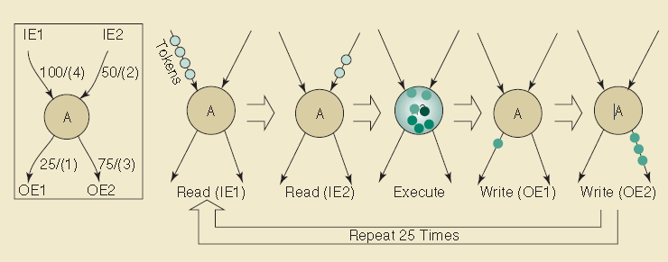
Firing Rules
Rules by which data is processed by a task from the synchronous data flow (SDF) computational model
Tasks are coarse-grained tasks represented in a DAG and we use the PE local memory as buffers between nodes, replacing the FIFO
Tasks mapped to the same PE must be executed sequentially to avoid memory conflict.
If a task requires a large amount of input data, the data must be sliced

Slide 48
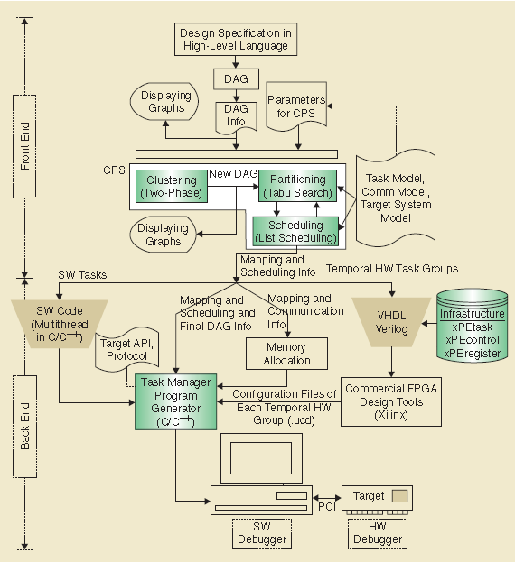
Proposed co-design environment
responsible for system specifications, input intermediate format & system partitioning/scheduling
reads a textual input file that includes DAG information and parameters for the clustering, partitioning, and scheduling process
involves hardware/software task design and implementation, design verifications, control mechanisms, and system debugging.

Slide 49
CPS Algorithm
Helps designers in task clustering(two-phase), partitioning(tabu search) and scheduling(list)
2-phase clustering:
Pre-processing step to modify the granularity of tasks and enable more task parallelism
Achieve 15% shorter processing time for different task granularities
tabu search :
partition tasks into software and hardware
modified for real system(search space of K^{N} (where K is the number of processing elements and N is the number of tasks)
list scheduler:
used to order tasks without any shared resource conflicts, with regard to partitioning results, task precedence, and the target system model
used as a cost function to examine the processing time of the guessed solutions from the partitioner

Slide 50
Task manager
Once all the hardware tasks for a given PE are available, they are wrapped in a predesigned circuit, called xPEtask
Commercially available synthesis and place-and-route tools are then used to produce the final configuration files for each hardware element.
Each task in this implementation method requires some hardware overhead to implement the task frame wrapper circuit. Therefore, our system favours partitioning algorithms that generate coarse-grained tasks.
The results from the partitioning and scheduling process, the memory allocator, the task control protocol, the API functions, and the configuration files of hardware tasks are used to automatically generate the codes for the task manager program that controls all operations in this system (dynamic configuration, task execution, and data transfer).
The resulting task manager is inherently multithreaded to ensure that tasks can run concurrently where possible

Slide 51
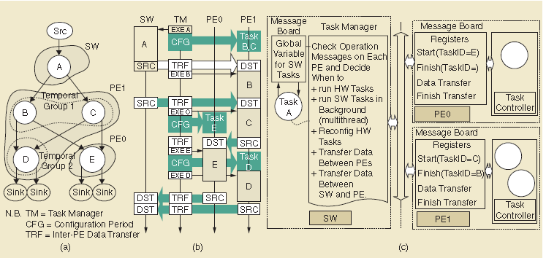
(a) DAG example, (b) operation sequences of the task manager and (c) the task manager control view

Slide 52
Task manager
Task manager uses centralised control
Runs on software CPU(host pc)
To properly synchronize the execution of the tasks and the communication between tasks, our task manager employs an event-triggered protocol when running an application.
Event triggers- the termination of each task execution or data transfer
Signalling of such events is done through dedicated registers.
With a single CPU model, the software processor must run simultaneously the task manager and the software tasks, so multithreaded programming model considered.

Slide 53
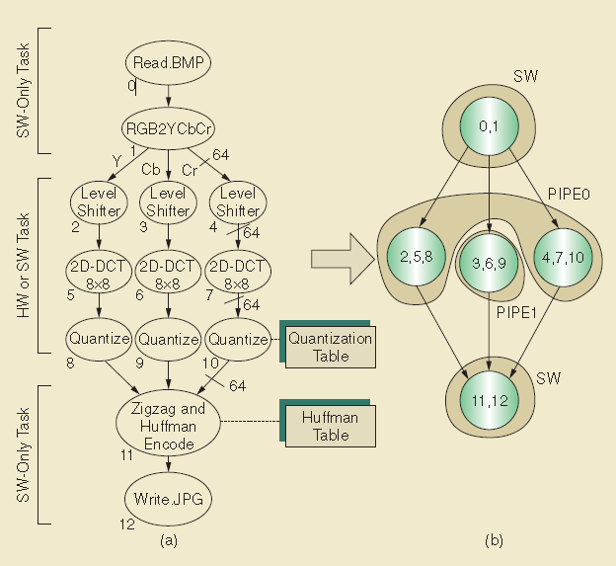
Case Study : JPEG Compression
used as a real co-design application
standard JPEG compression with block size of 8 × 8 pixels for color images is implemented using the DCT baseline method with sequential encoding

Slide 54
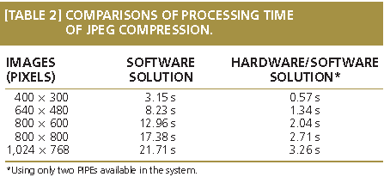
Experimental results
For the software-only solution, C++ codes of every task module
are written and run under the control of the task manager program.
The values are averaged from 20 runs on the UltraSONIC host, a PC with a Pentium II processor running @ 450 MHz
tasks including Level Shifter, 2D-DCT, &Quantizer (consume about 88% of processing time if all tasks are run in software) -> moved into hardware

Slide 55
Shortfalls of the study
Not applicable to process streaming data that employs a pipelined structure
Viability for configuration reuse was not discussed
The PIPE memory is local and not shared
The task manager has limited concurrency when it comes to Ultrasonic system

Slide 56
Conclusions
Introduces and demonstrates a task-based hardware/software co-design environment specialized for real time video applications
Automated partitioning and scheduling environment (the predesigned infrastructure in the form of wrappers) and the task manager program help to provide a fast and robust route for supporting demanding applications in our co-design system
The UltraSONIC reconfigurable computer, which has been used for implementing many industrial- grade applications at SONY and Imperial College, allows us to develop a realistic system model

Slide 57
Questions????

