Slide 1
Low-Frequency Versatile Wireless Power Transfer
Osman Salem, Alexey Guerassimov, and Ahmed Mehaoua University of Paris Descartes – LIPADE Division of ITCE, POSTECH, Korea
Anthony Marcus and Borko Furht,
Department of Computer and Electrical Engineering and Computer Science, Florida Atlantic University
Jonathan David
2013 IEEE International Conference on Communications, pp.4373,4378, 9-13 June 2013

Slide 2
The Need for Improvement
Non-rechargeable batteries only support implants with extremely low power consumption
Pacemaker must be replaced every 5-8 years by invasive surgery, battery occupies 90% of device volume
RF radiation hazard and tissue absorption are concerns in wireless power technologies
An accurate impedance matching network is required for efficient power delivery
Power scavenged by bio-surroundings is still only in the nano-watt range

Slide 3
The Need for Improvement
Cardiac pacemakers
Retina prostheses (emerging technology)
Brain-computer interfaces
Drug delivery systems
Smart orthopedic implants

Slide 4
The Solution
Use of a low-frequency electrical power transfer technology
Wireless power transfer has existed, however medical trials have used devices operating in the GHz range

Slide 5
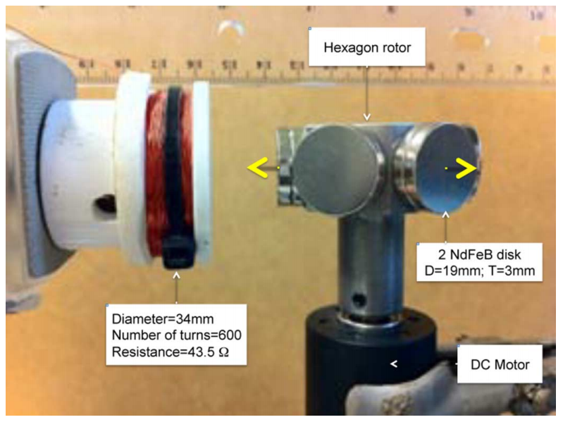
How does it work?
Magnetic field is generated by rotating permanent magnets
An inductive coil at the receiving end is charged

Slide 6
What are the advantages?
Radiation hazard completely avoided
Resistance instead of reactance dominates the impedance of the coil due to the low frequency
Resistance is less likely to change based on the application
More materials can be used for the receiving coil
The magnetic field can penetrate various materials

Slide 7
Stronger magnets compensate for lower frequency!

Slide 8
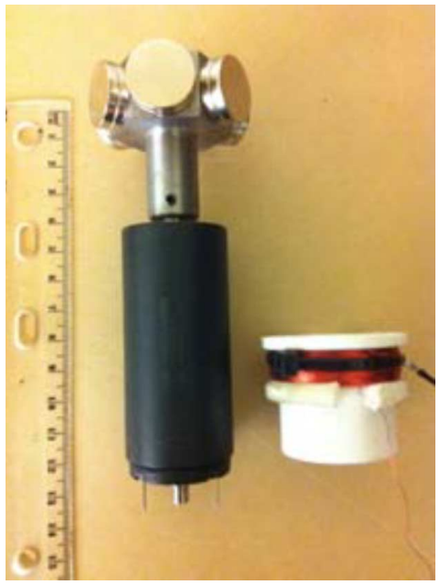
Design of Rotor and Coil
Magnetization of disk magnets is perpendicular to the surface
Polarization on the head is alternated to create an alternating magnetic field
Diameter of the coil matters
Too small and some magnetic flux is lost
Too large and multiple magnets will affect coil

Slide 9
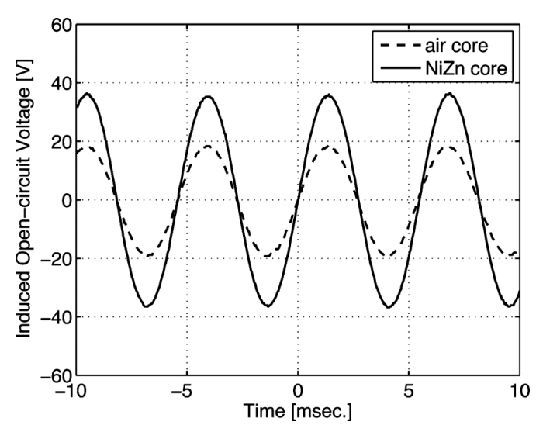
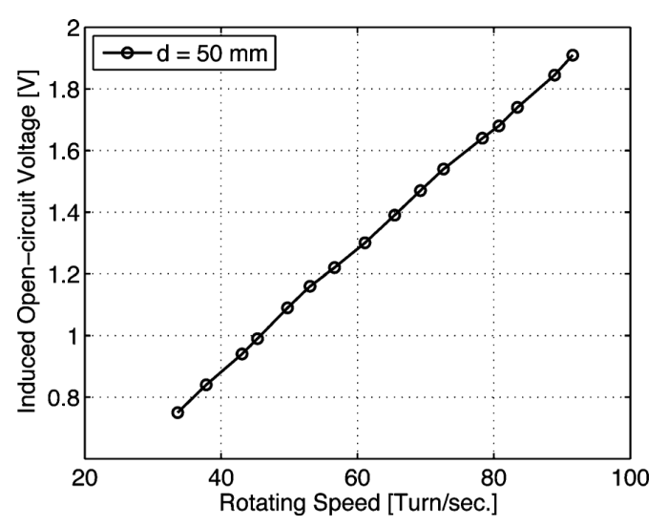
Design of Rotor and Coil

Slide 10
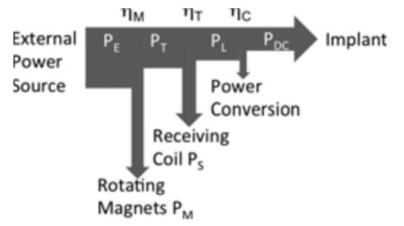
Delivered Power
Power delivered to the implant from the external source is reduced mainly by three forces
Power consumed to rotate magnets
Drag caused by induced current in receiving coil
Power lost due to conversion from AC to DC

Slide 11
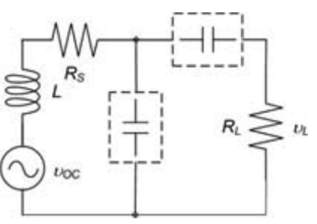
Delivered Power
Equivalent circuit is shown
In RF applications, wL is much greater than RS and RL
Choosing a suitable capacitor value is difficult in practice

Slide 12
Inductance and capacitance negligible!

Slide 13
Efficiency
Characterized by the ratio of delivered AC power at the load to the total power consumed by the DC motor
Motor in study consumes 1.445W, with a current of 0.170A
Extra power consumed is due to the receiving coil
Efficiency can be hurt by external factors
Human body (replicated with saline solution in studies)
External housing (medical grade stainless steel, aluminum)

Slide 14
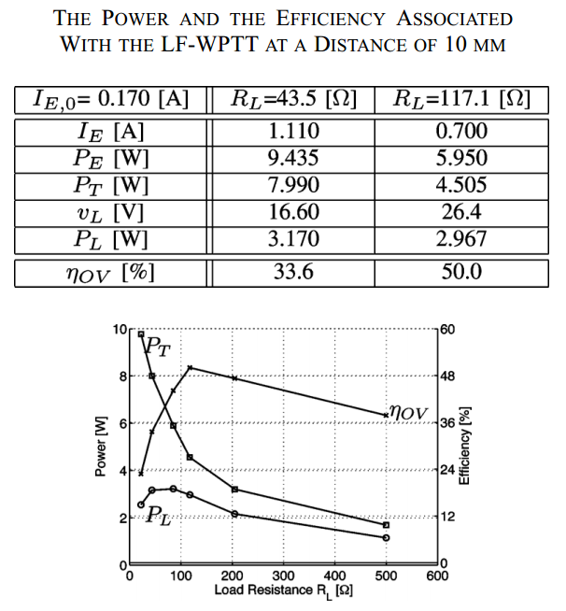
Efficiency

Slide 15
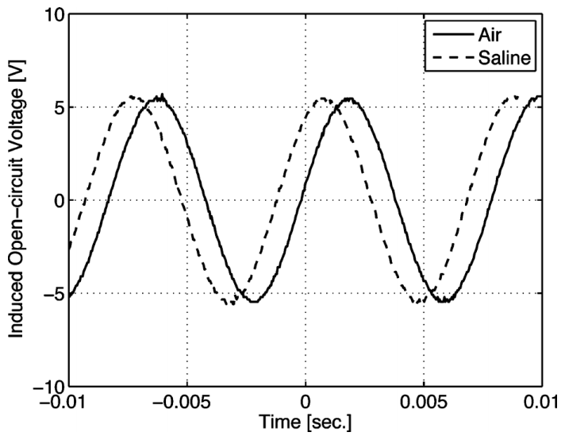
Results

Slide 16
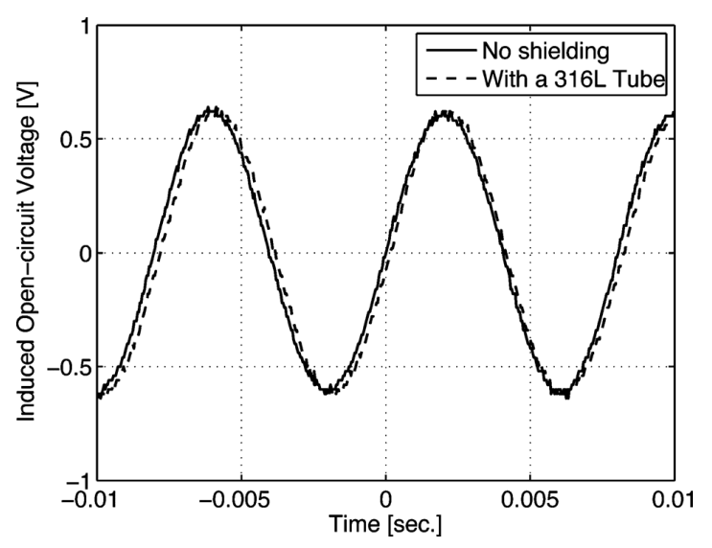
Results

Slide 17
Negligible power losses

Slide 18
Drawbacks
Device is bulky due to the size of the antenna
No wireless communication transfer through power delivery system
RF power transfer has this capability

Slide 19
Shortfalls of the Study
Many different materials could have been used to evaluate power transfer
Study seemed to be very basic
No comparison against efficiency of RF power transmission

Slide 20
Conclusions
Low-frequency wireless power transfer provides an efficient way to power medical implants
Coupling circuitry is not needed
Will work in a variety of conditions
Unfortunately, resulting device is large due to receiving coil size
Unknown how it compares to RF technologies

Slide 21
Questions?

Slide 22
Near-Threshold OOK-Transmitter with Noise-Cancelling Receiver
Mai Abdelhakim, Leonard E. Lightfoot, Jian Ren, Tongtong Li
Department of Electrical & Computer Engineering, Michigan State University
Air Force Research Laboratory, Wright-Patterson Air Force Base
Jonathan David
2013 IEEE International Conference on Communications, pp.1720,1724, 9-13 June 2013

Slide 23
The Need for Improvement
Power consumption is a highly critical requirement for future wireless body-area network sensors
Of all the circuit components on system-on-chip designs, the wireless transceiver usually consumes the most power (70-80%)
Design considerations make development of an energy efficient WBAN difficult
Reliability and noise immunity are key requirements aside from power consumption

Slide 24
The Need for Improvement
Body absorption can affect the signal-to-noise ratio of the transceiver
Noisy blocks (like the ADC or a switching power supply) in the SoC can increase bit-error rates
Affects OOK, which has difficulty discerning between coupling noise and small-signal data inputs

Slide 25
The Solution
Introduce a MICS (402-405MHz) transciever that operates in the near threshold domain (~.65V)
Remains energy efficient by using high frequency and low voltage
Noise sensitivity reduced by using a super-regenerative oscillator
Noise injections appears common-mode

Slide 26
Transceiver Architecture
OOK (on-off keying) is used
Simple, highly sensitive, and low-power
Received signal
Sent through low-noise amplifier and DCO
Structure referred to as a super regenerative receiver
A replica SRR is used to mitigate on-chip noise
Generates common-mode reference envelope for comparisons
Envelope detector receives signal from SRR
Signal output at a maximum of -16 dBm

Slide 27
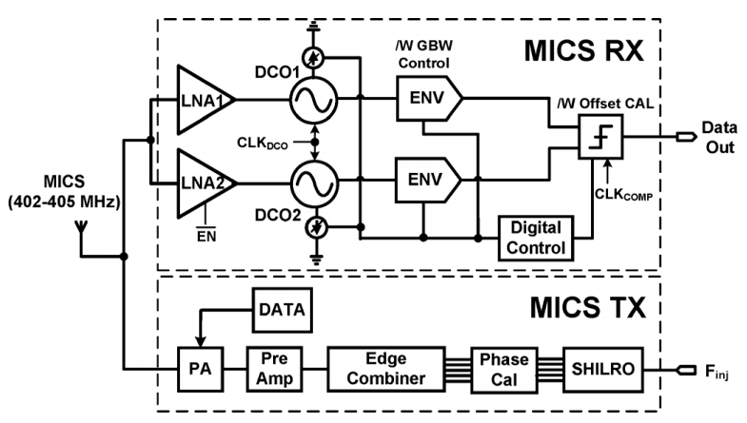
Transceiver Architecture

Slide 28
Near-Threshold Transmitter
Uses sub-harmonic injection locking and edge combining
Eliminates the use of a PLL
Power hungry
Slow settling time
Prevents use of aggressive duty cycling

Slide 29
Sub-Harmonic Injection Locking
Sub-harmonic injection occurs when an incident frequency is a sub-harmonic of the oscillator free-running frequency
Used for frequency synthesis and phase lock
As the division ratio increases, the noise rejection ability decreases

Slide 30
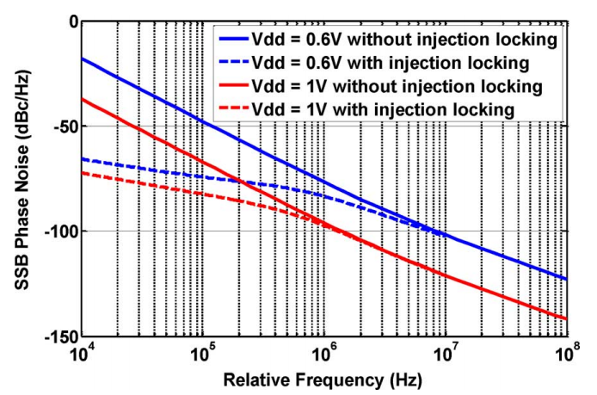
Near-Threshold Operation
Improves energy efficiency
Increases signal to noise ratio, resulting in larger oscillator phase noise

Slide 31
Spur Suppression
Injected signal is typically a square wave, which consists of large harmonic content
The N-th harmonic locks the oscillator, while other harmonics appear on the output as spurs
Decreasing the locking range reduces the SNR of the spurs
Decreasing the locking range decreases the loop bandwidth
Easier to lose lock
Time to lock on a signal is increased

Slide 32
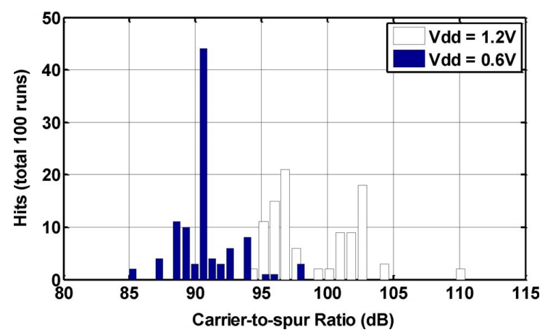
Spur Suppression

Slide 33
Super-Regeneration
Exploits the non-linear gain at the startup of an LC oscillator
Exponential time-dependent gain is achieved for a short period of time, resulting in a large magnitude regardless of the input signal
Workings of this are not immediately obvious
To properly take advantage of this, a very high-Q filter is needed
Luckily, the SRR “tank” circuit can be tuned to create this filter!

Slide 34
Super-Regeneration
Simplified, the digitally controlled oscillator is set in Q-enhancement mode to select a band of interest
Conductance of the DCO is switched from + to -, which increases the tank current
Increased tank current achieved super-regeneration, and the selected signal is amplified

Slide 35
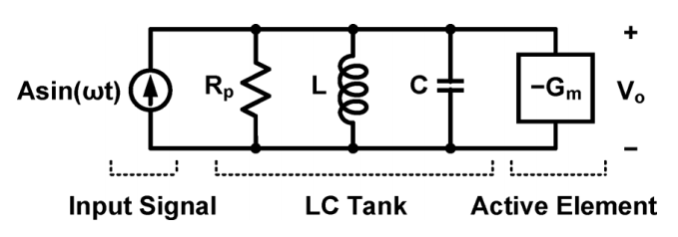
Super-Regeneration

Slide 36
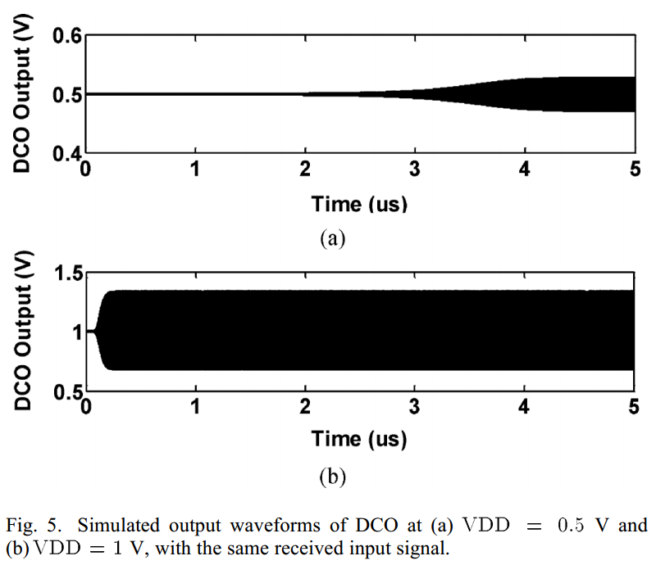
SRR at Low Power

Slide 37
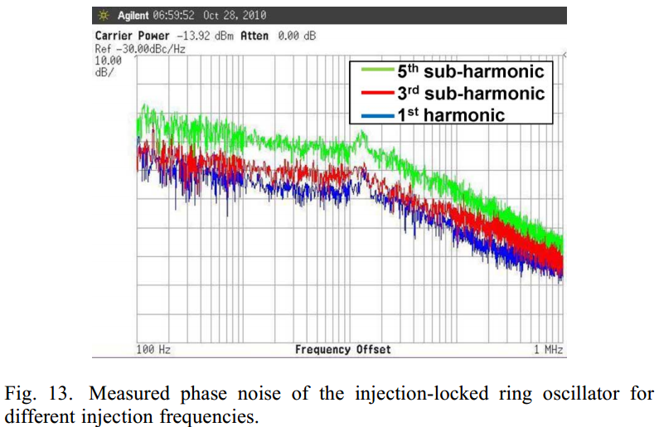
Results

Slide 38
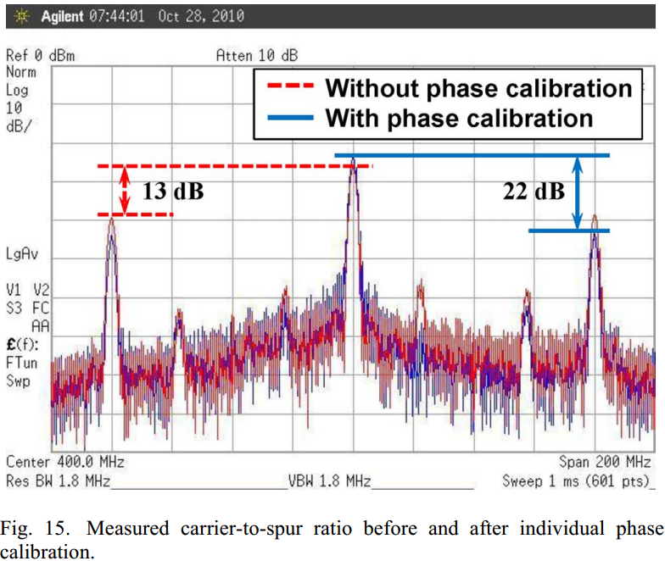
Results

Slide 39
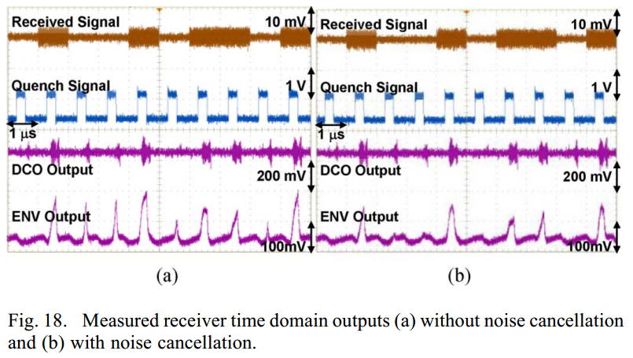
Results

Slide 40
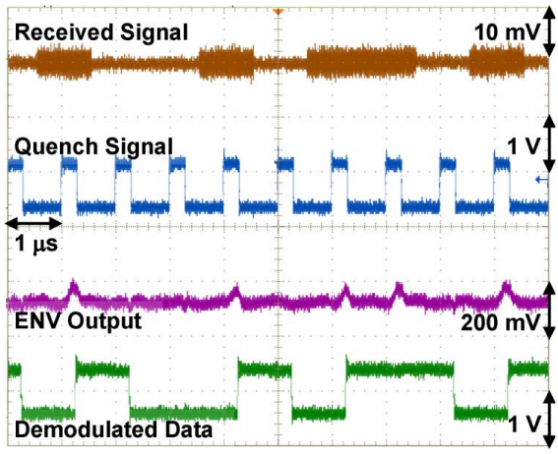
Results

Slide 41
Shortfalls of the Study
Operation at close to threshold voltage renders circuitry very susceptible to voltage spikes
Locking range of sub-harmonic injection when compared to a PLL

Slide 42
Conclusions
A low-power, noise-cancelling transceiver is possible with the proposed device
Sub-harmonic injection locking provides a viable, low-power alternative for a PLL
Super-regeneration allows for low-power amplification
Received data is accurate
Is operating at such a low voltage dangerous?

Slide 43
Questions?

Slide 44
THANK you!

