Slide 1
Building a RTOS for MPSoC Dataflow Programming
Osman Salem, Alexey Guerassimov, and Ahmed Mehaoua University of Paris Descartes – LIPADE Division of ITCE, POSTECH, Korea
Anthony Marcus and Borko Furht,
Department of Computer and Electrical Engineering and Computer Science, Florida Atlantic University
Jonathan David
2013 IEEE International Conference on Communications, pp.4373,4378, 9-13 June 2013

Slide 2
The Need for Improvement
Multiprocessor System-on-Chip (MPSoC) designs are becoming standard in high performance DSP applications
Zync
Altera SoC
ZigBee
Thus, being able load balance and make efficient use of parallel resources is of increasing importance
Need for a tool to ease MPSoC programming

Slide 3
The Solution
Design of a real-time operating system capable of effectively managing resources
Use of dataflow models shown to favor parallel algorithms
Favors data locality
Reduces multi-core scheduling constraints to data dependencies
Use of data flow graphs instead of thread declarations
Execution handled by MPSoC RTOS
Frees programmer from creating program primitives for task migration and synchronization

Slide 4
How does it work?
Partitions each application between available cores
Parallelism of each application is stated inside of a dataflow graph
Ensures good load balancing
Reduces computation latency
MPSoC RTOS reuses C/C++ code for its actors
Combines it with parameterized dataflow coordination language

Slide 5
Highly dependent upon dataflow model!!!

Slide 6
Dataflow Model
Well suited for applications based on a loop
Telecommunications
Video processing
Describes computation by splitting loop into actors
Data exchanged through inputs/outputs only
State of actor is not shared
Flow model is created before execution, and can be totally reconfigured once before starting a new executions

Slide 7
Dataflow Model
Graph is represented by C++ objects
Compile within dataflow management module
On each OS clock tick:
Dataflow graph parameterized
Temporary graph of execution obtained
Each actor gets an RTOS task

Slide 8
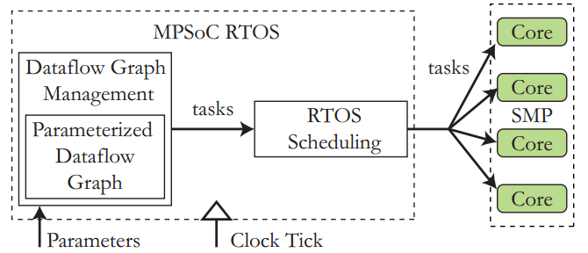
Dataflow Graph Management
An expansion is performed on the application
Dataflow graph transformed into temporary graph
Each actor is executed only once in an iteration
Temporary graph is dependent on parameter values that change between each iteration

Slide 9
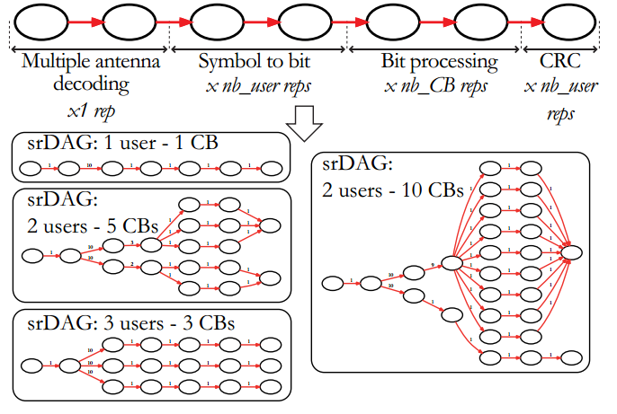
Dataflow Graph Management

Slide 10
Expansion phase Can be performed in real time!!!

Slide 11
Dataflow Graph Management
RTOS task is created for each actor
Tasks then scheduled on the cores of the MPSoC device
Alternate algorithms for dataflow management can be created, only restriction is that a dataflow graph can be produced

Slide 12
Scheduling
Split into two phases
Master/Slave Phase
Symmetric Phase

Slide 13
Master/Slave Phase
Master core executes dataflow graph management, posts actors to the slave cores, and finally posts actors to itself
Each core has a 1-place queue to receive an order to execute a task
Message contains address of the task in shared memory
Input/output buffer information contained
After first task dispatching is complete, all cores become pairs and the symmetric phase begins

Slide 14
Master/Slave Phase

Slide 15
Symmetric Phase
Each core can access the schedule function
Mutex semaphores provided within library
Highest priority task executed first
Scheduler called in two scenarios
Execution of task is preempted by higher execution task
Task execution completes
If a core has no remaining tasks, the scheduler saves the current task’s context state and the core returns to its private memory

Slide 16
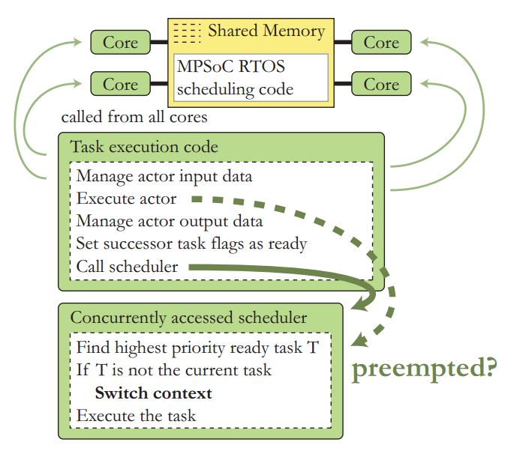
Symmetric Phase

Slide 17
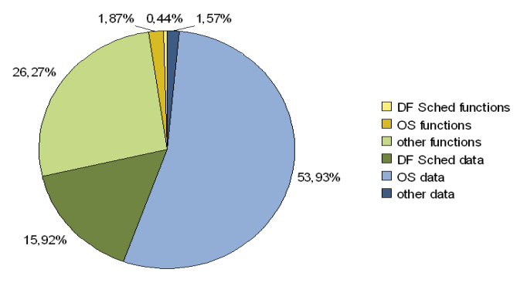
Results
OS takes up a lot of space (more than 50%)!
Due to the size and task stacks allocated by kernel

Slide 18
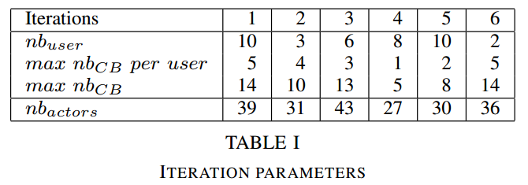
Results
Different number of actors for each iteration

Slide 19
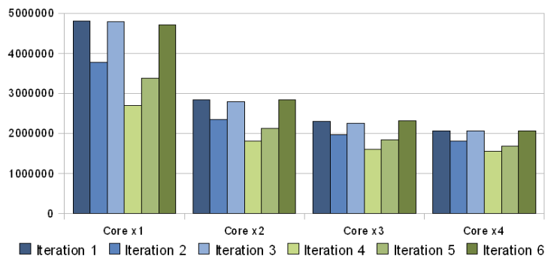
Results
Performance improves with number of cores
Definite diminishing returns
Shared memory accesses creates a bottleneck

Slide 20
Shortfalls of the Study
Study is focused primarily on signal processing
Does not mention how the dataflow graphs are created, or how much time it takes (only mentions it falls within parameters for the tested algorithm)
Does not mention how much of a bottleneck is created by using one core as a master
No comparison against traditional/hand coded method

Slide 21
Conclusions
Proposed MPSoC RTOS can ease difficulty of programming for modern day DSP applications
Increase in performance with number of cores
Bottleneck with increased memory accesses
Large amount of memory occupied by proposed OS
Actors can be written in C or C++
Where is the competition?
Can’t compare, does it result in a trade-off?

Slide 22
Questions?

Slide 23
R3TOS: Reliable Reconfigurable Real-Time Operating System
Mai Abdelhakim, Leonard E. Lightfoot, Jian Ren, Tongtong Li
Department of Electrical & Computer Engineering, Michigan State University
Air Force Research Laboratory, Wright-Patterson Air Force Base
Jonathan David
2013 IEEE International Conference on Communications, pp.1720,1724, 9-13 June 2013

Slide 24
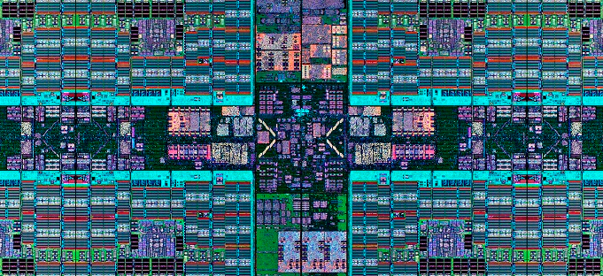
The Need for Improvement
FGPAs provide promising possibilities for the future as semiconductor manufacturing reaches its physical limits
Obtain best performance per transistor count per unit of consumed energy
Increase in reliability
High amount of computation in given space and time

Slide 25
The Solution
Use of online specialization
Intelligent reuse of resources in the FPGA
Architecture kept fault-free by reconfiguring around damaged areas of the chip
Maintain a “software look and feel” to avoid a collapse in productivity and cost
Satisfy requirements of high-performance, real-time, fault-tolerance necessary in applications

Slide 26
RTOS != ROS

Slide 27
Fundamental ROS Services
Software OS augmented with functions to manage reconfigurable hardware
Task loading
Memory management
Scheduling and allocation
Communications
Hardware hardware
Hardware software
Input/output
Accessible through AP, with runtime support

Slide 28
R3TOS Foundations
Resource reusability and computation ephemerality
Intensive use of fine-grained reconfiguration
Aims to keep resources available to any incoming task at any time
Circuits configured when required, then removed
Clock distribution wires
Task communication channels
Resources can be used for either computation or communication purposes

Slide 29
R3TOS Foundations
Control logic to drive tasks is attach to their own circuitry, as opposed to predefined reconfigurable slots with fixed control logic and comm structures
Self-contained, closed structures
Fully relocatable within FPGA

Slide 30
Task Control Logic (TCL)
Includes input data buffer, output data buffer, and hardware semaphore enable/disables computation
Provides means to virtually lock physical data and control data of hardware tasks to logical positions in the configuration memory of the FPGA
Frees the allocation of a task from being constrained by communication interfaces during design time
TCLs are accessible through the configuration interface of whichever memory position they are mapped to

Slide 31
TCL Advantages
Number of tasks executed concurrently only limited by resources on the FPGA
Tasks can be allocated around damaged resource
Increased computation density
Complexity of allocation algorithms reduced
No need to be aware of underlying implementation-related irregularities in the reconfigurable area
No need to preserve static routes

Slide 32
TCL Advantages
Tasks can be de-allocated quickly using multiple frame write configuration commands
Simply blank an entire region
Each task can be clocked at its highest frequency, rather than running entire fabric on same clock
Device ages uniformly

Slide 33
The Downsides
Bottleneck from the internal configuration access port leads to significant time overheads
Configuration of a hardware task delays its execution
Configuration of on-demand communication channels incurs an overhead greater than the time needed for created a virtual connection through a network-on-chip

Slide 34
Computing Model
Task definitions and interactions described using parallel software syntax (POSIX Pthreads)
Body of some tasks implemented in hardware
R3TOS addresses two main hardware tasks:
Data-stream processing, to be used with data-intensive applications with regular dependencies
Hardware-acceleration tasks
User relies on the R3TOS API to program their reconfigurable application
Execution of tasks controlled by main CPU

Slide 35
Computing Model
The software microkernel (SWuK) interacts with the hardware microkernel (HWuK)
SWuK schedules/executes software tasks and forwards hardware tasks to the HWuK
Hardware related services offered in the API are determined by the HWuK
Scheduler server to schedule hardware tasks
Allocator server manages FPGA resources
Configuration manager to translate high-level operations into reconfiguration commands for the FPGA

Slide 36
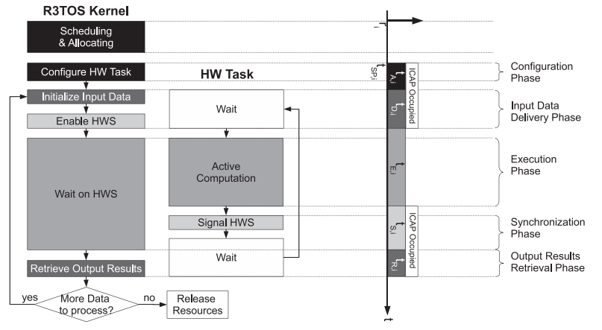
Computing Model

Slide 37
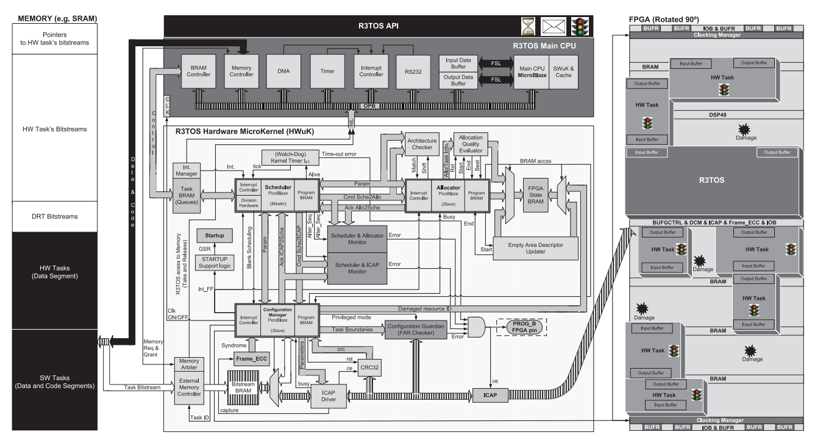
General Architecture
A little bit complex, probably

Slide 38
General Architecture
Three main parts
HWuK
Main CPU
Memory

Slide 39
Hardware Microkernel
Each component is implemented separately to allow for parallelism in the HWuK processes
Allows for low runtime overhead and area overhead
Main core of all HWuK components is the PicoBlaze
Requires only 96 slices
HWuK components mastered by scheduler
Allocator and configuration manager act as slaves
Communication between components managed by a very strict set of rules, overseen by two monitors (to detect malfunctions)

Slide 40
R3TOS Main CPU
Xilinx on-chip processor (32-bit MicroBlaze soft-core) is used as main CPU
Timer and interrupt peripherals included to expand functionality
Program executed by CPU is held in directly accessible program memory (BRAMs in FPGA)
Interfaced with the HWuK based on interrupts and shared memory

Slide 41
Memory
Bitstream memory and main memory held on one external chip
Data and code segments of software tasks
Data segments and bitstreams of hardware tasks
Bitstreams of the data relocating tasks
Lowest part of memory contains a pointer table, allowing the HWuK to know the exact location of each task bitstream

Slide 42
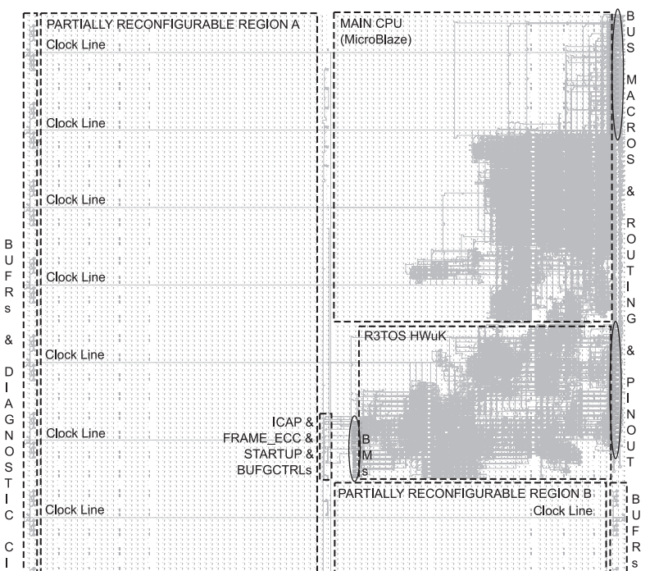
Proof of Concept

Slide 43
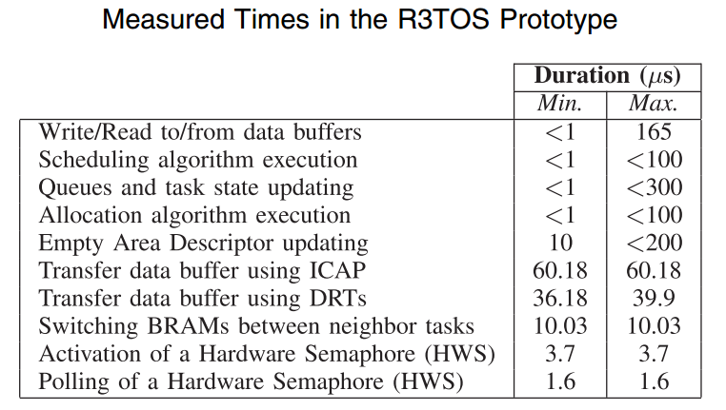
Proof of Concept

Slide 44
Shortfalls of the Study
Has yet to be seen if the implementation is practical for most applications
Can’t be seen how execution times are effected
How difficult is coding?
Energy usage of device?
That’s is about it…the paper is pretty solid

Slide 45
Conclusions
R3TOS allows for a viable, reconfigurable, real-time operating system
Many advantages gained by freeing hardware from static communication lines
Better able to use resources
Even wear over device
Possible performance increases
Viability of design must wait for practical implementation, currently only proof of concept

Slide 46
Questions?

Slide 47
THANK you!

