Slide 1
Sensor Fault and Patient Anomaly Detection
Osman Salem, Alexey Guerassimov, and Ahmed Mehaoua University of Paris Descartes – LIPADE Division of ITCE, POSTECH, Korea
Anthony Marcus and Borko Furht,
Department of Computer and Electrical Engineering and Computer Science, Florida Atlantic University
Jonathan David
2013 IEEE International Conference on Communications, pp.4373,4378, 9-13 June 2013

Slide 2
The Need for Improvement
Average lifetime has increased
Advancement in medical procedures
Technological advances
Increased knowledge base
Unfortunate problem: Its hard to care for everyone!
Increase in average lifetimes means an increase in the population
Shortage of healthcare professionals

Slide 3
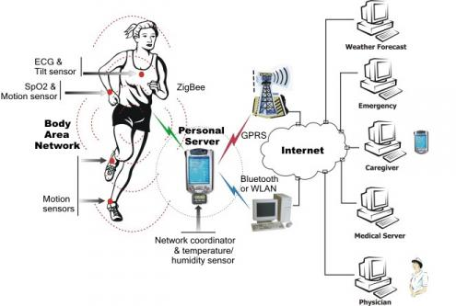
The Solution
Wireless Body Area Networks (WBAN)
Network of wireless sensors to relay patient information
Uses accurate, high-throughput networks
Allows patient greater freedom and mobility

Slide 4
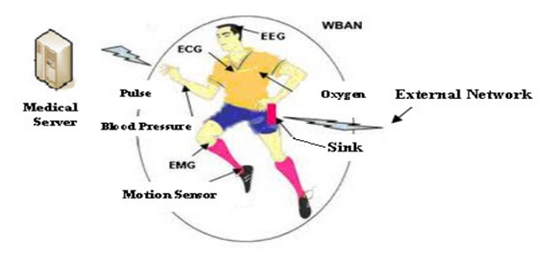
What can be measured?
Heart rate
Pulse
Oxygen saturation
Body Temperature
Respiration Rate
Blood Pressure
Blood Glucose
Galvanic Skin Response
It is quite comprehensive!

Slide 5
How does it work?
Networked sensors transmit to central device
Can be patients cell phone, base station in house, etc.
Handles processing and storage
Sends alarm upon detection of anomaly
Used on patients with chronic illnesses
Can be used to monitor patient recovery after surgical procedures

Slide 6
Are there any problems? Are there ever not any? The sad truth of engineering

Slide 7
Problems
Faulty measurements
Hardware failures
Security issues
Sensors have limits
Reduced computational power
Limited storage capacity
Limited energy resources
Passed to central device for processing

Slide 8
Detect Faulty Measurements
Focus on what is correctible: bad readings
A faulty reading can mean an error or that a patient is entering a critical state
The differences are distinguished using historical data
Achieved using an anomaly detection mechanism
Suitable for WSNs given the lack of attack signatures
Patterns checked against dynamically updated normal model
Unfortunately, in the training phase it is difficult to find normal data to establish a normal profile

Slide 9
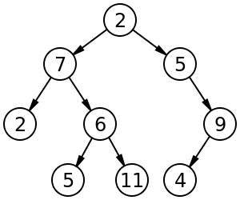
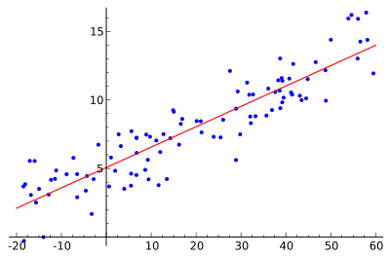
How does the paper tackle this?
Use a J48 decision tree to detect abnormalities
Apply linear regression to find abnormal measurements in an abnormal record

Slide 10
Use a what to do what?

Slide 11
Decision Tree J48
Implementation of C4.5 decision tree
Classifies record and reduces temporal complexity
Attributes are stored in non-terminal nodes
Terminal nodes represent an outcome
An algorithm is used to obtain the gain ratio of each attribute, which allows for hierarchical distribution among the tree nodes

Slide 12
Linear Regression
Predicts the current measurement for each parameter
Sends a trigger when current value is greater than the predicted value by a certain threshold
Correlation analysis conducted to detect faults

Slide 13
Is it abnormal? If it is, Is it an error or a health issue?

Slide 14
Why use this approach?
The purpose is to detect abnormal patterns
Process needs to be real-time and must be fast
Uses data passed to central device for processing
Sensors don’t have the processing power or storage for this
J48 used because it is efficient at classification
Easier to sort through large chunks of data
Quicker identification of data that contains anomalies
Linear regression determines if it is an error
If one anomaly, the value is replaced by predicted value
It two anomalies, medical teams are alerted

Slide 15
How well does it work?
Results focused on five vital signs
Heart rate ϵ [80 – 120]
Pulse ϵ [80 – 120]
Respiration Rate ϵ [12 – 30]
SpO2 (Oxygen Saturation) ϵ [90 – 100]
Body Temp ϵ [36.5 – 37.5]
Based on two phases
Training
Machine learning methods used create model for data
Detection
Inputs classified as abnormal if they deviate from the model

Slide 16
Results
Anomalies can be seen at approximately times .7 and 2.4
Two alarms are raised
At .7, alarm due to abnormal pulse AND SpO2
At 2.4, alarm due to highly irregular heart rate

Slide 17
Results
Figure 5 uses methods proposed in paper
Figure 6 uses k-NN (k Nearest Neighbors)
More computationally expensive
Higher error than additive regression
Figure 7 uses a decision table
Produces the worst results in all cases

Slide 18
Results
Linear regression has lowest mean error
Approach achieves a high True Positive Rate with a corresponding low False Positive Rate

Slide 19
Shortfalls of the Study
Does not mention what happens when data is continuously read as faulty
May be indication of underlying health problem
Indication that sensor needs to be replaced
Learning phase is glossed over
Does it learn when patient is doing physical activity?
How long is the learning phase?
Paper could use more fault tolerant methods
Readings of same type from multiple sensors (TMR)

Slide 20
Conclusions
The approach used in the paper performs well
High True Positive rate
Low False Positive rate
Supposedly less computational power than other approaches
Supposedly less storage used
Some areas of the study remain dubious
Power comparisons?
Computation time?
Detection and replacement of faulty sensors?

Slide 21
Questions?

Slide 22
Architecture Design of Mobile Access WSNs
Mai Abdelhakim, Leonard E. Lightfoot, Jian Ren, Tongtong Li
Department of Electrical & Computer Engineering, Michigan State University
Air Force Research Laboratory, Wright-Patterson Air Force Base
Jonathan David
2013 IEEE International Conference on Communications, pp.1720,1724, 9-13 June 2013

Slide 23
The Need for Improvement
WSNs impact on military and civilian applications
Need efficient and reliable communication over large-scale networks
Energy constraints
Trade-off between efficiency and throughput
SENMA (sensor networks with mobile access points)
Mobile access units traverse network to collect data
Improves energy efficiency of the sensors
Improvement in terms of energy over ad-hoc
Sensors do not perform energy-consuming routing functions
Unfortunately, there is a large delay in data collection

Slide 24
The Solution
Use mobile access coordinated wireless sensor networks (MC-WSN)!
Energy efficient, reliable, allows time-sensitive info
Network is divided into cells
Each cell is covered by one MA
MA deploys, recharges, and replaces nodes
Also replaces compromised nodes (enhanced security)
Data is sent to a cluster head in each cell
Cluster head is always located at center of cell
Easy data gathering (location is known, easy to find)

Slide 25
Improvement over SENMA
Number of hops from any sensor to the MA is minimized to pre-specified number
Set by network deployment and design topology
Delay is not based on speed of the MA!
Only based on number of hops and wave speed
Energy consumption is also improved
Determined by MA distance from nearest cluster head
Independent of MA coverage area and node density
Higher energy efficiency, lower delay times!

Slide 26
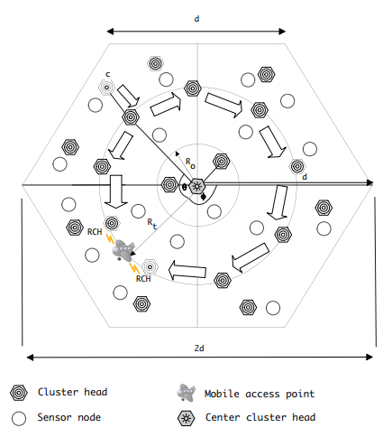
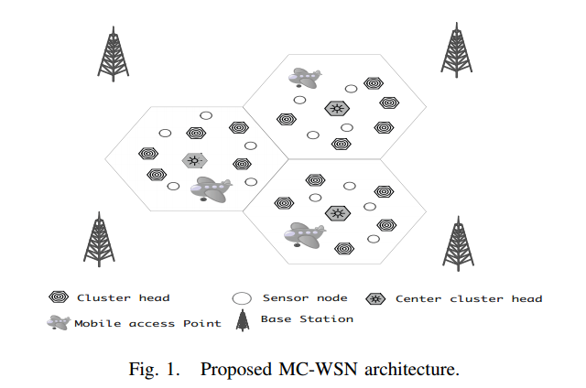
Design of the Cells
Hexoganal cells
Each cell has one MA
Sensor nodes deployed, each group with a cluster head
One powerful center cluster head
Center cluster head communicates with the MA

Slide 27
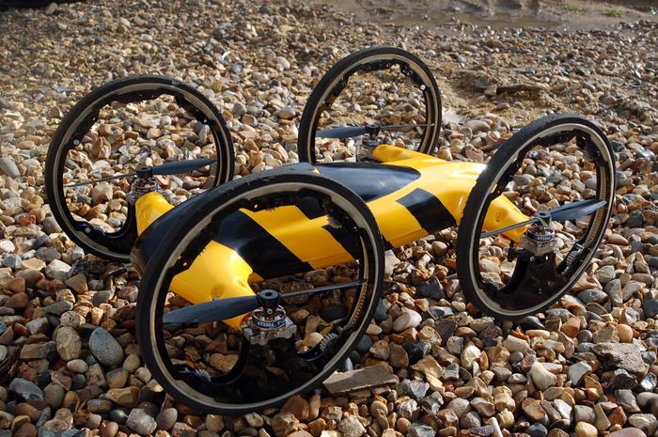
The Mobile Access Point
UAV capable of land travel
Multiple duties
Deploys
Replaces
Recharges
Collects data
Returns collected data to a base station
Only moves for data collection if routing path fails
Communication with main cluster head and the nearest cluster head

Slide 28
Main Features of MC-WSN
Resolves network deployment and extend lifetime
MAs manage deployment of sensors and CHs
Node signals MA when it is low on energy
Minimizes delay times
Speed dependent on number of hops and wave speed
MAs determine the topology of the network
Provide high energy efficiency
Sensor nodes communicate to nearest cluster heads
No inter-cluster routing necessary

Slide 29
Main Features of MC-WSN
Enhanced network security
Compromised sensors and cluster heads are replaced
The MA itself roams the cell, keeping its location private
Enhanced resilience, reliability, and scalability
Self-healing architecture
Health relayed to MA by the central cluster head and/or nearest cluster head
If routing paths fail, MA can roam cell to collect data

Slide 30
Creating the Network
Form clusters
CHs broadcast Hello message with ID and location
Each sensor connects to nearest CH
Ring set-up (boundary)
MA traverses the cell, broadcasts Start message to CHs
MA denotes the cluster heads along its ring path
Discover links to ring
CHs broadcast a message to find neighboring CHs
Continues until all CHs find at least one neighbor

Slide 31
Creating the Network
Discover links to the central cluster head
CCHs broadcasts a signal to find neighboring CHs
The signal is forwarded by the CHs until it reaches CHs on the ring
Establish links to the ring or central cluster head
Cluster heads establish connections with the central cluster head or the closest cluster head
The process is completed when the receiver successfully confirms a connection

Slide 32
Data Gathering
Periodical sensing and collecting stages
Sensors report information to the cluster heads
Cluster heads report to other cluster heads or CCH
Transmission interference is avoided
Sensors report in a given time slot
Nodes of different clusters use different spreading codes
Transmissions from sensors to CHs, between CHs, from CHs to the MA, and from the CCH to the MA all use different frequency ranges
MA sends a beacon signal, allowing CHs to communicate with it

Slide 33
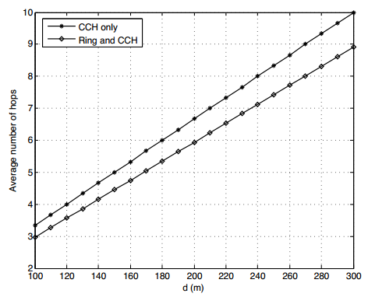
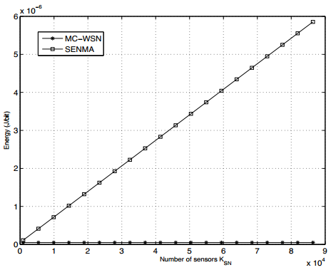
Results
Ring and CCH method produces lower average number of hops
Energy used by MC-WSN setup is orders of magnitude lower than SENMA setup

Slide 34
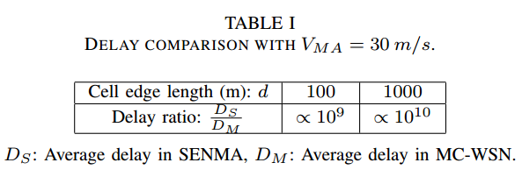
CRAZY GAINS!

Slide 35
Shortfalls of the Study
What happens if the MA fails?
Data seems to only flow into the MA from CCH and the CHs, no check ups are performed on the MA
How much energy is needed to run the MA?
How practical is the MA?
Is it feasible with todays technology?
Complicated machinery
Seems to be very expensive
Is the energy saved by the network worth the cost of running the MA?

Slide 36
Conclusions
MC-WSN provides multiple improvements over SENMA
Huge reduction in energy consumptions
Massive decrease in delay times
Reliable, secure network
Unfortunately there are many questions
Cost comparisons?
Is the maintenance of the MAs worth the benefits?
Practical to deploy with modern technology?
If not now, when?

Slide 37
Questions?

Slide 38
THANK you!

