Slide 1
A Framework to Analyze Processor Architectures for Next-Generation On-Board Space Computing
Tyler M. Lovelly
Ph.D. student
University of Florida
Donavon Bryan
Kevin Cheng
M.S. students
University of Florida
Rachel Kreynin
B.S. student
University of Florida
Dr. Alan D. George
Professor of ECE
University of Florida
Dr. Ann Gordon-Ross
Assoc. Professor of ECE
University of Florida
Gabriel Mounce
Deputy Chief, Space Electronic Tech.
Air Force Research Laboratory

Slide 2
Introduction
Space computing presents unique challenges
Harsh and inaccessible operating environment
Stringent constraints on power, reliability, programmability
Limitations for on-board performance and mission capabilities
Increasing need for high-performance on-board computing
Demand for real-time sensor and autonomous processing
Limited communication bandwidth to ground stations
Existing rad-hard processors cannot meet performance requirements
Typically several generations behind commercial processors
Based on architectures not specifically designed for space computing
Framework created to analyze processor architectures for next-generation on-board space computing
Study wide range of architectures based on performance and power
Gain insights into architectural capabilities for key computations

Slide 3
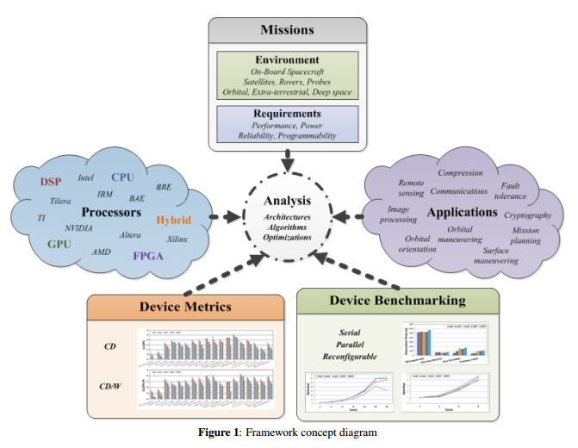
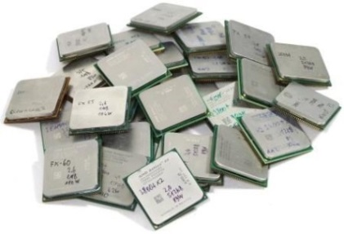
Framework
Space-computing taxonomy
Broadly define and classify space-computing domain
Simplify into key computations
Device metrics
Analyze wide range of architectures
Based on theoretical device capabilities
Performance & power
Device benchmarking
Further analyze promising architectures based on key computations
Parallelization across processor cores and reconfigurable fabrics

Slide 4
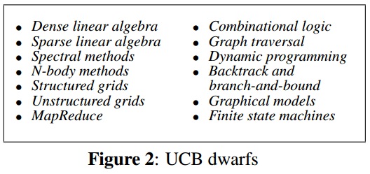
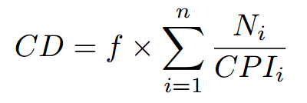
Background and Related Research
Computational dwarfs
Defined by UCB as “an algorithmic method that captures a pattern of computation and communication” ^{[1]}
Used to characterize applications based on key computational patterns
Concept can be adapted and applied to any domain of computing
Device metrics
Computational Density (CD) & CD per Watt (CD/W) ^{[2]}
Focus on performance and power requirements for space missions
Device benchmarking
Greater hardware cost and development effort than device metrics
Provides greater insight into architectures, algorithms, optimizations
[1] K. Asanovic et al., "The Landscape of Parallel Computing Research: A View from Berkeley,” Technical Report No. UCB/EECS-2006-183, University of California, Berkeley, Dec 18 2006
[2] J. Richardson et al., “Comparative Analysis of HPC and Accelerator Devices: Computation, Memory, I/O, and Power,” Proc. of High-Performance Reconfigurable Computing Technology and Applications Workshop (HPRCTA), at SC’10, New Orleans, LA, Nov 14 2010

Slide 5
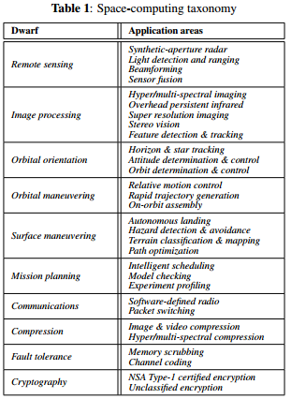
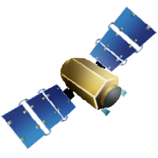
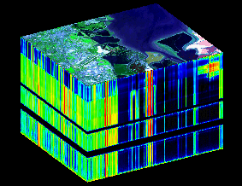
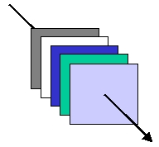
Space-Computing Taxonomy
Space dwarfs
Studied common and critical space apps and missions
Established computational dwarfs for space computing
Space benchmarks
Key computations selected for space benchmark suite
Example: satellite mission
Critical application
Hyper-spectral imaging
Corresponding dwarf
Image processing
Key computations
Matrix multiplication
QR decomposition

Slide 6
Device Metrics Analysis
Initial analysis on broad and diverse set of architectures
Closest comm. arch. to rad-hard Boeing MAESTRO
GPUs give high CD, but too high power for many space missions
Hybrid architectures analyzed in isolated or combined fashion
Existing rad-hard outperformed by comm. architectures
Commercial counterpart of rad-hard Virtex-5QV
No DPFP support for high-precision space apps
FPGA provides most CD & CD/W to hybrid device
Intel Atom S120 has power-efficient advantage for space

Slide 7
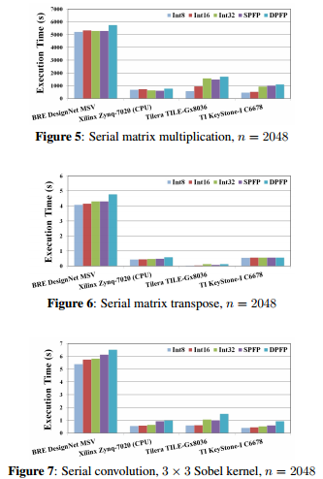
Device Benchmarking Analysis
Developed space benchmarks for several targeted architectures
Rad-hard CPU
Based on PowerPC750FX
Similar arch to BAE Systems RAD750
Commercial CPUs and DSP
Generated initial performance results based on serial operation
Rad-hard technology outperformed by commercial architectures
Even when commercial architectures are limited to single-core operation
Supports device metrics data for rad-hard vs. commercial architectures
Efficient computation of floating point operations
Data type & precision less important for memory-intensive benchmark

Slide 8
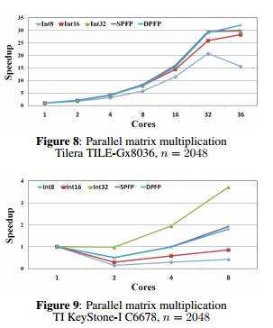
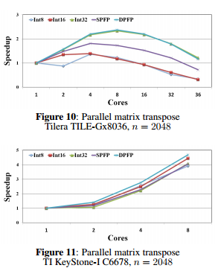
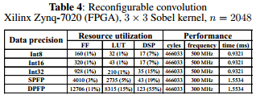
Device Benchmarking Analysis
Parallel benchmarking on multi/many-core architectures
OpenMP shared-memory parallelization strategy
Space benchmarks parallelizable across processor cores
Eventual tipping points when overhead surpasses speedup
FPGA benchmarking
Parallel-pipelined hardware datapath
Alleviate performance bottlenecks for critical space applications
Optimal # cores based on benchmark, data type & precision, problem size
More optimization needed to achieve significant speedup
Not enough cores to reach tipping point in parallelization
FPGA resource usage grows with data precision
Significant resources not required, even for highest precision

Slide 9
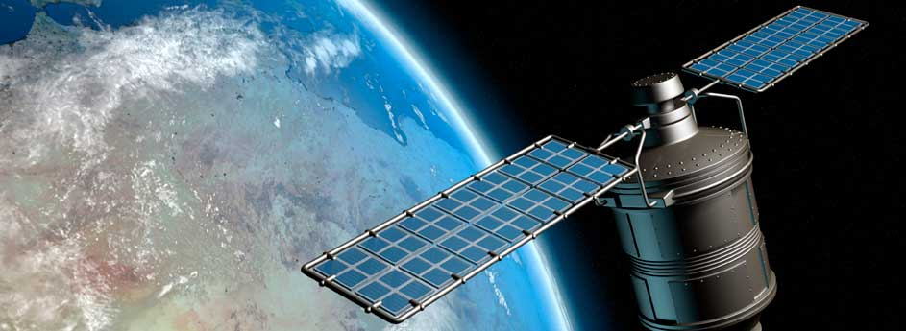
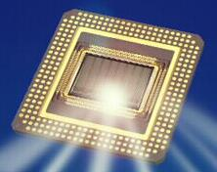
Conclusions and Future Research
Framework created to analyze processor architectures for next-generation on-board space computing
Space-computing taxonomy
Established set of computational dwarfs for space
Key computations selected for space benchmarking
Device metrics analysis
Wide range of architectures analyzed with CD and CD/W metrics
Initial insights into performance and power efficiency for various architectures
Device benchmarking analysis
Conducted serial, parallel, and reconfigurable benchmarking
Further supports metrics data that rad-hard tech becoming outdated
Space apps parallelizable across processor cores and reconfig. fabrics
Expand results with new devices and benchmarks
Multi/many-core CPUs and DSPs; comm. and rad-hard
Leverage established libraries and architecture-specific optimizations
Notes:
Slide 8: Justin
Requesting a minimum of 3 memberships, directly correlating to how many platforms and benchmarks we can do

