Slide 1
Real-Time Systems
Dave Ojika

Slide 2
Image-Processing Semester Roadmap
Part I. Reconfigurable Systems
Motivating research
Current research
Fast and Flexible High-Level Synthesis from OpenCL using Reconfiguration Contexts
Part II. Architectural Optimizations
From OpenCL to High-Performance Hardware on FPGAs
OpenCL for FPGAs: Prototyping a Compiler
Part III. Real-Time Systems
Real-time Image Processing with Reconfigurable Hardware
Gigapixel-size Real-time Interactive Image Processing with Parallel Computers

Slide 3
Outline
General Background [10 frames]
Paper I
Introduction
System Description
Goal of Research
Hardware Platform
Hardware Library
Application
Results
Conclusions
Paper II
Introduction
Technological Driver
Application
Main Features
Mechanism
Design Implementation
Results
Conclusions

Slide 4
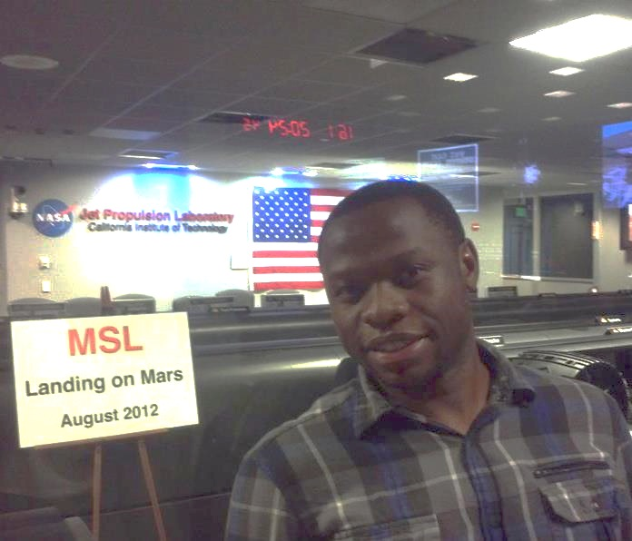
Machine Vision
Machine vision or computer vision (CV) can substitute human vision for a number of application tasks such as
Target tracking
Robot guidance
Tasks inspection
MSL
Autonomous operation aided by machine vision
Real-time operation highly critical!

Slide 5
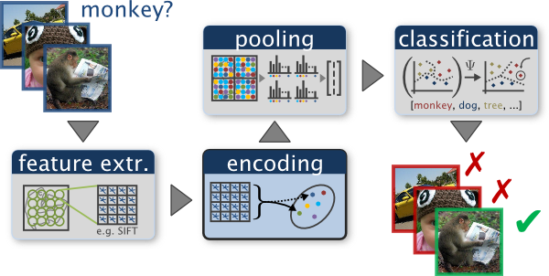
Real-Time System in Machine Vision
Machine vision requires real-time capabilities; are often used in real-time applications
System extracts relevant information from an image through several processing steps
Image acquisition →
Input
Image processing →
*Processing
Feature extraction →
*Processing
Decision making →
Output
*Processing: [enhancement, restoration, analysis, creation]
[local maxima, etc.]

Slide 6
Image Processing
Very important field in machine-vision
OpenCV – image/video processing algorithms
Operations are difficult to achieve in real-time using software techniques
Large amounts of data involved when dealing with high resolution images
Nevertheless, one of the most attractive areas for reconfigurable computing
Notes:
This presentation is not about reconfigurable computing just yet…
Reconfigurable computing and Real-time often go hand in hand
FPGA (a kind of reconfigurable hardware) naturally makes real-time possible

Slide 7
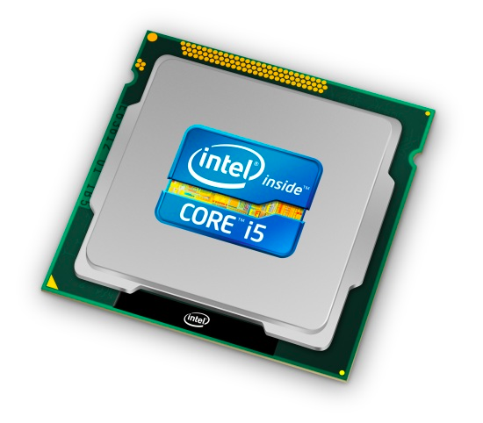
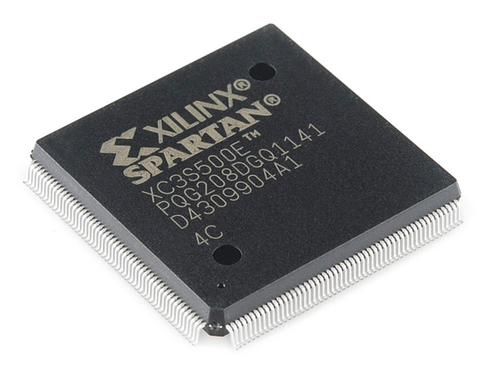
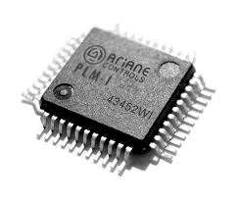
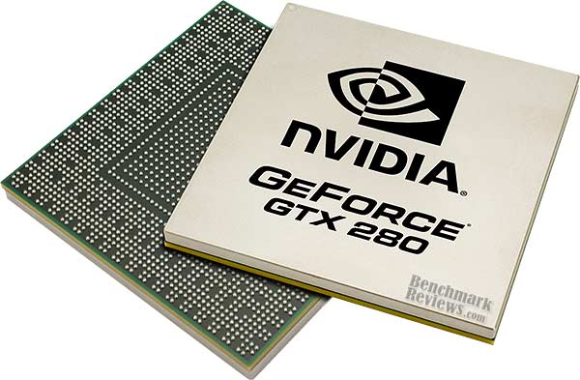
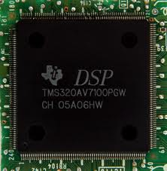
Reconfigurable Hardware
Traditional approach
Fixed-logic
CPU, DSP, GGPU
map application to hardware
RC approach
Custom-logic
FPGA, ASIC
map hardware to application
Reconfigurable circuits are advantageous
Deliver hardware performance and software flexibility
Re-programmability
Price/performance benefits compared to ASIC
Notes:
ASIC are somewhat fixed. FPGA are fully customizatble after fabrication Custom circuit unlike traditional approach that maps application to hardware GGPU are starting to have wide spread application not only for graphics processing

Slide 8
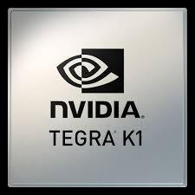
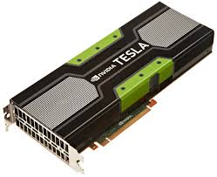
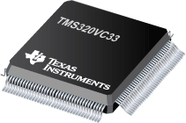
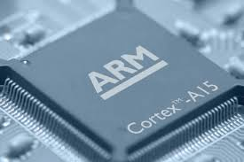
Fixed-Logic in Real-Time Systems
Performance probably not as much compared to FPGA
CPU
Architecture: fetch, decode, …
Limited parallelism: ILP, TLP
GPU, DSP
Throughput matches with FPGA
Huge power consumption
However, its not business as usual…
ARM: low-power CPU
Intel Many-Core CPU: Xeon Phi
Tesla GPU: Tesla & Tegra – massive parallelism with CUDA cores
TI DSP: special-purpose Image/Video Processing ASICS (TI CorePac)
Notes:
GPU, DSP rival FPGA in terms of performance but only at huge power consumption. Theses devices are power hungry

Slide 9
Fixed-Logic in Real-Time Systems (cont.)
CPUs pure-software approach utilize fast clock (to deal with sequential operations) - are quickly inhibited by laws of physics
However many advanced techniques: OOO, speculative execution, dynamic scheduling, branch prediction
Not enough to solve problem of data-parallel image/video apps
Multicore and many-core processors (SMP) have become almost the standard in high performance computing
For many embarrassingly parallel apps, FPGA preferred
GPU and DSP have been traditional used for image/video processing, but are very power hungry
Focus on of this presentation is on use of reconfigurable hardware to maintain real-time constraints
Notes:
So Reconfigurable hardware does seem promising for image processing, huh?
Lets see…

Slide 10
Real-time Image Processing with Reconfigurable Hardware

Slide 11
Introduction
A PCI-based system for image processing using hardware/software technique
“PCI-based reconfigurable system for real-time image processing using reconfigurable hardware”
Real-Time: focus of this whole talk
Image Processing: choice domain application area
Reconfigurable Hardware: choice architecture
PCI: link between 2 and 3
And, the rest is grammar…
Motivation
Image processing app require huge amounts of data
Software-based approach too difficult to achieve real-time
Notes:
We already gave motivation for domain application area and architecture (FPGA)
sounds complicated? Not at all. Lets brake it down: PCI can be a bottleneck
Why PCI?

Slide 12
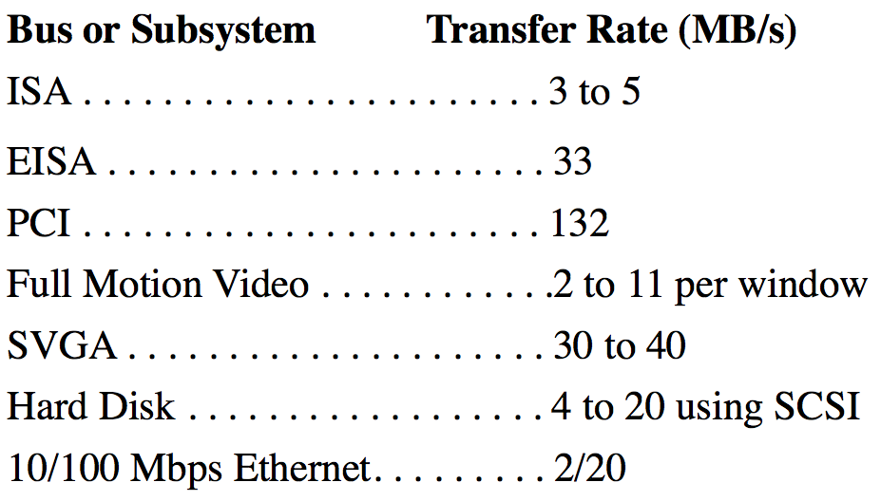
PCI Bus Interface
PCI provides a fast link between host system (hosting raw images) and reconfigurable hardware (processing these images)
To achieve real-time, need to minimize communication bottlenecks as much as possible
Other communication interfaces
ISA (3~5 MB/s): being replaced by PCI
USB
It is pretty much the standard for
host-accelerator interfacing
Features many many generations with
varying bandwidth and lanes
Notes:
- “Avoid Bottlenecks Using PCI Express-Based Embedded Systems” - RTC Magazine (embedded systems technology

Slide 13
System Description
HOT2-XL (a PCI board) used as co-processor for image processing
Environment based on library of hardware modules that implement a some of the most common operations in image processing
Also implemented, is a Visual C++ application in order to validate hardware design
System is an integrated hardware and software environment dedicated to processing images in real-time
Software processes are executed by the CPU
Hardware processes are implemented on the FPGA
Essentially an area of hardware-software co-design
A continuously growing area of research
Deals with optimal solutions for partition a task into hardware and software domains
Area, power, performance, etc. trade-offs
Notes:
How has reconfigurable hardware supported real-time image processing? Vega-Rodriguez et. all ( our friend, and his friends, at Univ Extremadura in Spain at their department de Informatica

Slide 14
Goal of Research
Make real-time machine vision system suitable for both scientific purposes and commercial applications
Maximize both flexibility and efficiency (throughput)
Reduce cost
A Parato-optimal design problem?

Slide 15
Hardware Platform (Hot2-XL)
What is Hot2-XL board?
Seem to have been used a lot by author
Papers
AN FPGA-BASED IMPLEMENTATION FOR MEDIAN FILTER MEETING THE REAL-TIME REQUIREMENTS OF AUTOMATED VISUAL INSPECTION SYSTEMS
Cork stopper classification using FPGAs and digital image processing techniques
An Optimized Architecture for Implementing Image Convolution with Reconfigurable Hardware
What makes platform unique?
Not a lot of information found online about board
Board costs $1995
Google search: ? ☹
Board Main features
FPGA
2 Fully independent 32-bit banks of RAM (4MB total)
Configuration Cache Manager
Notes:
Author Vega-Rodriguez
Board from (from Virtual Computing Corporation)
What we certainly know:
FPGA PCI-bus custom computing board
Growing popularity for image processing apps
Growing popularity for image processing applications (as a coprocessor) [year 2001]
Features:
2 Fully independent 32-bit banks of RAM (4MB total)

Slide 16
Library of Hardware Modules
Collection of image processing algorithms in form of hardware modules
Consists of diverse categories of image processing operations
Point, histogram, convolution, morphology, …
16 modules completed
Final purpose to combine modules along with software process into a hardware/software co-design environment aimed at machine vision application
Complement image (CI)
Binary contrast enhancement or Thresholding (BCE)
Histogram (H)
Brightness slicing (BS)
Vertical gradient filter (VGF)
Horizontal gradient filter (HGF)
Diagonal gradient filter (DGF)
Low-pass filter (LPF)
High-pass filter (HPF)
Laplacian filter (LF)
Histogram sliding and stretching or brightness contrast adjustment (HSS)
Binary erosion (BE)
Binary dilation (BD)
Gray-scale erosion (GSE)
Gray-scale dilation (GSD)
Median filter (MF)
Hardware modules downloaded from host
FPGA quickly reconfigured as required by application

Slide 17
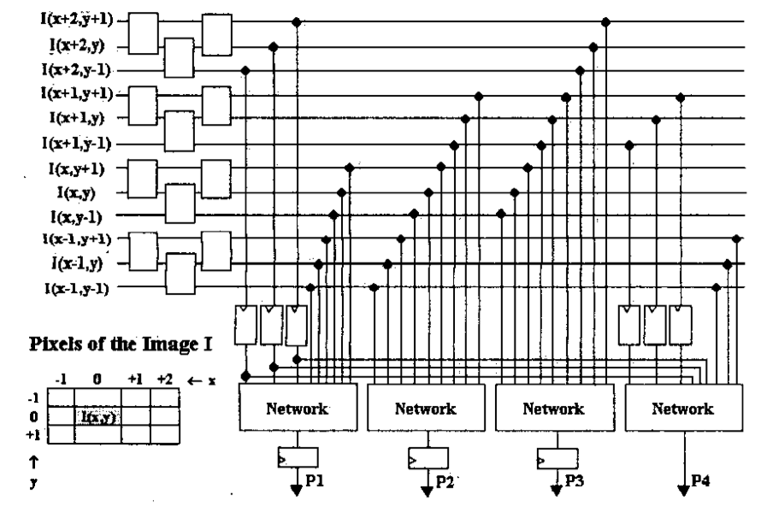
Library of Hardware Modules (cont.)
All hardware modules in VHDL models and schematics
Models designed, simulated, refined and synthesized using Xilinx tools
Modules optimized for performance using several techniques
Replication and pipelining
Optimization of multiplier by means of adder trees (convolution)
Reduction of sorting and selection network (median filer, gray scale morphological)
Search for high regularity
Re-utilization of common resources
Example
Median Filter
32 bit-words (4 8-bit pixels)
Replicated functional units
Re-use of common resources
Notes:
filer applied to four pixels neighborhood simultaneously
Computation of four pixels (P1, P2, P3, P4) performed in 2 stages (pipelined)
Results in 4x acceleration of operation
While stage 1 computes the pixels P1, P2 and P3 according to the three words read in the current clock cycle, stage 2 computes P4 and writes the resulting word associated with the three words read in the previous cycle.

Slide 18
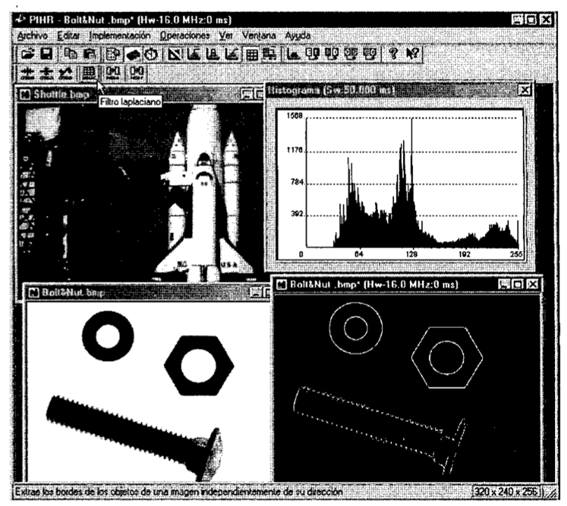
The PIHR Application
PIHR: Procesamineto de Imagenes mediante Hardware Reconfigurable
Designed to validate library of hardware
Written in Visual C++
Operates on PC based-systems with Windows
Consists of:
GUI application
HOT2-XL board
Hardware library of modules
HOT Run-Time Reconfiguration

Slide 19
How PIHR Works
Load, store, copy, paste and visualize bitmap
Select window with source image
Choose processing platform:
software (CPU) or hardware (HOT2-XL)
Result: execution time
hardware and software
For functional test, hardware and
software versions compared
Performance differences are also compared between both versions
To get measurements, dimension of image and number of colors reported
Number of pixels per millisecond is then obtained
Notes:
Can change clock frequency (360 KHz and 100 MHz of hardware version in order to evaluate offsets as a result of changes in clock frequency

Slide 20
Configuration Manager
PIHR uses Configuration Manager; allows configuration of hardware modules
Reduce configuration overload of frequently used modules
Onboard Configuration Cache maintains the list of hardware modules in the cache
When configuration cache is full, application replaced modules based on LRU policy
Potentially saves reconfiguration time of hardware modules that need to be programmed on the FPGA because the module will probably be in the cache

Slide 21
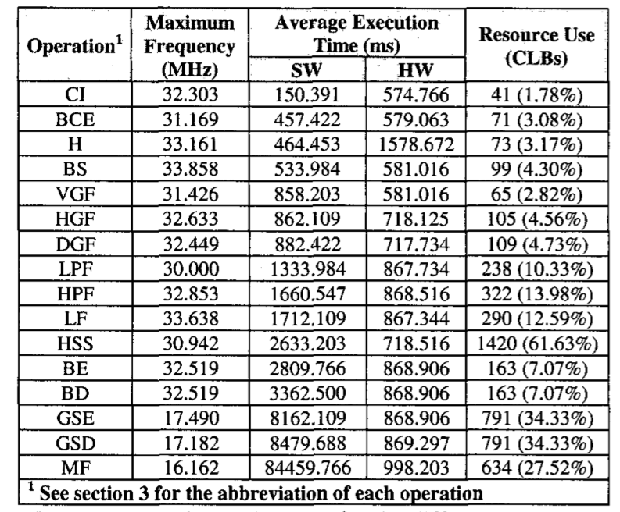
Results
Complement image (CI)
Binary contrast enhancement or Thresholding (BCE)
Histogram (H)
Brightness slicing (BS)
Vertical gradient filter (VGF)
Horizontal gradient filter (HGF)
Diagonal gradient filter (DGF)
Low-pass filter (LPF)
High-pass filter (HPF)
Laplacian filter (LF)
Histogram sliding and stretching or brightness contrast adjustment (HSS)
Binary erosion (BE)
Binary dilation (BD)
Gray-scale erosion (GSE)
Gray-scale dilation (GSD)
Median filter (MF)
Almost all hardware modules admit maximum clock freq of 33 MHz
Coincides with PCI bus speed/specification for a 32bit/33MHZ system
Notes:
The operations are sorted in less to more execution time for the software version, and therefore in order of less to more complexity Operations sorted in less to more execution time for the software version, and therefore in order of less to more complexity
Maximum Frequency and Resource Utilizations obtained from Xilinx Foundation Series tools are synthesis, and are actual measurements on implementations (not estimations)
Almost all the hardware modules admit a maximum clock freq of 33 MHz Therefore a bandwidth of 132 Mbytes/sec bandwidth
→ we can see that interface unit (PCI) is as important as the hardware itself. Usually the bottleneck

Slide 22
Kernel Performance
GSE and GSD
maximum freq decrease significantly almost by half
Algorithm includes sorting and selection
Circuits need great deal of logical resources to implement
Increased # CLBs utilization in FPGA
CI
Very simple operation - hardware implementation not advantageous (configuration time overload)
H
Implementation carries out total of 8 sequential R/W operations for each word
Multiple memory ops. occur sequentially
Not taking advantage of the inherent parallelism
30 images of 640x480x256 each
Reconfiguration time: 440 ms
Time to process 30 images
Hardware: 574 – 1578 ms
Software: 150 – 84459 ms
C++ compiler with optimization
Pentium 2 @ 350 MHZ
64 MB of RAM
Notes:
Incased circuits also result in great level of propagation delays (both logic and routing → increase min clock period, decrease max. clock freq

Slide 23
Conclusion
PCI-based image processing system reconfigured in runtime to adapt to requirements of an application
Reconfigurable hardware (HOT2-XL FPGA board) and library of hardware modules
Emphasis of hardware-software co-design, adding flexibility to the development process
Able to explore design trade-offs trade-offs
Demonstrated effectiveness of parallelization techniques: replication, pipelining
Achieve improved performance through efficient resource utilization
FPGA-based image processing applications show significant speedup compared to CPU software-based counterparts for complex algorithms

Slide 24
Gigapixel-size Real-time Interactive Image Processing with Parallel Computers

Slide 25
PiCEIS
What is it?
Parallel Computation Environment for Imaging Science
Image processing package designed for efficient execution on massively parallel computers
Effective use of aggregate resources of the computing system
Large and accurate production processing using existing of the shelf hardware
Goal:
Reduce difficulty in writing scalable parallel programs
Reduce time to add new functionalities
Provide real-time interactive image processing

Slide 26
Introduction
Large images are pervasive
High-resolution and multi-spectral cameras from satellites, nuclear magnetic resonance
Some Hi-Res image sources
IKONOS
Digital imagery
Space Digital imaging
SPOT
Possible to process large images quickly & effectively
Fundamental problems and requirements for improving processing of satellite images remain unchanged since the 60’s
Spatial & spectral resolution, radiometric resolution, network and memory bandwidth constraints and display output requirements

Slide 27
Technological ‘Driver’
More advanced satellites constantly put in place
Post-processing beyond workstations and small shared memory imperative
High performance serial processing becoming pervasive with software and low cost high-end devices (Pentium4, Athlon, Itanium-2)
Systems not sufficient enough to process large images
Specialized parallel hardware can handle large images
Unusable for multiple applications due to large hardware/software development cost
Cluster of off-the-shelf hardware maybe cost effective – development of software still lagging

Slide 28
Approach
Efficient and portable parallel programming methodology
Processes images using commercial distributed shared-memory massively parallel computers
IBM SP and Linux Cluster
Portable library allows for shared memory operations
In-core and out-of-core computations, visualizations, parallel I/O
Domain decomposition methodologies and software
Solve partial differential equations, computation chemistry, parallel rendering
Technique permits easy interface for processing tiles of images with user-specified routines as well as serial software: OpenCV, Python Image Library, Java toolkits
Processor-specific, optimized low-level libraries used
Vendor tools: Intel’s custom image processing lib; IBM’s ESSL lib

Slide 29
Main Features
Data rearrangement and movement concern
Can be time consuming to program; cause reliability concerns regarding message passing
Can be alleviated using Global Arrays shared memory model
Model has direct interface to ScaLAPACK, TOM and integral transformations (FFT)
Users can customize image-processing routine
No knowledge of data distribution, memory hierarchies or underlying programming model required
Load balancing easily adapted to different scenarios
Complexity of message passing moved to library level; handled by global arrays

Slide 30
Mechanism
Complicated indexing task moved to Global Arrays
Support for clusters of heterogeneous nodes, with different amounts of memory and processing power
Used efficiently by allocating different sizes of data to each node
No special algorithm or code required
Can perform dynamic load balancing by tracking computational time over key loops over a number of iterations

Slide 31
Global Arrays Tools
Provides much of the underlying support for the parallelism in PiCEIS
Memory Allocator:
Access to local memory
Global Arrays:
Provide portable globally addressable shared-memory programming on distributed shared-memory computer
Aggregate Remote Memory Copy Interface (ARMCI):
Provide general purpose, portable and efficient remote memory copy operations (one-sided communication) optimized for noncontiguous (strided, scatter/gather, I/O vector) data transfer
Parallel I/O (ParIO) and Disk Resident Array (DRA):
Extend the shared memory model to disk
Notes:
Global Arrays and ARMCI interoperate with
message passing interface (MPI) [16] for message passing
and can be considered an extension of MPI-2

Slide 32
Global Arrays
Global Arrays supports the shared-memory model
Allows nodes to share arrays between processes as if the memory is physically shared while providing separate mechanisms to access shared data

Slide 33
ARMCI
ARMCI (through Global Arrays) provides programmer with simple routines to access and manipulate data
Uses one-sided communication that allows for the overlap of computation and communication
Platform-specific; uses all available resources to achieve best performance

Slide 34
Design Implementation
Modular design
Three major components are driven by a script file read at runtime
Which analysis algorithm to be displayed
What device display will use
How data to be read and written to disk

Slide 35
Operation
Data access implementation abstracted
Stores data on disk
Data is accessed and analyzed using Global Arrays and serial analysis algorithms; each serial algorithm derived from ComputeFunction

Slide 36
Visualization and Display
Large distributed data makes gathering compute-intensive and time-consuming
Output mechanism couples parallel processing with parallel rendering
Each link
theoretically capable of bandwidth of 45 megapixels
IBM SP equipped with IBM Scalable Graphics Engine
High performance graphics frame buffer directly connected to GigE network comm. switch fabric by 4 links (16 is the max)
Notes:
24-bit color, full-motion, parallel image
output using the SGE has been benchmarked

Slide 37
Performance & Experimental Result
IBM SP2
Distributed shared-memory computer
26 Quad-core nodes
CPU is an IBM Power 3 processor @ 375 MHz
Each node has 3 GB of memory
input file is a Landsat 300 Mbyte image
HP Linux Cluster
128-node/256 Itanium-2 processors (McKinley processors).
1 Tflop peak theoretical performance
1.5 Tbytes of RAM
500 Mbyte Landsat image
Image converted to 8-byte floating-point
Two algorithms employed: Texture and Modified Radon Transform
Bump in timings due to a new, evolving system
Architecture by HP
Notes:
24-bit color, full-motion, parallel image
output using the SGE has been benchmarked

Slide 38
Conclusion
Global Arrays tools key contribution to scalability
Tools enable shared memory programming model with one-sided communication and async parallel I/O
An object-oriented framework
Provides developers with an easier framework to develop scalable software for massively parallel computers
Performance numbers indicate we are approaching goal of real-time image processing of very large image files
Goal to be ability to process large image files (greater than 75 megapixels) under 10 seconds
Future directions include analysis and viewing of 3-dimensional data

Slide 39
Q&A

Slide 40
Thank you

