Slide 1
Reconfigurable Computing
David Ojika

Slide 2
What to Expect
Part I: Background
Motivating research [10 mins]
Part II: Introduction
Current research [10 mins]
Part III: Guest Paper
Reconfigurable Computing [20 mins]
Fast and Flexible High-Level Synthesis from OpenCL using Reconfiguration Contexts
Reference I: Intermediate Fabrics: Virtual Architectures for Circuit Portability and Fast Placement and Routing
Reference II: Design and Implementation of a Heterogeneous High-Performance Computing Framework using Dynamic and Partial Reconfigurable FPGAs
Q&A [10 mins]
Notes:
This section: Reconfigurable Computing, encompasses all of these

Slide 3
Three people were under an umbrella but never got wet!
How did they do it?
Notes:
Quick brainteaser

Slide 4
It never rained! ;)

Slide 5
Reconfigurable Processing in Low-Power Programmable DSP
Part I: Background

Slide 6
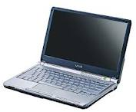
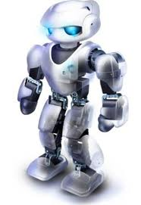
The People-Problem (Notional)
A computer named Robocomp
To be launched to the moon
Mission I: Acquire lunar samples:
acoustics – analog signal
oxygen and hydrological
soil samples, etc
Mission II: Process data on-the-fly
Robocomp
ACS
Robocomp
Robocomp-X
ACS: Adaptive Computing System

Slide 7
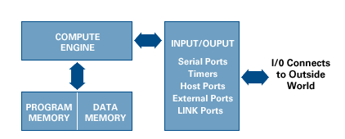
Digital Signal Processing
Analog
Conversion
Digital
Acoustics Subsystem
- Multi-standard codec: MP3, AAC, WAV
- Fast sampling
Real-time playback
Low-Power!!!
Notes:
Entire system could represent image or video processing. Signal processing encompasses both.

Slide 8
10 Minute Outline
Solutions to Low-Power Processing
Granularity of Programming Model
Granularity Models
Power Reduction Techniques
Multi-Granularity Architecture
Multi-Granularity and Energy-Flexibility Gap
Multi-Granularity Architecture Template
Experimental Examples
Conclusion & Future Work
Mission Success?

Slide 9
Solutions to Low-Power Processing
Previous Approaches
General Purpose (GP) processors with extend instruction set
GP – Co-Processor structures
Application Specific processors (ASIC)
Processors with power-scalable performance
A Reconfigurable Architecture Solution
Dynamic reconfiguration of hardware modules
Match reconfiguration level (or architecture) with task
A good matching ensures that only necessary computation fabrics are enabled and using up power
How to define a good model for matching??

Slide 10
Granularity of Programming Model
Programming model:
Level of system reconfiguration chosen in accordance with the model of computation of the target task
Granularity:
Digital composition of the building blocks of a computation – electrically and structurally
Energy
Utilization
Computational
Complexity
task
Granularity

Slide 11
Granularity of Models
Stored-program
Dataflow
Datapath
Gate-level
I. Stored-program model
(Zero level reconfiguration)
Logic (gate) level
(Highest level of reconfiguration)
Notes:
Two extremes

Slide 12
Granularity of Models (cont.)
II. Dataflow model
III. Datapath model
Notes:
Middle two

Slide 13
Power Reduction Techniques
Operate at low voltage and frequency
Power = Voltage^2 x Capacitive load x clock
Reduce energy waste on modules and interconnect
Application-specific module
Preserve locality in task algorithm
Use energy on demand
Static configuration – avoid extensive multiplexing

Slide 14
Multi-Granularity Architecture
Energy
Utilization
Computational
Complexity
Programmable
domain
task
ASIC FPGA CPLD Traditional
Processor
Granularity
How to:
Maintain programmability
Make task more application-specific
Big, big challenge!

Slide 15
Multi-Granularity & Energy-Flexibility Gap

Slide 16
Multi-Granularity Architecture Template
Components
Satellites:
Reconfigurable processing elements
GP Processor:
(general processor core)
Communication Network
Reconfigurable Bus

Slide 17
Experimental Example
Acoustics Subsystem
- Multi-standard codec: MP3, AAC, WAV
- Fast sampling
Real-time playback
Low-Power
PL-DSP
Traditional DSP
Notes:
We employ one of the previously described power-saving model

Slide 18
Experimental Results
Energy versus concurrency
Voice-Coder Processor: 1.5V, 0.6mm CMOS technology
175 pJoule per MAC operation
At max clock rate 30MHZ → 5.7 GOPS/Watt
Operation: Full-dot vector operation
Total predicted power between 2 and 5mW

Slide 19
Experimental Example II
CDMA Baseband Processor
High performance Correlator
Impossible to construct processor from functional modules
Diminishing return, Amdahl's law
Correlator Solution:
Use of set of accumulators
Removes need for multipliers
Proposed by: Nazila Salimi -
“CDMA Correlator Implementation in FPGA”
From Dr. Yutao He’s Note. Lecture Note 2

Slide 20
Conclusion
Making an application configurable usually carries with it, large energy overhead
To minimize energy, applications must use the right model of computation for only the time period required.
Balance must be set for maintaining an optimal performance level against power dissipation
More research needs to be done in keeping energy dissipation low without sacrificing performance
→ FPGA design automation research needs a new paradigm!

Slide 21
OpenCL Benchmarking of Image Processing Applications on FPGA
Part II: Research

Slide 22
Introduction
Modern HPC devices powerful but quite challenging for app designers
Combination of disparate hardware and software programming models
Portability of computation kernels often a challenge, coupled with need to maintain designers productivity
Image processing applications largely compute-intensive
Naturally lend themselves to parallel computation due to their inherent data-parallel nature
Produce vital results that are used to extract information and valuable for decision making
OpenCL framework enables architecture-independent programming while improving portability, performance and productivity
Studies have shown trade-offs depending on application and architecture
This study will comprise of a comparison and analysis of performance for several image processing dwarfs
Study two main architectures: reconfigurable-logic device and fixed-logic device
Implementations in both OpenCL and native device language (Verilog/VHDL and C/C++) will be compared based on real-time performance and power trade-offs
Notes:
Increased interest from industry and CHREC members
Lots of ongoing research by vendors and in academia: Xilinx, Altera; Virginia Tech’s OpenCL & the 13 Dwarfs

Slide 23
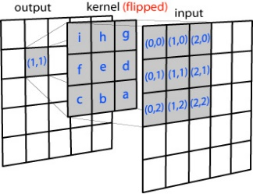
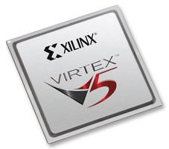
Approach
Kernel investigation
Research image processing kernels and algorithm
Determine amenability to OpenCL-based parallelization
Architecture study
Altera Stratix-5 FPGA
Study new device architecture
Intel Xeon Phi Many-Core CPU
Leverage previous experience from architectural capabilities of device
Kernel portability
Map kernels to hardware
Apply architecture-dependent optimizations
Gather insights from kernel-architecture optimizations
OpenCL kernel benchmarking
Functional portability
Performance compared to architecture’s native implementation
Performance portability
Performance across different hardware architectures
Notes:
Functional Portability: To what extent is OpenCL a suitable substitute for current programming standards. (by comparing with C/C++ and Verilog/VHDL).
Performance Portability: To what degree is OpenCL suitable as a single standard targeting multiple platforms. (by mapping to other architectures: Intel Xeon Phi).
Opencl Idea: Use all the available computing resources on device to make kernel run really fast

Slide 24
Research Outline
Kernel Exploration
Research image processing kernels and algorithm that are highly amenable to parallelization
Kernel Layer
Kernel
C++ Implementation
Serial Implementation
Leverage existing kernels and recast, or build from scratch
Test and validate
Implementation
Layer
OpenCL Implementation
Convert code to OpenCL
Leverage OpenCL kernels: Vendors, Open-source (OpenDwarfs, et. al)
OpenCL Implementation
Device Layer
Reconfigurable-Logic Device
Fixed-Logic Device
Device Porting
Kernel mapping
Device-specific optimizations
Insights and Conclusion
Experience accumulated from all levels
Performance and productivity evaluation; others, e.g. power
Benchmarking

Slide 25
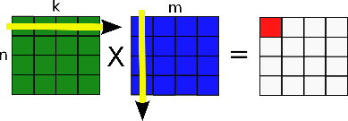
System Architecture
Heterogeneous Architecture
Compute-intensive tasks can be offloaded to accelerators
Disparate FPGA and Many-Core architecture
Will leverage RC Middleware
Possibly, RDMA for Many-Core
2 divergent architectures
Reconfigurable-Logic: Stratix 5
Fixed-Logic: Xeon Phi
Currently not truly heterogeneous – kernels not running concurrently
Mix and match kernel/architecture can be complex
All possibilities of cross-product of performance metrics with bandwidth required
{Glops/s, … } x {L2, DRAM, PCIe, Network } → Requires comprehensive benchmarking

Slide 26
Application Case Study
Edge Detection
Set of mathematical operations that collectively aim to determine points in a digital image
Vital algorithm in image processing and machine vision
Feature detection & tracking
Algorithm
Sobel Filter
Commonly used algorithm for edge detection apps
Others: Canny, Kayyali
Fig. 1: Application Structure
Benchmarking
OpenCL-based kernel benchmarks
Spatial domain: 2-D Convolution
Frequency domain: 2-D FFT
Fig. 2: Design Strategy
Dependency
Notes:
Algorithm:
The Sobel filter inherently exhibits parallelism that allows programmers to exploit ways of parallelizing the algorithm on different architectures.
It was the benchmark of choice for Rita Cucchiara and Massimo Piccardi in their evaluation of image processing on SIMD parallel machines [2]
Benchmarking:
will study, parallelize, map and where necessary, optimize

Slide 27
Evaluation Method
Human perception
SNR
Functional portability
Performance portability
Improvement over native lang.
Roofline Model or others
FPGA resource utilization
Realizable Utilization
Real-time performance metric
Power metric
Notes:
High-Level Combined Architecture-Application Evaluation Method. Architectural issues and application behavior exhibit a two-way interaction, with only a thin line of separation.
Functional Portability: To what extent is OpenCL a suitable substitute for current programming standards. (by comparing with C/C++ and Verilog/VHDL).
Performance Portability: To what degree is OpenCL suitable as a single standard targeting multiple platforms. (by mapping to other architectures: Intel Xeon Phi).
*Final real-time performance metric measured in frames/sec

Slide 28
Current Milestones
Verification and Validation
Two MATLAB-based models for validation of data from edge detection app
Model A: Spatial Domain
Sliding Window/direct pixel manipulation via convolution
Model B: Frequency Domain
Based on FFT, Dot-Product Multiply and Inverse FFT operations
Source
After edge detection
After normalization
1bit monochrome
Serial 2-D FFT C++ implementation
Based on Cooley-Tukey algorithm: O(nlogn) (Radix 2, for N = 2^{k})
More general purpose and gives better scheduling [1]
Implementation provided insights on algorithm and understanding of its parallelization technique
Served as foundation for subsequent OpenCL-based implementation
Why its so important:
Employed in a large body of image, signal and video processing
More investigation attached to appendix (appendixA.pdf)
2-D FFT OpenCL
Initial run for single-precision 1024x1024 complex numbers
Offline compilation of kernel for Altera FPGA
Takes a very large amount of time as with traditional compilation methods
Runtime API programming
However, Online programming of FPGA with kernel binary fairly seamless
Estimated resource utilization from tool
[1] Cooley-Tukey FFT on the Connection Machine (1991)
Notes:
Other FFT alorithms:
Stockham (Radix 2 , for N = 2^{k})
Sande-Tookey (Radix 2 , Decimation in Frequency, for N = 2^{k})
Bluesteins (Radix 2 , for any N) Stratix 5: 2D FFT (1024x1024 SP Complex)
Processing time = 5.2304ms
Throughput = 0.2005 Gpoints / sec (20.0476 Gflops)

Slide 29
Future Work I
Notes:
On the one side, kernel exploration and algorithm study completed Edge detection and SAD to be orchestrated in pipelined fashion (for either MPSD or MPMD) after insights from device-kernel benchmarking.
SAD: sum of absolute differences provides a simple way to automate searching for objects inside an image.
Unreliable due to the effects of contextual factors such as changes in lighting, color, viewing direction, size, or shape.
May be used in conjunction with other object recognition methods, such as edge detection, to improve the reliability of results.

Slide 30
Future Work II
Notes:
On the one side, kernel exploration and algorithm study completed Edge detection and SAD to be orchestrated in pipelined fashion (for either MPSD or MPMD) after insights from device-kernel benchmarking
Internship phone call from Intel about potentials of implementing iWarp within-the-rack.

Slide 31
Fast & flexible high-level synthesis from opencl using reconfiguration contexts
Part III: Guest Paper

Slide 32
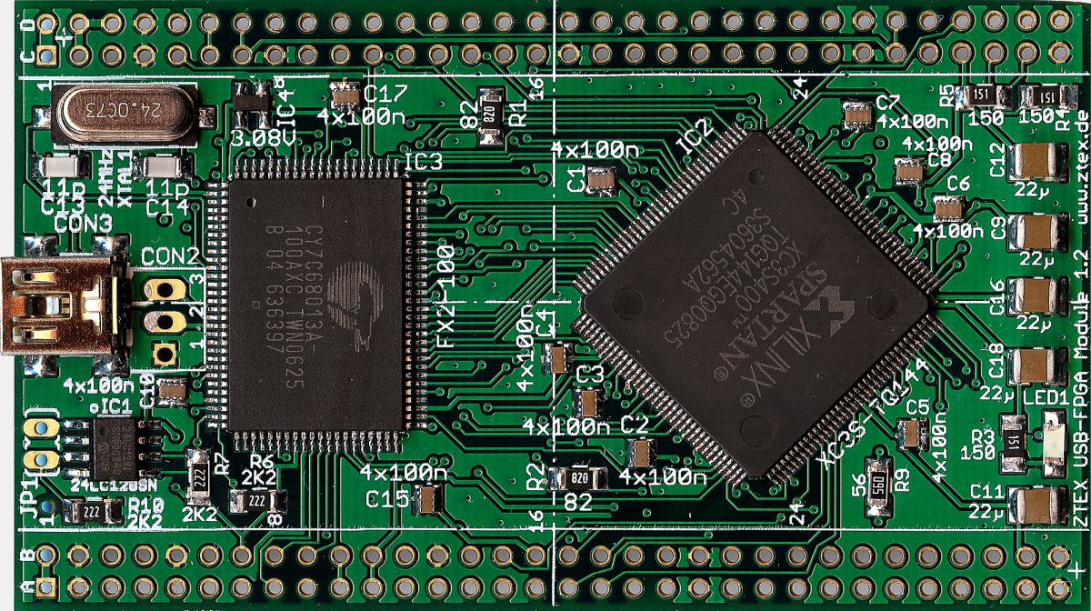
What is RC?
We all know the gist!
Notes:
Guess everyone here know what RC is.
- Architecture, benefits, etc

Slide 33
RC is Challenging
Reconfigurable computing promising but design tools pose challenge to designers
Huge compilation time: synthesis →P&R → mapping
Design iteration difficult and productivity limited
Runtime compilation difficult; contributes to niche FPGA usage
OpenCL enables high-level synthesis of FPGA
Vendors adopting standard to alleviate steep learning curve associated with native language (VHDL/Verilog)
Can be likened to Assembly vs C → only a small penalty in performance
Altera, Xilinx. But other vendors with proprietary HLS: Xilinx, Convey
Presents significant potential:
Portability
Productivity
Performance

Slide 34
OpenCL-Based Approach
On CPU and GPU, “online” compilation possible
When kernel changes, host simply loads a different kernel on accelerator: in ms
“OpenCL mainly used to program accelerators“
However, the case is different for FPGAs
Kernel has to be re-compiled every time system changes
Takes a huge amount of time: 8 hours to days
Not a good idea for dynamic hardware, or even for a fixed instance of hardware!
“Online” compilation not typically done
Kernel pre-compiled “offline” into binaries and loaded as needed
Notes:
this illustration is important to understand the following

Slide 35
Limitations of OpenCL Approach
Current HLS approach conflict with mainstream OpenCL
Orders of magnitude FPGA compilation time
Limited support for changing/adding kernels after compilation
Can PR in some way? → reconfiguration contexts
Reconfiguration Contexts
Key features
Coarse-grain units instead of finer-grained LUTS
Backend synthesis
Thus, allowing use of (virtually) any OpenCL tool on the frontend
Advantages
Compile kernel faster
Change kernel online

Slide 36
Backend Synthesis
Intermediate Fabrics (IF) – Leverages Dr. Stitt’s previous work
See video online ☺
Summary
1000X faster place & route compared to device vendors' tool
21% increased FPGA resource utilization (drive logic)
Uses coarse-grained resources implemented atop FPGA
Avoids decomposing of circuits into finer grain LUTS
Maps circuit unto app-specialized resources (FP, FFT)
Specializes IF for OpenCL
Compliments existing OpenCL synthesis approach
Enable fast compilation: compiling any kernel
Enable fast reconfiguration: adding and changing kernels
Automatically determines effective fabric architecture for given application (previous IF were manually designed)
Notes:
…and FOR a given a given application, it automatically determines the efective fabric architecure

Slide 37
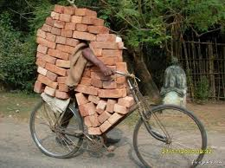
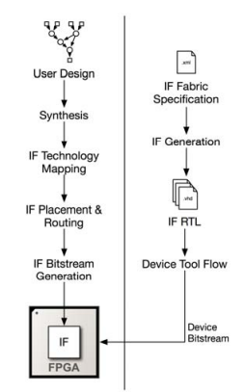
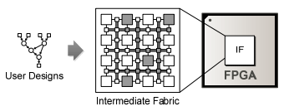
Intermediate Fabric Optimality
Impossible to create optimal fabric for all combinations of kernels
Context-design heuristics finds optimal IF
Intermediate Fabric
1. Analyzes kernel requirements from application or domain
2. Cluster kernels based on similarity into set of fabrics called reconfiguration contexts

Slide 38
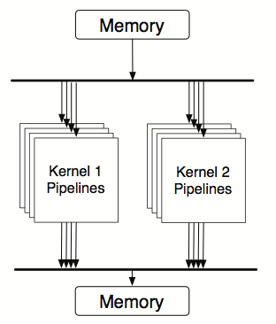
Reconfiguration Context (w/o IF)
Kernel-Specific accelerators (existing approach)
Provides no support for kernels not known at system generation
Limitation of existing OpenCL synthesis
Example: context tasked with supporting three kernels
Implements three kernel-specific accelerators
Although, possibly more efficient than IF (as seen in pipelined archi.)
Limited scalability due to lack of resource sharing across kernels

Slide 39
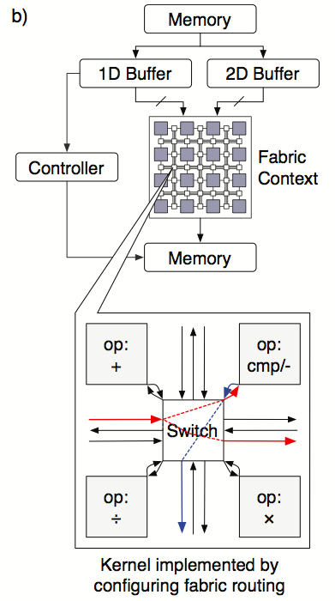
Reconfiguration Context (with IF)
IF-Based Context
Only common computational resources fixed during system generation
Fixed resources: FFT, Mult, Accum, Sqrt
Reconfigurable interconnection
Provide flexibility to support kernels similar to one for which context was originally designed
Important for iterative design development
Versatile for changing system system requirements and workloads

Slide 40
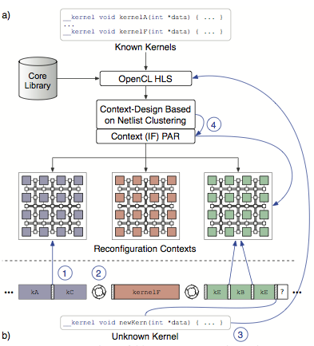
Reconfiguration Context in Operation
OpenCL Front-end
Read source kernels
Synthesize kernel into netlists (coarse-grained cores & controls)
IF Backend
Read generated netlist
Apply context-based heuristics (based on netlist clustering)
Group netlist into sets of similar of resource requirements
Design IF-based context for each set → reconfiguration context
FPGA Front-End
Place and Routing
Reconfiguration Context compiled into bitstreams using device-vendor tools

Slide 41
Reconfiguration Context in Operation
Dynamic Operation
While a context is loaded to FPGA
Rapidly configure context to support different member kernels (kA, kB)
Required kernel not in context:
reconfigure FPGA with new context
A new kernel added to system:
Front-end tool: synthesize kernel
Backend: Cluster kernel into existing an context
Performs context PAR to create bitfile for kernel
Notes:
----- Meeting Notes (3/11/14 13:20) -----
Whilel context is loaded to FPGA… the IF rapid configures context to support different kernels.

Slide 42
Context-Design Heuristics
Designing appropriate contexts most critical part of tool flow
Main challenges of context-based design are:
How many contexts to be created to support all the known kernels
What functionality/resources to include in the context: DSP, FFT, etc.
How to assign kernels to contexts
Clearly an optimization problem!
Maximize reuse of resources across kernels in a context
Minimizing area of individual context
A well designed context seeks to:
Minimize individual context area by minimizing number of resources reused across kernels in a context
Helps design fit under area constraints
Useful for scaling each context to increase flexibility and support similar kernels other than those known at compile time

Slide 43
Heuristics Mechanism
Groups of kernels often exhibit similarity in their mixture of operation
Example as seen in application-specialized processors in many domains
While computational resources are fixed, interconnection remains flexible
Key enabler for IF-based context
Heuristic considers functional similarity over any structural similarity
Exploit of structural similarity between kernel (e.g to reduce interconnection area) an alternative clustering method
Functional grouping still useful when cost of functional resources expected to be high than cost of interconnect
Notes:
Heuristics can be quite complex

Slide 44
Heuristics Mechanism
Ignores functional timing differences
Assumes that differences are minimized through pipelining [2]
Timing can be considered during grouping when timing pipelining isn't sufficient
Using additional fmax dimension in a clustering heuristics
Contexts that minimally support one member of a group should support other members of the group
Although each member might require different number of resources, or addition of other resources
Identifying these groups is vital for designing contexts that are compatible with kernels similar to the kernels inside each group

Slide 45
Heuristics Mechanism (IF)
Features identified using clustering heuristics in an n-dimensional feature space
Feature space defined by functional compositions of system’s kernel netlist
Example: given an application containing 2kernels – FIR and SAD
Clustering would operate on SAD = <0.3, 0.0, 0.7> and FIR = <0.5, 0.5, 0.0> in the space <f_add, f_mul, f_cmp/sub>
K-means clustering used to group netlists in space
Results to up to K sets of netlists for which individual contexts will be designed
Heuristic can use resources requirement of core to estimate area required by each cluster
K to be selected subject to user or system-imposed area constrains
User may set select value for k so satisfy systems goals for flexibility

Slide 46
OpenCL-IF Compiler
A custom tool based on Low-Level Virtual Machine (LLVM) and C frontend
First compiles kernel into LLVM’s intermediate representation
Substitutes custom intrinsics for system system functions (e.g get_global_id)
Uses LLVM’s standard optimization parses
Inlining auxiliary functions
Loop unrolling
Some common hardware-specific optimizations
Creates a control data flow graph (CDFG)
Simultaneously maps LLVM instructions to compatible cores (specified in user-specified library)
Cores may be added to library to enable limited application- and target-specific optimizations

Slide 47
OpenCL-IF Compiler
DFGs independently scheduled and bound to final resources provided by the context using other approaches [2]
Resulting kernel netlist implemented on context through place & route
Yields a context context bitsream for each kernel
At runtime, kernel executed after configuring its context with corresponding bitstream
Execution mutually exclusive per context
A unique feature of OpenCL-IF is support for efficient data streaming from external memories
Previous approaches implement kernel accelerators that comprise multiple pipelines competing for global memory through bus arbitration
However some study addressed this memory bottleneck by using specialized buffers
Notes:
Previous approaches implement kernel accelerators that comprise multiple pipelines competing for global memory through bus arbitration

Slide 48
Experimental Setup
Evaluation of context-design heuristics
Setup provides minimal guidance by using only framework’s known kernels
Single framework for computer vision applications
Multiple image-processing kernels executing in different combinations at different times
Representative of stages in larger processing pipelines
Evaluation Metrics
Compilation time
Area
Clock frequency
FIR
Gaussian
Sobel
Bilinear
Threshold
Mean
Max
Min
Normalize
SAD
10 OpenCL kernels
Fixed-point and single-precision floating-points

Slide 49
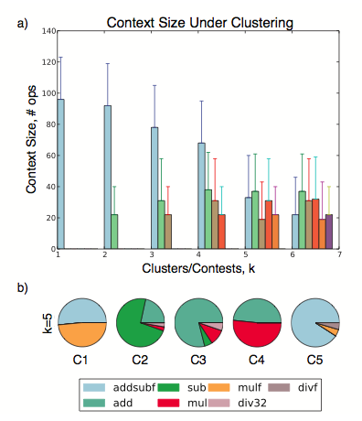
Results
Using 5 clusters provides significant 60% decrease in cluster size
Flexibility in allowing implementation of different kernels under area constraints (by implementing context minimally)
Cluster size can increase (up to fabric capacity, or area constraint) if further flexibility is desired
Provides better matching for underlying kernels
Different k values introduce trade-offs
Can be beneficial in order applications depending on designer intent

Slide 50
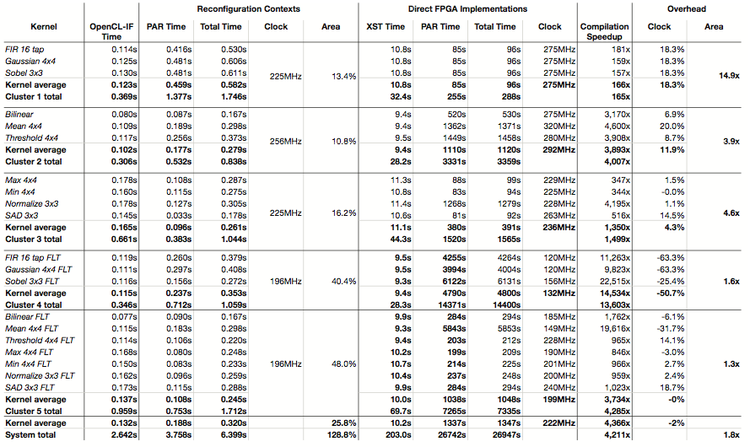
Comparison of compilation time, area, and clock frequency for OpenCL-IF reconfiguration contexts and direct FPGA implementations for a computer-vision application with k=5. Floating-point kernels are shown with an FLT suffix

Slide 51
More Results
After context generation, reconfiguration context enabled compilation of entire system of kernels in 6.3s
4211x faster than 7.5 hours required via ISE direct compilation to FPGA
Floating point kernels experience greater compilation speedup (6970x vs 1760x)
More fine grained resources hidden by their context
Each kernel compiled at an average of 0.32 seconds
Provides an estimate of the compilation time a new, context-compatible kernel
Clock overhead negligible on average
Additional pipelining in fabric’s interconnect benefit some circuits
System require 1.8X additional area compared to implementing kernel directly
Not necessarily an overhead due to significant added flexibility

Slide 52
Configuration Time and Bitstream size
Context can be reconfigured with new kernel in 29.4 us
On average, 144x faster than FPGA reconfiguration
Enables efficient time-multiplexing of multiple kernels

Slide 53
Conclusions
Introduced a backend approach to complement existing OpenCL synthesis using coarse-grained reconfiguration contexts
Enabled 4211x faster FPGA configuration compared to device-vendor tools
Cost overhead of 1.8x area overhead
Reconfiguration context context can be reconfigured in less than 29us to support multiple kernels
While using slower FPGA reconfiguration context to load new contexts to support significantly different kernels
Clustering heuristics introduced to create effective contexts that group kernels into functional similarity
Leverage previous work on intermediate Fabrics (IF) that supports requirements of each group

Slide 54
Future Work
Evaluating other architectures for reconfiguration contexts
Including more specialized (and less flexible) interconnects
Strategies for managing multiple context through partial reconfiguration and optimization enabled through runtime kernel synthesis

Slide 55
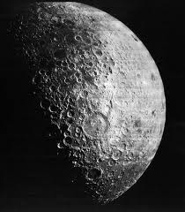
Questions?
Xie-Xie, Gracias, Namaste, Dalu, Thank you …
RoboComp-X
M i s s i o n A c c o m p l i s h e d ?!

