Slide 1

Partial Reconfiguration
Not just a half baked job of reconfiguring
Dr. Ann Gordon-Ross
Associate Professor of ECE
University of Florida
Rohit Kumar
Research Student
University of Florida

Slide 2
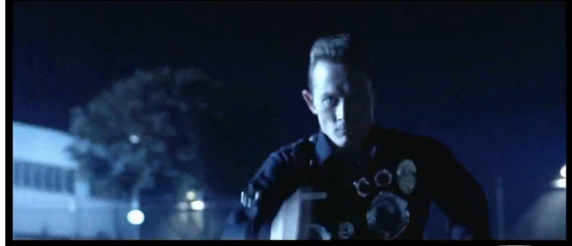
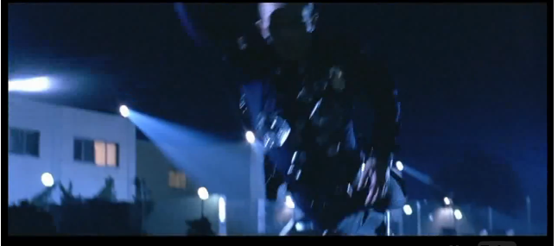
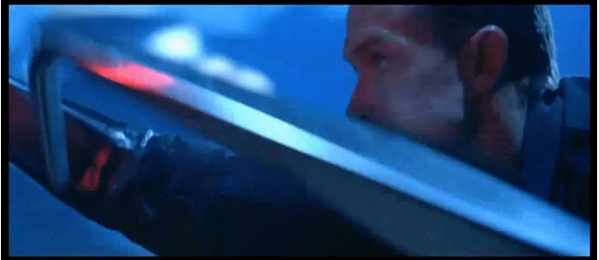
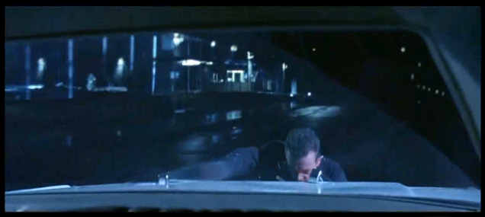
Partial Reconfiguration is All Around Us
Changing situations…
…require part of the system to reconfigure on the fly

Slide 3



Partial Reconfiguration is All Around Us
But, FPGA reconfiguration
is disruptive
  Resets the device
  Lose all data
  Causes downtime
Downtime is dangerous

Slide 4


Full Reconfiguration:
This is your
FPGA on PR
This is your FPGA
Static
Task 1
Task 2
Task 2
Task 1

Slide 5

Why Partial Reconfiguration?
So what??
I’ll just put both tasks on
the same device!
Sure, why not?
But, devices have limited space!
Not impressed
Reason #1
Sharing many tasks on a single region saves area!
FPGA
Task 1
Task 2
Task 3
Task 4
Task 5
Task 6

Slide 6

Why Partial Reconfiguration?
I got it! I’ll just use PR on a
tiny cheap FPGA and time-
multiplex everything!
Okay, we’ll give you
that one
But, it’s a trade off
  The more parallelism, the better the performance
  Plus, some tasks must be run in parallel
Reason #2
Using less area on a smaller device is less costly!

Slide 7
Why Partial Reconfiguration?
So that’s it??
I pay a bunch more just to
use less area?
Well, you know you could save power?
  Imagine you have two versions of a task
    High-performance version
    Low power version
  When performance is critical
    Load the high-performance version
  When performance is less critical
    Load the low-power one
Man, what a buzz-kill
Reason #3
Replace tasks with low-power versions when possible!
FPGA

Slide 8
Why Partial Reconfiguration?
So what??
I’ll just use clock gating (CG)
and dynamic frequency
scaling (DFS), both of which
are available for Xilinx FPGAs
Right… well… you see… actually….
Hmm…
Shut up

Slide 9

Why Partial Reconfiguration?
Okay, but I’m not sold
unless there are 4 reasons.
Did you know PR keeps your
device safe in space?
  In space, cosmic radiation corrupts SRAM!
  These are called single event upsets (SEU)s
With PR, you can patch FPGA configuration memory
  Without turning off the device
  This is called “scrubbing”
FPGA
10111011
FPGA
01101100
Reason #4
PR keeps circuits safe in harsh environments
But FPGA configuration memory uses SRAM!

Slide 10


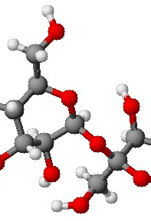

So you wanna make a PR design…
First, we make partitions
  Partitions are like black boxes
    They start out empty
    Then we load modules
  Modules run tasks
  To change tasks
    Load a new module
    Old one is overwritten
The FPGA (not to scale)
Partition 2
f
Partition 1
a
f
a
b

Slide 11

So you wanna make a PR design…
Modules have to fit like puzzle pieces
  Black boxes have a defined interface
  All modules must fit that interface
Where the ports are matters as well
  Ports must be in the same place for every module
  “Partition pins” are port location definitions
  They ensure connections are not broken during PR
The FPGA (not to scale)
Partition 2
f
Partition 1
a
f
a
b

Slide 12

So you wanna make a PR design…
Quit sugar-coating it, sirs, I
am not a child you know.
Oh, fine. This is what you’re
going to learn today:
  Logically partitioning your application into modules
  Preparing your partitioned design in ISE
  Floor-planning the layout of your device in PlanAhead
  Implementing your design in PlanAhead
  Finding your inner child through meditation (time permitting)

Slide 13

Step 1: Logical partitioning
The first step to make a PR design is breaking the application into sets of mutually exclusive components
Easy there buddy
Two components are mutually exclusive if
  Only one is used at a time
  One’s inputs don’t directly depend on the other’s outputs
Only mutually exclusive components share a partition
  So, before you can make your design…
  You must find as many of these as you can

Slide 14



Step 1: Logical partitioning
He’s still not reassured
Okay, lets do an example
This is an up/down counter
The add and the subtract
  …are mutually exclusive
  Only one is used
  They do not depend on each other
The store and the add
  …are not mutually exclusive
  The store depends on the add’s output
The add and subtract can share a partition
  The add forms one reconfigurable module
  The subtract forms another reconfigurable module
Direction = up
Result = 0
Direction = up
Result = 0
PR!
up
Direction?
down
Result ++
count
Result ++
Result --
Result ++
Store Result
Get Direction
Store Result
Get Direction

Slide 15


Now some cool stuff that our group has been doing in CHREC

Slide 16
F4-13: Partially Reconfigurable System Development and Management
Dr. Ann Gordon-Ross
Associate Professor of ECE
University of Florida
Rohit Kumar
Elizabeth Graham
Aurelio Morales
Shaon Yousuf
Zack Smaridge
Research Students
University of Florida
Number of supporting memberships: 1.5

Slide 17
F4-13: Goals, Motivations, and Challenges
Goal
Increase reconfigurable computing (RC) system designer productivity
    Optimize area, power, and performance
    Reduce design time effort
Motivations
Partial reconfiguration (PR) enables area and power savings
    PR isolates reconfiguration to portions of FPGA
    Enables resource time-sharing
  Distributed computing provides increased system computation capability
    Leverage network of PR-capable FPGAs
    Leverage distributed resource management services
  Early design space pruning
  reduces design time
  Design automation enables
  rapid system implementation
    Source code’s PR analysis aids
    design parameter selection
    Scripts and tools reduce
    manual design flow steps
Challenges
    PR requires application- and device-specific, low-level knowledge
    Efficient design space exploration (DSE) for PR-centric system design
    Maintaining application data integrity
    across PR-centric distributed RC systems
    Identifying automatable
    design flow steps

Slide 18


F4-13: Approach
Task A
Task C
Identifies resource- and performance-optimized PR architectures
Enables distributed processing and management across VAPRES nodes
One-click
PR Design Space
Exploration
Node-Level
Distributed
Resource
Management
Leverage PRML to generate PR applications from source code
Leverage high-level synthesis
tools to generate VHDL code
Leverage intermediate fabrics¹
and DAPR+² for fast DSE
Adapt system-wide version of DDRM for server/client
Leverage dynamic hardware task management tools
Design and test
DDRM application
PR-centric
RC System Development
Automated
Design
Implementation
Dynamic
Hardware
Task
Management
Design automation tool
suite (DAPR++) to aid
PR system design
Generates distributed RC
system for increased computational capacity
Expand context save and restore (CSR) and hardware task relocation (HTR) features
Optimize CSR and HTR to maximize task throughput
and resource utilization
Alleviates tool flow overhead and reduces implementation effort
Enables load balancing across local
and remote VAPRES nodes
Task B
¹ Developed by F2-10
² Developed by F4-11
DSE – Design Space Exploration
DAPR+ – Design Automation for PR FPGAs
DDRM – Distributed Dynamic Resource Manger
PRML – PR Modeling Language

Slide 19
Task A: PR Design Space Exploration Framework
Streamlined framework for rapid application partitioning,
PR design space exploration, and implementation
Automatically generates PR application from non-PR high-level source code
Explores PR design space to find area/power/ performance optimized PR application
Alleviates
complexities in PR design implementation via automated
tool flows
Automatically generates PR application from non-PR high-level source code
Framework components
Partitioning
Automatic modeling and PR partitioning of application’s C source code via PRML¹
Implementation
Automation and integration of vendor’s and various third-party tools
PR design space exploration
Low-level automated floorplaning and partitioned application’s area/ power/performance evaluation
¹ Published in FCCM’13

Slide 20
Task B: PR System Design Automation with DAPR++ Tool Suite
  DAPR++ tool suite aids designing RC systems using automation
Slave FPGA 1
Slave FPGA 2
DAPR++ Tool Suite
PR Architecture Generator
Network Generator
PR Task Manager
Throughput Profiler
Bitstream Manager
PRR
Floorplanner
Creates master and slave FPGA component layout tree
Creates FPGA VHDL black boxes for all components
Master FPGA
CAW13
GPP
PRRs
PRRs
Switch
Automatically generates target device resource mapping
Heuristically floorplans PRRs and partition pins
Creates network protocols for master and slave FPGAs
CAW13
CMW12
Creates PR task reconfiguration schedules to reduce reconfiguration time
CAW13
Modifies bitstreams and enables task context save (CS) and context restore (CR)
Records data packet transfer rates between master and slave FPGAs
Notes:
Click 1 (start of slide):
We know PR design is a complex to design process, so in order to alleviate this complicated design process, we introduce the DAPR++ tool suite.
Click 2:
The DAPR++ tool suite alleviates PR design by automation. DAPR++ tool suite aids PR system generation for an application using 6 useful tools:
Click 3:
A PR architecture generator that helps generate a PR architecture template and VHDL blackboxes for the PR application.
Click 4:
A PRR floorplanner that automatically generates the target architecture resource map and heuristically floorplans the application's PRRs.
Click 5:
A manager API that helps modify and manage bitstreams using context save and context restore hardware management tools
Click 6:
A network generator that generates data transfer protocols an Ethernet interfaces for the Architecture
Click 7:
A PR task manager creates task schedules that prioritize reducing reconfiguration delay in order to speedup overall application execution
Click 8:
A throughput profiler that records the application's throughput and reports this throughput data to PRML for architectural improvements.
Click 9:
For CMW 13, we developed the PR task manager tool and also enhanced the PRR floorplanner.

Slide 21
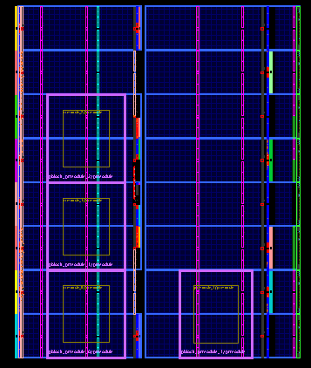

Task C.1: Node-level DDRM
Node-level DDRM facilitates VAPRES network management
  Automatically manages task relocation
    Minimizes system delays caused by task relocation latency
  Uses custom node communication procedures
    Maintains global node execution status
  Task relocation circumvents node-level restrictions
    Individual nodes have limited resources and power
    Network nodes to leverage shared resource pool
  Example applications: sensor networks, target tracking
Node-level DDRM controls nodes’ task distribution
  Node is a client for local tasks, server for remote tasks
  Client determines new node and PRR for task execution
    Algorithm developed in system-level test version of DDRM
  Clients communicate with servers to locate new PRR and transfer PRM
    Created automated communication functions to coordinate inter-node transfer of bitstreams, context, test results, and node status
DDRM
DDRM
DDRM
DDRM
DDRM
DDRM
DDRM – Distributed Dynamic Resource Manager
PRR – Partially Reconfigurable Region
PRM – Partially Reconfigurable Module

Slide 22
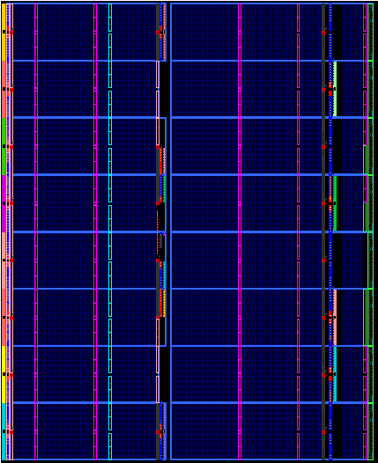

Task C.2: Hardware Task Management Tools
On-chip CSR
On-chip HTR
Distributed processing and load balancing tools for networked VAPRES nodes
  Portable across different FPGA architectures
  On-chip context save and restore (CSR) and hardware task relocation (HTR) software
    PRM execution state retained on PRM preemption
    Enhances task switching in PR-capable FPGAs
    Suitable for autonomous, multitasking PR systems
VAPRES node
VAPRES node
M1
PRR1
merged
M1
PRR2
M1
PRR2
M1
PRR1
M2
PRR1
M2
PRR1
PRR
1
PRR
1
PRR
2
M3
PRR2
New CSR and HTR features
  Supports DSPs/BRAMs/LUTRAMs and multiple PRR rows/columns
  Reduced execution times
Experimental results on XUPV5 board
  Linear growth rate in CSR execution times w.r.t. number of PRM flip-flops
  HTR execution times
    Linear growth rate for context save (CS) and context restore (CR)
    Non-linear growth rate for task relocation (TR)
  System designers can trade off PRR size/granularity and
  CSR/HTR execution times based on application requirements
DSP – Digital Signal Processing
BRAM – Random Access Memory Block
PRR – Partially Reconfigurable Region
PRM – Partially Reconfigurable Module
VAPRES – Virtual Architecture for Partially Reconfigurable Embedded Systems
Notes:
Great animations!

