Slide 1
Core Architecture Optimization for Heterogeneous Chip Multiprocessors
Rakesh Kumar, Deam M Tullsen, UCSD
Norman P Jouppi, HP Labs, Palo Alto, CA
PACT’06 Proceeding of the 15th international conference on parallel architectures and compilation techniques
ACM Newyork, NY, USA

Slide 2
Background
Multiple-core processor architectures:
High instruction throughput while keeping power and complexity under control
More flexibility for designer to meet specific performance/power goals
Single-ISA heterogeneous MP consists of multiple core types on the same die
Mapping of Application to cores that best fits its runtime resource requirements
Resulting in higher efficiency over the homogenous counterpart

Slide 3
Traditional heterogeneous architecture
Composed of existing architectures (different generations or voltage and frequency scaled editions of a single processor)
Failed to reach the full potential of heterogeneity, for 3 reasons
use of pre-existing designs presents low flexibility in choice of cores
core choices maintain a monotonic relationship, both in design and performance
all cores considered perform well for a wide variety of applications

Slide 4
Good heterogeneous architecture
Re-evaluate the benefits of heterogeneity in power and area efficient architectures
Demonstrate methodologies for arriving at good heterogeneous designs
we examine both those that find the best designs but do not scale well to larger design spaces, and those that scale yet still find good architectures
finding the best designs across many different assumptions and constraints

Slide 5
Effective heterogeneous CMP design
Not constructed of cores that make good general-purpose uni-processor cores or homogeneous MP
Best way to design- tuning each individual core for a class of applns with common characteristics
Customizing cores to subsets of workloads
Performance advantages
Heterogeneous workloads
Homogeneous workloads

Slide 6
Goal of this paper
Identify the characteristics of cores that form the best heterogeneous architectures
Demonstrate principles for designing such an architecture
Start with a set of applications and a set of constraints on the processor
Identify the best architecture for that workload, given some objective function to evaluate the goodness of an architecture
Requires that we accurately reflect the wide diversity of applications(parallelism, memory)

Slide 7
Assumptions
Performance of individual cores is separable
accurate assumption if the cores do not share L2 caches or memory channels
still makes good design decisions with shared L2 caches
Good static scheduling of threads to cores for highest performance
Consider only major blocks to be configurable, and only consider discrete points
For eg, we consider 2 instruction queue sizes and cache configurations (per cache) but only a single branch predictor, because the area/performance tradeoffs of different sizes had little effect in the experiments

Slide 8
This methodology would find a design very much in the neighbourhood of the best design
Consider and compare processors with a fixed number (4) of cores
Accurate comparisons would be more difficult, because the interconnect and cache costs would vary
Heterogeneous designs are much more tolerant than homogeneous when running a different number of threads than the processor is optimized
Apply multiple times to fully explore design space

Slide 9
Search through the design space
Exhaustive search and Efficient search
finding the best design typically is an exhaustive search of all core combinations, accounting for every permutation of our benchmarks on each combination
Impractical for more benchmarks and more architectural options

Slide 10
Customising cores to workloads
Cores can be chosen in an unconstrained manner (satisfies processor budgetary constraints)
Monotonicity- property of a multicore architecture
total ordering among the cores in terms of performance & this ordering remains the same for all applications
Monotonic MP may not provide the “best fit” for various workloads
Custom design of a heterogeneous multi-core architecture allows us to relax the monotonicity
Non-monotonicity-
different cores on the same die can be customized to different classes of applications

Slide 11
Modelling of CPU Cores
4-core MP assumed to be implemented in 0.10 micron, 1.2V
Each core has a private L2 cache and each L2 bank has a corresponding memory controller( four memory controllers)
Considers both in order and ooo cores
OOO based on MIPS R10000 & inorder on EV5
Evaluate 480 cores as possible building blocks for constructing the multiprocessors
gshare branch predictor with 8k entries for all the core
96 distinct in-order cores and 384 distinct OOO cores
L2’s contribution to overall power consumption did not vary significantly between four-core designs taking up the same area, even when the total number of serviced memory requests differed.

Slide 12
Parameters and their possible values for the core configurations
Issue width | 1 , 2 , 4 | Int-FP PhysReg-ROB (OOO) | 64-64-32, 128-128-64
I-Cache | 8KB DM, 16KB 2way, 32KB 4way, 64KB 4way | L2 Cache | 1MB/core, 4-way, 12cycle access
D-Cache | 8KB DM, 16KB 2way, 32KB 4way, 64KB 4way dual ported | Memory Channel | 533MHz, doubly-pumped, RDRAM
FP-IntMul-ALU units. | 1-1-2, 2-2-4 | ITLB-DTLB | 64, 28 entries
IntQ-fpQ (OOO) | 32-16, 64-32 | Ld/St Queue | 32entries

Slide 13
Modelling Power and Area
Area budget - sum of the area of the 4 cores of a processor (L1 cache being part of the core)
Power budget- sum of the worst case power of the cores of a processor
Peak activity power considered (critical constraint in the arch and design phase of a processor)
Total area and power estimates: we assume the area and power of a core can be ≈ as the sum of its major pieces
Area can range from 13.2mm² to 88mm².
Power can range from 16.4W to 65.2W.

Slide 14
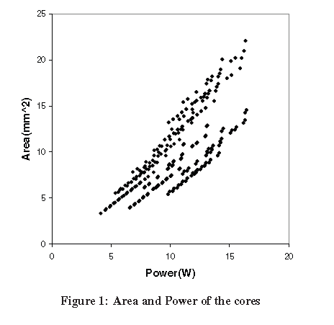
Contd..

Slide 15
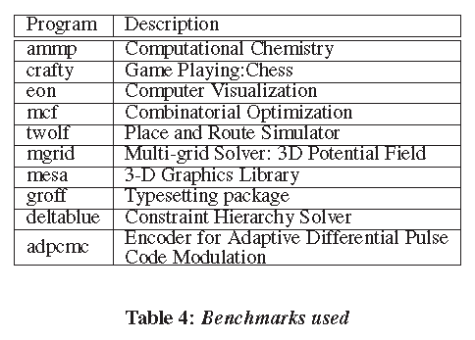
Modelling Performance
Evaluations are done for multi-programmed workloads
Simulated all 26 benchmarks from the SPEC suite for 250 million cycles using the EV5 processor model after fast-forwarding for an appropriate no of instruc
Based on the no of main memory references per instruction- processor bound or bandwidth bound
7 benchmarks were chosen from these two sets in proportion to the occurrence of these classes of benchmarks in the SPEC suite(represents entire spec suite)
groff, deltablue and adpcmc from the IBS, OOCSB and Mediabench suites
Every multiprocessor is evaluated on two classes of workloads- all different & all same

Slide 16
Evaluation methodology
2.2 billion distinct 4-core MP constructed from 4 cores
Performance of MP=Sum of the performance of each core of the MP
Find the single thread performance of each application on each core
Simulate for 250 million cycles, after fast-fwding an appropriate no of instructions (4800 simulations)
Static mapping not dynamic (evaluating 2.2 billion MP becomes intractable if dynamic mapping)

Slide 17
Evaluation Metric
Weighted speedup for our evaluations
= Σ each running thread’s IPC/ IPC on simplest core in this study when running alone
The IPC is derived by running a thread for a fixed amount of time
This metric guards against multiprocessor design points that produce artificial speedups by simply favouring high-IPC threads

Slide 18
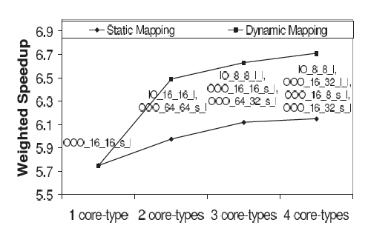
Analysing MP for a given workload
OOO/IO_i$size_d$size_execunits_physreg
Best MP- from static mapping
Mcf, overfit for mesa, underfit for eon and deltablue
Mesa, inorder 8K L1$, more func units
Mcf, ooo 16K I$, 8K D$
Deltablue, ooo 16K I$, 32K D$
Eon, ooo 64k I$, 32K D$

Slide 19
Analysing multi-core processors for a given budget
Homogeneous CMP designs
heterogeneous better than homo<1%
Better by 8% when 40W
Better by 17% when 30W
Advantage of diversity exists for all-same workloads too
Heterogeneity advantage depends on the power budget available

Slide 20
Best heterogeneous CMP not constructed of cores that appear in good homogeneous CMP
Tune each individual core to a class of applications with common characteristics
30W, Hetero > homo 11%
40W, Hetero > homo 10%
40W, Hetero > homo 8%
Significant benefit to diversity provided power or area is constrained
2core types sufficient for moderately power constrained
For highly power limited designs, increased diversity better
Interpretation w.r.t. homogenous designs (lose 9% with 40W and 23% with 30W against heterogeneous at 2% and 9% (40% power saving))

Slide 21
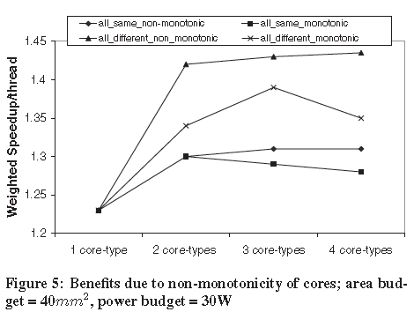
Quantifying inefficiency due to monotonicity
All-same: benefits from non-monotonicity is small
All-different: non-monotonic designs > monotonic
The best non-monotonic design with 2 core types outperforms the best corresponding monotonic design by 7.5% & the best homogeneous CMP design by 15.4%
Performance peaks at 3 core types for monotonic designs
Cost of monotonicity in terms of performance is greater when budgets are constrained

Slide 22
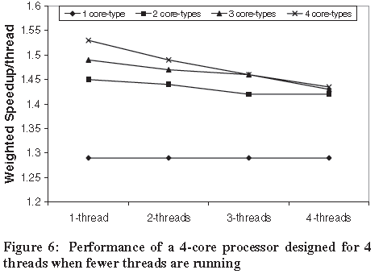
Varying Thread-Level Parallelism
Not always Processors have 4 threads to run
Optimize the cores for 4 threads, but run with fewer threads
For all levels of TLP, gradation among the processors remain the same
Relative performance increases with fewer threads, even though the processor was designed assuming a TLP of 4
A heterogeneous processor with 4 core types, for eg, outperforms the best homogeneous 4-core design by 18.6% when there is only a single thread running

Slide 23
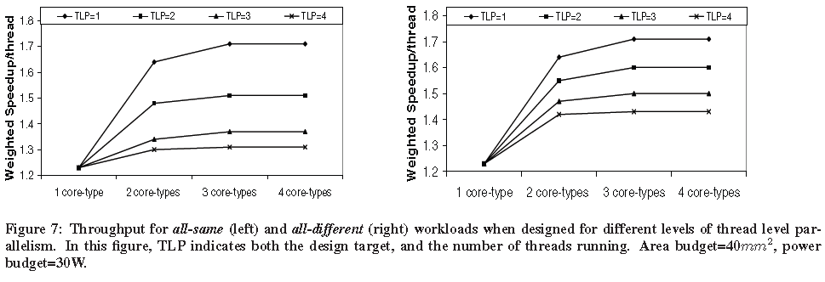
Contd..
Benefits of heterogeneity : more pronounced when machine is designed for about the same threading level that is running, particularly with the all-same workload
Marked gain incurred by a single thread (TLP=1) when 2 ->3 unique core
Best single-thread designs - balanced and non-monotonic
Better singlethread performance with heterogeneous cores than with the largest monolithic core we are considering in this study

Slide 24
Shortfalls of the study
The interconnect effect has not been considered
Memory-bandwidth limitation has not been prioritised and discussed
Training and test benchmarks have not been explicitly specified

Slide 25
Conclusions
Attempt to look at the design of cores for a heterogeneous CMP
Goal is to determine how to do good heterogeneous CMP design for a given set of workloads, area & power budgets
Identify the charac of the cores of heterogeneous CMPs for highest power and area efficiency
Best way to design: tune each core
Benefits greater under tightly constrained power & area budgets

Slide 26
Questions???

Slide 27
Architecture-Aware Mapping and Optimization on a 1600-Core GPU
Daga, M.; Scogland, T.; Wu-chun Feng, Parallel and Distributed Systems (ICPADS), 2011 IEEE 17th International Conference on , vol., no., pp.316,323, 7-9 Dec. 2011

Slide 28
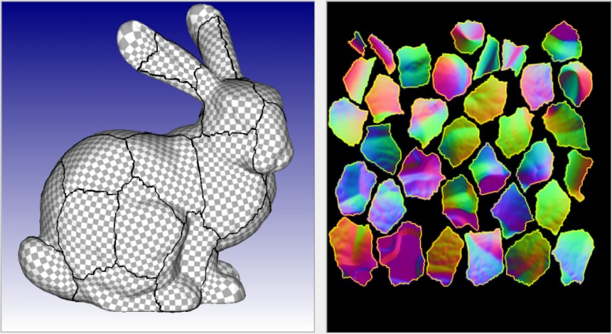
Overview to GPUs
Challenges with respect to programmability
Framework to aid Programmability-CUDA, OpenCL
OpenCL- across different platforms & arch
CUDA- Nvidia GPUs
Optimizations in CUDA for Nvidia not applicable over other GPUs
Architecture specific optimizations
optimization strategies specific to OpenCL on AMD GPUs
Financial computing
Scientific computing
Image processing

Slide 29
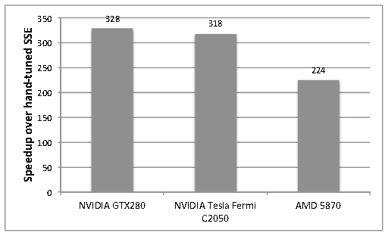
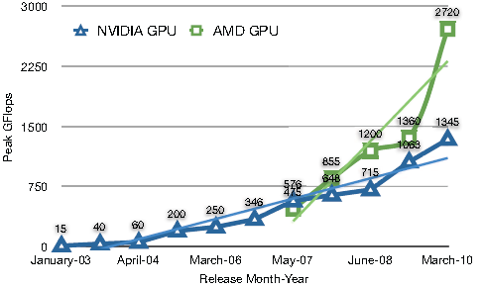
Performance comparison of GPUs
Speedup on GPU platforms with Nvidia specific optimizations
Peak performance of AMD GPU vs Nvidia GPU
Performance numbers for a molecular modelling application that used well-known CUDA optimizations on two different NVIDIA GPUs, each from a different generation, as well as an AMD GPU i.e, CUDA-based optimizations coded in OpenCL (Speedup on AMD about 30% lower than Nvidia)
Peak performance of an AMD GPU is more than two-fold higher than a NVIDIA GPU

Slide 30
OpenCL and GPU basics
OpenCL application
C/C++ code
OpenCL code
Kernels(functions)
1-3D work groups
threads
Allocates memory,
Compile opencl code, stage and runs it on GPU
Architectural similarity:
Compute Unit- Registers, local memory & const memory
Memory model- Global, image, local, constant

Slide 31
Commandments of GPU optimization
Run many threads
Use on-chip memory
Organize data in memory
Minimize divergent threads
Reduce dynamic instruction count

Slide 32
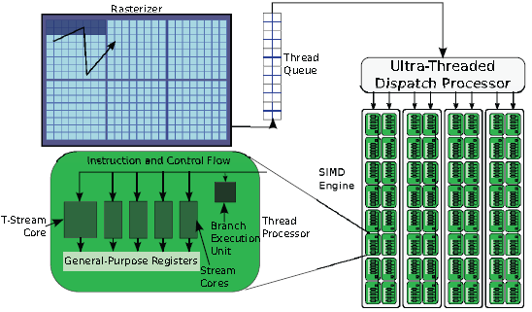
AMD architecture
Design highly tuned for 2-D data and computations with few conditionals & min random access
Compute unit is a SIMD engine & contains several thread processors, which each contain 4 processing cores & special-purpose core and a branch exec unit
T-stream core- math func
only 1 branch execution unit exists for every 5 processing cores
Any branch, divergent or not incurs some amount of serialization
AMD: VLIW based | Nvidia has scalar core
Vector type &math overhad in nvidia but on AMD gives material speedups
AMD GPUs : more processing elements, so more slots to fill

Slide 33
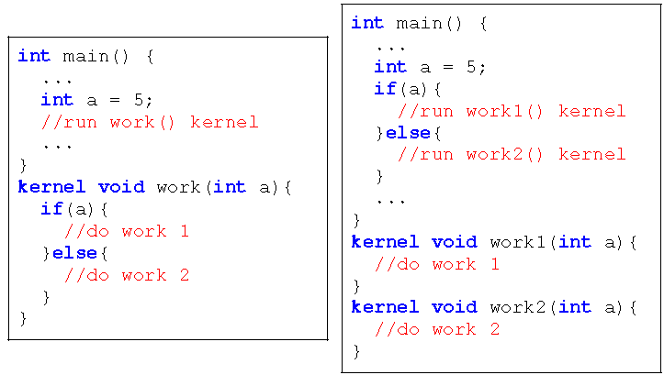
AMD optimizations: Kernel Splitting
1 branch unit for every 5 processing cores
Even non-divergent branches can cause significant performance degradation
CPUs: performance loss is minimal due to speculative execution & branch prediction
Implementation:
Conditionals whose result can be predetermined prior to the beginning of the kernel - moved from the GPU kernel -> CPU
kernel split into 2 kernels, each of which takes a different branch of that conditional
CPU then calls the kernel which follows the correct branch
Simple but complicated to implement
Optimised version of molecular modelling requires 16 kernels to implement this to all inputs

Slide 34
Local Staging
Reuse data loaded into onchip memory
subsequent accesses are more efficient than accessing from original location in global memory
AMD: local & const memory are significantly slower to access than registers
For small amounts of data & data not shared btwn threads, regs are faster
AMD GPUs have 4 times more regs than Nvidia GPUs
If more than 124 regs used by each thread, local variables spill to global memory & degrade performance

Slide 35
Vector types
OpenCL are analogous to SIMD vectors for SSE or AltiVec units on CPUs
Most used type of this class is float4
matches both the size of a pixel in graphics and size of an SSE word.
Using vector types in CUDA programs maps the operations down to scalar types (except loads and stores) little performance benefits
AMD GPUs is optimized for accesses of 128 bits as well as computation on vectors of 2-4 floats. T-Stream core not optimized.
The overhead of unpacking the vector and performing the transcendentals is higher than doing all the math with scalars.
Though scalar math is faster, loading memory in float2 or float4 is more efficient than loading scalars
Pre-fetching with vector loads, unrolling a loop to perform the math in scalars, &storing the vector

Slide 36
Image Memory
Older versions of NVIDIA GPUs, image memory was commonly listed as a way to increase memory performance
caching helped with repeated access, improved data access times
Offers many transformations meant to speed-up the access of images, but it is equally capable of reading arbitrary data in float4 vectors
Loading larger types from memory is more efficient than loading scalars
Benefits of caching and more efficient memory access patterns offered by image memory on AMD

Slide 37
Combining optimizations
2 optimizations can improve performance of a base application individually, they will combine to create a faster implementation when applied together
Hill climbing used for optimization
But combining optimizations does not work well with the GPUs

Slide 38
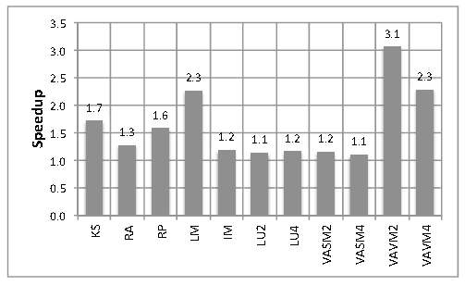
Results & Analysis: Kernel Splitting
Delivers a 1.7-fold performance benefit
Reason:
AMD GPU architecture has only 1 branch exec unit for 5 processing cores
Branching on an AMD GPU incurs a huge performance loss
For eg, the branch itself now takes 5times as long as branches on the NVIDIA GPU arch
Speedup Due to Each Optimization over Unoptimized OpenCL GPU Version
KS: Kernel Splitting, RA: Register Accumulator,
RP: Register Preloading, LM: Local Memory, IM: Image Memory, LU{2,4}: Loop Unrolling{2x,4x}, VASM{2,4}: Vectorized Access & Scalar Math{float2, float4}, VAVM{2,4}: Vectorized Access & Vector Math{float2, float4}

Slide 39
Local Staging
Reducing the number registers utilized per thread
AMD has 4 times that of NVIDIA
GEM kernel:
GEM involves accumulating the potential at the vertex due to each atom in the molecule
Superior performance on the AMD GPU
Register accumulator and obtain -1.3-fold speedup
Preloading data into the register -1.6 fold speedup
Use of local memory on the GPU -2.3-fold speedup
Using local memory is 1.4-fold faster than using register preloading in isolation

Slide 40
Image memory
L1 and L2 caches provide lower memory access latency
Read-only mode: FastPath memory access utilized on AMD GPUs to leverage the presence of L2 cache
Read-write mode: GPUs sacrifices the L2 cache in order to perform atomic operations on global objects
1.2 fold speedup was obtained on AMD
Degraded the performance by 8% in Nvidia

Slide 41
Vector types
Loop unrolling:
Reduces the number of dynamic instructions that control the loop
Eg, pointer arithmetic, end of “test” loops
Reduces branch penalties
Accessing global memory as vectors faster than scalar
Vector math :
provide >3x speedup, as in case of float2. AMD GPUs are capable of issuing 5 FP, scalar operations in a VLIW
vectorized math assists the compiler in filling the 5-way VLIWs in each compute unit.
The dynamic instruction count is also reduced by a factor of the length of the vector as multiple scalar instructions are packed into a single instruction

Slide 42
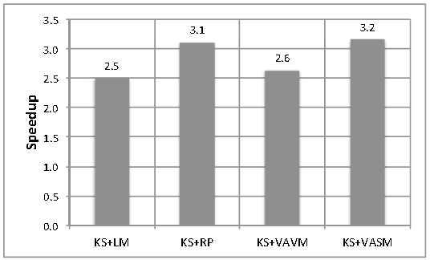
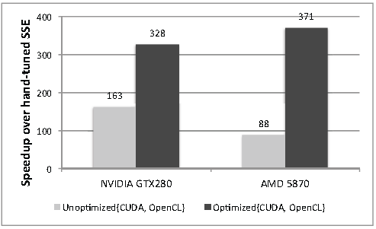
Efficacy of Combining Instructions
Some of these results are due
to register pressure and the
num of threads that can run
concurrently changing as the
Num of regs and amount of
local memory change
Speedup due to combining optimizations on unoptimised openCL
Best: OpenCL on AMD GPUs, kernel
splitting (KS) + register preloading
(RP) + image memory (IM)

Slide 43
Shortfalls of the study
Diversity of applications not included
Comparison done against NVIDIA GPU and not with other AMD GPUs

Slide 44
Conclusion
Suitable for HPC
Well-known optimizations from one architecture do not always apply favourably to another
Presented and evaluated several less-known optimizations for OpenCL on AMD GPUs
Performance of the molecular modelling application on AMD Radeon HD 5870 with openCL
12% better than optimized CUDA version
371 fold speedup over the hand tuned SSE version of CPU
46 fold speedup over 8 core CPU

Slide 45
Questions???

