Slide 1
Design and hardware implementation of chaotic encryption scheme in real time embedded systems
Authors:
Amit pande and joseph zambreno
Publication :
Signal Processing and communication
conference, 18-21 july, 2010

Slide 2



Intro to cryptography
Confidentiality
End-Point Authentication
Message Integrity
Alice
Bob
channel
data, control messages
secure
sender
secure
receiver
data
data
Trudy
Notes:
Confidentialiyy: only sender, intended receiver should “understand” message contents : sender encrypts, receiver decrypts
End-Point Authentication: sender, receiver want to confirm identity of each other
Message Integrity: sender, receiver want to ensure message not altered (in transit, or afterwards) without detection

Slide 3
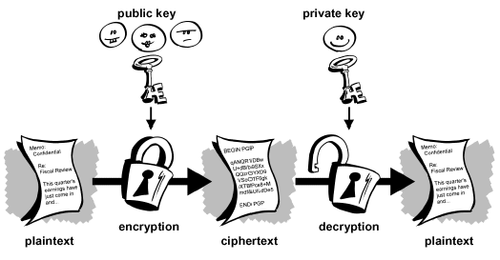
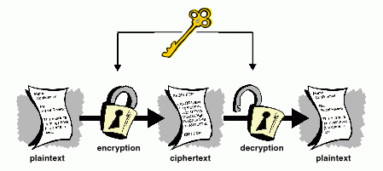
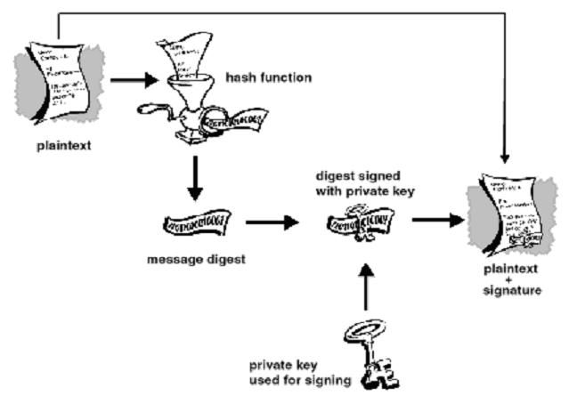
Types of Cryptography
Crypto often uses keys:
  Algorithm is known to everyone
  Only “keys” are secret
Public key cryptography
  Involves the use of two keys
Symmetric key cryptography
  Involves the use one key
Hash functions
  Involves the use of no keys
  Nothing secret: How can this be useful?

Slide 4
Symmetric key cryptography
K
K
S
S
plaintext
message, m
encryption
algorithm
ciphertext
decryption
algorithm
plaintext
K (m)
m = K_{S}(K_{S}(m))
S
symmetric key crypto: Bob and Alice share same (symmetric) key: K
e.g., key is knowing substitution pattern in mono alphabetic substitution cipher
Q: how do Bob and Alice agree on key value?
S

Slide 5
Breaking an encryption scheme
Cipher-text only attack: Trudy has cipher text that she can analyze
Two approaches:
  Search through all keys: must be able to differentiate resulting plaintext from gibberish
  Statistical analysis
Known-plaintext attack: Trudy has some plaintext corresponding to some cipher text
  eg, in monoalphabetic cipher, trudy determines pairings for a,l,i,c,e,b,o,
Chosen-plaintext attack: Trudy can get the ciphertext for some chosen plaintext

Slide 6
Ciphers- Overview
Ciphers
Block
Stream
Symmetric key cipher
Secure only for a fixed length of bits
Same key to encrypt all blocks, degrades security
Data encryption standard(DES), Advanced Encryption Standard (AES), developed by IBM
Encrypt individual bits
Starts with a secret key (seed)
Generate keying stream
ith bit of keying stream is a func of the key & the first i1 ciphertext bits
Combine stream with plain text to form cipher text(usually XOR)

Slide 7
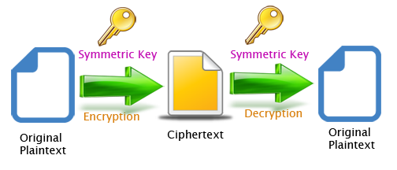

What does a good cipher do?
Large key to resist brute-force search
Resistant to attacks
Lesser hardware resources
High throughput
Size of the enciphered text should be no larger than the original message
Discretisation needs to be addressed (short cycle length, non ideal distribution, correlation)

Slide 8
Proposed model
Construction of a chaotic encryption stream cipher
Cipher uses a Pseudo-random sequence generator based on Modified logistic map
Hardware implementation in FPGA
Proposed cipher gives 16 bits of encrypted data/cycle
Embedded devices with tight constraints (power consumption, hardware resources)

Slide 9
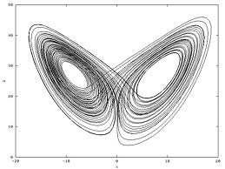
Chaotic Systems
Sensitive dependence on initial conditions
Fulfil the Shannon requirements of confusion and diffusion
Continuous time chaotic systems require repeated resynchronisation to match the phase at encoding and decoding ends
Discrete chaotic systems behave as private key encryption algorithms and can be implemented in fixed point hardware.
Notes:
In Shannon's original definitions, confusion refers to making the relationship between the ciphertext and the symmetric key as complex and involved as possible; diffusion refers to dissipating the statistical structure of plaintext over bulk of ciphertext. This complexity is generally implemented through a well-defined and repeatable series of substitutions and permutations.

Slide 10
Logistic Map
X_{n+1} = λ_{LM}*x_{n} (1-x_{n})
A simple model of resource-limited population growth
Dependent on value of λ_{LM}-growth rate
λ_{LM} ≈3.57 is the onset of chaos
beyond 3.57 exhibit chaotic behaviour
Islands of stability

Slide 11
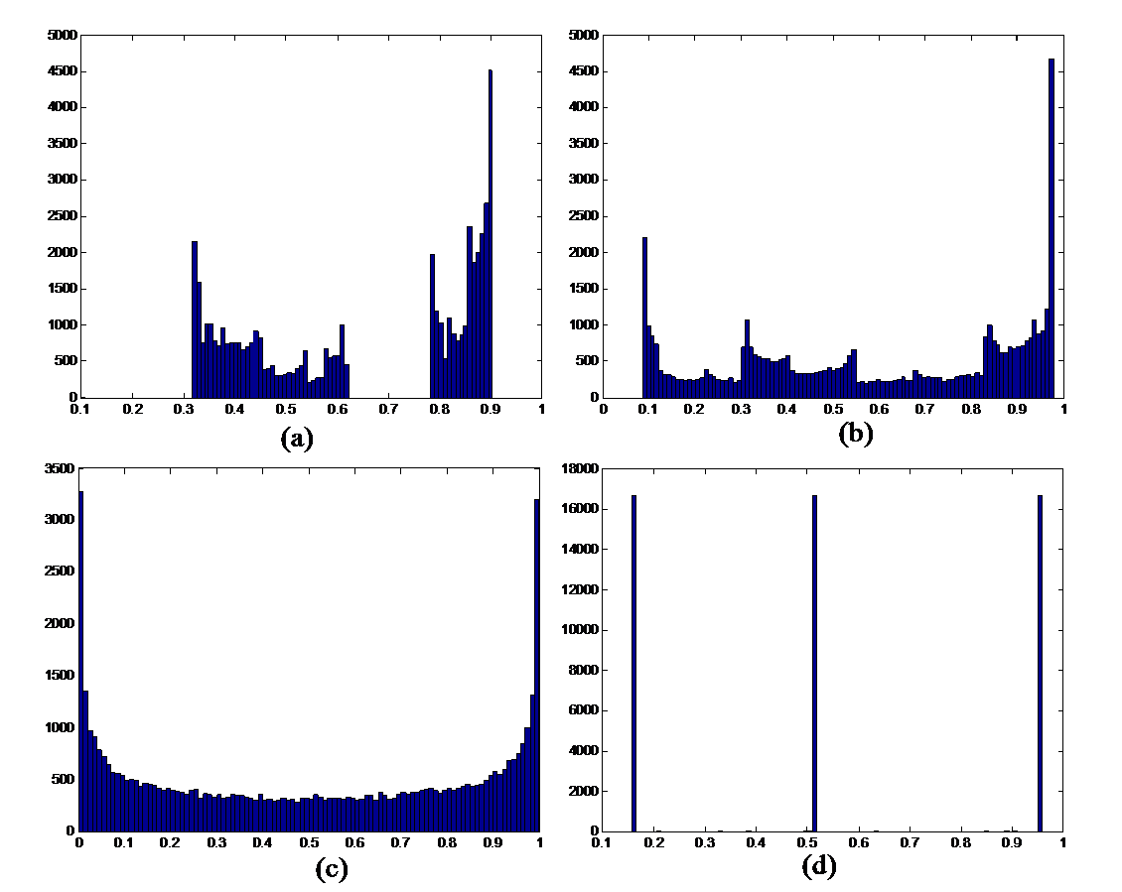
Histogram for 50000 samples using LM with initial seed=0.100010
a) λ_{LM} =3.61
b) λ_{LM} =3.91
Interval of great sensitivity to initial conditions
range(0,1) symmetric distribution around 0.5
Islands of stability
c) λ_{LM} =4
d) λ_{LM} =3.83

Slide 12
Modified logistic map
X_{n+1} = λ_{LM}*x_{n} (1-x_{n}) + μ
x_{n} ∈ [α,1-α], α<0.5
Maxima occurs at x_{n} = 0.5, Max value=λ/4+μ
Minima occurs at x_{n} = α or 1- α,
min value= λ*α*1- α + μ
Solving yields :λ=4/(1-2α) & μ=α(2α-3)/(1-2 α)
End result: Flatter symmetric distribution for all values of α
Avoids any islands of stability

Slide 13
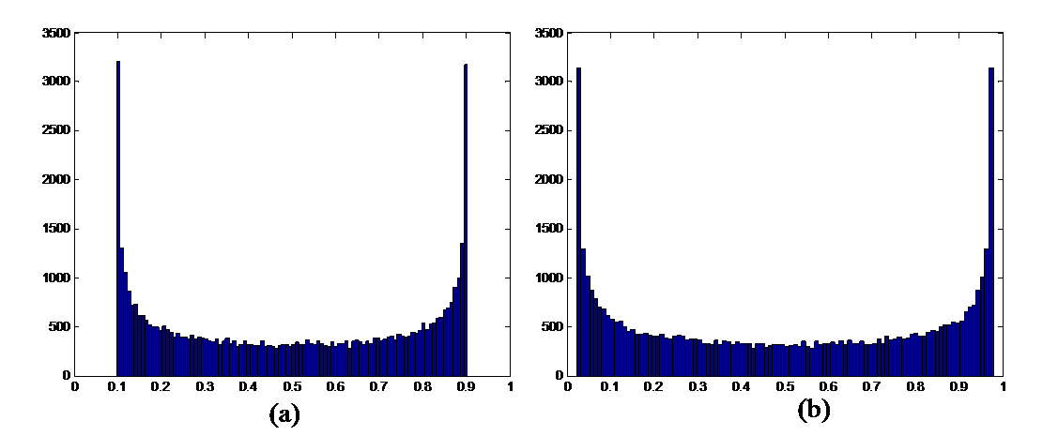
Histogram for 50000 samples using MLM with α values corresponding to
λ_{LM} =3.61
λ_{LM} =3.91

Slide 14


Quantization
x_{n} quantized to obtain 16 bit value
X_{n} represented in fixed point as
Y_{n} restricted to the least significant 16 bits
Many to one quantization
b_{n} obtained for random feedback scheme
  b_{n} = {a_{n}-1} ie the MSB

Slide 15
Pseudo Random Sequence
z_{n} =y_{n} ⊕ y_{n-1} ⊕y_{n-2}
No linear correlation between y_{n} and z_{n}
Statistical de-correlation makes it difficult to trackback y_{n}

Slide 16
Masking and random feedback
C_{n} = P_{n} ⊕ Z_{n} ⊕ Fb_{n}
  C_{n} - cipher text,
  P_{n} – plain text,
  z_{n} – pseudo random sequence,
  Fb_{n} – random feedback input from the past cipher text
Fb_{n} = {C_{n-1} when b_{n} =0, C_{n-2} when b_{n} =1}

Slide 17
How secure is this model?
Difficult to predict key value XORed to the plain text
Sequences z_{n} and y_{n} are linearly uncorrelated
Y_{n} is obtained by sampling x_{n} , which is used to iterate the chaotic map.
Chaotic map more sensitive to the MSB than to the LSB, so will become difficult to track back x_{n}
100 iterations of the MLM to allow diffusion of initial key bits and parameter values(though 20 is sufficient)

Slide 18
Hardware implementation
Fixed point implementation(more efficient in hardware)
Bit width of plain and cipher text is 2 bytes
64 bits fixed point precision is chosen (x(i), λ, μ)
α (0,0.375) in fixed point with 0 int bits and 64 fract bits
λ(4,16)
μ (-3,-15.0975)
Effective key space : 2¹²⁵

Slide 19
Hardware specifications
Virtex 6 XCVLX75TL FPGA using Xilinx11.0
Optimization
  Add two pipelining stages to the multiplier
  Single DSP slice can perform 25*18 bits multiplication
  For 64*64 bits multiplication 12 slices needed.
  But due to truncation of 64 bits , optimization possible

Slide 20
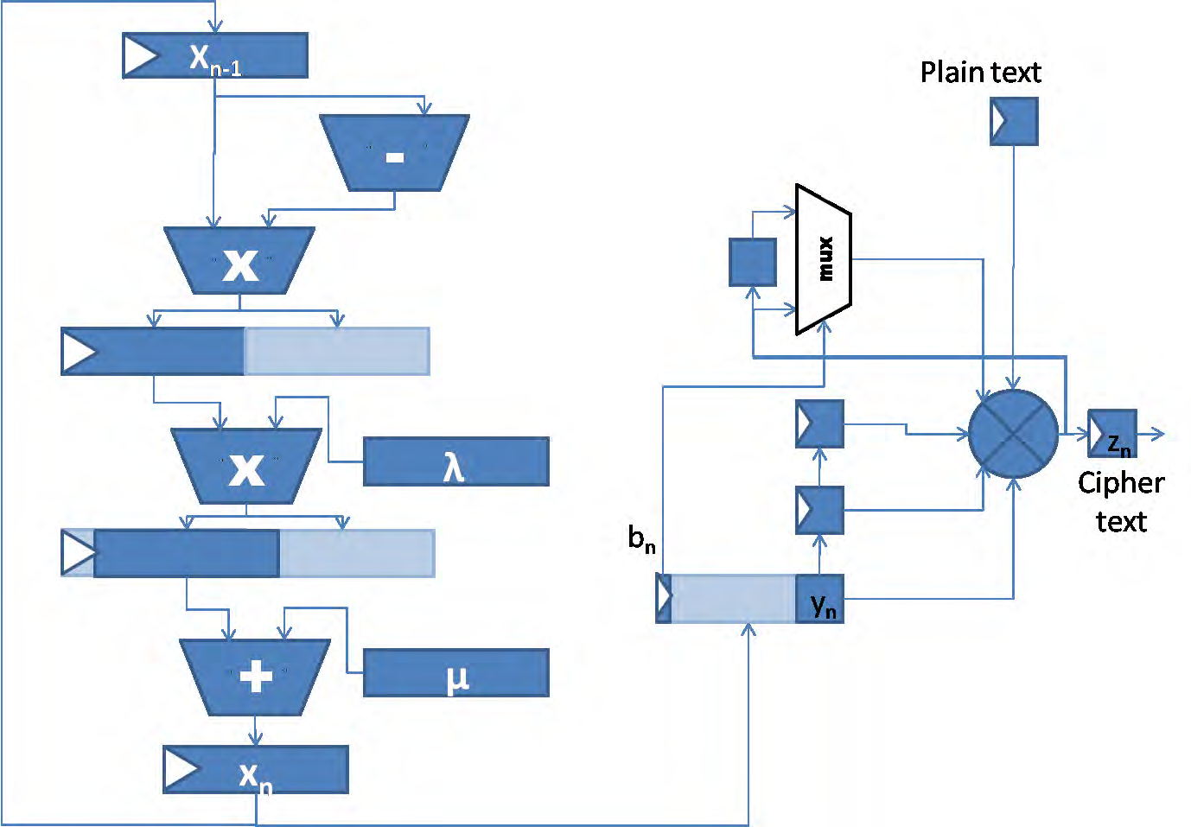
Implementation of chaotic stream cipher
X_{n-1}
X_{n-1} *(1-x_{n-1})
Z_{n}=C_{n}⊕P_{n} ⊕FB_{n}
X_{n-1}*(1-x_{n-1})* λ
C_{n} =Y_{n}⊕Y_{n-1}⊕ Y_{n-2}
X_{n-1}*(1-x_{n-1}) * λ
+ μ
Y_{n}
X_{n}

Slide 21
Resource utilisation
 | Orig. design | opt . design
Clock frequency (MHz) | 69 | 93
No DSP48EI slices | 23 | 16
No. slice registers | 228 | 160
No. slice LUTs | 354 | 643

Slide 22
Shortfalls of the paper
Logistic map is very basic type of chaotic map
Synchronization problems not discussed( message loss during any transition period)
MLM was not tested using crypt attacks, chosen-plain text and chosen-cipher text attacks

Slide 23
Conclusion
Chaotic stream cipher based on Modified Logistic Map
Secure against plain text attacks
Hardware implementation of proposed scheme achieved clock frequency of 93 MHz
Suitable for real time embedded applications.

Slide 24

Questions???

