Slide 1
Fast & Flexible High-Level Synthesis from OpenCL using Reconfiguration Contexts
Naveen R. Iyer Kowshick Boddu
Published in:
Micro, IEEE
DOI:10.1109/MM.2013.108
Publisher: IEEE
Authors:
James Coole, Greg Stitt
University of Florida
Dept. of Electrical & Computer Engineering and
NSF CHREC
Gainesville, FL, USA
jcoole@ufl.edu, gstitt@ece.ufl.edu

Slide 2
What is Reconfigurable Computing
Reconfigurable computing (RC) is the study of architectures that can adapt (after fabrication) to a specific application or application domain
RC is a way of implementing circuits without fabricating a device
CLB
CLB
Switch box/matrix
CLB
CLB

Slide 3
Challenges in RC
Reconfigurable computing promising but design tools pose challenge to designers
Huge compilation time: synthesis →P&R → mapping
Design iteration difficult and productivity limited
Runtime compilation difficult; contributes to niche FPGA usage
OpenCL enables high-level synthesis of FPGA
Vendors adopting standard to alleviate steep learning curve associated with native language (VHDL/Verilog)
Can be likened to Assembly vs C → only a small penalty in performance
Altera, Xilinx. But other vendors with proprietary HLS: Xilinx, Convey
Presents significant potential:
Portability
Productivity
Performance

Slide 4
OpenCL-Based Approach
On CPU and GPU, “online” compilation possible
When kernel changes, host simply loads a different kernel on accelerator: in ms
“OpenCL mainly used to program accelerators“
However, the case is different for FPGAs
Kernel has to be re-compiled every time system changes
Takes a huge amount of time: 8 hours to days
Not a good idea for dynamic hardware, or even for a fixed instance of hardware!
“Online” compilation not typically done
Kernel pre-compiled “offline” into binaries and loaded as needed

Slide 5
Limitations of OpenCL Approach
Current HLS approach conflict with mainstream OpenCL
Orders of magnitude FPGA compilation time
Limited support for changing/adding kernels after compilation
Can PR in some way? → reconfiguration contexts
Reconfiguration Contexts
Key features
Coarse-grain units instead of finer-grained LUTS
Backend synthesis
Thus, allowing use of (virtually) any OpenCL tool on the frontend
Advantages
Compile kernel faster
Change kernel online

Slide 6
Backend Synthesis
Summary
1000X faster place & route compared to device vendors' tool
21% increased FPGA resource utilization (drive logic)
Uses coarse-grained resources implemented atop FPGA
Avoids decomposing of circuits into finer grain LUTS
Maps circuit unto app-specialized resources (FP, FFT)
Specializes IF for OpenCL
Compliments existing OpenCL synthesis approach
Enable fast compilation: compiling any kernel
Enable fast reconfiguration: adding and changing kernels
Automatically determines effective fabric architecture for given application (previous IF were manually designed)

Slide 7
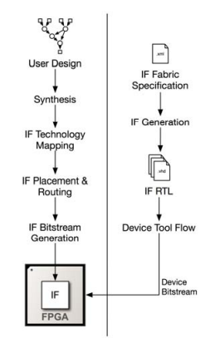
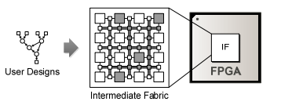
Intermediate Fabric Optimality
Impossible to create optimal fabric for all combinations of kernels
Context-design heuristics finds optimal IF
Intermediate Fabric
1. Analyzes kernel requirements from application or domain
2. Cluster kernels based on similarity into set of fabrics called reconfiguration contexts

Slide 8
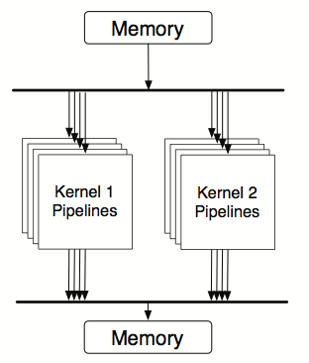
Reconfiguration Context (w/o IF)
Kernel-Specific accelerators (existing approach)
Provides no support for kernels not known at system generation
Limitation of existing OpenCL synthesis
Example: context tasked with supporting three kernels
Implements three kernel-specific accelerators
Although, possibly more efficient than IF (as seen in pipelined archi.)
Limited scalability due to lack of resource sharing across kernels

Slide 9
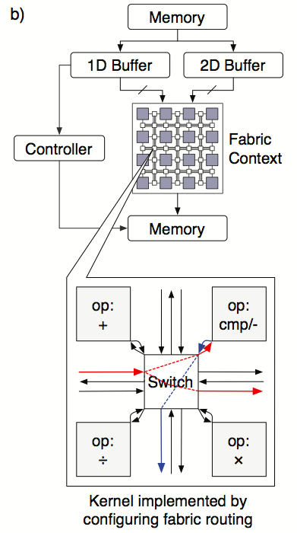
Reconfiguration Context (with IF)
IF-Based Context
Only common computational resources fixed during system generation
Fixed resources: FFT, Mult, Accum, Sqrt
Reconfigurable interconnection
Provide flexibility to support kernels similar to one for which context was originally designed
Important for iterative design development
Versatile for changing system system requirements and workloads

Slide 10
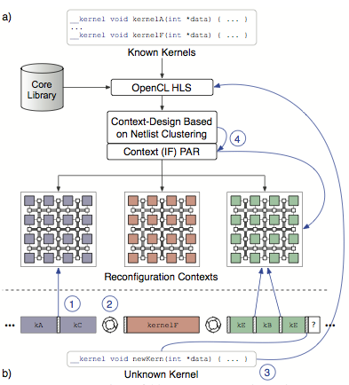
Reconfiguration Context in Operation
OpenCL Front-end
Read source kernels
Synthesize kernel into netlists (coarse-grained cores & controls)
IF Backend
Read generated netlist
Apply context-based heuristics (based on netlist clustering)
Group netlist into sets of similar of resource requirements
Design IF-based context for each set → reconfiguration context
FPGA Front-End
Place and Routing
Reconfiguration Context compiled into bitstreams using device-vendor tools

Slide 11
Reconfiguration Context in Operation
Dynamic Operation
While a context is loaded to FPGA
Rapidly configure context to support different member kernels (kA, kB)
Required kernel not in context:
reconfigure FPGA with new context
A new kernel added to system:
Front-end tool: synthesize kernel
Backend: Cluster kernel into existing an context
Performs context PAR to create bitfile for kernel

Slide 12
Context-Design Heuristics
Designing appropriate contexts most critical part of tool flow
Main challenges of context-based design are:
How many contexts to be created to support all the known kernels
What functionality/resources to include in the context: DSP, FFT, etc.
How to assign kernels to contexts
Clearly an optimization problem!
Maximize reuse of resources across kernels in a context
Minimizing area of individual context
A well designed context seeks to:
Minimize individual context area by minimizing number of resources reused across kernels in a context
Helps design fit under area constraints
Useful for scaling each context to increase flexibility and support similar kernels other than those known at compile time

Slide 13
Heuristics Mechanism
Groups of kernels often exhibit similarity in their mixture of operation
Example as seen in application-specialized processors in many domains
While computational resources are fixed, interconnection remains flexible
Key enabler for IF-based context
Heuristic considers functional similarity over any structural similarity
Exploit of structural similarity between kernel (e.g to reduce interconnection area) an alternative clustering method
Functional grouping still useful when cost of functional resources expected to be high than cost of interconnect

Slide 14
Heuristics Mechanism
Ignores functional timing differences
Assumes that differences are minimized through pipelining [2]
Timing can be considered during grouping when timing pipelining isn't sufficient
Using additional fmax dimension in a clustering heuristics
Contexts that minimally support one member of a group should support other members of the group
Although each member might require different number of resources, or addition of other resources
Identifying these groups is vital for designing contexts that are compatible with kernels similar to the kernels inside each group

Slide 15
Heuristics Mechanism (IF)
Features identified using clustering heuristics in an n-dimensional feature space
Feature space defined by functional compositions of system’s kernel netlist
Example: given an application containing 2kernels – FIR and SAD
Clustering would operate on SAD = <0.3, 0.0, 0.7> and FIR = <0.5, 0.5, 0.0> in the space <f_add, f_mul, f_cmp/sub>
K-means clustering used to group netlists in space
Results to up to K sets of netlists for which individual contexts will be designed
Heuristic can use resources requirement of core to estimate area required by each cluster
K to be selected subject to user or system-imposed area constrains
User may set select value for k so satisfy systems goals for flexibility

Slide 16
OpenCL-IF Compiler
A custom tool based on Low-Level Virtual Machine (LLVM) and C frontend
First compiles kernel into LLVM’s intermediate representation
Substitutes custom intrinsics for system system functions (e.g get_global_id)
Uses LLVM’s standard optimization parses
Inlining auxiliary functions
Loop unrolling
Some common hardware-specific optimizations
Creates a control data flow graph (CDFG)
Simultaneously maps LLVM instructions to compatible cores (specified in user-specified library)
Cores may be added to library to enable limited application- and target-specific optimizations

Slide 17
OpenCL-IF Compiler
DFGs independently scheduled and bound to final resources provided by the context using other approaches [2]
Resulting kernel netlist implemented on context through place & route
Yields a context context bitsream for each kernel
At runtime, kernel executed after configuring its context with corresponding bitstream
Execution mutually exclusive per context
A unique feature of OpenCL-IF is support for efficient data streaming from external memories
Previous approaches implement kernel accelerators that comprise multiple pipelines competing for global memory through bus arbitration
However some study addressed this memory bottleneck by using specialized buffers
Notes:
Previous approaches implement kernel accelerators that comprise multiple pipelines competing for global memory through bus arbitration

Slide 18
Experimental Setup
Evaluation of context-design heuristics
Setup provides minimal guidance by using only framework’s known kernels
Single framework for computer vision applications
Multiple image-processing kernels executing in different combinations at different times
Representative of stages in larger processing pipelines
Evaluation Metrics
Compilation time
Area
Clock frequency
FIR
Gaussian
Sobel
Bilinear
Threshold
Mean
Max
Min
Normalize
SAD
10 OpenCL kernels
Fixed-point and single-precision floating-points

Slide 19
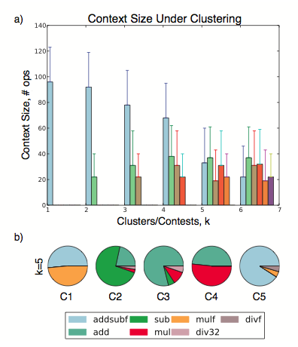
Results
Using 5 clusters provides significant 60% decrease in cluster size
Flexibility in allowing implementation of different kernels under area constraints (by implementing context minimally)
Cluster size can increase (up to fabric capacity, or area constraint) if further flexibility is desired
Provides better matching for underlying kernels
Different k values introduce trade-offs
Can be beneficial in order applications depending on designer intent

Slide 20
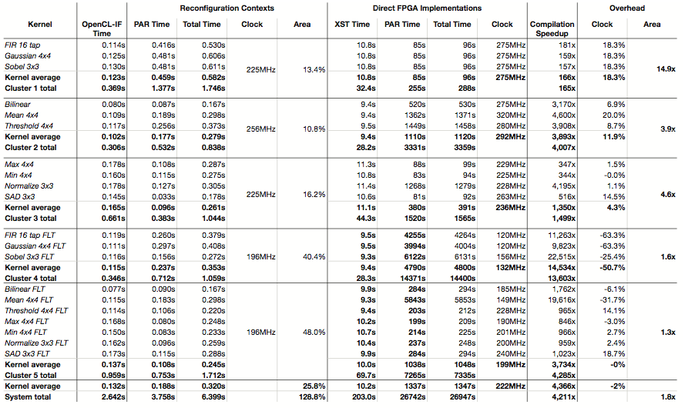
Comparison of compilation time, area, and clock frequency for OpenCL-IF reconfiguration contexts and direct FPGA implementations for a computer-vision application with k=5. Floating-point kernels are shown with an FLT suffix

Slide 21
More Results
After context generation, reconfiguration context enabled compilation of entire system of kernels in 6.3s
4211x faster than 7.5 hours required via ISE direct compilation to FPGA
Floating point kernels experience greater compilation speedup (6970x vs 1760x)
More fine grained resources hidden by their context
Each kernel compiled at an average of 0.32 seconds
Provides an estimate of the compilation time a new, context-compatible kernel
Clock overhead negligible on average
Additional pipelining in fabric’s interconnect benefit some circuits
System require 1.8X additional area compared to implementing kernel directly
Not necessarily an overhead due to significant added flexibility

Slide 22
Configuration Time and Bitstream size
Context can be reconfigured with new kernel in 29.4 us
On average, 144x faster than FPGA reconfiguration
Enables efficient time-multiplexing of multiple kernels

Slide 23
Limitations & Conclusions
Introduced a backend approach to complement existing OpenCL synthesis using coarse-grained reconfiguration contexts
Enabled 4211x faster FPGA configuration compared to device-vendor tools
Cost overhead of 1.8x area overhead
Reconfiguration context context can be reconfigured in less than 29us to support multiple kernels
While using slower FPGA reconfiguration context to load new contexts to support significantly different kernels
Clustering heuristics introduced to create effective contexts that group kernels into functional similarity
Leverage previous work on intermediate Fabrics (IF) that supports requirements of each group
HLS tools such as LabVIEW provide another way of implementing algorithms in high level. Studies on such tools are not covered in the paper.

