Slide 1
The “Chimera”: An Off-The-Shelf CPU/GPGPU/FPGA Hybrid
Computing Platform
Naveen R. Iyer Kowshick Boddu
Publication:
Ra Inta, David J. Bowman, and Susan M. Scott.
Int. J. Reconfig. Comput. 2012,
Article 2 (January 2012), 1 pages.
DOI=10.1155/2012/241439

Slide 2
Paper’s focus
Viable alternative solution to many common computationally bound problems (Astronomical)
Analyse the bottleneck of the CPU which limits the performance (interconnects).
Speculate the merits of HCS (Chimera)

Slide 3
Heterogeneous Computing System
Need for Hardware accelerators
- Astronomical problem exhibit a substantial computational bound.
What is HCS?
- CPU/GPGPU/FPGA desktop computing system built from COT elements

Slide 4
Need for HCS in Astronomical Data Analysis
Universe is expanding
homogeneity of the microwave background
strong evidence for the existence of dark matter and dark energy
- significant computational bound and would not have been possible without a breakthrough in data analysis techniques

Slide 5
Problems with existing HPC
the most powerful HPC systems (the “Top 500”) were purely CPU based
power consumption, and hence heat generation, is proportional to clock speed, processors have begun to hit the so-called “speed wall”
traditional HPC systems: over half the lifetime
cost of a modern supercomputer is spent on electrical power

Slide 6
CPU Vs Hardware accelerators
Many embarrassingly parallel computations rely on linear algebraic operations that are a perfect match for a GPU.
This, in addition to the amount of high level support, such as C for CUDA, means they have become adopted as the hardware accelerator of choice by many data analysts.
FPGAs were found to be faster by a factor of 15 and 60 over a contemporaneous GPU and CPU resp.), video processing
FPGA implementation of Quasi-Random Monte Carlo outperforms a CPU version by two orders of magnitude and beats a contemporaneous GPU by a factor of three),

Slide 7
Need for HCS
This caveat notwithstanding there are a number of distinctions amongst each hardware platform intrinsic to the underlying design features.
considerations in mind, the paper presents a system that attempts to exploit the innate advantages of all three hardware platforms,

Slide 8
“Chimera” Heterogeneous
CPU/GPU/FPGA Computing Platform
Greek beast with a head of a goat, a snake, and a lion on the same body
Chimera platform would conform to the Uniform Node Nonuniform System (UNNS)
Configuration, or perhaps an optimized version of each node within an Axel-type cluster.
The “Axel” [37] system is a configuration of sixteen nodes in a Nonuniform Node UniformSystem(NNUS) cluster, each node comprising anAMDPhenomQuad-core CPU, an Nvidia Tesla C1060, and a Xilinx Virtex-5 LX330 FPGA.

Slide 9
Architecture
Uniform Node Nonuniform System
- The node contains either FPGA/ microprocessors connected to high speed network
Non uniform node uniform systems
- Each node containing a FPGA with micro processor tightly coupled

Slide 10
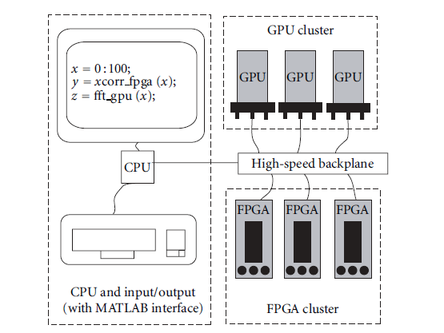
heterogeneous
CPU/GPGPU/FPGA system.

Slide 11
Interconnect
Important element in this system is
the high-speed backplane(interconnect).
The interconnect protocol is Peripheral Component Interconnect express
The PCIe bottleneck presented the most significant limitation to the computing model.

Slide 12
Reasons to ignore PCI bottleneck
(e.g., generation of pseudorandom numbers) Large data
sets are developed and processed solely on-chip.
In other cases, processing pipelines may be organized
to avoid this bottleneck.
FPGA devices, in particular, are provided with very high speed I/O connections allowing multiple FPGAs to process and reduce data-sets before passing them to the final, PCIe limited device.
The purpose of the Chimera is to prove the concept
of the hybrid computing model using low-cost COTS
devices.

Slide 13
Goals of Chimera
protocol that allows FPGA-GPU communication without the mediation of a CPU, we are currently developing kernel modules for the PCIe bus
A primary goal of the Chimera system is to provide access to high-performance computing hardware for novice users.

Slide 14
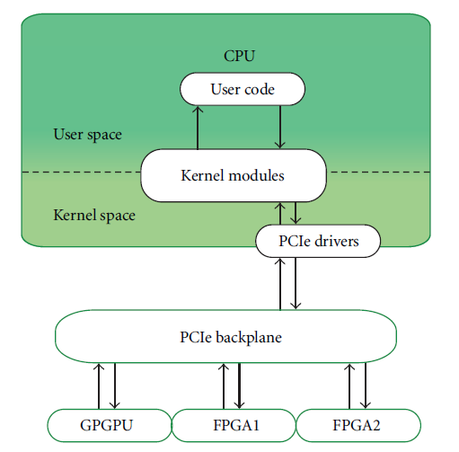
Complete Architecture

Slide 15
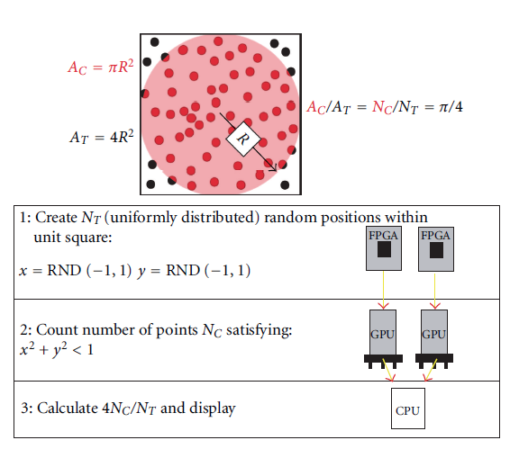
Monte Carlo Integration

Slide 16
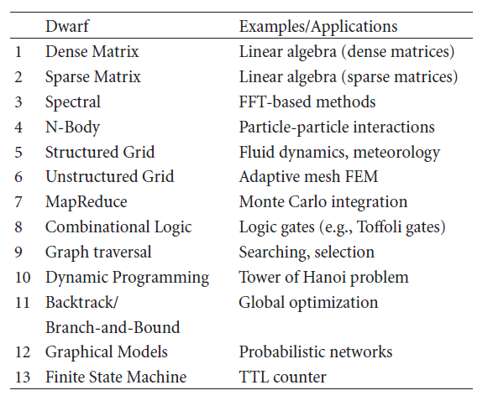
The “Thirteen Dwarves” of Berkeley

Slide 17
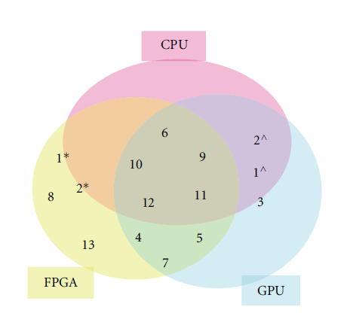
Appropriate Hardware
Acceleration Subsystem Combination
Performance is heavily dependent on the particular implementation, generation of subsystem (including on-board memory, number of LUTs, etc.), and interconnect speed

Slide 18
When to use RC?
  Depends on:
    NRE Cost - Non-recurring engineering cost
      Cost involved with designing application
    Unit cost - cost of a manufacturing/purchasing a single system
    Volume - # of units
  Total cost = NRE + unit cost * volume
Implementation Possibilities
GPU & ASICs
Microprocessor
RC (FPGA,CPLD, etc.)
Performance

Slide 19
Limitations & Conclusion
CPU/GPGPU/FPGA Hybrid Computing Platform promises efficient resource utilization for most of the applications
Limitations include development and integration costs
More discussion on PCIe bottleneck is required
Depending on applications, some units may remain idle which is a downside in HPC

