Slide 1
DESIGN AND IMPLEMENTATION OF A HETEROGENOUS HIGH-PERFORMANCE COMPUTING FRAMEWORK
Niharika Chatla Vibhav Kundalia
9043-1959 3156-1935

Slide 2
INTRODUCTION
Recent Trend : Integrating reconfigurable computing with high performance computing.
Advantages : Reconfigurable computing based on FPGA can accelerate the high performance computing.
Why ?
Exploits coarse-grain functional parallelism.

Slide 3
Framework
Proposed Framework : Dynamic and Partial Reconfigurable computing nodes integrated with high performance computing nodes based.
Reconfigurable nodes have the ability for partial reconfiguration.
Use of Partial Reconfiguration
configuration file small
Time of reconfiguration short
can do general purpose processing / behave as computing nodes based on the requirement.

Slide 4
System Architecture
General-purpose nodes and dynamic partial reconfigurable nodes
communicates through the high speed interconnection network
Master-slave mechanism
General purpose nodes assign computing tasks on partial reconfigurable nodes.

Slide 5
Dynamic partial reconfigurable nodes can dynamically load different hardware configuration.
Adapts the hardware structure based on the application.
Advantages : Uses the same hardware resources to provide different computing functions.

Slide 6
Architecture Overview
General-purpose nodes connected with dynamic partial reconfigurable computing nodes through the high-speed interconnection network
General-purpose nodes distribute tasks to reconfigurable computing nodes through remote access library.
Remote access interface library provides uniform access interface for the applications.
Reconfigurable nodes perform calculations and return the results.

Slide 7
Dynamic and Partial Reconfigurable computing functioning
In reconfigurable computing nodes, partial reconfiguration computing is one of the main functions.
Different computing services dynamically configured based on the application requirements.
manages
Network communication
Task management
Task monitoring
Reconfiguration control
PRC nodes also provide microprocessors, memory and network interface to run simple software applications.

Slide 8
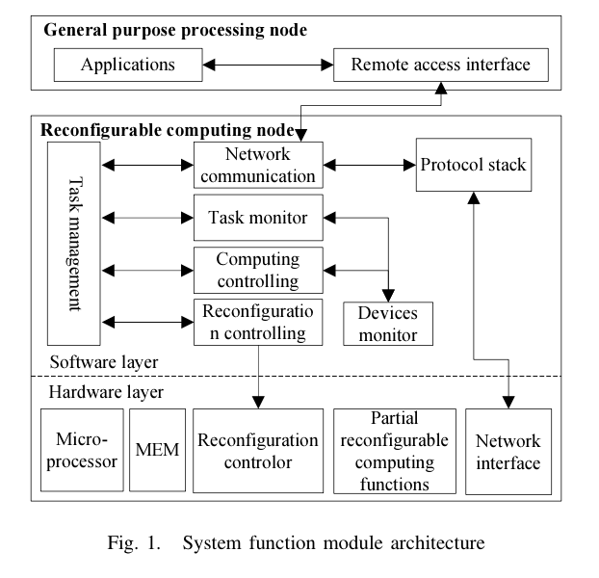
Task management module
responds to the computing tasks delivered by the network communication module.
monitors local configuration.
determines whether the configuration update is necessary
calls reconfigurable module if the update is required.

Slide 9
General Processing Node software
System Software take cares of the following functions
General processing nodes
call the library of interface through which application can access to the reconfigurable computing nodes.
the remote access interface transforms the user specific computing into tasks that can be computed in reconfigurable computing node.
Access library provides uniform access interfaces for the user application program which can call the computing functions through instructions and necessary parameters.
Example, library function for fixed-point matrix multiplication

Slide 10
Example, library function for fixed-point matrix multiplication

Slide 11
Reconfigurable Computing Node Design
Hardware Structure has to handle
designing the basic structure of the system
partitioning the system static and dynamic module
selecting the static module function units
designing the reconfigurable interface module
designing the reconfigurable computing unit
Static logic part is used to implement the uninterrupted task.

Slide 12
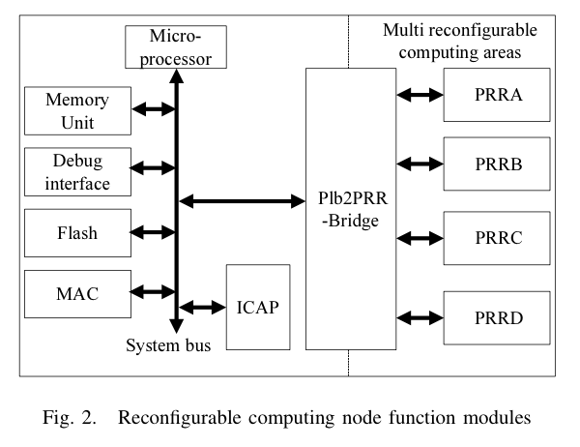
Static logic Partition
The microprocessor takes care of task scheduling.
The media access control(MAC) unit provides the network communication interface.
Memory Cell uses the on-chip BRAM.
Flash memory stores the code execution, data and configuration files.
Reconfigurable control unit embedded with the ICAP module.

Slide 13
Reconfigurable logic Partition
implements different hardware architecture for different computing functions.
Bus and reconfigurable computing unit bridge achieve the communication between static logic and reconfigurable logic.

Slide 14
Reconfigurable Computing node Software
Node Software :
Service program designed to run on the reconfigurable computing nodes to provide computing services to the general-purpose processing nodes.
interface library that provides the application access to the reconfigurable nodes
Reconfigurable nodes on the service side and the general purpose nodes on the client side.

Slide 15
Reconfigurable Computing node Software
Software can be implemented in two ways :
using a real time OS
without any OS
can provide multi-task scheduling, interrupt handling, memory management etc using a real time OS
But uses more intensive system resources
Fewer resources used for system without OS.

Slide 16
Implementation of Dynamic Partial Reconfiguration
Advance Encryption Standard(AES) is one of the applications where this system is incorporated.
AES is the symmetric key block cipher algorithm.
The packet and key length for a block cipher is alterable.
The packet and key length used in our example is 128 bits.
divided into 16-byte packets and organized into 4x4 matrix order.
Matrix is called state.

Slide 17
AES algorithm is formed by iterative transformation.
Each transformation has operations :
Byte substitution(SubByte)
Line Shift(Shift Rows)
Column confused(Mix columns)
Round Keys plus (AddRoundKey)
The calculating functions are divided into several sub-modules.
Memory access modules
Cache modules
Encryption calculation modules
Master Control Module

Slide 18
Master Control module :
controls memory access module
controls encryption module
controls interrupt handling
Encryption calculation sub-module can perform operation on 512 piece operand at once.
Master module takes care of the assignment, controlling the computation process and memory operations.
The hardware implementation of reconfigurable computing nodes include
the implementation of top-level module
generation of partial reconfigurable configurable data
saving partial reconfigurable configurable data.
To generate partial reconfigurable configurable data introduce netlist files, the layout, and the detection of design rules.

Slide 19
System Performance Analysis
Setup used :
Virtex-4 Development board of Avnet with a clock Frequency of 100Mz.
The General-purpose processing nodes use the Core 2 Duo 1.83Ghz processors.
100M Ethernet for interconnection.
Formulae :
Speedup ratio of computing unit = Software execution time of computing function/hardware execution time based on reconfiguration mode.
Speed-up ratio of partial reconfigurable node = Software execution time of applications/ execution time based on reconfiguration mode

Slide 20
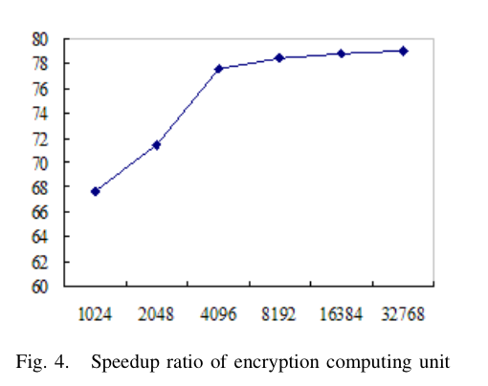
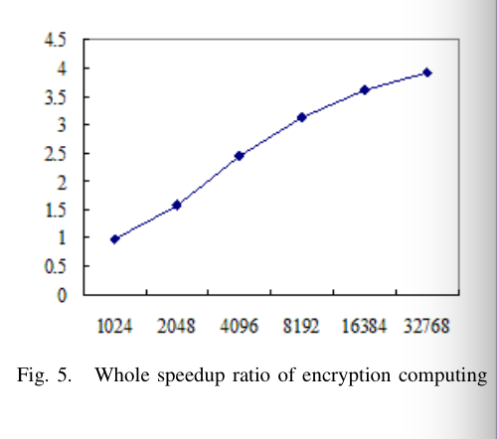

Slide 21
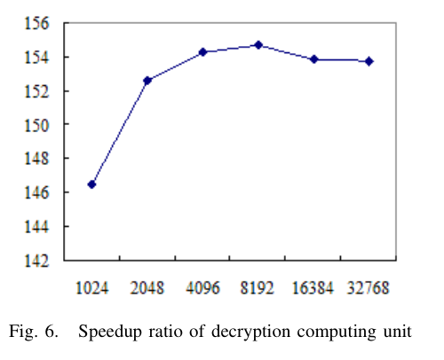
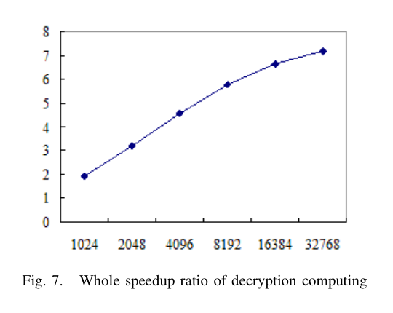

Slide 22
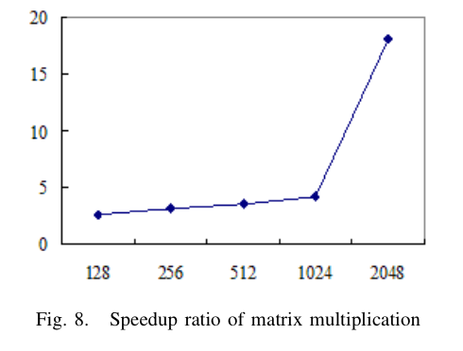
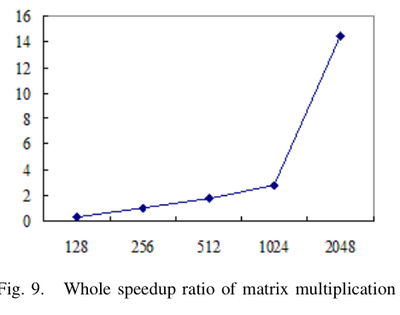

Slide 23
Conclusions
Results show that the design of resources to achieve more functions using the dynamic partial reconfigurable computing nodes alongside the general-purpose processing nodes can improve the system performance.

Slide 24
Maxwell – a 64 FPGA Supercomputer

Slide 25
Developers
The FPGA High-Performance Computing Alliance:
EPCC
Alpha Data Ltd
Nallatech Ltd
Xilinx Corporation
Institute for System Level Integration
Algotronix Ltd

Slide 26
Target Application Requirements
Significant runtime in computational kernels
Computational kernels are small
Computational kernel data can be made private
Data transfers between kernel-private and other data must be minimal

Slide 27
Target Application Requirements
Parallel computational kernels should be compute bound rather than memory bound
Restricted workspace is required for computational kernels
Parallel decomposition must be compatible with a 2D torus

Slide 28
Physical architecture
Maxwell comprises
five IBM BladeCentre chassis
32 IBM Intel Xeon Blades
64 Xilinx Virtex-4 FPGAs
Dell Precision 670 headnode (4 GB memory, 1 TB local SATA)
Each Blade
diskless 2.8 GHz Intel Xeon with 1 GB main memory
hosts two FPGAs through a PCI-X expansion module
FPGAs mounted in two card types
Nallatech H101
Alpha Data ADM-XRC-4FX

Slide 29
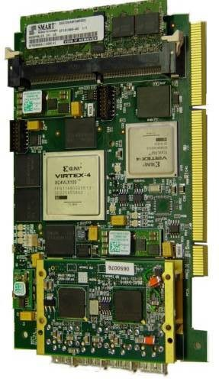
Nallatech H101
Xilinx V4LX160 main device
16 MB SRAM
4x 4MB banks
6.4 GB/s total bandwidth
512 MB SDRAM
1x 512 bank
3.2 GB/s total bandwidth
V2Pro FX4 device for comms
4x 2.5 Gb/s MGT (‘RocketIO’)

Slide 30
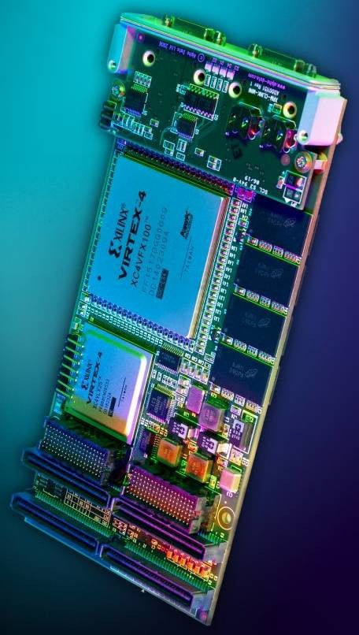
Alpha Data ADM-XRC-4FX
Xilinx V4FX100 main device
16 MB SRAM
4x 4MB banks
6.4 GB/s total bandwidth
1,024 MB SDRAM
4x 256MB banks
8.4 GB/s total bandwidth
Comms inherent in V4FX
4x 3.125 Gb/s MGT (‘RocketIO’)

Slide 31
Overall topology
All 64 FPGAs are wired together directly
two-dimensional 8x8 torus
this direct connection allows full distributed-memory parallel programming purely on the FPGAs
The Xeons are connected over gigabit Ethernet
single 48-way Netgear switch
supports any inter-process communication that remains ‘above’ the FPGA level
Thus two networks
all-to-all ‘software’ network
nearest-neighbour, 8x8 , hardwired ‘FPGA’ network

Slide 32
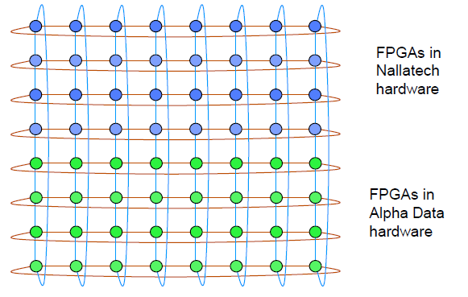
FPGA topology
FPGAs connected in a 2D torus of Rocket IO connections

Slide 33
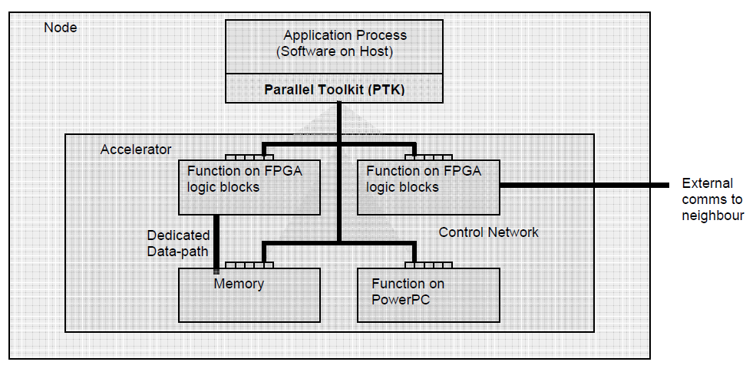
Logical view
As a collection of 64 nodes

Slide 34
Software environment
Linux Red Hat-variant CentOS
Standard GNU/Linux tools
Sun Grid Engine (SGE) as the batch scheduling system
MPI for inter-process communication
Similar to other parallel clusters
But Maxwell also has the FHPCA Parallel Toolkit (PTK)
–a set of infrastructure and practices intended to address acceleration issues

Slide 35
What is the Parallel Toolkit?
The PTK is a set of practices and infrastructure intended to address identified acceleration issues e.g.
associating processes with FPGA resources
associating FPGAs with bitstreams
managing contention for FPGA resources within a process
managing code dependencies to facilitate re-use
PTK infrastructure written mostly in C++
bash used for scripting tasks

Slide 36
Demonstration applications
1. Monte Carlo option pricing (MCopt)
2. Three and four-D facial imaging (DI3D)
3. CSEM modeling – Oil and Gas (OHM3D)

Slide 37
Initial demo benchmarks
Demo 1 –MCopt
runs 320xfaster per FPGA
Demo 2 –DI3D
runs at sustained 2.5xfaster per FPGA
Demo 3 –OHM3D
runs at sustained 5.5xfaster per FPGA (on 8 nodes)

Slide 38
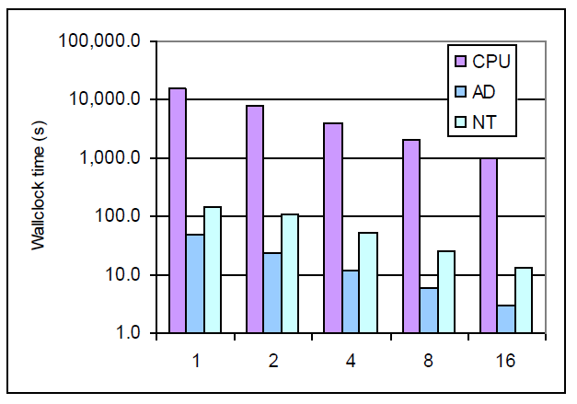
MCopt performance (log scale)

Slide 39
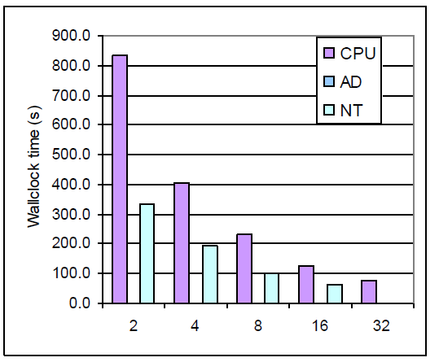
DI3D performance

Slide 40
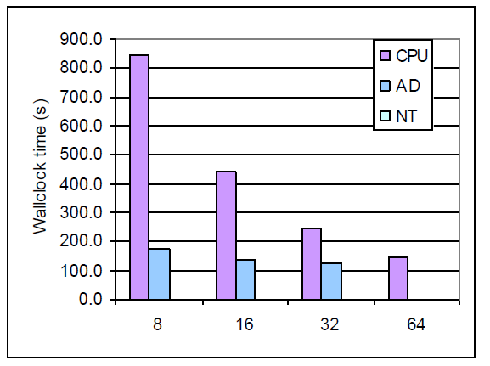
OHM3D performance

Slide 41
Concerns
Can FPGAs be used as main processors?
yes: you can fit a lot of logic
but: complexity & compilation overhead makes development slow
in parallel arrays?
yes: RocketIO is a good connection technology
but: some form of all-to-all routing is desirable
against real HPC applications?
yes: where the numeric kernel is compact & well-defined
but: memory bandwidth limitations are still critical

Slide 42
Limitations and Future work
Not enough experimental data
Even in three given applications
Scalability issues
General purpose??
Explore ways to improve programmability

Slide 43
Novo-G: At the Forefront of Scalable Reconfigurable Supercomputing

Slide 44
Why?
Reconfigurable computing (RC), wherein the architecture adapts to match each application’s unique needs, and thus approaches the speed and energy advantages of application specific integrated circuit (ASIC), while offering the versatility of CPUs.

Slide 45
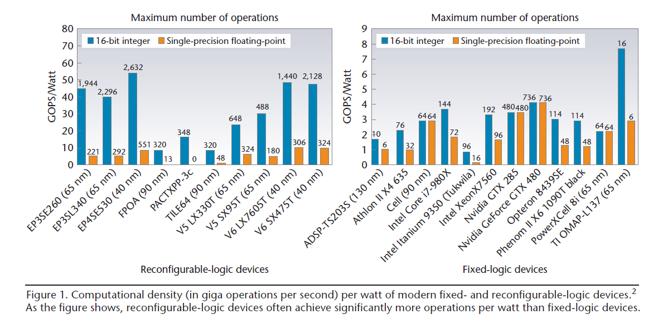
Device performance

Slide 46
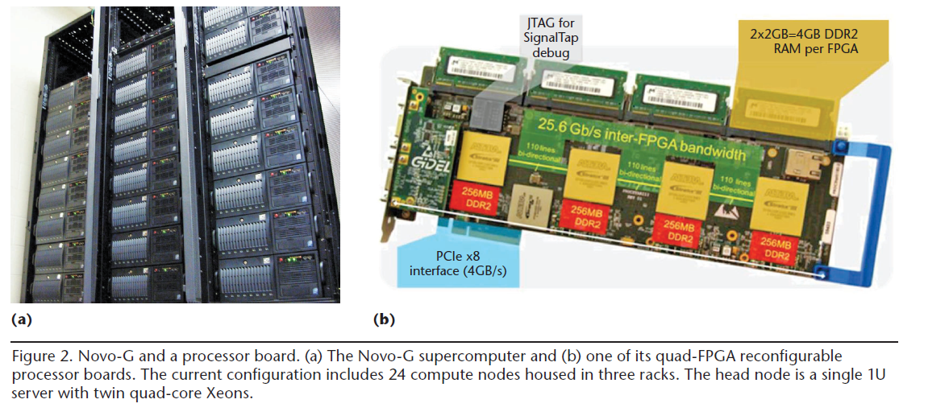
Novo-G and a processor board

Slide 47
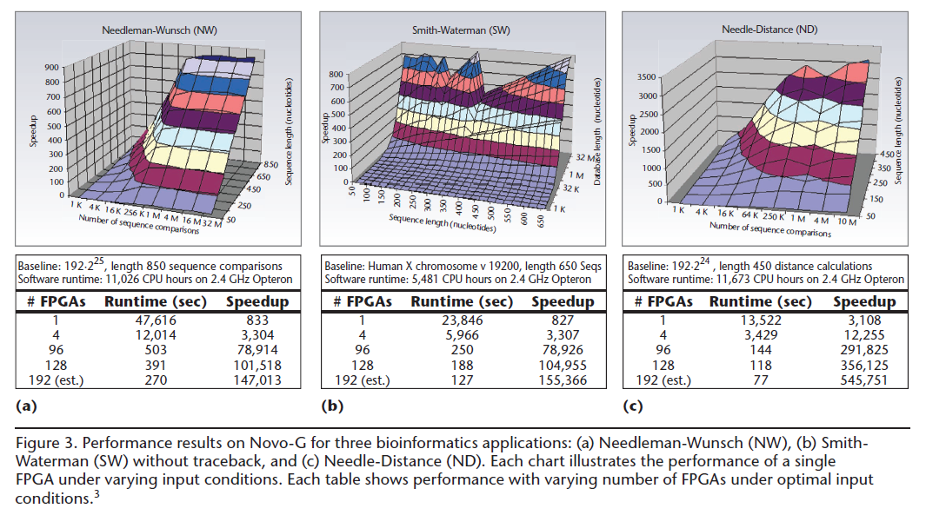
Performance results on Novo-G

Slide 48
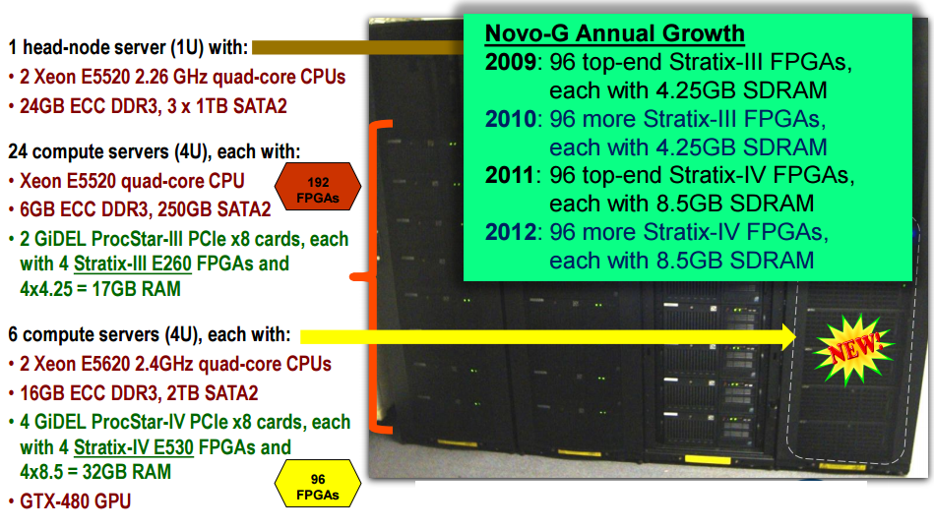
Novo-G

Slide 49
Experimental results
Speedup with one FPGA on each of the three applications peaked at approximately 830 for NW and SW and more than 3,100 for ND
Ramping up from a single FPGA to a quad-FPGA board
speedups grow almost linearly to about 3,300 for NW and SW and more than 12,000 for ND.
At the largest scale of test experiments—32 boards, or 128 FPGA
speedups for NW and SW exceeded 100,000 and ND exceeded 356,000.

Slide 50
Limitations
Memory capacity, throughput, and latency often limit performance if unbalanced
Won’t provide all applications with the same speedups as these examples

Slide 51
PAPERS
Paper 1:
Design and Implementation of a Heterogeneous High-performanceComputing Framework using Dynamic and Partial ReconfigurableFPGAs
Xingjun Zhang ; Yanfei Ding ; Yiyuan Huang ; Xiaoshe Dong Computer and Information Technology (CIT), 2010 IEEE 10th International Conference on DOI: 10.1109/CIT.2010.401 Publication Year: 2010 , Page(s): 2329 – 2334
Paper 2:
Maxwell - a 64 FPGA Supercomputer
Baxter, R. ; Booth, S. ; Bull, M. ; Cawood, G. ; Perry, J. ; Parsons, M. ;Simpson, A. ; Trew, A. ; McCormick, A. ; Smart, G. ; Smart, R. ; Cantle, A. ;Chamberlain, R. ; Genest, G. Adaptive Hardware and Systems, 2007. AHS 2007. Second NASA/ESA Conference on DOI: 10.1109/AHS.2007.71 Publication Year: 2007 , Page(s): 287 - 294 Cited by: Papers (15)
Paper 3:
Novo-G: At the Forefront of Scalable Reconfigurable Supercomputing
George, A. ; Lam, H. ; Stitt, G. Computing in Science & Engineering Volume: 13 , Issue: 1 DOI: 10.1109/MCSE.2011.11 Publication Year: 2011 , Page(s): 82 - 86 Cited by: Papers (18)

Slide 53
THANK YOU

