Slide 1
FAULT TOLERANCE IN FPGA BASED SPACE-BORNE COMPUTING SYSTEMS
Niharika Chatla Vibhav Kundalia
9043-1959 3156-1935

Slide 2
INTRODUCTION
Long mission times and harsh environment are a challenge for electronic circuits in space applications.
Hence it is important to develop efficient error mitigation techniques in order to cope with the transient and permanent faults to improve the reliability of space applications.

Slide 3
FAULT TOLERANCE
The fault may occur in either hardware or software.
The major hardware faults in space applications are radiation induced faults which can be transient or permanent.
Transient faults are caused by single event effects which are induced by high-energy subatomic particles.
Permanent faults are caused by radiation effects, hidden manufacturing defects and aging of the die.
Fault tolerance is the property that enables a system to continue operating properly in the event of the failure of some of its components.

Slide 4
Reconfigurable architecture
Triple modular redundancy is well known to prevent the transient faults from causing functional errors.
But the TMR modules cannot heal the permanent errors themselves.
Hence a dynamic reconfigurable computing FPGA architecture based on a TMR system has been proposed to deal with the transient and permanent errors.
Reconfiguration provides more possibilities for SRAM-based FPGAs into space. Additionally, reconfiguration is an improvement in terms of resource utilization and costs.

Slide 5
Triple modular redundant system
The TMR system mainly includes three TMR modules and the TMR voter.
The control and data signals form each module are voted against each other by a TMR voter.
The function of a voter is to decide the real output of the system.
It uses the classic majority voting scheme.

Slide 6
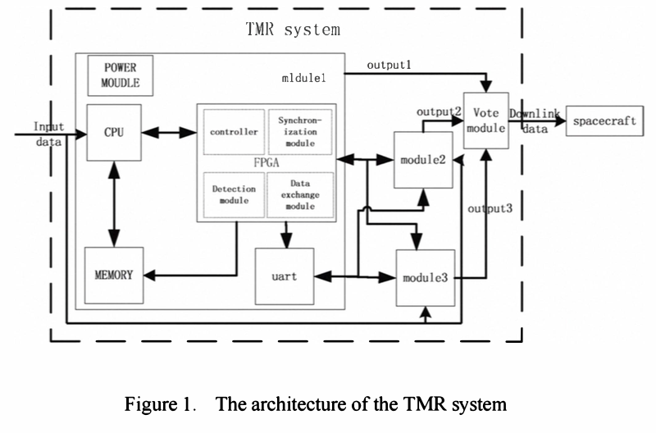
Fig. The architecture of TMR System

Slide 7
SYSTEM ARCHITECTURE
This system implements TMR system which has FPGA incorporated into it for reconfiguration.
Each module has a processor, FPGA , memories and communication portion.
The base processor is 32-bit RISC processor based on SPARC V8 architecture.
The processor implements both the controller and scheduler of the given system.

Slide 8
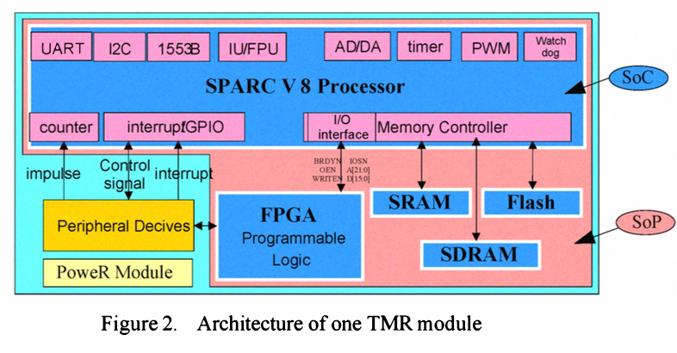

Slide 9
Memories are used to store all the partial reconfiguration bitstream data information and store the software program.
There are three memories, 8M Flash, 1M SRAM and 16M SDRAM.
Hardware units mapped into the FPGA can be interfaced to the system bus through a peripheral bus.
I/O of the processor is used to configure the FPGA.
Download of the FPGA bitstream is performed at the beginning from the FLASH.
To allow validation of the FPGA configuration, the bitstream may be read back by the processor.

Slide 10
DYNAMIC PARTIAL RECONFIGURATION
Each TMR module can be divided into two modules: the fixed module and the reconfigurable module.
Fixed module including the peripheral bus and the IP cores will not be reconfigured at run-time.
The reconfigurable modules placed in reconfigurable area are used for different algorithms.

Slide 11
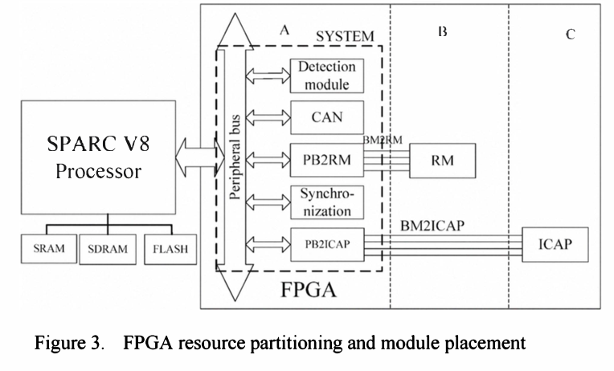
Fig. FPGA resource partitioning and module placement

Slide 12
Module Design
The design methodology is based on modular design concept
Three main modules in whole system : System module, ICAP module, Reconfigurable module.
All connections across different areas connect each other through the Bus Macro, through which the reconfigurable modules connect to the static part of the design and other modules.

Slide 13
SYSTEM MODULE
System module : Data exchange module, synchronization module and required peripherals to run the system are present in it.
PB2RM and BM2ICAP are the interfaces needed between the peripheral bus and the bus macro to write back or read back.

Slide 14
ICAP Module
ICAP module is used to read/write a configuration from/to the BRAM to/ from a specific reconfigurable module
It can finish the self-reconfiguration of the FPGA.
Whenever a new reconfigurable module has been mapped and it starts its computation, the ICAP informs the processor that the reconfiguration action ended.
Then the controller enables all the communications interrupted by the reconfiguration.

Slide 15
Reconfigurable module
The implantation of the RM modules is checked in FGPA compiler before implementation.
A CAN receiver is realized in RM module.
Finally all the bitstreams needed to implement the system description onto FPGA is created and verified.

Slide 16
SELF-REPAIR
Self-repairing is done in a sequence of three steps : Error detection and localization, Reconfiguration and Recovery.

Slide 17
Error detection and localization
It detects faults and raises the countermeasures.
Localization is done by halting the faulty units and all the buffers associated with it.
Transient fault detects accumulated to detect the permanent faults.

Slide 18
Reconfiguration
Repair process is started after an error is detected and its location known.
In case of transient fault reprogramming the FPGA solves the error.
In hardware faults, the circuit has to be moved from the defective area and mapped into unused resources in the FPGA.

Slide 19
Recovery
After reconfiguration, the newly placed device is reset and synchronized with the rest of the device.

Slide 20
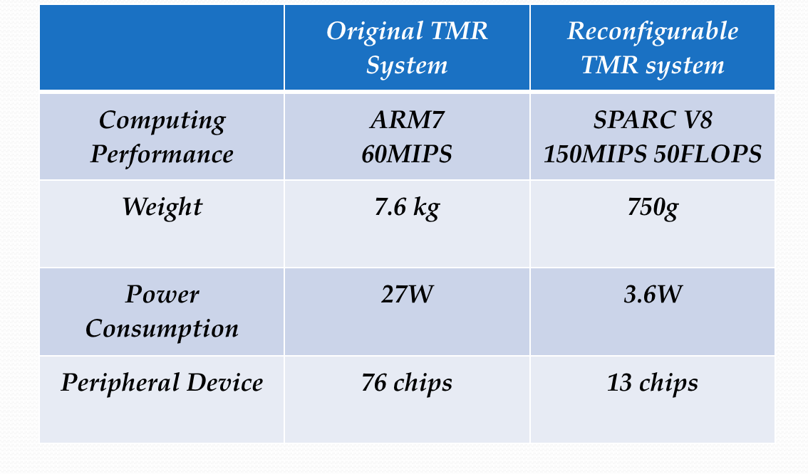
Comparison of the original TMR system with the reconfigurable TMR system architecture
 | Original TMR System | Reconfigurable TMR system
Computing Performance | ARM7 60MIPS | SPARC V8 150MIPS 50FLOPS
Weight | 7.6 kg | 750g
Power Consumption | 27W | 3.6W
Peripheral Device | 76 chips | 13 chips

Slide 21
Decentralized Run-Time Recovery Mechanism for Transient and Permanent Hardware Faults for Space-borne FPGA-based Computing Systems

Slide 22
Concept of Collaborative Macro-Function Units (CMFUs)
Growing demand for commercial space-borne computing systems
Space-grade radiations hardened FPGA vs Commercially available FPGA
Built-In-Self-Recovery (BISR) based on CMFUs
CMFUs can collaborate to perform specific mode of operation
Decentralized
Increased reliability, decreased recovery time

Slide 23
Distributed Architecture for Fault Tolerance and Mitigation

Slide 24
CMFU
Macro-function-level processors based on customizable cores
Cores are augmented with additional functionality
Implemented in form of a Co-Op Unit
A) Scheduling of Processing and BIST Activities
B) Scheduling of Connections and Disconnections
C) Mode Monitoring, Connectivity Requests

Slide 25
Co-op Unit FSM Behavior

Slide 26
Distributed Control and Communication Infrastructure
Must provide communication capabilities to components in system
Must be able to implement the connectivity requirements and respond to connectivity change requests correctly
Must distribute health information for the system components (including its own)

Slide 27
Communication and Control Infrastructure Architecture

Slide 28
Connector Unit FSM Behaviour

Slide 29
Example System Architecture

Slide 30
Process of Mitigation
1) Download new bit-stream for the component, targeting a different slot
2) Change operation mode, such that the relocated component is used
3) Load a test bit-stream into the faulty slot or connector unit
4) Run BIST procedures determine if fault is permanent

Slide 31
Resource Costs and Overheads

Slide 32
Resource Costs and Overheads
Resource overhead comparison

Slide 33
Conclusion and Shortfall
Conclusion
Allows for mitigation for both transient and permanent faults by dynamic component re-location
Recovery from single point faults take the same time and therefore predictable
Reduced recovery time
Hardware overhead per slot is not much compared to duplex or TMR solutions
Shortfall
The configuration engines are not discussed

Slide 34
Reference papers
Paper 1 -
Implementation of a reconfigurable computing system for spaceapplications
Yimao Cai ; Yuanfu Zhao ; Lidong Lan System Science, Engineering Design and Manufacturing Informatization (ICSEM), 2011 International Conference on Volume: 2 DOI: 10.1109/ICSSEM.2011.6081320 Publication Year: 2011 , Page(s): 360 - 363
Paper 2 -
Decentralized run-time recovery mechanism for transient and permanent hardware faults for space-borne FPGA-based computingsystems
Dumitriu, V. ; Kirischian, L. ; Kirischian, V. Adaptive Hardware and Systems (AHS), 2014 NASA/ESA Conference on DOI: 10.1109/AHS.2014.6880157 Publication Year: 2014 , Page(s): 47 - 54

