Slide 1
Concentration Zone/ Delta correlation based data prefetcher aided by stream buffer
Kowshick Boddu
04/09/2015

Slide 2
Prefetch
Hardware driven; hardware decides which memory addresses to prefetch based on past accesses or future instructions
problems with lateness, inaccurate addresses, lengthening the critical path)
Software driven; compiler issues prefetch instructions
problems with extra instruction overhead

Slide 3
Czone/Delta Correlation Prefetching
Divides the memory space into equal-sized concentration zones(Czones)
Global history buffer to detect patterns in miss address “deltas” within each Czone
A tuning algorithm dynamically configures Czone sizes and prefetch degree - Adaptivity

Slide 4
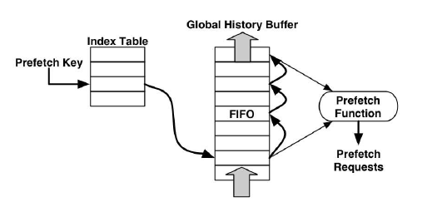
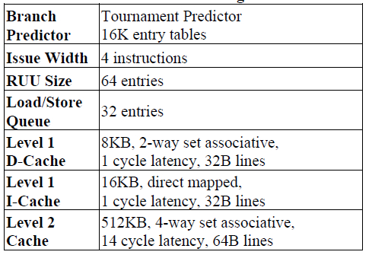
Implementation
Global history buffer pre-fetching
Configuration

Slide 5
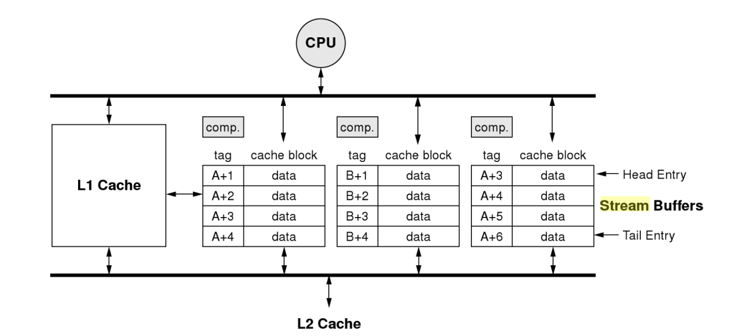
Small Stream buffer aiding prefetch
Screen clipping taken: 09-12-2014, 02:09
Reference
N. P. Jouppi. 1990
“Improving direct-mapped cache performance by the addition of a small fully-associative cache and prefetch buffers”

Slide 6
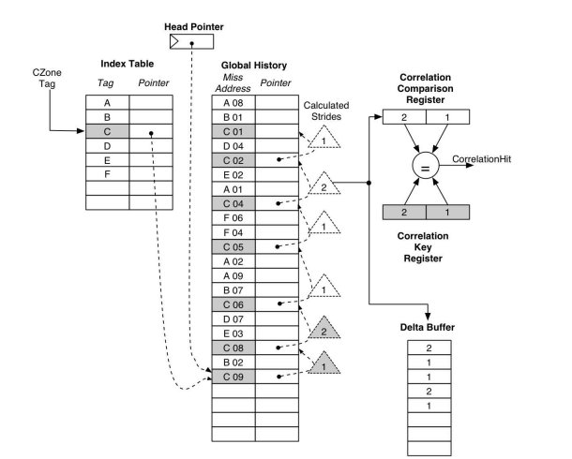
Prefetch hardware on Cache Miss

Slide 7
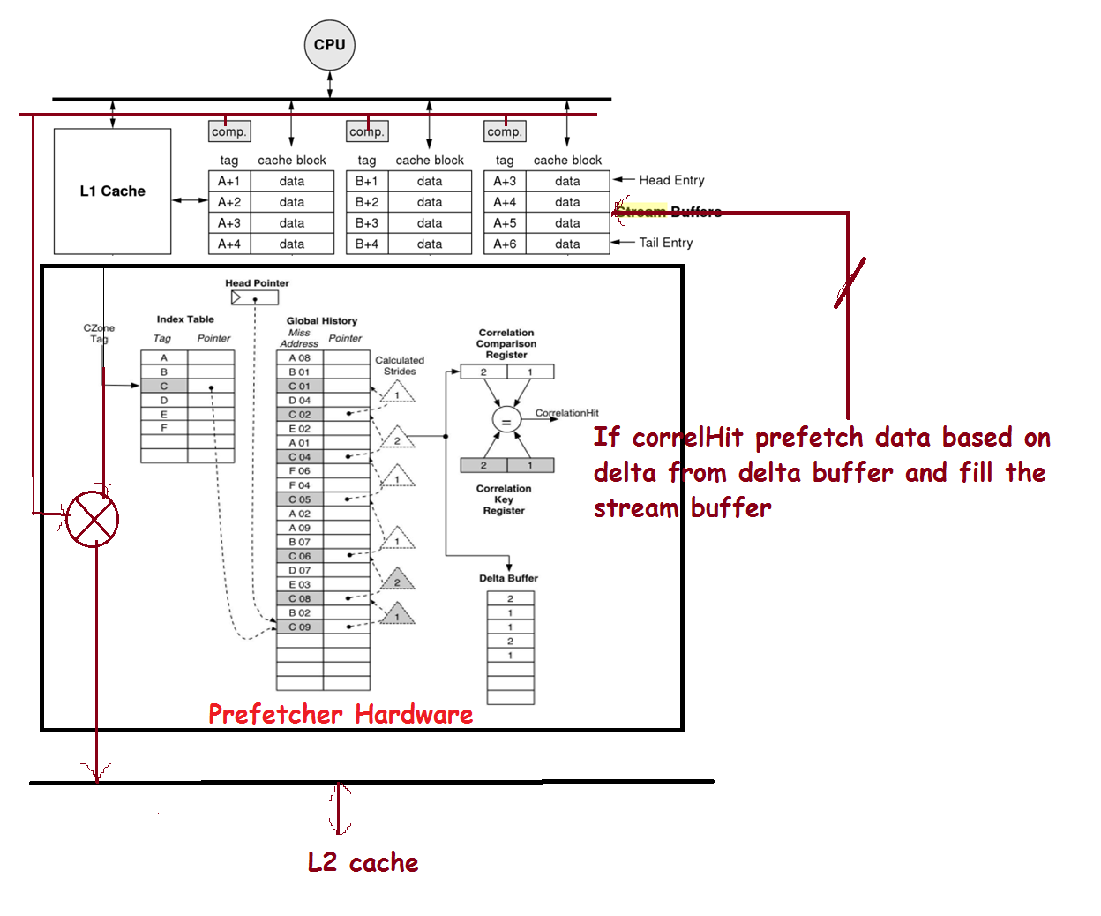

Slide 8
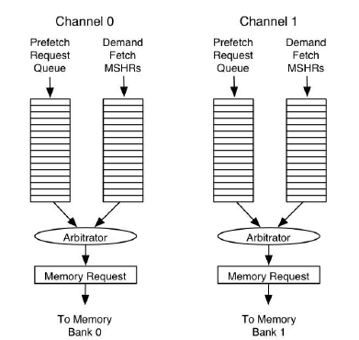
Memory Bus interface
Miss status handling register for demand fetches
Keeps track of the demand fetch FIFO
If MSHR reaches high, prefetch is stalled untill Demand fetch is empty

Slide 9
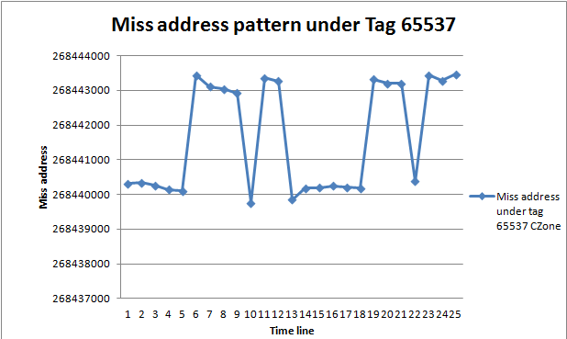
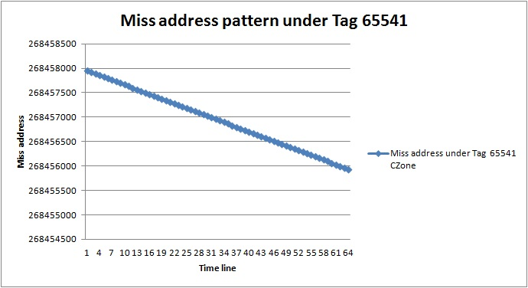
Visual represention of cache access

Slide 10
Adaptive prefetching
Different programs use different data structure and access patterns
Optimal Czone size and prefetch degree vary across programs and within single program
Adopted Algorithms
Oracle Tuning
Phased-Based Tuning

Slide 11
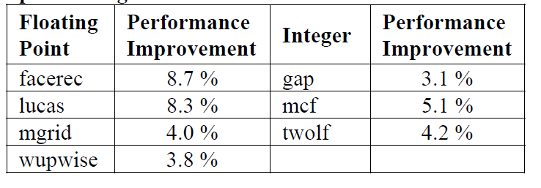
Oracle Tuning Algorithm
Divides program execution into fixed intervals of one million instruction
Performance evaluation for varying Czone size and varying prefetch degree
Choose the best configuration at the end
Performance improvement with oracle tuning

Slide 12
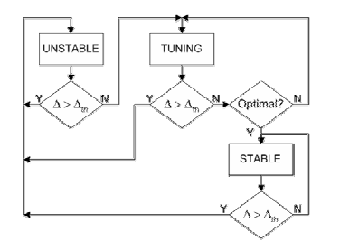
Phased-Based Tuning Algorithm
Control dynamically configutrable hardware structures
Tuning is performed on phase change
Tuning algorithm for dynamic adaption

Slide 13
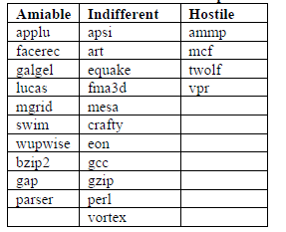
Benchmarks
Three groups of benchmarks
Amiable – Atleast one prefetching method stuided improves performance by more than 5%
Indifferent – None of the prefetching methods hurt performance, and no method improves by 5%
Hostile - Prefetching tends to degrade performance
Benchmark Groups

Slide 14
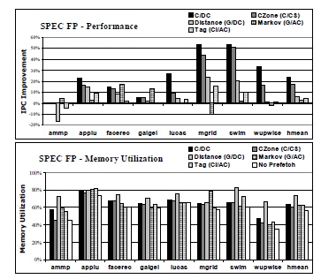
Evaluation/Results(1/3)
SPEC FP IPC Improvement and Memory utilization

Slide 15
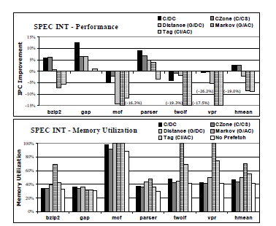
Evaluation/Results(2/3)

Slide 16
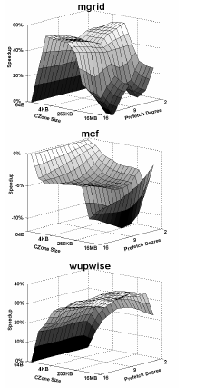
Perfomance variation

Slide 17
Conclusions
C/DC requires very small prefetch table (few kilobytes) when compared to other methods
Czone prefetch is sensitive to Czone size, Optimal Czone size
Not as accurate as constant stride prefetch method leading to higher memory utilization
Limitations of the paper
No clear explanation of what the execution phases of the program

Slide 18
Thank You Questions?

