Slide 1
Virtualizing and Sharing Reconfigurable Resources in High-Performance Reconfigurable Computing Systems
Presented by : Shreya sriperumbuduri
Siddharth ambadasu
Jayalakshmi muthiah
1/57

Slide 2
Citation
El-Araby, E.; Gonzalez, I.; El-Ghazawi, T., "Virtualizing and sharing reconfigurable resources in High-Performance Reconfigurable Computing systems," High-Performance Reconfigurable Computing Technology and Applications, 2008. HPRCTA 2008. Second International Workshop on , vol., no., pp.1,8, 16-16 Nov. 2008
doi: 10.1109/HPRCTA.2008.4745683
Keywords: {field programmable gate arrays;microprocessor chips;parallel architectures;reconfigurable architectures;Cray XD1;Cray XT5h;FPGA chips;SPMD programming model;asymmetric distribution;high-performance reconfigurable computing systems;microprocessors;parallel computers;partial run-time reconfiguration;reconfigurable processors;reconfigurable resources;single-program multiple-data model;Concurrent computing;Coprocessors;Field programmable gate arrays;Hardware;High performance computing;Microprocessors;Permission;Platform virtualization;Resource virtualization;Runtime;Dynamic Partial Reconfiguration;Field Programmable Gate Arrays (FPGA);High Performance Computing;Reconfigurable Computing},
URL: http://ieeexplore.ieee.org/stamp/stamp.jsp?tp=&arnumber=4745683&isnumber=4745673
2/57

Slide 3
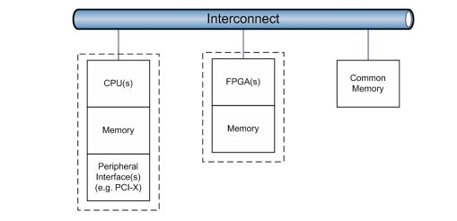
High Performance Reconfigurable Computers
What are high performance reconfigurable computers?
- High Performance Computers are Parallel Computers with added FPGA chips.
- Give efficient Speed up’s.
Examples of HPRC’s
> Cray XT5h , Cray XD1 ,
SRC-7 , SRC-6 and
SGI Altix/RASC.
3/57

Slide 4
Single Program Multiple Data
Execution of Parallel Applications on High Performance Reconfigurable Computers (HPRC) follows Single Program Multiple Data (SPMD) model.
The single program, multiple data (SPMD) model of parallelism consists of a set of parallel threads that run the same program.
SPMD model combines independent threads of execution with global collective communication and synchronization operations.
4/57

Slide 5
Challenges
Major challenges faced during the implementation of SPMD model are
Asymmetric Distribution of the Reconfigurable Processors relative to the Conventional Processors.
Heterogeneity caused as reconfigurable processors (FPGA’s) are used as Co-processors.
Underutilization of processing resources when the ratio of microprocessors, reconfigurable processors and communication channels differ from unity.
5/57

Slide 6
Motivation
Proposal to share reconfigurable resources among underutilized microprocessors through Virtual SPMD view.
Increase in the number of virtual reconfigurable resources to obtain unity ratio among the resources and maintain symmetry.
Partial Run-Time Reconfiguration (PRTR) is used for hardware virtualization techniques and the experimental setup is performed on Cray XD1 HPRC system.
6/57

Slide 7
Virtual Hardware
Virtual Hardware is
Effective and efficient technique to increase the availability of hardware resources
Implement larger circuits
Reduce the costs by adopting smaller FPGA
Virtual FPGA architecture increases Flexibility
Architecture is defined for Virtual FPGA which can be implemented among different existing components.
Virtual architecture has limited amount of Virtual logic blocks and slower clock speed compared to real FPGA component.
7/57

Slide 8
Run time Reconfiguration
Full Run-Time Reconfiguration (FRTR)
FRTR divides applications into a number of modules with each module implemented as a separate circuit.
Modules are dynamically uploaded onto the reconfigurable hardware as they are needed to implement the application.
The reconfiguration latency (time) introduces a significant overhead for FRTR.
Partial Run-Time Reconfiguration (PRTR)
Application modules can be dynamically uploaded and deleted from the FPGA chip without affecting other running modules.
8/57

Slide 9
Run time Reconfiguration
Users cannot modify the existing HPRC system nor have access to the FPGA configuration ports.
Use the API functions provided by vendor.
Proposed a Virtualization infrastructure consisting of an OS Run-Time layer augmented with another layer of user APIs.
virtualization infrastructure is extended for sharing the reconfigurable processors, and their communication channels.
9/57

Slide 10
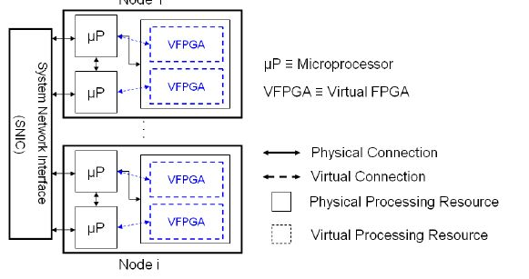
Execution Model
Assume HPRC architecture with asymmetric heterogeneity at the node level.
Input applications require a few hardware functions (tasks) that need to be executed on dedicated reconfigurable resources.
Physical reconfigurable resources (FPGAs) will be virtualized and split into multiple virtual FPGAs (VFPGAs).
Figure: SPMD view of
reconfigurable resources
on HPRCs
10/57

Slide 11
SPMD considerations
Application tasks are distributed across the VFPGAs maintaining a 1:1 correspondence among the tasks and their dedicated resources (VFPGAs).
Maximum number of VFPGAs/PRRs should not exceed the number of microprocessors per node.
The required tasks by applications, Ntasks, are assumed to be equal to or less than the maximum number of VFPGAs/PRRs, Nregions.
The condition, i.e. Ntasks ≤Nregions, has to be satisfied for SPMD model.
11/57

Slide 12
Execution Cycle
The execution cycle for any task on an HPRC consists
computations time
The total I/O time
The configuration time
12/57

Slide 13
FRTR
The execution model of FRTR on each node is sequential among tasks.
Typical task execution using FRTR on HPRC
13/57

Slide 14
PRTR
The execution model of the proposed virtualization technique and sharing mechanism is a combination of three processes
Entry/Birth Process
Computation Process
Exit/Death Process
In the proposed model tasks can continue their computations in parallel while other tasks are entering into and/or exiting from the system.
14/57

Slide 15
Mathematical Model Notations
The following notation will be used in our mathematical model
N_{regions} is the maximum number of VFPGAs that can be provided based on the available microprocessors.
N_{tasks} is the total number of hardware tasks.
T_{in} is the average input transfer time from any microprocessor to its dedicated VFPGA.
T_{comp} is the average task computation time.
T_{out} is the average output transfer time from any VFPGA to its associated microprocessor.
15/57

Slide 16
Mathematical Model Notations (Cont..)
T_{config} = T_{FRTR} is the full configuration time for FRTR.
T_{PRTR} is the average partial configuration time for PRTR.
T^{FRTR} _{total} is the total execution time of FRTR.
T^{PRTR} _{total} is the total execution time of PRTR
S is the speedup or performance gain of using PRTR relative to FRTR
16/57

Slide 17
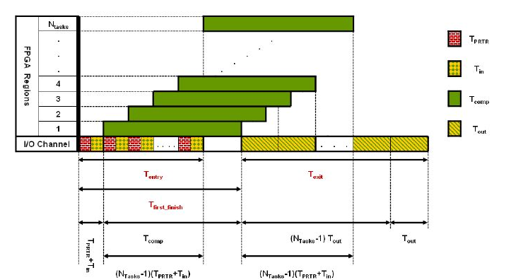
Execution Profile For Sharing Virtual Reconfigurable Resources
Different traffic scenarios depending on the relative speed rates among Entry/Birth, Computation, Exit/Death processes
Faster entry than computation, with slower exit than entry
17/57

Slide 18
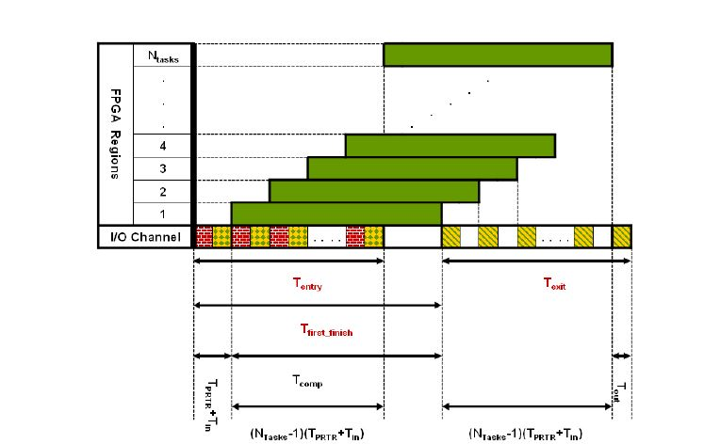
Execution Profile For Sharing Virtual Reconfigurable Resources
Faster entry than computation, with faster exit than entry
18/57

Slide 19
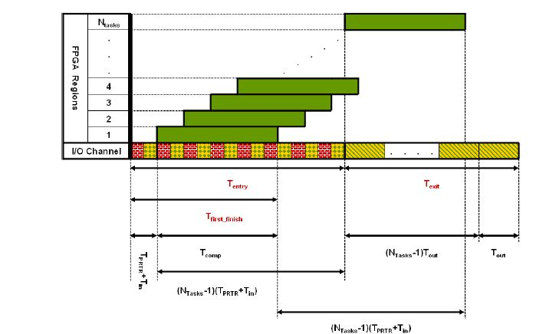
Execution Profile For Sharing Virtual Reconfigurable Resources
Slower entry than computation, with slower exit than computation
19/57

Slide 20
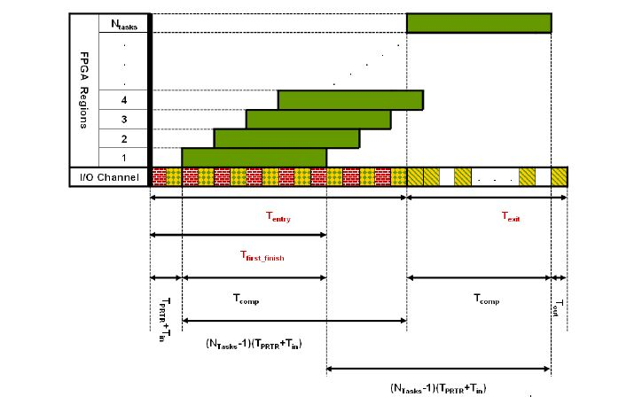
Execution Profile For Sharing Virtual Reconfigurable Resources
Slower entry than computation, with faster exit than computation
20/57

Slide 21
Mathematical Model Derivations
Combining the necessary condition for SPMD behavior and entry and exit conditions shown in above figures
Total Execution time:
The performance gain (speedup) of PRTR in reference to
21/57

Slide 22
Mathematical Model - Summary
Estimating the upper bound for the performance gain (speedup) as the number of tasks increases indefinitely,
From the above equation, the asymptotic performance gain increases linearly with the task computation.
The proposed technique significantly reduces the total execution time.
22/57

Slide 23
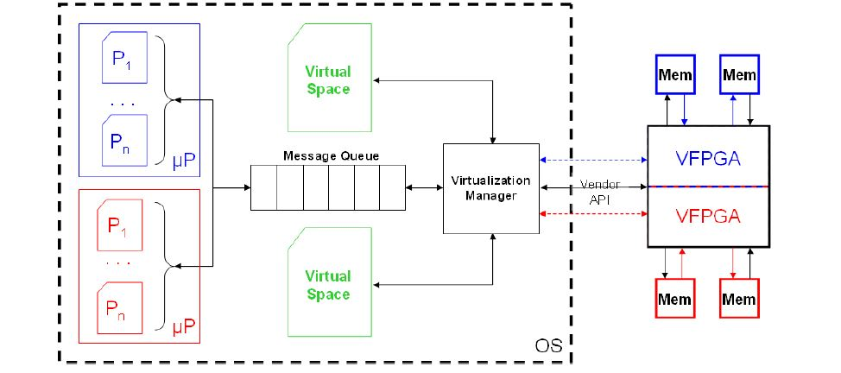
Experimental Setup
Internal Configuration Access Port (ICAP)
used to develop new API for enabling PRTR
on Cray XDI HPRC system.
First layer is an Operating System (OS)
Run-Time Services layer on top of which lies
the second layer which is an API layer.
Run-Time virtualization layer
consists of
1. Virtualization manager (VM)
2. Request queue
3. Virtual memory space.
APIs are categorized as Setup APIs,
Configuration APIs, Transfer of Control APIs,
and Execution APIs
23/57

Slide 24
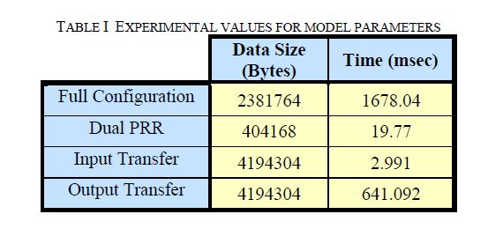
Experimental Results
Table shows data transfer times, configuration times as well as the bit stream size associated
with the layout configuration considered i.e sequence of image processing functions, namely median filtering followed by sobel edge detection as well as smoothing filtering.
24/57

Slide 25
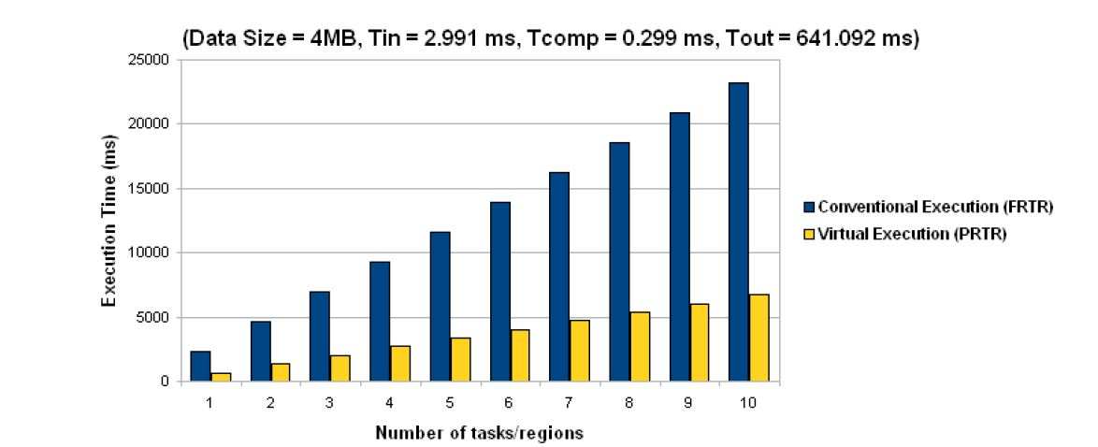
Behavior of I/O Intensive Applications
25/57

Slide 26
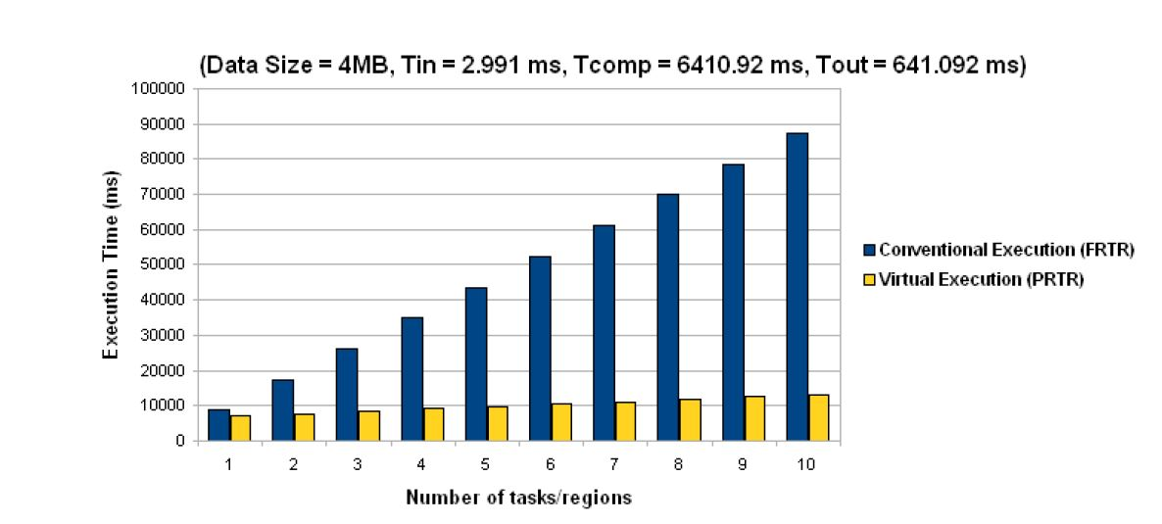
Behavior of Computational Intensive Applications
26/57

Slide 27
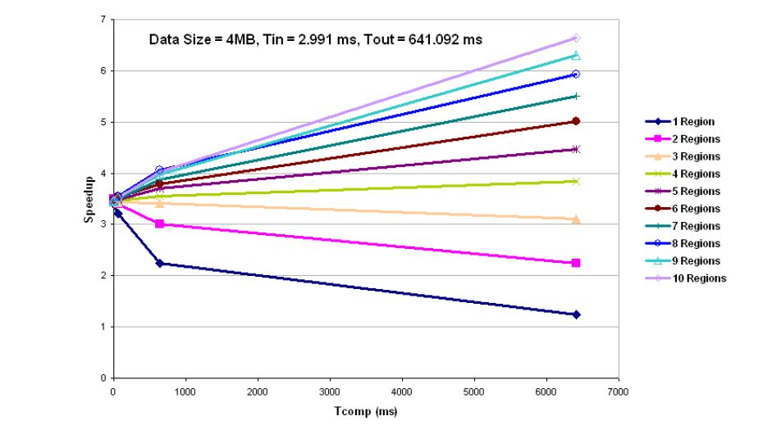
Speedup Achieved using Multiple PRRs(VFPGA’s)
27/57

Slide 28
Conclusion
From theoretical and practical setup we derived a formal and an analytical model of SPMD execution on HPRC systems relative to the baseline of Full Run-Time Reconfiguration (FRTR).
The experimental results showed good agreement with the analytical model expectations.
Sharing reconfigurable resources among the underutilized microprocessors by providing a virtual SPMD view allows improving the overall system versatility and application performance.
28/57

Slide 29
Run-Time Resource Allocation for Simultaneous Multi-Tasking in Multi-Core Reconfigurable Processors
29/57

Slide 30
Citation
Ahmed, W.; Shafique, M.; Bauer, L.; Hammerich, M.; Henkel, J.; Becker, J., "Run-Time Resource Allocation for Simultaneous Multi-tasking in Multi-core Reconfigurable Processors,"Field-Programmable Custom Computing Machines (FCCM), 2011 IEEE 19th Annual International Symposium on , vol., no., pp.29,32, 1-3 May 2011 doi: 10.1109/FCCM.2011.46
Keywords: {microprocessor chips;multiprocessing systems;reconfigurable architectures;adaptive reconfigurable fabric allocation;functional-block-level performance constraint;mixed-grained reconfigurable fabric resource;multicore reconfigurable processor;run-time resource allocation;simultaneous multitasking;task-criticality;video conferencing;Decoding;Fabrics;Kernel;Multicore processing;Program processors;Quality of service;Resource management},
URL: http://ieeexplore.ieee.org/stamp/stamp.jsp?tp=&arnumber=5771243&isnumber=5771238​
30/57

Slide 31
Introduction
Modern Multi-core reconfigurable processors are mixed-grained.
Various cores coupled with multiple fine-grained and coarse grained reconfigurable fabrics
Fine-grained fabric – bit/byte-level operations (bit shuffling, packaging, merging etc.)
Coarse-grained fabric – (sub)-word-level operations (add, subtract, multiply, etc.)
There is a need to efficiently support simultaneous multi-tasking with run-time mixed-grained fabric allocation in multi-core reconfigurable processors for exploiting the Task-Level Parallelism!!!!
31/57

Slide 32
Motivation
Multi-core Reconfigurable processors exploit
Task-level Parallelism: by executing multiple tasks on different cores in parallel
Instruction-level Parallelism: by accelerating the functional blocks of applications using Instruction Set Extensions (ISEs) to the cores.
- ISEs consist of data-paths that may be reconfigured on parts of a fine-grained or a coarse-grained reconfigurable fabric - shared among different cores.
- This enables different kernels to have different ISEs – different speedups for different utilizations of fabric.
32/57

Slide 33
Motivation (Contd..)
Challenges to fully exploiting simultaneous multi-tasking:
a) Heterogeneous nature of fine- and coarse-grained fabrics and the scenarios of runtime varying
task mapping,
workload conditions, etc.
b) lack of efficient fabric allocation schemes that operate with consideration of simultaneous multi-tasking.
33/57

Slide 34
Role of Dependent Tasks
Dependent tasks share a common deadline and priority – application based.
Example: video conferencing application, the video and audio encoding and decoding tasks are considered as dependent tasks as they share a common deadline (30 frames/sec) and they depend on each other as they cannot start their next job until both of them do not complete their job.
34/57

Slide 35
Role of Dependent Tasks
Dependent tasks significantly differ in their memory requirements and computational properties.
Example: Some tasks exhibit control-dominant and/or bit/byte-level processing (bit shuffling, packing, merging, etc.), while some other tasks exhibit data-dominant and/or (sub) word-level processing.
The requirements of these tasks may vary frequently at run time - which may lead to the situation where one or more tasks may become critical in determining the overall Quality of Service (QoS) of dependent tasks.
35/57

Slide 36
Task’s Criticality
The task is termed as critical if it misses or going to miss the deadline and the margin with which the task misses (or going to miss) the deadline denotes the task’s criticality.
Importance of criticality the dependent tasks - to perform load balancing and frequency scaling
To enable simultaneous multi-tasking on multi-core reconfigurable processors under high throughput and QoS constraints
- a run-time system is desirable that efficiently allocates the mixed-grained fabric resource (at run-time) among different competing dependent tasks, while considering their respective criticalities
36/57

Slide 37
Our Approach
Processor Control Unit
- an integral run-time system for multi-core reconfigurable processors.
It ensures the application’s QoS by dynamic deadline adaptations and mixed-grained fabric allocation to simultaneous multiple tasks at the functional block level.
The proposed processor control unit achieves this using its two major components:
Constraints-based Fabric-Allocator
QoS Controller
37/57

Slide 38
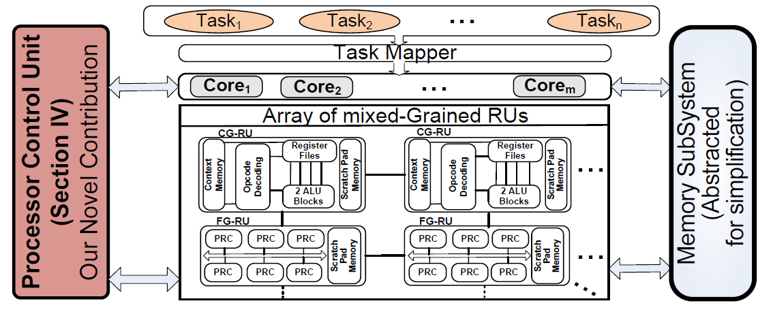
OUR MULTI-CORE RECONFIGURABLE PROCESSOR
38/57

Slide 39
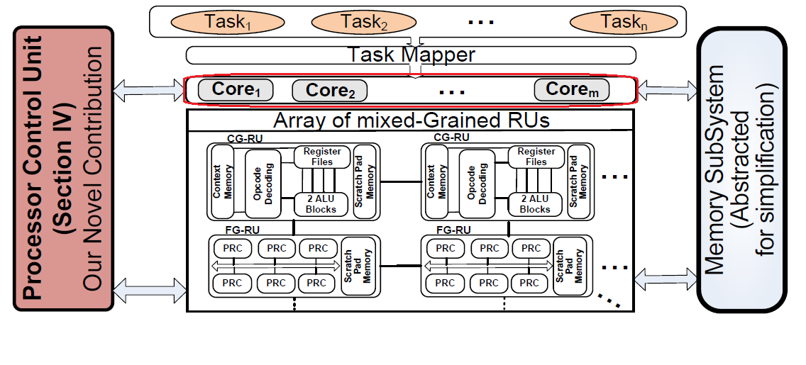
OUR MULTI-CORE RECONFIGURABLE PROCESSOR
Integration of Processor Control Unit with the multi-core reconfigurable processor:
Several RISC cores tightly-coupled with an array of fine-grained (FG)- and coarse-grained (CG)- reconfigurable units (RUs).
39/57

Slide 40
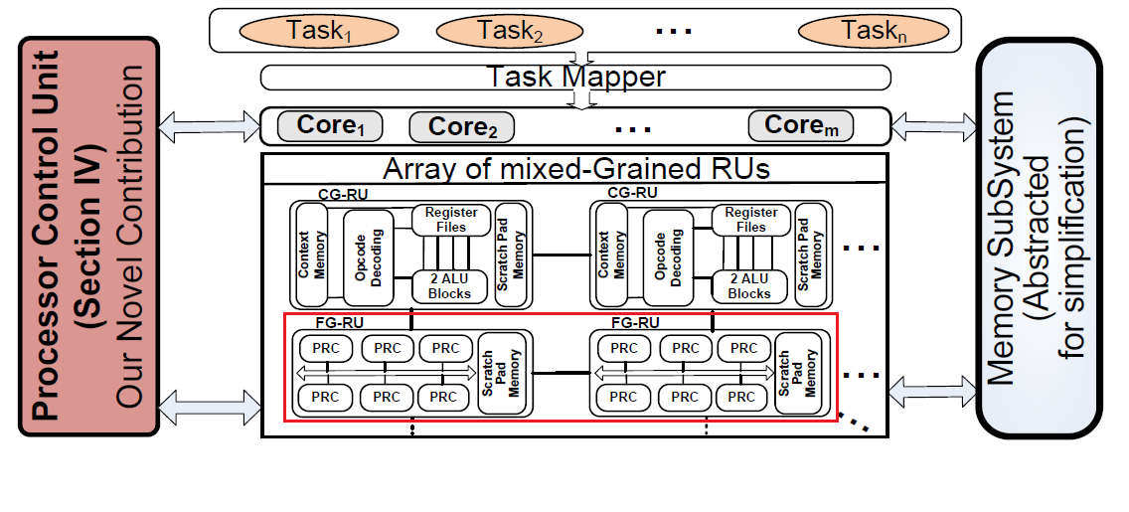
OUR MULTI-CORE RECONFIGURABLE PROCESSOR
Integration of Processor Control Unit with the multi-core reconfigurable processor:
A FGRU is realized as an embedded FPGA, which consists of Partially Reconfigurable Containers (PRCs) that can be reconfigured to contain different hardware accelerators.
40/57

Slide 41
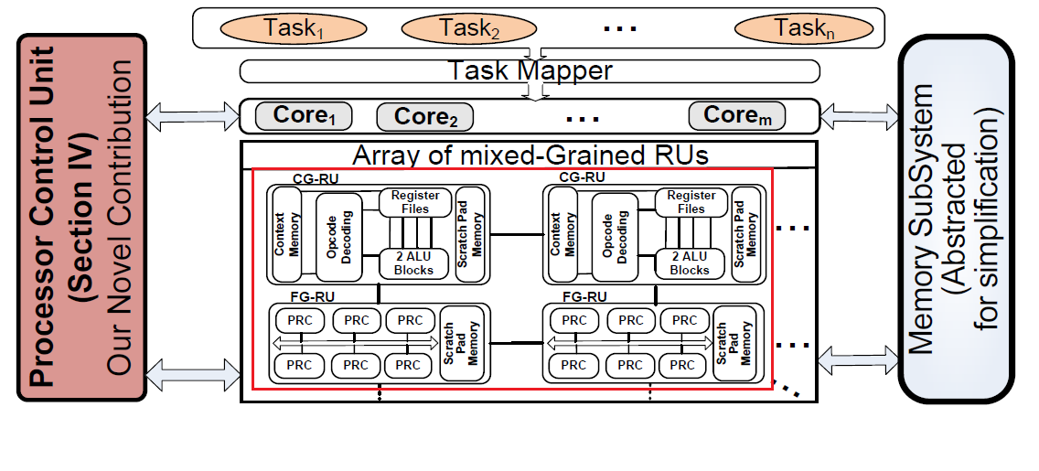
OUR MULTI-CORE RECONFIGURABLE PROCESSOR
Integration of Processor Control Unit with the multi-core reconfigurable processor:
Both FG- and CG-RUs have dedicated scratch pad memories – connected to the Memory Sub-System – to allow for fast data access and to store intermediate results.
41/57

Slide 42
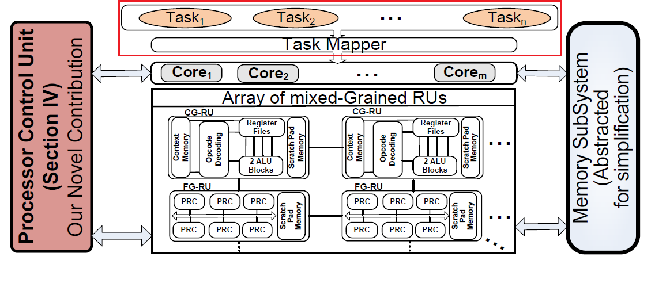
OUR MULTI-CORE RECONFIGURABLE PROCESSOR
Integration of Processor Control Unit with the multi-core reconfigurable processor:
The Task Mapper maps an incoming task to a RISC core.
Different RISC cores can execute their tasks in parallel and use RUs to expedite them.
42/57

Slide 43
PROCESSOR CONTROL UNIT
reacts to different scenarios, while considering the system constraints, the current load on the system, and the utilized resources.
enables the possibility to bring the system to perform with required QoS under run-time varying scenarios.
43/57

Slide 44
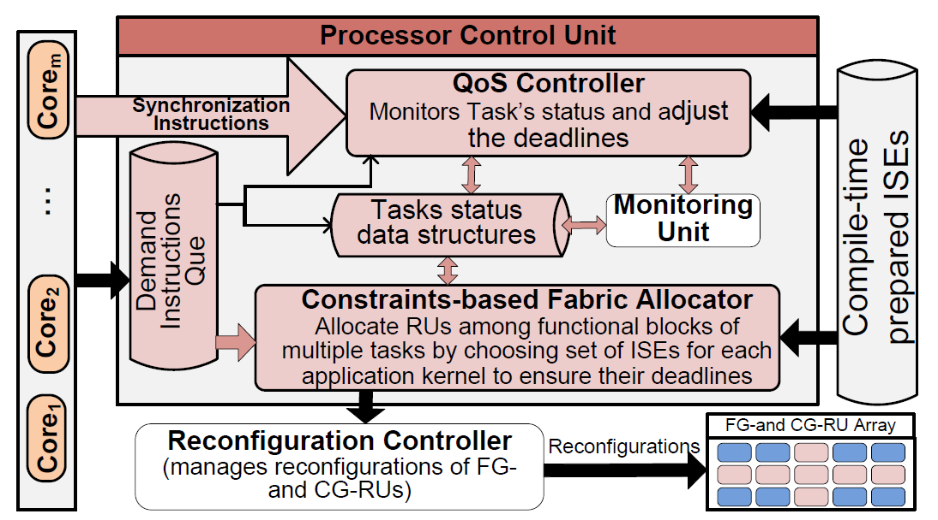
PROCESSOR CONTROL UNIT
44/57

Slide 45
PROCESSOR CONTROL UNIT
Each task requests the fabric area for its upcoming predicted functional blocks by issuing a Demand Instruction to the PCU.
The PCU queues these Demand Instructions if it is already processing a previous Demand Instructions.
Otherwise it starts the Constraints-based Fabric Allocator to allocate the Reconfigurable Units (RUs) to the demanding tasks.
The goal of Processor Control Unit at run time is to meet the deadlines of each task.
It employs the Constraints-based Fabric Allocator and the QoS Controller to achieve this goal.
45/57

Slide 46
QoS Controller
The QoS Controller is triggered by Demand Instructions and Synchronization Instructions that are issued at QoS check points.
It determines the criticalities for all executing tasks, which is used as an input to Constraints-based Fabric Allocator.
The main objective is to fine-tune the deadlines assigned to each functional block.
Initially the deadlines are proportionally distributed at functional block level based on their expected execution time.
At run-time, QoS Controller uses the real time values monitored by the monitoring unit
46/57

Slide 47
QoS Controller
QoS calculates the actual time taken by the previous functional blocks of the given task during the same QoS period
Based on the actual time t_{k} taken by preceding functional blocks (i.e. 0,…,i-1)
and deadlines (fb_dl) assigned to the subsequent functional blocks (i.e. i,…, n),
the QoS Controller estimates the total time that task would require to complete its job and then adjusts the deadlines of remaining functional blocks proportionally
The objective of the QoS controller at the completion of QoS period is to estimate the achieved QoS of each task and assign criticality.
The criticalities are proportionally estimated based on the time left for each active task to complete its job.
47/57

Slide 48
Constraints-based Fabric Allocator
allocates the RUs to the predicted functional blocks in such a way that each functional block can fulfill its deadline
choosing a performance efficient set of ISEs.
Known: The number of CG-RUs and the total number of PRCs
Task of CFA - to find the set of ISEs for all parallel executing tasks with goal that each functional block achieves its deadline
Constraint: the fabric used by all tasks at any instance is not more than the total fabric area.
Output: the list of data-paths which need to be reconfigured on the allocated Rus.
Heuristic based algorithm employed due to run-time nature of our Constraints-based Fabric Allocator
48/57

Slide 49
Constraints-based Fabric Allocator
sorts the tasks with respect to their criticalities
favors the local optimal task t_{s} by giving more resources to it with the goal of minimizing the difference between the deadline d_{x,y} and actual time t_{x,y} taken by functional block y of task x
The QoS Controller updated the task criticalities, which are feed back to Constraints-based Fabric Allocator to fine-tune the found solution
49/57

Slide 50
Experimental Setup
Leon-II processor (based on SPARC V8 architecture) as RISC cores.
The CG-RUs are operating at 400 MHz, while the FG-RUs are operating at 100 MHz.
The reconfiguration bandwidth of the FG-RU is 67584 KB/s (for Xilinx Virtex-II FPGAs).
The 32-bit load/store unit is available to each CG-RU, while each FG-RU is provided with two 128-bit load/store units.
50/57

Slide 51
Experimental Setup
Leon-II processor (based on SPARC V8 architecture) as RISC cores.
The CG-RUs are operating at 400 MHz, while the FG-RUs are operating at 100 MHz.
The reconfiguration bandwidth of the FG-RU is 67584 KB/s (for Xilinx Virtex-II FPGAs).
The 32-bit load/store unit is available to each CG-RU, while each FG-RU is provided with two 128-bit load/store units.
The complete system is simulated on our multi-core cycle-accurate instruction-set-simulator.
Its inputs (i.e., the data-paths latencies and reconfiguration cycles for FG- and CG-RUs) are obtained after place-and-route using Xilinx-FPGA-tools and ASIC-synthesis-flow for TSMC using the same technology node (i.e., 90nm), respectively.
51/57

Slide 52
Experimental Evaluation
Uses a secure video conferencing application which consists of H.264 video encoder/decoder and AES encrypt/decrypt tasks.
Comparison with State-of-the-Art:
State of the art consists of multi-core reconfigurable processors (like 4S, Morpheus) and different task and functional block level allocation policies
Overhead and Implementation Details:
The Processor Control Unit uses one of the available CGRUs to execute its algorithms.
Constraints-based Fabric Allocator is the most compute intensive part.
52/57

Slide 53
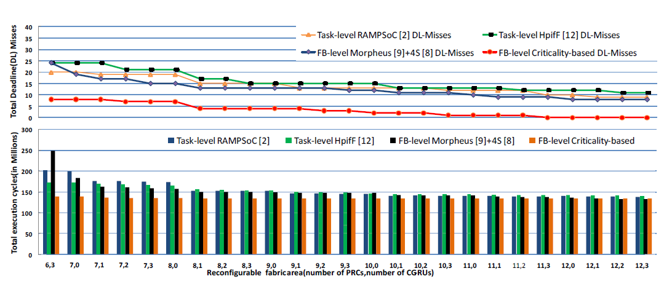
Experimental Results
53/57

Slide 54
Experimental Results
Compared to Task-Level RAMPSoC:
On avg, 6.1x deadline misses and achieve up to 1.6x performance improvement.
The major advantage in performance improvement is achieved when available fabric is limited, i.e., between (6,3) and (11,3).
The reason is that due to equal fabric allocation to all tasks, the tasks requiring more fabric than others, suffers from deadline misses.
Here, H.264 encoder and decoder miss most of their deadlines as they do not get the required fabric.
54/57

Slide 55
Experimental Results
Functional block-level policy for Morpheus [9] and 4S [8]
like architectures (FB-level Morpheus+4S):
On avg, 1.9x performance improvement and reduces the average deadline
misses by 5.3x times.
Reason: The task criticality and adjust accordingly during run-time at functional block level, while Morpheus+4S like approach tries to achieve high performance without considering the criticality of each task.
55/57

Slide 56
Experimental Results
Compared to Task-level Highest performance improvement
factor First (HpifF) policy:
On avg, 6.9x deadline misses and achieve up to 1.4x time performance improvements (avg. 1.3x).
Need to evaluate the system with few other applications!
56/57

Slide 57
Conclusions
Processor Control Unit enables efficient simultaneous multi-tasking in multi-core reconfigurable processors with functional block level allocation of the mixed-grained reconfigurable fabric, while maintaining the application’s QoS requirement under run-time varying scenarios.
Constraints-based Fabric-Allocator adaptively allocates the fabric to different tasks considering their refined criticalities, such that the margins for deadline misses are reduced.
The QoS controller increases or decreases the criticality of each task based on the current state of the system and further guides the Constraints-based Fabric-allocator to refine its next allocation decisions.
Compared to state-of-the-art, our scheme reduces the deadline misses by (on average) 6x, while improving the overall performance by 1.3x.
57/57

