Slide 1
Dynamic Hardware/Software Partitioning: A First Approach Authors -Greg Stitt, Roman Lysecky, Frank Vahid
Presented By : Aditya Kanawade
Guru Sharan

Slide 2
INTRODUCTION
Crucial Step --> Deciding which components of the system should be implemented in software and which ones in hardware.
Provides better results than hardware-only & software-only solutions.
Required in single chip platforms incorporating both microprocessor and FPGA.
Provides efficient communication resulting in improved performance and reduced power.
FPGA is treated as an extension of the microprocessor.
Designer moves critical software regions from the microprocessor onto FPGA hardware improving performance and reducing energy consumption

Slide 3
INTRODUCTION CONTD.
Limited success of HW/SW partitioning due to tool flow problems.
Steps to be followed by designer:
1. First , use an appropriate profiler to detect regions that contribute to a large percentage of program execution.
2. Second, a designer must use a compiler with partitioning capabilities to partition the software source.
3. Third, designer must apply a synthesis tool to convert the partitioning compiler’s hardware description output to an FPGA configuration.
Complicate tool flow, require extra designer effort and hence companies won’t do it.

Slide 4
Ideal Dynamic Partitioning Approach
Monitor a microprocessor’s executing binary program, detect critical code regions, decompile those regions, synthesize them to hardware, place and route that hardware onto on-chip configurable logic, and update the binary to communicate with the logic.
Performed entirely on-chip.
Requiring no extra designer effort, and causing no disruption to standard tool flows.

Slide 5
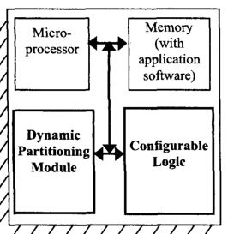
SYSTEM ARCHITECTURE
Consists of embedded microprocessor, memory and on- chip configurable logic.
Dynamic partitioning module dynamically detects the most frequently executed software regions and reimplements those regions as hardware on configurable logic.
Based on platforms like the Triscend A7, which runs the microprocessor and configurable logic at 60 MHz.

Slide 6
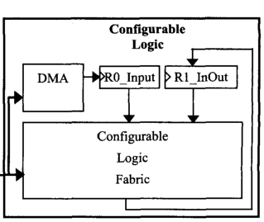
ARCHITECTURE FOR CONFIGURABLE LOGIC
DMA controller to access memory.
32-bit input register (RO-Input) stores the data
32-bit register (R1-InOut) for input and output
The configurable logic stores output data in the R1-InOut register before the DMA controller writes the data back to memory.
To allow for easy routing to the R1-InOut register, we use a fixed 32-bit channel connecting the output from the configurable logic fabric to the R1-InOut register.

Slide 7
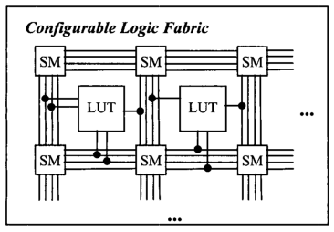
CONFIGURABLE LOGIC FABRIC
General configurable logic fabric (CLF) -> Mapping, placing, and routing is time consuming.
Designed a simplified configurable logic fabric --> simple logic required to implement SW inner loops.
Place and route tasks are simplified.
CLF architecture --> matrix of simple 3-input 2-output look-up tables (LUTs) surrounded by switch matrices (SMs) for routing.

Slide 8
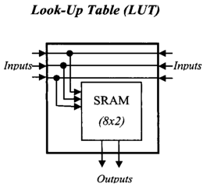
LOOK UP TABLE
LUT --> 8 2-bit words wide SRAM.
Connect LUT to the routing channels from either side of the LUT.
Outputs of LUT are connected at the bottom.

Slide 9
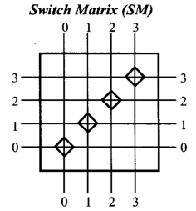
SWITCH MATRIX
Four routing channels on each side.
Switch matrix can only connect a wire from one side to other wire on other side but on same channel.
Designing simplifies the routing algorithm since we can only route a wire using a single channel throughout the configurable logic fabric.
When wire must switch channels
Connect special connection matrix at the
bottom of the CLF.

Slide 10
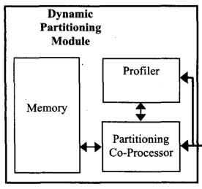
DYNAMIC PARTITIONING MODULE
Partitioning co-processor and memory --> runs a program that decompiles and synthesizes selected binary regions for hardware implementation.
MIPS microprocessor --> partitioning co-processor.
Profiler --> detects the most frequently executed application software loops
Doesn’t impose size overhead.

Slide 11
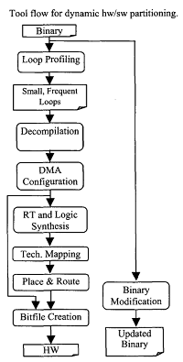
TOOL FLOW

Slide 12
LOOP PROFILING
The loop profiler detects regions of software that should be implemented as hardware.
Typical profilers change program behavior and requiring extra tools.
Profiler is non-intrusive and monitors instruction addresses on the memory bus.
Whenever a backward branch occurs, the profiler updates a cache entry that stores the branch frequency.
The profiler uses a small cache to save area and power.
Accurate and impose less than 1% power and area overhead for a MIPS microprocessor.

Slide 13
TOOL FLOW

Slide 14
DECOMPILATION TOOL
Decompilation converts the software loops into a high-level representation more suitable for synthesis.
First it converts each assembly instruction into equivalent register transfers --> provides an instruction-set independent method of decompilation.
It builds a control flow graph for the software region & constructs a data flow graph.
Parser builds trees for each register transfer and then combines the trees into a full data flow graph.
Uses Standard compiler optimizations to remove the overhead introduced by the assembly code and instruction set.

Slide 15
TOOL FLOW

Slide 16
DMA CONFIGURATION TOOL
It maps the memory accesses of the decompiled loop onto our DMA architecture.
Memory accesses --> read/writes, increment and decrement address updates, etc.
Number of loop iterations must be determined before the loop executes.
Memory accesses are limited to sequential locations, we can remove all address calculations from the decompiled loop.
DMA controller will transfer data that is needed before the loop starts using hardware enable signal.
After initialization, the hardware starts a block request that will fetch one memory location per cycle in the case of a read or write one location per cycle in the case of a write.
Since loop bodies are limited to a single cycle, a DMA block request is able to fetch data at the exact rate needed by the hardware.
After the block request is finished, the hardware uses a final DMA transfer to write back any results.

Slide 17
TOOL FLOW

Slide 18
REGISTER TRANSFER(RT) SYNTHESIS
Register-transfer (RT) synthesis converts each output bit into a Boolean expression by traversing the dataflow graphs of the software region.
LOGIC SYNTHESIS
Converts Boolean logic network to Directed Acyclic Graph(DAG).
Each internal node in DAG correspond to simple logic gates.
Simplifies logic network --> two level logic minimization algorithm.
TECHNOLOGY MAPPING
Traverses DAG backwards from output node and combines nodes to create 3-input 2 output LUT nodes which can be directly mapped to configurable logic fabric.

Slide 19
TOOL FLOW

Slide 20
PLACEMENT
Place LUT in configurable logic fabric.
Placement is done in following steps:
Relative placement of nodes --> Determine Critical Path --> Placement of path into single horizontal row.
Determine dependencies between non-placed nodes and already placed nodes.
Depending on this dependency, place node either above(input to placed node) or below(uses output from placed node) as close as possible to dependent node.

Slide 21
ROUTING
Use Greedy algorithm.
Routing is performed in three steps:
Route wires between input nodes and LUT.
Route wires between LUT and output nodes.
Route wires between LUT’s.
Switch Matrix --> routing wires between configurable logic fabric.
Partially routed wire reaches switch matrix --> it routes towards the destination LUT node.
If switch matrix is not available for routing --> the algorithm will back track to the previous switch matrix and attempt to route the wire in the opposite direction to find alternate route.

Slide 22
BITFILE CREATION
(Place and Route + DMA Configuration) information
into a single bit-file to initialize configurable logic.

Slide 23
BINARY MODIFICATION
Updates software binary to utilize hardware for the loops.
Replaces the original software instructions for the loop with a jump to hardware initialization code.
The initialization code enables the hardware by writing to port that is connected to the hardware enable signal.
The enable instruction is followed by code responsible for shutting down the microprocessor into a power-down sleep mode.
When the hardware finishes execution, the hardware causes software interrupt and wakes up the microprocessor which resumes normal execution.
Jump instruction at the end of the hardware initialization code is used to jump to original software loop.

Slide 24
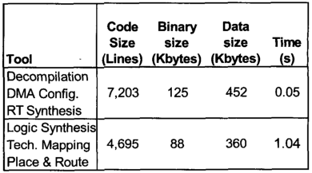
DYNAMIC PARTITIONING TOOLS
Code Size is the number of lines of C code used to implement each tool.
Binary Size is the size in kilobytes of the tools compiled to a MIPS binary.
Data size is the maximum data memory needed during tool execution.
Time is the execution time of each tool on a 60 MHz MIPS

Slide 25
EXPERIMENTAL BENCHMARKS
g3faXl and g3fax2 are the same group three fax decode benchmark.
g3faX1 is a small loop --> that accumulates the values from an array in memory, requiring only an adder in the configurable logic.
g3fax2 is a small loop that writes a value to every location in a memory block requires only single DMA block write.
brev is a small program that reverses the bits of 32-bit values in memory.
url is a small loop that writes a value to each location in an array.
logmin is our own benchmark that is part of an on-chip logic minimization kernel.

Slide 26
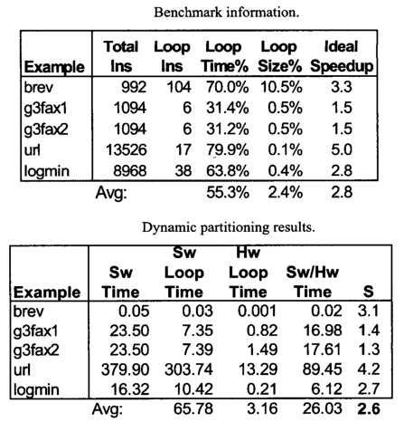
EXPERIMENTAL RESULTS
Average speedup for the four examples
was 2.6, which is very close to the
ideal speedup of 2.8.

Slide 27
FUTURE WORKS
Future work consists of extending the architecture and tools.
Extending our configurable logic to handle sequential logic and extend our tools to handle a wider variety of loops, including loops requiring multiple cycles in hardware and having more complex memory access patterns

Slide 28
Exploration of Tasks Partitioning Between Hardware Software and Locality for a Wireless Camera Based Vision Sensor Node
Authors - Khursheed Khursheed, Muhammad Imran, Abdul Wahid Malik, Mattias O’Nils, Najeem Lawal,Thörnberg Benny
2011 Sixth International Symposium on Parallel Computing in Electrical Engineering

Slide 29
Wireless Vision Sensor Network
Image sensor, On board Computation, Communication links
Operates on two dimensional data
Requires higher processing power & communication BW
Assumes that all raw data is sent to central base station without local processing
Consists of Vision Sensor Nodes (VSNs)

Slide 30
VSN Composition
Image Sensor – acquiring images of the area of interest
Processor – local Image processing
Transceiver – communicating the results to base station

Slide 31
Architecture of VSN

Slide 32
Functions of VSN
Perform – Complex Image processing
Morphology and Labelling
Features extraction and Image compression

Slide 33
Designing & Constraints
Traditional Approach – Sequential method
Co-design Approach – Concurrent method
Constraints – Low energy consumption, compact size, light weight, high reliability, low cost….

Slide 34
Ex-1: FireFly Mosaic Wireless camera
Consists of a Wireless Sensor Platform
Uses a real time distributed IP infrastructure
Works on Collision free TDMA based communication protocol
FireFly – low cost, low power sensor platform, uses a RTOS and an expansion board

Slide 35
Ex-2 : SensEye
Multi-tier of heterogeneous wireless nodes and cameras
Aims at low power, low latency detection and low latency wakeup
Uses low power elements to wakeup high power elements

Slide 36
Vision Tasks
Image Capturing
Subtraction
Segmentation
Morphology & Labelling
Bubble Removing
Features extracting
TIFF Group4 compression on FPGA & SENTIO32

Slide 38
Experimental System
Aim – Detection of magnetic particles in a flowing liquid
Classified by size and number
Used for failure detection in machinery
Air bubbles – considered as objects
Removal of bubbles – 2 ways
i) Pixel Based Method
ii) Object Based Method

Slide 39
Pre-Processing
Image is subtracted from the background
Background – Initially stored in Flash Memory
Stored background – subtracted from image – to detect objects – could be magnetic particles/flowing bubbles
Pixels Gray Value < pre-defined threshold => 0 -----Representing Black
Others => 1 ------ Representing white
Resulting Image == Binary Image with 0s & 1s

Slide 40
Bubble Remover
Pixel Based Bubble Remover is used
It detects and removes bubbles
Moving Object – Object Changes its location in 2 consecutive frames
Corresponding pixels in 2 consecutive frames are compared
If their Binary values are different – confirms to be a part of bubble
A 0 is placed at that pixel location ----- Bubbles are removed

Slide 41
Labelling & Features Extraction
Each object ----- Assigned a unique label
==> Based on it ---- Area & Location of each object is determined
Image Compression
TIFF Group4 compression , segmentation, morphology, Fine tuning
Communication
Final Data – transmitted to Central BS
Uses an IEEE 802.15.4 transceiver --- embedded in SENTIO32 platform

Slide 42
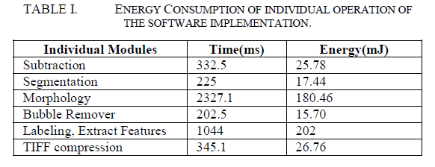

Slide 43
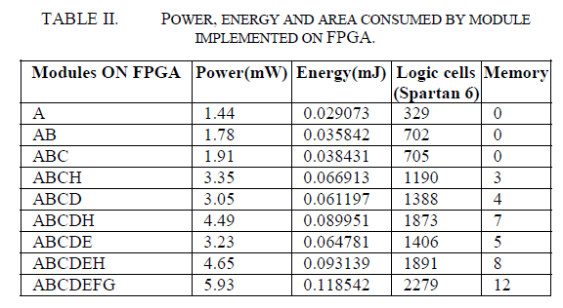
A – Image Capture ; B – Subtraction; C – Segmentation; D – Morphing; E – Bubble Removal; H - Compression

Slide 44
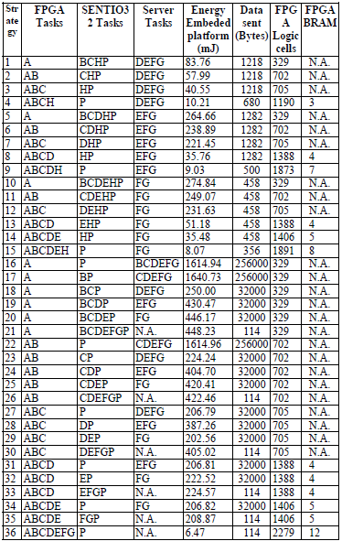

Slide 45
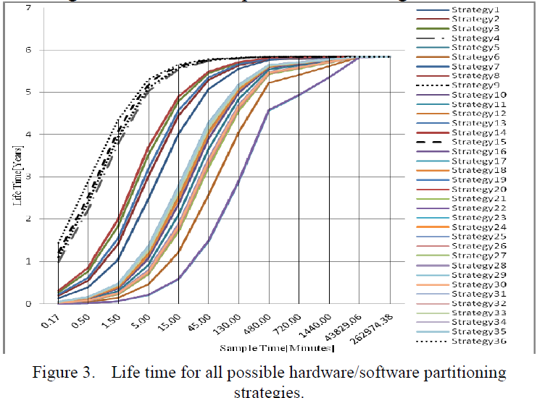

Slide 46
Good things
The paper provides proper background & examples to understand some of the important concepts explained in the paper
Provides a good comparison of HW/SW partitioning strategies
Short falls
It does not explain about TIFF Group4 compression technique
The proposed model is not tested on other platforms except SENTIO32
Future Work
Improvising the proposed model & testing it on other RTOS platforms
Making it more Energy efficient and building efficient Vision Sensor Networks

Slide 47
Thank You
Questions ?

