Slide 1
A Schedulability Analysis for Weakly Hard Real- Time Tasks in Partitioning Scheduling on Multiprocessor Systems
Energy Reduction in Weakly Hard Real Time Systems
Singh Y, Popli M, Shukla Jaypee University of Information Technology
1st Int’l Conf. on Recent Advances in Information Technology | RAIT-2012 |-IEEE
Ismail H, Jawawi D N A Universiti Teknologi Malaysia
2014 8th Malaysian Software Engineering Conference (MySEC)-IEEE
Presented By,
Guru Sharan
Aditya Kanawade

Slide 2
INTRODUCTION
Real time systems are classified into three categories:
1. Hard Real Time Systems
No deadline must be missed
2. Soft Real Time Systems
Few deadline misses are acceptable
3. Weakly Hard Real Time Systems
Few deadline misses are accepted --> Evenly spaced
QoS is compromised
Represented by (m,k) model --> m out of k tasks meet deadline
1/32

Slide 3
Basic Model of Real Time Systems
2/32

Slide 4
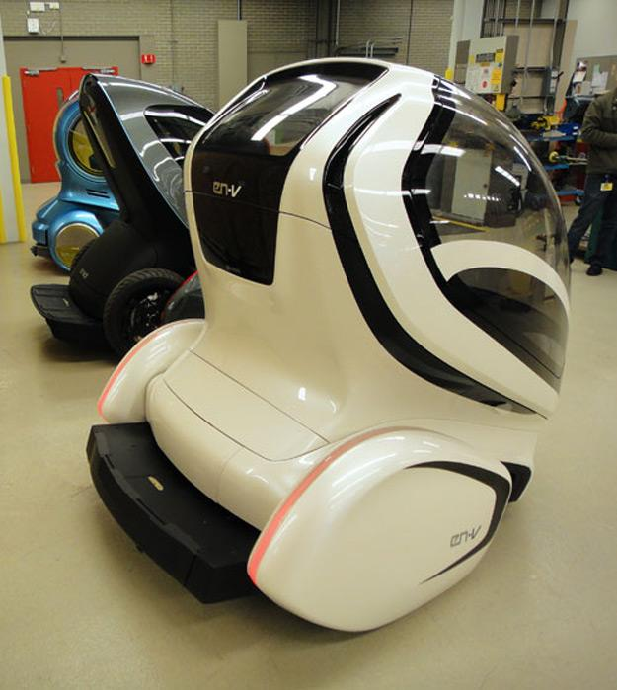
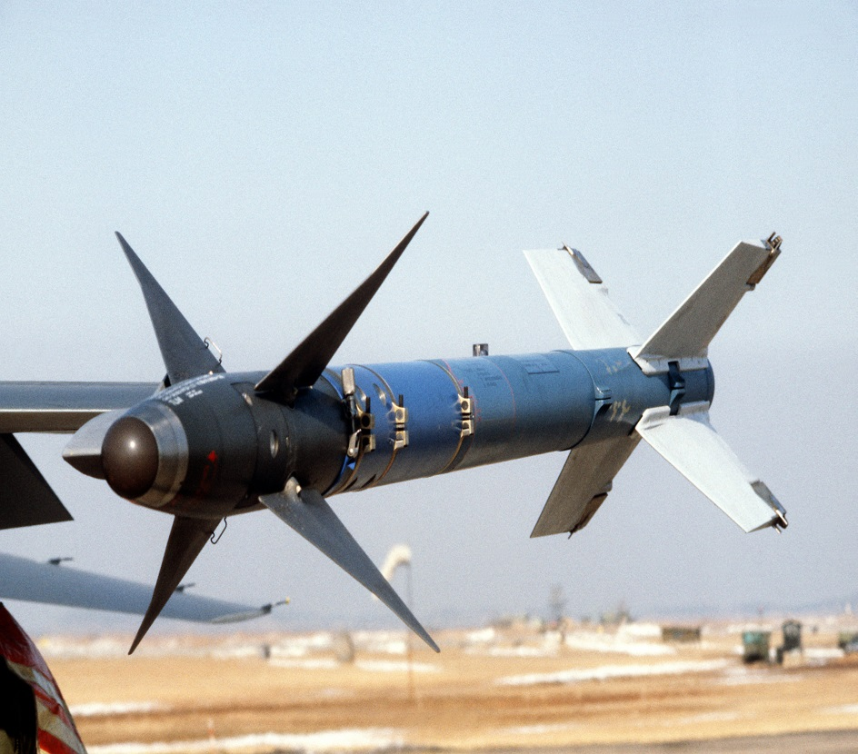
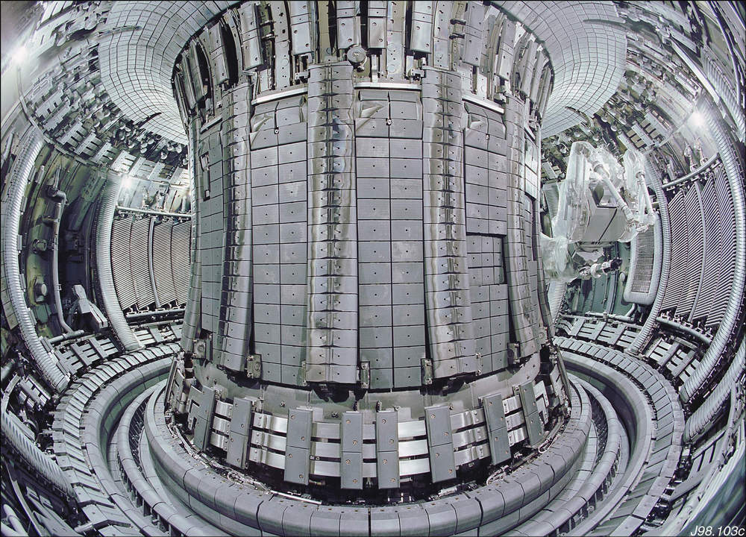
EXAMPLES

Slide 5
SCHEDULING TYPES
Clock Driven Scheduling
Task scheduling decisions are made at clock interrupt points
Off line schedulers --> predetermines which task will run and when
Very little run time overhead
Cannot handle aperiodic and sporadic tasks since exact occurrences of such tasks cannot be predicted
4/32

Slide 6
Priority Driven Scheduling
Scheduling based on priority of task
Higher priority task pre-empts running lower priority task
It is classified into 2 approaches:
1. Static Approach
2. Dynamic Approach
5/32

Slide 7
STATIC APPROACH
Priorities are assigned to tasks once for all and every job of a task will have same priority
Rate Monotonic Algorithm(RM)
Assigns static priorities based on task periods
The task with the shortest period gets the highest priority, and the task with the longest period gets the lowest static priority
6/32

Slide 8
Deadline Monotonic Algorithm
Assigns static priorities based on deadline
The task with relatively shorter deadline will have higher priority
7/32

Slide 9
DYNAMIC APPROACH
Priorities of tasks may change from
request to request
Earliest Deadline First(EDF)
Earlier the deadline --> higher will be the priority
During scheduling --> task having the shortest deadline is scheduled
8/32

Slide 10
POWER SAVING TECHNIQUES
Dynamic Voltage Scaling(DVS)
Speed of frequency dependent components is decreased if it is operating at lower voltage
When speed is reduced, response time of task increases
Thus leading to missing of few deadlines
Longer execution times increase energy leakage due to leakage current
9/32

Slide 11
Dynamic Power Down(DPD)
Switching to sleep state from idle state to reduce energy consumption
If energy required for switching to sleep state is less than or equal to the energy consumption in idle time --> switching to sleep state is preferred
10/32

Slide 12
PARTITIONING TECHNIQUES
Used in case of selection of m jobs from a window of k consecutive jobs for execution
Deeply Red Pattern
It aligns the optional jobs together so that a component has a better opportunity to switch into sleep state to save energy
DISADVANTAGE - Larger size busy intervals and hence need more energy to be feasible
11/32

Slide 13
Evenly Distributed Pattern (Even Pattern)
First job released is mandatory
Distribution of mandatory and optional jobs is even
3. Reverse Evenly Distributed Pattern
First job released is optional
Distribution of mandatory and optional jobs is alternating
12/32

Slide 14
Hybrid Pattern
Different type of patterns for different tasks
Irrespective of whether the task is mandatory or optional it can be assigned with Red or Even pattern
Mixed Pattern
Combination of Hybrid pattern and Reverse Evenly Distributed Pattern
13/32

Slide 15
RATE MONOTONIC vs INVERSE RATE MONOTONIC
Energy and deadline are counter productive
Rate Monotonic – Shorter is the period, higher is the priority
Inverse Rate Monotonic – Higher is the period, higher is the priority of the task set
Task set ---> Group of small tasks ---> Each task set consists of execution time, period, deadline, no. of jobs, no. of consecutive jobs; specific to it
14/32

Slide 16
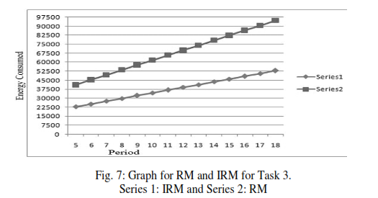
Example of Inverse RM algorithm
Higher is the period --> Higher is the Priority
Consider the example
A = { T1, T2, T3 } where
T1=(3,10, 10, 1, 4) T2=(4, 16, 16, 1, 1)
T3=(10, 40, 40, 1, 1)
15/32

Slide 17
A Schedulability Analysis for Weakly Hard Real- Time Tasks in Partitioning Scheduling on Multiprocessor Systems

Slide 18
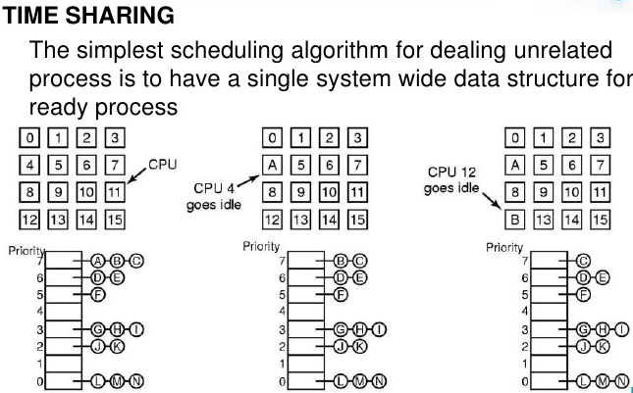
17/32

Slide 19
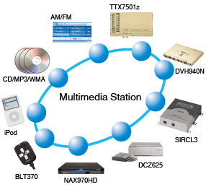

Slide 20
SCHEDULING TYPES BASED ON PRIORITY
Static Priority Scheduling
Easy to implement
Processes are assigned a fixed priority
Less overhead compared to dynamic schemes
Can handle overloads in a better way
19/32

Slide 21
Distance Based Priority Scheduling
Classical Approach followed
Applies to both Uniprocessor and multiprocessor systems
Guaranteed QoS
Promising performance in overload conditions
20/32

Slide 22
OFFLINE SCHEDULING
Each task is divided into 2 sets – mandatory and optional
Mandatory tasks – scheduled according to pre-defined priorities
Optional tasks – Assigned with lowest priority
Runtime overhead caused by migration of tasks can be avoided
21/32

Slide 23
BIN PACKING ALGORITHM
Each task/group of tasks has its own dedicated processor
Partitioning Approach – Divides tasks into partitions
A schedulability test is performed
Then decided whether the task allocation in the processor is required
22/32

Slide 24
R-BOUND-MP-NFRNS method
Sorting tasks in ascending order of periods where the first task needed to be considered is the task with shortest period
Schedulability Test - Each uniprocessor uses the above equation
The next-fit-bin-packing algorithm is used to assign each task
The task is assigned to processor 1, incase of failure to assign a task to processor ‘p’
23/32

Slide 25
CASE STUDY autonomous mobile robot(amr) system
Consists of Hard tasks and Soft tasks
Task set – Includes various robot operations
Robot traverses in a structured environment
Robot software controls the movement of robot while avoiding obstacles in its environment
24/32

Slide 26
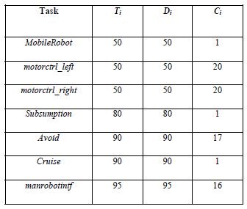
TASK SET OF AMR CASE STUDY
25/32

Slide 27
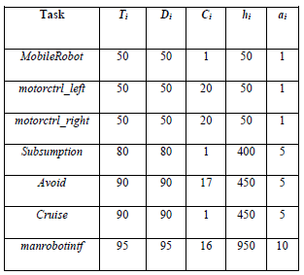
HYPERPERIOD ANALYSIS
26/32

Slide 28
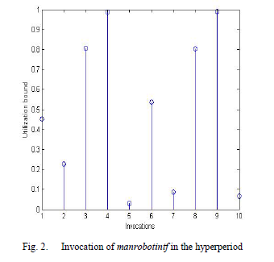
Experimental results
27/32

Slide 29
DRAWBACKS
The first paper discusses more about Scheduling aspects of Weakly hard real time systems rather than energy reduction aspects
The partitioning techniques described are not clear and do not provide the basis for their selection
The experimental results are based on certain assumptions which are not strongly supported in the context of energy reduction
28/32

Slide 30
The second paper does not provide proper background necessary to understand the algorithms mentioned in the paper
It generalizes few techniques to both uniprocessor and multi-processor systems but does not explain them in the individual contexts
Lacks clear experimental results and does not indicate the parameters used for determining the results
29/32

Slide 31
FUTURE WORK
Testing the proposed Inverse Rate Monotonic Algorithm in multi-processor environment
Developing a standard scheduling approach for multi-processor systems
Increasing the predictability of tasks for weakly hard real-time systems
30/32

Slide 32
CONCLUSION
Both the papers introduce new concepts related to weakly hard real time systems
Various scheduling techniques and the need for them in weakly hard real time systems has been explained
New scheduling schemes and its analysis along with a case study gives good support for its usage in multi-processor systems
31/32

Slide 33
Questions ?
32/32

