Slide 1
Revolutionizing farming using Swarm Robotics
Guru Sharan B S, K S Nikhil, Anil H, Chaitra V
6th International Conference on Intelligent Systems, Modeling and Simulation, Kualalampur, Malaysia, |IEEE, Feb 10-12 2015
Presented By,
Guru Sharan B S
Aditya Kanawade

Slide 2
SWARM ROBOTICS – FUTURE OF ROBOTICS ?
SWARM ROBOTS - Advent in co-ordination and multitasking of multi-robot systems
Composition - Groups of simple and similar bots
Biological References – Swarm behavior in Bees, Ants, Wasps, termites …
1/20

Slide 3
SWARM ROBOTS TODAY
In Industries : As delivery co-ordinators to various stations on the assembly lines, forms interlinks between various departments and buildings inside the environment
In Household Systems : Children play tools, micro-security stations, vacuum cleaner …
In Hospitals : Safely transports from point A to point B, manoeuvres through corridors of a hospital, restaurant, office blocks, elevators and various departments to deliver items
2/20

Slide 4
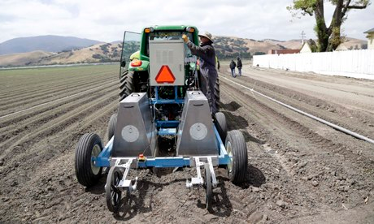
ROBOT FARMERS ARE FUTURE OF AGRICULTURE
FARMBOTS – Bots which can plough, water, sow seeds, harvest …
Importance – Reduces complex machinery, manufacturing cost greatly
3/20

Slide 5
SWARM ROBOTS FINE BUT WHY FARMING ?
AUTONOMOUS
COST EFFECTIVE
Why robotics in farming?
HIGH RELIABILITY
DEPLETING LABOUR FORCE
4/20

Slide 6
PRELIMINARY DESIGN
PRELIMINARY DESIGN
5/20

Slide 7
6/20

Slide 8
BLOCK DIAGRAM
7/20

Slide 9
C O M P O N ENT S
Submersible Water Pump : Flow Rate GPM/LPM :1.0 GPM
[3.8 LPM]
Voltage Controller/ Voltage Step Down Unit
Other Mechanical Components
12 V Lead Acid Battery Source
MSP430 G225 Series: Ultra Low Cost; Ultra Low Power Microcontroller
CC2500 : low-cost 2.4 GHz transceiver designed for very low-power wireless applications. Configurable data rate up to 500 kBaud.
Servo Motor: Control System: Pulse width control, 1500 μs neutral Operating Voltage: 4.8V ～ 6.0V (DC)STD Direction: Counter clockwise/pulse traveling 800 to 2200 μsec.
L293DNE: Wide Supply-Voltage Range: 0V to 36 V, Separate Input-Logic Supply Output
8/20

Slide 10
CODE COMPOSER STUDIO v5
Code Composer Studio™ (CCStudio) is an integrated development environment (IDE) for Texas Instruments (TI) embedded processor families.
TERMITE
Termite is an easy to use and easy to configure RS232 terminal. A conventional easy to use interface consists of a program interface line, capable of representing the transmitted and received data
SQL Server
Hosting a SQL server in a data base system which can control and handle data coming from a wireless source for interaction and remote control.
SOFTWARE USED
9/20

Slide 11
10/20

Slide 12
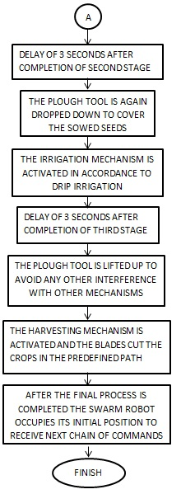
F L O W CH A R T
11/20

Slide 13
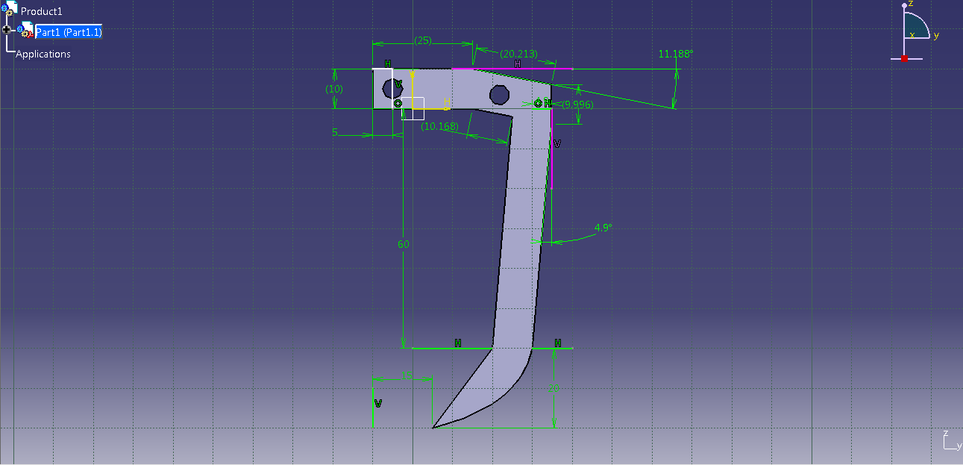
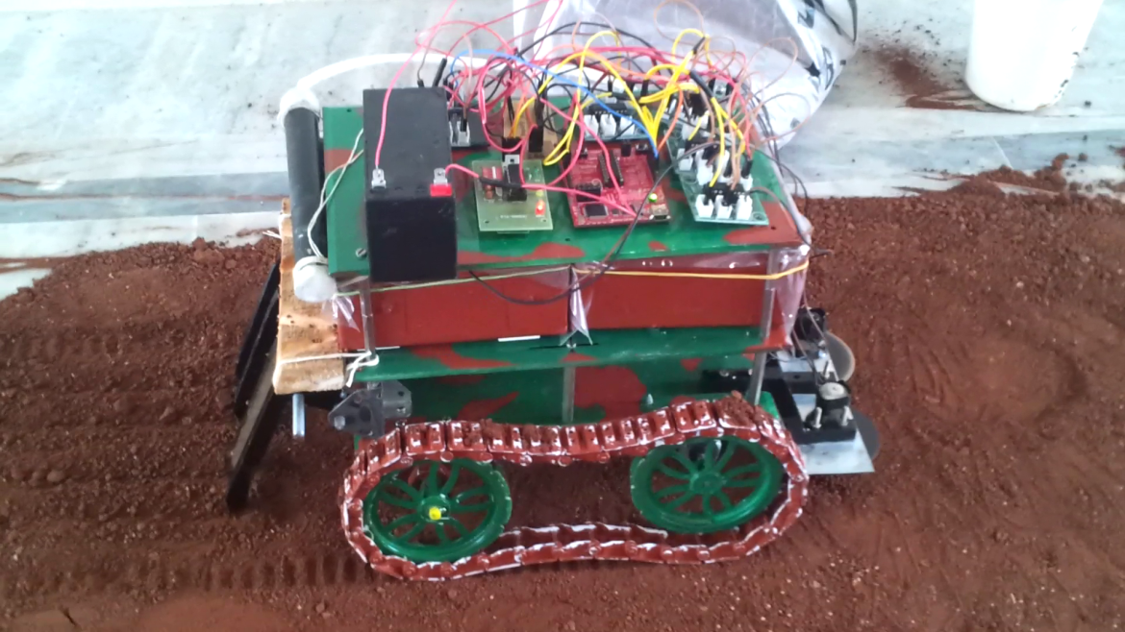
PLOUGHING MECHANISM
12/20

Slide 14
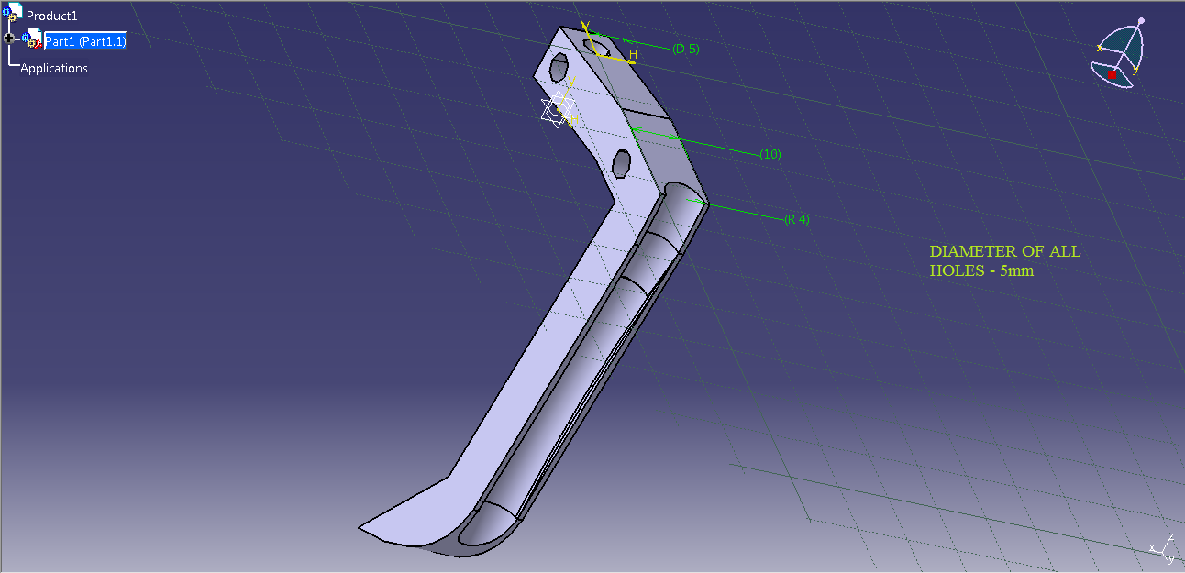
SEEDING MECHANISM
13/20

Slide 15
IRRIGATION/FERTILIZATION
14/20

Slide 16
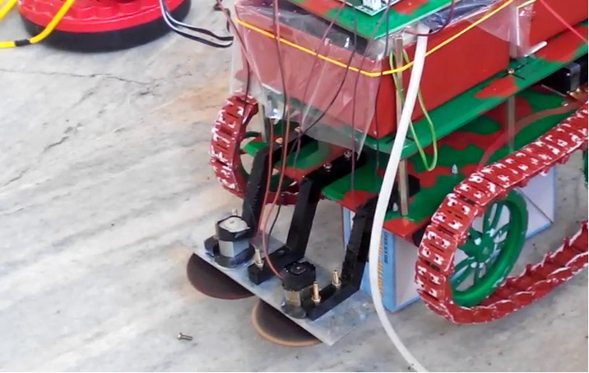
HARVEST SUPPORTER
15/20

Slide 17
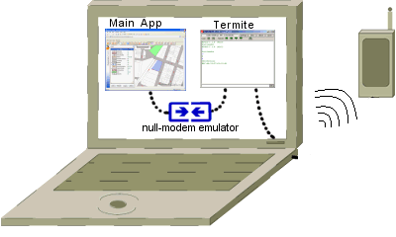
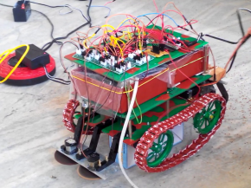
SWARM BEHAVIOUR
Central DB Signals
Interbot Signals
16/20

Slide 18
EXPERIMENTAL RESULTS
17/20

Slide 19
ADVANTAGES
Simple & Robust Design
Highly Efficient
Reduces the human work
Autonomous
Reliable
18/20

Slide 20
SHORTFALLS
Scalability
Inter Bot Communication
Self Repairing/Healing
Under Drastic Conditions
19/20

Slide 21
FUTURE WORK
Making it more Scalable
Implementing Self Healing/Repairing
Harnessing Solar Power
Using CLOUD technology
20/20

Slide 22
ADDITIONAL REFERENCES
https://www.youtube.com/watch?v=4ErEBkj_3PY
https://www.youtube.com/watch?v=zTNjOl6kjm0
https://www.youtube.com/watch?v=w2itwFJCgFQ
https://www.youtube.com/watch?v=CDsNZJTWw0w

Slide 24
ANY QUESTIONS ?
S

