Slide 1
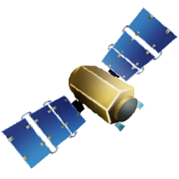
28th Annual AIAA/USU Conference on Small Satellites, 05AUG14
CHREC Space Processor
A Multifaceted Hybrid Architecture for Space Computing
Investigators and Students
Dylan Rudolph, Christopher Wilson, Jacob Stewart, Patrick Gauvin, Alan George, Herman Lam, Gary Crum, Mike Wirthlin, Alex Wilson, Aaron Stoddard
Research Partners
University of Florida (lead), NASA Goddard, Brigham Young University, NASA Kennedy, Honeywell, Space Micro, and growing!
Research highlighted in this presentation was supported by CHREC members and by the I/UCRC Centers Program
of the National Science Foundation under Grant Nos. EEC-0642422 and IIP-1161022.

Slide 2
Introduction and Background
James MacKinnon

Slide 3
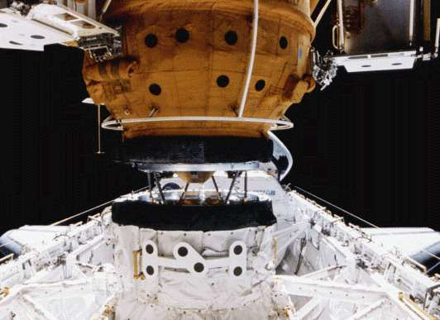
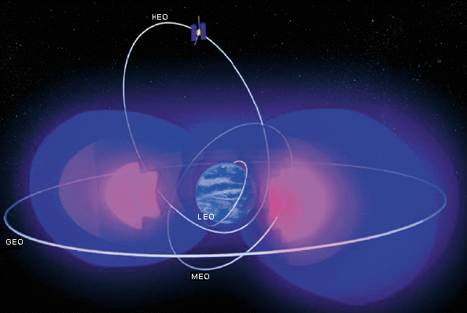
Major Challenges for Space
Research focus on Advanced Space Computing
New concepts, methods, and technologies to enable and deploy high-performance computing in space
Why is it necessary and important?
Escalating demands for sensor-data processing
Downlink bandwidth to Earth is extremely limited
Sensor data rates are dramatically increasing
Post processing is not as viable
Escalating demands for autonomous processing & control
Autonomy requires high-speed computing for decision-making
Severe propagation delays for human in-the-loop for commands

Slide 4
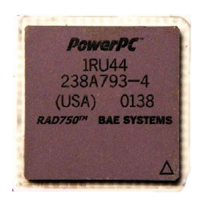
Space Computing Requirements
Embedded space environments have strict requirements and restrictions
Performance (throughput and real-time)
Size, Weight, Power, and Cost (SWAP-C)
Reliability (device lifetime and radiation effects)
Single-Event Effects
Total Ionizing Dose
Next-generation satellites and spacecraft will require high-performance processing
Traditional radiation-hardened general-purpose processors unable to keep up
Honeywell RHPPC: .08 GOPS*
BAE Systems RAD750: .266 GOPS*
Zynq 7020: 324.15 GOPS*
Low Power
Depend-ability
Low Cost
Speed
Lifetime
*GOPS for 8-bit Integer Operations c/o Device Metrics

Slide 5
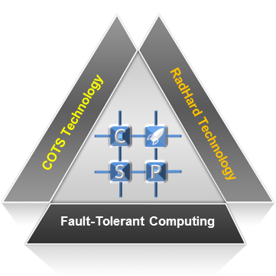
Goals, Motivations, Challenges
Goals: Explore innovative strategies, architectures, and systems for hybrid space computing
Motivations: Space computers with radiation-hardened processors will be unable in some cases to meet demands of future missions
Managing platforms with limited size, weight, power, and cost (SWaP-C) budgets while providing high performance and high reliability
Research needed to explore hybrid methods featuring COTS processors, augmented with fault tolerance in various forms, & supported by RadHard
Challenges: Concept of hybrid space computers is relatively new and untested, requiring thorough research and analysis for deployment
Space systems are complex, time-consuming, and arduous to develop
Analytical research is needed to explore design approaches
Experimental research is needed to evaluate design approaches
COTS = commercial off-the-shelf
RadHard = radiation-hardened

Slide 6
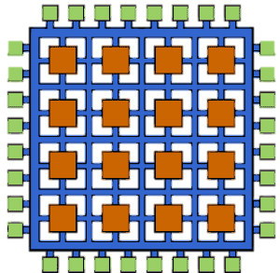
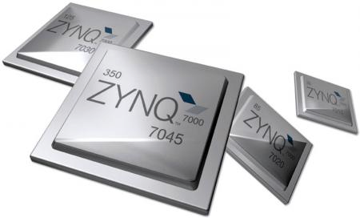
Featured Technology
Field Programmable Gate Array (FPGA)
Large amount of logic resources and specialized design units connected with a complex and configurable routing network
Lower frequency and power over conventional CPU
Massive algorithm parallelism for immense speedup
System-on-Chip (SoC)
Integrated Circuit that combines many processing technologies into a single chip
Xilinx Zynq 7020
Dual ARM Cortex-A9 processors
NEON SIMD engines
Low-power 28nm Artix-7 FPGA
Some applications are control-flow oriented and better suited for CPUs

Slide 7
Flight Hardware
Jacob Stewart

Slide 8
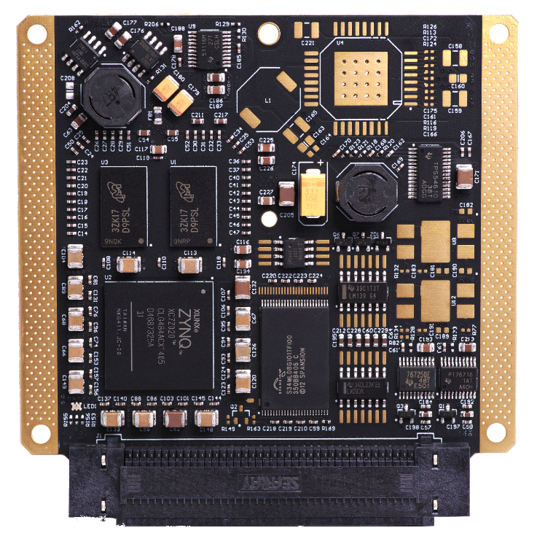
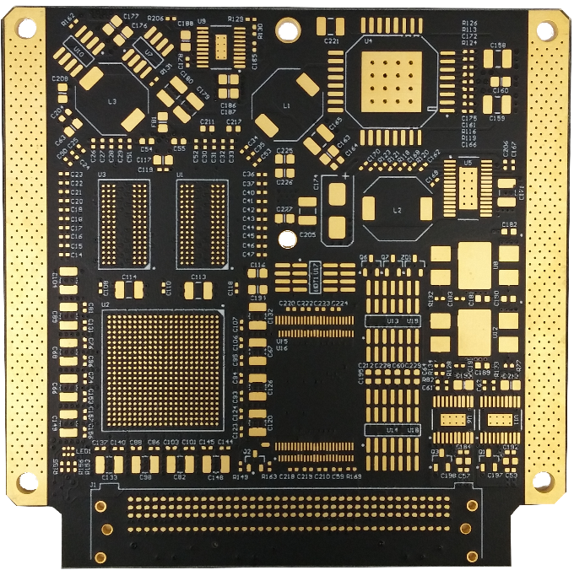
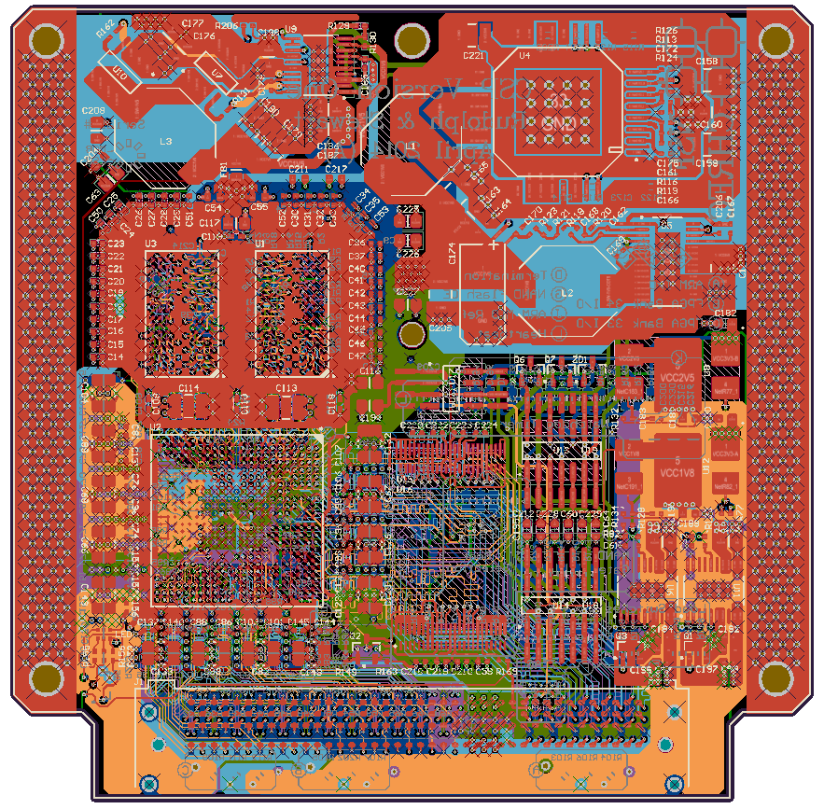
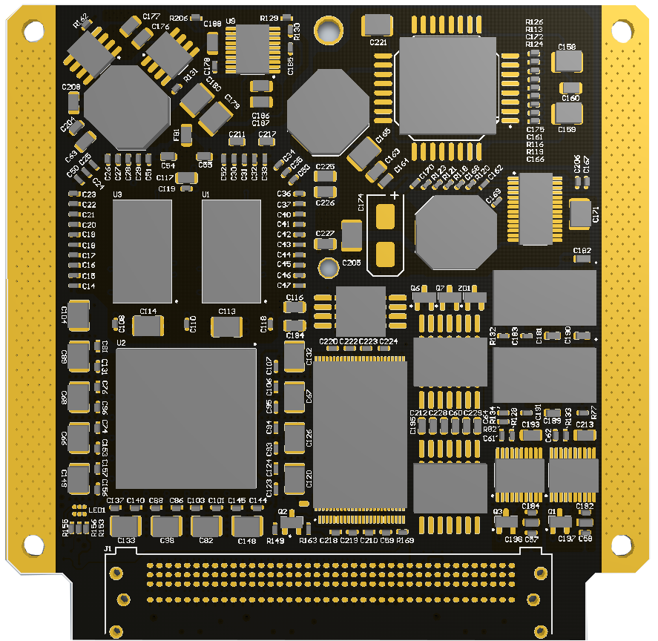
CHREC Space Processor (CSP)
Goal: Create a high-performance and reliable space computing platform
Expand CSP to fulfill a variety of demands in space computing
System Overview
Multifaceted hybrid space computer
Hybrid system (COTS + RadHard technology)
Hybrid processor (multicore + FPGA subsystems)
NAND Flash
Mission Development
Auxiliary flight hardware and test equipment
Backplane and Power/Interface boards
Reusable mission software
CFS/cFE with Wumbo
Space applications
Image processing (enhancement and compression)
Zynq - 7020
Power Circuit
DDR3 SDRAM
Watchdog/Reset
RSA Reliable Bootstrap
ECC
FPGA Scrubbing
Project Leads: Jacob Stewart & Patrick Gauvin
Project conducted in collaboration with NASA Goddard, BYU, NASA Kennedy

Slide 9
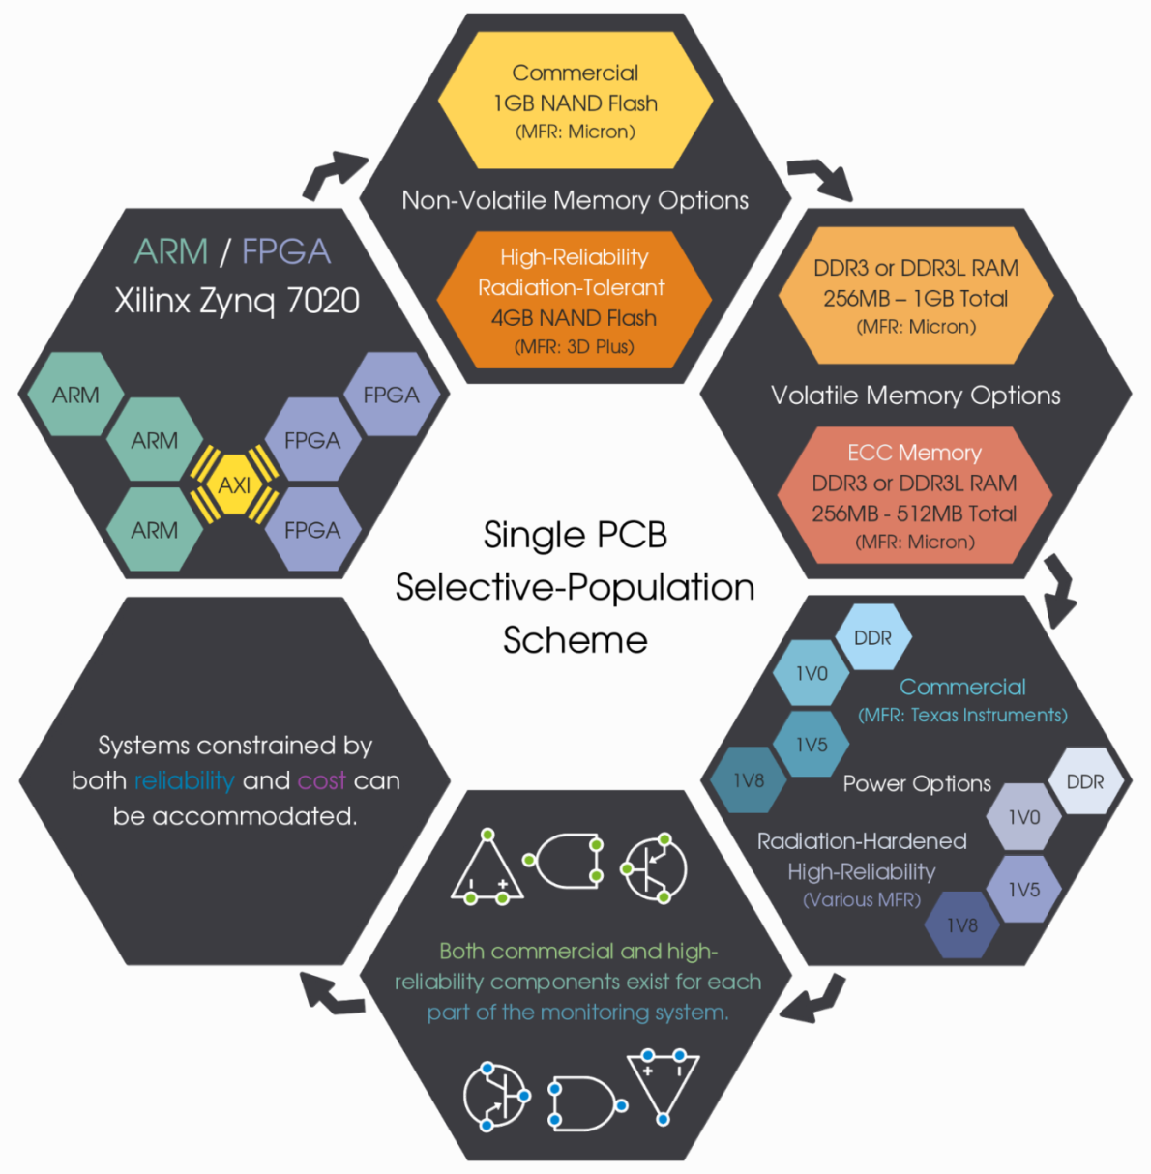
CSPv1 Dual Format
COTS (Testing) Board (COTS+FTC)
Hybrid (Flight) Board
(COTS+RadHard+FTC)

Slide 10
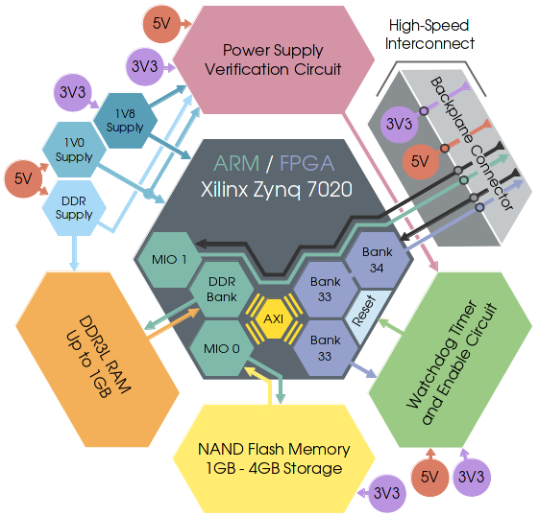
CSPv1 System Description
Requires 3V3 and 5V0, other voltages generated on-board
1.7 – 3.5 W depending on maximum load state
160-pin Samtec Searray connector (no other I/O)
60 High-Speed FPGA I/O pins
26 High-Speed ARM I/O pins
Watchdog circuit based around Intersil supervisor
Other information:
50-60 grams loaded
1U form factor (10x10 cm)
62 mil thickness, 12-layer PCB
2x256MB DDR3 RAM
Reference Slide

Slide 11
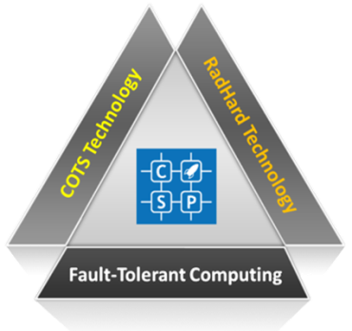
COTS+RH+FTC on CSPv1
COTS
Zynq-7020 hybrid SoC
Dual ARM A9/Neon cores
Artix-7 FPGA fabric + hard IP
DDR3 memory
RadHard
NAND flash
Power circuit
Reset circuit
Watchdog unit
FTC = Fault-Tolerant Computing
Variety of mechanisms
Dual ARM A9/Neon cores
External watchdog unit to monitor Zynq health and reset as needed
RSA-authenticated bootstrap (primary, secondary) on NAND flash
ECC memory controller for DDR3 within Zynq
ADDAM middleware with message, health, and job services
FPGA configuration scrubber with multiple modes
Internal watchdogs within Zynq to monitor behavior
Optional hardware, information, network, software, and time redundancy
Reference Slide

Slide 12
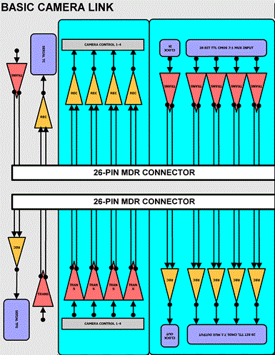
Camera Link
Uses 11 LVDS pairs
4 Data and 1 clock pair feed a SERDES core on the FPGA
80 MHz reference clock deserializes data at a 7:1 ratio
Max throughput of 240 MB/s
4 are dedicated to camera control
Used for triggering and setting exposure
Length of control pulse determines shutter exposure time
2 are low speed serial UART links
Configures all other camera controls
Examples of controls include:
Pixel bit depth
Analog and digital gains
Image testing modes
Trigger mode selection

Slide 13
Overall Architecture
CSP
Deserialized Data
AXI-Stream
AXI-HP
Camera
SERDES
AXI-Stream Converter
Image Processing
Pipeline
VDMA
DDR3
UART

Slide 14
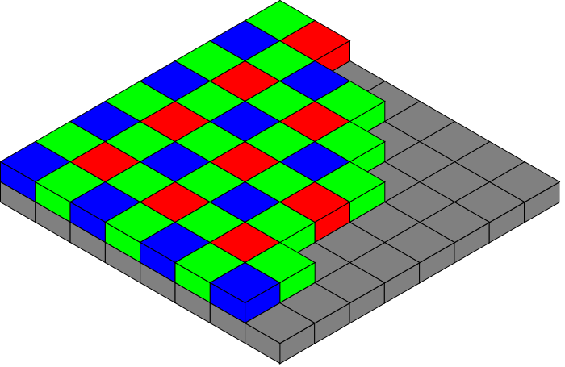
Image Processing
Xilinx provided licenses for their video processing IP core library
Current cores being used:
Bayer Interpolator
Accepts the 12-bit per pixel filtered data and interpolates it into RGB
Image Enhancement
Edge detection and smoothing
Useful for reducing noise
Colorspace Conversion
RGB to YCrCb
Conversion required by other cores

Slide 15
Flight Software
Joseph Kimbrell

Slide 16
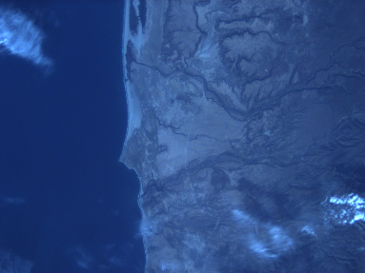
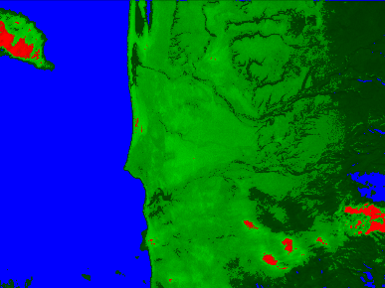
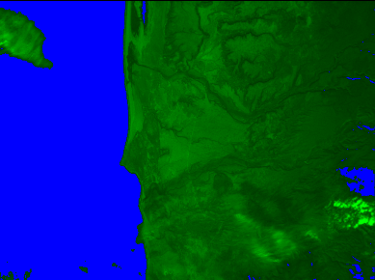
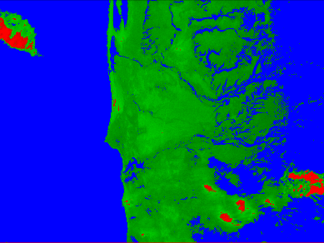
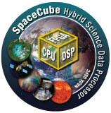
Software Suite
Flight Software Development (cFE)
File upload and download capability
Telemetry output and command ingest
Full testbed for evaluating new commands
Applications and Interface Design
NEON-accelerated image processing
STAR, Jpeg Compression, Edge enhancement, 2-D Convolution, and Thumbnailer
Image download via SpaceWire
STAR – Surface Threshold Average Rater
Processing System
FPGA Fabric
Wumbo GNU/Linux
Partial Reconfiguration Region
Comm. Interfaces
Hardware Accelerated Applications
Aerospace Middleware Applications
Partial Reconfig. Controller
AXI-4 Bus
FPGA Cores
Core Flight Executive
Kernel Modules
Communication Interfaces
Reliable Bootstrap
FPGA Cores

Slide 17
ARM Software Reliability Assurance
Master device in system – ARM processor
Connected to system non-volatile memory
Configures and initializes FPGA
Critical to ensure device boots up properly
Use Zynq’s built in RSA authentication features to verify boot images
Redundant boot images
Caches can trigger interrupts on parity failure

Slide 18
FPGA Software Reliability Assurance
Configuration scrubber uses readback strategy
Continuously reads configuration data
Compared to golden frame stored in main memory
Overwrites configuration frame with golden frame contents if error detected
PR Support
Scrubber paused during partial reconfiguration
Otherwise, reconfiguration would be reverted
Golden frame updated before resuming

Slide 19
System Reset Methodology
CSP uses multi-level heartbeat
External heartbeat connected to internal heartbeats
ARM (Application health information)
FPGA hardware elements
Internal monitors attempt to reset failed elements
External heartbeat fails if this process also fails

Slide 20
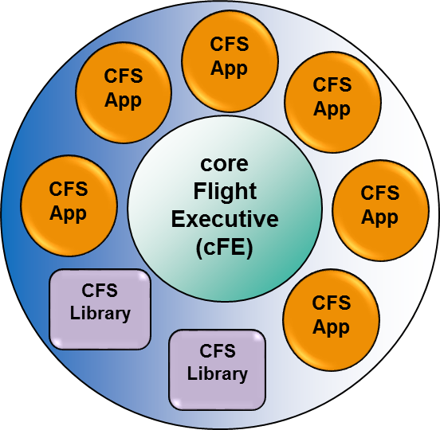
Core Flight Executive
Integrate with NASA Goddard’s reusable flight software framework
Open source version available at SourceForge
Perform local device management, software messaging, & event generation
Core Components
Core Flight Executive (cFE): Mission-independent software services
Core Flight System (CFS): Applications and libraries running on cFE
Core Flight System
cFE Core
Stored Commands
Health & Safety
Scheduler
Other Apps
Scrubber
File Manager
cFE Core
CFS Apps
Mission Apps
Software Bus
SpaceWire
Watchdog
Camera Support
Time Sync
Image Self Check
PR
Error Logging
Notes:
Supporting abstraction and utility services
Connected via Software Bus
File Manager
Processes ground commands
Health and Safety
Application and event monitoring, watchdog servicing, execution counter reporting, CPU aliveness indication
Housekeeping
Packet-driven telemetry message builder
Stored Commands Task
Receives commands from ground
Scheduler
Generates messages when specified

Slide 21
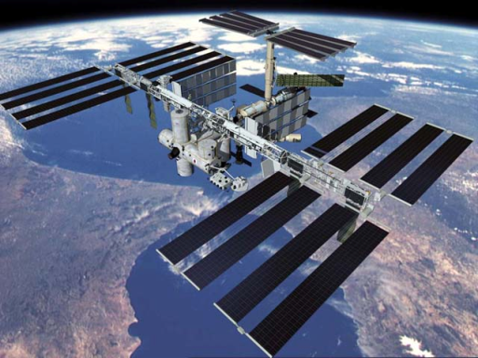
NASA Missions for CSPv1
Two confirmed for NASA Goddard
CSP featured as new technology for space computing
NASA technology mission
STP-H5/ISEM on ISS – late 2014 delivery
Two CSPv1 computers working in tandem
SpaceWire, Camera Link, reconfiguration
NASA science mission
CeREs Cubesat – early 2015 delivery to NASA
Heliophysics experiment in LEO
One CSPv1 computer for on-board processing
Additional missions in planning
TechCube 1
Escape

Slide 22
Artist Illustrations (c/o NASA)

Slide 23
Conclusions
Major challenges lie ahead
Escalating app demands in harsh environment
Tightening constraints of platform, budget, process
Necessitates adeptly doing more with less
CHREC Space Processor
Focus upon reconfigurable space computing
Adaptive (performance, reliability, power) for mission needs
Focus upon multifaceted hybrid computing
Agile mix of COTS + RadHard + FTC; fixed & reconfigurable
Focus upon scalable building blocks
Address needs of small, large, & clustered spacecraft

Slide 24
Questions and Shortfalls
Hardware
No explicit experimentation process for hardware reliability (e.g. TID part lifetime)
Untested in actual flight environment
Software
Doesn’t address drawbacks of disabling FPGA scrubber during PR
Downtime could miss errors from SEUs
Suggestion: PR needs to be done very fast
Could use data to validate software reliability choices

Slide 25
Questions?

