Slide 1
Space Communications: Congestion Control Methods
joe Kimbrell
James mackinnon
Jacob stewart

Slide 2
Paper Selection
Panigrahi, B.; Yanxiao Zhao; Sohraby, K., "Deep space autonomous network using reverse channel for congestion control," Electro/Information Technology (EIT), 2013 IEEE International Conference on, vol., no., pp.1,6, 9-11 May 2013. doi: 10.1109/EIT.2013.6632720
Ravandi, M.G.; Mortazavi, M.; Ghorshi, S., "CPM: A congestion control method for interplanetary network," Electrical and Computer Engineering (CCECE), 2014 IEEE 27th Canadian Conference on, vol., no., pp.1,5, 4-7 May 2014 doi: 10.1109/CCECE.2014.6901050

Slide 3
Deep Space Autonomous Network
Using Reverse Channel for congestion control

Slide 4
Communications Beyond Earth
Three major challenges faced by communication systems in deep space
Long propagation delays between source and destination
Range from tens of minutes to hours
Example – Communications between Earth and Mars ranges from 8.5 to 40 minutes
Long distance makes conventional transport protocols impractical
ACK/NACK are inefficient
Intermittent connectivity
Planets’ positions vary with time
Line of sight required for communication between nodes
Limited buffer size on intermediate nodes
If node buffer is full, incoming data packets are dropped
Source node gets no feedback about packet loss
Proposed modifications to TCP protocols difficult to implement

Slide 5
Deep Space Autonomous Network
Communications beyond Earth form store-and-forward Deep Space Autonomous Network (DSAN)
Integration of multiple independent networks
Sensor arrays, space stations, colonies, etc.
Example – Sending data from Mars to Earth
Messages collected from surface sensor network on Mars and stored in gateway
Messages delivered to and stored in intermediate node
Messages delivered to Earth

Slide 6
Novel Approach
Utilize long delay channel as memory resource for congestion control
Overflow packets transmitted back to source instead of being dropped
Continues to send packets back and forth until destination accepts data
Probability of packet loss significantly reduced
Indirectly provides feedback on congestion status at destination
Source takes measures to control packet flow if data returned
Tells planet sensors to slow down transmission
Stores sensor data and slows transmissions (rate control)
Simulation results verify reverse channel with rate control outperforms traditional approach
Energy consumption
Number of retransmissions per packet

Slide 7
Considerations for a System Model
Two-hop DSAN system model
Source, relay node, destination
Reverse channel proposed in addition to regular forward channel
Destination sends packets back to source if buffer full
Source and relay nodes maintain queues
Source queue larger than relay queue
Destination buffer may lack storage
Connection to next destination unavailable or if incoming traffic exceeds outgoing traffic
Returned packets join incoming traffic at source to retransmit
As opposed to dropping packets at destination
Source responds to returned packets
Control rate of data flow to reduce congestion

Slide 8
Assumptions for the Study
Nodes assumed static
Planet mobility slow compared to packet transmission time
Once line of sight between nodes established, remains for period of time
Control Case
No ACK mechanism
If packet dropped at destination, source unaware
Dropping of packets at destination only due to lack of buffer space
Assume all else is ideal
No channel error
Low SNR
Made possible by using high transmission power at source

Slide 9
No Reverse Channel
General Case in which there is only packets travelling in the forward direction
Typically in the direction of Earth due to large amounts of sensor data being
Distance between nodes is vast and delay times long
Prevents the use of a normal ACK/NACK protocol
Sender is ignorant of any packet loss at receiver
Loss severely degrades throughput
Sender transmits multiple redundant copies of a packet to ensure it arrives
Packets are spaced to avoid overflows
Consumes more energy per packet
Trades efficiency and speed for fault tolerance

Slide 10
Reverse Channel
Retransmit packets if relay node packet buffer is full
Uses the time the packets are “in flight” as a form of storage
Packets are bounced back and forth until they are accepted at relay
A separate connection called a downlink channel
Operates at a separate frequency from the uplink/forward channel
Two major benefits
Ensures a much lower rate of packet loss
Enables the source gateway to control the flow of packets into the system

Slide 11
Reverse Channel With Rate Control
Basic principal is the same as without rate control
Rate Control provides congestion mitigation by slowing transmit of packets
When the relay starts to receive duplicated packets it slows transmission
Rate at which transmission is slowed is called alpha
Alpha is varied depending on the rate of received duplicates
Data rates reduced in two ways
Configures the sensors to reduce capture rate
Stores packets from sensors and releases them at a slower rate
Storing packets uses energy
The energy used for storage is usually less then the energy used for transmission

Slide 12
Energy Consumption
Packet transmission energy consumption usually greater than packet storing
Deep space communication use high gain amplifiers
Transmission amplification power usage can reach into the 10’s of watts
Storing energy requirements can become significant in deep space scenarios
Extremely long delays lead to long buffering periods
Storage requires power sources to be maintained
Many factors can determine storage energy
System configurations
Hardware specifications
Operating system
Memory management algorithms

Slide 13
Energy Consumption Metrics
Energy is a vital resource on space missions
Is reverse channel congestion control worth the cost?
Two main metrics:
Energy consumption per successful packet
Called E_{c}
Takes into consideration both cost of transmission and storage power consumption
Average number of retransmissions per successful packet
Called N_{a}
A measure of how many times a packet is retransmitted before acceptance
Retransmissions count in both directions
Simulation is used to estimate these values

Slide 14
Simulation Overview
Comparisons made between multiple packet management methods
No Reverse Channel
If the relay node buffer is full, packets are dropped
Source node transmits K=3 redundant packets for each original packet
Reverse Channel (with no rate control)
If the relay node buffer is full, packets are sent back through the reverse channel; however, the source node does not slow down packet transmission speed
Reverse Channel (with rate control)
If the relay node buffer is full, packets are sent back through the reverse channel and the source node slows down by a factor of alpha

Slide 15
Simulation Parameters
Base assumptions for simulations
Two-hop model
Source node transmits to relay node which transmits to the final destination
Channel Characteristics
Source – Node propagation delay of 400s
Direct channel data rate of 100kbps
10 KB packet sizes
Relay Node Characteristics
Average packet arrival time of 1s
Queue size of 50 packets
Packet Relay speed of $R_{dst}$
2000 steady state observation period of the simulation
High power ($P_{t}=20W and P_{r}=15W$) 30 GHz (Ka-Band) transmissions
Retransmissions will not be caused by poor reception

Slide 16
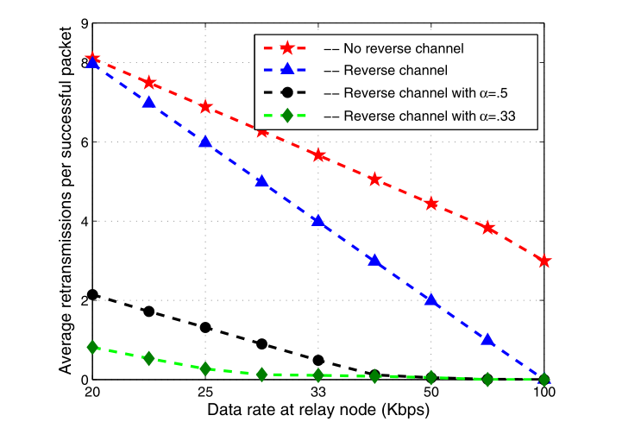
Simulation Results Number of retransmissions
Verbal Insight
Reverse channel with rate control requires the least amount of retransmissions for this system
Without rate control, the reverse channel is less effective at limiting retransmissions for this system
The lack of a reverse channel requires 3 retransmissions per packet and therefore is the most costly

Slide 17
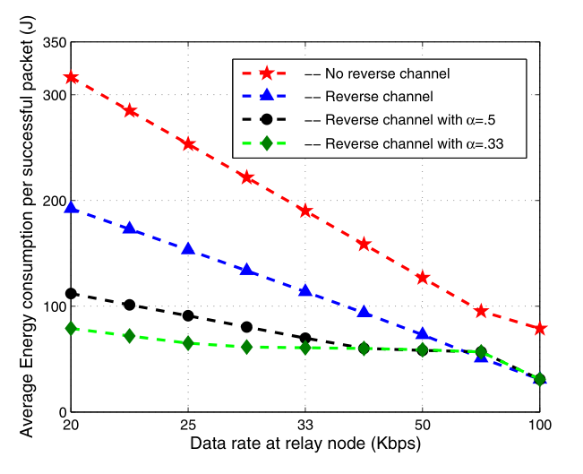
Simulation Results Average Energy Consumed per Successful Packet – Transmission
Verbal Insight
Reverse channel with rate control requires the least amount of energy per packet
Without rate control, the reverse channel is less effective at limiting energy used per packet
The lack of a reverse channel requires 3 retransmissions per packet and therefore is the most costly in terms of energy used

Slide 18
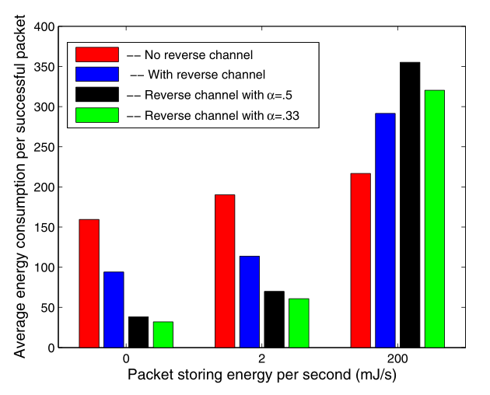
Simulation Results Average Energy Consumed per Successful Packet – Storage
Verbal Insight
For the low storing energy cases, reverse channel with rate control saves the most energy
For the higher storing energy case, the lack of a reverse channel decreases the power used on storage
No clear indication of what point is the crossover

Slide 19
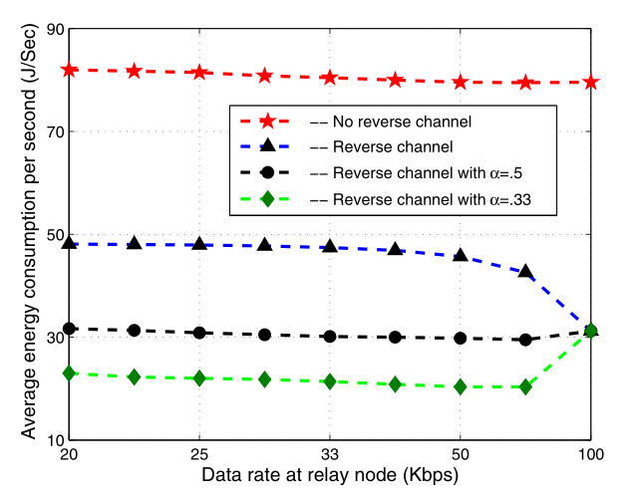
Simulation Results Average Energy Consumed per Successful Packet – Transmission
Verbal Insight
With varying relay node data rates, the reverse channel with rate control performs the best
At higher data rates, all of the reverse channel methods merge

Slide 20
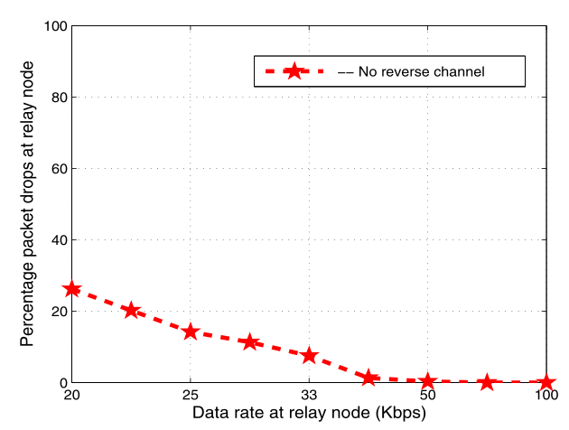
Simulation Results Average Energy Consumed per Successful Packet
Verbal Insight
All reverse channel methods drop no packets
Lacking a reverse channel, packets are dropped due to the data rate of the relay node being too low

Slide 21
Control Packet Mechanism
Congestion control method for interplanetary network

Slide 22
Introduction
Interplanetary network (IPN)
Network providing communication and navigation services for spacecraft
Difficulties arise with the distance and variability between transmissions
Each node operates as a point to point communication node
TCP/IP does not fit well with IPNs due to intermittent connectivity, long delays, and high bit error rates
A new TCP is required for deep space communication networks

Slide 23
IPN Architecture
Networks that operate independently and communicate with one another
1. IPN Backbone Network
2. IPN External Network
3. PlaNetary Network
3a. PlaNetary Satellite Network
3b. PlaNetary Surface Network

Slide 24
IPN Backbone and External Networks
IPN Backbone Network
Provides infrastructure for communications between –
Earth-based operations
Ground stations on planets and moons
Satellites and relay stations
Includes data links between elements with long-haul capabilities
IPN External Network
Consists of groups of spacecraft between planets, sensor clusters, space stations
Some nodes have long-haul capabilities

Slide 25
PlaNetary Network
Comprised of PlaNetary Satellite Network and PlaNetary Surface Network
Consists of –
Satellites orbiting planet
Rovers and mission elements on surface
Implemented on any planet to provide interconnection and cooperation among satellites and surface elements

Slide 26
PlaNetary Satellite Network
Satellites circling planets provide relay services
Between Earth and planet
Communication and navigation services to surface elements
Some surface elements can communicate with satellites
Receive data and commands
Includes links between orbiting satellites
Includes links between satellites and surface elements
Composed of satellites in multiple layers
Location management of PlaNetary Surface Networks

Slide 27
PlaNetary Surface Network
Provides communication links between high power surface elements
Rovers and landers
Communicate with satellites
Provides power-stable wireless backbone on planet
Includes surface elements that don’t communicate with satellites directly
Organized in clusters
Spread out in ad hoc manner
Requires special protocol stack to meet requirements of each sub-network
Must work with terrestrial networks to connect to terrestrial internet

Slide 28
Control Packet Mechanism (CPM)
Reliable transfer method for IPN in backbone network
Purely rate controlled method
Uses a series of informational packets to determine transfer rate
Method supports connection between single sender and receiver
Ex: ground station to space station or between relay links
Intermediate devices are receiver of previous sender and sender for next receiver
Relay links act as store-and-forward routers
Susceptible to packet loss and congestion
Congestion can lead to increases in delay and packet retransmissions
CPM can help to avoid congestion problems

Slide 29
Control Packet Mechanism (CPM)
CPM is based around a packet based transmission scheme
Packets are transmitted together as a logical unit called a frame
Frames also contain data that will be used to shape the connection
Handshakes are used to initialize connection
Uses SNACKs instead of ACKs
SNACK is a selective negative acknowledgment
Reduces congestion in the reverse link
Fewer SNACKs than ACKs
Saves energy by virtue of there being fewer of them
Error rates in the link can be estimated from ratio of SNACKs to total packets

Slide 30
Method of Operation – Phase 1
Source sends two identical handshake packets consecutively to receiver
Duplicate packets ensure a low probability of a loss
Once the receiver gets the handshake it starts transmitting data frames
Initially the frames are limited to 5 packets
Small number of packets are because the link quality is unknown
Data frames contain information about receiver
This first burst is called the Information Packet 0 (IP0)
Source uses IP0 to calculate free buffer size
CFBS = FBS – NIF*(Frame Size)
CFBS – Current Free Buffer Size
NIF – Number of Interval Frame
Total time in phase 2RTT

Slide 31
Method of Operation – Phase 2
Starts after T > 2RTT
Each side of the transmission sends information packets in their frames
Additional information now in these packets
They still contain the free buffer space
Additionally contain SNACKs
Sender and receiver keep track of packets sent in frames
SNACKs indicate lost packets
SNACKed packets are retransmitted
Parameter called Error Link is calculated from information packets
This parameter is used to tune connection speed to
Minimizes packet loss and congestion

Slide 32
Error Link
Important parameter for adjusting network
Calculated using:
EL = (Numbers of lost packets)/(Number of Packets in Frame)
The number of lost packets is determined by the information packet
SNACKs correspond to lost packets
Error Link is used to calculate the size of the next frame
Care is taken to ensure the size of the next frame is not larger than the FBS

Slide 33
Congestion Control
Occurs when the forward and reverse links when the buffer is full in the receiving or transmitting node, respectively
Because of the high and variable distance between transmission points knowing the congestion is very difficult
The question becomes, “How do we detect the congestion?”
Two methods presented for congestion control
Block out
Frame lost and InP lost

Slide 34
Congestion Control
Block Out
When the error link goes above 50% it indicates that 50% of the packets must be retransmitted
Sender stops transmitting for a set period of time
Sender will begin transmitting once the error link goes below 50%
Frame lost and InP lost
Sender enters a timeout period
Begins retransmission frame if after 2RTT of the sending frame it has not received its InP
Benefit of not wasting time before retransmitting

Slide 35
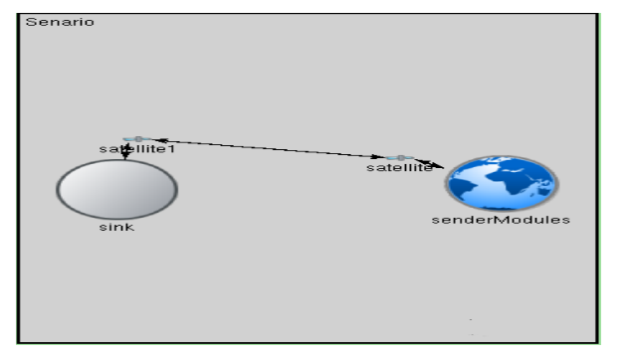
Results - Setup
Simulation Configuration
Discrete time simulation to represent discrete events in space communications
Simulation based on OMNeT++4
C++ simulation library with discrete, component-based, modular simulation capabilities
Network Configuration
Earth Ground station (source) transmits to earth orbiting satellite
Deep space communication from earth orbiting satellite and Mars orbiting satellite
Mars Ground station (sink) receives data from Mars orbiting satellite
Scenario
10GB of data to be transmitted from Earth Ground station to Mars ground station
Buffer sink is equal to 10MB

Slide 36
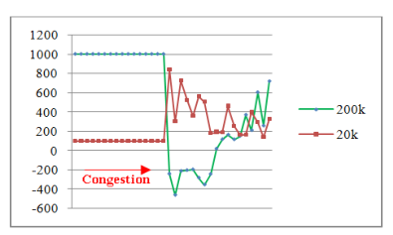
Results – Congestion
Verbal Insight
A correctly sized sink buffer results in no congestions
Higher data rates lead to more congestion
Negative values indicate congestion as well as the packet being dropped
Overhead
CPM does not increase any overhead because it doesn’t change the sending patterns
The reverse link uses SNACKs instead of ACKs

Slide 37
Shortfalls
DSAN
Priority of retransmitted packets not discussed
Claims alternate TCP protocols are difficult to implement without backing this up
Simulations limited in scope
Assumes an ideal environment – need future work with channel noise and other nonidealities
CPM
Paper was very poorly edited, and had a large amount of grammatical mistakes
It made several unsubstantiated claims
Graph was missing axis labels, which made it hard to understand

