Slide 1
Reconfigurable Computing
Methods for Increasing Portability and Productivity
Joe Kimbrell
James MacKinnon
Jacob Stewart

Slide 2
Paper Selection
Kirchgessner, R.; George, A.D.; Lam, H., “Reconfigurable computing middleware for application portability and productivity,” Application-Specific Systems, Architectures and Processors (ASAP), 2013 IEEE 24th International Conference on , vol., no., pp.211,218, 5-7 June 2013 doi: 10.1109/ASAP.2013.6567577
Vuletic, M.; Pozzi, L.; Ienne, P., “Programming transparency and portable hardware interfacing: towards general-purpose reconfigurable computing,” Application-Specific Systems, Architectures and Processors, 2004. Proceedings. 15th IEEE International Conference on , vol., no., pp. 339,351, 27-29 Sept. 2004 doi: 10.1109/ASAP.2004.1342483

Slide 3
Reconfigurable Computing
Middleware for Application Portability and Productivity

Slide 4
Introduction
Advantages of reconfigurable devices
Flexibility for application specific tasks
High performance, low power
Difficulties of using reconfigurable devices
Lack of standardization between platforms
Difficult to port code
Vendor specific cores

Slide 5
Possible Solution - HLS
High-level synthesis (HLS)
Reduce the difficulties of FPGA development
Encounter the same lack of portability
HLS tool must support various platforms
Impulse-C: per-platform support packages
ROCCC: per-platform application cores
FPGA device development outpaces tool development
HLS tools must make assumptions which decreases efficiency of generated core

Slide 6
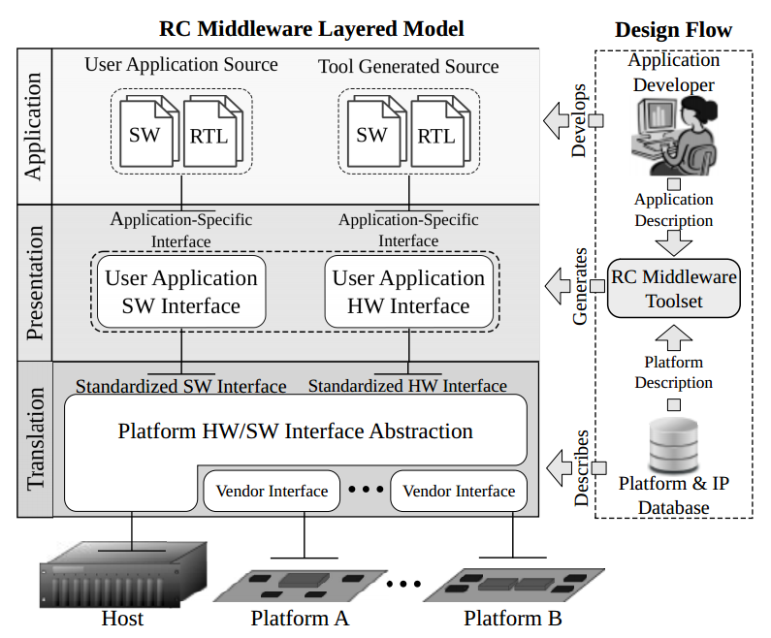
RC Middleware (RCMW)
Designed to enable more portability
User specifies required resources and interfaces via XML at design time
Including number, type, size, and data types of each resource
RC Middleware toolset creates a portable hardware and software interface
Portability is no longer a concern as the interface can be generated for many different devices

Slide 7
Related Work
RCMW is a complementary technology to other FPGA abstraction methods
Intermediate Fabrics – coarse grained logic blocks that increase FPGA compile times
FPGA-on-FPGA overlays – provides compatibility between devices without requiring bitfile recompilation
OpenCL and Liquid Metal (Lime)
High-level programming models focusing on improving portability

Slide 8
Approach
RCMW composed of three layers
Translation Layer
Converts platform-specific resource interfaces to a standardized RCMW interface
Presentation Layer
Uses the RCMW interface to provide user specified resource requirements
Application Layer
Final interfaces allow user to develop application without platform dependencies

Slide 9
Translation Layer (HW)
Converts vendor-specified physical interfaces to an RCMW-standardized interface format
Including interfaces for inter-FPGA communication, memories, and host communication
RCMW-standardized interface can then be integrated further in the Presentation layer
Exposes FPGA block RAM on the device
Allows for the user to implement lower-latency OCM

Slide 10
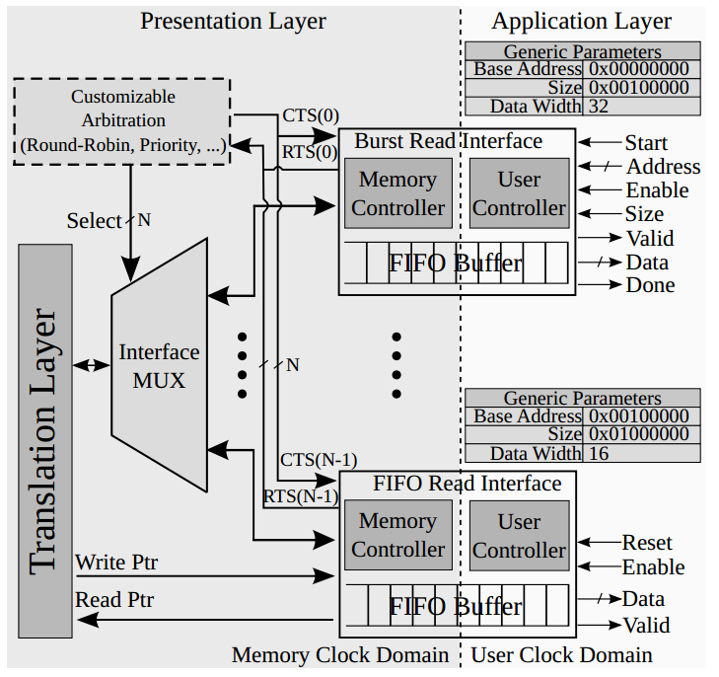
Presentation Layer (HW)
Converts standardized physical resources into resources usable by the application
Consulting the RCMW IP database
Contains components for arbitration, interface conversion and controllers, and multiplexing
Variable number of interfaces can be provided in FIFO or burst mode
Configured via XML framework
Interfaces, pin assignments, and timing constraints

Slide 11
Presentation Layer (HW) Resource Arbitration
Resource Arbitration allows for multiple interfaces to map to a single physical interface
Bandwidth to support multiple interfaces
Coordinated via arbitration controller
Ready-to-send (RTS) and clear-to-send (CTS) signals
RTS signal
Asserted when a configurable number of bytes remains in the buffer, indicating the controller is ready to access memory
CTS signal
Asserted when the interface takes control of the physical memory bus
De-asserted when the interface gives up control of the physical memory bus

Slide 12
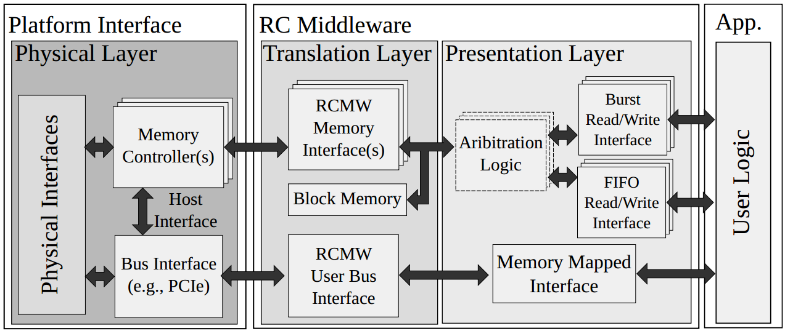
Application Layer (HW)
Provides application-specific hardware interfaces required by the user
Interface provided in the form of a top-level entity
No knowledge required of underlying hardware

Slide 13
Software Abstraction Implementation

Slide 14
Software Abstraction
Provides object-oriented API based on C++11
C++11 used for improved threading and memory management
Standardized register and memory interfaces

Slide 15
Translation Layer (SW)
Standardized interface exposed through Board class
Each platform has subclass in board to implement –
Blocking reads/writes
Non-blocking reads/writes
Board enumeration
Bitfile initialization
Memory and FPGA objects inside board represent physical components on platform
Implemented using vendor-specific API or RCMW-specific driver interface

Slide 16
Presentation Layer (SW)
Generated as subclass of RCMW application class
Application class encapsulates instances of resource interface objects requested in the XML specification
At runtime –
Loads bitfile
Initializes memory interfaces (calls bind)
Runs user code (calls execute)
Resources automatically released at end of execution

Slide 17
Application Layer (SW)
Implemented by application class
Only need to build app in execute stub
Improves productivity
Thread-safe timing library

Slide 18
RC Middleware Toolset
Handles generating presentation layer
Maps application resources onto platform resources
Three-step generation
Parsing XML description
Mapping application to platform resources
Generates HDL/C++ for interfaces
Structural HDL generated for hardware instances
Application class software created in C++
Makefile also generated to ease compilation

Slide 19
RC Middleware Tool Flow

Slide 20
Mapping
Most complex step in presentation layer generation
Determines locations of memory and FIFO resources
Mappings vary greatly between target platforms
Iterates through all application to physical mappings
Evaluates with cost function
Lowest cost mapping gets used
Cost function based on number of IP instances and metadata information
Metadata about interfaces used to help evaluate cost
Maximum operating frequency
Device resource utilization reports

Slide 21
Experimental Results

Slide 22
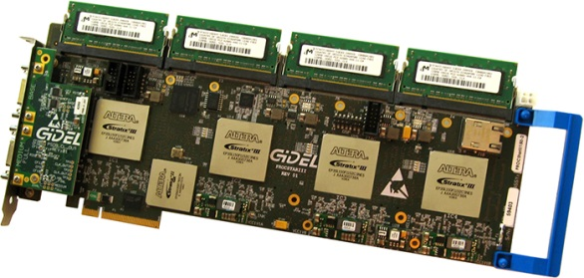
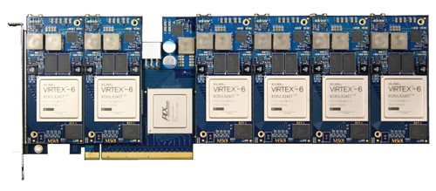
Experimental Setup
Three different platforms were used for testing
GiDEL PROCStar III
Altera Stratix III FPGA
4 GB DDR2 and 256 MB SDRAM per FPGA
GiDEL PROCStar IV
Altera Stratix IV FPGA
8 GB DDR2 and 512 MB SDRAM per FPGA
Pico Computing M501
Xilinx Virtex-6
512 MB DDR3 per FPGA

Slide 23
Experimental Setup
Software used:
Quartus II v11.1 for Altera bitfile generation
Used GiDEL drivers for PROCStar board tests
Xilinx ISE 14.1 for Xilinx bitfile generation
Used with Pico boards
GCC with C++11 support using –O3 optimizations
Used for compiling the RCMW’s software API

Slide 24
Performance Analysis
Native and RCMW implementations compared
Performance overhead was analyzed in two ways
Read and Write performance
Measured by timing memory transfers from the host and FPGA
Tested with a variety of data sizes
Area overhead
Measured using post-fit component device utilization summary generated by Quartus and ISE

Slide 25
Performance Analysis
Greatest overhead occurred between the host and external memory
PROCStar III was the worst at 80% overhead
Overhead was caused by RCMW’s additional features
Thread-safety mainly to blame
M501 has thread-safety built in
Performs better than both other boards
Transfer size had large effect on overhead
Overhead approaches zero for large transfer sizes
Overhead increased transfer time by microseconds

Slide 26
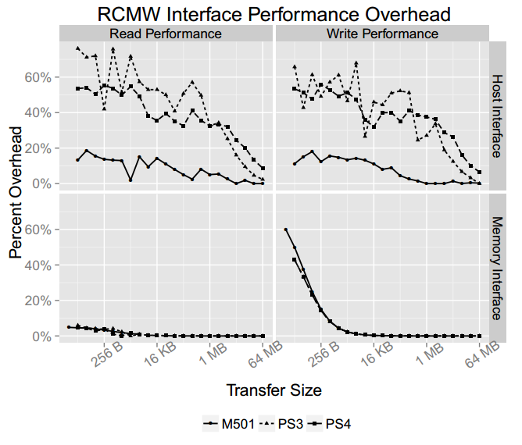

Slide 27
Area Analysis
Area split up into three categories
RCMW
Logic overhead of middleware components
Application
Area usage dedicated to implementing benchmark
Vendor IP
Consists of vendor supplied IP such as memory controllers, FPGA to host interface (PCIe), PLLs, etc
RCMW typically took less than 1% of total fabric area
This can vary depending on the number of interfaces

Slide 28
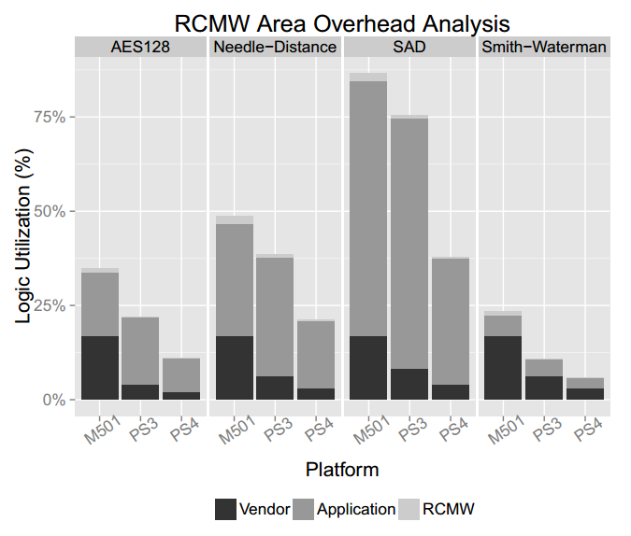

Slide 29
Productivity Analysis
Split into three metrics
Software lines of code (SLoC)
Hardware lines of code (HLoC)
Total development time
Each benchmark was ported to the hardware platform from existing OpenCores IP
Same developer worked on all the benchmarks
This ensured number of lines of code stayed consistent

Slide 30
Productivity Analysis
RCMW required much less development than native
GiDEL (Altera)
65% less SLoC
41% less HLoC
53% less development time
Pico (Xilinx)
66% less SLoC
59% less HLoC
69% less development time

Slide 31
Portability Analysis
RCMW makes it possible to easily port projects between diverse hardware platforms
RCMW toolset executed only once per platform
Architectural differences did affect performance
Benchmarks requiring more memory interfaces like image segmentation ran better on GiDEL hardware
Pico hardware supported a newer PCIe standard which increased the speed of the host-FPGA connection

Slide 32
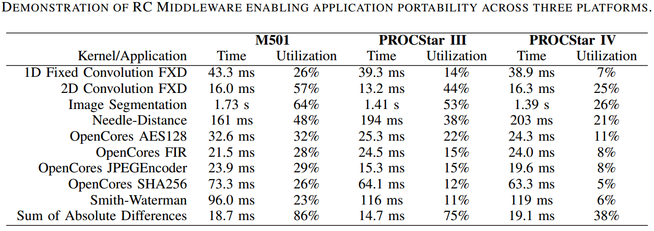
Overall Performance

Slide 33
Conclusions
Drastically decreased the amount of time/coding required for the development
Increased the portability of FPGA apps between hardware platforms
Allows developer to code from an application centric viewpoint and not worry about low level hardware

Slide 34
Future Work
Larger case study to fully evaluate RCMW productivity
Variety of developers and applications needed to fully flesh out the effectiveness of the middleware
Vendor specific IP cores hurt portability
Work is needed to be able to enable interoperability of vendor cores like memory and interface controllers

Slide 35
Programming Transparency and Portable Hardware Interfacing
Towards General-Purpose Reconfigurable Computing

Slide 36
Introduction
Two main types of computation
Temporal computation
Computation running on general processors
Most common
Spatial computation
Computation in specifically-designed hardware for a particular application
Application specific

Slide 37
FPGA Pros and Cons
Pros
FPGAs provide flexibility for spatial tasks without developing ASICs
ASICs even more expensive, not reprogrammable
Allow for design growth of unit through re-programmability
Cons
Higher unit cost for FPGAs compared to processors
Reduces large-scale production abilities
Slower clock speed than processors and ASICs

Slide 38
Reconfigurable System-on-Chip
Lack of unified programming methodology
Increases difficulty of software development
No standardized interfaces for hardware accelerators
Makes portability difficult
Must be easier to program and more portable
Make RC systems better for general-purpose computing

Slide 39
Microprocessors vs RC Devices
Microprocessors
Easily programmed and run on abstraction layers
OS, libraries, virtual machines
Hide platform specific details
RC devices
Software and hardware need to be written and interfaced
Exposed platform-dependent communication details to programmer
Difficult to manage
Less portable

Slide 40
Goal
New programming paradigm for RC devices
Decoupled from underlying platform
App-level programmers don’t have information about hardware
Hardware designers not exposed to interfacing details
Don’t know where data to be processed is located
Underlying architecture provides abstraction layer to fit between hardware and software design
Supports programming model
Abstraction layer provides transparency and uses standard interfacing between software and hardware

Slide 41
Transparent Programming Model
Application Programmers
Code high-level concepts without knowledge of underlying platform
Could be sequential or parallel code
Authors considered parallel multithreaded model
Shared memory paradigm

Slide 42
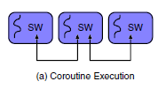
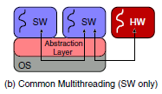
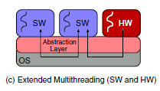
Multithreaded Programming Model
Co-routine execution – First approach to multithreading without system-level support
Common multithreading supported by abstraction layer
Ignores existence of hardware threads
Extended multithreading supports seamless integration of hardware threads
Programming transparent
Interfacing portable

Slide 43
Extended Abstraction
Multithreaded apps achieved through coroutine execution
Abstraction layer of libraries/OS support currently used for thread management
Doesn’t cover possibility for hardware threads
Non-standardized communication and interfacing
Bad for hardware accelerators
Solution – Extend thread abstraction layer
Provide support for standard integration of hardware threads
Threads communicate over standardized interfaces
Normal abstraction layer still in place

Slide 44
Designing Portable Software Architectures

Slide 45
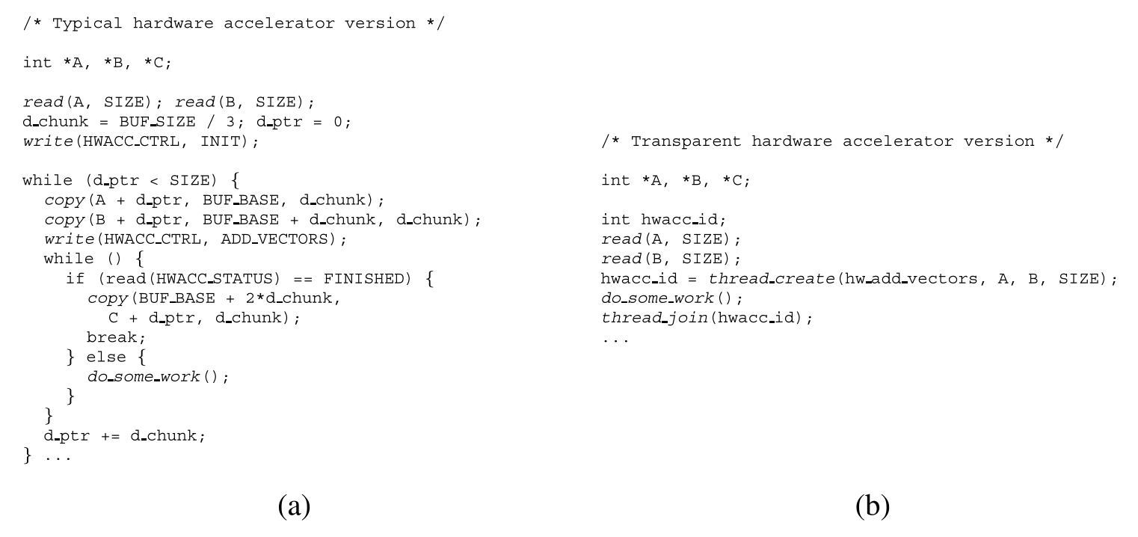
Software Threads
Underlying Goal: Portability
General Guidelines
Software thread should interface with virtualization layer and not hardware accelerators directly

Slide 46
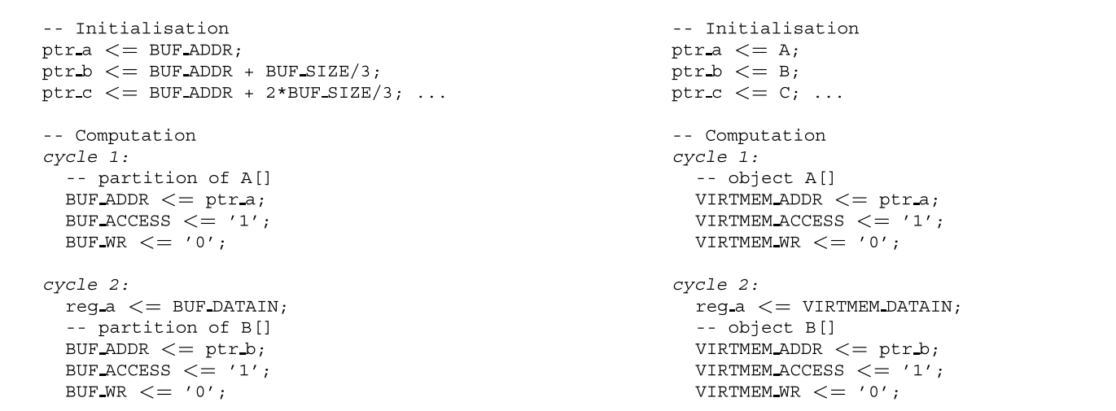
Hardware Threads
Underlying Goal: Portability
General Guidelines
Hardware thread should interface with virtualization layer and not main memory directly
Interconnect accessible via communication assistants

Slide 47
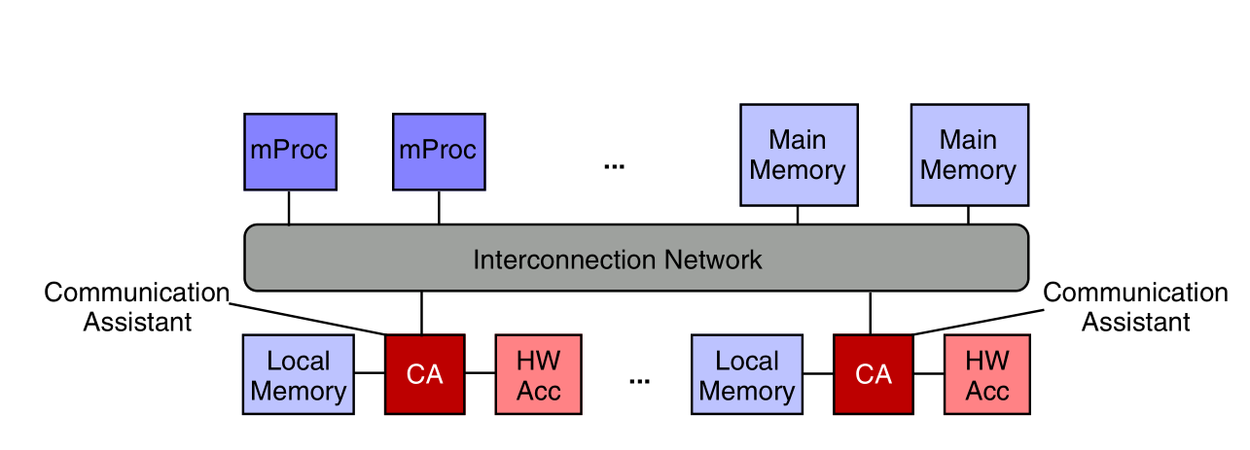
Architectural Effects
Portable code that abstracts the underlying hardware from the application designer
Paper explicitly does not address resource management, just portability

Slide 48
Software – Hardware Interaction
Software initiates execution and passes parameters through virtualization layer to hardware accelerator
Hardware Accelerator accesses memory and synchronizes with other system components through communication assistant
Address translations and memory copies go through virtualization layer
Acceleration core passes result back, control is returned to the software thread

Slide 49
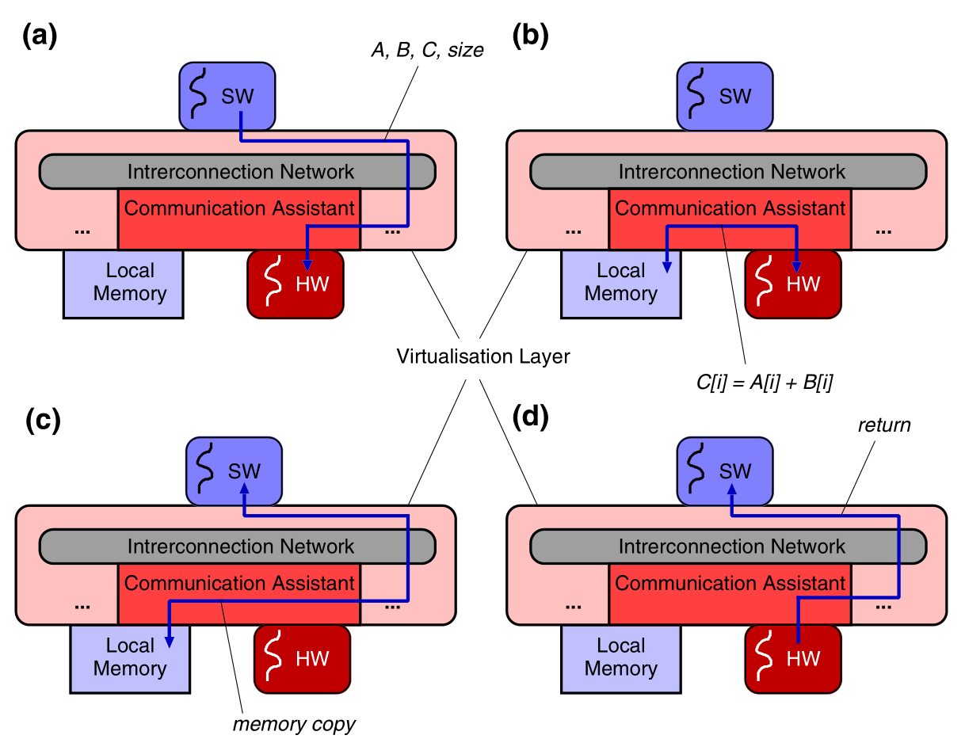
Software – Hardware Interaction

Slide 50
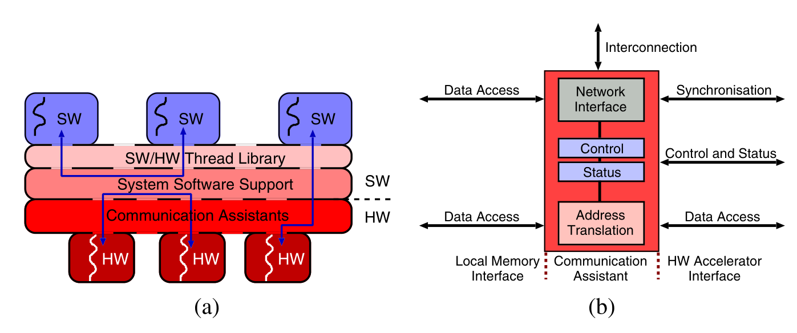
Virtualization Layer - Outsides
Software Threads
Abstracted via thread libraries and system software
Designed by application developers to accomplish task
Hardware Threads
Abstracted via Communication Assistants
Perform address translation and network interfacing
Designed to accelerate software tasks

Slide 51
Virtualization Layer - Insides
Inner abstraction to coordinate thread libraries with communication assistants
Perform memory translations between software threads, hardware accelerators and local/central memory
Perform additional processing, prefetching, or other advanced data management techniques

Slide 52
Advanced Techniques

Slide 53
Dynamic Optimizations
Multiple layers of abstractions decreases efficiency
Virtualization layer can be used for optimization
Layer could detect memory access patterns
Use this information to perform prefetching
Hides communication latency
Can be used for detecting sequential data accesses
E.g. Supplying data in advance for a Vector Addition

Slide 54
Automated Synthesis
High level language concepts hard to map to hardware
Pointers complicate hardware synthesis
Virtualization layer allows generation of memory addresses as they are
Recursion handled by hardware thread calling itself
Virtualization layer decides dynamically what to do
If accelerator supports recursion then it runs as is
If not then the layer will call a software equivalent of the hardware thread

Slide 55
Flexible Software Migration
Allows runtime software to hardware migration
Can add abstraction layers such as JVM
Conserves “compile-once-run-anywhere” principle

Slide 56
Real Implementation

Slide 57
Programming
Virtualization layer simplified using sequential execution model
Eliminates memory consistency problems
Layer implemented as Virtual Memory Window (VMW)
Main function initializes data and passes virtual pointers to hardware accelerator
Utilizes standardized OS services to call accelerator
Switches back to software after hardware execution
Obscures all communication details

Slide 58
Architecture
Software runs on ARM processor
Accesses memory through AMBA bus
Hardware accelerator core instantiated into FPGA and accessed via Window Management Unit (WMA)
WMU
Acts as communication assistant for hardware core
Translates virtual addresses to physical addresses

Slide 59
Results
Ran multimedia benchmark ADPCM Decode
Measured execution time
Pure software
Typical coprocessor (Directly programmed from user app)
VMW-based version of coprocessor
Significant improvement with the VMW version
Typical coprocessor achieved 20x speedup
VMW-based version
w/o prefetching 15x speedup
w/ prefetching 23x speedup

Slide 60
Results
Manage Time – Time required manage WMU
Copy Time – Time required to copy pages to/from main memory
Sleep Time – Time while VMW manager sleeps waiting for WMU

Slide 61
Conclusion
Authors address problems that plague every RC system
Lack of standardization for programming
Lack of standardization for hardware designing
Brings RC closer to general purpose computing needs
Model suppresses difference between software and hardware from the viewpoint of the programmer
Virtualization layer abstracts platform details
Despite overhead virtualization layer can be a big benefit
Overhead actually can be leveraged to optimize on the fly
Presented case study of a real reconfigurable system

Slide 62
Shortfalls
Middleware
Case study was limited to one developer
Only mentions the problems with Vendor IP even though this is a huge problem for portability
Portability
Only tested on one kernel so ADPCM Decode might be an outlier
Paper spent a lot of time explaining basic programming concepts

Slide 63
Questions?

