Slide 1
Performance and Energy Efficiency of GPUs and FPGAs
Betkaoui, B.; Thomas, D.B.; Luk, W., "Comparing performance and energy efficiency of FPGAs and GPUs for high productivity computing," Field-Programmable Technology (FPT), 2010 International Conference on , vol., no., pp.94,101, 8-10 Dec. 2010
Jones, D.H.; Powell, A.; Bouganis, C.; Cheung, P.Y.K., "GPU Versus FPGA for High Productivity Computing," Field Programmable Logic and Applications (FPL), 2010 International Conference on , vol., no., pp.119,124, Aug. 31 2010-Sept. 2 2010​
Presented by
Aishwarya Dhandapani
Taru Doodi

Slide 2
CPU vs Accelerators
CPUs use task parallelism
Multiple tasks map to multiple
threads
Tasks run different instructions
10s of relatively heavyweight threads
run on 10s of cores
Each thread managed and scheduled
explicitly
Each thread has to be individually
programmed
Focus on improving latency
Accelerators use data parallelism
SIMD model (Single Instruction
Multiple Data)
Same instruction on different data
10,000s of lightweight threads on 100s
of cores
Threads are managed and scheduled
by hardware
Programming done for batches of
threads (e.g. one pixel shader per
group of pixels, or draw call)
Focus on improving throughput

Slide 3
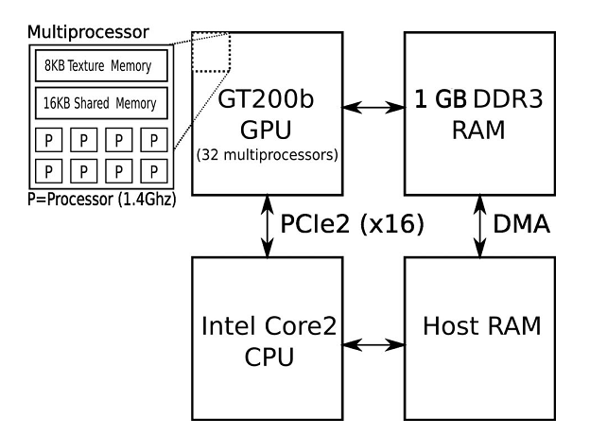
NVIDIA GTX 285
Device Overview
  Stream Processors: 240
  Core Clock: 1400 MHz
  Process Technology: 55nm
  TDP: ~200W
  Memory Controller: DDR3

Slide 4
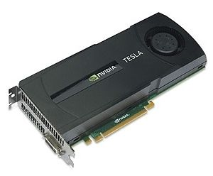
NVIDIA Tesla C1060
Device Overview
  Stream Processors: 240
  Core Clock: 1330 MHz
  Process Technology: 55nm
  TDP: ~160W
  Memory Controller: GDDR3

Slide 5
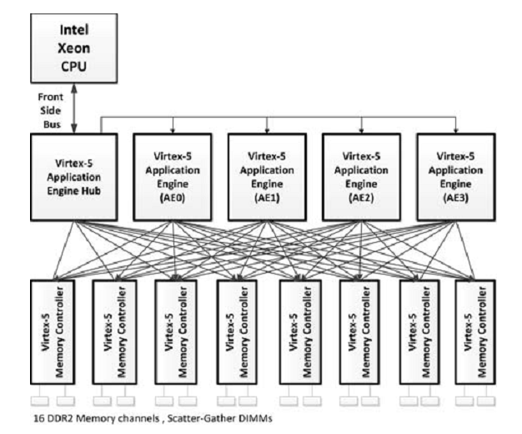
Convey HC-1
Device Overview
  5 Virtex-5 LX330 FPGAs
  FPGA clock: 300 MHz
  Memory Controller: DDR2
  Host: Intel Xeon 5183 clocked at 2.13 GHz

Slide 6
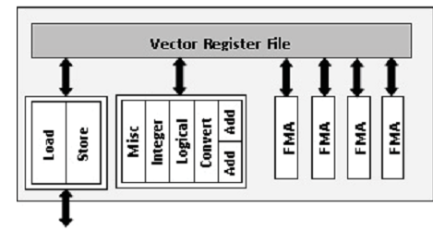
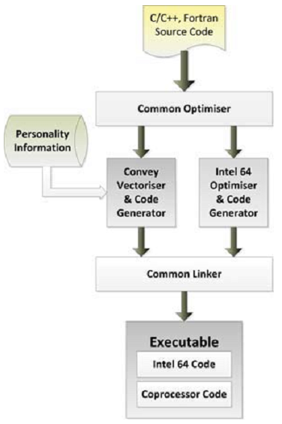
Kernel Optimizations (1/2)
Convey HC-1
  Convey personalities: A group of a set of instructions that are designed for an application or class of applications
  Personalities are stored as pre-compiled FPGA bit files.
  Personalities used: single precision vector personality, double-precision vector personality and financial analytics personality
  In addition to the personalities, Convey Math Library, Basic Linear Algebra Subroutines (BLAS) were used

Slide 7
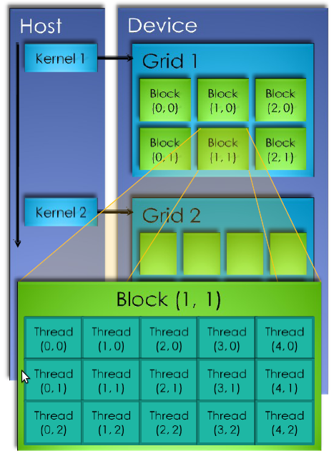
Kernel Optimizations (2/2)
NVIDIA GPUs
  CUDA development model was used to benchmark the GPU
  CuBLAS which is a ported version of BLAS for GPU implementation was used for optimized implementation

Slide 8

Why do we need optimizations?
The architectures under comparison are diverse in nature
To analyze the efficiency of an application on the architecture, the application has to be programmed to take advantage of the architecture’s strengths
It would be a mammoth task to write a benchmark that is optimized for each architecture in a short period of time
Therefore it is essential to use libraries that are optimized for a particular device/architecture

Slide 9

Memory Controllers
Memory controllers are digital circuits that manage the data flow to and from the compute units of a processor
They contain the logic required to read from and write to the DRAM
They also refresh the DRAM periodically, without which the DRAM will lose the data written to it
Double data rate(DDR) memory controllers are used to drive DDR SDRAM, where data is transferred on both rising and falling edges of the system's memory clock.
DDR memory controllers allow for twice the data to be transferred without increasing the memory cell's clock rate or bus width.
GDDR is a memory controller designed for use on graphics processors and is different from DDR.

Slide 10
Experimental Setup for Paper 1
The HC-1 is a 2U server card that uses four Virtex-5’s as application engines (AE) to execute the distributed processes.
The HC-1 also uses another Virtex-5 for process management and eight Stratix-II’s for memory interfaces.
The resulting system has 128GB of DDR2 RAM with a maximum bandwidth of 80GB/sec.
The memory address space is virtually shared with the host processor, making memory allocation and management simple.
The GTX285 has 240 core processors running at 1.4GHz and supports up to 4GB of external DDR3 RAM (we use a 1GB version) with a maximum bandwidth of 159GB/sec.
A single core of an Intel 2GHz Quad (Core2) Xeon with 4GB DDR3 RAM

Slide 11
Experimental Setup for Paper 2
The Convey HC-1 used in this work has a single multicore Intel Xeon 5138 processor running at 2.13GHz with 8GB of RAM.
The HC-1 Coprocessor is configured with 16GB of accelerator-local memory.
AEs consist of four Xilinx V5LX330 FPGAs running at 300MHz.
The memory controllers are implemented on eight Xilinx V5LX155 FPGAs, while the AEH is implemented on two Xilinx V5LX155 FPGAs.
NVidia’s Tesla C1060 GPU has 240 streaming processors running at 1.3GHz.
4GB of GDDR3 memory at 800MHz, offering up to 102GB/sec of memory bandwidth.
CPU: Intel Xeon E5420 Quad-Core CPU with multi-threaded applications.

Slide 12
Kernels
Scalar Sum of a Vector
N-Body Simulation
Dense Matrix Multiplication
Pseudo Random Number Generator
Monte-Carlo Methods for Asian options
STREAM
Fast Fourier Transform

Slide 13
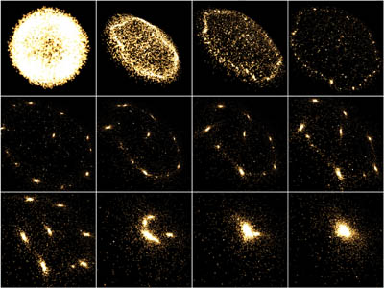
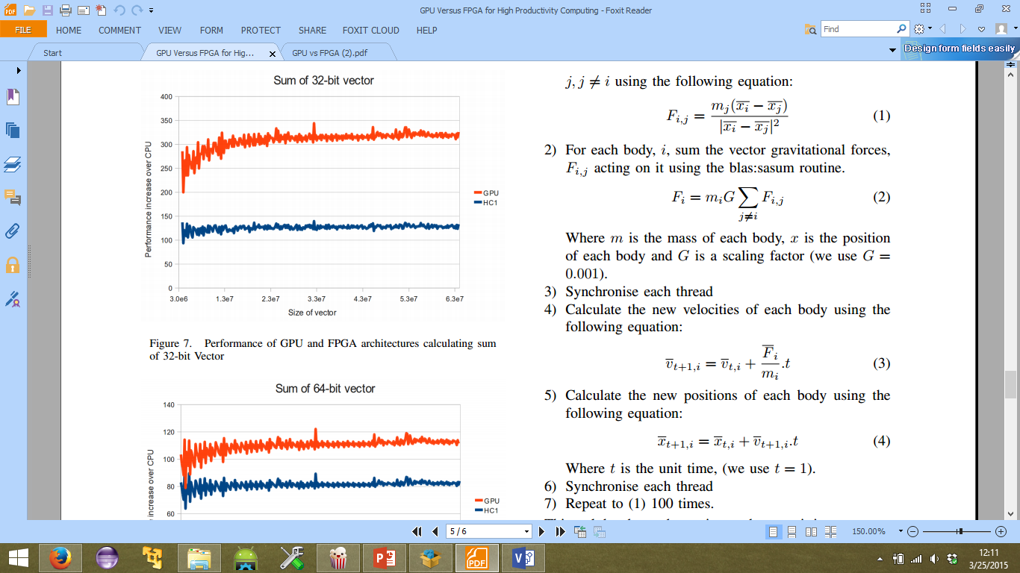
N Body Simulation
2 Dimensional , O(N²) complexity
Calculate force between two bodies
Sum up all the forces
Calculate new velocities of each body
Calculate new position of each body

Slide 14
Pseudo Random Number Generator
Mersenne Twister algorithm
32 bit random numbers
Nvidia PRNG is implemented as custom software on a fixed architecture.
Convey PRNG uses a pipeline shift-register architecture in custom firmware as part of their financial applications personality.

Slide 15
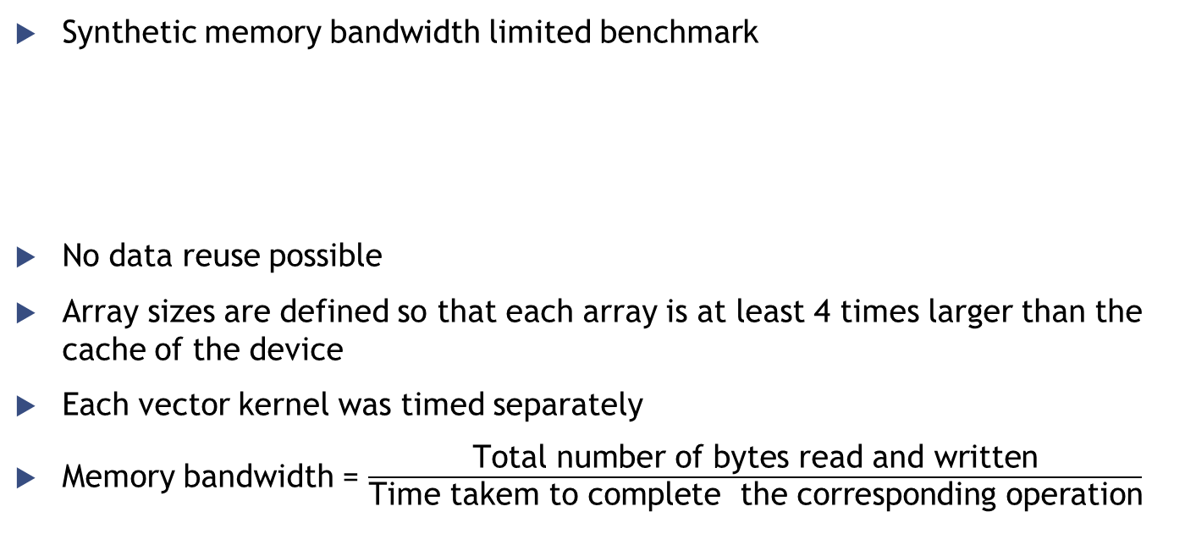
STREAM
Synthetic memory bandwidth limited benchmark
No data reuse possible
Array sizes are defined so that each array is at least 4 times larger than the cache of the device
Each vector kernel was timed separately
Memory bandwidth = $\frac{\text{Total} \text{number} \text{of} \text{bytes} \text{read} \text{and} \text{written}}{\text{Time} \text{takem} \text{to} \text{complete} \text{the} \text{corresponding} \text{operation}}$
COPY: c←a
SCALE: b←αc
ADD: c←a+b
TRIAD: a←b+αc, Where a, b, c ∈ Rm ; α∈R

Slide 16
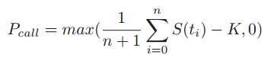
Monte Carlo Methods for Asian Options
Monte Carlo methods are a class of algorithms that use psuedo-random numbers to perform simulations, allowing the approximate solution of problems which have no tractable closed-form solution.
Asian options are a form of derivative which provides a payoff related to the arithmetic average of the price of an underlying asset during the option life-time:
Where, P_{call} is the payoff of the Asian call option, S(t_{i}) is the asset price at time t_{i}, and K is the strike price.
Highly parallel execution
Low memory bandwidth requirements

Slide 17
Dense Matrix Multiplication
Vital kernel in many scientific applications.
One of the most important kernels for LINPACK
The HPC vendors provide
  Optimized hardware
  Optimized software libraries
The SGEMM routine in the BLAS library performs single precision matrix-matrix multiplication, defined as follows:
c←βC+αAB
whereA, B, C∈R^{n×n} ; α, β∈R^{n}

Slide 18
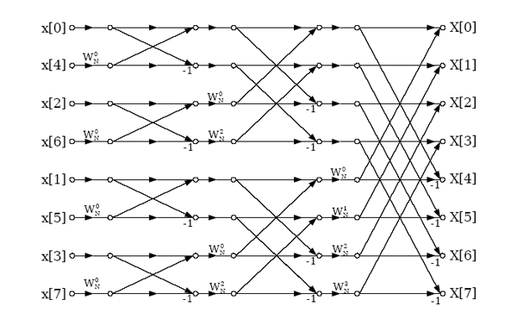
Fast Fourier Transform
Fast Fourier Transform is efficient way of calculating the DFT and its inverse.
FFT requires both high computation throughput and high memory bandwidth.
FFT requires non-unit stride memory access, and hence exhibits low spatial locality.
FFTW is more efficient than the Intel MKL implementation.
It requires O(N) memory accesses.
It requires O(NlogN) floating-point operations.
CUFFT is used for the GPU.

Slide 19
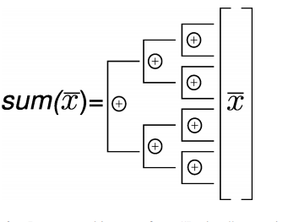
Scalar Sum of a Vector
Combination of reduce operations and synchronizations
Partially synchronous tree architecture process
Uses BLAS library routines in implementations
32 and 64 bit vector implementations

Slide 20
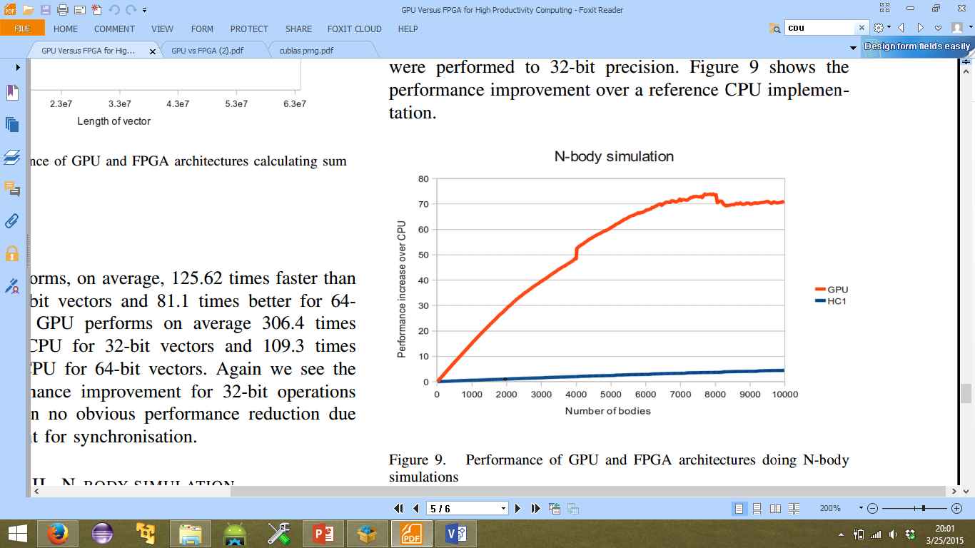
Results: N Body Simulation
Sample size 4800-9600
GPU performed 43.2 times the CPU
HC-1 performed 1.9 times the CPU
Tsoi and Luk* implemented customized hardware and firmware & concluded that an FPGA based N-body simulation can run ∼ 2×faster than a GPU.
  Improved GPU performance slightly (7.8s versus 9.2s)
  Much slower performance on FPGA (37.9s versus 5.62s)
* K. Tsoi and W. Luk, “Axel: A heterogeneous cluster with FPGAs and GPUs,” Proceedings of the 18th annual ACM/SIGDA international symposium on Field programmable gate arrays, pp. 115–124, 2010

Slide 21
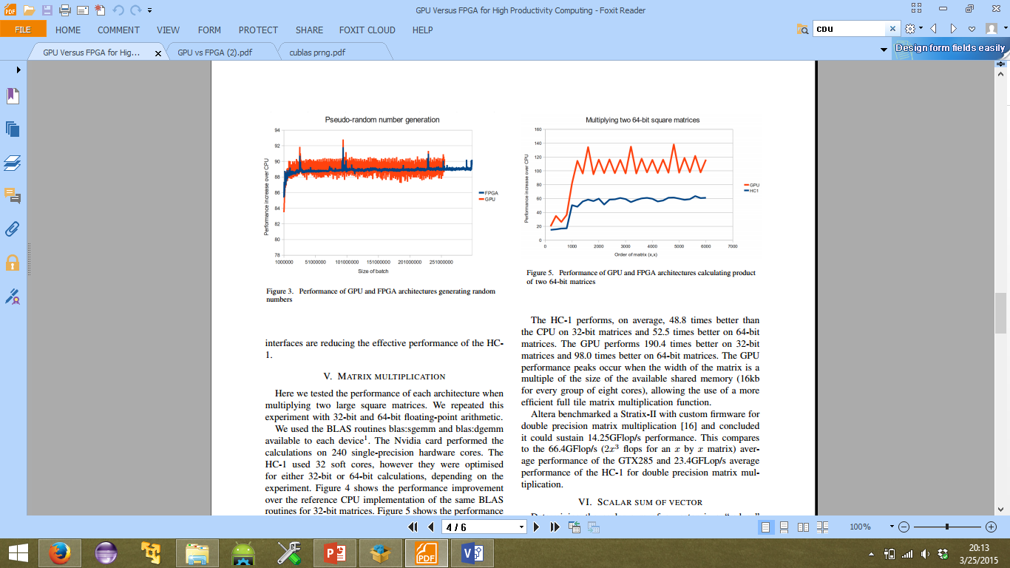
Results: Pseudo Random Number Generator
GPU does batch processing and is sensitive to the size of the batch
HC-1 has bandwidth 128 times greater than on the GTX285 hence larger batches can be generated.
HC-1 performs 88.9 times better than CPU
GPU performs 89.3 times better than CPU

Slide 22
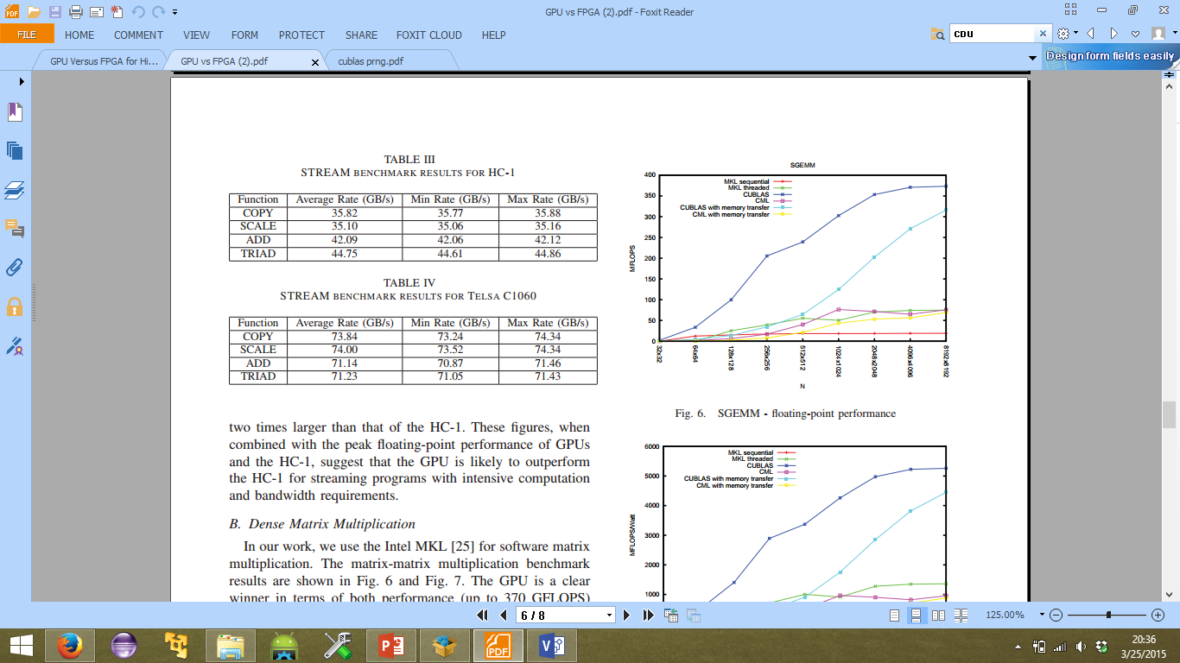
Results: STREAM
Arrays of 32 Million floating-point elements (4 bytes for each element)
Requires over 300MB of memory
GPU sustains a bandwidth that is almost twice that of the HC-1

Slide 23
Results: Monte Carlo Methods for Asian Options
One million simulations over a time period of 356 steps
HC-1 performs 18 times better than the multi-threaded CPU implementation
Vectorization of FOR loop results in major speed up
It is comparable to Single precision GPU performance
Convey finance analytics personality doesn’t support single precision flops
Random number generator is implemented as a custom hardware library in HC-1
GPU implementation is instruction based
The GPU and the HC-1 coprocessor are only about 2 to 4 times more energy efficient than the CPU
Near full utilization of devices and hence higher power than the other kernelsone million simulations over a time period of 356 steps

Slide 24
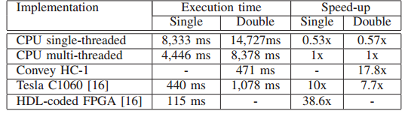
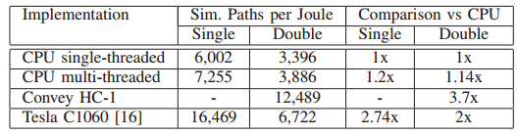
Results: Monte Carlo Methods for Asian Options
Performance
Energy Efficiency

Slide 25
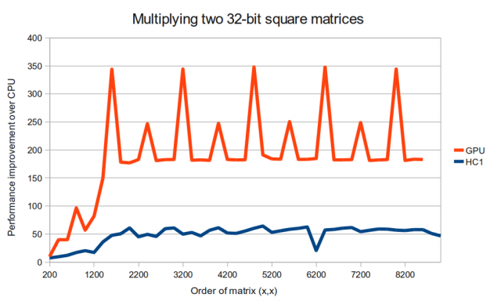
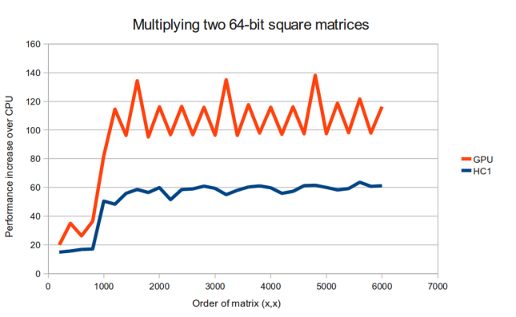
Results: Dense Matrix Multiplication(1)
32 bit square matrices
GPU performs 109.4 better than CPU
HC1 performs 48.8 better than CPU
64 bit square matrices
GPU performs 98.0 better than CPU
HC1 performs 52.5 better than CPU
GPU performance peaks occur when the width of the matrix is a multiple of the size of the available shared memory (16kb for every group of eight cores)

Slide 26
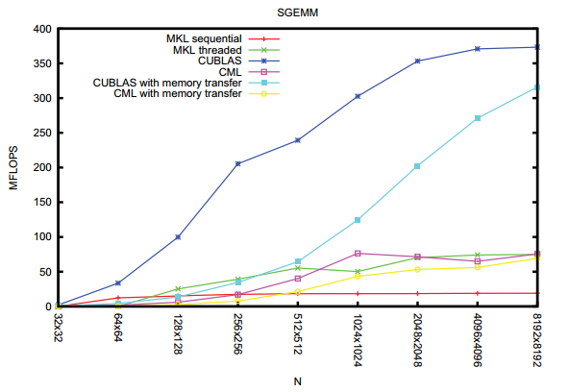
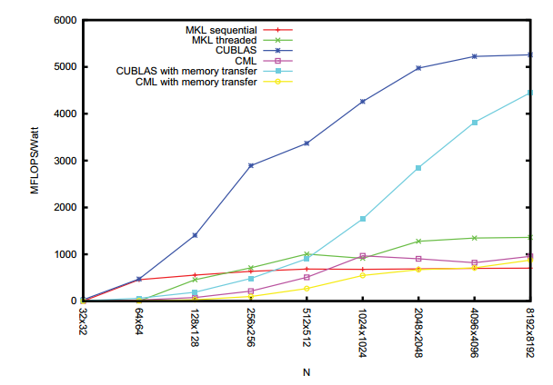
Results: Dense Matrix Multiplication(2)
Performance
Energy Efficiency
GPU performs better in terms of both performance (up to 370 GFLOPS) and power efficiency (over 5GFLOPS/Watt).

Slide 27
Results: Dense Matrix Multiplication(2)
The GPU is about 5 times faster than both the CPU and the Convey Coprocessor.
This speed-up decreases to about 2.5 to 4.2 times if we include data transfer from the main memory to the GPU memory.
HC-1 coprocessor can be slower than the CPU when data transfers from the host processor memory to the coprocessor memory are taken into account.

Slide 28
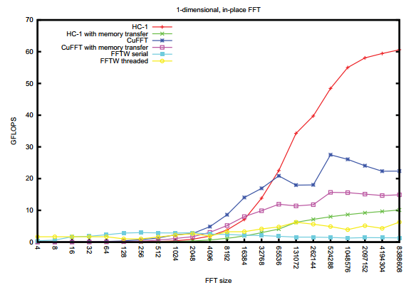
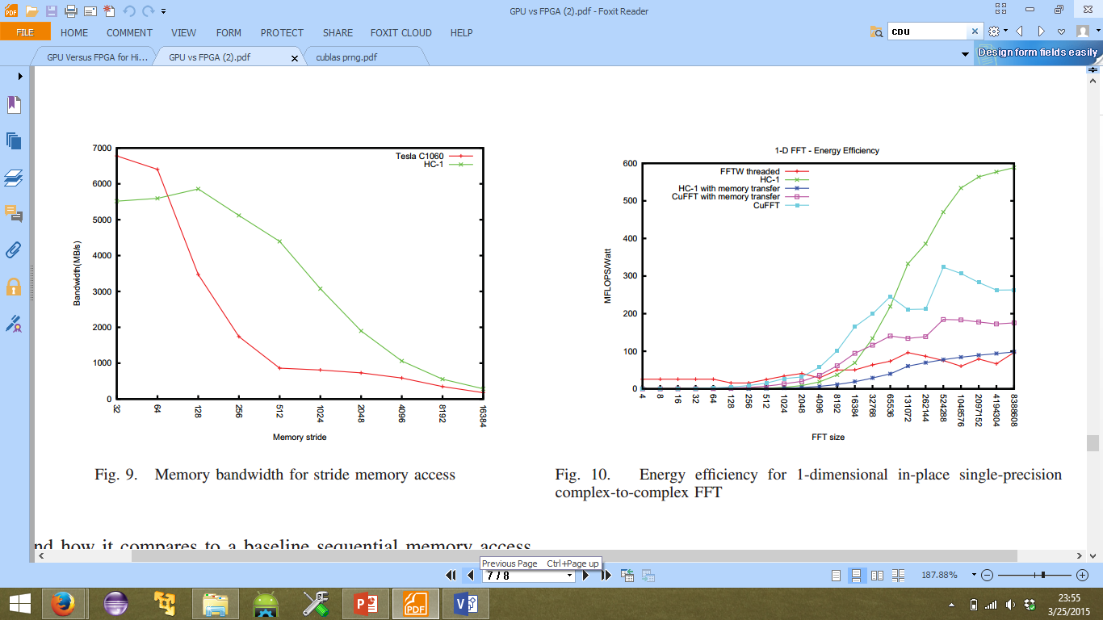
Results: Fast Fourier Transform
Performance
Energy Efficiency

Slide 29
Results: Fast Fourier Transform
Performance of a one-dimensional in-place single-precision complex-to-complex FFT.
FFT on HC1 is 16 times faster than a single threaded FFTW
It is 4 times faster than multi-threaded implementation.
The Tesla C1060 uses GDDR memories which are optimized for sequential memory access operations and stream programming for graphics applications.
  BLAS routine blas:sscopy is available for each platform.
  This routine copies a real vector into another real vector.
  The increment between two consecutive elements in each vector can be specified, i.e. the stride parameter.

Slide 30
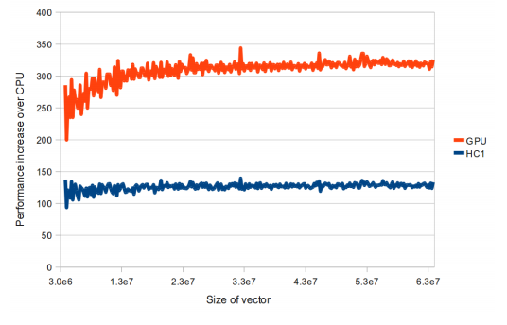
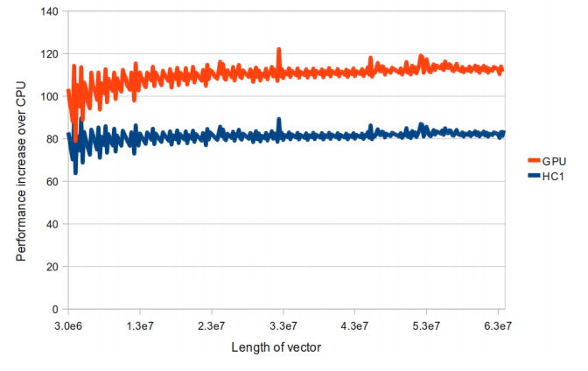
Results: Scalar Sum of a Vector
32 bit vector
HC1 is 125 times faster than CPU
GPU is 306 times faster than CPU
64 bit vector
HC1 is 81 times faster than CPU
GPU is 109 times faster than CPU

Slide 31
Conclusions
Paper 1
  Convey HC-1 and GTX 285 performance compared to CPU performance
  Both devices outperformed the CPU implementation of all benchmarks
  For most benchmarks GPU outperformed the CPU by more than the FPGA outperformed the CPU
Paper 2
  GPUs often outperform FPGAs for streaming applications. The performance of the HC-1 was limited by its floating point performance
  HC-1 has better non-sequential memory accesses which makes it outperform the GPU for applications such as FFT
  HC-1 demonstrates superior performance and energy efficiency for applications that require low memory bandwidths like Monte Carlo benchmark

Slide 32
Pros and Cons
Paper 1
  Comparison of FPGA and GPU performance with single core CPU implementation is not fair comparison
  Tradeoffs in using GPUs and FPGAs not discussed
  Power consumptions not considered
  Could have presented a better analysis of the devices considered
Paper 2
  Detailed analysis of collected data
  Tradeoffs of both architectures discussed in depth

Slide 33

Questions?

