Slide 1
MEMORY MANAGEMENT IN MOBILE ENVIRONMENT
Kanika Chawla
Parth Shah
Sowmith Boyanpalli

Slide 2
CITATION
Shigemori Yokoyama, Takahiro Okuda, Tadanori Mizuno and Takashi Watanabe, ”A Memory Management Architecture for a Mobile Computing Environment”.

Slide 3
MOTIVATION
Today we can communicate using our mobile phones even in remote areas.
But certain challenges still remain
  Narrow bandwidth of wireless communication
  Unstable connectivity
  Limitations of battery at mobile terminals

Slide 4
THE MMM TECHNOLOGY
Above problems solved by controlling a part of mobile terminal’s memory and a part of server’s memory which are common to each other.
Achieves the following:
  Synchronization of common data between mobile terminal and server
  Increase in processing speed
  Reduction in communication cost
  Easy programming of applications
  Power reduction

Slide 5
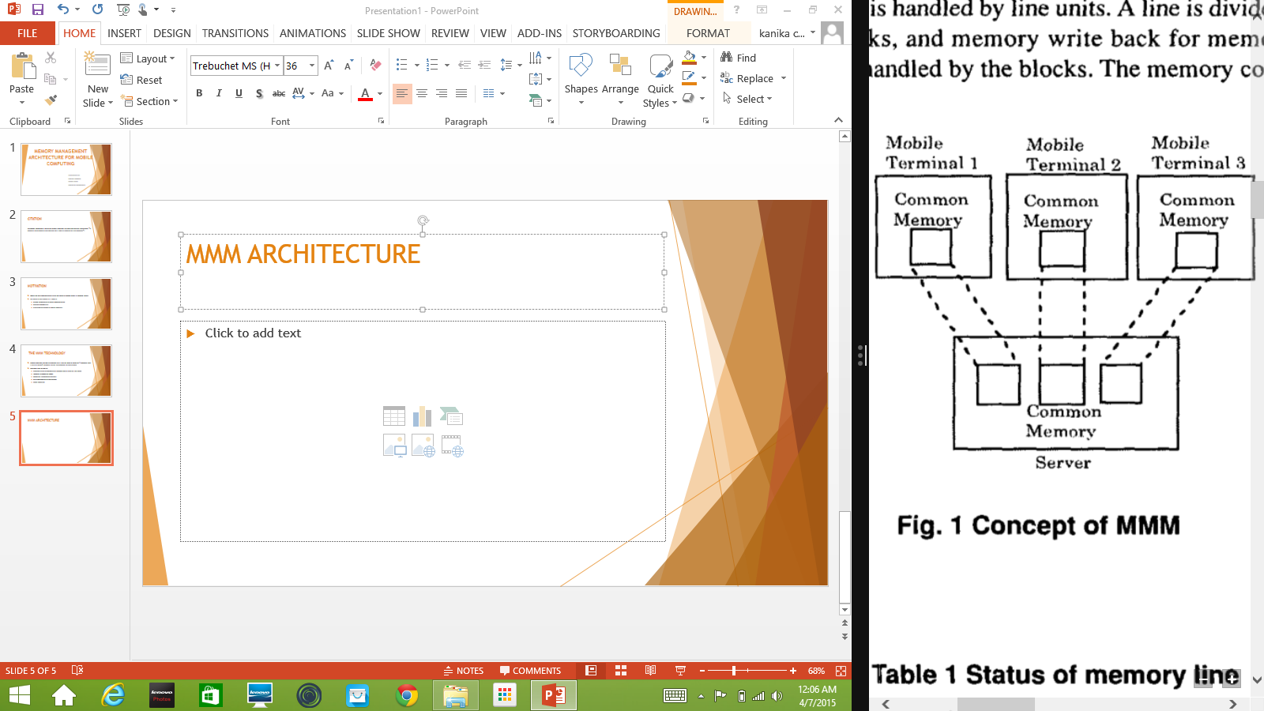
MMM ARCHITECTURE
Common memory used
  Can be accessed by both mobile terminal and server

Slide 6
MMM ARCHITECTURE
Three main concepts used in the new MMM architecture are:
  Cache memory: data is fetched from remote location and stored in local memory for easy access
  Distributed shared memory: common address spaces are at physically distinct locations but have the same address.
  Virtual memory: a part of common memory space of the server is used as virtual memory for the mobile terminal.

Slide 7
WHAT CAN BE ACHIEVED USING MMM
Applications can run faster
  Do not need to program the network aspects to read/write from the server
  All data available locally
  Communication is more efficient
    Only necessary data being communicated at necessary time
    This technique can be implemented using additional hardware of convectional circuits

Slide 8
MEMORY MANAGEMNET SYSTEMS
The memory is managed using the following 5 key points:
  Memory lines and control status field
  Memory control status field and line status
  Memory access and line transfer control
  Resolution of line access conflict
  Control of communication failure

Slide 9
  MEMORY LINES AND CONTROL STATUS FIELD
Memory is divided into fixed areas called lines
Line sizes are between 16 Bytes – 4096 Bytes
Line unit handles the memory mapping between mobile terminal and server
Lines are further divided into blocks, where memory write back is handled
Block sizes are between 16 Bytes – 1024 Bytes
Further, The Control Status Fields control the memory line status.
  Ensures memory consistency
  i.e. lines on mobile terminal and server with same line number should have same data

Slide 10
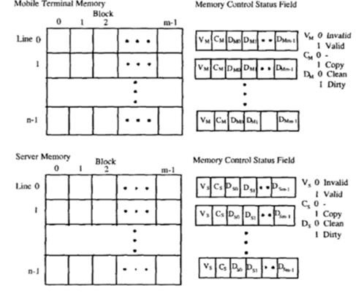
  MEMORY CONTROL STATUS FIELD
  AND LINE STATUS
Control status field is divided into three bits:
  Valid bit: shows if the line is valid(1) or invalid
  Copy bit: whether the line has been copied back
  to server/mobile terminal(1) or not
  Dirty bits: whether write operation has been
  performed on the blocks.

Slide 11
MEMORY ACCESS AN DLINE TRANSFER CONTROL
In case of memory access,
  The kind of memory operation is determined by the kind of memory access
  The next memory line status is determined by current memory line status
  The line transfer control and related line status control are performed in memory exception interrupt(MEI)
  MEI is invoked by memory access

Slide 12
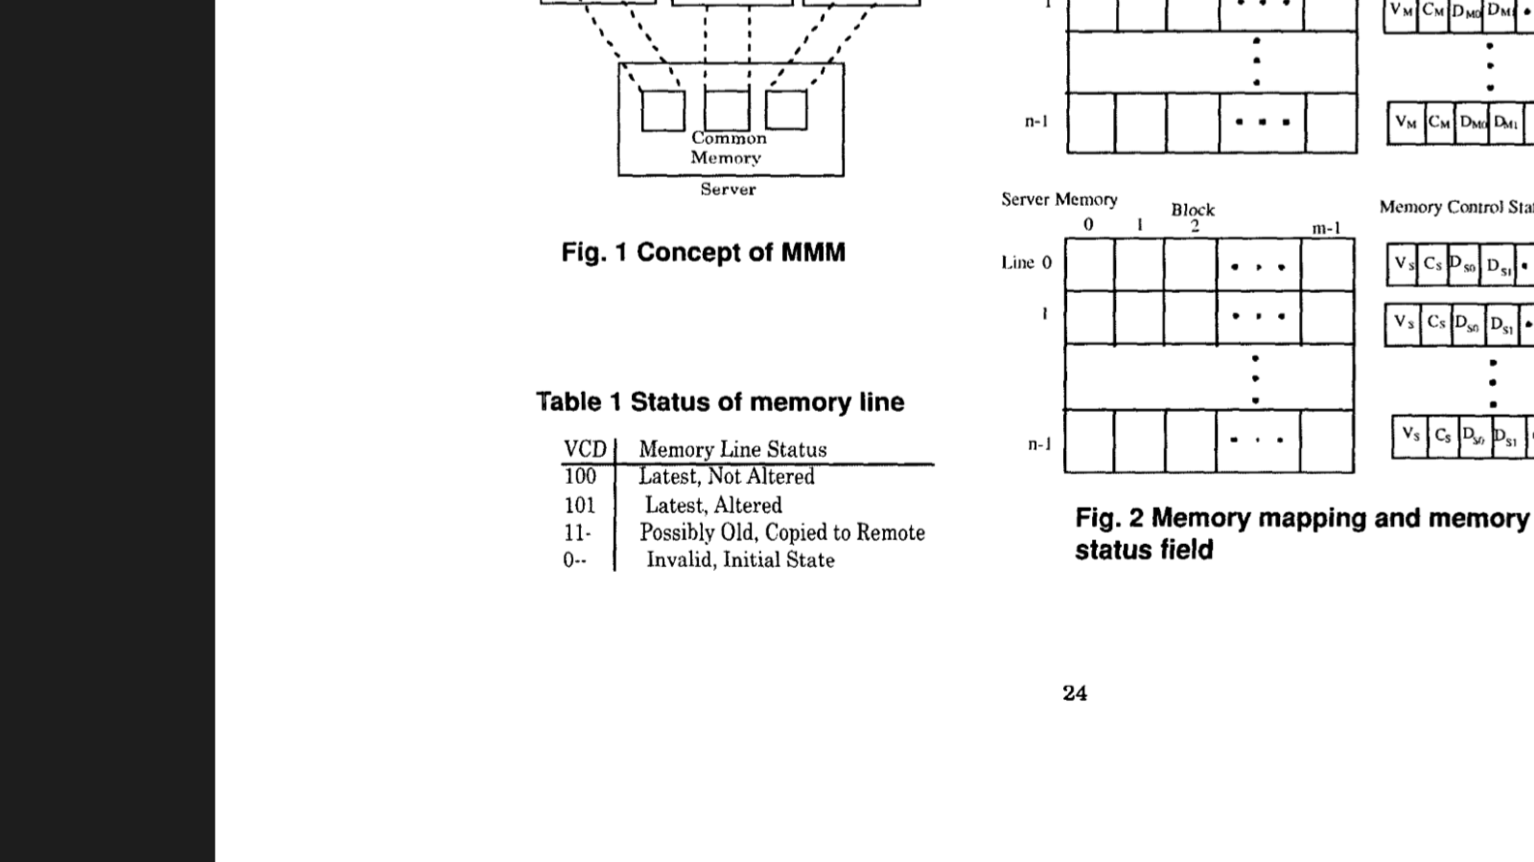
MEMORY EXCEPTION INTERRUPT
Communications between a mobile terminal and server to transfer the lines are executed in a memory exception interrupt
Taking some sample cases for memory access and line transfer control

Slide 13
SAMPLE MEMORY ACCESSES
If status is VC(m)= 100
  Content is valid as V = 1, i.e. read/write has been successfully performed on mobile terminal
  It has not been copied to the server yet as C = 0
  If line status is invalid i.e. V(m) = 0 or old VC(m) = 11
    The MEI occurs to achieve memory consistency
    Exception routines on mobile terminal and server communicate to transfer designated line
    When line is requested from mobile terminal , a remote interrupt occurs on the server

Slide 14
For V(m)=0 , content is transferred to the mobile terminal
For VC(m)=11, then D(s) bits are further inspected
  if D(s) bit of a block is 1 then corresponding data is transferred
  If all D(s) are 0 then no transfer because no alterations have been done
    VC(s) is then set to 11 and interrupt routine is terminated

Slide 15
In mobile terminal’s interrupt routine , during the transfer of data from server, the line status becomes
  VCD(m) = 100 which corresponds to the newest line
  Again if the write operation is performed D(m) bits are set

Slide 16
RESOLUTION OF LINE ACCESS CONFLICT
A deadlock situation occurs if the mobile terminal and server request the same line at the same time.
To prevent this the remote interrupt is turned off between the memory exception and completion of the first instructions execution after the end of interruption
By this method when the same line is used the memory line is accessed alternatively between the mobile terminal and the server

Slide 17
CONTROL OF COMMUNICATION FAILURE
In the case of exception communication should be established.
If the communication fails the control program reports the status of memory to the application

Slide 18
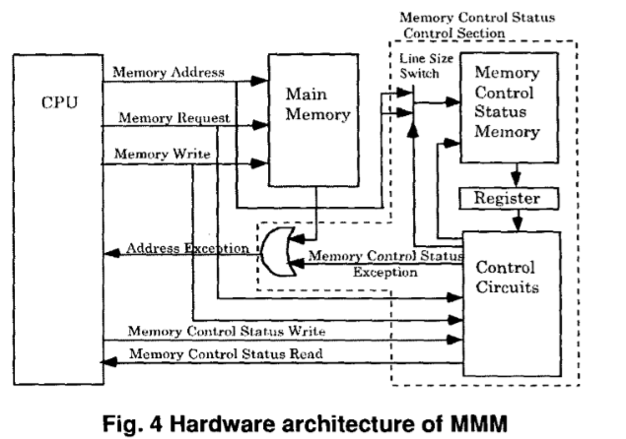
EXPERIMENTAL SETUP
MMM system can be realized by using a processor with a standard architecture

Slide 19
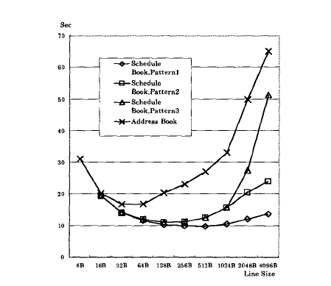
LINE SIZE VS DATA TRANSFER TIME

Slide 20
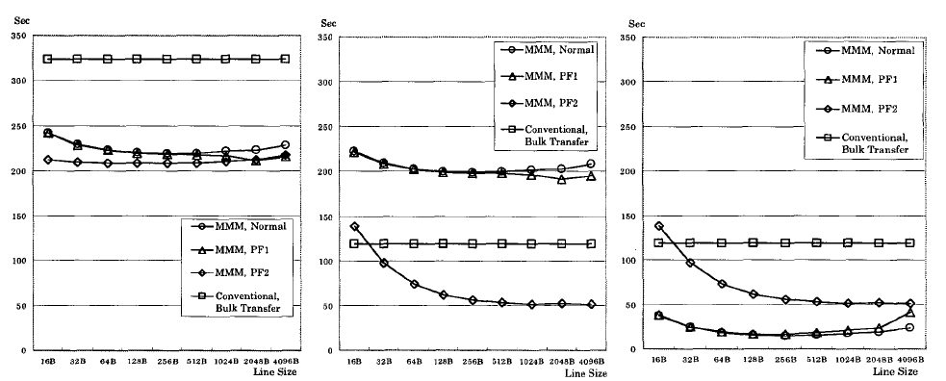
COMPARISON OF MMM AND A CONVENTIONAL
MEMORY SYSTEM ON A MOBILE TERMINAL

Slide 21
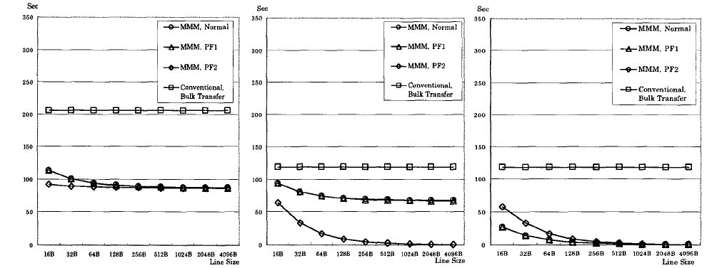
COMPARISON OF MMM AND A CONVENTIONAL
MEMORY SYSTEM ON A SERVER

Slide 22
Limitations
Data in the paper is redundant with lot of information repeated
It doesn’t discuss any fault tolerant

Slide 23
CONCLUSION
MMM is the most preferable memory architecture for mobile terminals and servers .
Introducing MMM achieves synchronisation of common data on the moobile terminal and server.
The applcation executes faster and efficiency of communication system increases by decreasing the communication cost and saving power.
Prefetching multiple lines increases the efficiency.

Slide 24
A Distributed Cache Management Architecture for
Mobile Computing Environments
Presented at 2009 IEEE International Advance Computing Conference (IACC 2009)
By: G. Anandharaj, Dr. R. Anitha

Slide 25
Introduction
Presents an effective technique to improve performance in a mobile environment
Caches frequently accessed data items on client side
Reduces data access latency as data access request can satisfied from the local cache or active node cache

Slide 26
Introduction
Cache management in mobile environment includes following issues to be addresses:
  Cache discovery algorithm :- Efficiently discover, select and deliver requested data from neighboring nodes
  Cache admission control: - Decides what data to cache
  Cache consistency algorithm: - Ensures no stale data are present
  Cache replacement algorithm: - Decides which data to replace

Slide 27
Distributed Cache Management Architecture (CCCM)
Goal: to reduce the caching overhead and provide optimal consistency and replacement.
To improve the network utilization, reduce the search latency, bandwidth and energy consumption.

Slide 28
Network Model
Mobile Computing Network
  Geographic area divided into cells
  Cells consists of Base Station (BS) and Mobile Terminals (MT)
  Intra-cell and Inter-cell communication managed by BSs.
  MTs communicate with BS by wireless network
Mobile network with n cells C1, C2, …, Cn
For each cell Ci, DSi is database server that keep pieces of information, that is accessed by other systems
S1, S2, … Sm are the clients in each cell.

Slide 29
Tree Based Database Architecture

Slide 30
Tree Based Database Architecture
The different DSs may be considered as mobile networks owned by different service providers.
Communication between DSs takes place only through their root databases Each cell is controlled by a DS2.
Each DS2 is co located with a BS, which performs query processing on a query arrival.
A number of DS2s are clustered into one DS1and several DSIs are connected to a single DSO.
The DSO maintains a location profile for each mobile client currently residing in its service area. It consists of a record for each client in the entire mobile system.

Slide 31
Organization of Databases
Index file & Data File
Index file points to the location profile of mobile clients in data file
Client location profile contains pointer to DS of one level down the hierarchy of the client
Index File
Data File
DS

Slide 32
Location Update Procedure
Client C1 moves from one DS2 to another DS2
  Sends request message to associated DS2 which routes it to DS1
If DS1 remains same then old DS2 is updated with new DS2, old DS2 gets cancellation message
  If DS1 changes, DS0 updates the old DS1 with new DS1, old DS1 gets cancellation message, New entry in DS2
Old DS2 removes the entry and sends the location profile to new DS2
New DS2 adds new record and stores the location profile

Slide 33
Distributed Cache Management Architecture (DCMA) – Cache Placement
Neighboring active slides form a cooperative cache system
In case of data miss in the local cache, client searches in its zone.
Active node decided based on weight
  Wi = (BWi + SPi + CRi ) / ALi
Vector W = {Si, Wi}
All the nodes above a cutoff are Active nodes Sk, W > Beta
Database server caches data into active nodes

Slide 34
Cache Discovery Algorithm
Determines where the requested data is located
The list Sk is broadcasted to all clients, once it is created
For a miss, node sends request packet to active nodes
Active node having data sends ack packet to sender node
Ack contain Timestamp and Weight
Based on this information, sender node requests data from best active client with a confirm packet
Best client sends requested data

Slide 35
Cache Consistency Algorithm
Update message is sent to the nearest client in list Sk
Ack sent and forwards update to next client in list
Procedure repeats for all nodes until ack received
The sender propagates the data with new timestamp to all clients sending ack

Slide 36
Cache Replacement Algorithm
Least Relevant Value replacement policy
Based on:
  Access probability
  Distance: Caches data for farther node; saves bandwidth and reduces latency
  Size: Larger cache block makes room for more data

Slide 37
Experimental Results

Slide 38
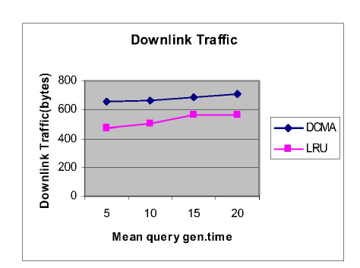
Downlink Traffic Vs The Query Generation Time

Slide 39
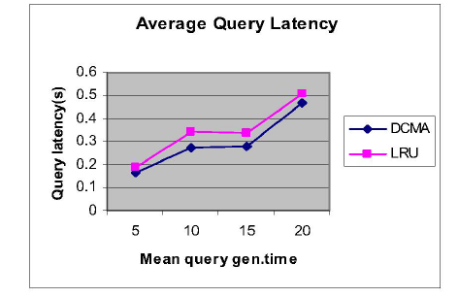
average query latency as a function of Tquery.

Slide 40
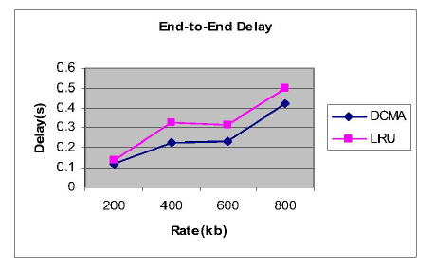
Average End-to-end Delay For Different
Traffic Rates

Slide 41
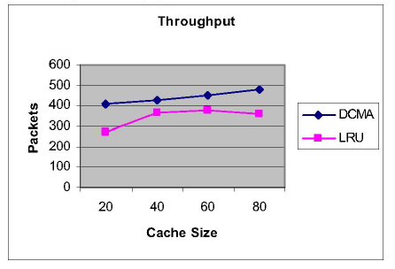
Average Throughput Received For Different Cache Sizes

Slide 42
Pitfalls
No fault tolerant mechanism
May degrade performance

Slide 43
Conclusion
DCMA (Distributed cache management architecture ) includes cache placement, discovery , consistency and replacement techniques
It provided efficient technique for location update in the case of moving clients.
It achieves lower latency , reduced packet loss, reduced network bandwidth consumption, reduced data server workload.

Slide 44
Questions & Discussion

