Slide 1
Embedded Runtime Reconfigurable Nodes for wireless sensor networks applications
Chris Morales
Kaz Onishi

Slide 2
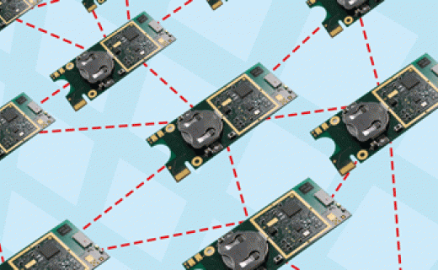
Wireless Sensor Networks
Expected to be :
Autonomous
Low Power
Context aware
Flexible
Can have thousands of nodes spread out
Makes development and support complicated
Traditionally microcontrollers were used
New design alternatives use reconfigurable hardware

Slide 3
Reconfigurable Systems
Been studied as alternative for both ASIC and GPP
Traditional GPP suffer from I/O imbalance
FPGA have the necessary I/O and performance
Runtime reconfiguration changes FPGA configuration at runtime
Can perform hardware updates at runtime
Can save memory during runtime

Slide 4
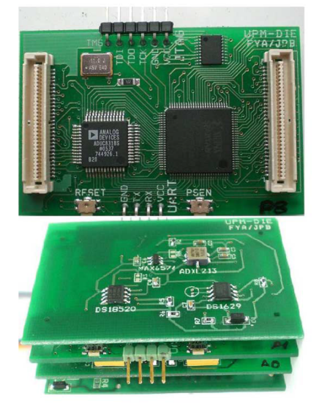
The Cookie Sensor Network (1/2)
Designed to provide flexibility and adaptability
Applies modularity at HW level
Uses reconfigurable layered PCB
Future redesigns can be per layer
Can interchange different layers for different applications
4 main layers
Processing – 8051 microcontroller and Spartan 3 FPGA
Communication – ZigBee module
Power supply
Sensors

Slide 5
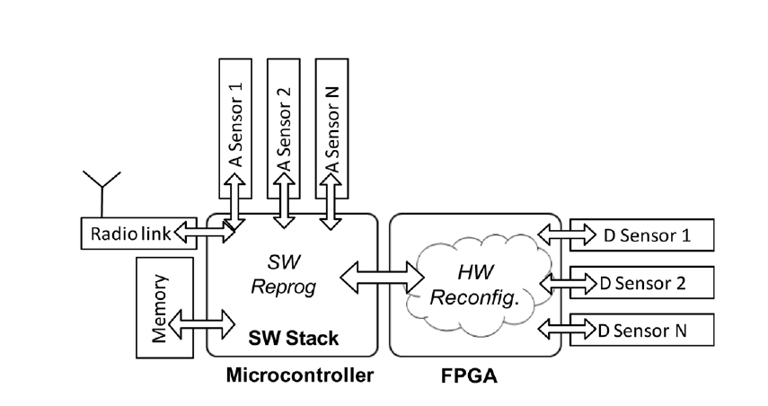
The Cookie Sensor Network (2/2)
Analog sensors to ADC
Digital sensors to FPGA
FPGA will handle all data processing
Microcontroller handles node communications

Slide 6
Node Reconfiguration (1/3)
Two general reconfiguration scenarios
Reconfiguration at network level
Usually during deployment where final function of each network is defined
Network function needs to change
Can cover both SW and HW
Reconfiguration at node level
Computationally intensive tasks take advantage of HW parallelism
Mainly HW
To cover both cases partial runtime reconfiguration built
Partial reconfiguration has been used as technique
Allows independent modification of individual sensors

Slide 7
Node Reconfiguration (2/3)
Microcontroller is in charge of receiving new configuration
Also in charge of programs for SW
Reconfigurability is controlled by a software stack
Avoid the complexity of an OS
First layer is abstraction layer for porting across different platforms
Node variables and state variables define states of device
Node descriptors define available resources
State variables define resources currently being used
Control layer includes reconfiguration policy
Application layer defines the current goal of a node

Slide 8
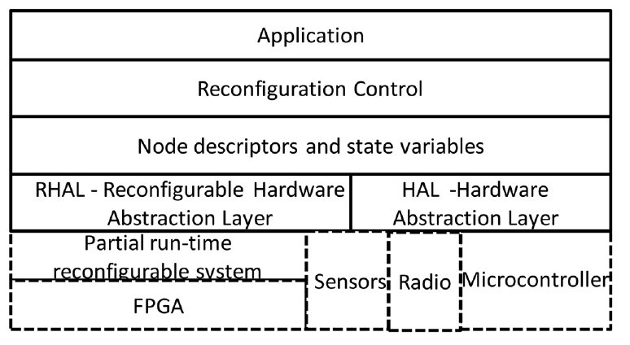
Node Reconfiguration (3/3)

Slide 9
Partial Runtime Reconfiguration (1/2)
Partial configuration files smaller
Leads to lower memory and bandwidth requirements
Separated into fixed and reconfigurable sections
FPGA reconfiguration was built based on virtual architecture
1D virtual architecture used because it is frame based
Entire columns of logic elements are reconfigured
Coarse grained granularity since reconfiguration is a full IP core

Slide 10
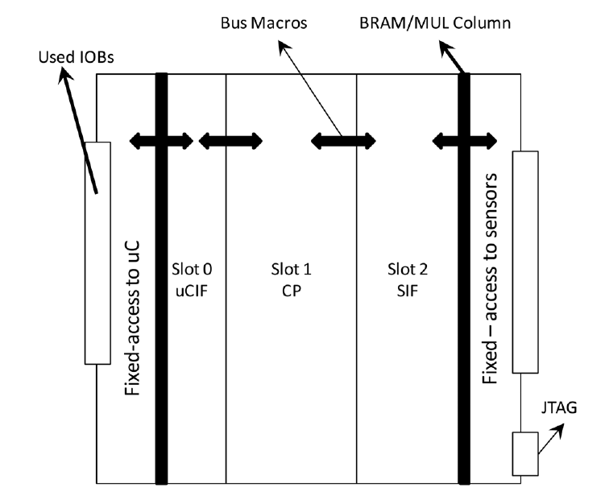
Partial Runtime Reconfiguration (2/2)
Reconfigurable area is divided by slots
On chip communication is important aspect
Each slot is connected to neighbors via bus macros

Slide 11
Reconfigurable System Evaluation
Several parameters have been defined to evaluate the following
The delivery of new HW configurations and SW programs through the WSNs (energy required)
Re/Transmission energy
Multiple hops between nodes may be need before reaching destination node
Reception energy
Energy required to store the reconfigurable file
The use of reconfigurable systems in WSNs (memory and energy resources consumed)
How much memory required to store previous reconfigurable or partial reconfigurable files out of the total memory in the node

Slide 12
Formulas used for Evaluations 1/4
Transmission Energy:
The energy used during HW configurations and SW programs data transmission
$E_{rec}=T_{trans}×P_{trmode}$
Reception Energy:
$E_{rec}=T_{rec}×P_{recmode}$
Retransmission Energy:
$E_{ret}=T_{ret}×P_{retmode}$

Slide 13
Formulas used for Evaluations 2/4
Reconfiguration Energy:
The energy used during a single reconfiguration
$E_{reconf}=T_{reconf}×P_{reconfmode}$
Standby Energy:
$E_{sdmode}=T_{sbmode}×P_{sbmode}$

Slide 14
Formulas used for Evaluations 3/4
$E_{node}=The total Energy available at the node$
Transmission Cost:
$C_{trans}=\frac{E_{trans}}{E_{node}}$
Reception Cost:
$C_{rec}=\frac{E_{rec}}{E_{node}}$
Retransmission Cost:
$C_{ret}=\frac{E_{ret}}{E_{node}}$
Reconfiguration Cost:
$C_{reconf}=\frac{E_{reconf}}{E_{node}}$

Slide 15
Formulas used for Evaluations 4/4
If transmission requires multiple hops before reaching destination node then:
The total Remote Reconfiguration Cost is:
$C_{trr}=C_{trans0}+\sum_{1}^{NHOPS}{C_{ret}+C_{recNHOP+1}}$
NHOP is the number of hops
The second aspect is the cost of memory resources to store a partial reconfiguration in a local library with respect to the importance of the reconfiguration.
$C_{lib}=\frac{{CN}_{mem}}{N_{mem}}−{CN}_{imp}, 0≤{CN}_{imp}≤1$
${CN}_{mem}=reconfiguration memory usage$
$N_{mem}=Total node memory$
${CN}_{imp}=$Importance of the partial Reconfiguration
$C_{lib}=Memory Cost$ must be less than 1
$C_{lib}$ not allowed to go above a threshold ($C_{trsh})$

Slide 16
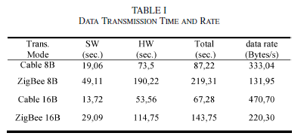
Reconfigurable System Evaluation
Data Transmission Time and Rate Table 1 considerations
ZigBee transmissions were done with a single hop
There was half of the data rate with ZigBee when compared to cable transmissions and required twice the time to transmit when using ZigBee

Slide 17
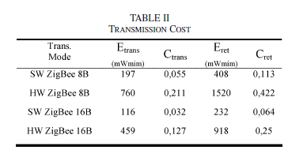
Reconfigurable System Evaluation
Transmission energy cost table 2 considerations
Enode = 3600mWmin per node (4 AA batteries (1Ah per battery) per node, two 3V sets in parallel)
Therefore capacity is .02Ah per node for 100 hours
Test have shown that the 16 bytes transmission fail with a high rate in long distance connections compared with 8 bytes based transmissions but the energy cost is greater with 8 bytes

Slide 18
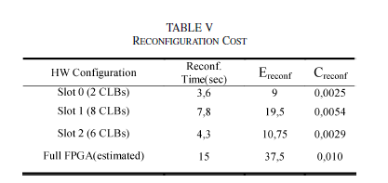
Reconfigurable System Evaluation
Reconfiguration energy cost are much less than transmission energy cost

Slide 19
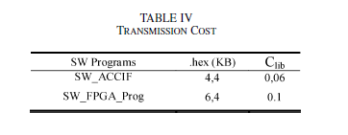
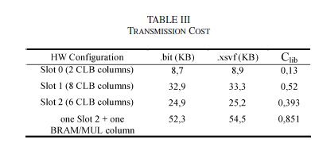
Reconfigurable System Evaluation
Table 3 and Table 4 considerations
${CN}_{imp}=0$ This was chosen for simplicity
A full configuration file is 131KB which brings $C_{lib}>1$
$N_{mem}=62KB$

Slide 20
Future Work
No data for retransmission energy cost was provide since only a single hop for energy analysis was implemented
Every 100 hours (4 days) must change out the 4 AA batteries for each node if operating at a constant .02Ah limit. How reasonable is this at a large scale? Is the WSNs running 24/7?

