Slide 1
An Approximate Timing Analysis Framework for Complex Real-Time Embedded Systems
Published in 2010 13th IEEE International Conference On Computational Science And Engineering
Yue Lu, Thomas Nolte and Johan Kraft
Malardalen University, Vasteras, Sweden
Presented by:
Nikhil Hanji
Akash Solomon

Slide 2
Introduction
2/27
Complex Real-Time Embedded Systems are very large, ﬂexible, and highly conﬁgurable software systems.
They contain many event-triggered tasks being triggered by other tasks in complex, nested patterns.
Many tasks have intricate dependencies in their temporal behavior;
Asynchronous message-passing
Globally shared state variables
Task offsets
Dynamic periods and priorities of tasks

Slide 3
Why CRTES?
3/27
In safety-critical applications, ensuring both functional and temporal correctness are often equally important.
E.g. Worst-Case Response Time (WCRT) of the adhering tasks in systems has to be known.
Examples of CRTES include;
Industrial Machinery
ABS systems

Slide 4
Background
4/27
Due to complexity of CRTES, existing theories for modeling and analysis of real-time systems have limited applicability.
Real-Time Analysis (RTA) requires to make certain assumptions of CRTES;
The tasks considered are independent.
Existence of Worst-Case Execution Time (WCET) of each task.
Quality of analysis which directly affects the WCET estimate of each task.
Static WCET Analysis is used most often. However, unable to model the temporal task dependencies of CRTES.

Slide 5
Background
5/27
One solution is to use a more detailed analysis model, describing execution control flow on the code-level.
UPPAAL and TIMES tool suites can result be used for exhaustive analysis.
May result in a state-space explosion issue.
Alternative approach is to use Monte Carlo simulation-based methods.
Suffers from low space-state coverage.

Slide 6
Modeling of CRTES
6/27
The target CRTES are described by the modeling language in the RTSSim simulation framework.
In RTSSim, the system S contains a set of non-blocking tasks. A task $τ_{i}$ is released after a non-negative time oﬀset Oi.
Each task also has a period Ti, a maximum arrival jitter Ji, and a priority Pi.
Periods and priorities can be change dynamically.
Monte Carlo simulation is used by providing randomly generated simulator input data as above.

Slide 7
Problem Formulation
7/27
Research has recently proved that the time complexity of computing a WCRT of an independent task τi by using basic RTA is NP-hard.
$$R_{i}^{n+1}=C_{i}+\sum_{∀_{j}∈hp(i)}{\left[\frac{R_{i}^{n}}{T_{j}}\right]}∗C_{j}$$
Where $C_{i}$ is the WCET of task $τ_{i}$, hp(i) is tasks with priority higher than task $τ_{i}$.
A feasible solution is to ﬁnd a tight interval consisting of lower and upper bounds on the WCRT of tasks, by using approximation techniques.

Slide 8
Proposed Timing Analysis
8/27
The authors propose an approximate timing analysis framework for CRTES, named AESIR-CORES.
(Advanced and Enterprising Solutions for Innovative Research on COmplex Real-time Embedded Systems)
They seek to provide an interval on WCRT estimates of tasks, which consists of lower and upper bounds.
The upper bound on the WCRT of tasks is given by RapidRT, combining Extreme Value Theory(EVT) with other statistical methods.
The lower bound on the WCRT of tasks is obtained through HCRR.

Slide 9
9/27
An interval on the WCRT estimate
of tasks given by the CTA methods
HCRR
RapidRT
Monte Carlo simulation
Exact WCRT
Basic RTA
0
Value of WCRT
A tighter interval on the WCRT estimate
of tasks given by AESIR-CORE
Figure 1: Illustration of applying diﬀerent WCRT analysis methods in the system model of CRTES.

Slide 10
AESIR-CORES: Control Flow
10/27

Slide 11
Hill-Climbing with Random Restarts
11/27
HCRR is a meta-heuristic search algorithm based on hill climbing using random-restarts.
Mechanisms used are Jump-back threshold and Random-Restart threshold.
HCRR algorithm begins by choosing as starting point the best simulation instance from Monte Carlo simulation.
Random values of the simulation instance are selected and modiﬁed using the neighborhood procedure.

Slide 12
RapidRT
12/27
RapidRT is based on Extreme Value Theory(EVT).
RapidRT takes n reference data sets with m simulation traces having tasks’ response times.
For each reference data-set, the algorithm returns the WCRT estimation.
RapidRT will verify if the sampling distribution consisting of n WCRT estimates given by EVT conforms to a normal distribution or not.

Slide 13
RapidRT
13/27
If so, RapidRT will calculate the conﬁdence interval of the EVT distribution, at the given conﬁdence level 99.7%, and choose the upper bound of the CI as the ﬁnal WCRT estimate.
If not, a sampling statistic bootstrap will be used to obtain the upper bound of the CI of the EVT distribution.
Given the modeled system, the possibility of the actual WCRT being higher than the WCRT estimate given by RapidRT, is no more than 1.5×10−12 (i.e., (100%−99.7%)/2×10−9).

Slide 14
RapidRT: Algorithm
14/27
Construct n reference data sets for the WCRT estimates by running m Monte Carlo simulations for each reference data set, and find maximum value.
Perform the WCRT estimates on the task under analysis per each reference data set;
Set the initial block size b to 1, for each reference data set.
If the number of blocks k =[m/b] is less than 30, algorithm stops.
For each of the k blocks, ﬁnd the maximum values.
Estimate the best-ﬁt Gumbel parameters μ and β to the block maximum values by using a lower-part binary search algorithm.
Calculate a WCRT estimate based on the best-ﬁt Gumbel Max parameters estimated above, and a target acceptance probability Pe.

Slide 15
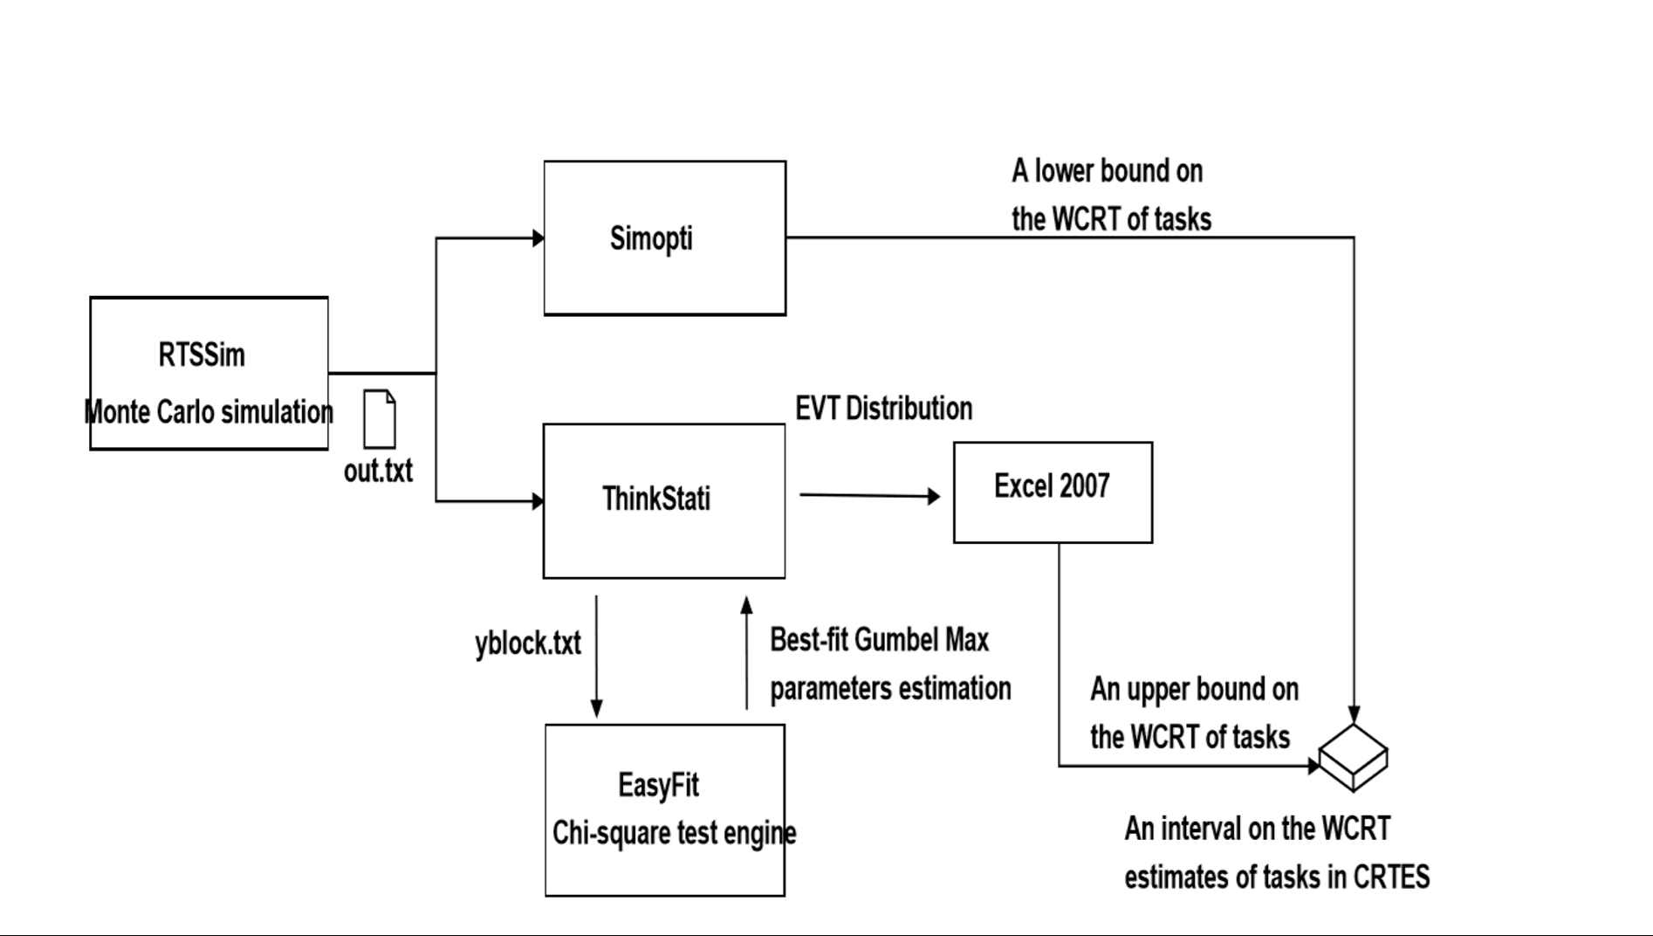
Implementation
15/27
Our test-bed is running OS Microsoft Windows XP.
The computer is equipped with the Intel Core Duo CPU E6550 processor, 2GB RAM and a 4MB L2 Cache.
The processor has 2 cores and 1 frequency level: 2.33 GHz.

Slide 16
Evaluation Models: Model 1 (M1)
16/27
M1 is representing a control system for industrial robots developed by ABB Robotics
Behavioral mechanisms which RTA cannot take into account:
Tasks with intricate dependencies in temporal behavior due to IPC and GSSVs
The use of buffered message queues for IPC, where triggering messages may be delayed
Tasks that change scheduling priority or periods dynamically, in response to system events
The modeled system controls a set of electric motors based on periodic sensor readings and aperiodic events
Describes behavior with a significant impact on the temporal behavior of the system, such as resource usage (e.g., CPU time), task interactions and important state changes

Slide 17
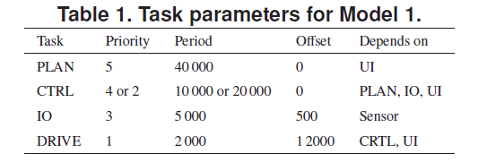
17/27
The model contains four periodic tasks with the parameters shown below

Slide 18
Model 2 (M2)
18/27
Based on a test application from Arcticus systems, developers of the Rubus RTOS, used in heavy vehicles
Uses a pipe-and-filter architecture, where tasks trigger other tasks through trigger ports, forming transactions
3 periodic transactions and one interrupt-driven task, in total 11 tasks
There exist no shared variables or IPC via message passing which can impact the tasks’ timing and functional behavior
Tasks have large variations in execution times, which makes the state space of this model very large

Slide 19
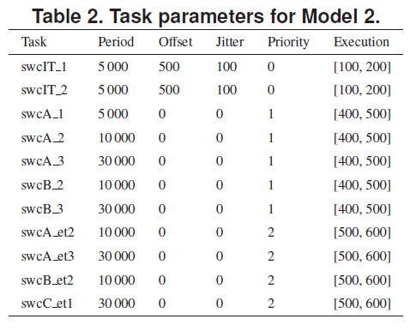
19/27
The parameters of tasks and their execution times are shown below

Slide 20
Model for Validation (MV)
20/27
Based on M1, the adhering task execution dependencies are simplified
GSSVs have been removed
priority and period are strictly static
explicit loop bounds have been added manually
the constant offset of tasks is removed
This makes both using the basic RTA using the RTCF without blocking to calculate the WCRT of tasks under analysis, and achieving the exact WCRT by using both Monte Carlo simulation and HCRR, feasible.

Slide 21
Results
21/27
For MV, when the actual WCRT value of the task under analysis is known;
The upper bound on the WCRT estimate given by AESIR-CORES is 13.13% less pessimistic when compared to the upper bound obtained by the basic RTA in the CTA methods.
Though both of AESIRCORES and the CTA methods ﬁnd the actual WCRT value, the interval given by AESIR-CORES is 47.60% tighter than the one derived from the CTA methods.

Slide 22
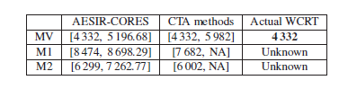
Results
22/27
For M1 and M2, when the actual WCRT value of the task under analysis is not known;
Using AESIR-CORES, such an upper bound can be derived from RapidRT under a hard statistical constraint, i.e.1.5×10−12, which could be considered to bound the actual WCRT value.
CTA methods cannot determine the upper bound due to the underlining assumptions.

Slide 23
Validity of WCRT Interval
23/27
Sample size for all reference data sets in the analysis is statistically sufficient
The sampling distribution for each reference data set is sound in the sense that it has a statistically large enough sample size and accuracy
Gumbel Max distribution allows us to statistically state that the probability of existence of an exact WCRT value that is greater than the resulting EVT estimate is no more than 10⁻⁹
An upper bound of the CI of the EVT distribution which ensures that the possibility of having an actual WCRT value larger than the estimate given by RapidRT is less than 1.5 × 10⁻¹²

Slide 24
Conclusion
24/27
Link between RTA and CRTES
Approximate timing analysis framework - AESIR-CORES
Three simulation models used
Validity of results discussed
Gaps in the paper
Event of EVT distribution not being a normal distribution.
Use of resampling statistic bootstrap for determining upper bound.
Use of Gumbel parameters to find WCRT estimate.

Slide 25
Future Work
25/27
Develop more advanced sampling strategy for covering unlikely conditions in the statistical RTA of CRTES
Conduct more evaluations of AESIR-CORES in industrial circles
Consider using the proposed statistical RTA for CRTES together with trace-driven techniques for analyzing real systems execution

Slide 26
Questions?

Slide 27
THANK YOU!

