Slide 1
A Real-Time Gracefully Degrading Avionics System for Unmanned Aerial Vehicles
Published in:
National Aerospace & Electronics Conference (NAECON), 2012 IEEE
Authors:
Belal H. Sababha
Princess Sumaya University for Technology, Amman, Jordan
Osamah A. Rawashdeh and Waseem A. Sa’deh
Oakland University, Rochester, Michigan, USA
Presented by:
Srinivas Narne, Yash Kulkarni and Shefali Gundecha

Slide 2
Overview
Fault-tolerance
Graceful Degradation
Test-Bed
Avionics system
Gracefully degraded avionics system
Recovery Manager

Slide 3
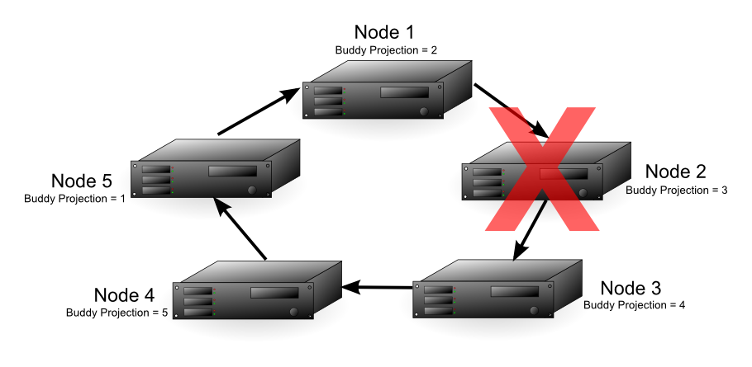
Fault Tolerance
Fault tolerance is the ability of a system to continue operation in presence of hardware and software faults.
In safety-critical applications, the correct operation is vital, requiring the use of fault tolerant techniques in applications.
It is typically achieved through redundancy in hardware and software to enable fault detection and recovery.

Slide 4
Graceful Degradation
Reconfiguration necessitates the preservation of the recent history for every software task that is responsible of certain functionality in order to be able to restart the task later from the point that it failed at
Saving the state of a task to stable storage is referred to as checkpointing the state of that task
A system manager that is responsible for fault detection, rollback and recovery is implemented on a separate MCU

Slide 5
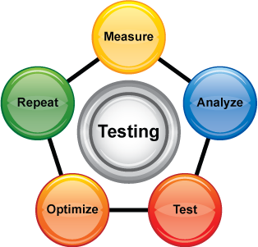
The Test-Bed
A quadrotor system is used as testbed
Ground Station
Flight Control
Data Processing
Run-time Monitoring
Aerial Vehicle
Avionics System
Payload System

Slide 6
The Test-Bed (Cont.)
Connections between the subsystems
1.3 GHz link for video down-streaming
75 MHz traditional R/C radio for manual flight control
2.4 GHz ZigBee link for telemetry and reconfiguration control
Body of quadrotor consists of magnesium hub joining four carbon fiber arms.
Mounted at the end of each arm is a magnesium motor mount that holds a brushless motor and propeller assembly.
In addition to the processors, other hardware components include an IMU, altimeter, and a modular GPS unit for attitude, altitude, and position estimation, respectively.

Slide 7
The Avionics System
The avionics system is a triple processor setup
Telemetry Processor
Interface Processor
Control Processor
All three processors are Freescale HCS12 microcontrollers running μC/OS-II, the real-time operating system (RTOS)
All MCUs are connected to a CAN bus. A forth dedicated MCU collects checkpoints written by other MCUs from the CAN bus and stores them to stable storage.

Slide 8
The Avionics System (Cont.)
The control processor is responsible for vehicle stabilization and navigation
These functions are achieved by executing software tasks implementing the Proportional-Integral- Differential (PID) control loops
PID gains are found experimentally, and are wirelessly reconfigured by the reconfiguration host on the ground station to allow in-flight tuning

Slide 9
The Gracefully Degrading Avionics System
The attitude stability tasks:
Roll, pitch and yaw PID control tasks
The control feedback task:
IMU task

Slide 10
The Continuously repeated data communication pattern
During the process of attitude stability control

Slide 11
Checkpointing 101
Checkpointing protocol : BCS
Chosen due to the relatively low amount of overhead it induces compared to other checkpointing protocols
What exactly is the BCS protocol?
For a consistent global checkpoint for all processes
Every process maintains and propagates an index idx
Process pi initializes idx i to 0 and increments it after a checkpoint is taken
When pi sends a message, it piggybacks idx i onto it
When pi receives a message m with idxm > idx i, it takes a forced checkpoint

Slide 12
Checkpointing for our system
Tasks chosen for checkpointing:
The three attitude stability tasks and the motors control task (T_{motors_control})
T_{motors_control} is a task inside the sensor-actuator module
Why?
The computations they perform depend on historical data from previous computations
Data that are checkpointed:
For each of the three PID tasks, the accumulative error used in the integral (I) term of the PID controller as well as the previous error used by the differential (D) term of the PID controller
For T_{motors_control} , the current corrections that are used to adjust the speed of the four motors propelling the quadrotor.
Stored in dedicated arrays

Slide 13
Checkpointing Loop

Slide 14
The Recovery Manager !

Slide 15
Recovery Manager
Each checkpointing task has a unique heart beat message broadcasted through the CAN network as long as it is functioning correctly
Fault injection
Through an external MCU connected to the CAN bus
Can send a command to the RTOS running on any other MCU in the network to kill any specific task executed by that MCU
The recovery manager can send a recover command to the RTOS running on any other MCU in the network
The recover command asks the RTOS to recreate a task and initialize it to a certain state (recovery state).
The recovery state is sent in combination with the recover command

Slide 16
Recovery Manager

Slide 17
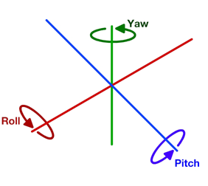
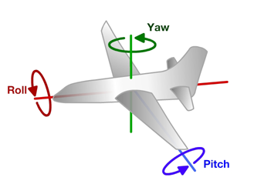
Experimental Setup
1 KB memory – checkpointing storage
Acceptable execution rates for the three attitude stability PID control loops
Roll PID: 20 ms (i.e. 50 Hz)
Pitch PID: 20 ms (i.e. 50 Hz)
Yaw PID: 60 ms (i.e. 16.7 Hz)
Fault injected into the roll PID control task.
Recovery time noted.
Notes:
The stable memory available for checkpointing storage is
around 1 Kbyte (exactly 1320 Bytes). From an application
point of view, to maintain a stable flight, the acceptable
execution rates for the three attitude stability PID control
loops are as follows:
i. Roll PID: 20 ms (i.e. 50 Hz)
ii. Pitch PID: 20 ms (i.e. 50 Hz)
iii. Yaw PID: 60 ms (i.e. 16.7 Hz)
An experiment was conducted by injecting a fault into the roll PID control task and measuring the time to recover the system. This experiment was performed on the avionics system with a varied checkpoint frequency for all checkpointing tasks from 1 local checkpoint per execution loop to 1 local checkpoint per 30 execution loops.

Slide 18
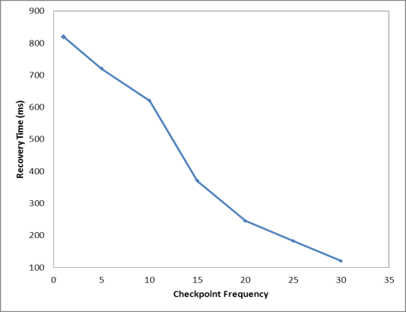
PERFORMANCE RESULTS
Frequency of exchanging application messages is constant.
With increase in local checkpoint frequency, maintained checkpointing indexes increase rapidly. But no such increase in the exchange of application messages. Recovery manager side - more checkpoints to be stored
Notes:
From the figure, it can be observed that the recovery time decreases as the local checkpoint frequency increases. This is due to the following reason. The frequency of exchanging application messages in the distributed network is constant and does not change with the change of local checkpoint frequency. So, as the local checkpoint frequency increases the checkpoint indexes maintained by each of the checkpointing tasks increases rapidly. The exchange of application messages that piggyback these indexes does not increase, hence reduced checkpoint synchronization.

Slide 19
In case of lack of synchronization, checkpoints most likely do not have same index value
=> More time to find a consistent recovery line
From the study,
Recovery time for the system at 1 checkpoint per 30
execution loops = 120ms
Execution rate for the fastest task in system = 20ms
System will miss 6 (120 ms/20 ms) execution loops - Acceptable in this case
In general, to judge that a recovery time delay is acceptable or not depends on the application & how many execution loops are lost (during the recovery process).
Notes:
Furthermore, at the recovery manager’s side, more checkpoints are received and required to be stored to stable storage.
However, the received checkpoints due to the lake of synchronization are more probable to not have the same index value, demanding more time to find a consistent recovery line by the recovery manager. On the other hand, as the local checkpointing frequency decreases, more application messages are available to synchronize the indexes among all checkpointing tasks. So the checkpoints received by the checkpointing manager are more probable to be synchronized, hence requiring less time to find a recovery line by the recovery manager, therefore less time to recover.
From the study, the recovery time for the system at 1 checkpoint per 30 execution loops was 120 ms. And because the execution rate for the fastest task in the system is 20ms, the system will miss 6 (120 ms/20 ms) execution loops, which is acceptable in these kinds of applications according to our flight testing. In general, to judge that a recovery time delay is acceptable or not depends on the application and how much execution loops it is going to lose during the recovery process.

Slide 20
Conclusion
Graceful Degradation – promising technique
Dependability + Reduced cost, size, weight & power
Paper overviews a graceful degradation approach to achieve fault tolerance
System included checkpointing coordination, checkpoint management, stable storage, and recovery management
Implementation in form of an avionics system - 3 control loops in parallel
Faults injected during run-time causing the system’s stability control tasks to fail
The system was able to recover in a very short time duration
Notes:
Graceful degradation is a promising technique that may achieve dependability with a significant reduction in cost, size, weight, and power requirements. This paper overviews a whole graceful degradation approach to achieve fault tolerance in resource constrained real-time embedded systems. The paper presented the development and implementation of an architecture for a complete gracefully degrading system that includes checkpointing coordination, checkpoint management, stable storage, and recovery management. The implementation was in form of an avionics system executing three control loops in parallel. Faults were injected during run-time causing the system’s stability control tasks to fail. The system was able to recover in a very short time (around 120 ms), which was acceptable for the application to stay stable according to our flight testing

Slide 21
Our Take on the Paper
Reduction in SWaP but no data available for comparison
“Our flight testing” – no specifications of test conditions mentioned
No insight provided on the mentioned “applications”
Notes:
Environmental(temp pressure humidity wind ), height
It says safety critical applications in the beginning but doesn’t specify any.
Quad rotors could have military appli for surveillance purposes, human detection in collapsed buildings,etc. packet deliveries, or just for better video recordings on weddings etc and clearly each of their requirements/conditions of operation would be different.

Slide 22
REFERENCES
Quadrotors and the Future of Engineering :
http://science.howstuffworks.com/innovation
Gustavo M. D. Vieira , Islene C. Garcia , Luiz E. Buzato, “Systematic Analysis of Index-Based Checkpointing Algorithms using Simulation”, IX Brazilian Symposium on Fault Tolerant Computing, 2001

Slide 23
THANK YOU FOR YOUR ATTENTION ! ANY QUESTIONS ?

