Slide 1
Robustness of Evolvable Hardware in the Case of Fault and Environmental Change
Published in: Proceedings of the 2009 IEEE International Conference on Robotics and Biomimetics
Authors: Jian Gong, Mengfei Yang
Presented by
Nikhil Hanji
Akash Solomon

Slide 2
Introduction
Within space, controllers and robots are vulnerable.
Robots and controllers are susceptible to faults during operation:
Unexpected state and/or operation.
Changing environment.
Fault Tolerance is required to handle the faults incurred.
Difficult for large and complex circuits and systems.
The attribute of robustness is critical.
Robustness and adaptability, can be introduced by using “Evolvable Hardware”.
Validated by analysis through fault modelling.

Slide 3
Introduction
Faults may be modeled as an abnormal state of the circuit.
Causes the controller to behave non-deterministically.
Assuming the number of circuit faults is finite;
The fault set can be defined as $T=\left\{t_{i}\right| i=1,2,…,m\}$ ;m is the number of faults.
The fault model set can be defined as $M=\{M_{1},M_{2},…M_{h}\}$, where
$M_{j}=\left\{t_{j1},…,t_{jl}\right\};(j=1,…,h)$,
h number of fault model sets, with l number of faults in each fault model.

Slide 4
Introduction
The current environment can be considered as the functional requirement.
Intuitively, change of environment alters functional requirements.
The environment/requirement can be modelled as a set R;
$R=\{r_{1},r_{2},…,r_{n}\}$;
where $r_{i}$ is an environment requirement, $n$ is the number of environments.

Slide 5
Circuit Function State Definition
Different circuits have different function, depending on environment.
The circuit function state set can be defined as;
$$U=\left\{u_{1},u_{2},…,u_{n}\right\};$$
When there is no fault, each $u_{i}$ conforms to $r_{i}$, for $i=1,2,…,n$.
The state $\left(r_{i},u_{i}\right)$ is a working stable state, called “legal state” denoted by $s_{i}$.
All legal states form legal state set $S=\left\{s_{1},s_{2},…,s_{n}\right\};$
$S ⊆ R×U$

Slide 6
Circuit Function State Definition
The state $(r_{i},u_{j})$ is not a working state, called an “illegal state”, shown as $\overline{s_{i}}.$
Where $i=1,…,n; j=1,…,n; i≠j$
All illegal states form illegal state set $\overline{S}=\{\overline{s_{1}},\overline{s_{2}},…,\overline{s_{n}}\}$.
Universal Set I is given by $I⊂R ×U$;
$I=S+\overline{S}$;
Hence $\overline{S}=I−S$.
Legal state set represents circuits without faults.
Illegal state set represents circuits with faults, unstable state of evolution.
If in unstable state, must be repaired else will fail.

Slide 7
Circuit State Transformation
Three factors which cause circuit state transforms;
By Fault: When fault arises; denoted by given fault model $M_{i}$ in set $M$.
Circuit state transfers from state $(r_{i},u_{i})$ in set $S$ to state $(r_{i},u_{j})$ in set $\overline{S}$.
By environmental change: Change in environment from $r_{i}$ to $r_{j}$ in set $R$.
Circuit state transfers from state $(r_{i},u_{i})$ in set $S$ to state $(r_{j},u_{i})$ in set $\overline{S}$.
By evolution: Through successful evolution of circuit.
Circuit state transfer from state $(r_{i},u_{j})$ or $(r_{j},u_{i})$ in set $\overline{S}$ to state $(r_{i},u_{i})$ or $(r_{j},u_{j})$ in set $S$.

Slide 8
Circuit State Transformation

Slide 9
Example
The configurable circuit consists of LUT’s, a multiplexer, and I/O ports.
The expected function can be implemented with one LUT.
Fault tolerance is acquired through use of second LUT.
Multiplexer decides between the LUT output.
Environment $r_{1}:c=f_{1}\left(a,b\right)=a \bigwedge{b}$
Environment $r_{2}:c=f_{2}\left(a,b\right)=\left(a \bigwedge{b}\right)∨\left(\overline{a}∧\overline{b}\right)$
Circuit function $u_{1}:c=g_{1}\left(a,b\right)=a \bigwedge{b}$
Circuit function $u_{2}:c=g_{2}\left(a,b\right)=\left(a \bigwedge{b}\right)∨\left(\overline{a}∧\overline{b}\right)$

Slide 10
Scenario 1
Evolution after fault $M_{1}$
($r_{1},u_{1})→M_{1}$ $→(r_{1},u_{2})$ $→Evolution→$ $(r_{1},u_{1})$

Slide 11
Scenario 2
Evolution after fault $M_{2}$
($r_{2},u_{2})→M_{2}$ $→(r_{2},u_{1})$ $→Evolution→$ $(r_{2},u_{2})$

Slide 12
Scenarios 3 and 4
Evolution after environment changes to $r_{2}$
Evolution after environment changes to $r_{1}$

Slide 13
State Transformation

Slide 14
Evolvable Hardware Experimental Setup
System consists of a configurable circuit, a high performance computer, evaluation logic and configuration logic.

Slide 15
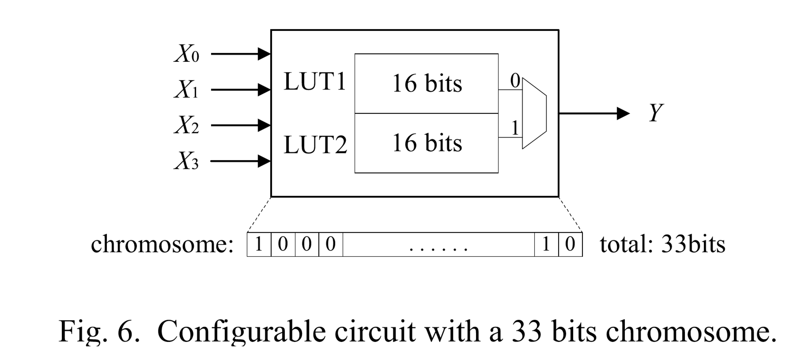
Configurable Circuit
The configurable circuit has 4 inputs $X_{0}, X_{1},X_{2},X_{3}$ and 1 output $Y$.
16 input configurations for 2 LUTs’, along with 1 bit control signal.
33 bit chromosome represents configuration of the circuit.

Slide 16
Evolvable Hardware Algorithm
High performance computer generates random initial population of chromosomes.
Computer downloads individuals to configurable circuit, sequentially.
Each individual is evaluated in configurable circuit.
Computer uploads evaluation of all individuals from configurable circuit.
Fitness of the population is calculated.
If optimal fitness is reached, the evolution is successful. Else evolution continues.

Slide 17
Genetic Algorithm
Standard Genetic Algorithm is used.
Start with a “population” of “individuals”
Rank these individuals according to their “fitness”
Select pairs of individuals to “reproduce”
Higher fitness → greater probability of selection
Each pair of “parents” produces two “children”
Because of “crossover,” children receive “genes” from both parents
Introduce random “mutations” in some of the children
Repeat until a desired fitness level has been reached or some number of generations have elapsed.

Slide 18
Genetic Algorithm
Three Genetic Algorithm operators are used;
Roulette wheel selection, one-point crossover, and one-point mutation.
Crossover rate = 0.4.
Mutation rate = 0.02.
Population size = 100.
Maximum number of generations = 500.
The fitness of each individual is calculated according to;
$fit=\sum_{l=1}^{l=16}{{fit}_{l}}$ (${fit}_{l}=1, if matches expected out$put
${fit}_{l}=0, if not)$
If $fit$ is found to be equal to ${fit}_{op}=16,$ the individual is optimal.

Slide 19
Evolution Scenarios
The circuit evolves in normal condition (without faults and environmental change.)
The evolution target is $Y=\overline{X_{3}}⊗X_{2}⊗\overline{X_{1}}⊗\overline{X_{0}}$
This is also the environment $r_{0}.$The circuit state is $S_{0}$ for successful evolution.
The circuit evolves after a stuck-at-fault, from state $S_{0}$.
Stuck-at-0 fault in the first LUT with address 0001.
The circuit evolves after environment changes to $r_{A}$ from the normal state $S_{0}$.
The environment $r_{A}$ is $Y=\overline{X_{3}}∧X_{2}∨\overline{X_{1}}∧\overline{X_{0}}$
The circuit evolves after environment changes to $r_{B}$ from the normal state $S_{0}$.
The environment $r_{B}$ is $Y=\overline{X_{3}}X_{2}\overline{X_{1}}\overline{X_{0}}$ $∨X_{3}\overline{X_{2}}\overline{X_{1}}\overline{X_{0}}$ $∨X_{3}X_{2}\overline{X_{1}}X_{0}$ $∨\overline{X_{3}}X_{2}X_{1}X_{0}∨X_{3}\overline{X_{2}}X_{1}X_{0}∨\overline{X_{3}}\overline{X_{2}}X_{1}\overline{X_{0}}∨X_{3}X_{2}X_{1}\overline{X_{0}}$

Slide 20
Evolution Scenarios
The configurable circuit evolves in the four scenarios to verify the robustness of evolvable hardware.
The mean fitness, standard deviation and terminal generation of each evolution run can reflect the robustness of evolvable hardware.
Mean fitness of each evolution run $\overline{a}$ , according to
$\overline{a}=(\frac{1}{G})\sum_{j=1}^{j=G}{(\left(\frac{1}{P}\right)\sum_{i=1}^{i=P}{a_{ij});} \overline{a_{j}}=(\frac{1}{P})\sum_{i=1}^{i=P}{a_{ij}}}$
where $a_{ij}=fit$
Standard deviation of fitness $\overline{v}$, according to
$\overline{v}=\sqrt{(\frac{1}{G})\sum_{j=1}^{j=G}{{(\overline{a_{j}}−\overline{a})}^{2}}}$

Slide 21
Results

Slide 22
Results

Slide 23
Results

Slide 24
Results
In the experiment, 119 runs are performed for each scenario.
All the evolution runs are successful, so that the robustness of evolvable hardware is verified.
It can be seen from the figures that the trends of$\overline{a}$, $\overline{v}$ and $g$ has no obvious difference among four scenarios.
Consequently, the robustness of evolvable hardware in the case of fault and environmental change is verified by the experiment.
With enough resource, the circuit can manage to survive whatever happens.

Slide 25
Genetic Algorithms and Artiﬁcial Neural Networks to Combinational Circuit Generation on Reconﬁgurable Hardware

Slide 26
Introduction
Evolvable Hardware (EHW) builds systems whose reconﬁgurable part is under the control of an Evolutionary Algorithm.
There are many ways to optimize circuits using their truth-table representation.
Heuristic algorithms have been developed and used. e.g ESPRESSO, GA.
Evolvable part of these systems can also be implemented using Artiﬁcial Neural Networks.
Trained network should be able to recognize circuit patterns, making optimization easier and fast.

Slide 27
Introduction: Genetic Algorithm and ANN
The genetic algorithm executes two basic steps:
Create an initial population and begin the main loop that evolves this population.
The main loop consists of performing operations on individuals and evaluating them according to a ﬁtness function.
This loop is repeated until we reach the stopping criteria.
Artiﬁcial Neural Networks (ANN’s) are structures composed by artiﬁcial neurons that can be grouped forming networks.
The knowledge is represented by the value of interconnected weights that are actualized by learning algorithms.

Slide 28
Methodology
Proposed method starts with the random generation of valid truth-tables.
Work created a database for ANN training with 200 tables distributed in search space.
All these tables were optimized with the ESPRESSO algorithm.
Input/output pairs (input table / optimized table) resulted on a training ﬁle.
This ﬁle was used for ANN supervised learning algorithm.
Developed network and results are compared with GA and Espresso.

Slide 29
Genetic Algorithm
The GA was implemented with parameters as;
Number of individuals=50;
Crossover rate= 100%;
Mutation rate = 20%;
Number of generations = 500.
For a truth-table with n input variables, each individual’s chromosome has n positions.
Generating initial population, the number of product terms composing each individual is randomly chosen.
Each individual can have from one to max product terms.
The algorithm replaces original values with don’t cares, in a maximum of ﬁfty percent.

Slide 30
Genetic Algorithm
In order to distinguish don’t cares derived from 1 and from 0;
0-not(variable)
1-variable
2-Don’t Care from 0
3-Don’t Care from 1
Avoids individual generation out of search space.
Search space is composed by all possible true lines grouping.

Slide 31
Crossover

Slide 32
Genetic Algorithm
Bit-to-bit mutation: Probability of change each position of individual’s chromosomes
Changes 0 to 2 (DC from 0), and vice-versa
Changes 1 to 3 (DC from 1), and vice-versa
Ensuring new individuals are not out of search space.
Epidemic operator kills all individuals of population, except the best one (elitism)
Activated when no improvement in fitness value.

Slide 33
Fitness Function
$$f_{1}=\frac{100 × \sum_{j=0}^{2^{i}−1}{1−\left|x_{j}−d_{j}\right|}}{2^{i}};$$
$f_{1}$ computes the correctness of the individual;
$$f_{2}=\frac{1}{p+size};$$
$f_{2}$ enriches individuals with smaller number of terms;
p=100, after exhaustive testing.
$$f=−(f_{1}+f_{2});$$
$f$ is minimized to obtain optimal value of individual.

Slide 34
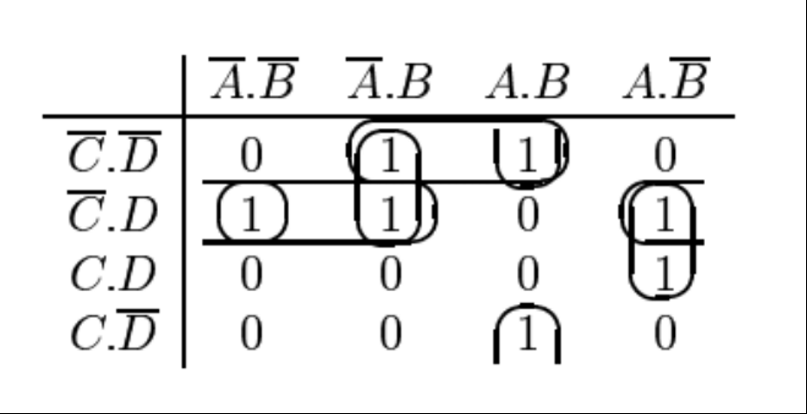
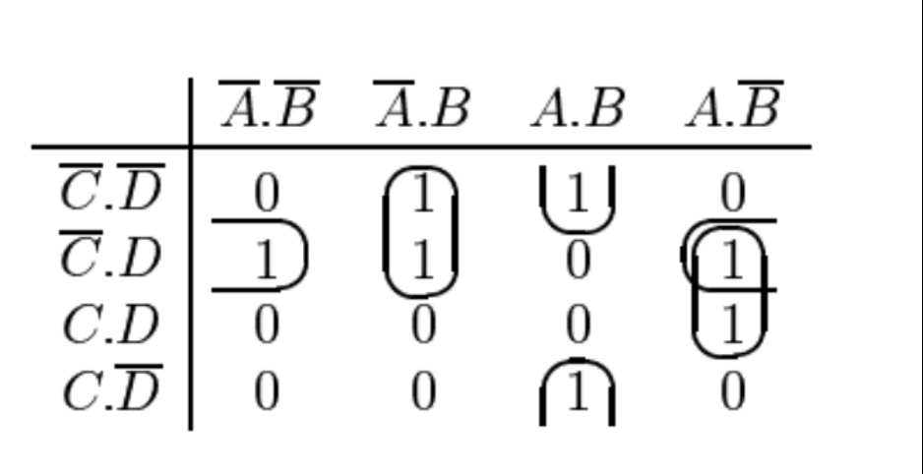
ESPRESSO
Fundamental Digital Electronics by Brian Lawless
The ESPRESSO Algorithm is a heuristic algorithm.
Consists of three basic steps;
Expand
Irredundant Cover
Reduce

Slide 35
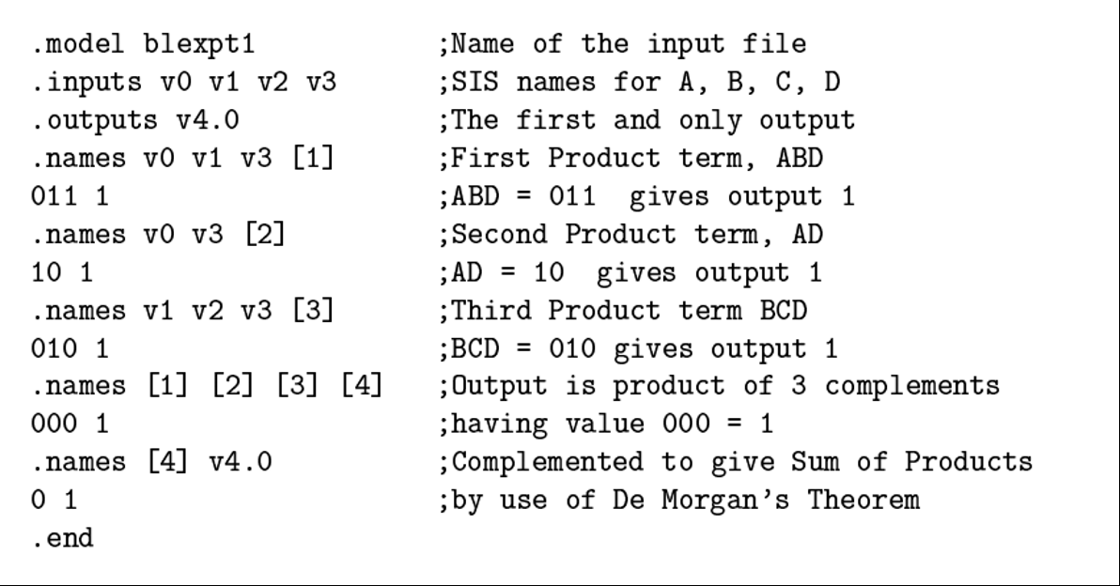
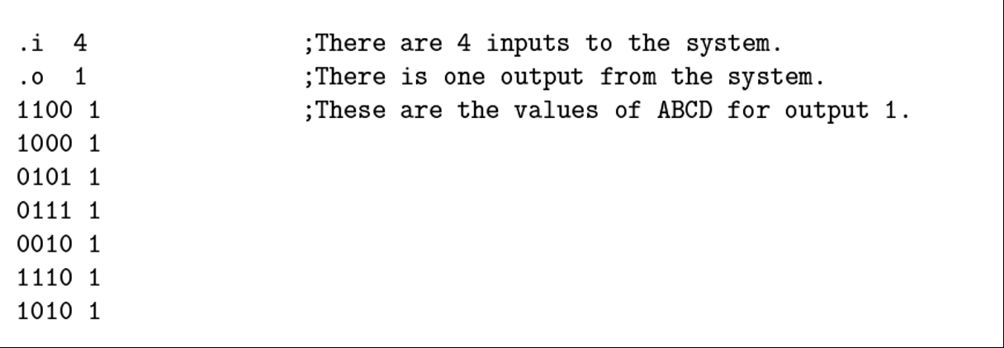
Artificial Neural Networks
ANN training needs an input database.
To ﬁnd the best circuit for each truth-table, we use the ESPRESSO algorithm.
ESSPRESSO Input File ESSPRESO Output File

Slide 36
Artificial Neural Networks
ANN algorithm was implemented as follows:
As input, network will receive the outputs for each truth table.
The input is a set of 16 integer values (4 input variables)
Networks output values represents the inputs of the minimized truth-table.
Forty outputs for training and validation set is sufﬁcient.

Slide 37
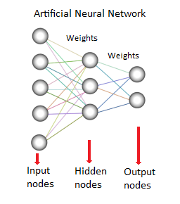
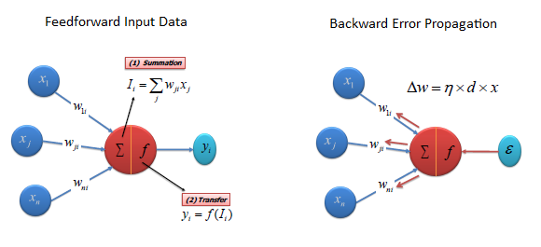
Artificial Neural Networks
Designed network had 16 inputs, two hidden layers with 10 neurons and 40 outputs.
Chosen training algorithm was resilient back-propagation (RPROP).

Slide 38
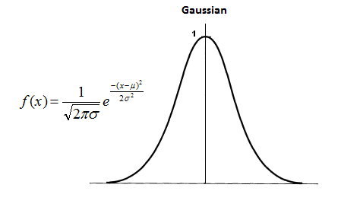
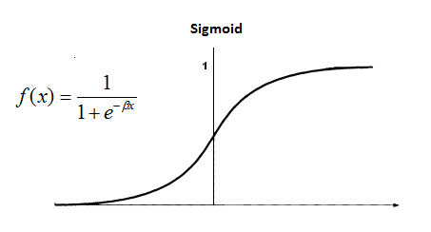
Artificial Neural Networks
Hidden activation function was sigmoidal symmetric with range between -1 to 1.
Output activation function was Gaussian symmetric function, with range between -1 to 1.
Training time is approximately 3 hours on a Intel Dual Core processor.
Minimum mean square error (MSE) achieved was 2.274

Slide 39
Implementation
Implemented system works as follows:
System input is a ﬁle with a truth-table that;
Describes a digital circuit with n inputs and one output that represents system task.
After receiving the truth-table, the circuit optimization search the best possible circuit executing the genetic algorithm;
After algorithm achieved stopping criteria, this module sends only the best individual to be conﬁgured in hardware.

Slide 40
Implementation
PAL implementation uses VHDL hardware description language.
Integrated to the system using Quartus II IDE together with SOPC Builder.
PAL is capable to store any boolean expression on sum of products form by size.
JTAG interface is responsible for the communication between the system and the computer.
CPU communicates with LCD display and reconﬁgures PAL with the best individual.

Slide 41
Implementation

Slide 42
Implementation

Slide 43
Results

Slide 44
Results
Developed genetic algorithm for given inputs, is almost instantaneous to ﬁnd the optimized table.
This result is very near to ESPRESSO execution time, and outputs.
Previous work’s genetic algorithm was slower than new genetic algorithm.
New algorithm can optimize more complex truth-tables on acceptable time.
This introduces greater scalability for the system.

Slide 45
Results
The results of the neural network for validation tables and test tables were all don’t care values (< 0).
When don’t care values were set to -1, tables of two, three and four inputs were completed with don’t care values for non existing line outputs.
All results were only wires without gates.
For different sizes of tables, the network needs different amounts of input neurons.
Number of neurons is an static value ﬁxed as the minimum required amount.
This has tended network output values all for don’t care values, because there were lots of don’t care values completing tables of 2 and 3 inputs.
Threshold approach is difficult because outliers were common.

Slide 46
Results
Hardware synthesis results are: system complete hardware used 16% of FPGA logic elements and 45% of I/O pins. PAL used 11% of logic elements itself.
After analyzing execution times and results, GA achieved better results (equals to ESPRESSO results) than ANN results.

Slide 47
Conclusions
Genetic algorithm can be modiﬁed in order to solve more complex tables and, be applied to a larger number real problems with real-time constraints.
Unlike ANN, GA also have the advantage of being input-size independent.
Results of ANN showed that for this modeling:
For each input variable number, one network should be projected.
Example tables should be balanced after generation.
Modeling should be changed if the network uses a large different number of inputs.

Slide 48
Gaps In Papers
Robustness Of Evolvable Hardware in Case of Hardware and Environmental Change
Assumes that evolution will always be successful, does not deal with unsuccessful evolution Considers small number of inputs to truth table
Genetic Algorithms and Artificial Neural Networks to Combinational Circuit Generation On Reconfigurable Hardware
Generation of example truth tables
Forty sets of outputs is suffice for modelling
Determination of parameter p
Despite ANN not being able to obtain the circuit, GA experimental data to validate results

Slide 49
Future Work
More efﬁcient ﬁtness techniques that avoid evaluating the same truth-table lots of times.
More appropriate database initialization of truth tables for ANN.
Multi-objective genetic algorithms used to evaluate two or more conﬂicting ﬁtness objectives.
Reconﬁgurable hardware implementation aside from PAL, to compare performance.

Slide 50
Questions?

Slide 51
THANK YOU!

