Slide 1
Schedule-Aware and Compression-Aware Dynamic Cache Reconfiguration in Real Time Embedded Systems
Shreya sriperumbuduri
Siddharth ambadasu
Jayalakshmi muthiah

Slide 2
Introduction
Design and Optimization in Real time systems
Energy Constrained – Battery operated
Time Constrained
Hard task deadlines
– Tasks must complete execution by their deadlines in order to ensure correct system behavior
– Example: Safety-critical systems
Soft task deadlines
– These systems remain effective even if their deadlines are not guaranteed to be met.
– Minor deadline misses may lead to temporary service or quality degradation, but will not lead to incorrect behavior
– Example: Gaming, multimedia, housekeeping devices
Some common Optimization techniques in Real time systems
Processor idle time (slack time) – uses Dynamic Power Management (DPM) techniques to put the system to sleep when idle.
Dynamic Voltage Scaling (DVS) methods – reduce the clock frequency such that tasks execute slowly without violating their deadlines
Dynamic Reconfiguration of the cache hierarchy

Slide 3
Dynamic Cache Reconfiguration
Dynamic cache reconfigurations
Promising for improving energy and performance
Hard to implement in real-time systems
Dynamic computation is expensive
Dynamic reconfiguration leads to timing uncertainty
Propose a scheduling-aware dynamic cache reconfiguration technique to generate significant energy savings in soft real-time systems by exploiting static analysis during runtime.

Slide 4
Real Time Scheduling Techniques
Commonly used scheduling techniques
Earliest Deadline First (EDF) scheduling
Dynamic scheduling algorithm
Places processes in a priority queue
Whenever a scheduling occurs, queue will be searched for the process closest to its deadline – this process is next to be scheduled for execution
Rate Monotonic (RM) scheduling
Static scheduling algorithm
Priorities are assigned on the basis of cycle of duration of the job – the shorter the cycle duration is, higher the job’s priority

Slide 5
Cache in Real Time Systems
Challenges of using caches in Real Time Systems
Difficulties due to the unpredictability imposed on the system
Scheduling algorithms have difficultly calculating WCET for tasks
Techniques to overcome the scheduling difficulties
WCET analysis - a static, design time analysis of tasks in the presence of caches to predict cache impact on task execution times
Cache locking - useful cache lines are “locked” in the cache when a task is preempted so that these blocks will not be evicted to accommodate the new incoming task
Cache partitioning - cache is partitioned into reserved regions, each of which can only cache data associated with a dedicated task
Cache-related preemption delay analysis - tight delay estimation so that prediction accuracy is higher than in traditional WCET analysis.

Slide 6
Reconfigurable Cache Architectures
Reconfigurable cache architecture – as proposed by Zhang et al
imposes no overhead to the critical path
the cache tuner consists of small custom hardware or a lightweight process running on a coprocessor, which can alter the cache configuration via hardware or software configuration registers
four separate banks, each of which acts as a separate way
Way concatenation - logically concatenates ways - enables configurable associativity
Way shutdown - shuts down ways to vary cache size
Configurable line size, or block size - setting a unit-length base line size and then fetching subsequent lines if the line size increases

Slide 7
Determining Best Cache Configuration
Dynamic Analysis - cache configurations are evaluated in system during runtime
Limitation - imposes unpredictable performance or significant energy overhead
Static Analysis - non-intrusive – most appropriate for real-time systems
Application-based tuning - alternatives are explored and the best cache configuration is selected for each application in its entirety
Phase-based tuning - best cache configuration is selected for each phase of execution within an application
Best cache configuration may be stored in a look-up table or encoded into specialized instructions
Previous methods focus solely on energy savings and not deadlines, which are imperative in real-time systems.

Slide 8
Reconfigurable Cache Architecture - Overview
An efficient and near optimal strategy for cache tuning based on static program profiling for both statically and dynamically scheduled real-time systems
statically executes, profiles, and analyzes each task intended to run in the system
Information obtained in the profiling process - utilized to make reconfiguration decisions dynamically
Example:
Assume a system with two tasks, T1 and T2.
Traditionally, the system will use a base cache configuration – Cache_{base}

Slide 9
Overview (Contd..)
Each task into 2 phases – Each phase of each task has a different optimal cache configurations
Phase₁ - starts from the beginning to the end
Phase₂ - starts from the half position of the dynamic instruction flow (midpoint) to the end
Cache¹_{T1},Cache²_{T1},Cache¹_{T2},Cache²_{T2} - represent the optimal cache configurations for phase₁ and phase₂ of task T1 and task T2, respectively

Slide 10
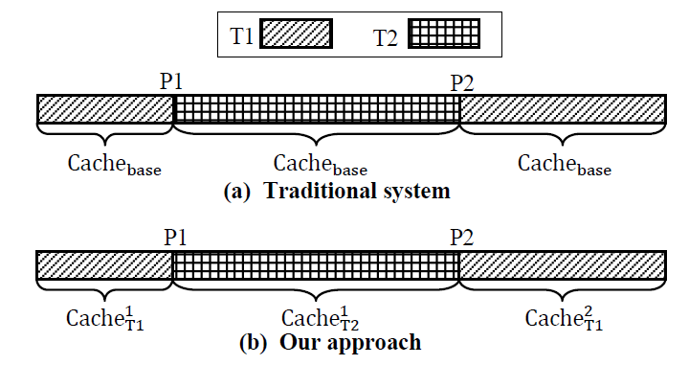
Overview (Contd..)
T2 arrives (at time P1) and preempts T1
Traditional Approach - the system executes using Cache_{base} exclusively
With Reconfigurable Cache
the first part of T1 executes using Cache¹_{T1}
Cache¹_{T2} is used for execution of T2
When T1 resumes at time point P2, the cache is tuned to Cache²_{T1} - since the actual preemption point is closer to the midpoint compared to the starting point
Note: the actual preemption point of T1 is not exactly at the same place where we pre-computed the optimal cache configuration (midpoint).
Reduces energy consumption up to 74% without introducing any performance
penalty

Slide 11
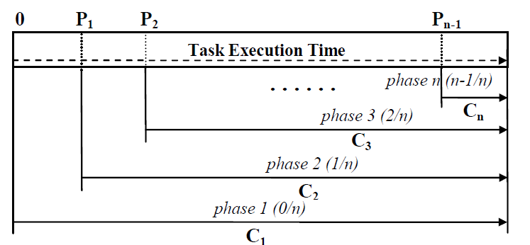
Phase-based Optimal Cache Selection
A task is divided by n potential preemption points (0, P₁, P₂ … P_{n-1})
A phase is the period of time between a predefined potential preemption point and task completion - also called partition points
Each phase has its optimal cache configuration (C1, C2 … Cn) - Performance-optimal and energy-optimal
A static profile table is generated for each task

Slide 12
Phase-based Optimal Cache Selection
Potential preemption points may not be the same as actual preemption points
They are used for cache configuration selection.
Partition granularity - the number of dynamic instructions between partition points - determined by dividing the total number of dynamically executed instructions by the partition factor
Partition factor determines the potential preemption points and resulting phases
Large partition (finer granularities) factor leads to large look-up table
Not feasible due to area constraints
Large partition factor may not save more energy
Partition factor around 4 to 7 is profitable
A static profile table is generated for each task - stores the potential preemption points and the corresponding optimal cache configurations for each task

Slide 13
Scheduling-Aware Cache Reconfiguration
Statically scheduled systems
Arrival times, execution times, and deadlines are known a priori for each task
Statically profile energy-optimal configurations for every execution period of each task without violating any task deadlines
Dynamically scheduled systems
Task preemption points are unknown
New tasks can enter the system at any time
Conservative approach
Aggressive approach

Slide 14
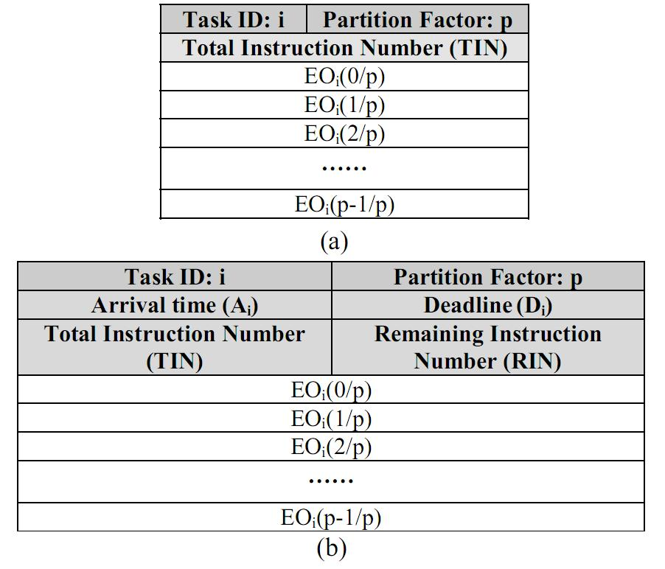
Conservative Approach
Energy-optimal cache configuration with equal or higher performance than base cache
Nearest-neighbor
Use the nearest partition point to decide which cache configuration to tune to
Static Profile table (a)
(EO_{i(n/p)}) represents deadline-aware energy-optimal configuration for partition phase n/p in task i.
n/p – nth phase in a set of p phases
TIN - total dynamic instruction count executed in a single run of that task.
Task list entry (b)
Runtime information – Arrival time (Ai), Deadline (Di) and remaining number of dynamic instructions (RIN)
Information used by both the scheduler and the tuner
When a newly arrived task begins execution, the deadline-aware energy-optimal cache configuration (EOi(0/p)) is obtained from the task list entry, and the cache tuner adjusts the cache appropriately.

Slide 15
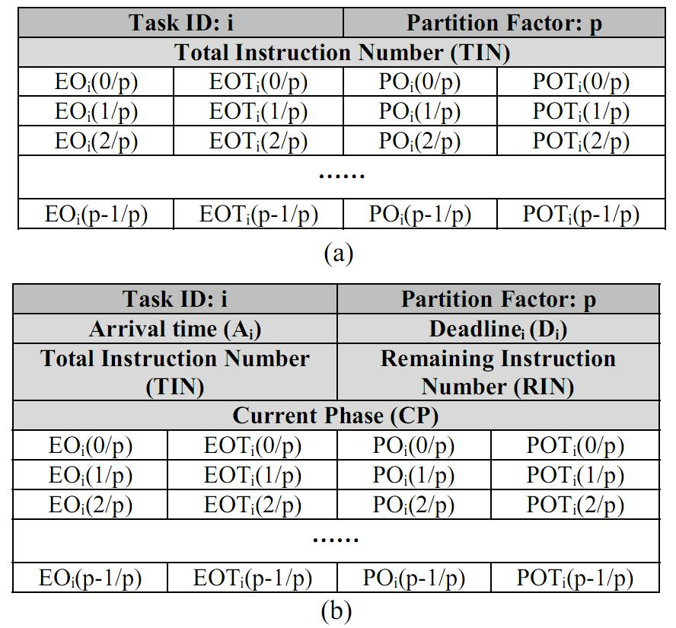
Aggressive Approach
Energy-optimal cache configuration & Performance-optimal cache configuration
Includes their execution time as well.
Ready task list (RTL) – in addition to task list
Contains all the tasks currently in the system
Static Profile table (a)
Energy - optimal configuration
Performance -optimal configuration
Approximate execution time for each configuration
Task list entry (b)
Runtime information – Current Phase indicator (CP_{i})
EO, EOT, PO, and POT stand for the energy-optimal cache configuration, the energy-optimal cache configuration’s execution time, the performance-optimal cache configuration, and the performance-optimal cache configuration’s execution time, respectively.

Slide 16
Aggressive Approach
When task T is the only task in the system
Always tune to energy-optimal cache if possible
When task T preempts another task
Run schedulability check
Discard the lowest priority task if absolutely necessary
Tune to energy-optimal cache
If all other tasks in RTL can meet their deadlines using their performance-optimal caches
When task T is preempted by another task
Calculate and store runtime information (RIN, CP)

Slide 17
Experimental Setup
SimpleScalar to obtain simulation statistics
Used external I/O (eio) trace file, checkpointing and fast forwarding to generate static profile table
Energy model
Calculates both dynamic and static energy consumption, memory latency, CPU stall energy, and main memory fetch energy.
Dynamic energy consumption was updated for each cache configuration using CACTI 4.2
Benchmarks – EEMBC and MediaBench
Reconfigurable cache Configuration - four-bank cache of base size 4 KB, which offers sizes of 1 KB, 2 KB, and 4 KB, line sizes ranging from 16 bytes to 64 bytes, and associativity of 1-way, 2-way, and 4-way.
Base cache configuration - a 4 KB, 2-way set associative cache with a 32-byte line size

Slide 18
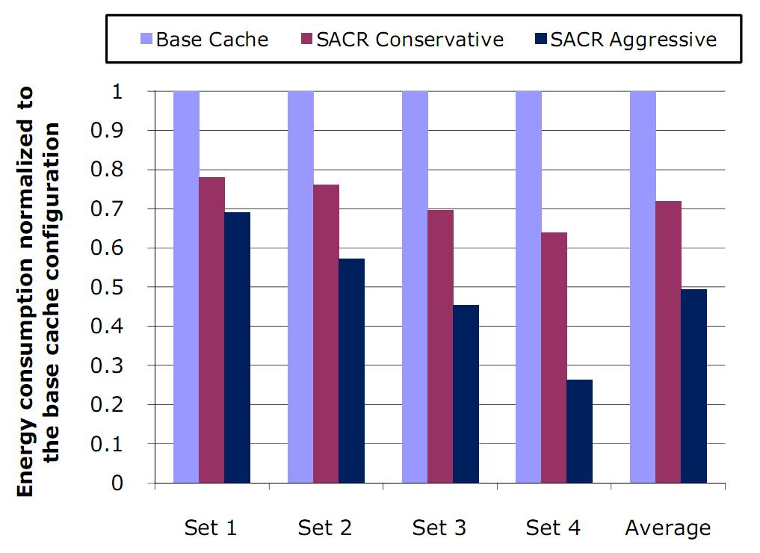
Energy Savings (Instruction Cache)
28% average energy savings using conservative approach
51% average energy saving using aggressive approach

Slide 19
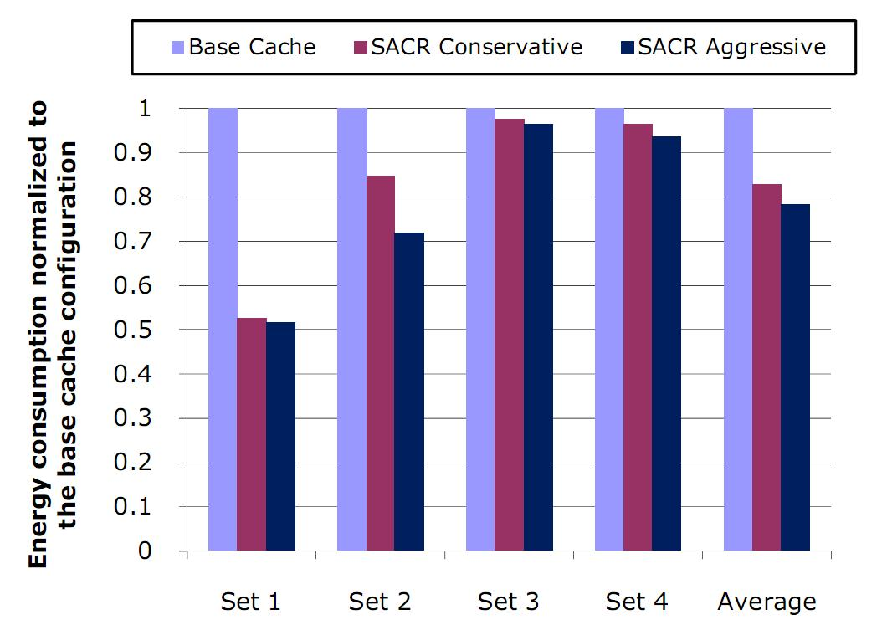
Energy Savings (Data Cache)
17% average energy savings using conservative approach
22% average energy saving using aggressive approach

Slide 20
Hardware Overhead
Profile Table stores 18 cache configurations
Synthesized using Synopsys Design Compiler
Assumed lookup frequency of one million nanoseconds
Table lookup every 500K cycles using 500 MHz CPU
Average energy penalty is 450 nJ
Less than 0.02% of overall savings (2825563 nJ)

Slide 21
Compression Aware Dynamic Cache Reconfiguration (CACR)

Slide 22
Code Compression in Embedded Systems
Major Design Constraints in Embedded Systems: Memory and time
Cost & size of the system
Power Consumption
DCR may increase the execution time – not desirable in real time systems
Code compression with cache reconfiguration resolves timing constraints by effectively shrinking the program size – fits critical portion of application into a smaller cache

Slide 23
Code Compression Techniques
Traditional Dictionary Based Code Compression
Hamming Distance Base Code Compression
Our Approach : Bitmask Based Code Compression
Compression Algorithm
Decompression Mechanism

Slide 24
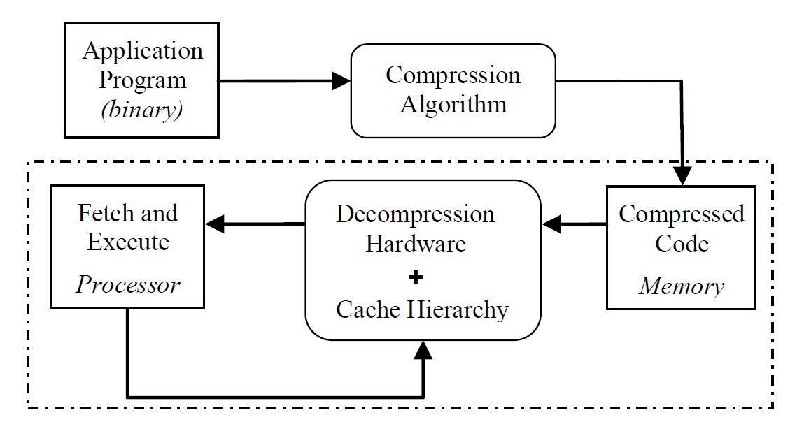
Traditional Code Compression Methodology

Slide 25
Compression Ratio
Compression Ratio
Smaller compression ratio is better
Compression Ratio = Compression Program Size
Original Program Size

Slide 26
Compression Techniques
Dictionary-based approach
Good Compression Ratio
Fast decompression Scheme
Hamming Distance Approach
Limited: profitable only upto 3 bitmasks
Our approach
Use bitmasks to maximize matching patterns
Improve compression ratio even further

Slide 27
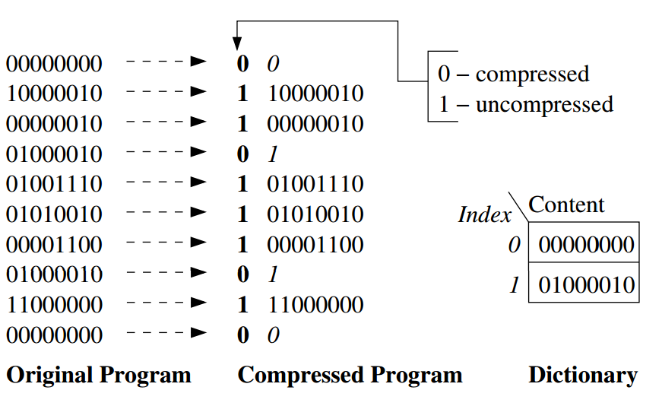
Traditional Dictionary Based Code Compression
Original Code Size – 80 bits
Compressed Code Size – 62 bits
Dictionary Size – 16 bits
Compression ratio – (62+16)/80 = 97.5%

Slide 28
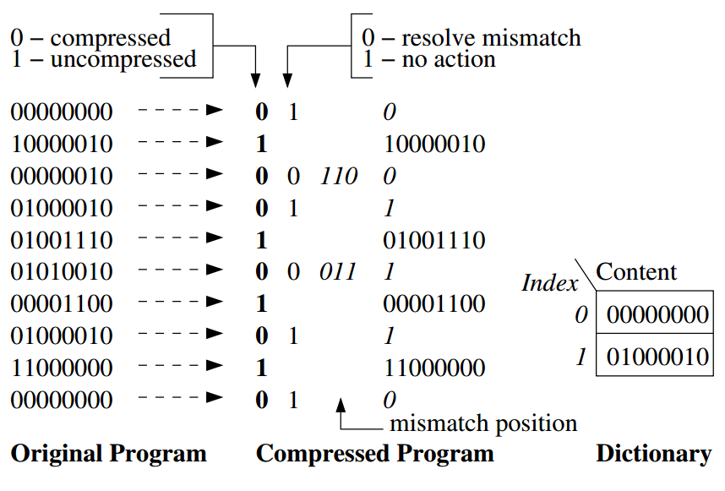
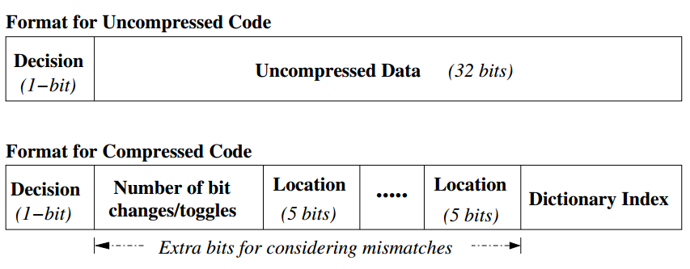
Hamming Distance Compression
Improved Dictionary-based approach
Compression ratio depends on number of bit changes during compression
Compression ratio – 95%
Encoding scheme for incorporating mismatches

Slide 29
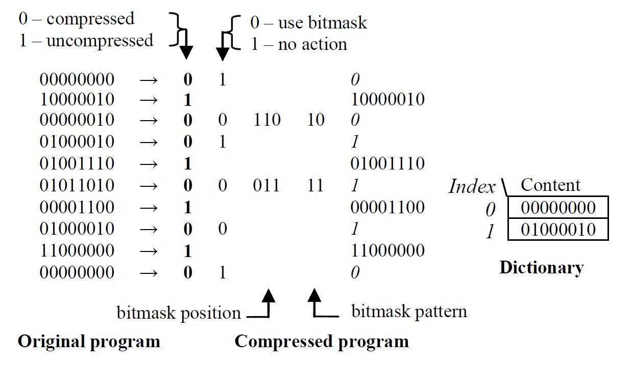
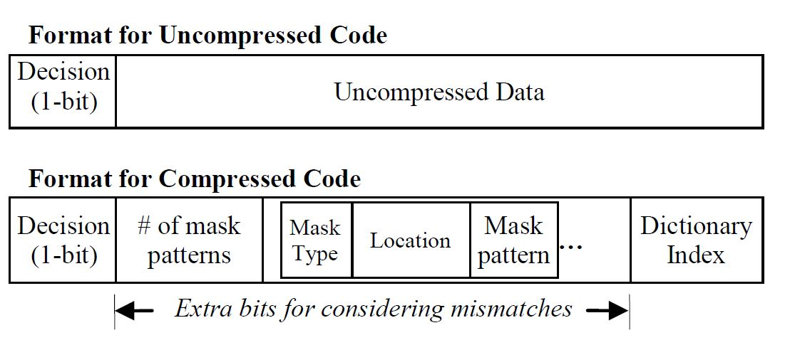
Bit-mask based code Compression
Increased matching patterns
Data compressed using bitmask requires 8 bits
Compression ratio – 80%
Challenges: Bitmask selection and dictionary selection
The mapping of old addresses (in the original uncompressed code) to new addresses (in the compressed code) is kept in a jump table.
Example of a compressed word

Slide 30
Compression Aware DCR - Algorithm

Slide 31
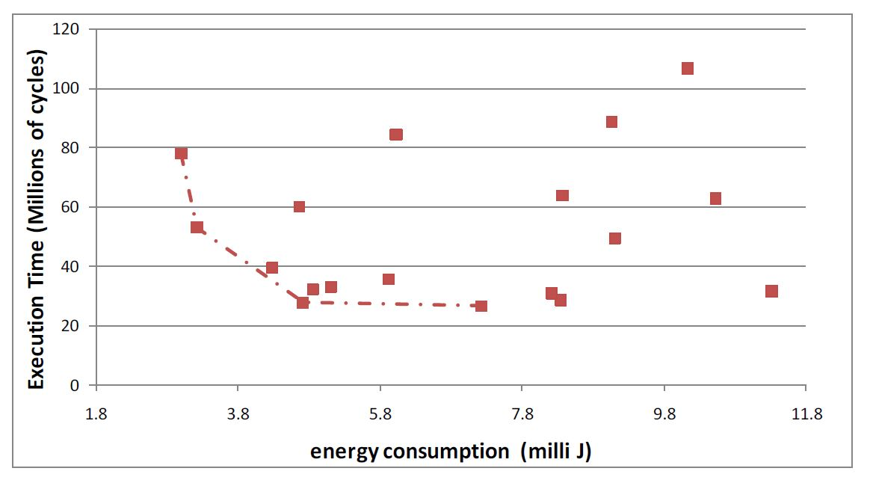
Performance – Energy Consumption Trade-off
– Anagram Benchmark
Pareto optimal alternatives are connected using dashed lines

Slide 32
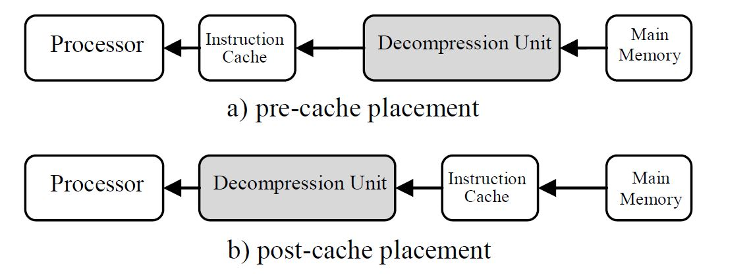
Placement of Decompression Unit
Pre-cache placement – memory contains compressed code – instructions are stored in cache in uncompressed form
Has little effect on energy and performance of cache
Post – cache placement - the decompression unit is placed between cache and processor thus both memory and cache contain compressed instructions.
The best choice to achieve maximum performance as well as minimum energy consumption.
However, post-cache placement can introduce significant performance overhead to the system.

Slide 33
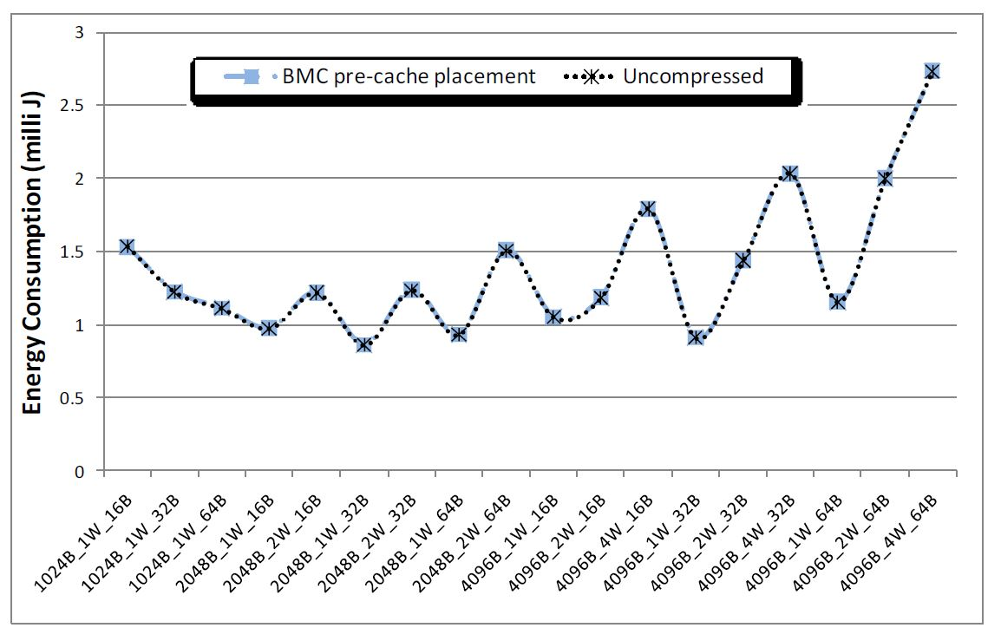
The impact of pre-cache placement of decompression
engine on cache energy – djpeg benchmark

Slide 34
Experimental Setup
Benchmarks
jpeg, djpeg, epic, adpcm (rawcaudio and rawdaudio), g.721 (encode, decode) benchmarks from the MediaBench
dijkstra, patricia, crc32, bitcnts from MiBench
Code Compression Techniques - bitmask-based, dictionary-based and Huffman code compression
Dictionaries of sizes - 1 KB, 2KB, 4KB, and 8 KB.
Three mask sets - one 2- bit sliding, 1-bit sliding and 2-bit fixed, and 1-bit sliding and 2-bit fixed masks.
Dictionary-based and Huffman compression - 0.5 KB, 1KB, 2KB, 4KB, and 8 KB dictionary sizes with 8 bits, 16 bits and 32 bits word sizes were used
Best choice – dictionary size of 2 KB and word size of 16 bits.
Code compression is performed offline
ECOFF (Extended Common Object File Format) header files provided in SimpleScalar toolset - compressed code back into binary files so that they can be loaded into the simulator.
Cache configurations same as in DCR

Slide 35
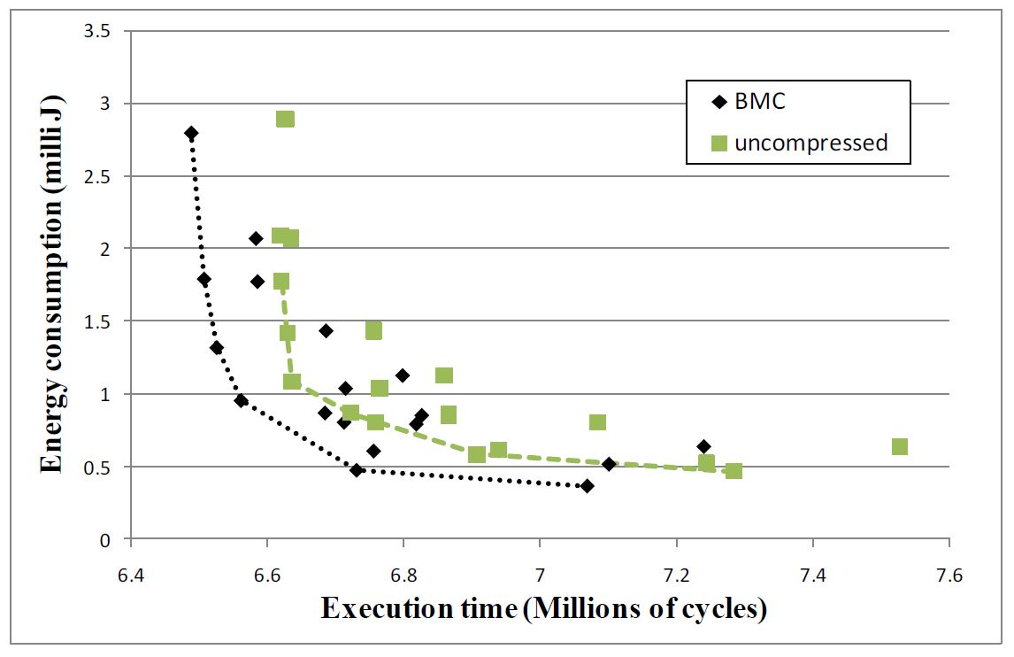
Performance-Energy consumption tradeoff for compressed and uncompressed codes using rawcaudio (adpcm-enc) benchmark

Slide 36
Energy Savings
Instruction cache subsystem – 10% - 76% with an average of 52% - utilizing only DCR
BMC + DCR – energy savings upto 48% on top of 10% - 76% obtained only by DCR – without performance degradation
Our Approach – average 65% energy savings

Slide 37
Performance Improvements
DCR alone – 11% performance loss on average
BMC + DCR – 75% performance improvement (g721_enc)

Slide 38
Conclusion
Dynamic cache reconfiguration is a promising approach to improve both energy consumption and overall performance.
65% reduction on average in overall energy consumption of the cache subsystem as well as up to 75% performance improvement in embedded systems when code compression is integrated with DCR.
FUTURE WORK
Hard real-time systems
Multi-core and multi-processor systems
Optimal mask and dictionary selection techniques
Gaps in the paper
How partition factor is determined during static profiling?
Working of the decompression unit is not explained

