Slide 1
FPGA Glitch Power Analysis and Reduction
Vibhav Kundalia Niharika Chatla
UFID – 31561935 UFID - 90431959

Slide 2
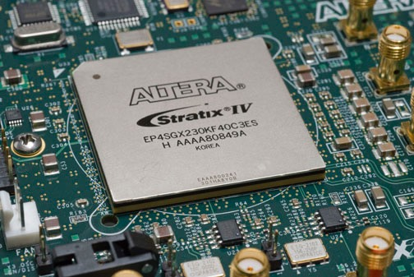
FPGA – Field Programmable Gate Arrays
Used for Implementing Digital Systems
Pros
Flexible
Low time-to-market
Cons
Power Consumption (upto 10x more power than equivalent ASIC design)

Slide 3
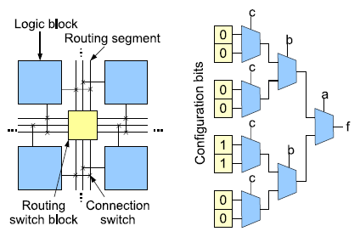
FPGA Architecture
Island-style architecture
Logic blocks connected through programmable routing network
Look-up-tables (inside logic blocks)
L-input LUT can implement k variable logic functions and requires 2^k configuration bits
Hardware implementation of truth table

Slide 4
Power in FPGAs
Static Power
Current leakage in transistors
Dynamic Power
Signal transition for 0 to 1 or 1 to 0
Functional transition
Necessary for correct operation of circuit
Glitch
Transitions that arise from unbalanced delays to the inputs of a logic gate
Doesn’t affect the functionality of a synchronous circuit but has significant effect on power
4-73% of total dynamic power, average 22.6%

Slide 5
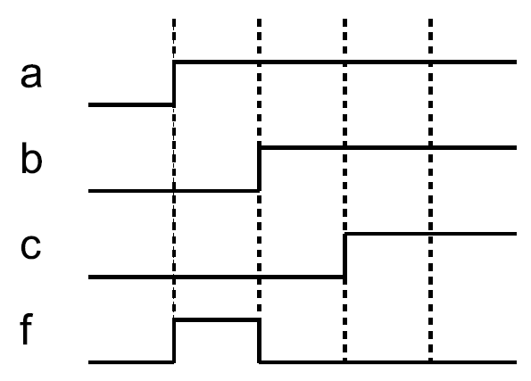
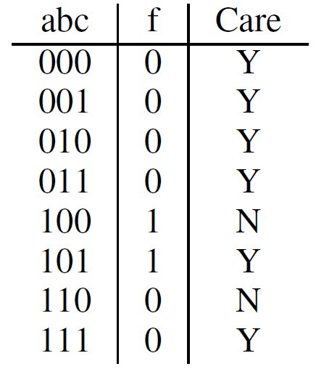
Glitch Example

Slide 6
Glitch Reduction in FPGAs
Algorithms that attempt to balance delays
Technology mapping stage
Mapping based on glitch-aware switching activities
Routing stage
Faster arriving inputs delayed by extending path
Architectural level
Programmable delay elements
All incur area or performance overhead
Flip-flop insertion/pipelining
Break up deep combinational logic paths into stages of pipeline
Fewer logic levels reduces opportunity for imbalanced delays
Hazard-free logic synthesis techniques
Change don’t-care values to reduce glitches

Slide 7
Dynamic Power of FPGA
Terms
n : number of nets in circuit
S_{i} : switching activity of net i
C_{i} : capacitance of net i
f : frequency of circuit
V_{dd} : supply voltage
The glitch reduction algorithm aims to lower the switching activity as a means of reducing dynamic power

Slide 8
Proposed Solution
Glitch reduction algorithm based on don’t-cares
Selects don’t-care output values of LUTs in such a way that reduces glitches
Performed after placement and routing
Uses timing simulation data for guidance
No area or performance overhead
Inspired by hazard-free logic synthesis techniques for asynchronous circuits

Slide 9
Don’t-cares in Logic Circuits
Entries in truth table where output can be set as either logic-0 or logic-1 without affecting correctness of circuit
Two categories
Satisfiability don’t-cares (SDCs)
Particular input pattern can never occur on inputs
Observability don’t-cares (ODCs)
Output cannot propagate to circuit’s primary outputs

Slide 10
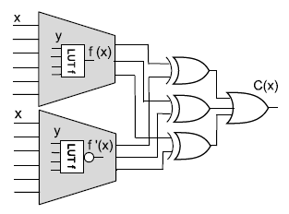
Don’t-care Analysis
ABC logic synthesis network
Developed at UC Berkeley
Boolean satisfiability (SAT)-based complete don’t-care analysis that determines don’t-care minterms
Utilizes miter circuit to find don’t-cares
If C(x) = 0, y is don’t care minterm of LUT f

Slide 11
Glitch Power Analysis
Examined amount of glitch power dissipated by 20 MCNC benchmark designs
Experimental setup
Altera Quartus 10.1
65nm Stratix III devices
ModelSim 6.3e used for functional and timing simulation using 5000 random input vectors
Dynamic power computed using Quartus PowerPlay
Glitch power
dynamic power(timing simulation) – dynamic power (functional simulation)

Slide 12
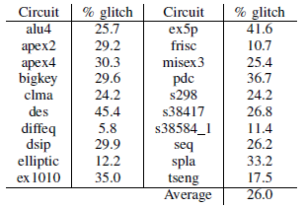
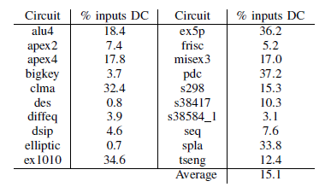
Glitch Power Analysis
Percentage of dynamic power from glitches
Range: 5.8-45.4%
Average : 26.0%
Percentage of LUT input states that are don’t-cares
Range: 0.8-37.2%
Average: 15.1%

Slide 13
Glitch Reduction Algorithm
Inputs
Placed and Routed Netlist
Value change dump file(VCD)
The algorithm iterates through each LUT in the netlist from shallower to deeper ones.
For each LUT
Compute the don’t cares of the LUT
Scan the input vectors
Set the values of the don’t cares.

Slide 14
Glitch Reduction Algorithm
Computing the don’t-cares for a LUT
ABC’s SAT-based don’t-care analysis is used
Scanning the input vectors
Voting mechanism
Set the value of don’t cares and update the netlist
Set to the value with more votes
Netlist is updated before proceeding to the next LUT
The functionality of the circuit should be guaranteed.

Slide 15
Input Vector Scan
The sequence of local input vectors to the LUT extracted from the VCD file.
The input vectors are examined in order.
Whenever an input vector corresponding to a don’t care is reached
check for the closest care states in the past and future of the don't care input vector.
cast the vote for 0 or 1 based on these care states if they are same.
Otherwise, no vote is cast.
Vote count is maintained for each don't care in a LUT.

Slide 16
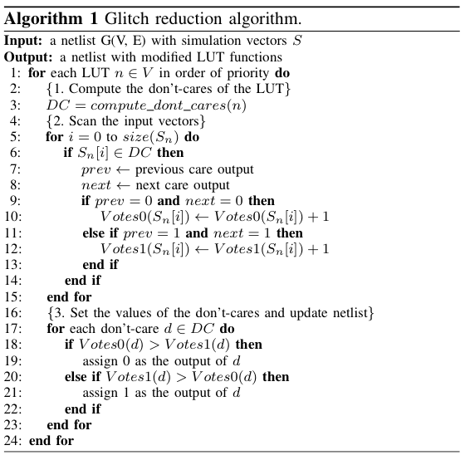

Slide 17
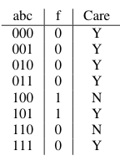
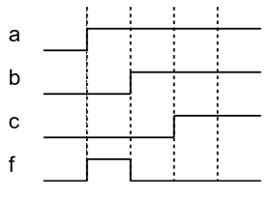

Slide 18
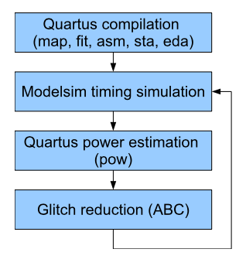
Iterative Flow
Run the simulation using the modified circuit after glitch reduction.
The algorithm is repeated iteratively.
Runtime of algorithm is less.

Slide 19
Experimental study
Experimental Setup
20 MCNC benchmark circuits
Quartus II 10.1
Altera Stratix III 65nm FPGA family
Modelsim SE 6.3e
For each circuit
5000 random input vectors are applied
Combinational equivalence checking is used after the glitch reduction step.
Three passes of the optimization loop are performed.
Power measurements performed by Quartus Powerplay.

Slide 20
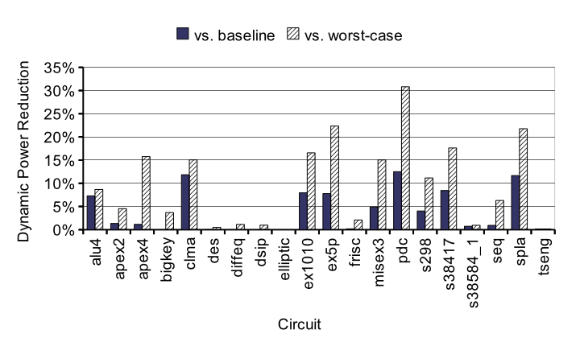
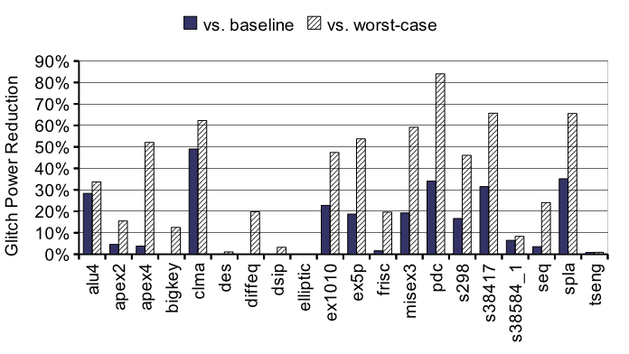
Results
Dynamic Power reduction in comparison with baseline settings
Average : 4%
Peak : 12.5%
Glitch Power reduction
Average : 13.7%
Peak : 49%
Dynamic power reduction optimized vs worst-case settings
Average : 9.8%
Peak : 30.8%

Slide 21
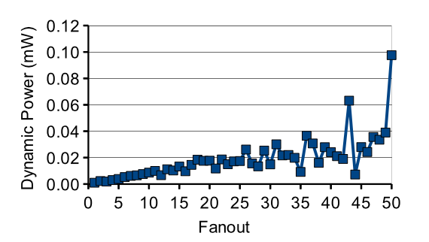
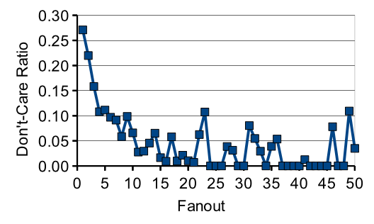
Power & don’t-care ratio vs Fanout
Relationship between don’t cares, power and fanout presents a challenge to glitch reduction algorithm.
Increase in fanout increases the average dynamic power of the FPGA due to increase in capacitance.
High fanout signals have fewer don't cares in their driving LUTs than low fanout signals.
Signals consuming most power are poor targets for glitch reduction techniques based on don't cares.

Slide 22
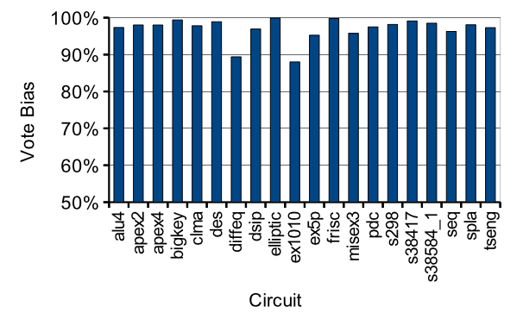
Power vs Average Voltage Bias
Vote bias is defined as the percentage of votes that were cast for the most popular setting.
There usually exists a highly preferable setting for a particular don’t-care minterm in a LUT.
Observations suggest that don’t-care logic values can be selected with a high degree of confidence.

Slide 23
Conclusions
Glitch power is a significant portion of total power.
can be reduced using don't care based optimizations.
As glitch reduction technique performed after placement and routing, it has no effect on circuit area.
Future work
Integrate algorithm into power-aware FPGA CAD Flow.
To investigate whether other stages of CAD flow could improve algorithm effectiveness.

