Slide 1
Comparative Analysis of Present and Future Space Processors with Device Metrics
Tyler M. Lovelly
Ph.D. student
University of Florida
Kevin Cheng
M.S. student
University of Florida
William Garcia
B.S./M.S. student
University of Florida
Dr. Alan D. George
Professor of ECE
University of Florida
This work was supported in part by the I/UCRC Program
of the National Science Foundation under Grant Nos. EEC-0642422 and IIP-1161022

Slide 2
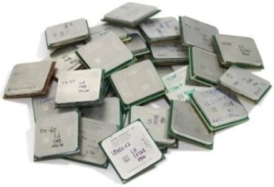
Papers of Interest
J. Richardson, S. Fingulin, D. Raghunathan, C. Massie, A. George, and H. Lam, “Comparative Analysis of HPC and Accelerator Devices: Computation, Memory, I/O, and Power,” Proc. of High-Performance Reconfigurable Computing Technology and Applications Workshop (HPRCTA), at SC’10, New Orleans, LA, Nov 14 2010
Lovelly, T.M.; Bryan, D.; Cheng, K.; Kreynin, R.; George, A.D.; Gordon-Ross, A.; Mounce, G., "A framework to analyze processor architectures for next-generation on-board space computing," Aerospace Conference, 2014 IEEE , vol., no., pp.1,10, 1-8 March 2014 doi: 10.1109/AERO.2014.6836387

Slide 3
Introduction & Background

Slide 4
Introduction
Space computing presents unique challenges
Harsh and inaccessible operating environment
Severe resource constraints – power, size, weight
Stringent requirements for performance and reliability
Increasing need for high-performance space computing
Escalating demands for real-time sensor and autonomous processing
Limited communication bandwidth to ground stations
Legacy space processors that cannot meet performance requirements
Generations behind commercial-off-the-shelf (COTS) processors
Based upon architectures not particularly suited to needs of space computing
Quantitative and objective analysis of processor architectures
Device metrics analysis based on architectural capabilities
Broad and diverse set of architectures under consideration
Targeting space processors and low-power COTS processors (≤ 30 W)

Slide 5
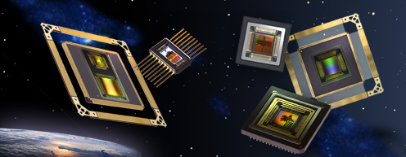
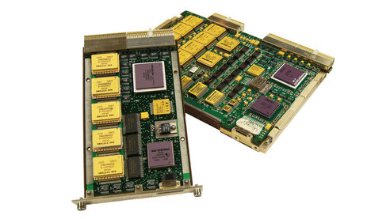
Space Processors
Radiation-hardened (RadHard) processors for high reliability
Outcomes of radiation-hardening
Cumulative effects
Total-Ionizing Dose (TID) ≥ 300 krad(Si)
Single-Event Effects (SEEs)
Immunity to Single-Event Latchup (SEL), Upset (SEU), Functional Interrupt (SEFI)
Performance and power
Slower operating frequency, reduction in cores or execution units, increased power
Techniques for radiation-hardening
Radiation-hardening by process
Insulating oxide layer used in process
Radiation-hardening by design
Specialized circuit-layout techniques
Radiation-hardening by architecture
Fault-tolerant computing strategies

Slide 6
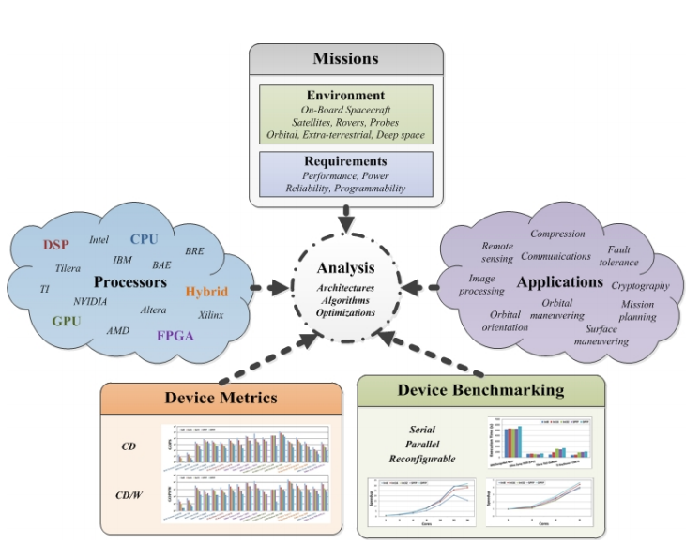
Framework to Analyze Processors

Slide 7
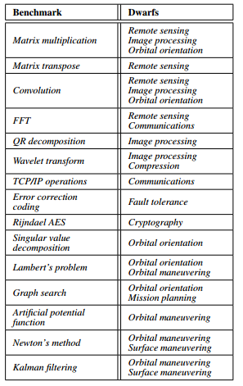
Dwarfs/Benchmarking
What key benchmarks are of interest for space computing?

Slide 8
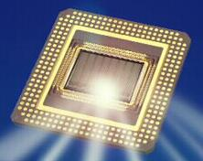
Device Metrics
Suite of quantitative and objective metrics developed by NSF CHREC Center at University of Florida ^{[1-2]}
For comparative analysis of broad and diverse set of processors
Central processing units (CPUs)
Digital signal processors (DSPs)
Field-programmable gate arrays (FPGAs)
Graphics processing units (GPUs)
Hybrid combinations of above (often SoCs)
Highly useful for first-order analyses and comparisons
Study broad range of devices with metrics to determine best candidates
Later, study best candidates more deeply with selected, optimized benchmarking
Different methods used for fixed- and reconfigurable-logic devices
Metrics data collected from architectural features of device
Determined from vendor-provided information and tools
Experimental testbed in lab is not required for metrics analysis
[1] J. Williams, A. George, J. Richardson, K. Gosrani, C. Massie, H. Lam, “Characterization of Fixed and Reconfigurable Multi-Core Devices for Application Acceleration,” ACM Transactions on Reconfigurable Technology and Systems (TRETS), Vol. 3, No. 4, Nov. 2010, pp. 19:1-19:29.
[2] J. Richardson, S. Fingulin, D. Raghunathan, C. Massie, A. George, and H. Lam, “Comparative Analysis of HPC and Accelerator Devices: Computation, Memory, I/O, and Power,” Proc. of High-Performance Reconfigurable Computing Technology and Applications Workshop (HPRCTA), at SC’10, New Orleans, LA, Nov 14, 2010.

Slide 9
Device Metrics Analysis
Analyzing performance (GOPS) and power (GOPS/W)
Computational Density (CD) measures theoretical performance
Reported in giga-operations per second (GOPS)
Calculated separately for varying data types
8-bit, 16-bit, and 32-bit Integer (Int8, Int16, and Int32)
Single-precision and double-precision floating point (SPFP and DPFP)
Determine operations mix (additions, multiplications, etc.) based on target apps
CD per Watt (CD/W) measures performance scaled by power
Analyzing memory and input-output bandwidth (GB/s)
Internal Memory Bandwidth (IMB) measures throughput between processor and on-chip memory (cache or BRAM)
External Memory Bandwidth (EMB) measures throughput between processor and off-chip memory (DDR2, DDR3, etc)
Input-Output Bandwidth (IOB) measures throughput between processor and all off-chip resources (DDR, GigE, PCIe, GPIO, etc.)

Slide 10
Device Metrics Examples

Slide 11
Device Metrics: CPU Analysis (1/2)
Example: Freescale P5040 (RadHard RAD5545)
COTS counterpart of RadHard RAD5545 CPU from BAE Systems
Fixed-logic CPU: 2.2 GHz, 49 W, quad-core, no SIMD engine
Calculating CD and CD/W
Each core contains
3 integer execution units 1 floating-point execution unit
Can issue 2 instructions each cycle
Calculate operations/cycle for each data type
Int8: 2 ops/cycle Int16: 2 ops/cycle Int32: 2 ops/cycle
SPFP: 1 op/cycle DPFP: 1 op/cycle
CD_{Int8,Int16,Int32} = 4 cores × 2.2 GHz × 2 ops/cycle = 17.6 GOPS
CD/W_{Int8,Int16,Int32} = 17.6 GOPS / 49 W = 0.36 GOPS/W
CD_{SPFP,DPFP} = 4 cores × 2.2 GHz × 1 ops/cycle = 8.8 GOPS
CD/W_{SPFP,DPFP} = 8.8 GOPS / 49 W = 0.18 GOPS/W
Operations mix of 50% add, 50% mult

Slide 12
Device Metrics: CPU Analysis (2/2)
Calculating IMB, EMB, and IOB
Each core contains
L1 data cache: 8-byte bus L1 instr cache: 16-byte bus L2 cache: 64-byte bus
Total of 2 DDR3 controllers: 8-byte bus; 1600 MT/s
IMB_{L1data} = 4 cores × 2.2 GHz × 8 bytes = 70.4 GB/s
IMB_{L1inst} = 4 cores × 2.2 GHz × 16 bytes = 140.8 GB/s
IMB_{L2} = 4 cores × 2.2 GHz × 64 bytes = 563.2 GB/s
EMB = 2 DDR3 × 8 bytes × 1600 MT/s = 25.6 GB/s
IOB = DDR3 + 10GigE + 1GigE + PCIe + SATA2.0 + GPIO
= 25.6 GB/s + 5 GB/s + .5 GB/s
+ 8 GB/s + .3 GB/s + 8.8GB/s = 48.2 GB/s
Assumes 100% cache hit rate
Based on optimal SerDes lane config.

Slide 13
Device Metrics: FPGA Analysis (1/2)
Example: Xilinx Virtex-5 FX130T
COTS counterpart of RadHard Virtex-5QV FX130 FPGA from Xilinx
Reconfigurable-logic FPGA: different methods required for metrics ^{[3]}
Calculating CD and CD/W
FPGA logic resources
Look-up tables (LUTs), Flip-flops (FFs), Multiply-accumulate units (DSPs)
Generate and implement compute cores on FPGA with vendor tools
All combinations of operation and data types: with and without DSP resources
Collect data on resource usage and max. operating frequencies
Linear-programming algorithm optimally packs cores onto FPGA
Max. cores = max. ops/cycle (with pipelined cores)
Use vendor-provided tools for power estimation
Calculate dynamic power based on resource usage for cores
CD_{Int8} = 2358 ops/cycle × 0.353 GHz = 833.2 GOPS
CD/W_{Int8} = 833.2 GOPS / 16.53 W = 50.42 GOPS/W
Operations mix of 50% add, 50% mult
Same process used for all data types
[3] N. Wulf, J. Richardson, and A. George, “Optimizing FPGA Performance, Power, and Dependability with Linear Programming,” Proc. of Military and Aerospace Programmable-Logic Devices Conference (MAPLD), San Diego, CA, April 9 - 12, 2013.

Slide 14
Device Metrics: FPGA Analysis (2/2)
Calculating IMB, EMB, and IOB
298 Block RAM units (BRAMs): 9-byte bus, 2 ports, 0.266 GHz operating frequency
5 DDR2 controllers: 8-byte bus, double data rate, 0.266 GHz operating frequency
840 GPIO pins: 0.8 Gb/s data rate
20 RocketIO GTX transceivers: 6.5 Gb/s data rate
IMB_{BRAM} = 298 BRAMs × 0.266 GHz × 9 bytes × 2 ports = 1430.04 GB/s
EMB = 5 DDR2 × 0.266 GHz × 8 bytes × 2 (double data rate) = 21.33 GB/s
IOB = DDR2 + GPIO + RocketIO GTX transceivers
= 21.33 GB/s + (840 pins × 0.8 Gb/s)
+ (20 transceivers × 6.5 Gb/s) = 121.58 GB/s
Based on max. packing of memory controllers

Slide 15
Benchmarking Examples

Slide 16
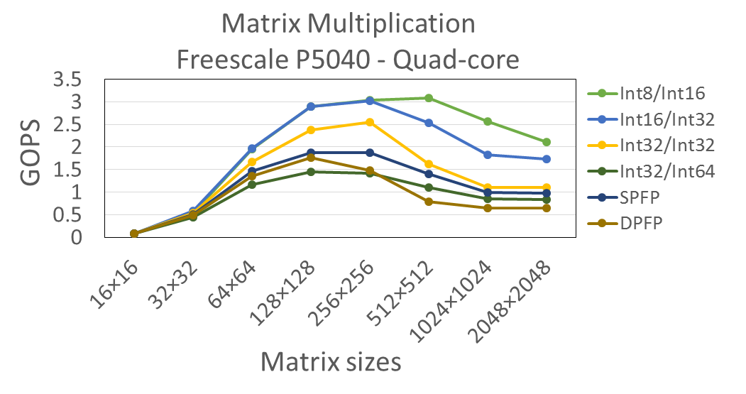
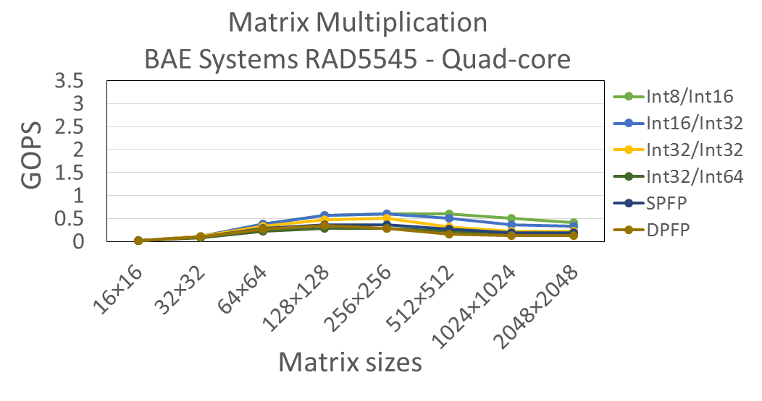
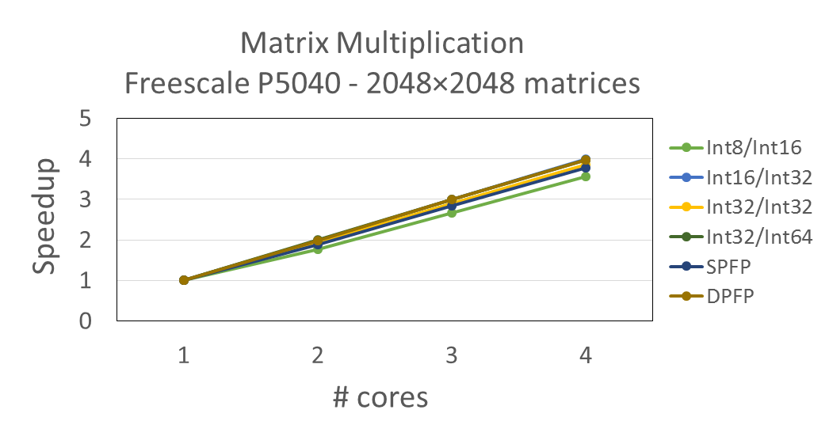
Benchmarking: P5040 (1/2)
Matrix multiplication of two $n×n$ matrices
Generated results for various data types, problem sizes, # cores
Estimated RAD5545 performance based on reduced frequency
Max performance of ~3.09 GOPS
Max performance of ~0.61 GOPS
Performance analysis
Scales down with higher precision
Exception: Int32/Int64 slower than SPFP due to larger output matrices
Very high parallel efficiency; approaching linear speedup
Speedup consistent for all data types

Slide 17
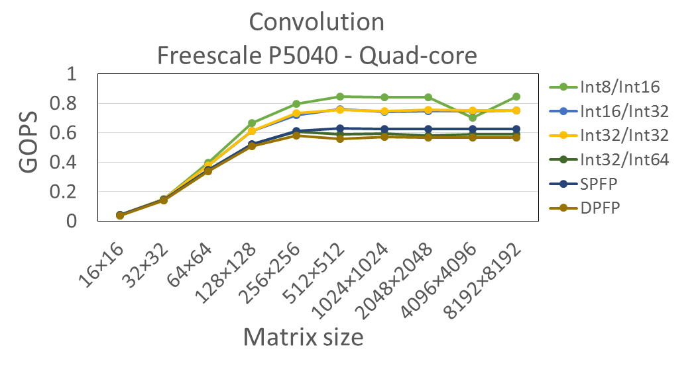
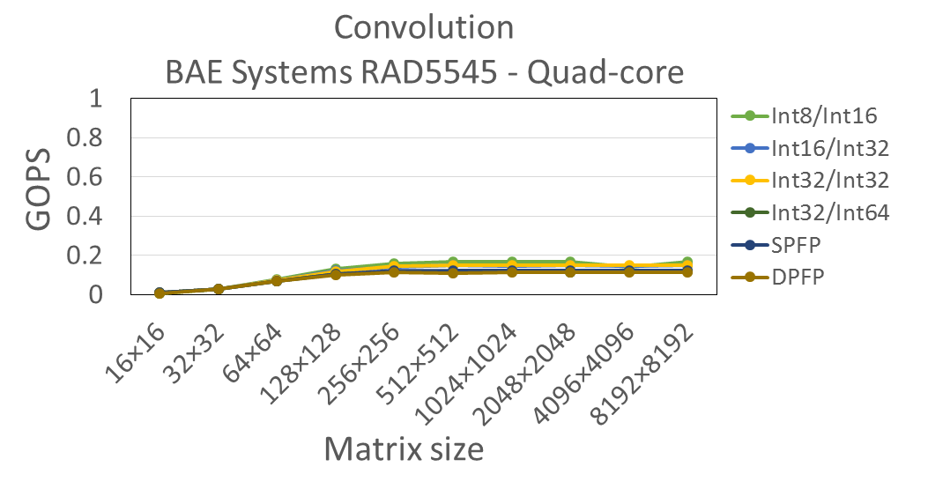
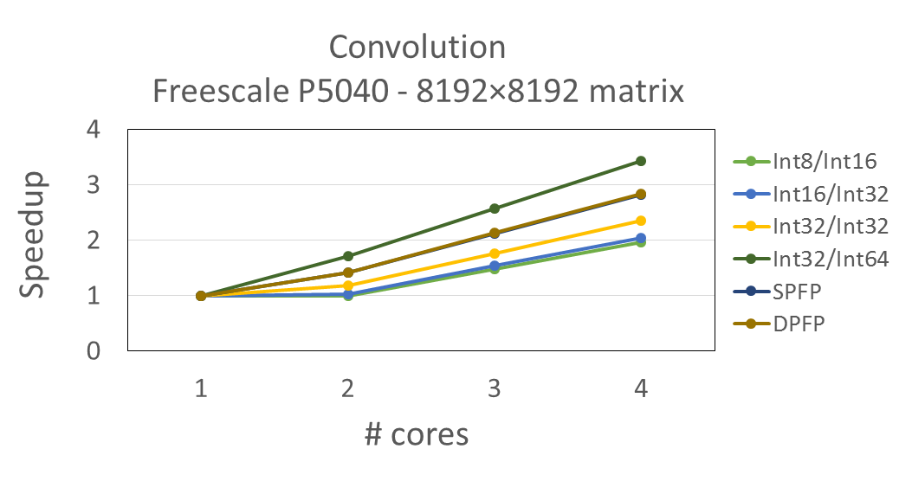
Benchmarking: P5040 (2/2)
Convolution of $n×n$ matrix with $3×3$ Sobel filter
Generated results for various data types, problem sizes, # cores
Estimated RAD5545 performance based on reduced frequency
Max performance of ~0.84 GOPS
Max performance of ~0.17 GOPS
Supports higher sizes than matrix multiplication
Performance analysis
Scales down with higher precision
Slower GOPS than matrix multiplication
More overhead from indexing matrices
Moderate parallel efficiency with peak performance at 4 cores

Slide 18
Current Research Data

Slide 19
Space Processor Comparisons (1/2)
COTS counterpart to RadHard BAE Systems RAD5545
COTS counterpart to RadHard Xilinx Virtex-5QV FX130
COTS device in CHREC Space Processor (CSP)
Older RadHard CPUs greatly outperformed
COTS device in Space Micro Proton400k
RadHard
RadHard data unavailable; loss in performance is expected
COTS counterparts to RadHard
COTS being deployed in space
FPGA gives better CD and CD/W than CPU
FPGAs give high CD and CD/W for all data types
Many-core CPU gives high integer CD, but low CD/W
DSP gives high floating-point CD and CD/W
Results displayed in logarithmic scale

Slide 20
Space Processor Comparisons (2/2)
After FPGAs, multi-core and many-core CPUs give high IMB
BRAMs in FPGAs give much greater IMB than caches
Older RadHard CPUs greatly outperformed
RadHard
RadHard data unavailable; loss in performance is expected
COTS counterparts to RadHard
COTS being deployed in space
Highest EMB and IOB given by FPGAs
Multi-core and many-core CPUs give high EMB and IOB
EMB based on controller for external L2 cache
No controllers for external memory
Results displayed in logarithmic scale

Slide 21
RadHard vs. COTS Counterparts (1/2)
RadHard version achieves ~28% of original CD
RadHard version achieves ~73% of original CD
RadHard version achieves ~30% of original CD
RadHard version achieves ~33% of original CD
COTS vs. RadHard
COTS vs. RadHard
Less cores, but adds floating-point units
COTS vs. RadHard
Less integer and floating-point units
COTS vs. RadHard
RadHard version achieves ~29% of original CD/W
RadHard version achieves ~49% of original CD/W
RadHard version achieves ~14% of original CD/W
RadHard version achieves ~31% of original CD/W
Results displayed in logarithmic scale

Slide 22
RadHard vs. COTS Counterparts (2/2)
Exception is RADSPEED, which achieves ~93% of original IMB
Changes in IMB for RadHard versions largely consistent with changes in CD
No L2 cache
COTS vs. RadHard
Only supports external L2 cache
COTS vs. RadHard
COTS vs. RadHard
COTS vs. RadHard
Changes in EMB for RadHard versions is consistent with changes in IMB
No controllers for external memory
EMB based on controller for external L2 cache
Results displayed in logarithmic scale

Slide 23
RadHard vs. COTS Comparisons (1/2)
RadHard CPU gives ~2-17% of integer CD and ~2-28% of floating-point CD of leading COTS devices
RadHard DSP gives ~0.4-6% of integer CD and ~13-80% of floating-point CD of leading COTS devices
RadHard CPU
RadHard DSP
COTS CPU
COTS CPU + DSP
COTS FPGA
COTS CPU + GPU
RadHard CPU gives ~2-9% of integer CD/W and ~1-17% of floating-point CD/W of leading COTS devices
RadHard DSP gives ~0.8-5% of integer CD/W and ~9-68% of floating-point CD/W of leading COTS devices
Results displayed in logarithmic scale

Slide 24
RadHard vs. COTS Comparisons (2/2)
RadHard CPU gives varying % of IMB of leading COTS devices
~18% for CPU, ~12% for DSP,
~1% for FPGA, ~39% for GPU
RadHard DSP gives small % of IMB of leading COTS devices
~3% for CPU, ~2% for DSP,
~0.2% for FPGA, ~6% for GPU
RadHard CPU
RadHard DSP
COTS CPU
COTS CPU + DSP
COTS FPGA
COTS CPU + GPU
RadHard CPU gives varying % of EMB/IOB of leading COTS devices
~24/33% for CPU, ~29/31% for DSP,
~9/4% for FPGA, ~60/67% for GPU
RadHard DSP gives varying % of EMB/IOB of leading COTS devices
~27/22% for CPU, ~24/29% for DSP,
~8/3% for FPGA, ~50/63% for GPU
Results displayed in logarithmic scale

Slide 25
Appendix: Device Metrics Data
 | Processor | Type | CD (GOPS) |  |  |  |  | CD/W (GOPS/W) |  |  |  |  | IMB (GB/s) |  |  | EMB (GB/s) | IOB (GB/s)
 |  |  | Int8 | Int16 | Int32 | SPFP | DPFP | Int8 | Int16 | Int32 | SPFP | DPFP | L1 cache | L2 cache | BRAMs
RadHard | Honeywell HXRHPPC | CPU | 0.080 | 0.080 | 0.080 | 0.080 | 0.080 | 0.011 | 0.011 | 0.011 | 0.011 | 0.011 | 1.280 | 0.000 | 0.000 | 0.000 | 0.160
 | BAE Systems RAD750 | CPU | 0.266 | 0.266 | 0.266 | 0.133 | 0.133 | 0.053 | 0.053 | 0.053 | 0.027 | 0.027 | 3.192 | 0.000 | 0.000 | 1.064 | 1.592
 | Aeroflex/Gaisler GR712RC | CPU | 0.080 | 0.080 | 0.080 | 0.025 | 0.025 | 0.053 | 0.053 | 0.053 | 0.017 | 0.017 | 4.800 | 0.000 | 0.000 | 0.400 | 1.213
 | Boeing MAESTRO | CPU | 101.920 | 50.960 | 25.480 | 12.740 | 12.740 | 4.591 | 2.295 | 1.148 | 0.574 | 0.574 | 101.920 | 50.960 | 0.000 | 8.320 | 15.070
 | BAE Systems RADSPEED | DSP | 17.708 | 17.708 | 10.119 | 70.832 | 35.416 | 1.181 | 1.181 | 0.675 | 4.722 | 2.361 | 14.912 | 7.456 | 0.000 | 6.990 | 14.185
COTS counterparts to RadHard | Freescale PowerPC603e | CPU | 0.266 | 0.266 | 0.266 | 0.266 | 0.266 | 0.076 | 0.076 | 0.076 | 0.076 | 0.076 | 4.256 | 0.000 | 0.000 | 0.000 | 2.128
 | IBM PowerPC750 | CPU | 0.800 | 0.800 | 0.800 | 0.400 | 0.400 | 0.170 | 0.170 | 0.170 | 0.085 | 0.085 | 9.600 | 0.000 | 0.000 | 3.200 | 4.000
 | Tilera TilePro64 | CPU | 358.400 | 179.200 | 89.600 | 0.000 | 0.000 | 15.583 | 7.791 | 3.896 | 0.000 | 0.000 | 358.400 | 179.200 | 0.000 | 22.400 | 29.150
 | Freescale P5040 | CPU | 17.600 | 17.600 | 17.600 | 8.800 | 8.800 | 0.359 | 0.359 | 0.359 | 0.180 | 0.180 | 211.200 | 563.200 | 0.000 | 25.600 | 48.200
 | Clearspeed CSX700 | DSP | 24.000 | 24.000 | 13.714 | 96.000 | 48.000 | 2.400 | 2.400 | 1.371 | 9.600 | 4.800 | 16.000 | 8.000 | 0.000 | 7.500 | 21.500
 | Xilinx Virtex-5 FX130T | FPGA | 833.200 | 416.300 | 89.680 | 80.230 | 17.530 | 50.420 | 23.810 | 6.088 | 5.754 | 2.025 | 0.000 | 0.000 | 1430.042 | 21.334 | 121.584
COTS being deployed in space | Freescale P2020 | CPU | 4.000 | 4.000 | 4.000 | 8.000 | 8.000 | 0.615 | 0.615 | 0.615 | 1.231 | 1.231 | 176.000 | 80.000 | 0.000 | 8.000 | 10.620
 | Xilinx Zynq-7020 (CPU) | CPU | 32.020 | 16.010 | 8.000 | 8.000 | 2.670 | 57.610 | 16.720 | 6.860 | 6.860 | 2.290 | 53.360 | 10.670 | 0.000 | 10.664 | 11.030
 | Xilinx Zynq-7020 (FPGA) | FPGA | 292.130 | 135.990 | 39.340 | 30.740 | 10.460 | 88.260 | 57.140 | 15.130 | 10.060 | 4.210 | 0.000 | 0.000 | 1154.387 | 6.400 | 53.050
 | Xilinx Zynq-7020 (Hybrid) | CPU+FPGA | 324.150 | 152.000 | 47.340 | 38.740 | 13.130 | 72.350 | 42.820 | 12.560 | 9.160 | 3.590 | 53.360 | 10.670 | 1154.387 | 42.656 | 89.670
COTS | Intel Atom Z2760 | CPU | 144.000 | 72.000 | 36.000 | 21.600 | 7.200 | 48.000 | 24.000 | 12.000 | 7.200 | 2.400 | 18.800 | 7.200 | 0.000 | 6.400 | 9.192
 | Intel Core i7-4610Y | CPU | 594.600 | 316.200 | 177.000 | 124.800 | 78.400 | 51.704 | 27.496 | 15.391 | 10.852 | 6.817 | 742.400 | 92.800 | 0.000 | 25.600 | 64.100
 | TI OMAP4460 | CPU | 146.170 | 73.090 | 36.540 | 36.140 | 12.000 | 77.420 | 38.710 | 19.360 | 19.140 | 6.360 | 120.000 | 36.000 | 0.000 | 6.400 | 11.710
 | Tilera TILE-Gx8036 | CPU | 486.000 | 270.000 | 162.000 | 54.000 | 54.000 | 16.200 | 9.000 | 5.400 | 1.800 | 1.800 | 1152.000 | 576.000 | 0.000 | 12.800 | 45.920
 | Freescale MSC8256 | DSP | 24.000 | 24.000 | 12.000 | 12.000 | 6.000 | 3.974 | 3.974 | 1.987 | 1.987 | 0.993 | 192.000 | 96.000 | 0.000 | 12.800 | 17.940
 | TI KeyStone-I TMS320C6678 | DSP | 960.000 | 480.000 | 240.000 | 160.000 | 80.000 | 47.291 | 23.645 | 11.823 | 7.880 | 3.940 | 960.000 | 160.000 | 0.000 | 12.800 | 33.860
 | TI KeyStone-II 66AK2H12 | CPU+DSP | 1459.200 | 729.600 | 364.800 | 198.400 | 99.200 | 67.280 | 33.640 | 16.820 | 9.150 | 4.570 | 1049.600 | 176.000 | 0.000 | 28.800 | 48.220
 | Xilinx Spartan-6Q LX150T | FPGA | 590.400 | 185.100 | 37.960 | 21.220 | 7.859 | 60.580 | 22.460 | 5.947 | 3.889 | 1.467 | 0.000 | 0.000 | 675.360 | 24.000 | 57.800
 | Xilinx Artix-7Q 350T | FPGA | 1245.000 | 939.100 | 163.300 | 134.200 | 45.520 | 75.490 | 52.650 | 13.730 | 8.930 | 3.721 | 0.000 | 0.000 | 3598.614 | 16.000 | 75.600
 | Xilinx Kintex-7Q 410T | FPGA | 2295.000 | 1696.000 | 380.600 | 224.300 | 91.950 | 74.280 | 51.360 | 18.030 | 8.715 | 3.500 | 0.000 | 0.000 | 6555.268 | 42.667 | 184.292
 | Xilinx Virtex-7Q X980T | FPGA | 4356.000 | 2186.000 | 890.500 | 539.600 | 207.200 | 75.130 | 48.310 | 14.790 | 8.763 | 3.469 | 0.000 | 0.000 | 12368.430 | 89.600 | 417.425
 | Altera Stratix III EP3SL150 | FPGA | 1115.000 | 329.700 | 87.100 | 69.430 | 21.550 | 37.470 | 16.460 | 5.332 | 2.575 | 1.264 | 0.000 | 0.000 | 2020.140 | 38.400 | 64.800
 | Altera Stratix IV EP4SGX230 | FPGA | 2563.000 | 811.500 | 258.100 | 153.000 | 60.550 | 99.320 | 41.230 | 15.040 | 5.995 | 2.694 | 0.000 | 0.000 | 6906.600 | 44.800 | 87.900
 | Altera Cyclone V GXFC9E6 | FPGA | 1113.000 | 358.800 | 81.530 | 94.170 | 31.810 | 138.300 | 65.970 | 18.170 | 8.645 | 3.463 | 0.000 | 0.000 | 3843.000 | 32.000 | 51.813
 | Altera Arria V GXFB7K4 | FPGA | 3329.000 | 1197.000 | 310.000 | 260.700 | 97.100 | 131.800 | 70.330 | 20.610 | 8.607 | 3.481 | 0.000 | 0.000 | 9656.000 | 44.800 | 103.800
 | Altera Stratix V GXEBBR1 | FPGA | 7885.000 | 1999.000 | 499.000 | 461.300 | 140.600 | 168.900 | 69.100 | 19.230 | 8.669 | 3.063 | 0.000 | 0.000 | 15840.000 | 44.800 | 191.125
 | Xilinx Zynq-7045Q | CPU+FPGA | 1896.020 | 719.810 | 269.200 | 194.100 | 65.270 | 70.640 | 44.690 | 12.250 | 7.930 | 3.170 | 53.360 | 10.670 | 4493.863 | 34.110 | 126.630
 | Altera Cyclone V SoC SXFC6D6 | CPU+FPGA | 454.800 | 149.500 | 40.990 | 45.960 | 13.840 | 104.480 | 44.560 | 13.230 | 8.510 | 3.030 | 74.000 | 14.800 | 1754.550 | 46.930 | 69.180
 | Altera Arria V SoC SXFB5H4 | CPU+FPGA | 3168.400 | 1170.200 | 294.200 | 246.900 | 91.290 | 125.680 | 65.960 | 19.300 | 8.520 | 3.400 | 64.000 | 0.000 | 9128.000 | 53.330 | 107.960
 | NVIDIA Tegra 3 | CPU+GPU | 265.984 | 137.984 | 73.984 | 73.984 | 25.600 | 132.992 | 68.992 | 36.992 | 36.992 | 12.800 | 240.000 | 25.600 | 0.000 | 10.680 | 118.400
 | NVIDIA Tegra 4 | CPU+GPU | 473.980 | 261.180 | 154.780 | 109.180 | 30.400 | 94.800 | 52.240 | 30.960 | 21.840 | 6.080 | -- | -- | 0.000 | -- | --
 | NVIDIA Tegra K1 | CPU+GPU | 697.600 | 440.000 | 311.200 | 256.000 | 44.400 | 139.520 | 88.000 | 62.240 | 51.200 | 8.880 | 358.400 | 36.800 | 0.000 | 13.854 | 22.550
Notes:
Slide 8: Justin
Requesting a minimum of 3 memberships, directly correlating to how many platforms and benchmarks we can do

Slide 26
Conclusions & Future Research

Slide 27
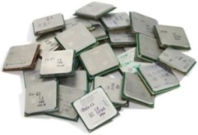
Conclusions and Future Research
Conclusions
Device metrics provides powerful 1st order evaluation
Lower cost
Much less time to analyze
Benchmarking is used for more detailed analysis
Cost of acquiring testbeds
Time and cost spent to develop benchmarks for specific architectures
Leveraging both provides valuable insight
Future Research
Profile operations mixes of more space dwarfs
Perform device metrics with resulting operations mixes
i.e. 20% ADD, 30% DIVIDE, 50% MULT (a.o.t 50% ADD / 50% MULT)
Benchmark more COTS devices & extrapolate to RadHard
i.e. Scale by clock speed and power
Notes:
Slide 8: Justin
Requesting a minimum of 3 memberships, directly correlating to how many platforms and benchmarks we can do

Slide 28
Notes:
Slide 8: Justin
Requesting a minimum of 3 memberships, directly correlating to how many platforms and benchmarks we can do

