Slide 1
Time-Triggered Ethernet: Concepts and Switch Design
Andrew Mortellaro
William Garcia

Slide 2
Literature Survey
Kopetz, Hermann; Ademaj, A.; Grillinger, P.; Steinhammer, K., "The time-triggered Ethernet (TTE) design," Object-Oriented Real-Time Distributed Computing, 2005. ISORC 2005. Eighth IEEE International Symposium on , vol., no., pp.22,33, 18-20 May 2005
Steinhammer, K.; Grillinger, P.; Ademaj, A.; Kopetz, Hermann, "A Time-Triggered Ethernet (TTE) Switch," Design, Automation and Test in Europe, 2006. DATE '06. Proceedings , vol.1, no., pp.1,6, 6-10 March 2006

Slide 3
Problem
Real-time systems depend a deterministic communications architecture
The open-nature of Ethernet makes guaranteeing strict temporal properties difficult
Unification is imperative
Support for real-time and non-real-time applications
Specialized communications solutions are costly
Chip mask development
Software-tool development
Generic unified platform supported by COTS components would significantly reduce cost

Slide 4
Time-triggered protocol
Developed by Real-Time Systems Group
Supports bandwidth up to 25 Mbits/sec
NEXT-TTA Project
Implemented TTP on COTS Gigabit Ethernet
COTS Ethernet switch unpredictable in nature
Disappointing resource utilization
Applications in the aerospace, railway, and automotive domains

Slide 5
Time-Triggered Ethernet (TTE)
Unifies real-time and non-real-time traffic
Distinguishes between two traffic types:
Event-triggered (ET) – standard traffic handled by existing IEEE Ethernet standards
Time-triggered (TT) – temporally guaranteed traffic for safety-critical configurations
TTE aims to handle both traffic types over single communications architecture

Slide 6
TTE Requirements
Certification
Most demanding requirement
Need for correct operation in all fault scenarios
Repartitioning into fault-containment regions (FCRs)
Legacy Integration
Portability of existing Ethernet applications
No changes in software or hardware
Deterministic Message Transfer
Small delay and minimized jitter
Fault-Tolerant Global Time
Tantamount to safety-critical applications

Slide 7
TTE Requirements
Strong Fault Isolation
Physical Proximity fault toleration: distributed system
Elimination of error propagation
Consistent Diagnosis
Correct nodes should agree on “up” and “down” nodes
Important for reconfiguration and recovery
Scalability
Higher speeds (10 Gigabit/sec)
Number of system controllers

Slide 8
TT vs. ET systems
Event-triggered
Action is started for a significant non-temporal event
Can occur outside or inside the computer
Examples: state change, interrupt firing
Time-triggered
Action is started for a significant temporal event
Real time reaches a predefined instant, or trigger value
Trigger value has a period and phase
Occurs inside the distributed computer system
Example: command and control, telemetry

Slide 9
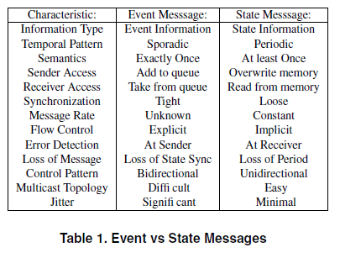
Event vs. State Messages
Event messages are event-triggered (Ethernet)
State messages are time-triggered (TTE)

Slide 10
Dependable Real-Time Systems
Dependable services demand redundant resources and a voting mechanism
Deterministic multicast transmission
The jitter, or difference between maximum and minimum delay, is a priori known characteristic parameter
Assures timeliness with a bounded latency
The receive order of messages is same as send order
Important for a TMR system
If the send instances of multiple messages are the same, then an ordering will be established a priori
Ensures conflict resolution

Slide 11
Open vs. Closed World Systems
Open-World Systems
Unknown number of clients compete for a server
Critical Instant: when all clients request server simultaneously
Guaranteed real time performance not guaranteed
Ex: the Internet
Closed-World Systems
Limited number of clients known a priori
Clients cooperate to establish a coordinated schedule
Server meets all requests within specified temporal bounds

Slide 12
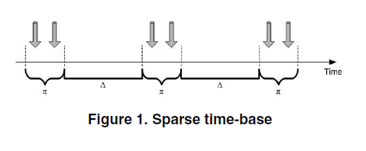
Global Sparse Time
Time-triggered system must contain global time base
Periodic synchronization of node’s local clock
Dense time base
Events may occur at any instant in timeline
Sparse time base
Events may occur within an active interval π
Silent interval Δ between any two active intervals

Slide 13
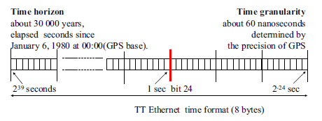
Time Format
Characterized by granularity and horizon
Granularity: minimum interval between ticks of digital clock
Horizon: the instant when time will wrap around
64-bit binary time format
Fractions of a second: 24 negative powers of 2
Full seconds: 40 positive powers of 2

Slide 14
Periods
Restricted to positive and negative powers of 2
Theoretically 64 different period durations
Period Bit: bit that specifies duration of period
Custom Implementation
16 different period choices from 2 seconds to 60 μseconds
Phase bits: twelve bits to right of period bit
Example: period of 1/2⁴ with phase 1/2⁶ + 1/2¹¹

Slide 15
Principles of Operation
Standard Configuration
Standard Ethernet controllers
TT Ethernet controllers
Single switch
Fault-tolerant Configuration
Safety-critical TT Ethernet controller (two port)
Two independent switches
Switches monitored by two independent guardians

Slide 16
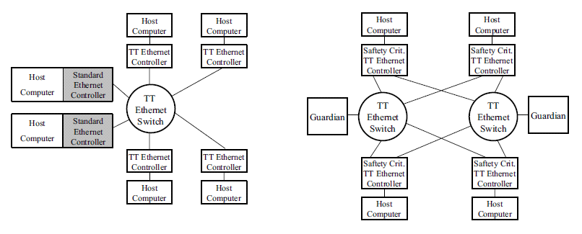
TT Ethernet Systems
Standard Configuration Fault-tolerant Configuration

Slide 17
The TT Ethernet Switch
Event-triggered messages
Stored in an ET-message queue of switch
Forwarded to specified receiver if outgoing channel free
Switch clears channel for incoming TT messages, then retransmits ET message once TT message terminates
Time-triggered messages
Delayed and then forwarded to addressed receivers
Clearance delay: time needed to clear transmission path for preempted ET message (4 μseconds in custom design)

Slide 18
The TT Ethernet Controller
Event-triggered messages
Conform to IEEE Ethernet standard
COTS Ethernet controller can process TT message
Time-triggered messages
For every new message type (period ID), allocate a local message-buffer with current version of state message
Outgoing message remains in buffer until phase bits of global time match those of the period ID
Incoming message overwrites current contents of the controller local message buffer

Slide 19
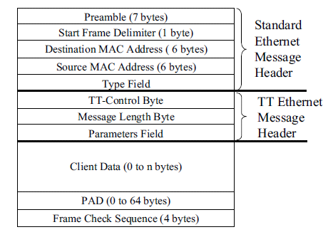
TT Ethernet Message Format
Since message type name is part of a TT message, host connected to COTS Ethernet controller can process message

Slide 20
Message Categories
ET Message
Handled in full conformance with IEEE Ethernet standard
Free-Form TT message
ET messages in the way of FFTT message will be preempted
Used in systems without clock synchronization
TT startup message
Initial synchronization, setup of startup phase
TT synchronization message
Maintain clock synchronization during operational phase
Unprotected TT message
Not protected by a guardian; intended for multimedia applications
Protected TT message
Protected by guardians; intended for safety-critical applications

Slide 21
Safety-Critical TT Ethernet Systems
Safety-Critical TT Ethernet Controller
Three ports: one to host, two to independent switches
TT message header contains membership vector, period counter, and signature of scheduler
The Guardian
Connected to switch by Ethernet port and set of parallel wires
Parallel wires observe and disable inputs and outputs of switch
Has knowledge of schedule of PTTMs
Fault-Tolerant Clock Synchronization and Startup
Combination of distributed fault-tolerant clock state synchronization algorithms and central rate correction algorithm

Slide 22
TT Ethernet Switch Architecture
Features
Classification of ET and TT packet traffic
Constant, a priori known transmission delay for TT traffic
Memory-less transmission path for TT traffic
Preemption of ET packets
Retransmission of preempted ET packets
ET packet handling according to Ethernet standard
Implementation
Custom board based on Altera EP1C20 FPGA
Eight-port Ethernet PHY transceiver
Exchanged data are Ethernet layer 2 packets

Slide 23
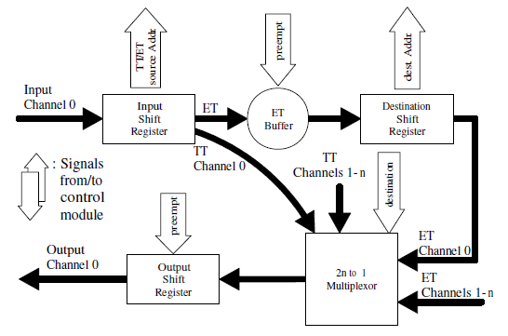
TT Ethernet Switch Functionality
Each TT packet takes same route through FPGA
Supports only 100 Mbit/sec
Field communication systems
Input Shift Register
Extracts source and destination
Length must be less than that of minimum frame length (~26)
ET-Buffer
Three modes
Normal read/write operation
ET preemption or packet collision
Buffer overflow
Multiplexor
Each is connected to all destination shift registers
Control module sets MUX to direct packet to respective output register

Slide 24
TT Ethernet Switch Experiment
Cluster of 4 nodes
Three nodes with TTE Controllers (transmit TT messages)
One node with Ethernet Controller (broadcasts ET messages)
TT Ethernet frames sent periodically
Based on configuration file stored at each node
5 different configurations; TT periods from 7.8 ms to 2 s.
Receiver expects TT message within time interval:
$[t_{arrival}−Π+{prop}_{j}^{i},t_{arrival}+Π+{prop}_{j}^{i}]$
$Π$: precision of global time
${prop}_{j}^{i}$: propagation delay from sender i receiver j
Lost frames are received outside time window
TTE Controller
Implemented on single-board computer “net4801”
Linux OS with real-time application interface (RTAI)

Slide 25
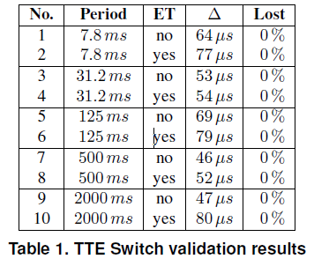
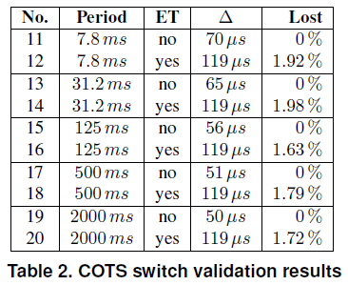
TT Ethernet Switch Results
Data gathered for 20 runs, 33000 TT messages
Δ: maximum difference between expected and actual frame arrival time
Experimental Results
TTE Switch showed no frame loss and lower Δ than that of COTS switch
COTS Switch showed frame loss for ET messages and higher Δ than TTE

Slide 26
Conclusion and Opportunities
Conclusion
Time-Triggered Ethernet Design
TTE is a unified communication architecture for non-real-time and real-time apps
Unification makes system design less costly
Time-Triggered Ethernet Switch
Transmission delays and jitter for COTS switch not satisfactory
Preemption enables constant TT transmission delay and bounded jitter
Opportunities
Results from TTE Design Paper
Group was currently implementing design on FPGA modules
Switch validation results for a safety-critical TTE configuration
Results were for a standard configuration
Reliability estimates would be useful for evaluating fault-tolerance

Slide 27
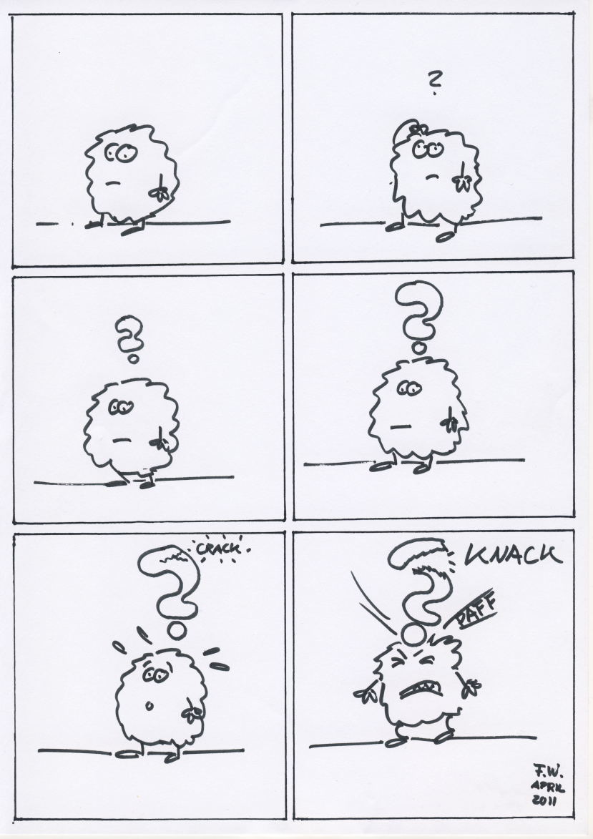
Questions?

