Slide 1

Embedded Systems & Wireless Networks
Alen Cruz
Cyril Kurien
Sal Torre

Slide 2
Embedded Systems & Sensors in Wireless Networks
Anna Hać
University of Hawaii at Manoa

Slide 3
Wireless Sensor Networks
System consisting of hundreds or even thousands of nodes which use sensors & wireless capabilities to operate autonomously, cooperatively, & efficiently to gather & communicate data
Each node includes:
Microcontroller
Battery
Sensor(s)
Wireless Modem

Slide 4
System Design Challenges
Energy*
Sensory Perception
Comm.*
Security
Cost
Packaging & Portability

Slide 5
Energy Consumption
The most substantial challenge
As nodes run out of power, connectivity decreases, the network partitions and will eventually become dysfunctional
Use scalability of energy consumption:
  Available resources
  Event frequency
  Output quality

Slide 6

Power-Aware Sensors
Combines software that is capable of energy-quality tradeoffs and hardware that can scale energy consumption

Slide 7
Communication Protocols
RF (Radio Frequency)
Bluetooth
UWB (Ultra-Wideband) → Wireless USB
NFC (Near-Field Communication) – (RFID compatible)
Zigbee (IEEE 802.15.4)*
WiFi (IEEE 802.11x)
WiMax (IEEE 802.16x)
Infrared

Slide 8

TinyOS
Operating system & platform for wireless sensor embedded devices
  Free
  Open-source (written in nesC)
  U of California – Berkeley & Intel
  www.tinyos.net
  Initial release: 2000

Slide 9
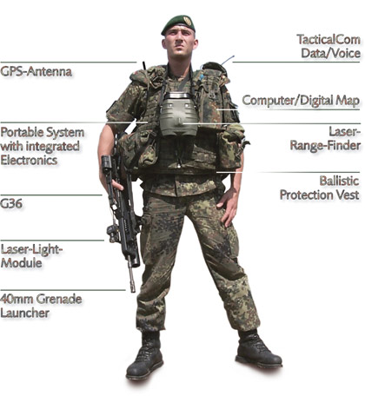
Applications
Healthcare
Heart rate
Blood Pressure
Environmental
Regional temperatures
Weather conditions
Military*
Squad Clustering
Surveillance
Detection
Civil
Monitoring roads/bridges
Traffic control

Slide 11
Accurate Prediction of Power Consumption in Sensor Networks.
By Olaf Landsiedel, Klaus Wehrle, Stefan Gotz.
From Protocol Engineering and Distributed Systems Group
At University of Tubingen, Germany

Slide 12
Uh oh!
Throughout the paper the authors use power and energy interchangeably.
Example:
“…we present AEON (Accurate Prediction of Power Consumption), a novel evaluation tool to predict energy consumption…”

Slide 13
Paper Overview
Authors present AEON- Accurate Prediction of Power Consumption.
Designed for use with sensor nodes and entire sensor networks.
Works by profiling both hardware components (CPU, radio, sensors, etc…) and software components (OS, Route, Communication, etc…).

Slide 14
Presentation Overview
Where it fits in context of sensor nodes:

Slide 15

Presentation Overview Cnt.
Related Work
AEON’s Energy Model
TinyOS & Applications
Energy Profiling
Conclusions & Future Work

Slide 16
Related Work
Most software energy models based on transmitted packets and CPU cycles.
Most hardware profiling tools focus on components of traditional CPUs, e.g. memory, cache, etc…
Power Tossim targets sensor nodes but hardware abstraction results in poor energy consumption prediction.
AEON attempts to cover all these shortfalls.

Slide 17
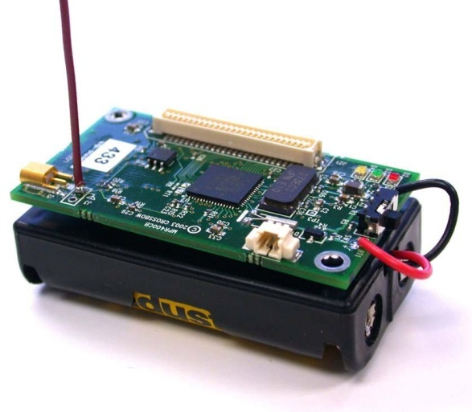
AEON’s Energy Model
Modeling energy consumption of Mica2 platform.
Measured current draw of each state of all component.
Consumption implemented in AVRORA sensor node simulator.
Model validated with use of oscilloscope and battery lifetime tests.

Slide 18
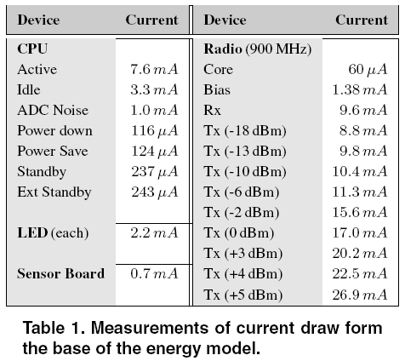
AEON’s Energy Model Cnt.

Slide 19
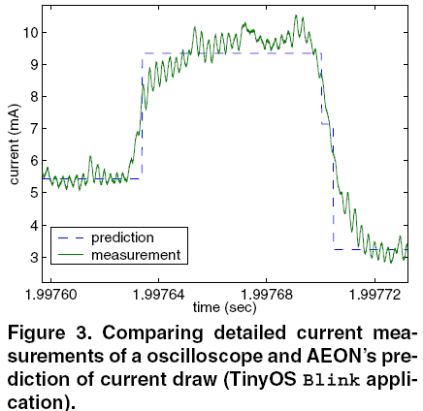
AEON’s Energy Model Cnt.

Slide 20
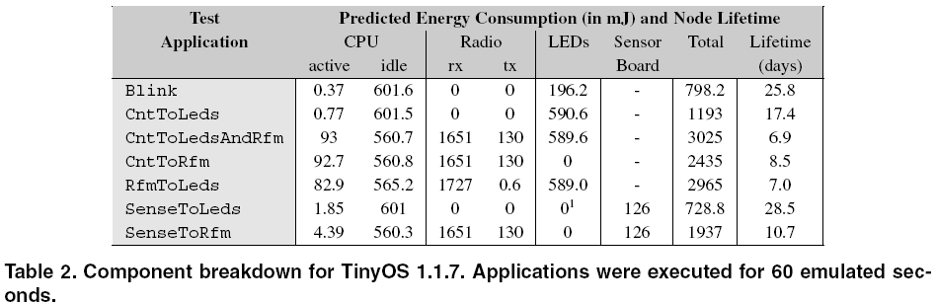
TinyOS and Applications
Previously built model used to evaluate efficiency of sensor node applications and operating system.
Helpful tool for developers to fine-tune applications based on energy efficiency.

Slide 21
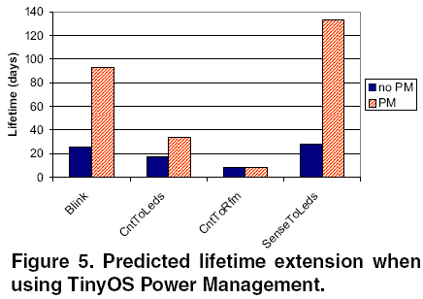
TinyOS and Applications Cnt.
AEON also analyzed different Low Power Listening Modes of TinyOS and TinyOS Power Management.

Slide 22
Energy Profiling
Breaks down energy consumption into individual routines and blocks of source code.
Done by mapping source code function to corresponding object code addresses and all functions are logged during program execution.
Determined five major components:
  High Level Communication: Packet handling, queuing, radio modes.
  Low Level Communication: SPI data transfer.
  Operating System
  Routing
  Sensing

Slide 23
Energy Profiling Cnt.
Surge is a program for displaying routing topology in sensor networks.

Slide 24
Conclusion and Future Work
No breakthroughs expected in battery technology in near future thus energy still limiting factor.
Therefore truly accurate evaluation of energy consumption and lifetime is crucial – AEON can provide this.
Future work will expand on AEON to improve sensor models and analysis of network reprogramming tools.

Slide 26
Performance Analysis of IEEE 802.15.4 and ZigBee for Large-Scale Wireless Sensor Network Applications
Mikko Kohvakka, Mauri Kuorilehto, Marko Hännikäinen, Timo D. Hämäläinen
Tampere University of Technology Institute of Digital & Computer Systems, Finland

Slide 27
Wireless Sensor Networks (WSN)
Defined as:
  “fully autonomous self-configuring ad-hoc networks… WSNs consist of thousands of tiny and very energy constrained nodes, which communicate wirelessly with each other, sense their environment, and share collaborative tasks”

Slide 28
Why the need for a special communication protocol?
Large number of nodes (potentially hundreds to thousands)
Frequent battery replacements are difficult
  Thus, the network lifetime should be on the order of years

Slide 29
IEEE 802.15.4
Developed by Wireless Personal Area Networks (WPAN) Working Group and released in December of 2000.
Physical (PHY) & MAC layers
Provides:
  Low-complexity
  Low-cost
  Low-power
  Low-data rate
Notes:
Based on bluetooth

Slide 30
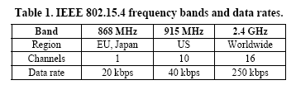
IEEE 802.15.4
May operate in 3 possible frequency bands
2.4 GHz is the most popular

Slide 31

ZigBee
Developed by the ZigBee Alliance and released in December 2004.
ZigBee is an open specification intended for low-power wireless networking
Complements IEEE 802.15.4 because of
  Network & security layers & application profiles
Packet freshness timers
128-bit Advanced Encryption Standard (AES)

Slide 32
Routing
Reactive Routing Protocols (RRP)
  Energy Aware Routing (EAR)
  Routing information is setup only on demand and maintained as long as it is needed → eliminates permanent routing tables
  Consumers of data (sinks) initiate route discovery

Slide 33
Medium Access Control (MAC) Layer
Non-beacon enabled
Simple CSMA with Collision Avoidance
Requires constant perception of incoming data
Beacon enabled
Exhibits power-saving features

Slide 34
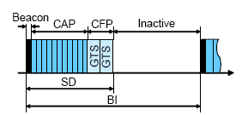
Beacon-enabled Mode
All communications take the form of a superframe structure:
  Periodically transmitted beacon frames allow nodes to synchronize to the network
  16 time slots form 3 parts:
    The beacon
    Contention Access Period (CAP)
    Contention-Free Period (CFP)
  Nodes enter sleep mode after each superframe

Slide 35
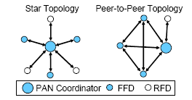
Network Topology

Slide 36
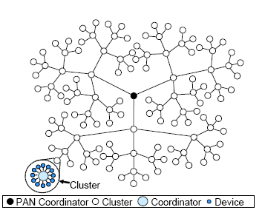
Network “Cluster-Tree” Topology

Slide 37
Node Designations
The superframe structure is maintained by the PAN coordinator
All coordinators may transmit beacons to maintain synchronization with their children

Slide 38
Clustering
Topology Discovery Algorithm
Selects set of nodes as cluster heads
Constructs reachability map
Logically organizes the network in the form of clusters
A tree of clusters are rooted at the monitoring node (coordinator)
Notes:
The PAN coordinator manages the superframe

Slide 39
Contention Access Period
Coordinators must ‘listen’ to the channel for the entire CAP to detect and receive data from their children
Child nodes may only transmit data and receive optional ACKs
  This increases their energy efficiency

Slide 40
Contention Access Period:
Hidden Node Collisions
The protocol is prone to this flaw:
  2 nodes outside the range of each other are transmitting data to a common coordinator
•
•
•

Slide 41
Contention Free Period
Optional feature that allows nodes to reserve bandwidth for delay critical applications by requesting a GTS time slot from the PAN coordinator
Provides better QoS in star topologies but poor service in mesh topologies

Slide 42
Battery Life Extension
Option to reduce coordinator energy consumption
  Allows the coordinator to sleep through a CAP during backoff periods to save energy
    Backoff periods happen during collisions

Slide 43

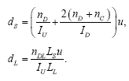


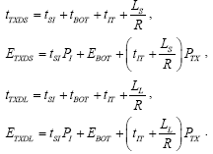

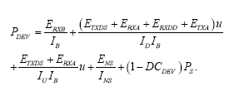



Analysis

Slide 44
Conclusions
Minimum device power consumption is as low as 73 µW when the beacon interval is 3.93s & uplink data is transmitted at 4 min intervals
Coordinator goodput is 34.4 bits/s
Coordinator power consumption 370 µW

Slide 46
Shooter Localization and Weapon Classification with
Soldier-Wearable Networked Sensors
Peter Volgyesi, Gyorgy Balogh, Andras Nadas, Christopher B. Nash, Akos Ledeczi
Institute for Software Integrated Systems, Vanderbilt University

Slide 47
Overview
Introduction
High-Level Architecture
Hardware Implementation
Effectiveness
Software Implementation
Detection Algorithm
Sensor Fusion

Slide 48
Introduction
Problem: sniping
Not new problem in war, but a technique insurgents have been using in Iraq
Authors introduced first sniper localization system, PinPtr in 2003
Different system deployed in Iraq currently
Paper focuses on its successor

Slide 49
Introduction
Snipers hide themselves
Hard for humans to quickly and accurately locate point of origin
Track by sound/pressure, sight

Slide 50
High-Level Solution
Multiple microphones pick up gunshot and record time of arrival
If 3-4 mics pick it up, record angle of arrival
Share this information plus the sensor’s location and orientation
External device aggregates data to locate shooter (sensor fusion algorithm)

Slide 51
High-Level Solution

Slide 52
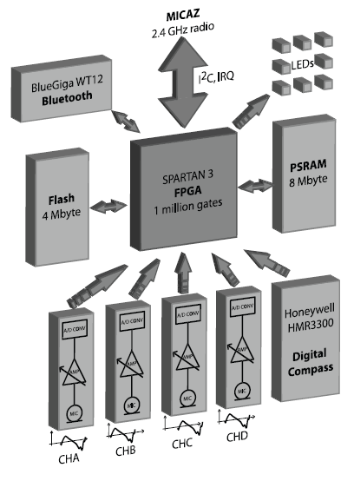
Hardware
COTS products
FPGA: Xilinx XC3S1000
Memory: 4MB Flash, 8 MB SRAM
Compass: Honeywell HMR3300
Bluetooth Transceiver: BlueGiga WT12
Microphone Interface: Analog Devices AD7476
Microphone: Panasonic WM-64PNT
WSN Interface: Crossbow MICAz

Slide 53
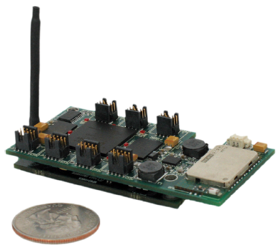
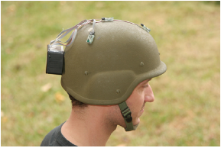
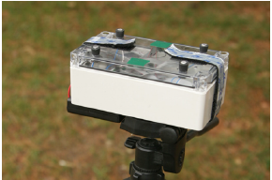
Hardware Realization

Slide 54
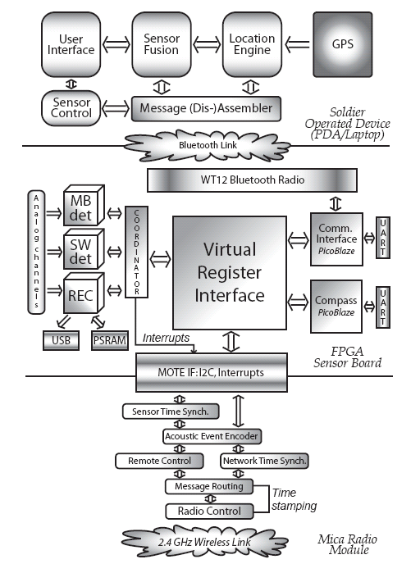
Software
Three subsystems, totally different implementations and paradigms
Challenge to implement and integrate

Slide 55
Software (Soldier Operated Device)
Target: PDA/laptop
Written in Java
Contains UI and sensor fusion software
Sends feedback to signal processing cores

Slide 56
Software (Sensor Board)
Target: FPGA
Written in VHDL/assembly
Acoustic sensing
Signal processing
Bridges communication

Slide 57
Software (Sensor Board)
Virtual register file
Dedicated DAQ/signal processing for each channel
FPGA runs at 20 MHz, uses 40% of slices, can safely run at 30 MHz

Slide 58
Software (Sensor Board)
Hard/soft cores
Soft cores actually execute true software programs
PicoBlaze cores (test/debug, compass data parsing) can be attached to any connection

Slide 59
Software (Radio Module)
Target: MICAz module, based on Atmel ATMega128L
Written in nesC for TinyOS

Slide 60
Software (Radio Module)
Robust MAC layer (802.15.4)
Needed to implement a routing service – Directed Flood Routing Framework (DFRF)
Needed to implement a synchronization protocol – Routing Integrated Time Synchronization (RITS)

Slide 61
Detection Algorithm
Needed to implement an algorithm for the FPGA to detect gunshot
Designed in Java using prerecorded signals, ported to VHDL and synthesized
Functional equivalence tested using test benches and automated scripts

Slide 62
Sensor Fusion
Process of combining data to provide more meaningful information
Algorithm is hierarchical
Nodes:
  Compute blast/shockwave direction of arrival
Soldier Operated Device:
  Compute range estimates
  Compute single trajectory
  Compute final range estimate
  Compute caliber
  Compute weapon type

Slide 63
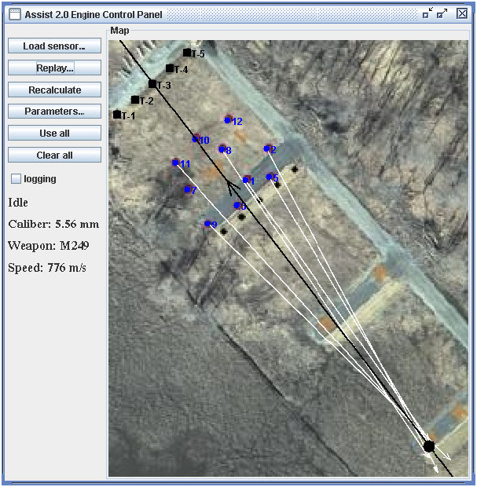
Effectiveness
10 sensor nodes
30 m x 30 m area
Shooters at 50 m, 100 m, 200 m, 300 m
Six weapon types
How effective was the system?

Slide 64
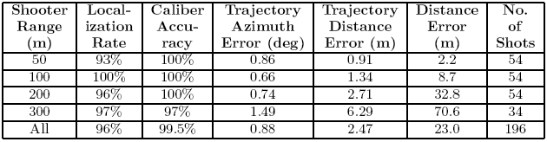
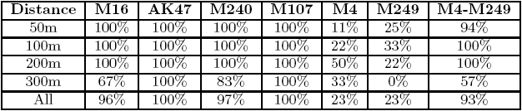
Effectiveness
Ambiguity
Poorer estimation of longer shots
Poor estimation of two guns

Slide 65

Questions?

