Slide 1
Wireless Sensor Networks:
A Survey
Arslan Munir
EEL 6935

Slide 2
Outline
Introduction
Wireless Sensor Networks Applications
Factors Influencing Sensor Network Design
Sensor Node Components
Sensor Networks Communication Architecture
Sensor Network Protocols
Sensor Networks Operating Systems
Sensor Networks Simulators
Conclusion

Slide 3
Introduction
sensor
  A transducer
  converts physical phenomenon e.g. heat, light, motion, vibration, and sound into electrical signals
sensor node
  basic unit in sensor network
  contains on-board sensors, processor, memory, transceiver, and power supply
sensor network
  consists of a large number of sensor nodes
  nodes deployed either inside or very close to the sensed phenomenon

Slide 4
Wireless Sensor Networks Applications
Military Applications
Monitoring friendly forces, equipment, and ammunition
Battlefield surveillance
Reconnaissance of opposing forces and terrain
Targeting
Battle damage assessment
Nuclear, biological, and chemical attack detection

Slide 5
Wireless Sensor Networks Applications
Environmental Applications
Forest fire detection
Bio-complexity mapping of environment
Flood detection
Precision Agriculture
Air and water pollution

Slide 6
Wireless Sensor Networks Applications
Health Applications
Telemonitoring of human physiological data
Tracking and monitoring doctors and patients inside a hospital
Drug administration in hospitals

Slide 7
Wireless Sensor Networks Applications
Home and Office Applications
Home and office automation
Smart environment

Slide 8
Wireless Sensor Networks Applications
Automotive Applications
Reduces wiring effects
Measurements in chambers and rotating parts
Remote technical inspections
Conditions monitoring e.g. at a bearing

Slide 9
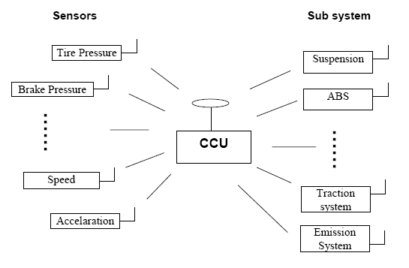
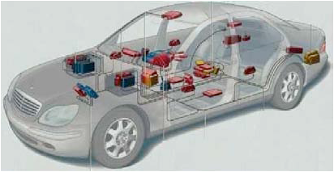
Wireless Sensor Networks Applications
Automotive Applications

Slide 10
Wireless Sensor Networks Applications
Other Commercial Applications
Environmental control in office buildings (estimated energy savings $55 billion per year!)
Interactive museums
Detecting and monitoring car thefts
Managing inventory control
Vehicle tracking and detection

Slide 11
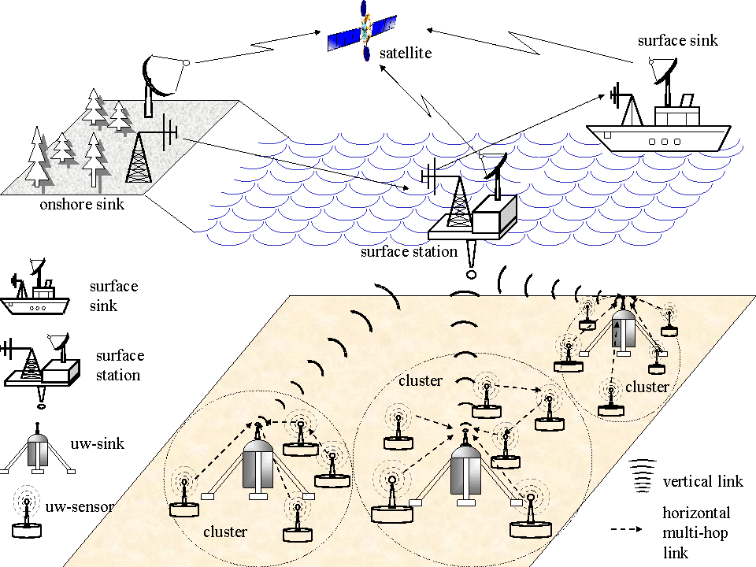
Underwater Acoustic Sensor Networks ref. Georgia Institute of Technology

Slide 12
Factors Influencing WSN Design
Fault tolerance
Scalability
Production costs
Hardware constraints
Sensor network topology
Environment
Transmission media
Power Consumption
  Sensing
  Communication
  Data processing

Slide 13
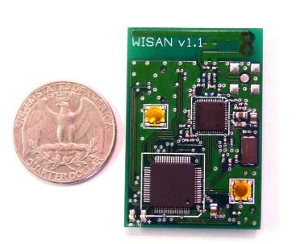
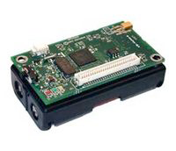
Sensor Nodes
Worldsens Inc. Sensor Node
Crossbow Sensor Node

Slide 14
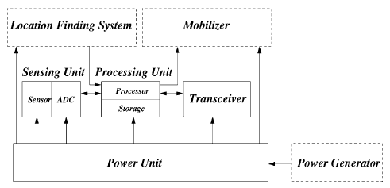
Sensor Node Components

Slide 15
Sensor Node Components
Sensing Unit
Processing Unit
Transceiver Unit
Power Unit
Location Finding System (optional)
Power Generator (optional)
Mobilizer (optional)

Slide 16
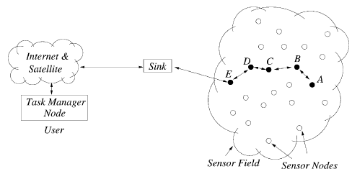
WSN Communication Architecture

Slide 17
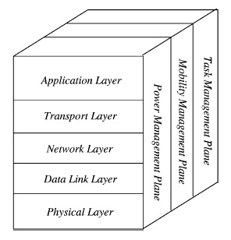
WSN Protocol Stack

Slide 18
A Few WSN Protocols
Sensor management protocol
  Provides software operations needed to perform administrative tasks e.g. moving sensor nodes, turning them on an off
Sensor query and data dissemination protocol
  Provides user applications with interfaces to issue queries and respond to queries
  Sensor query and tasking language (SQTL)
Directed diffusion
Sensor MAC (S-MAC)
IEEE 802.15.4

Slide 19
Data-Centric Routing
Interest dissemination is performed to assign sensing tasks to sensor nodes
  Sinks broadcast the interest
  Sensor nodes broadcast an advertisement for available data
Requires attribute-based naming
  Users are more interested in querying the attribute of the phenomenon, rather than querying an individual node
  E.g. the sensor nodes in the area where temperature is greater than 75 F

Slide 20
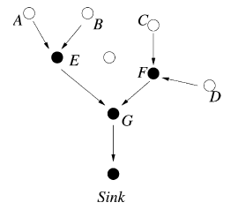
Data Aggregation in WSNs
Data coming from multiple sensor nodes are aggregated if they are about the same attribute of the phenomenon when they reach the same routing node on the way back to the sink
  Solves implosion and overlap problem
  Energy efficient

Slide 21
WSN Operating Systems
TinyOS
Contiki
MANTIS
BTnut
SOS
Nano-RK

Slide 22
TinyOS
Event-driven programming model instead of multithreading
TinyOS and its programs written in nesC
Main (includes Scheduler)
Application (User Components)
Actuating
Sensing
Communication
Communication
Hardware Abstractions

Slide 23
TinyOS Charactersitics
Small memory footprint
  non-preemptable FIFO task scheduling
Power Efficient
  Puts microcontroller to sleep
  Puts radio to sleep
Concurrency-Intensive Operations
  Event-driven architecture
  Efficient Interrupts and event handling
No Real-time guarantees

Slide 24
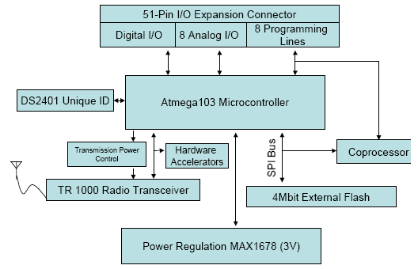
MICA Sensor Mote

Slide 25
MICA Mote Specifications
4 MHz ATMEGA103L Microprocessor
128 KB of Flash Program Memory
4KB RAM
10 bit Analog to Digital Converter (ADC)
3 Hardware Timers
Serial Peripheral Interface (SPI) bus
External UART
A coprocessor AT90LS2343 (to handle wireless reprogramming)
DS2401 silicon serial number (provides unique ID to nodes)
RF Monolithics TR1000 transceiver
External 4Mbit Atmel AT45DB041B Serial Flash Chip (for persistent data storage)
Maxim1678 DC-DC Converter (provides a constant 3.0 V supply)

Slide 26
Smart Dust Mote Specifications
4 MHz Atmel AVR 8535 Microprocessor
8 KB Instruction Flash Memory
512 Bytes RAM
512 Bytes EEPROM
Total Stored Energy approx. 1 Joule
TinyOS Operating System (OS) with 3500 bytes OS code space and 4500 bytes available code space

Slide 27
WSN Development Platforms
Crossbow
Dust Networks
Sensoria Corporation
Ember Corporation
Worldsens

Slide 28
WSN Simulators
NS-2
GloMoSim
OPNET
SensorSim
J-Sim
OMNeT++
Sidh
SENS

Slide 29
WSN Emulators
TOSSIM
ATEMU
Avrora
EmStar

Slide 30
Conclusion
WSNs possible today due to technological advancement in various domains
Envisioned to become an essential part of our lives
Design Constraints need to be satisfied for realization of sensor networks
Tremendous research efforts being made in different layers of WSNs protocol stack

Slide 31
References
I. F. Akyildiz, W. Su, Y. Sankarasubramaniam, and E. Cayirci, “Wireless Sensor Networks: A Survey”, Elsevier Computer Networks, volume 38, Issue 4, pp. 393-422, March 2002.
Dr. Victor Leung, Lecture Slides on “Wireless Sensor Networks”, University of British Columbia, Canada
D. Curren, “A Survey of Simulation in Sensor Networks”
Wikipedia, [Available Online] http://en.wikipedia.org/wiki/Wireless_Sensor_Networks

Slide 32
References
Dr. Chenyang Lu Slides on “Berkeley Motes and TinyOS”, Washington University in St. Louis, USA
J. Hill and D. Culler, “A Wireless Embedded Sensor Architecture for System-Level Optimization”, Technical Report, U.C. Berkeley, 2001.
X. Su, B.S. Prabhu, and R. Gadh, “RFID based General Wireless Sensor Interface”, Technical Report, UCLA, 2003.

Slide 33
Thank you!

