Slide 1
Occupant Classification System for Automotive Airbag Suppression
A.Jaffer Sharief
EEL 6935

Slide 2
Agenda
Introduction to Airbag Systems
Classification and Detection Challenges.
Occupant Classification in an Embedded System.
Design considerations.
Occupant Classification System in Action.
Conclusion

Slide 3
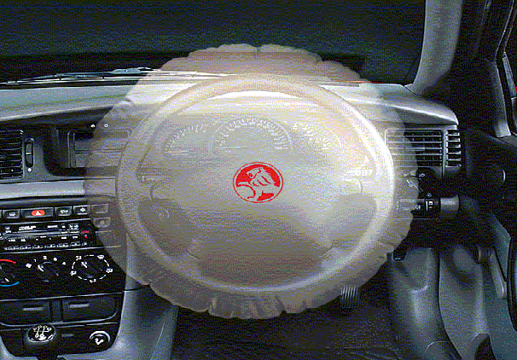
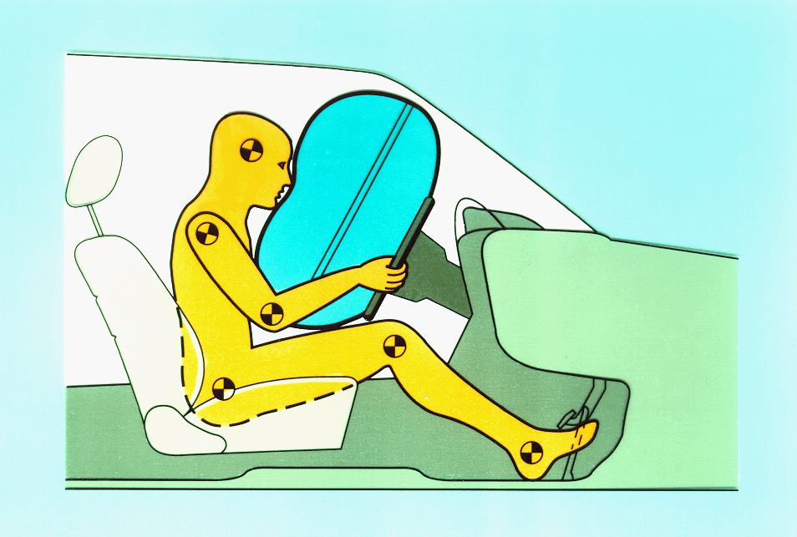
What is Airbags system ?
Airbags Control System is a passive restraint system which determines crashes and deploys Airbags, thus preventing loss of human life in crash situations.

Slide 4
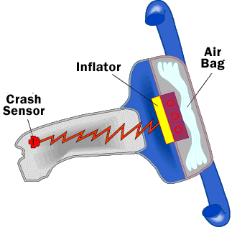
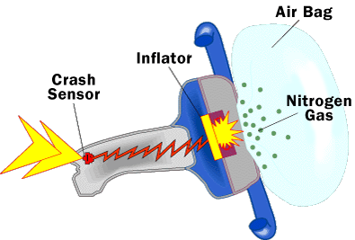
Working of Airbags
There are three parts to an airbag system :
The Airbag, made of a thin, nylon fabric,
which is folded into the steering wheel.
The Sensor, the device that tells
the bag to inflate.
A rapid pulse of Nitrogen Gas, which
is used to inflate the airbag.

Slide 5
Why is Classification needed?
Between 1987 and 2000, 6553 lives were saved by the airbags in US alone.
But …
85 children and 19 infants in Rear Facing Infant Seats (RFIS).
NHTSA mandates automatic airbag suppression when child or RFIS present.
Source: National Highway Transportation and Safety Administration (NHTSA)

Slide 6
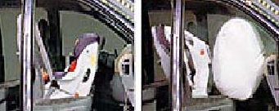
RFIS during airbag deployment:
RFIS before deployment RFIS after deployment

Slide 7
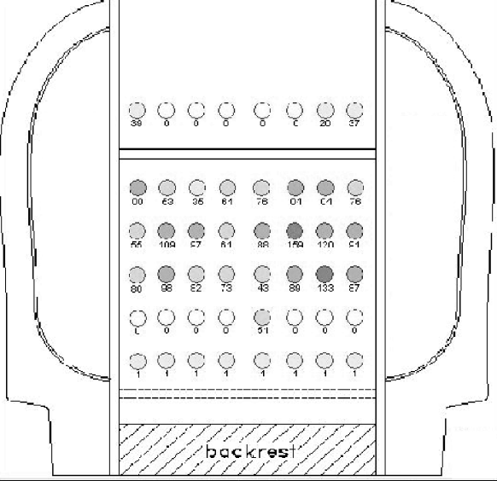
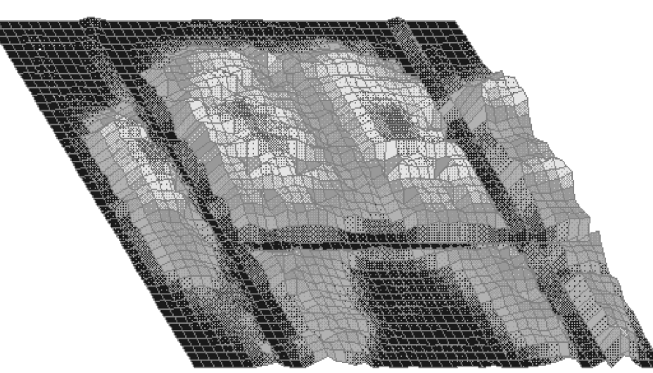
Approach 1: Weight Sensing
Seat Mat
Weight Pattern
Source: New generation BMW child seat and Occupant Detection Systems

Slide 8
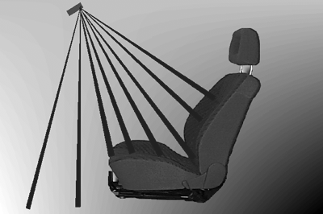
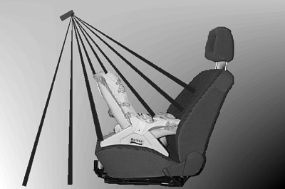
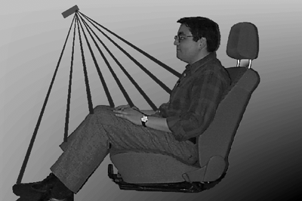
Approach 2: Computer Vision
Classes of Occupancy
Empty RFIS or Child Adult

Slide 9
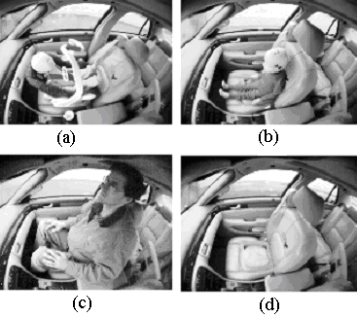
Challenges for Computer Vision
Inter-Class Variability

Slide 10
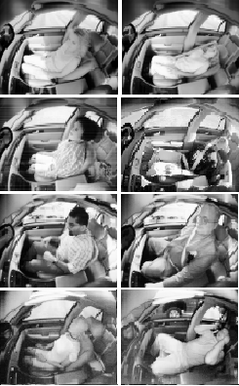
Challenges for Computer Vision
Inter-Class Variability
Light Levels ( day to night)
Seating Positions
Shadows and bright spots in same image due to motion.

Slide 11
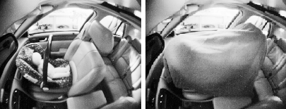
Challenges for Computer Vision
Intra-Class Variability
RFIS RFIS under blanket

Slide 12
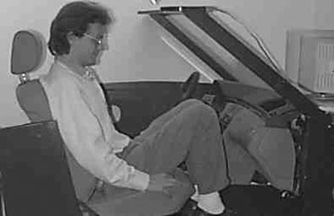
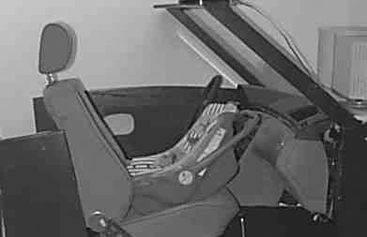
Challenges for Computer Vision
Inter-Class Similarity:
Two different classes showing about the same pattern

Slide 13
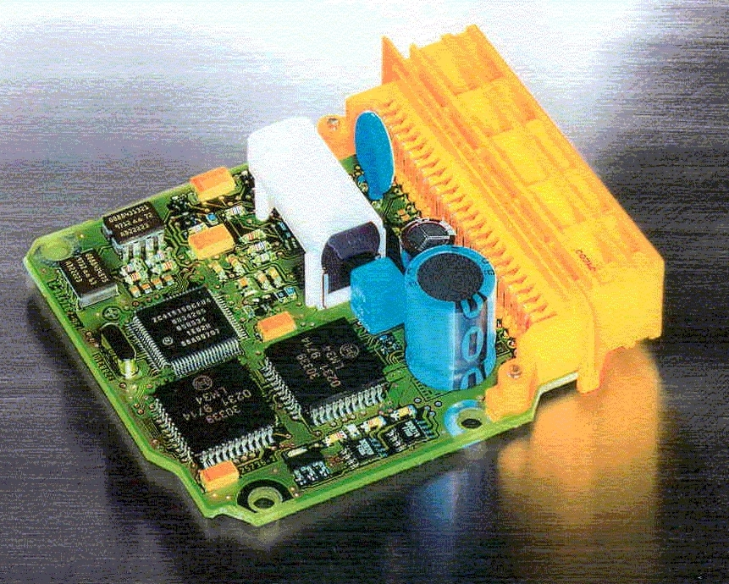
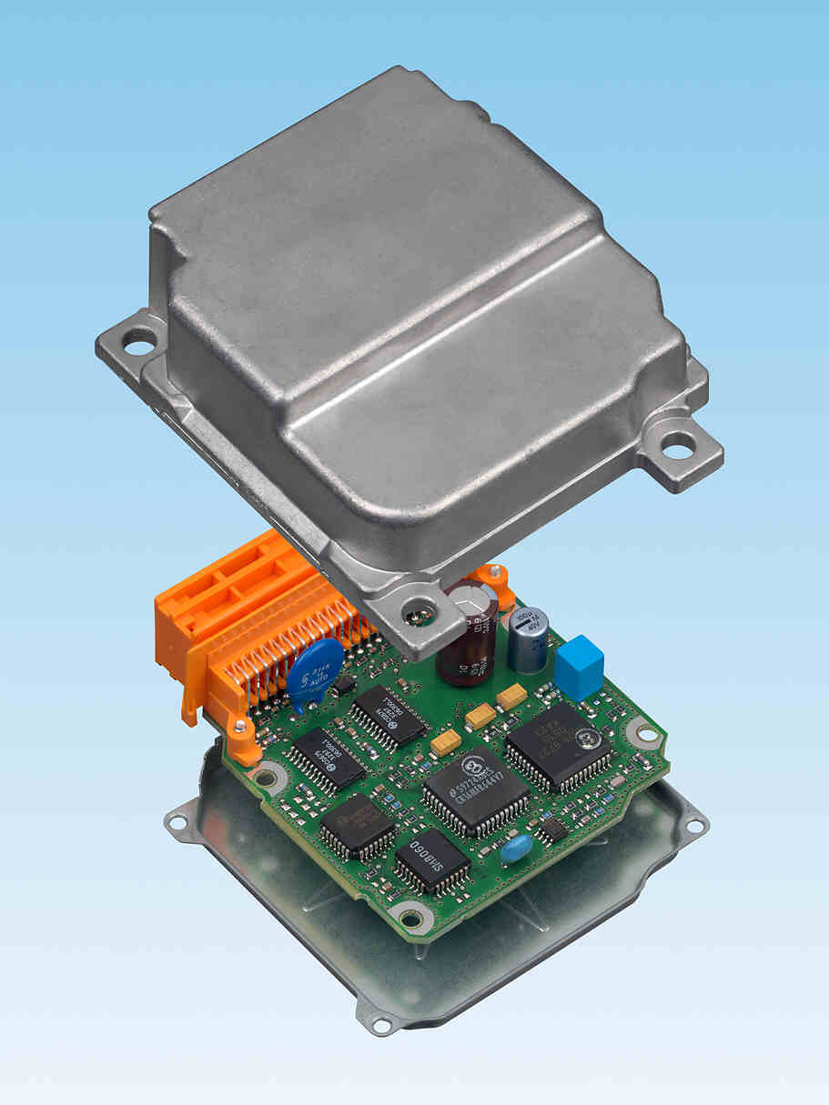
System Requirements
Real-Time Operation
Very Reliable
Compact
Low Power
Source: BOSCH Automotive

Slide 14
Architecture of the Occupant Classification System
Sensors
Electronic Control Unit (ECU)
Actuators
Front Airbag
Single Grey Scale Camera
Side Airbag
ASIC
DSP
μC
FLIC
Curtain Airbags
Belt
Pretensioner
I2C
Efficient
High Performance
CAN
Low Cost
High Reliability

Slide 15
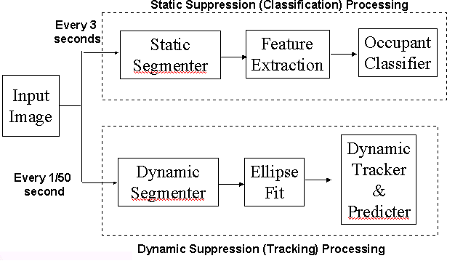
System Design

Slide 16
System Algorithm in Action
Edge Detection Algorithm
Eclipse Fit
Feature Extraction
Dynamic Tracking
Accurate Prediction

Slide 17
Conclusion
High Accuracy in detection and classification.
Can be scaled for new features such as face recognition and drowsiness alert systems.
Achieves quick time to market.
Very Robust and Real-time classification.

Slide 18
Questions ?

Slide 19
Thank you!

