Slide 1
M. Alsafrjalani D. Dzenitis
Partial Reconfiguration (PR)
Runtime PR for Software Radio

Slide 2
Outline
Introduction
PR in FPGA
Case Study
Conclusion

Slide 3
Introduction
Current trend:
FPGA’s are replacing ASICs
Lower cost, rapid development time
Offer reconfigurable computing (RC) as needed
Offers static and dynamic RC approaches
Challenge
Can we reduce the size of the device using RC?
Can we save on power?

Slide 4
Introduction Contd.
Yes!
Partial reconfiguration (PR) offers that flexibility
Save space:
One space required to provide multiple functionalities
Save power:
Unnecessarily unit is not used unless is configured!
What about adaptive allocation?
Still need the resource before allocating it
PR uses the same resource for different functionalities

Slide 5
Advantages of PR
Saves area
Swaps accelerators as needed or transmit/receiver, for instance
Saves power
Less resources idle = less power consumption
Faster than current technologies
Partial RC vs. Full RC
The remainder of the FPGA still runs without interruption

Slide 6
PR in Software Radio
Communication parameters are defined at runtime
Possess a multitude of function blocks that are always available to handle the bandwidth of the channel
But all functions on the same device is not feasible
FPGA is a natural approach
Via PR, functionality of a specific block is changed while remainder blocks are still functioning

Slide 7
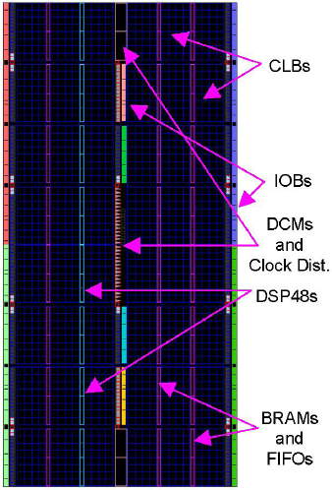
FPGA’s Structure Virtex 4
CLBs: configurable logic blocks
BRAMs: block random access memories
FIFO: first-in first-out buffers
DCMs: digital clock managers
DSP48s are Xilinx's digital signal processing units
IOBs are input-output buffers.

Slide 8
FPGA Structure Contd.
The FPGA is configured by writing bits to its configuration memory (CM)
The configuration data is organized into frames that target specific areas of the FPGA through frame addresses
When using PR, the partial bitstreams will contain configuration data for a whole frame if any portion of that frame is to be reconfigured

Slide 9
PR Speed
Depends on the size to be PR’ed
Old Virtex-4 allow only whole column PR
partial bitstreams are significantly larger
New ones allow arbitrarily shaped PR
Depends on the port:
The serial, JTAG (Joint Test Action Group; and IEEE standard), SelectMap, or ICAP (internal configuration access) ports
Metric used is uSec/Frame:
Frame is a 41 32-bit words
PR addressing overhead is about 10% and ignored in calculation
Other factors:
Implementation, target device, and source location

Slide 10
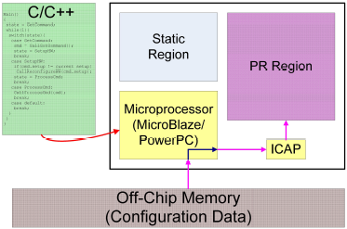
PR using uController
Eliminate the need for an external controller (PC)
Autonomous process
IBM power PC
Hard processor cores (additional to the SW ones)
Provide ability to process C/C++
Embedded on the Virtex boards
Desired conf. are loaded from external MEM
Events, such as detection of a signal, triggers PR

Slide 11
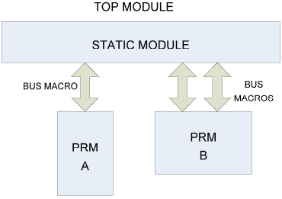
PR Design Hierarchy
Top module: static and partially reconfigurable sub-modules, SM and PRM, respectively
Communications must be declared using an 8-bit bus macros provided by Xilinx
PRM rest in the top module: any communication to lower, deep modules requires more routings

Slide 12
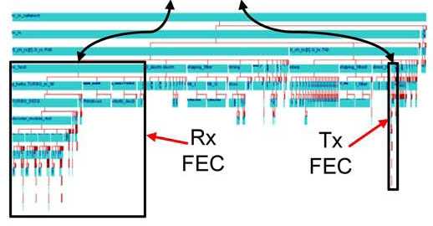
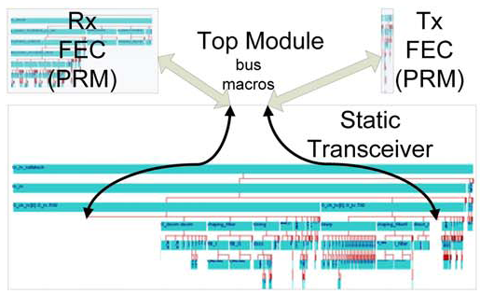
Before PR, static modules, fixed, less communication
PR, PRM modules are in top level; any replication/requirement of such module by the low level module will require communicating with top levels

Slide 13
PR Software Support
Initially, very little software support
Goal is to ease it and automate the process of generating PR designs
Xilinx:
Provides Early Access that works with PlanAhead (floor planner)
ISE tool is modified for PR
Automated command line: low-level details were previously was the responsibility of the user
PlanAhead provides info on available resources and statistics on utilization (helps in floor planning stage)

Slide 14
Real-World Applications of PR
Simplex Spread-Spectrum Transceiver
Dynamic Bandwidth Resource Allocation
Cognitive Radio
Hardware Acceleration For SDR
And many others not covered in this paper…

Slide 15
Simplex Spread-Spectrum Transceiver
Due to simplex communication, transmit and receive operations never occur simultaneously
DSSS (Direct Sequence Spread Spectrum) Demodulator only needed in the beginning during the code acquisition phase
Rx FEC Decoder Needed During Receive Operations
Tx FEC Encode Needed During Send Operations

Slide 16
Simplex Spread-Spectrum Transceiver
PR Approach With 2 PRRs (Partially Reconfigurable Regions):
First region can host both the send and receive modulators since they aren’t needed at the same time

Slide 17
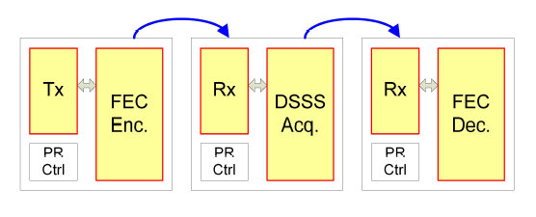
Simplex Spread Spectrum Transceiver
Second Region Can Host The DSSS Demodulator, Receive FEC Decoder, And Transmit FEC Encoder

Slide 18
Dynamic Bandwidth Resource Allocation (DBRA)
Used for controlling QoS on Networks
PR approach can take advantage of two situations:
When the SNR drops below a certain level and/or the bit error rate gets to high
When the SNR is high and throughput can be increased
Since these situations are mutually exclusive, their associated FUs can reside in the same PRR

Slide 19
Dynamic Bandwidth Resource Allocation (DBRA)
Depending on which situation is encountered, switch modules to either provide more reliable communication, or higher throughput communication
Turbo encoder switched to convolutional and Reed-Solomon encoder
Turbo decoder switched to a Viterbi and Reed-Solomon decoder

Slide 20
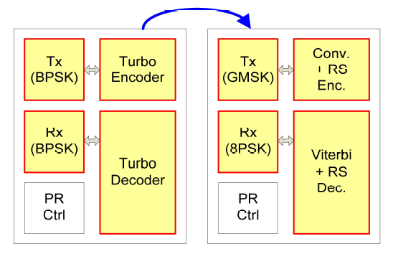
Dynamic Bandwidth Resource Allocation (DBRA)

Slide 21
Cognitive Radio
Operates by constantly scanning the frequency spectrum to detect where the signal is located (via modulation detection)
Once located, receiver begins demodulating
Since the modulation detector and demodulator are never in use at the same time, it’s a great application for PR

Slide 22
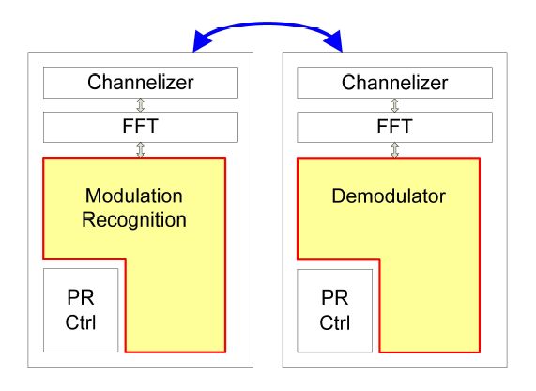
Cognitive Radio

Slide 23
Hardware Acceleration (SDR)
Modern FEC codes can be computationally intensive
Some SDR functions can’t even run on a general purpose processor
By using PR, can have hardware accelerators loaded as necessary depending on the channel being used
While reconfiguration is being performed, store received data in buffers

Slide 24
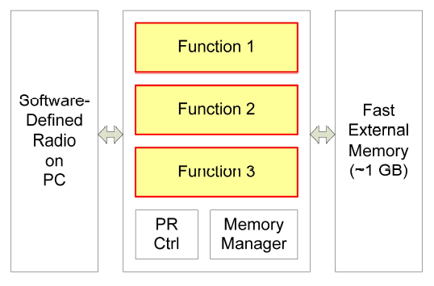
Hardware Acceleration (SDR)

Slide 25
References
E. J. McDonald, Runtime FPGA Partial Reconfiguration
C. Maxfield, The Design Warrior's Guide to FPGAs: Devices, Tools and Flows

Slide 26
Questions

