Slide 1
A Self-Tuning Cache architecture for Embedded Systems
Chuanjun Zhang, Frank Vahid and Roman Lysecky
Presented by: Wei Zang
Mar. 29, 2010

Slide 2
Outline
Introduction
Configurable cache architecture
Associativity: Way concatenation
Cache size: Way shutdown
Line size: line concatenation
Way prediction
Energy Evaluation
Self-tuning strategy
Experiment results
conclusions

Slide 3
Outline
Introduction
Configurable cache architecture
Associativity: Way concatenation
Cache size: Way shutdown
Line size: line concatenation
Way prediction
Energy Evaluation
Self-tuning strategy
Experiment results
conclusions

Slide 4
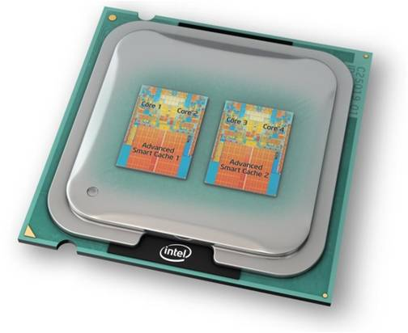
Introduction
Why configure cache?
Caches often consume about half of a microprocessor system’s power
Customized cache can improve performance, reduce power
In embedded systems
An embedded system may execute one application forever
Complicated programs have different cache requirements over time – adapt to program phases
What cache parameters?
Total size
Line size
Associativity

Slide 5
Introduction
Challenges:
Architecture that can configure size, line size and associativity to application
Drawbacks in using simulation to determine the best cache:
Simulation tool setup is very hard
Simulation is extremely slow
Simulation uses a fixed set of input data during execution, cannot capture actual run-time behavior where the data changes dynamically
Drawbacks in exhaustively searching all possible cache configurations:
May involve too many configurations
The number quickly increases when other components within the system are configurable (level2 cache, bus, etc.)
Too many cache flushes, very time and power costly
Propose a method of dynamically tuning cache in efficient manner

Slide 6
Outline
Introduction
Configurable cache architecture
Associativity: Way concatenation
Cache size: Way shutdown
Line size: line concatenation
Way prediction
Energy Evaluation
Self-tuning strategy
Experiment results
conclusions

Slide 7
Associativity: Way Concatenation
tag
2^6 sets
32 bytes
a₃₁ tag address a₁₃ a₁₂ a₁₁ a₁₀ index a₅ a₄ line offset a₀
Trivial area overhead
Configuration circuit
No performance overhead
reg₀
reg₁
c₀
c₁
c₀
c₁
c₂
c₃
index
^{6x64}
^{6x64}
^{6x64}
^{6x64}
c₂
c₃
data array
^{6x64}
^{6x64}
tag address
c₀
c₁
c₂
c₃
line offset
tag part
mux driver
data output
critical path

Slide 8
a₃₁ tag address a₁₃ a₁₂ a₁₁ a₁₀ index a₅ a₄ line offset a₀
Configuration circuit
reg₀
reg₁
c₀
c₁
c₂
c₃
bank1
bank2
bank3
bank4
Reg0 =1; Reg1 =1
Four-way
c0, c1,c2,c3 = 1
All banks are active
Given an address, four banks are selected as four ways, no matter what is a11 or a12

Slide 9
a₃₁ tag address a₁₃ a₁₂ a₁₁ a₁₀ index a₅ a₄ line offset a₀
bank4
Configuration circuit
reg₀
a11 a12
reg₁
c₀
c₁
c₂
c₃
Reg0 =0; Reg1 =0
Direct mapped
C0 = !a11 !a12
C1 = !a11 a12
C2 = a11 !a12
C3 = a11 a12
Concatenate address
bank2
bank1
bank2
bank3
bank4
!a11 a12
bank3
a11 !a12
Given an address, only one bank is selected according to a11 a12:
a11=0, a12=0, select bank1
a11=0, a12=1, select bank3
a11=1, a12=0, select bank2
a11=1, a12=1, select bank4
bank1
!a11 !a12

Slide 10
a₃₁ tag address a₁₃ a₁₂ a₁₁ a₁₀ index a₅ a₄ line offset a₀
Configuration circuit
reg₀
2-ways
reg₁
bank3
bank4
c₀
c₁
c₂
c₃
Reg0 = 0; Reg1 =1
Two-way
C0 = !a11
C1 = !a11
C2 = a11
C3 = a11
concatenate address in two banks
a11
bank1
bank2
bank3
bank4
bank1
bank2
!a11
Given an address, only two banks are selected
according to a11:
a11=0, select bank1 and bank2 to realize 2 ways
a11=1, select bank3 and bank4 to realize 2 ways

Slide 11
Configurable cache architecture
Bitline
Vdd
Bitline
Gated-Vdd
Control
Gnd
W1
W2
W3
W4
W1
W2
W3
W4
One Way
4 physical lines are filled when line size is 64 bytes
16 bytes
Counter
Four Way Set Associative(Base Cache)
Shut down two ways
bus
W1
W2
W3
W4
Way Shut down:
Use sleep transistor method (Powell et. al. ISLPED 2000)
Reduce static power
Reduce dynamic power by accessing fewer ways
Off Chip Memory
Two Way Set Associative
(Zhang et. al. ISVLSI 03)
Line Concatenation
W1
W2
W3
W4
Way prediction unit can be turned on/off.
Direct mapped cache
Way Concatenation

Slide 12
Benefits of a configurable cache
Cfg is for configurable cache tuned to the best configuration for each benchmark
Energy is normalized to the cnv4w32
Average of over 40% memory access energy saving

Slide 13
Outline
Introduction
Configurable cache architecture
Associativity: Way concatenation
Cache size: Way shutdown
Line size: line concatenation
Way prediction
Energy Evaluation
Self-tuning strategy
Experiment results
conclusions

Slide 14
Computing Total Memory-Related Energy
Considers CPU stall energy and off-chip memory energy
Excludes CPU active energy
Thus, represents all memory-related energy
energy_mem = energy_dynamic + energy_static
energy_dynamic = cache_hits * energy_hit + cache_misses * energy_miss
energy_miss = energy_offchip_access + energy_uP_stall + energy_cache_block_fill
energy_static = cycles * energy_static_per_cycle
energy_miss = k_miss_energy * energy_hit
energy_static_per_cycle = k_static * energy_total_per_cycle
(Vary the k’s to account for different system implementations)
Underlined – measured quantities

Slide 15
Outline
Introduction
Configurable cache architecture
Associativity: Way concatenation
Cache size: Way shutdown
Line size: line concatenation
Way prediction
Energy Evaluation
Self-tuning strategy
Experiment results
conclusions

Slide 16
Cache Self-tuning Hardware
Self-tuning method
Incorporates a cache parameter tuner on a SoC platform
Detect the lowest energy dissipation cache parameters
The tuner sits to the side and collects information used to calculate the energy
Mem
Processor
D$
Tuner
I$

Slide 17
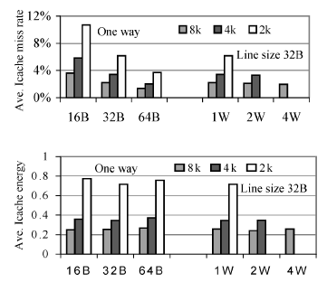
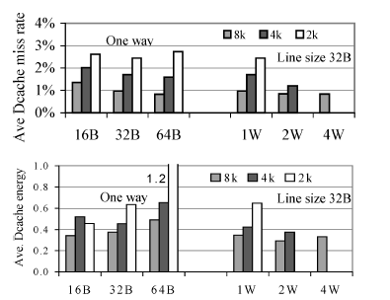
Designing a Search Heuristic: Evaluating Impact of Cache Parameters
Total cache size has the biggest average impact on energy and miss rate
Then cache line size (Data address tend not to have strong spatial locality compared with instruction addresses)
Least impact: associativity

Slide 18
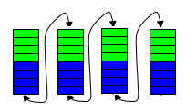
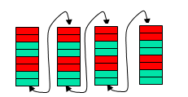
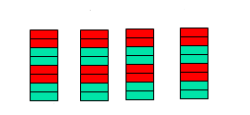
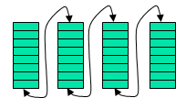
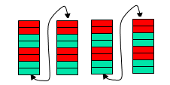
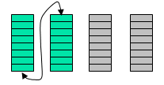
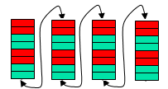
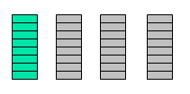
Search heuristic
Initial: 2K_1W_16B, without way prediction
Search cache size from 2K, to 4K to 8K bytes
Search cache line size from 16B to 32B to 64B
Search cache associativity from 1W to 2W to 4W
Decide weather to use way prediction
Time complexity
Search all space: O(m x n x l x p)
Heuristic : O(m + n + l + p)
Search Cache Size
Search Line Size
Search Associativity
Way prediction if more than 1 way
Suppose there are n configurable parameters, each has m values.
Total m^n different combinations
This heuristic only search m*n combinations at most

Slide 19
Outline
Introduction
Configurable cache architecture
Associativity: Way concatenation
Cache size: Way shutdown
Line size: line concatenation
Way prediction
Energy Evaluation
Self-tuning strategy
Experiment results
conclusions

Slide 20
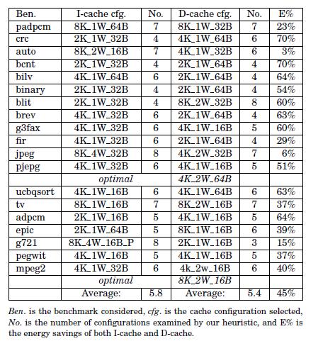
On average 5 searching instead of 27 total searching
2 (mpeg2 and pjpeg) out of 19 benchmarks miss the lowest power cache configuration.

Slide 21
Outline
Introduction
Configurable cache architecture
Associativity: Way concatenation
Cache size: Way shutdown
Line size: line concatenation
Way prediction
Energy Evaluation
Self-tuning strategy
Experiment results
conclusions

Slide 22
Conclusions
A highly configurable cache architecture
Reduces on average 40% of memory access related energy
A self-tuning mechanism is proposed
A special cache parameter explorer
A heuristic algorithm to search the parameter space
Thank you!

