Slide 1
An OBSM method for Real Time Embedded Systems
Veronica Eyo
Sharvari Joshi

Slide 2
What is OBSM?
On Board Software Maintenance
Software maintenance in software engineering is the modification of a software product after delivery to correct faults, to improve performance or other attributes, or to adapt the product to a modified environment
(Source: Wikipedia)

Slide 3
Related Work
Reduce the size of patch
Assign more memory to each module at compilation time
Only that module is rebooted
Disadvantage: difficult to predict the memory size of future patches

Slide 4
Related work continued
On-Board Control Procedures
Is a stand alone program
Capable of interacting with other on-board subsystems, with similar capabilities

Slide 5
Related work continued
Provide hardware redundancy
New version software runs with old version
Old version guards upgrading
Upgrades only if the new version works as expected for some time
Else rollback to a checkpoint

Slide 6
Component-based Dynamic Architecture
Is a configuration language for describing dynamic architecture
Specify the structure of Distributive systems
Separates the description of structure from that of computation and interaction
Use connectors for communication

Slide 7
Distributed object-based approach
Client object can transparently invoke a method on a server object
Requires CORBA architecture
Reliable group communication
Frequent checkpoint mechanism

Slide 8
Need to replace redundancy
High cost to have hardware or software redundancy
Communication and synchronization is time consuming

Slide 9
Framework
Compiler
Software Development Environment (SDE)
Software Validation Facility (SVF)
A generator for patch telecommands
A mission database of "memory images"

Slide 10
Framework
SDE
Patch Maker
Modify Information
Find Error
Verify
SVF
OB Software
Upload Patch

Slide 11
Types of Modifications
Kernel Modification
User Application Modification
Parameter Modification

Slide 12
Kernel Modification
OS may have bugs
If Preemptible Kernel:
PC register of each task may point to an instruction that will be modified
All the tasks must be stopped except the patch handle task
If Non-preemptible Kernel:
Task that is not ready needs to be restarted

Slide 13
User Application Modification
More common to modify user application
Different applications have different tasks
To upgrade the task is killed
Better than the approach of updating the whole and then rebooting the system.

Slide 14
Parameter Modification
Parameters refer to a global variable or static variable or a data area in memory
Local variable is in a stack and cannot be modified
Variables and data can be modified by rewriting the memory

Slide 15
Patch Information Fetching
SDE informs OBSM to fetch patch information
OBSM finds the files updated by the user modification
Comparison is carried out to find out which files have been modified

Slide 16
Task Analysis
Dependency
Software upgrading and function upgrading
Parameter modification necessitates that the task be restarted

Slide 17
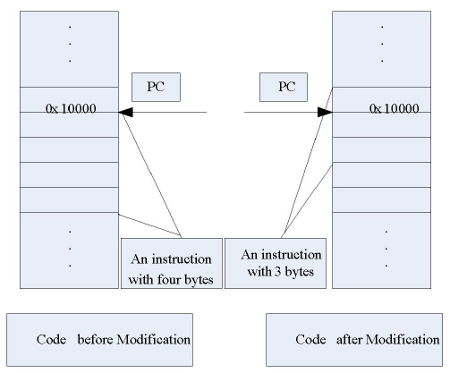
Task Analysis

Slide 18
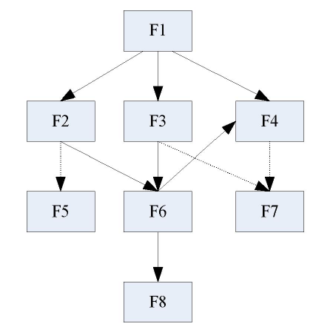
Caller Graph
A caller graph is created
Use breadth-first traversal to find all the dependant tasks
A list of all the functions that depend on the given function and find tasks whose entry points are in these functions.

Slide 19
Relocation and Re-relocation
To upgrade software we need a memory table which is costly to maintain
Implement it in the host machine
If a new version function is larger than the old one new function will be placed in a new location
Need re-relocation after the patch is uploaded

Slide 20
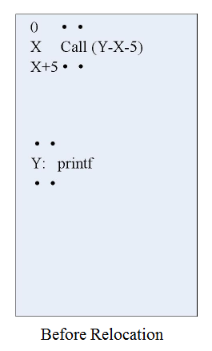
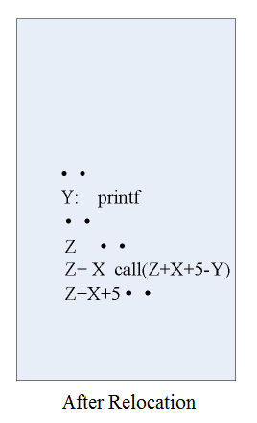
Relocation and Re-relocation

Slide 21
Patching
Receive the patch
Suspend the affected task
Update the parameter value or code
Restart the task
The task priority, entry point, base of stack and arguments are needed

Slide 22
Resource Protection
Resource release
Need to protect the resource when the task is killed
Register Mechanism
Reboot delayed mechanism

Slide 23
Results
Pentium-s, 100 MHz
3 source files modification (20 functions)
Conventional method: 2sec and 110µsec
Overhead of OBSM is15µsec

Slide 24
Conclusion
Develop a method to update the software by writing the patch to memory directly
To reduce overhead classify the type of modification
Task dependency analysis and resource protection help in correct upgrading
This method has some overhead but will be useful for applications which require frequent upgrading

Slide 25
Questions?

