Slide 1
Comparative analysis of High Level Programming for Reconfigurable Computers: Methodology and Empirical Study
Wen-qian Wu
EEL 6935

Slide 2
Contents
1
Reconfigurable Computing (RC) design flow
2
High level language (HLL) based design
3
Metrics of HLL and quantification
4
Experiment and result

Slide 3
RC design flow
Reconfigurable Computing system takes the advantage Hardware (e.g. FPGA) acceleration
Two main mechanisms for acceleration:
Loop unrolling and pipelining
Not all computations are fit for FPGA
Control intensive application
Floating point operations
Data transfer overhead
RC system is naturally a hybrid system which consists both software and hardware
Programming SW in C/C++/Java, HW in VHDL/Verilog
HW and SW partitioning
Notes:
HW/SW处可以加一副图！

Slide 4
HDL OR C
HDL is not so friendly
Ratio of VHDL to C developers 1: 10000
Function is dependent on architecture, not portable
Tedious, slow development cycle…
Most application developers are willing to give up some performance and chip utilization in exchange of productivity
High-level design tools are hence raised!

Slide 5
High Level design flow
High level design flow
Describing HW using HLLs is possible, and has been tried in several commercial products, such as Xilinx Forge, Celoxica Handel-C, Impulse-C, Mitrion-C, DSPLogic, etc.
C/C++, Java, Simulink, etc
High-level Synthesis
HDL
RT Synthesis
Netlist
Technology Mapping
Physical Design
Placement
Bitfile
Routing
FPGA
Processor
Notes:
Fig from RC!

Slide 6
High Level Language (HLL)
Benefits of HLL
Allow mathematicians and computer scientists to develop entire applications without relying on hardware designers.
Substantially increase the productivity of the design process.
Challenges of HLL
Able to compile high level description to HDL
Mutually synchronization and data transfer between microprocessor and FPGA
Facilitate HW and SW co-simulation and code reuse
This paper review 3 HLLs
Impulse-C (C-based)
Mitrion-C (C-based)
DSPLogic (graphical-based)

Slide 7
High Level Language (HLL) – cont.
Why choosing the 3 HLLs for studying
1) Fully developed HLL tools with variable platform supporting.
2) Each one wants to reach broader audience of potential RC users.
3) Each one has different and distinct vision on how to realize its goal.
Impulse-C: Imperative programming
Mitrion-C: Functional programming
DSPLogic: Schematic programming

Slide 8
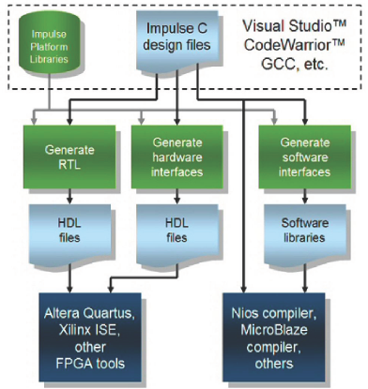
Impulse C
Translate C code to HDL
A subset of ANSI C
Pragma
pipelining and scheduling features may
be controlled at the level of your C
source code through the use of certain
predefined pragmas, like co pipeline,
co unroll, etc.

Slide 9
Impulse C
Built-in communication
Separate processes are made
for the SW (CPU) & HW (FPGA)
Communication via co stream
Synchronization via co signal
HW/SW co-simulation
Test vector is generated automatically
when performing C level simulation.
The test vector is used for writing testbench for HDL
Notes:
According to the previous presentations, HW/SW partitioning is at task level and can be performed dynamically. But when using HLL, the partitioning is at process level and as a designer, you must keep in mind that which process can take the advantage of HW acceleration and tag that process as HW process.

Slide 10
Mitrion C
Mitrion-C programming language is an implicitly parallel with syntax similar to C
Focus on parallelism and data-dependencies.
Any operation may be executed as soon as its data dependencies are fulfilled.
Software written in the Mitrion-C language is compiled into a configuration of Mitrion Virtual Processor (MVP)
MVP is a fine-grain, massively parallel, reconfigurable soft processor.
The configuration of MVP will be downloaded to FPGA.

Slide 11
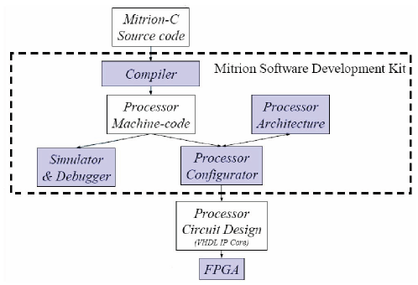
Mitrion C
Mitrion-C programming flow:

Slide 12
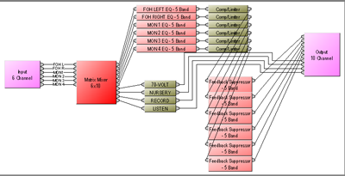
DSPLogic
DSPLogic provides RC toolbox
Offers a graphical (as well as text based) programming environment
Based on Xilinx System Generator for DSP package.
Enable the use of MATLAB/Simulink package
Blocks both from RC toolbox and Xilinx System Generator are used to create a Data Flow Graph.
Notes:
Try to find a graph…

Slide 13
HLL Metrics
How to evaluate HLL?
Metrics: easy-of-use, efficiency
Easy-of-use
In terms of total acquisition time + total development time
Acquisition time is dependent on the type of paradigm being adopted
Development time depends on both the paradigm and the application being developed
Also affected by programming model explicitness
The more explicit the programming model is, the more architectural details needs to be handled, the longer for both acquisition time and development time will be
User/developer previous experience also needs to be considered
Notes:
In RC application, programming model typically determines whether the programmer can control data transfers between the FPGA and the onboard memory, the FPGA and the microprocessor memory, and the FPGA and the microprocessor.

Slide 14
HLL Metrics
Efficiency
Ability to extract the maximum possible parallelism/performance with the lowest cost
In terms of end-to-end throughput, maximum achievable frequency and resource usage
Again, the user/developer experience should be taken into consideration

Slide 15
Quantification
Easy-of-use
Average ease-of-use factor:
is the average acquisition time of a reference language (usually VHDL)
is the difference of acquisition time between reference language and one HLL
Assumption: the number of user included in the experiment, the number of applications considered, the number of language for each paradigm and the number of platform being used as testbed should be as large as possible to achieve accurate result.

Slide 16
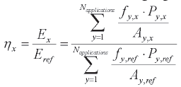
Quantification
Efficiency
Average efficiency factor of language x relative to a reference language, e.g. VHDL
Average ease-of-use factor ranges from 0 to 1
0 represents a language which is most difficult to use like VHDL
1 represents the easiest-to-use language
Similarly, average efficiency factor ranges from 0 to 1
0 represents least efficient language
1 represents most efficient language like VHDL

Slide 17
Applications
4 workload were selected for implementation on Cray-XD1
Pass-through
Reads input data from the uP and sends it back.
Purpose: measure the overhead of each HLL by the simplest application
Discrete wavelet transform (DWT)
Data encryption standard (DES) algorithm
DES breaking

Slide 18
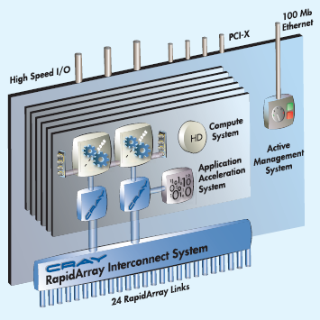
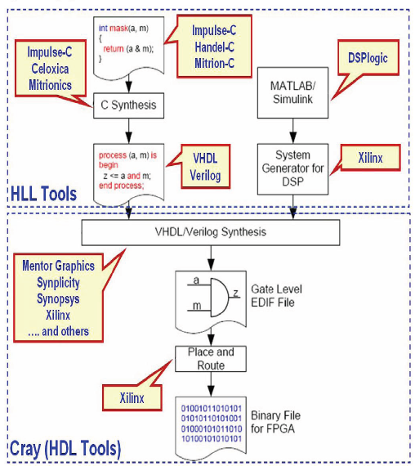
Cray-XD1 platform
General structure of the XD1:
One chassis houses 6 compute cards
Cards are connected via RapidArray
switch fabric
2 AMD Opteron uP, 2 RapidArry
proceesor and 1 FPGA accelerator
on each compute card
XD1 development flow

Slide 19
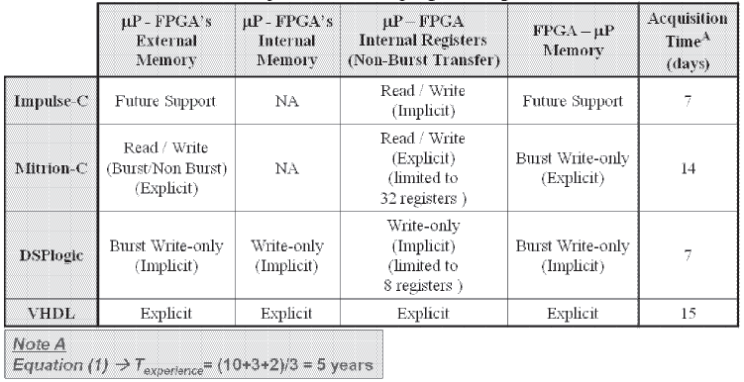
Result 1
Easy-of-use in terms of acquisition time

Slide 20
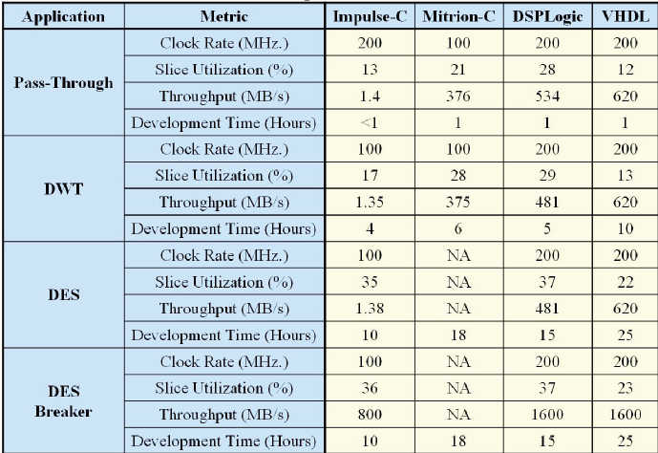
Result 2
Efficiency and development time

Slide 21
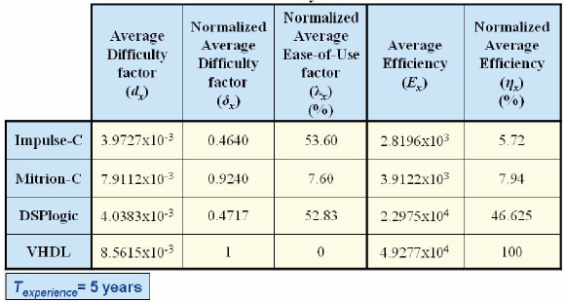
Result 3
Tools Efficiency vs. Easy-of-use

Slide 22
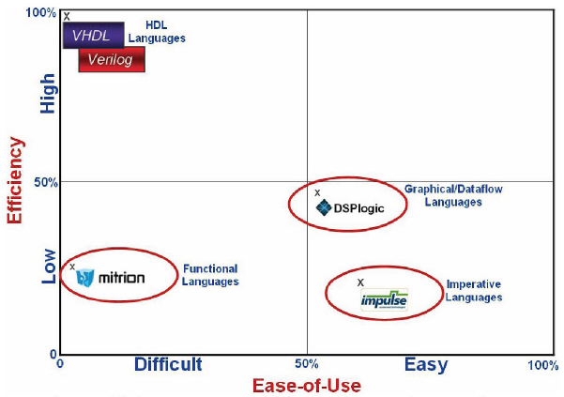
Result 3 – cont.
Tools Efficiency vs. Easy-of-use

Slide 23
Conclusions
A formal methodology and framework is established to evaluate different high level programming paradigms for RC application
The metrics we devised were easy-of-use, and efficiency of generating hardware characterized by high throughput at the lowest cost of resource usage
Encouraging:
preliminary results achieved by HLL are close to manual HDL
The SW to HW porting becomes considerably easier and more efficient with every new release
Lesson learned:
Optimized hardware is not the same as software optimization
Some hardware knowledge is still needed for performance optimization, for creating a new platform wrapper, etc.
Debugging hardware is another major problem. Tracing is difficult since the internal VHDL signals are unknown.

Slide 24
Thank You !
Questions?

Slide 25
Reference
[1] W. Luk, N. Shirazi, and P.Y.K. Cheung, Compilation Tools for Run-time Reconfigurable Designs, IEEE symposium on Field-Programmable Custom Computing Machines, FCCM 1997; 56-65
[2] K. Comptoon, S. Hauck, Reconfigurable Computing: A survey of Systems and Software, ACM Computing Surveys 34 (2) (2002) 171-210
Impulse C – “Impulse Accelerated Technologies” website available at http://www.impulsec.com/
Mitrion website available at http://www.mitrion.com
DSPLogic website available at http://www,dsplogic.com
Crat website available at http://www.cray.com

