Slide 2
Motivation
Collision Avoidance
Inefficient airspace utilization
Increased air traffic workload
Use of obsolete technologies

Slide 3
Requirements
Increase flexibility of vehicle operations
Fly higher number of vehicles in smaller airspace
Higher precision of flight plan and accomplishments

Slide 4
Agents aircraft auto-pilot (autonomous – independent of pilot)
Prepare detailed flight plan for airspace
Execute the flight plan

Slide 5
Deconfliction by Negotiation
Zones:
- Communication
- Alert
- Safety
- Collision

Slide 7
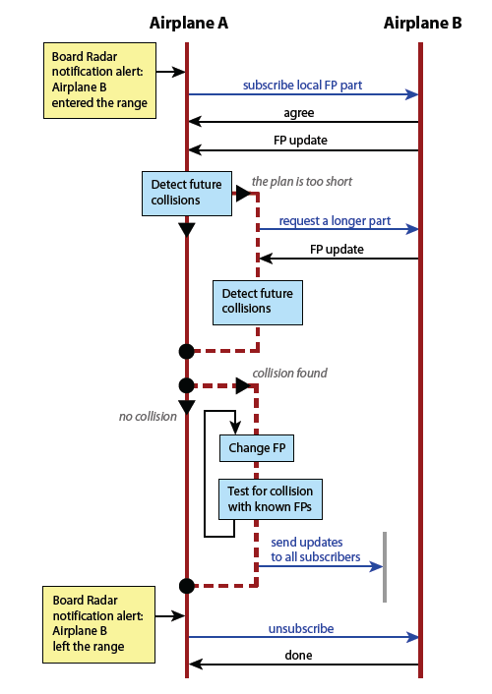
Negotiation Protocol

Slide 8
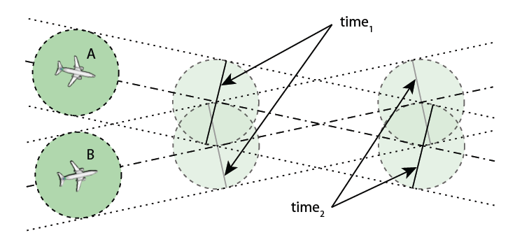
Deconfliction by Negotiation
Cooperative/non-cooperative deconfliction

Slide 9
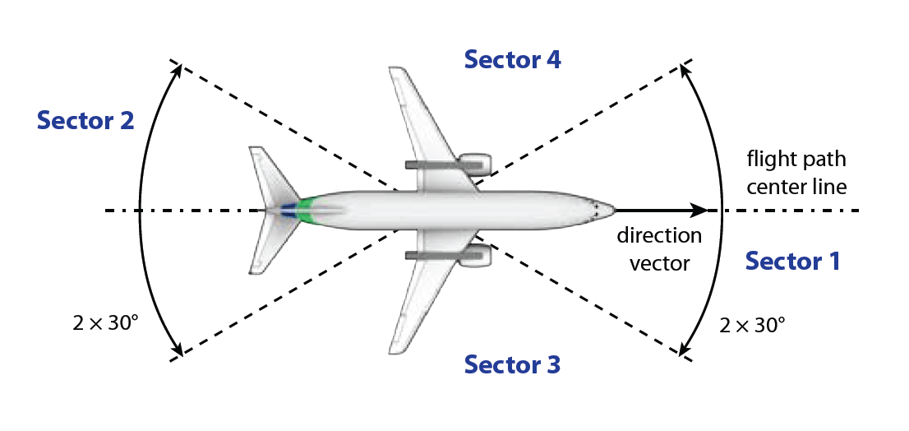
Collision Avoidance Mechanism
Side collision
Rear collision
Head-on collision
Side Collision

Slide 13
A-Globe: Multi-Agent Platform
Fast, lightweight, with mobility and inaccessibility support.
Provides Geographical Information System-like service.
Consumes limited amount of resources.
Does not support interoperability.

Slide 14
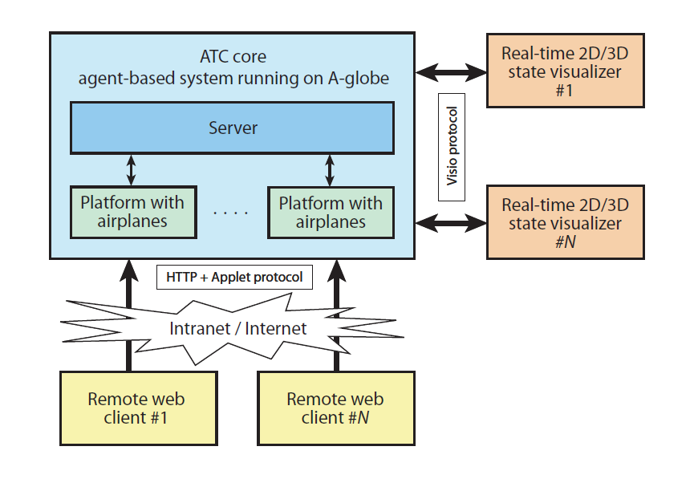
ATC System Structure Overview

Slide 15
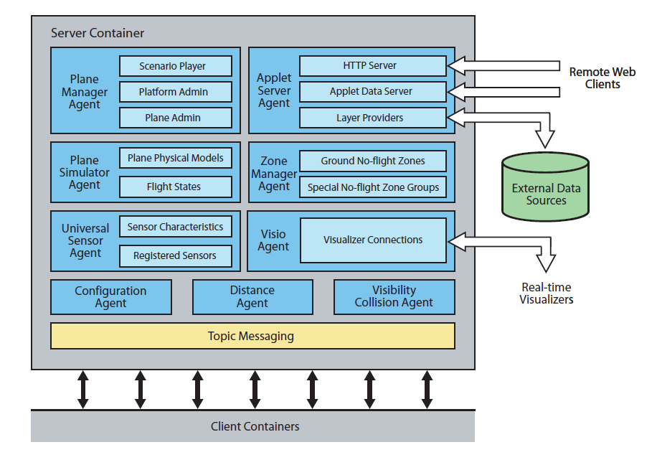
Server Component

Slide 16
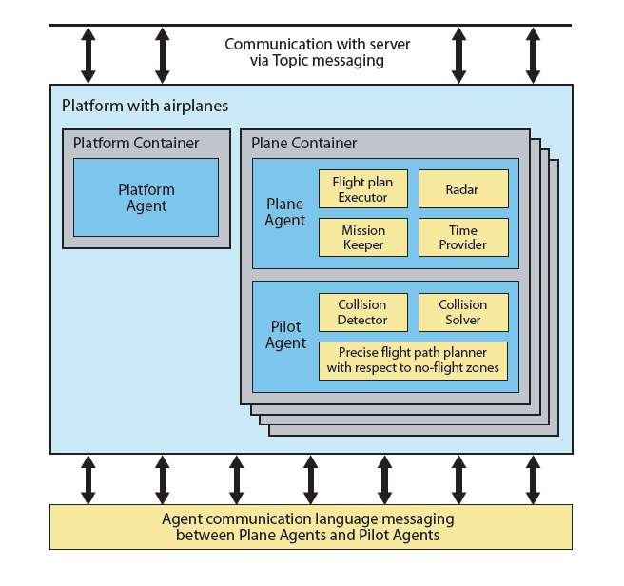
Platform Component

Slide 17
Flight Modeling
Flight planning
Waypoints: navigational point used for rough definition of the flight route; represents location and time interval of flight.
Segment: portion of flight path between two waypoints.
Elements: most basic parts of a flight plan (horizontal/vertical turns, spirals, warp elements).
Simulation

Slide 18
Flight plan, segments, elements

Slide 19
Flight Path Planning
Path Planning: create segments, fill segments with elements.
Time Planning: adjust flight plan so that time of flight for each segment matches time interval defined in start and end waypoints.
Avoiding no-flight zones: replace with flight path that bypasses no-flight zone.

Slide 20
Avoiding no-flight zones

Slide 21
Real Data Integration
NASA: a mosaic of Landsat7 images, resolution of 50m/pixel used as underlying ortophoto map of the US.
USGS: detailed vector shapes of 50 US state boundaries, 650 US airports, GPS coordinates, more than 26000 major US highway segments.
GNIS: more than 24000 US populated places, GPS coordinates, more than 80 US power plants with GPS coordinates (no-flight zones).
ATC flight data: airplanes including position, direction, rough flight plans (points in space through which the airplane is supposed to fly), detailed flight plans.

Slide 22
Flight Visualization
Real-time visio allows user to overview the entire simulation in a 2D/3D environment.
CrystalSpace used – open-source 3D game engine.
Written in C++ for efficiency and performance, using OpenGL graphics engine.

Slide 23
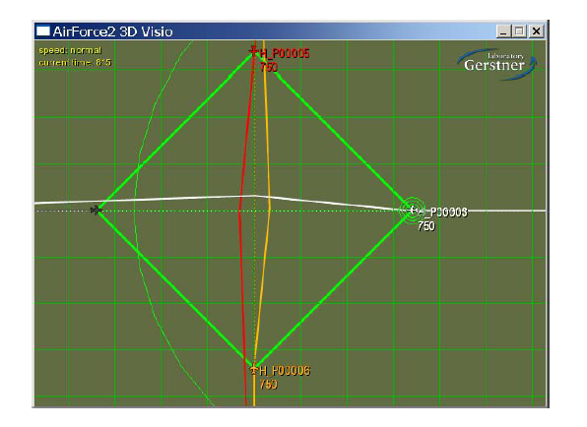
Real-time visualizer: 2D view

Slide 24
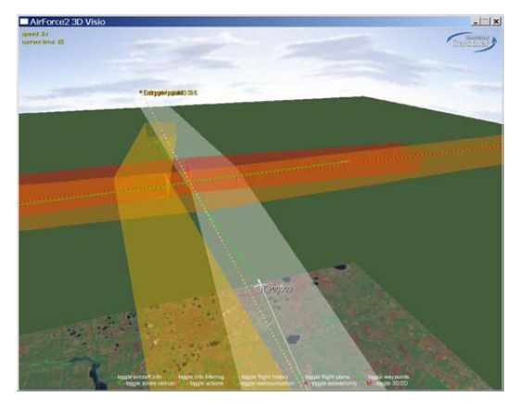
Real-time visualizer: 3D view

Slide 25
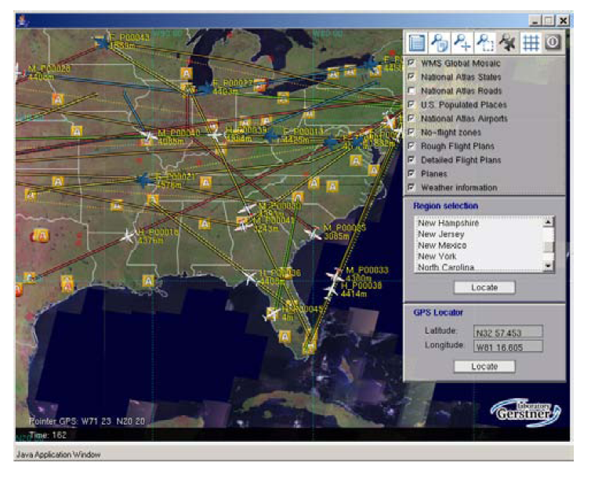
Remote client GUI Overview

Slide 26
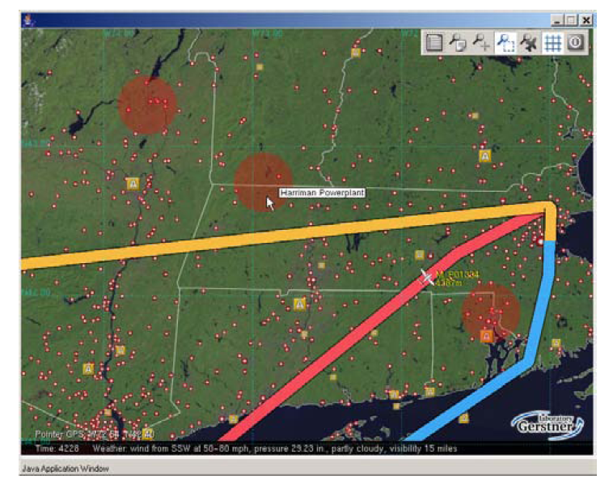
Flight plans avoiding no-flight zones

Slide 27
Conclusion
The ATC prototype assumes all airplanes use the same deconfliction rules.
Will be extended so that airplanes that detected future collisions would iterate through monotonic concession protocol (MCP).

