Slide 1
Important Sampling to Evaluate Real-time System Reliability - A Case Study
by Xiang Mao and Qin Chen

Slide 2
Outline
Introduction
Technical Background
Importance Sampling
The RAPIDS Simulator
Implementation
Experimental Result & Analysis
Conclusion
17:41

Slide 3
Introduction
Applications of real-time system:
Aircraft control
Traffic control
Factory automation etc.
Requirement of high reliability:
Deliver critical outputs in a timely fashion, even in the presence of a few component failures
17:41

Slide 4
Introduction
Reliability in real-time system is Dynamic
Modeling vs. Simulation
Drawbacks of Simulation
Require a very long computation times
Unreliability ≤ 10⁻⁵ ~ days to weeks
A solution – Importance Sampling
17:41

Slide 5
Introduction
Major works of the paper:
Implementing importance sampling in the RAPIDS simulator;
Analyzing the expected behavior of such a scheme;
Validating the implementation;
Investigating the tunable parameters in the scheme and providing guidelines on their use.

Slide 6
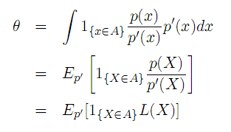
Importance Sampling
Help understanding – overheated processor
Introduction:
The set of failed states
Unreliability
X is a random variable with density function p(x)
17:42

Slide 7
Importance Sampling
Implementation Heuristics
Forcing (or accelerate): increase the rate at which state transitions occur.
Balanced failure biasing: bias the system towards more faults
Each of them has a likelihood ratio associated with it. The overall likelihood ratio is just the product of the individual ones.
17:43

Slide 8
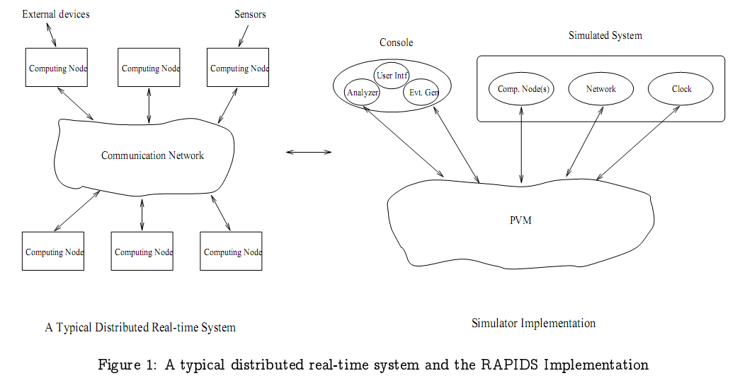
The RAPIDS Simulator
(Parallel Virtual Machine)
http://www.ecs.umass.edu/ece/realtime
17:43

Slide 9
Implementation
Event Generator
Decide the time of the next system state transition. Implement forcing to accelerate the state changes.
Decide whether the next transition is a fault arrival or repair. Implement failure biasing to push the system towards more component faults.
Calculate the likelihood ratio associated with each ‘change of measure‘ and store this value along with the event.
17:43

Slide 10
Implementation
Analyzer
Receive reports from the simulated system.
If it corresponds to one of the above mentioned ‘change of measure‘, update the current simulation weight.
If the system fails within the mission time, set the simulation output to the current value of the likelihood ratio; else set the simulation output to zero.
17:44

Slide 11
Experiments
Reliability region that Importance Sampling works well
Performance metrics
Simulation acceleration
Sample variance reduction
Notes:
Same sample variance;
Same number of simulations.

Slide 12
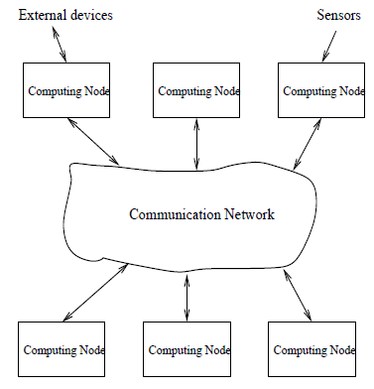
System Configurations
Increasing system reliability
Notes:
The system to be modeled can be viewed as a collection of computing nodes that are connected by a communication network.
Transient/permanent processor failure rate

Slide 13
Simulation Acceleration
Notes:
The bigger AF is, the more simulation speed-up is.
1. Except for config 1, IS achieves simulation speed-up;
2. As the system reliability increases, so does the acceleration factor;
3. If system reliability is low, it is better to use normal simulation.

Slide 14
Bias Parameter
Failure bias
How fast we push the system towards failure
Bad parameter
Too low or too high → high sample variance
Good parameter
Low sample variance → fewer samples/simulation speed-up!

Slide 15
Bias Parameter, cont’d
Notes:
Fixed system → fixed error rate + fixed number of simulations
Change bias → different sample variance

Slide 16
Conclusions
Importance Sampling in a simulator testbed
Achieves simulation acceleration, when the system reliability is high (unreliability ≤ 10⁻³ )
Proper tuning up of parameter needed to achieve sample variance reduction
Not suitable for less reliable systems

Slide 17
Question ?
The End
17:46

