Slide 1
Minimizing Response Time Implication in DVS Scheduling for Low Power Embedded Systems
Sharvari Joshi
Veronica Eyo

Slide 2
Introduction
Maintaining energy efficiency is crucial in battery operated embedded systems
The two primary ways to reduce power consumption in the processor:
Resource shutdown, also known as dynamic power management (DPM)
Resource slow down, also known as dynamic voltage scaling (DVS).

Slide 3
Dynamic power Management
DPM refers to power management schemes implemented while the system is still running.
DPM techniques have been proposed to minimize the power consumption in memory banks, disk drives, displays and network interfaces

Slide 4
Power management
Power mode transition for STRONGARM SA-1100 processor
P run= 400mW
Run mode
160ms
10 µs
90µs
10µs
Sleep mode
Idle mode
90µs
P sleep= 0.16mW
P idle=50mW

Slide 5
Dynamic Voltage Scaling (DVS)
DVS is more effective than DPM in reducing the processor energy consumption
It is a power management technique where the processor voltage and frequency is scaled down
DVS techniques exploit an energy-delay tradeoff that arises due to the quadratic relationship between voltage and power
Pcmos =v²f.
Applying DVS to mixed tasks require a compromise between energy reduction and system responsiveness

Slide 6
.DVS
V
0
L
T
A
G
E
0 t1 t2 t3 t4 t5 t6 t7 time
T1
T2
T3
T4
T5
T2
T5
T1
T3
T4

Slide 7
Prior work
Weiser et al and Chan et al proposed a DVS algorithm by predicting the CPU utilization and adjusting the system speed
Yifan and Frank proposed an EDF scheduling that splits highest priority jobs into two subtasks.

Slide 8
Overview
In this paper;
An algorithm for scheduling hybrid/mixed tasks is proposed
Benefits
improves responsiveness to periodic tasks
saves as much energy as possible for hybrid workload
Preserves all timing constraints for hard periodic tasks under worst case execution time scenario

Slide 9
Periodic tasks
Instances of tasks, T ={T1, T2, ..., Tn} are released at constant periods of time
It is characterized by
time period pi
worst case execution time(WCET) ci
The relative deadline of a task Ti =pi

Slide 10
Aperiodic tasks
The execution, start and end of tasks is constrained by maximum variations.
It is denoted by:{σklk = 1,2,...}
r is release time of job and not known in advance,
e is average WCET of the task, and is known only when job arrives at t=rk
Total Bandwidth Server handles the aperiodic workload

Slide 11
Total bandwidth server
Changes the deadline of the aperiodic load to an earlier time
It makes sure that total load of aperiodics does not exceed maximum value Us
us = cs/ps,
dk = max(rk, dk-1) + ek/us
where
cs is the execution budget
ps is the period of the server.
ek is WCET of aperiodic task σk.
dk is the kth deadline.

Slide 12
Ґ1 and Ґ2 are periodic tasks TBS: us=1-up=0.25
Ґ1
3 6 9 12 13 18 19 21 24 time
Ґ2
4 8 9 16 17 24 time
Aperiodic 1 d1 2 3 d2 d3
requests
0 3 4 7 9 11 14 16 17 21
A Total bandwidth example

Slide 13
TBS at full speed
Task set can be feasibly scheduled iff
uP+US <= 1
uP+US= Utot
Total CPU utilization is portioned between up and us
where up is worst case utilization of periodic tasks.

Slide 14
Static speed
System utilization can be increased and energy consumption is reduced by lowering operating frequency.
Lowering frequency also means performance degradation of the system
up+ us <= fi/fm
Where:
fi=fstatic is the suitable speed for task set
fm gives the maximum speed (0 <fi/fm < 1).
Notes:
In other words, DVS trades off performance for power and energy reduction.

Slide 15
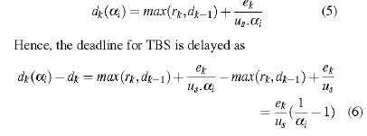
Deadline-based Frequency Scaling Algorithm (DFSA)

Slide 16
Results and Analysis
System assumptions:
Transmeta's Cursoe processor
hybrid/mixed tasks
The aperiodic load is varied in the experiment
Task which has the earliest deadline among all ready tasks has highest priority
Overhead of scheduling algorithm and voltage transition is negligible

Slide 17
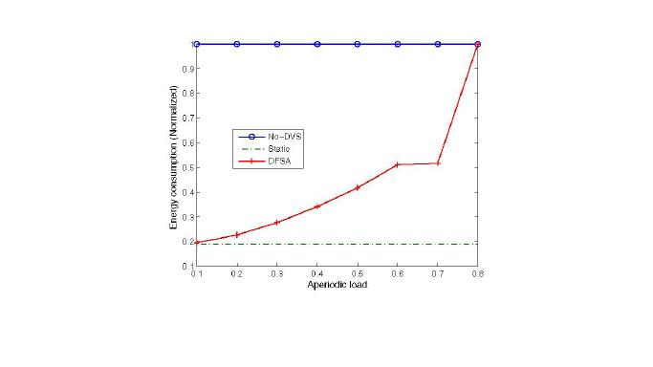

Slide 18
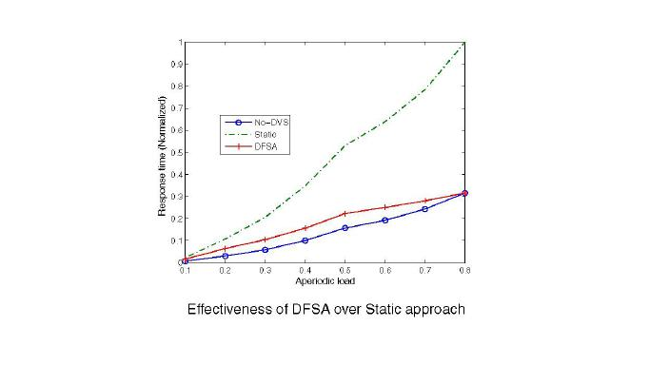

Slide 19
Conclusion
Dynamic Voltage Scaling has been projected as a promising technique for minimizing power consumption of low powered devices.
An inherit drawback associated with DVS is performance degradation
Power consumption of real-time systems was minimized by restricting aperiodic tasks deadlines
Future Work
Slack stealing mechanism will be used to further reduce performance penalty by considering the early completion of jobs.
er consumption of latest real-time systems by restricting aperiodic tasks deadline

Slide 20
References
G.E. Moore, Cramming More Components onto Integrated Circuits, Electronics, vol. 38, No. 8, pp. 114117, 1965.
N. A. Ghazaleh, B. Childers, D. Mosse, R. Melhem, and M.Craven, Energy Management for Real-Time Embedded Applications with Compiler Support, In Proceedings of ACM SIGPLAN Conference on Languages, Compilers, and Tools for Embedded Systems, 2003, pp. 284-293.
Shneiderman, Designing the User Interface: Strategies for Effective Human-Computer Interaction, MA: Addison-Wesley Reading, 1998.
A. P. Chandrakasan, S. Sheng, and R. W. Brodersen. Low Power CMOS Digital Design, IEEE Journal of Solid State Circuits, 1992, pp. 472-484.
P. Pillai, and K. G. Shin, Real-Time Dynamic Voltage Scaling for Low-Power Embedded Operating Systems, In Proc.of ACM Symp. On Operating Systems Principles, pages 89-102, 2001.
Weiser, B. Welch, A. Demers, and S. Shenker, Scheduling for reduced CPU energy, In Proceedings of the 1st Symposiumon Operating Systems Design and Implementation,pages 13-23, November 1994.
E. Chan, K. Govil, and H. Wasserman. Comparing algorithms for dynamic speed-setting of a low-power CPU, In Proceedings of the 1st ACM International Conf. on Mobile Computing and Networking (MOBICOM 95), pages 13-25,November 1995.
Yifan Zhu, and Frank Mueller, Feedback EDF Scheduling Exploiting Dynamic Voltage Scaling, In Proceedings of 10th IEEE Real-Time and Embedded Technology and Applications Symposium, 2004.
Y Shin, and K. Choi, Power Conscious Fixed PriorityScheduling for Hard Real-Time Systems, In Proceedings of Design Automation Conference, 1999, pp. 134-139.
V. Raghunthan and C. L. Pereia, Energy Aware Wireless Systems with Adaptive Power-Fidelity Tradeoffs, IEEETransactions on Very Large Scale Integration Systems, Vol.13, No. 2, 2005.
H. Aydin and Q. Yang. Energy-Responsiveness Tradeoffsfor Real-Time Systems with Mixed Workload, In Proceedings of 10th IEEE Real-time and Embedded Technology and Applications Symposium, pages 74-83, 2004.

Slide 21
Questions?

