Slide 1
Communication-Aware Allocation and Scheduling Framework for Stream-Oriented Multi-Processor Systems-on-Chip
Jamie Unger-Fink
John David Eriksen

Slide 2
Overview and Purpose
Allocation and Scheduling Problem
Better MPSoC optimization tool needed
IP and CP alone not good enough
Communication Issues
Real-time systems
Notes:
-For all embedded systems, you must think about how to solve the problem of allocating resources and scheduling tasks.
-As technology advances, we will see more processor cores on chip and these two problems will become more complex, need better tools.
-Must keep in mind communication issues, as we want to limit congestion on system bus between cores.
-This is especially significant for real-time systems, as we need to avoid unpredictability in our performance with respect to communication latencies.

Slide 3
Previous Work
Integer Programming
Constraint Programming
Benders Decomposition
Notes:
-Integer (Linear) Programming – Optimization approach using a list of requirements represented as linear equations, often used in Operations Research. Heuristics such as Genetic Algorithms, Simulated Annealing, and Tabu search used to come up with good solutions to IP problems. Problem is: suitable for only small problem sets, high computational cost, need a better way for our complex problems.
-Constraint Programming – Alternate approach to IP, based on constraints on timing and resources, eliminating infeasible options. Advantageous for general problems, but CP is more costly than IP for a well-defined problem.
-Bender’s Decomposition- Mathematician J.F. Benders, Solves communication issues that arise with a hybrid approach using IP and CP for different subsets of our problem… Highly complex Operations Research theorem

Slide 4
Hybrid Approach
Combination of IP and CP
Map tasks to processors and memory slots to storage devices using IP
Map scheduling of tasks with CP
Need architecture to test
Notes:
-This hybrid approach along with the architecture I will talk about later is what is proposed in the paper I am presenting.
-The idea is to map tasks to processors and memory slots to storage devices using IP and scheduling of tasks to CP

Slide 5
Target Architecture
Requirements:
Message exchange support
Local memory devices
Remote storage devices
Computation tiles are homogenous (e.g. ARM7 cores and scratch pad memories)
Messages moved between scratch pad memories
Notes:
-Message exchange support between computation tiles to determine bus availability and determine if tasks have been completed
-Local memory such as scratch pad memories used for fast access and storage (for fetching operands and storing input data)
-Remote devices can be unified memory with partitions or separate memory for each core.
-The ARM cores contain instruction and data caches as well.

Slide 6
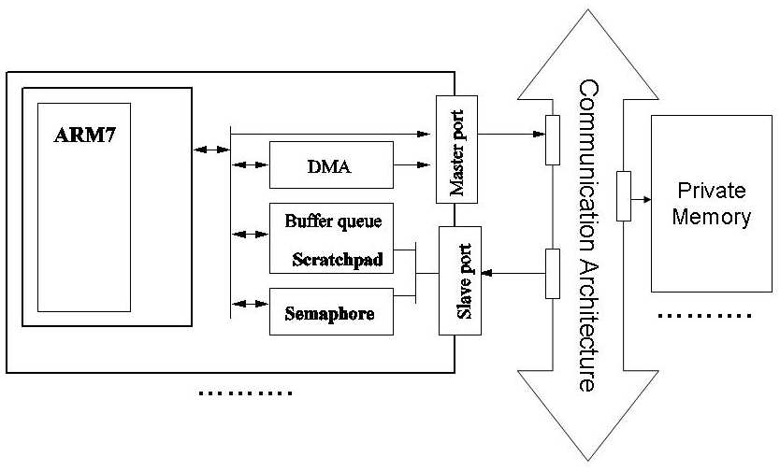
Architecture Diagram
Figure 1: Architecture
Notes:
-Should be noted that each core has to gain bus ownership to access private memory (remote memory I mentioned earlier)

Slide 7
Task Modeling
Multi-task applications
Pipelined task graphs
Stream-oriented applications
Real-time requirement
Notes:
-We use task graphs to model multi-task applications to the platform, specifically pipelined task graphs
-We use pipelining to take advantage of the parallelism that can be accomplished with this architecture, specifically for stream-oriented processing applications – audio and video applications, signal processing, anything with large data streams
-Real-time requirement should be set to be sure to obtain a certain throughput from the task pipeline

Slide 8
Task Modeling Diagram
Tasks are nodes, task dependencies are edges
Computation, storage and communication should be annotated
Task_{ij} represents jth repetition of ith task of pipeline
Horizontal Arrows are precedence constraints, diagonal arrows are communication constraints
Working rate - at least n² tasks
Figure 2: Task Graph with Precedence Constraints
Notes:
Each task has 3 kinds of memory requirements:
Program Data: computation data and processor instructions
Internal State: locally or remotely
Communication queues: outgoing and incoming messages to/from other tasks, stored in scratch-pad memories only
-We use scratch pad memory to ensure efficient communication
Analyze system at working rate, when all processes are running. To do this, we need the number of repetition of each task is equal to the number of tasks, n. So we need at least n² tasks

Slide 9
Bus Modeling
Avoid bus congestion to allow for predictable behavior
Additive Model
Overall bus BW equal to BW of concurrent tasks
Larger granularity helps with simpler optimization
Notes:
-If there is bus congestion, it can slow down the whole program and cause problems
-When the bus requires a BW for concurrent tasks less than a certain threshold, it can be treated as an additive model
-Bus allocation should be modeled as a unary resource, since it is either being used or not used

Slide 10
Bus Modeling
BW is not actual bus BW, but instead the upper threshold of the Additive Model
Task execution times will not be stretched
Figure 3: Traditional Bus vs Additive Model
Notes:
-In order to calculate the fraction of the BW absorbed by a task, we consider the amount of data they access and spread it over the execution time of the task, so it uniformly consumes that fraction of the BW throughout its execution.
-With the additive model, task execution times will not be stretched due to wait on the bus to become available (because it has already been characterized as a congestion free regime)

Slide 11
Problem Decomposition and No-Good Generation
Because of complexity, IP and CP alone are not good solutions
How to make them interact?
Master/subproblem
Solution or ‘No-good’
Notes:
-So we split the allocation and scheduling among them
-Interaction is the key issue.
-Set Allocation as Master Problem and Scheduling as Subproblem
-Master solved optimally and solution passed to subproblem, if no feasible solution comes from subproblem, a no-good is generated and the Master tries again

Slide 12
Allocation Problem Model
Allocates n tasks to m processors, can’t exceed local scratch pad size
Assumption: Remote memories are unlimited
Constraints Minimization Formula
Notes:
These are the constraints and equation to minimize, which isn’t in the scope of this class (but in Operations Research in Industrial Engineering)

Slide 13
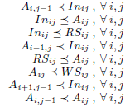
Scheduling Product Model
After allocation, we need to schedule n²
Since bus is additive, sum of concurrent task BW must be below threshold
Set to 50%
Send back ‘no-good’ if no solution
Constraints
Notes:
-Threshold was experimentally set to 50%

Slide 14
Comparison
Figure 4: Optimization Time Comparison
Notes:
-IP and CP can’t even find a solution for original problem, so they simplified the problem to see a comparison.
-In CP, they fixed the execution time except the variance in remote memory access
-In IP, they do not model the bus resource
-Time to complete with Hybrid Approach, IP and CP is significantly less than each individually (log scale)
-Also, with a cap of 15 minutes and a problem with 6 tasks and 3 or more processors, IP and CP can only solve 50% of the time while Hybrid can solve 100%

Slide 15
Methodology
Virtual Platform for pre-characterization
Simulation
Compare to metrics
Start with conservative threshold (50%)
OR
Start with a high BW threshold and decrease until it doesn’t fail
Notes:
-Virtual Platform for pre-characterization of the input task set
-Simulate the allocation and scheduling solutions provided by our approach
-Detect deviations of measured metrics compared to predicted metrics

Slide 16
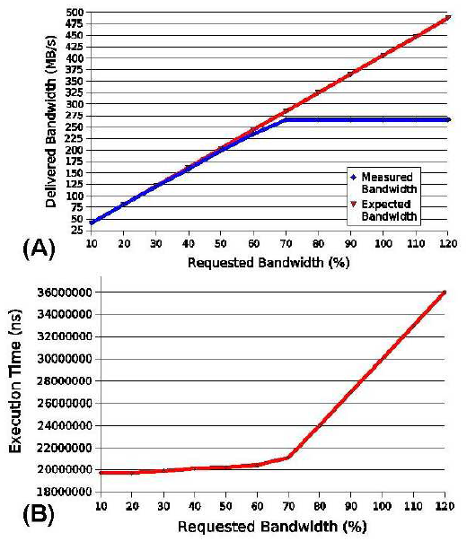
Validation of Bus Additive Model
Results show that the threshold turned out to be about 60% of real BW
After threshold, execution time increases for running tasks
Figure 5: Finding Threshold
Notes:
-Experiment is with uniform task blocks that take up 10% of real BW, results are for increasing the amount of blocks
-Experiments show that some tasks are not uniform and can drain most of the bandwidth, so the 60% is decreased to 50%

Slide 17
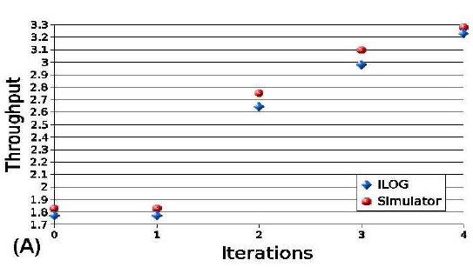
Validation of Allocation and Scheduling Solutions
4.7% average difference between expected and measured throughput
Can easily change system parameters
Figure 6: Expected vs Measured Throughput
Notes:
-To make sure modeling approximations aren’t significantly affecting the accuracy of the optimizer, they run the virtual platform with 50 different problem instances.

Slide 18
Conclusion
Combine IP and CP, get Hybrid Approach
Multi-processor platform with scratch pad memories
High granularity in Bus Modeling
Virtual Platform validation
Notes:
-This paper comes up with a novel approach using Integer Programming and Constraint Programming to solve the problem of Allocation and Scheduling for Multi-processor Systems-on-chip
-Homogenous cores with scratch-pad memories for quick access
-Efficient bus modeling using Additive Model and high granularity
-Validation and Verification using Virtual Platform

