Slide 1
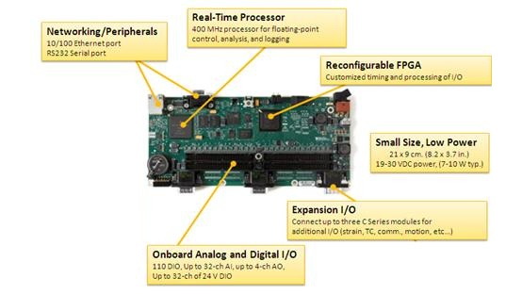
HW/SW partitioning of floating point software applications to fixed-pointed coprocessor circuits
- Nalini Kumar
Gaurav Chitroda
Komal Kasat

Slide 2
OUTLINE
Introduction
Prior Art
Hw/Sw Partitioning Of Floating Point Applications
Floating Point To Fixed Point Conversion
Fixed Point To Floating Point Conversion
Fixed Point Hardware Coprocessor
Results
Conclusions

Slide 3
INTRODUCTION
Prior Art
Hw/Sw Partitioning Of Floating Point Applications
Floating Point To Fixed Point Conversion
Fixed Point To Floating Point Conversion
Fixed Point Hardware Coprocessor
Results
Conclusions

Slide 4
KEY TERMS
Hw/Sw Partitioning
Dividing an application between software running on microprocessor and hardware implemented on FPGA or ASIC
Floating Point Application
Most programming languages use single and double precision floating point representations to represent real numbers.
In hardware the floating point implementations are highly pipelined and thus multi-cycle latencies are involved.
Area overhead and large power requirements
Coprocessor
Mapping Software applications to Coprocessor Circuits
Notes:
Fpga use moving from hardware prototyping and debugging to being incorporated into many computing domains and consumer electronics.
Hw/sw partitioning is the process of dividing an application between software executing on a microprocessor and hardware implemented within an fpga or asic
In hardware the floating point implementations are highly pipelined are highly pipelined and thus multi-cycle latencies are involved.
Typical performance gains of 10-100X with partitioning over sw execution
Reduction in energy consumption of up to 95%

Slide 5
NUMBER FORMAT
Floating point stored in binary scientific notation using sign magnitude format that allows a floating position of the radix point
Single precision floating point number consists of a sign bit(S), an 8-bit exponent(E), and a 23-bit mantissa(M)
Decimal Value =
Fixed point number is directly stored as a two’s complement binary number with a fixed radix point.
Fixed point addition and multiplication map directly to integer addition and multiplication.

Slide 6
Introduction
PRIOR ART
Hw/Sw Partitioning Of Floating Point Applications
Floating Point To Fixed Point Conversion
Fixed Point To Floating Point Conversion
Fixed Point Hardware Coprocessor
Results
Conclusions

Slide 7
EARLIER WORK
FRIDGE
System level fixed point design methodology
Designer provides localized annotations for critical fixed point operands using fixed-C extension to C
Simulation verifies correctness and automatically determines the fixed point representation needed
Fixify Environment
Uses simulation to determine the ideal fixed point operation
Design space exploration analyzes tradeoffs between numeric degradation, cost and performance
DSP have dedicated support for fast fixed point applications.
Optimizing the application performance executing on a DSP while meeting a designer specific accuracy constraint
Most approaches target the compilation phase of software development resulting in a fixed point software application
Notes:
Area requirements and multi cycle latencies preclude the use for most dedicated hardware for floating point operations that may be needed for some applications

Slide 8
MOTIVATION
Problem:
In hardware the floating point implementations are highly pipelined and thus multi-cycle latencies are involved
Key Idea:
Problem Subset: An application that does not require the dynamic range supported by floating point representation
Solution:
Fixed point implementation is a viable alternative that can be implemented efficiently in hardware

Slide 9
Introduction
Prior Art
HW/SW PARTITIONING OF FLOATING POINT APPLICATIONS
Floating Point To Fixed Point Conversion
Fixed Point To Floating Point Conversion
Fixed Point Hardware Coprocessor
Results
Conclusions

Slide 10
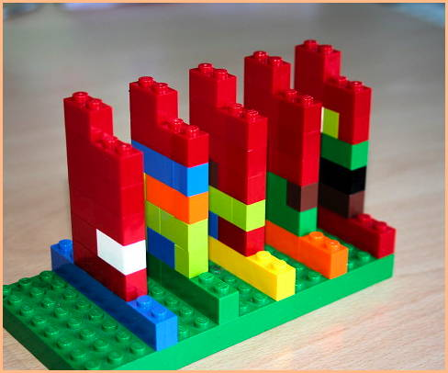
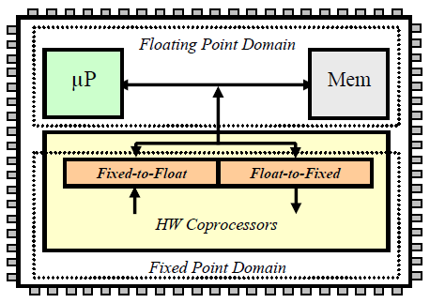
COPROCESSOR ARCHITECTURE
Partitioned application is separated into a floating point computing domain and a fixed point computing domain
Software portion encompasses microprocessor, cache and memory. It continues to use floats
Fixed point domain consists of hardware coprocessors using fixed point representation and the configurable float-to-fixed and fixed-to-float hardware converters
Hardware converters interface between the coprocessors and the microprocessor or memory
Fig.1 : Overview of proposed uP/coprocessor architecture

Slide 11
HW/SW PARTITIONING METHODOLOGY
Application Profiling
Software Application (C/C++)
Critical Kernels
Partitioning
Floating Point Profiling
Fixed Point Conversion
Fixed Point Representation
Hardware
Software

Slide 12
Introduction
Prior Art
Hw/Sw Partitioning Of Floating Point Applications
FLOATING POINT TO FIXED POINT CONVERSION
Fixed Point To Floating Point Conversion
Fixed Point Hardware Coprocessor
Results
Conclusions

Slide 13
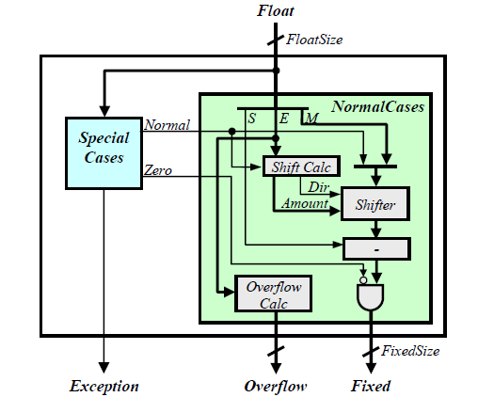
FLOAT-TO-FIXED CONVERTER - architecture
Configurable Verilog hardware description of a combinational logic design
Configuration parameters:
FloatSize
MantissaBits
ExponentBits
FixedSize
RadixPointSize
RadixPoint

Slide 14
FLOAT-TO-FIXED CONVERTER - components
SpecialCases: detect special representations defined with IEEE754 standard
Positive zero or Negative zero: Zero output signal is asserted
Denormalized numbers: Normal output signal is deasserted
Positive infinity, Negative infinity or Not-a-number(NaN): Exception signal is asserted if floating input is infinity or NaN since fixed point representation doesn’t support these two.
NormalCases: converts the input floating point value to the target fixed point representation
Calculate an Overflow output corresponding to additional bits needed to avoid overflow
Computes the shift direction and amount to align the floating point numbers mantissa with the fixed point representation
Calculates the 2’s complement of the aligned value for negative input specified by SignBit
All bits are and’ed with the inverse of Zero input from Special cases component
In the absence of a priori information of radix point, it can be provided as an input to the converter
Notes:
Denormalized number is a floating point number in which the mantissa directly specifies the corresponding value.

Slide 15
Introduction
Prior Art
Hw/Sw Partitioning Of Floating Point Applications
Floating Point To Fixed Point Conversion
FIXED POINT TO FLOATING POINT CONVERSION
Fixed Point Hardware Coprocessor
Results
Conclusions

Slide 16
FLOAT-TO-FIXED CONVERTER
Combinational logic design for converting fixed point into the target floating point representation
Same set of parameters as the float-to-fixed converter
Doesn’t have to deal with infinity and NaN cases since fixed point representation doesn’t support these special cases.
Only handles the special case for representing zero by representing it with positive zero.
Determines the sign of the fixed point number outputting the sign bit
For negative number, finds the 2’s complement
Priority encoder determines the position of MSB of fixed point value whose value is 1. This gives the shift direction and amount to shift the fixed point number – giving the mantissa and exponent

Slide 17
Introduction
Prior Art
Hw/Sw Partitioning Of Floating Point Applications
Floating Point To Fixed Point Conversion
Fixed Point To Floating Point Conversion
FIXED POINT HARDWARE COPROCESSOR
Results
Conclusions

Slide 18
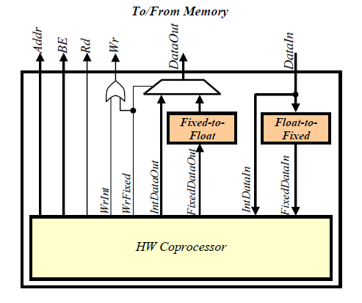
HARDWARE COPROCESSOR
Processor interface to memory integrating float-to-fixed and fixed-to float converters
Separate DataIn and DataOut
Separate inputs for integer and converted fixed point values - are provided to the coprocessor
Similarly, two outputs are provided by the coprocessor – IntDataOut and FixedDataOut

Slide 19
Introduction
Prior Art
Hw/Sw Partitioning Of Floating Point Applications
Floating Point To Fixed Point Conversion
Fixed Point To Floating Point Conversion
Fixed Point Hardware Coprocessor
RESULTS
Conclusions

Slide 20
EXPERIMENTAL SETUP
Three implementations are needed
12.20 – single precision float to a 32-bit fixed point with a radix point of 20
21.30 – single precision float to a 51-bit fixed point with a radix point of 30
17.47 – single precision float to a 62-bit fixed point with a radix point of 20
Verilog description synthseized to a Xilinx Virtex-5 FPGA using Xilinx ISE 9.2
250 MHz MIPS processor with support for floating point calculations
Main optimization goal – Speed!

Slide 21
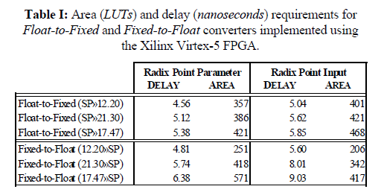
RESULTS
Area and delay for the three converters.
Float-to-fixed
9% faster
10% fewer LUTs
Fixed-to-float
25% faster
30% more LUTs

Slide 22
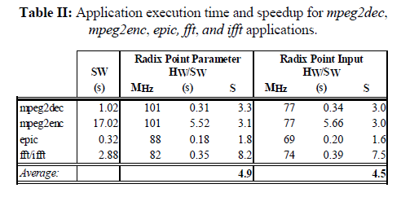
RESULTS
mpeg2dec: 32-bit fixed point with 20 radix point
mpeg2enc: both integer and floating point computations. 32-bit fixed point with 20 radix point
epic: double precision float operation. 64-bit fixed point with 47 radix point
fft/ifft: double precision float operation. 51-bit fixed point with 30 radix point
Radix point parameter converter:
Speedup range 1.8X to 8.2X; average speedup of 4.9X
Radix point input converter:
Average speedup of 4.5X; Maximum speedup of 7.5X

Slide 23
Introduction
Prior Art
Hw/Sw Partitioning Of Floating Point Applications
Floating Point To Fixed Point Conversion
Fixed Point To Floating Point Conversion
Fixed Point Hardware Coprocessor
Results
CONCLUSION

Slide 24
CONCLUSION
Does not require any designer effort to re-implement software floating point applications using a fixed point representation
Reduces the development time for HW/SW partitioning
Profiling is still required to determine fixed point representation
Dynamically adaptable approach: Hw coprocessor is implemented with an adaptive fixed point representation that can be adjusted at runtime to avoid potential overflows by trading off accuracy

Slide 25
QUESTIONS

