Slide 1
Route Packets, Not Wires: On-Chip Interconnection Networks
Veronica Eyo
Sharvari Joshi

Slide 2
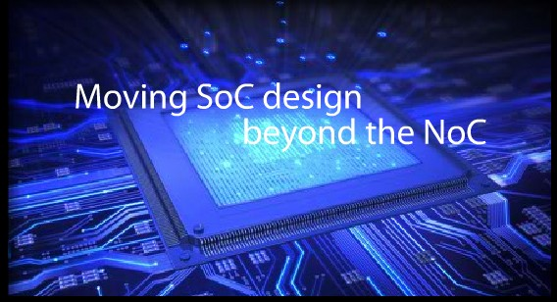
On-chip interconnect network/ NoC
The layered-stack approach to the design of the on-chip intercore communications is called the Network-on-Chip (NOC) methodology
New approach to design the communication subsystem of a System-on-Chip.
Asynchronous clocking
Networking theories and systematic networking methods

Slide 3
This is what a typical layout looks like

Slide 4
Proposal
Replace design-specific global on-chip wiring with a general-purpose on-chip interconnection network.
Connect top level modules by dedicated wires connect them to a network that routes packet between them.

Slide 5
A simple on-chip network
12mm x 12mm chip in 0.1mm CMOS technology with an 0.5mm minimum wire pitch
network uses a 2-dimensional folded torus topology with the nodes 0-3 in each row cyclically connected in the order 0,2,3,1

Slide 6
Input port Datagram interface to each tile
TYPE
2 Bits
SIZE
4 Bits
VIRTUAL CHANNEL
8 Bits
ROUTE
16 Bits
READY
8 Bits
Start of new packet (head)
Continuation of a packet (body)
End of packet (tail)
Idle cycle (idle)
Logarithmically encodes the size of the data in the data field from 0 (1 bit) to 8 (256 bits)
Specifies which of eight virtual channels this packet may be routed on
A source route that specifies two bits for each hop (left, right, straight, or extract).
A signal from the network back to the client indicating that the network is ready to accept the next flit on each virtual channel

Slide 7
Other resources
Registers:
Used to reserve resources for particular virtual channels
Provide time-slot reservations for certain classes of traffic
Pre-scheduling provides guaranteed, predictable performance for latency-critical or jitter-critical applications

Slide 8
Higher level protocol on Simple interface
Services that can be provided to network clients:
Memory read/write service
A flow-controlled data stream
A logical wire to the client
Provide a translation from a destination node to a route
The logic to implement many higher-level services on top of the simple network will be made readily available so it won’t have to be independently redesigned with each module

Slide 9
Router Architecture
Is needed at each tile
Consists of 5 input and output controllers

Slide 10
Pros and Cons
Network takes up upto 6.6% of the total tile area
The area of the router is dominated by buffer space
The total buffer requirement is about 10^4 bits along each edge of the tile
Enables the use of fault tolerant wiring and protocols
A spare bit can be provided on each network link and in each network buffer
Network handles both pre-scheduled and dynamic traffic
Static traffic must share the network with dynamic traffic

Slide 11
Topologies to utilize the abundant wiring resources
Method 1:
A wide (almost 300-bit) flit is sent broadside across router channels to use the maximum possible number of pins
Method 2:
A folded torus topology can be employed
Has twice the wire demand and twice the bisection bandwidth of a mesh network
Choice of a topology depends on many factors

Slide 12
Flow control methods to reduce Buffer count
Buffer space in an on-chip router directly impacts the area overhead of the network
Example network uses conventional virtual channel flow control and uses a large amount of buffer space
Trade-off between buffer storage requirement and performance

Slide 13
Need to exploit structured wiring
Well controlled electrical parameters of wiring enable the use of high-performance circuits
Circuits can be used to boost the bandwidth of individual wires
Circuits can ease the overhead of buffers

Slide 14
Predictable electrical parameters enable high performance circuits
Unstructured Wires
On –chip interconnection networks
Electrical characterization
Potential late stage impact
Parasitic capacitance
Conservative circuits needed to drive these wires
Synthesis tools oversize the drivers
Long wires require repeaters at periodic intervals
Structures the wiring
Defined precisely at the beginning
Paths are optimized for signal integrity
Structured wiring can be isolated from intra-tile wiring
Enable the use of aggressive circuits

Slide 15
Facilitating reuse with a universal interface
Compatibility and inter-opearbility
Extending reuse to network components
On-chip network is reusable
Can dedicate more resources to design, validate and tune the network
Flip side- fixing the die size will lead to wastage of on-chip area
On-chip networks improve the duty factor of wires
Shares the wires across many signals

Slide 16
Conclusion
Advantages of structure, performance and modularity
Well controlled electrical parameters in turn enable the use of high-performance circuits
Enhances modularity by providing standard interface
Challenges
Topologies must balance power efficiency with wire utilization
New flow control methods are required
Network interface support a wide variety of protocols and data widths

Slide 17
Questions?

